Slide 1
Placer County 4-H Youth Development Program
Project Leader Training
Notes:
Sign-In Table:
Easel with: welcome, sign-in, enter for a draw prize, take a folder, help yourself to refreshments, take a seat;
Sign-in sheet with a pen
Cup of pencils
Binders and sign-out sheet

Slide 2

Agenda
Potluck & networking – 20 minutes
Welcome – 5 minutes
  Sign-In
  Parking Lot
Icebreaker – 5 minutes
Presentation – 75 minutes
  The 4-H Program
  The 4-H Project
Policy – 30 minutes
Questions & Evaluation – 15 minutes
Notes:
Thank you for being here tonight. The investment of your time is very much appreciated.
The agenda tonight is listed here. To keep things rolling, I will stay on time. If more time is needed for questions, we can park them for the end or I can include items in a follow-up email.
Please make sure to sign-in.
Each project leader can take one binder. Sign your name on the check-out list.
Ground Rules: importance of respect in listening to presenter and to each other, offer input, participate, write ideas and thoughts down instead of side chit-chat. All ideas and concerns are important and should be shared.
The purpose of tonight’s training is: make sure all project leaders are operating on the same page according to current policies and practices; reiterate the purpose of 4-H which is to provide positive youth development; to share ideas and resources; to get to know each other

Slide 3
Icebreaker
Groups of 3-5
Introduce yourself to each other
Determine a project (use name plate)
Name the group (use name plate)
Determine representatives for project leader, Jr/teen leader, youth members, and parent (use name tags)
Notes:
Each group should be a different project. Record project names on the board.
We will be using these groups through out the presentation today.

Slide 4
4-H Project Leader’s Digest
In the resource folder
Online at http://www.ca4h.org/4hresource/forms/manuals/Project-Leader-Digest.pdf
This presentation is based on the topics
Notes:
Refer to digest in resource binder.

Slide 5




What is the 4-H Youth Development Program?
Educational program of the University of California
Part of the UC division of Agriculture and Natural Resources (ANR)
Made available through a partnership of county, state, federal governments, and community volunteers.
Notes:
Page 1:
What is 4-H at it’s basic self? It is an outreach educational program from UC. It is a medium for transporting the latest breakthrough research from UC to the general public on youth development.
Each partner contributes something different to the program.
National and state levels assist with policy and getting the research to us.
State provides staff to help with policy and overseeing the county program.
County level provides an office with clerical support and some supplies.
Volunteers provide a self-sustaining program based on policy.
History: Milestones in the Development of University of California Cooperative Extension.
Organizational Charts:
ANR Chart – where 4-H fits in University of California Cooperative Extension
Sectional Map – Sectional Leader’s Council
County Chart – Do we want a chart to show the flow of communication? Who is reporting to who and which are collaborating? Do we want a visual of what our county program is made up of? This would be a parking lot item to discuss later with Executive Council to help produce a chart.

Slide 6

In the 4-H Program, we:
Use Experiential Learning and Youth-Adult Partnerships
to focus on the development of Citizenship, Leadership & Life Skills
in order to promote a sense of Belonging, Mastery, Independence & Generosity which are the Essential Elements of youth development.

Slide 7
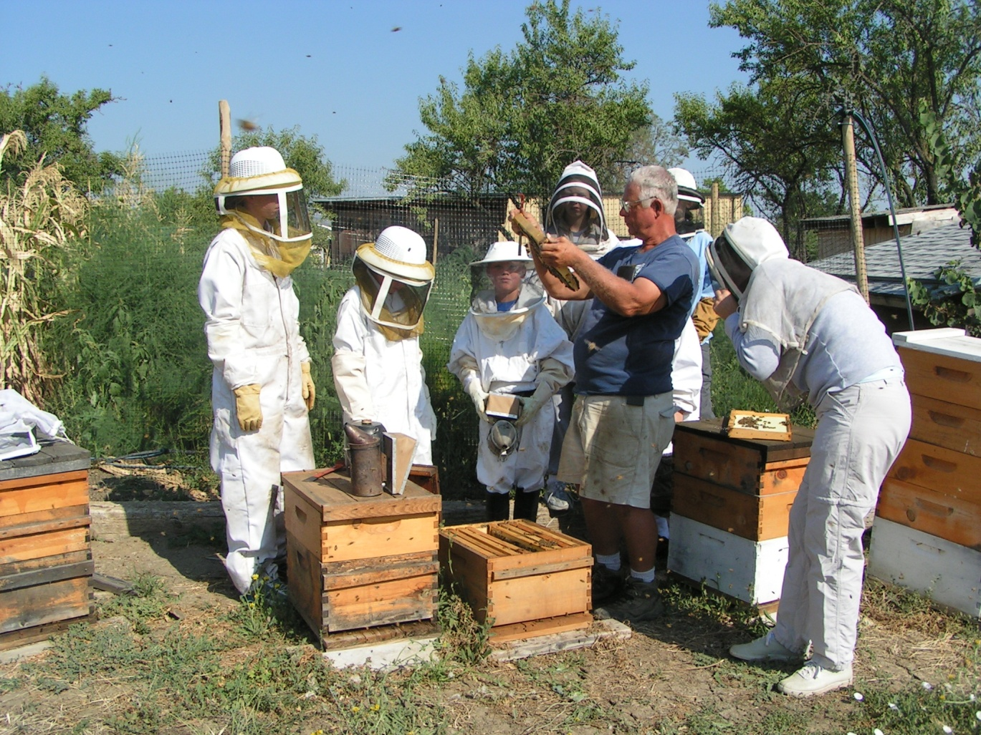
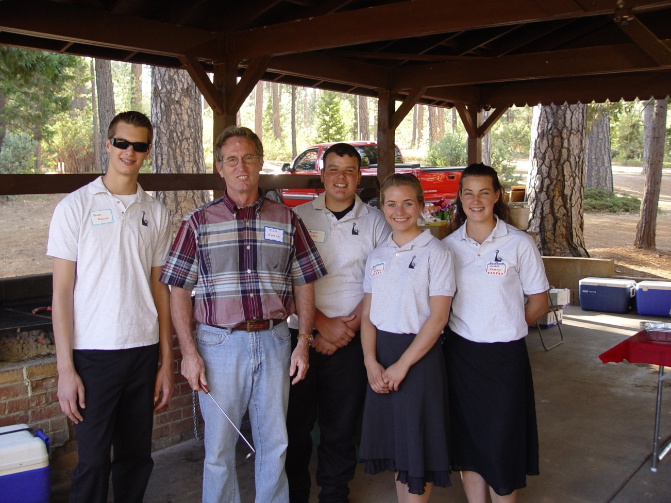
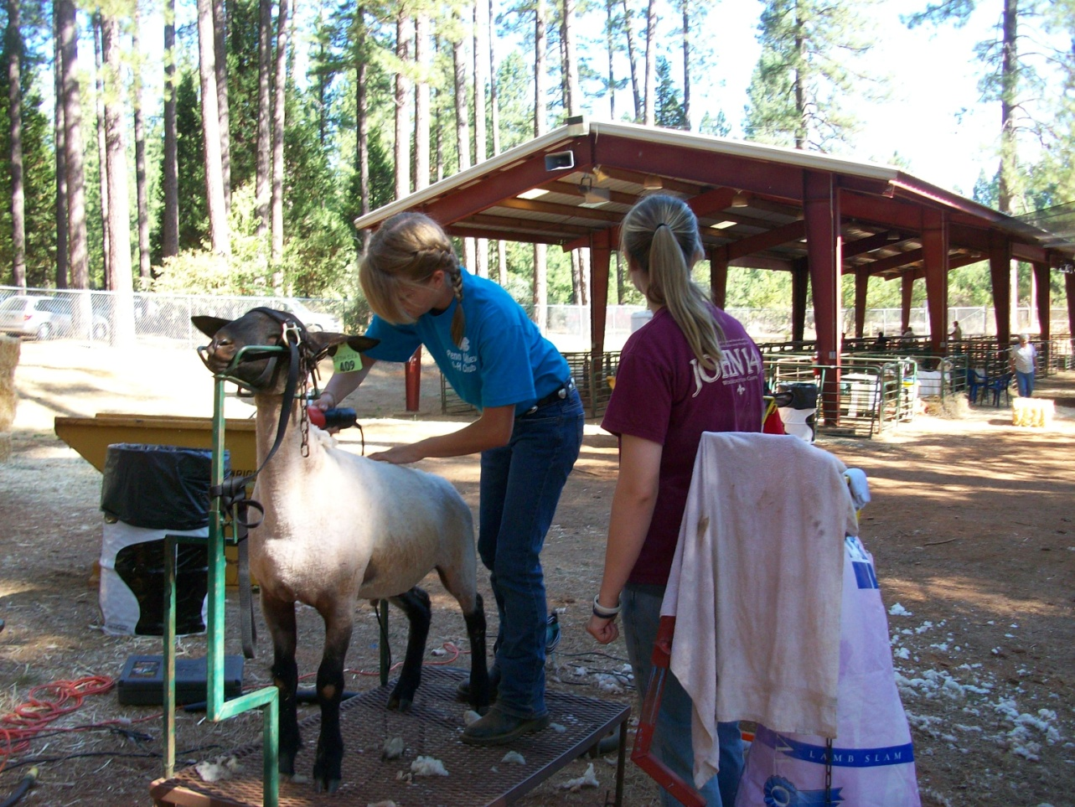
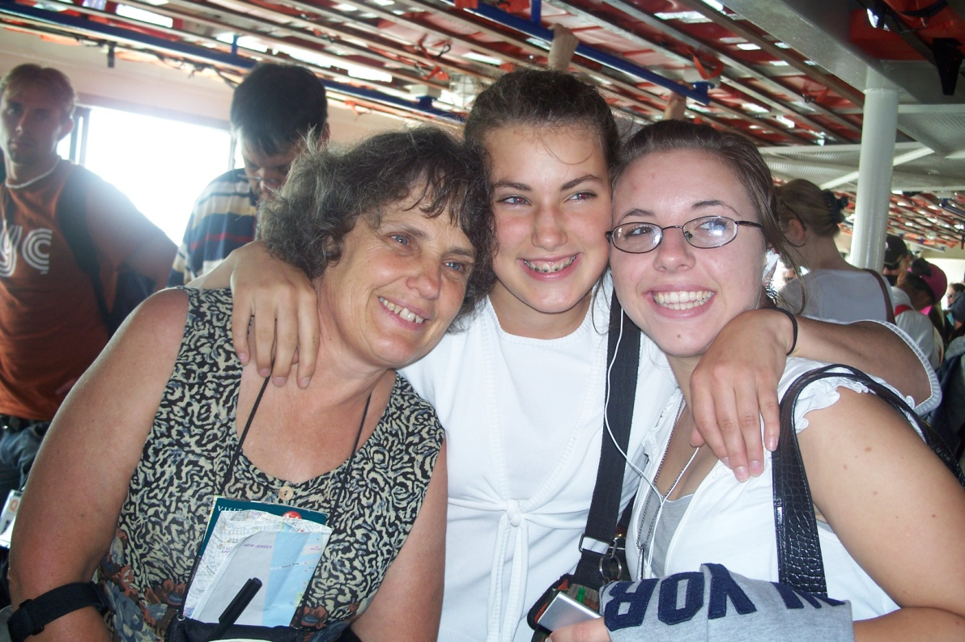
Essential Elements of Effective 4-H Youth Development Programs
Belonging
Mastery
Independence
Generosity
Notes:
Page 2:
Research has shown that youth have basic needs in order to develop in a positive and successful way. The 4-H program is designed to support this type of development.
Have four volunteers each read the first paragraph from the Essential Elements tab.
The University of Wisconsin developed the next document to help volunteers determine if their projects are meeting these basic needs of youth. It gives you questions to ask yourself and jr/teen leaders. It also gives you ideas on how to develop these essential elements into your project meetings.

Slide 8
Focus on Citizenship, Leadership, and Other Life Skills
All 4-H projects and activities should be designed to lead to the development of these skills.
Notes:
Page 3:
The life skills wheel should be utilized at every planning meeting. Each time an activity is planned out, look at the wheel and determine which life skill is being taught. Look at the different life skills to help determine a new activity. Offer many activities that will foster a development for a variety of skills.
When planning your project meetings and activities, ask yourself which life skill would the youth be practicing with that activity.

Slide 9
Citizenship: Acting with informed concern for self and others
  Best Practices for including in 4-H projects…
  Personal Development and Self-Esteem
  History and Cultural Heritage
  Exploring Policies and Laws
  Environmental Concerns
  Societal Issues and Our Role as Citizens
Notes:
Page 3:
Citizenship is much more than the Cal-Focus and Washington DC trips.
Exploring one’s self, taking a leadership class, joining a gym, making and reaching goals
Genealogy research, learning the history of a community, group, event
Learning the process of government at all levels, 4-H, school, city, county, state, national, law enforcement, agriculture
Global Warming, rainforest, use of natural resources, animal protection
Loitering of youth downtown, crime, current economic trends, teen drivers

Slide 10
Leadership: The ability to influence and support others in a positive manner for a common goal.
  Best Practices for promoting in 4-H projects…
  Partner in planning and leading the project
  Teach the project
  Practice self-governance
  Set goals and make decisions
  Learn to communicate with others
  Work with others
Notes:
Page 3:
Mentoring programs
Jr/teen leaders assisted by project leader
Club officers assisted by club leader or mentor
Adults can give tools, offer suggestions, provide only the structure and allow the youth to lead
Ask what the youth want first
Providing tools and training

Slide 11
Life Skills: the abilities and skills that are necessary and useful throughout life to be successful.
Steps for Promoting Life Skills Development:
Identify which life skill you will focus on.
Identify what youth need to experience to develop the life skill competency through the project activity.
Identify what the youth is expected to demonstrate after completing the project activity.
Ensure youth can practice the targeted life skill through experience or in a real life situation.
Plan to reinforce the use of this life skill in future situations.
Notes:
Page 3:
Emphasis should be made on the life skill being learned as it relates to actual project skill being taught.

Slide 12
Life Skills, Leadership, and Citizenship Activity
Within your project group,
develop a plan on how
you will build a life skill,
citizenship, or leadership, it into
a project activity
using the template.
Notes:
Use activity sheet in “Project Groups” envelope: Selecting Life Skills to be Practiced
Give a couple of minutes for each group to discuss amongst themselves.
Ask each group for one example.
Did any group add their own method? Have one or two shared with the others.

Slide 13
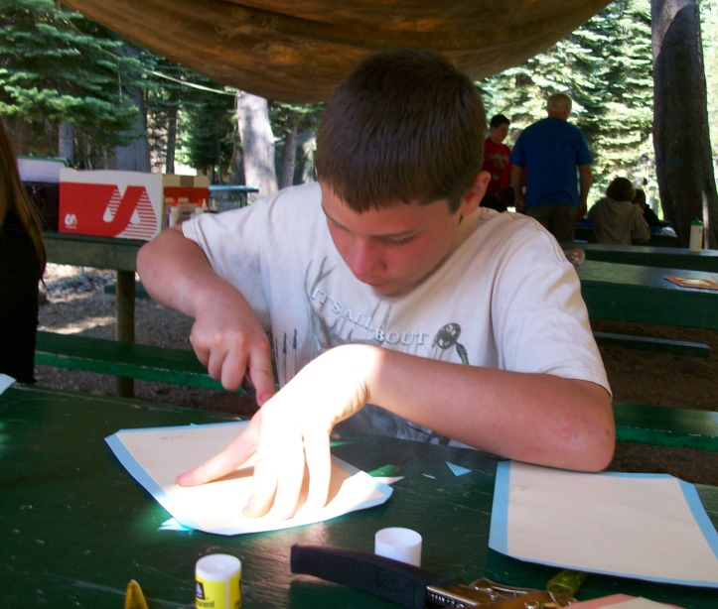
4-H Learning Method: Experiential Learning
Direct and hands-on
Uses open-ended questions
Allows participants to discuss experiences
Results in active reflection and discussion
Makes connections between activity and real-world
Applies the outcome to
independent situations

Slide 14
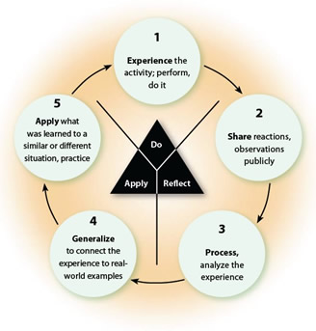
Experiential Learning Cycle
Experience It:
Do It!
Share:
What Happened?
Process:
What’s Important?
Generalize:
So What?
Apply:
Now What?
Notes:
Page 4:
Refer to model in the binder
Do It: After discussion on safety issues and maybe some background, allow the youth to just do it. Some activities might require more background and safety checks. Shearing sheep, trimming hooves, others? What activities may not need any start-up help? Any activity with instructions. Provide a hands on experience.
Share: share reactions and observations, encourage members to talk about what they observed and felt about the experience.
Process: start analyzing and reflecting, what went wrong, what went right, ask questions that help members think about what’s important.
Generalize: so why did we do this? How does this activity connect with real life? Talk about how the experience connects to the real world.
Apply: where will you use this knowledge? Apply what was learned to a new experience.
From one project group, give me an example of a learning activity that youth would experience in a meeting.
Using that example, let’s work through the cycle. (write responses on easel pad)
Utilize National Science Experiment if another example is needed.

Slide 15
Learning Styles
Visual or spatial learners
Learn best from visual displays, such as diagrams, illustrated books, videos and DVDs, handouts, and flip charts
Auditory learners
Learn best through verbal lectures, discussions, talking and listening
Kinesthetic learners
Learn better through moving, doing, and touching, hands-on approach
Notes:
Page 4:
This is included to make sure all project leaders remember that everyone learns differently. Get to know your youth, learn what works well for them and what motivates them. Not all styles work for everyone. Many people learn best with more than one style.

Slide 16
Learning Strategies
Competitive – “If I swim, you sink. If you swim, I sink.”
Individualistic – “If I sink or swim, it has no effect on whether or not you sink or swim.”
Cooperative – “We sink or swim together.”
Notes:
Page 5:
4-H utilizes all of these strategies based on the type of activity.
The Leader’s Digest does include some information on each.
For primaries, emphasis should be placed on cooperative learning strategy.

Slide 17
Youth Characteristics
Primary: 5-8 year olds
Junior: 9-11 year olds
Intermediate: 12-14 year olds
Senior: 15-19 year olds
Notes:
Page 8:
All age groups are different in their emotional, physical, cognitive, and social needs. We, as project leaders/educators, need to be aware of how to meet those needs.
Refer to characteristic sheets and age matrix in binder
Refer to Primary Member Leader’s Guide

Slide 18
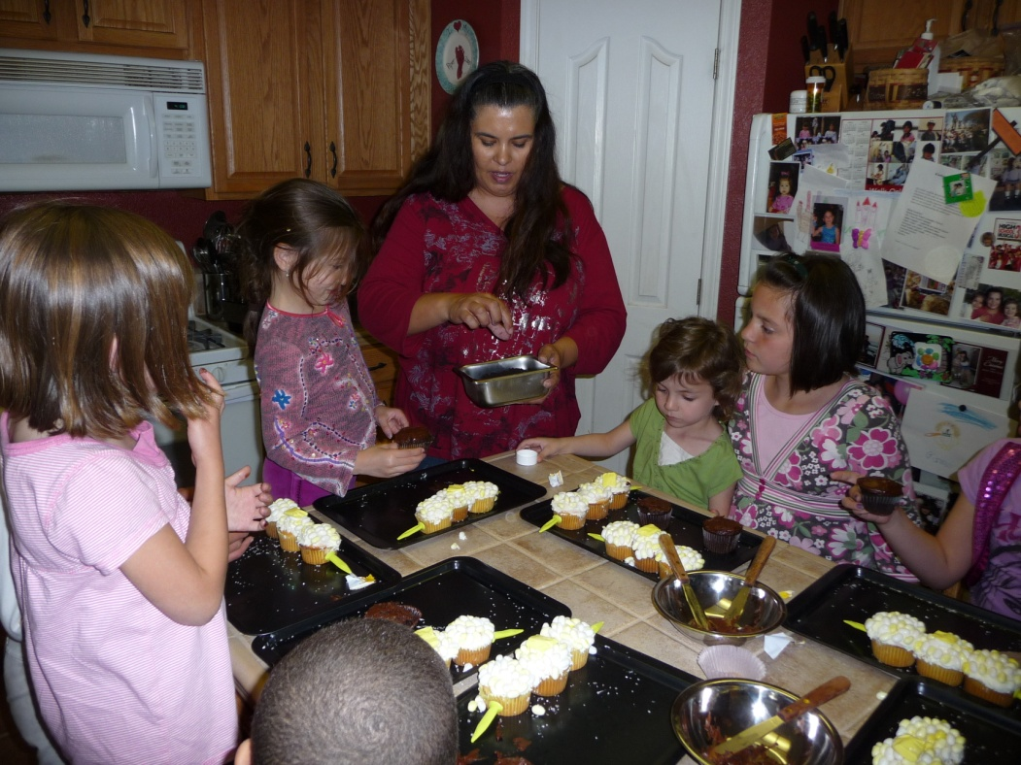
Project Group Activity – Youth Characteristics
Within your project group, use the provided age group to:
Draw and name a youth representing these best practices
Write or draw
specific examples of
what the project
leader could provide to
nurture these youth in
that project.
Introduce your youth
to the group.
Notes:
Have easel pad ready to hand out one sheet and a couple of markers to each group.
Provide tape to hang posters up.
Allow 5 minutes

Slide 19
5 – 8 Year Olds
Primary Member Characteristics
I am mastering physical skills, mostly commanding large muscles.
My physical growth is generally gradual, and about the same as boys my age.
I am a concrete thinker, mostly in the present.
I am curious about my immediate environment and rely heavily upon my sensory experiences. My attention span is short.
I am self-centered and sensitive.
I am strongly dependent upon adults and seek their attention.
I am beginning to explore social situations outside of my home, but still need adult approval.
Friendships are evolving for me, and sometimes I will play with boys.
Notes:
Talk about no competition and no large animals, primary member PDR – really about exploring and having fun!

Slide 20
9 – 11 Year Olds
Junior Member Characteristics
I am physically stronger and have better balance and coordination.
I am maturing at a different rate, sometimes slower than girls.
I favor concrete thinking, but am beginning to use reasoning skills and abstract thoughts.
I am creative, curious, and eager.
My self- confidence and self-esteem are fragile. I need recognition and praise.
I am beginning to question parental authority.
I am starting to guide myself, work as a team member, and exhibiting a sense of competition.
I enjoy group activities and look to older youth, but still need adult guidance.

Slide 21
12 – 14 Year Olds
Intermediate Member Characteristics
I am experiencing rapid and profound physical changes.
As a girl, I am experiencing sexual maturation and growth faster than boys my same age.
I can think hypothetically and abstractly.
My interests are broadening beyond my immediate world.
I am highly self-conscious and self-critical.
I have mood swings.
I am exhibiting independence, but still need adult guidance and approval.
I am concerned about peer relationships and personal appearance.

Slide 22

15 – 19 Year Olds
Senior Member Characteristics
I gone through puberty and am physically well-developed.
My sexual maturity is about the same as girls.
I am a competent abstract thinker.
I exhibit a sense of community awareness and concern for others.
I may have feelings of inadequacy and not being equal to my peers.
I am achieving independence from adults, and seeking and cultivating my own identity.
I am more independent and can accept adult roles.
I seek status within my peer group, and I am interested in mixed-gender activities and dating.

Slide 23

Summary of Part 1
We have looked at what 4-H is about:
Education program from UC
Provides the essential elements that every youth needs to succeed
Teaches leadership, citizenship, and life skills
It uses the hands-on learning method: Experiential Learning
Pliable enough to meet the different learning styles
Pliable enough to accommodate all learning strategies
Pliable enough to teach youth of all ages

Slide 24

Notes:
A quick break: As I was putting these slides together, I was reminded of all that we expect from you which is why I don’t want you to take this job lightly. You are playing a very important role in the life of a youth. Your time and dedication is very much needed and appreciated. Your positive attitude and good examples will help these youth succeed.
5 minute break

Slide 25
Now What?
What is a project leader?
What is a project?
How do I set up a project meeting?
How do I incorporate the youth in the decision making process?
What can I do to provide a safe and secure environment?
Where can I go for help?

Slide 26
What is the Project Leader?
Functions as a member of the club leadership team.
Works with members enrolled in the project to support and guide their learning of knowledge, skill, and attitudes.
Supports the University of California Placer County 4-H Youth Development Program policies, mission, and core values.
Notes:
Volunteer Job Description in resource binder.
Chaperone FAQ sheet in binder
Steps To Success
A Member’s Guide

Slide 27
What is a 4-H Project?
Planned work in an area of interest to the 4-H member.
Guided by a volunteer who is the project leader.
Aimed at planned objectives that be attained and measured.
Summarized by some form of record keeping
A minimum of six hours of instruction over a 12 month period.
Regularly scheduled and held meetings.
Consists of meetings, field trips, and related activities under guidance of a volunteer.
Notes:
Page 1 & 9:

Slide 28
The Project Leader Plan: Preparation
Utilize a three-ring binder or small file tote to
store all needed material
Get a list of project members from club leader
Order project materials
Review resource material at the UCCE county office
Meet with Jr/teen leaders to review plans and expectations for the year →
Use the Experiential Learning Model for the youth to both experience and process the project’s activities
Focus on at least two of the three focus learning areas
Promote the Essential Elements of Youth Development
Prepare project goals and expectations for members
Prepare a sample project meeting outline
Complete a calendar for the project year
Reflect and Evaluate
Notes:
Page 9:
Keep all project material in one location at home; set aside a drawer, desktop, box, etc for holding just your 4-H material.
Be familiar with the material; being an expert is not necessary, you are learning by doing just as the youth are.
Look at the different ages and genders; look for potential jr/teen leaders; look at years in project; start planning your activities to cover all age groups
Project materials are available through ANR and National 4-H. Other non 4-H curriculum are fine to use as long as the presentation meets the experiential learning style.
Lending library with books, videos, and lab kits; safety resources include the safety manual, Clover Safe Notes, and others. Refer to resource section of binder. Utilize the Proficiency Program (leader’s guide in resource binder.)
Jr/teen leaders are part of the decision making process; allow them to teach and to come up with teaching ideas; provide tools and assistance as needed
Visualize the Experiential Model every time a new learning activity is planned
All youth learn differently
Connect all activities to an Essential Element
Goals have an action, result, and timetable; allow for adjustments through out the year; review through out the year; evaluate at the end of the year.
Create an agenda for each meeting for all members to see – samples can be found on page 10 of the project leaders’ digest.
Having a full year calendar with all important dates helps the family to schedule attendance; have families bring their calendars to every meeting. Will fund raising be needed for activities?
What did the youth like or not like? What stood out for them? What new things were learned? What wasn’t learned? What would like to do for next year? Are there other project ideas related to this one?

Slide 29
Project Leaders Working with Teens Should…
Recognize
  Teens as equals in making decisions and accepting responsibilities
  The importance of good communication
  The importance of encouragement and support on a continuing basis throughout planning, implementation, and evaluation of the activity.
Understand that mistakes are opportunities to learn
Ask for assistance when needed
Plan on spending time to review the Junior and Teen Leadership Report form with the teens working with your group.

Slide 30
Major duties of a junior/teen leader
Work collaboratively with the adult leader to set goals, develop lesson plans, teach skills, and evaluate the activity.
  Each teen leader should have at least one major responsibility and at least three or four other assignments for which members of the group depend on them to provide leadership.
  Review the experience with the project leader after they present their lesson.
Coordinate the logistical details such as meeting times, locations, materials and supplies, and expenses with the leader.
Communicate with the leader and members about group expectations, responsibilities and expected outcomes.
Fill out Junior and Teen Leadership Development Report.
  Complete pages 1 & 2 at the beginning of the year.
  Complete pages 3 & 4 at the end of the year. ←
Notes:
Varies by age, experience, and other factors
Work with teens to plan, conduct, and evaluate a well rounded, well balance program. This is a team effort.

Slide 31
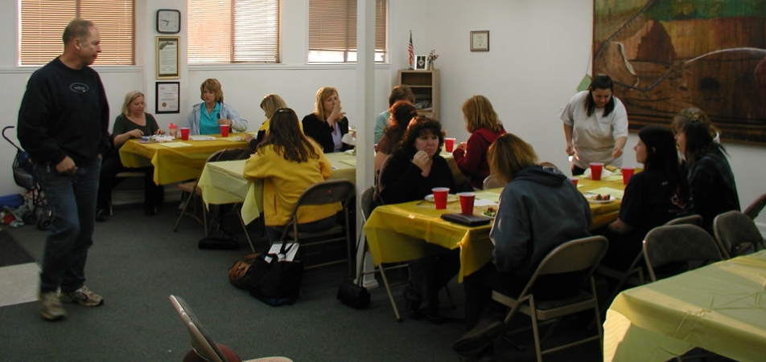
The Project Leader Plan:
First Project Meeting 60-90 minutes
Invite all members, jr/teen leaders, and parents
Make introductions
Hand out project meeting outline.
Review goals and expectations
Discuss calendar, supplies
to purchase, what to bring
to meetings, any needed
fundraising
Fun activity related to project
Hand out any material
Answer any questions
Make assignments
Adjourn
Review the meeting with jr/teen leaders
Notes:
Page 9:
Plan to use the first meeting as a time for getting acquainted, goal setting for members, and reviewing your plans and topics to be covered to achieve your goals
4) make the time to plan- plan time at the first meeting for each member to make personal project goals also develop your own goals for the project -

Slide 32
The project Leader Plan:
Project Meeting Outline 60-120 minutes
Interest getter (15 min)
Skills session (30 min)
Discussion (10 min)
Presentation (10 min)
Record keeping (10 min)
Summary and assignments (10 min)
Refreshments and recreation (5+ min)
Notes:
Page 9:
These are guidelines.
Each meeting might be different depending on the skills being taught.

Slide 33
Youth/Adult Partnerships
Learn about each other before
beginning the project.
Develop job descriptions, together, for all partners.
Identify expectations of everyone.
Identify goals.
Identify needed tasks and how they will be done.
Include youth as partners in all decision making.
Give encouragement, support, and recognition to all partners.
Notes:
Page 10:
Partners include youth members and family members.
Determine what is common between youth and adults.
What do youth want? What do adults want? What can happen that will bring those two wants together?
Youth are part of the decision making process, not just onlookers.

Slide 34
4-H policy
Adult Supervision
Chaperones
4-H Youth participation
Contracts
Insurance
  General Liability Insurance
  Product Liability Insurance
  Automobile Liability Insurance
  Accident & Sickness Insurance
Safety
Resources

Slide 35
Adult Supervision
Two appointed adult volunteers, or one appointed adult volunteer and another adult (one of which must be 21 years of age) are required for all programs, events, and activities.
When transporting youth that are not yours and if two adults cannot be present, there should be two or more youth.
Teens are not allowed to assume all of the responsibilities of adult 4-H volunteers. They are not covered by 4-H liability insurance which applies only to adults. For this reason, junior and teen leaders must be supervised by an appointed adult 4-H volunteer at all times when they lead a project or activity.
Notes:
No one-one-one interactions.

Slide 36
A note on Chaperones
Chaperone duties may be assigned to adult volunteers.
Must be at least 25 years of age.
(S)he has the responsibility of a delegation of youth at a 4-H YDP event or activity.
Parents and Guardians as Chaperones
  Must become a certified adult volunteer prior to serving in a chaperone capacity.

Slide 37
4-H Youth Participation
Primary Member participation
Youth from outside the county can participate in Placer County 4-H.

Slide 38
Contracts
Volunteers may not sign contracts of any kind on behalf of UC or obligate The Regents of the University of California in any way.
Only the county directory can sign contracts and agreements with any facility.
Forward all needed paperwork and FUR Form to county 4-H office.
  Allow approximately 2 weeks for processing.
A FUR Form is required when a 4-H activity is taking place at a location that requires a contract and proof of insurance.

Slide 39
General liability insurance
Agents are protected in the event of accidental damage to another's property or accidental injury to another person during the conduct of official business, or as the result of negligence.
Does not cover members or project animals.
Does not provide coverage for any personal or real property not within UC’s care, custody, and control.
All accidents or incidents that might result in claims against UC must be fully and promptly reported and an Incident Report Form must be completed and submitted to the 4-H office within 48 hours.
Notes:
Adult volunteers are UC agents when actively engaged in the course and scope of UC volunteer activities and thus are covered.
Junior and teen leaders are not covered by UC’s liability insurance, which applies only to adult volunteers.
Members are responsible for protection against damages caused by their animals.
Check with your insurance carriers and review personal insurance coverage before assuming the risks involved in using their personal property.

Slide 40
Product liability insurance
UC provides product liability insurance for projects when making and selling a product at 4-H YDP fundraising events.
Reminder to turn in fundraising approval – Form 8.7 prior to raising funds
Notes:
For pre-packaged food manufacturers assume responsibility for prepackaged food.

Slide 41
Automobile liability insurance
The insurance on that vehicle provides the primary coverage; UC self-insurance is secondary.
UC provides secondary automobile liability coverage for agents for acts (or omissions) committed in the course and scope of UC work.
To qualify for UC’s secondary coverage, you must maintain the minimum insurance coverage:
    $50,0000 for injury/death of one person;
    $100,000 for injury to/death of two or more persons in one accident; and
    $50,000 for property damage.
Notes:
If an adult volunteer does not maintain coverage in accordance with the UC’s minimum primary coverage requirements, the adult volunteer is personally responsible for the difference between their policy limits and UC’s secondary coverage requirements.

Slide 42
Automobile liability insurance
To be covered under 4-H insurance while transporting 4-H volunteers and youth to and from 4-H activities, the driver:
  has to have a valid California driver’s license.
  has to have car insurance as required by the state of California.
  has to use a safe operating vehicle.
  has to have seat belts for each passenger
  has to be 18 years of age or older
Full details of automobile accidents or injuries must be promptly reported on the Incident Report Form
Notes:
Members under the age of 18 may not drive other members on 4-H business at any time.

Slide 43
Accident & sickness insurance
4-H adult volunteers and members are covered when taking part in or attending an approved, regularly supervised 4-H YDP activity.
Covered while traveling directly between home and a 4-H YDP meeting place for a scheduled activity.
The Hartford Policy will not provide coverage until the other insurance is exhausted.
To file a claim submit the Hartford Insurance Company Notice of Claim Form and medical receipts to the county 4-H YDP staff.
  The supervising adult volunteer/claimant should review and sign the form prior to submitting it.
Notes:
Filing a Accident/Sickness Claim Form
The Hartford Insurance Company Notice of Claim form, with medical receipts for the accident or illness, must be submitted to the county 4-H YDP staff. The supervising adult volunteer or claimant should review and sign the form prior to submitting it to the county 4-H YDP staff.
The 4-H YDP staff will review and sign the form and forward it to Hartford for processing, and will copy the statewide 4-H YDP office. Please be sure that all questions are answered including the type of activity and the county submitting the claim. Use the Accident Instructions for the Adult Supervising the 4-H Activity or the Procedures for 4-H Accident/Illness Claims Instructions for UCCE County 4-H Staff to complete the accident/sickness claim.

Slide 44
Safety
Set a good example at all meetings.
Recognize hazards and correct them.
Demonstrate the proper use of equipment.
Discuss safety at every meeting.
Have a copy of the signed medial
release/health history information form for every adult and youth member.
To foster a safe and positive learning environment during any 4-H meeting, event, or activity, the 4-H Code of Conduct must be adhered to by all adult volunteers, youth members, family, and friends
Notes:
Page 11:
Refer to Safety section of the resource binder
Safety Manual
Clover safe notes
Insurance information
Pink medical form (original signatures are preferred but local hospitals and ambulance services will accept a copy.)

Slide 45
Resources
CCL (or Club Leadership Team Members)
The state 4-H website: http://www.ca4h.org/
The new state 4-H policy handbook (released July 1): http://www.ca4h.org/policy/
The Nevada County website: http://groups.ucanr.org/uccenevada4h/index.cfm
The County Coordinators
The Nevada County Leaders’ Council
UCCE – Nevada County 4-H Office/staff
4-H Family Newsletter (The Greensheet)
Adult Volunteers (including County Project Coordinators)
County Directory
Jr/Teen Leaders
All Stars
Trainings and Project Events
Resource Lending Library
4-H Mall incl National 4-H Curriculum: http://www.4-hmall.org/
UC ANR Publications Catalog: http://anrcatalog.ucdavis.edu/4HYouthDevelopment/
4-H Websites (state and national)
Local Businesses
Notes:
Resource list of websites and phone numbers is still under construction. Will release that list when complete.
Envelope with info available from the 4-H office.

Slide 46
Post-Workshop Survey
Please take a few minutes to complete the survey.

Slide 47
Thank You for coming tonight. Don’t hesitate to contact me with any further questions, concerns, or comments that come up.

