Slide 1
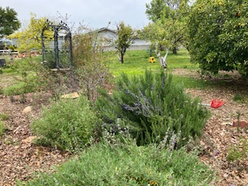
SPICE IT UP!
GROWING CULINARY HERBS
Photo by H. Peacock Morrow
Notes:
Created: April 2023/approved Kevin Marini May 2024
Created by: Heidi Peacock Morrow of Placer County Master Gardener(s) who created this originally
Audience: Loomis Library and Community Center and Zoom Presentation
Publicity:
Consider spicing up your garden with fresh herbs! Culinary herbs make food taste fantastic, and there is no better way to spice up your garden, than to add a few herbs to your planting list. In this class, learn growing techniques for traditional favorites and a few unusual herbs that are fun, fascinating plants to try on your herb gardening adventures!
Update History: for each update to the presentation include date, name of updater, explanation of update
(were additional slides added, were web links updated, etc.)

Slide 2
Who Are Master Gardeners?
Master Gardeners of Placer County
  Extend research-based, sustainable gardening and composting information
  Present accurate, impartial information to home gardeners
  Encourage public to make informed gardening decisions

Slide 3
Who Are Master Gardeners?
Where to find us…
Online, in the Media, and Special Publications
  Hotline: Call (530) 889-7388 or submit your questions online
  Website: pcmg.ucanr.org
  Facebook, Twitter, Instagram
  Gold Country Media monthly column
  Curious Gardener quarterly newsletter on our website
  Gardening Guide and Calendar

Slide 4
Who Are Master Gardeners?
Where to find us…
Workshops, Fairs and Festivals and Special Events
  Speakers by Request
  Workshops (various venues, check website)
  Farmers’ Markets (seasonal: Auburn, Roseville, Lincoln)
  Fairs and Festivals Booths (varies)
  Garden Faire (April)
  Mother’s Day Garden Tour (May 14th)

Slide 5
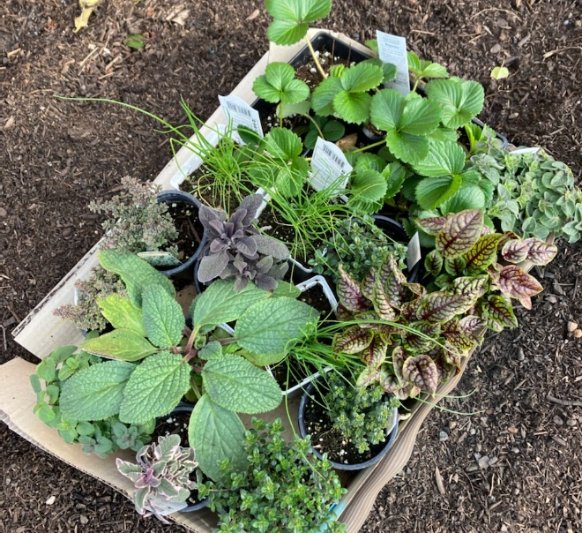
Today’s Agenda:
  Definitions
  Benefits of Growing Herbs
  Herbs in the Garden
  Propagation
  Harvest
  Preservation
  Storage
  Common Culinary Herbs
  Unusual Culinary Herbs
  Questions
Photo by H. Peacock Morrow

Slide 6

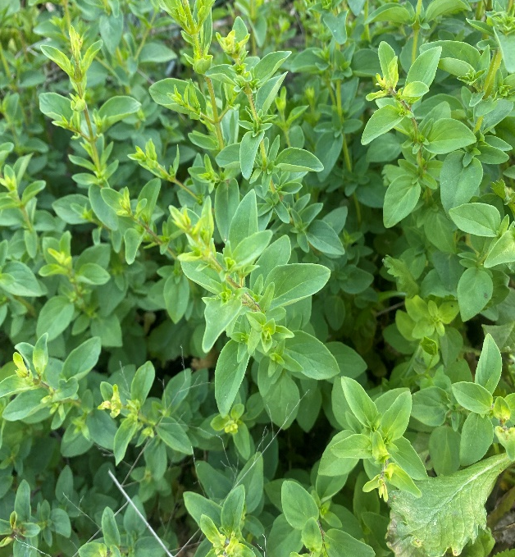
Definitions
  The word “herb” comes from the Latin word “herba”, which means grass or green plant.
  Most herbs are herbaceous, plants without a permanent woody stem.
  The broad term of “herb” often includes flowers, vegetables, grasses, and even trees!
Photo by T. Markel
Notes:
Photo of oregano in Tece’s garden

Slide 7

Herb vs Spice
Herb-the softer part of the plant including stems, leaves and flowers
Spice – the hard part of the plant such as roots, bark or seeds

Slide 8
WHAT’S IN IT FOR ME?
Herbs from the garden::
Fresh and high quality!
A healthy way to add flavor to food!
Always available in your garden!
A great way to save money!
Unique to the gardener-grow unusual herbs unavailable in the grocery store!
Add beauty to your garden!
Attract pollinators to your garden!
Many herbs are deer resistant!
Fun and rewarding!

Slide 9
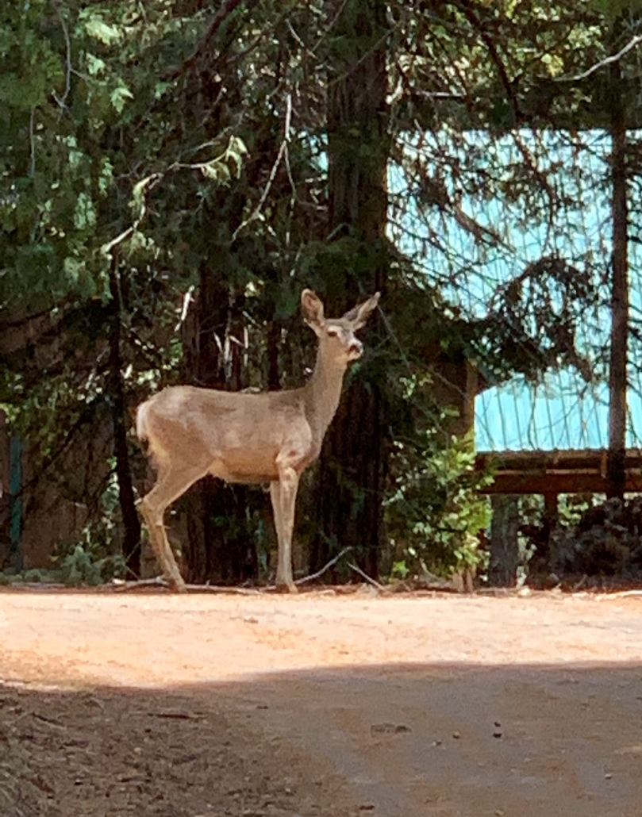
Deer Resistant Herbs
  Lavender
  Sage
  Thyme
  Mint
  Catmint
  Oregano
  Rosemary

Slide 10
Herbs in the Garden
Photo by H. Peacock Morrow

Slide 11
Location, Location, Location!
  Well drained soil
  Access to water
  6 hours sun
  Convenient for daily visits

Slide 12
Spice it Up!
Gardener’s Tips
Never use any fertilizer or pesticide That isn’t labeled for use on edible plants.
Growing culinary herbs is very similar to growing vegetables!
Herbs have few problems with pests and diseases.
Most annual herbs taste their best before they flower.
Pinch and use your herbs often.

Slide 13

Latin Names Matter!
  Common Name vs. Latin name (Botanical or Scientific)
  When using plants for food– be sure you have the correct plant.
  Check for the botanical name on the plant tag.
Notes:
When buying herb check the botanical name on the tag to be sure you get the plant you want. Many different plants share a common names.

Slide 14
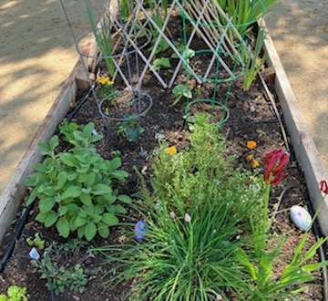
Where does your herb garden grow?
  Indoor
  Pots and Containers
  Cottage Garden
  Perennial Garden
  Vegetable Garden
  Raised beds
  Yard

Slide 15

Make Herbs the Star In your Landscape
Groundcover
  Thyme Thymus sp.
  Oregano
Edging
  Parsley Petroselinium Crispum
  Chives
Vines
  Hops Humulus lupulus
Trees
  Bay Laurel Laurus nobilis
Notes:
Culinary herbs can do double duty as ornamental plants. Parsley, especially the curly variety, makes a wonderful edging plant, if you don't have rabbits nearby.
Tall herbs, like bay laurel, can be potted and used as focal points. Herbs with variegated leaves, like golden or tricolor sage, are great in mixed containers, in flower beds, and other areas of interest.

Slide 16
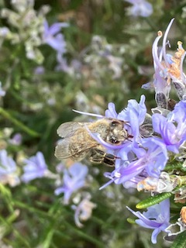
Hello Pollinators!
Herbs are pollinator friendly plants
Photos by H. Peacock Morrow
Please welcome pollinators into your garden! Pollinators are critically important to the ecosystems.
Notes:
Pollinators are crucially important to ecosystems. Without pollination many wild plants could not reproduce and survive. Animals (including humans) are indirectly dependent on the services pollinators provide, because they eat the fruits or plants that pollinators help create.

Slide 17
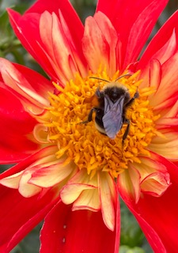
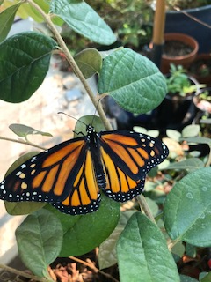
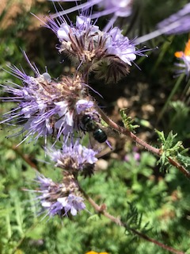
Welcome Pollinators!
Photos by K. Wiersh
Bees (not just honey bees) Wasps
Beetles Butterflies
Bats Moths
Flies
To learn more about pollinators and pollinator-friendly plants:
https://ucanr.edu/sites/PollenNation/Meet_The_Pollinators/
https://anrcatalog.ucanr.edu/Details.aspx?itemNo=8498
Notes:
Pollinators are crucially important to ecosystems. Without pollination many wild plants could not reproduce and survive. Animals (including humans) are indirectly dependent on the services pollinators provide, because they eat the fruits or plants that pollinators help create.

Slide 18
Propagate Culinary Herbs
By:
Seeds
Cuttings
Layering
Dividing

Slide 19
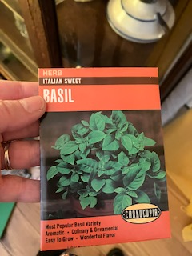
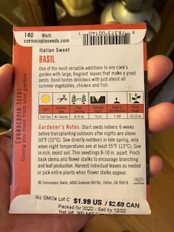
Seeds
  Follow directions on seed packet
  Start indoors (or outdoors after last frost)
  Use sterile, lightweight soil
  Water gently and keep moist
  Provide good air circulation
  Best for annuals (basil, dill, cilantro, parsley etc.)

Slide 20
Cuttings
  Make a slanted cut
  Remove bottom leaves
  Dip in rooting hormone (optional)
  Plant in moist, fast draining potting mix, cover.
  Best for woody herbs: Lavender, Geraniums, Sage, Rosemary

Slide 21
Layering
  Herbs respond well to layering
  To layer plants, place a rock on top of a branch, or dig a trench and mound the soil over part of a branch
  Roots will form at the nodes (the point on the stem where buds, leaves, and branching twigs originate) having soil contact.
  this part can then be removed from the parent plant.
  Many plants self layer – mints, oregano, rosemary, thyme, savory & lavender

Slide 22
Dividing
  Divide in early spring for fall blooming plants or fall for spring blooming plants
  Dig out root ball and soil
  Use a knife, shovel, trowel to split off healthy sections
  Best for chives, oregano, tarragon, sorrel

Slide 23
Harvesting Herbs
  Harvesting
    In the morning after the dew has evaporated
    Throughout the season
    Pinch and use your herbs often
    Young plants need to be pinched back to encourage them to branch out and become full

Slide 24
Preserving Herbs
  Drying
    Remove discolored leaves
    Make small bundles
    Hang upside down
    Warm, airy, dry location
    Away from direct sunlight
    Good air circulation
    Dry seed heads in paper or fine mesh bags

Slide 25
Preserving and Storing
  Package whole leaves
  Use airtight containers
  Store away from direct sunlight, heat and humidity
  Herbs must be dry- If moisture is detected after storing your herbs are not dry enough to store

Slide 26
Freezing Herbs
  For herbs that lose flavor when dried - Cilantro, basil, chives
  Mince & freeze in water in an ice cube tray
  Make into paste & freeze
    1/2 cup oil to 2 cups packed herbs (pesto)

Slide 27
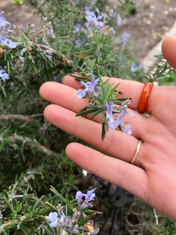
Just a handful of Herbs
of
Herbs!
Photos by H. Peacock Morrow
Herbs can change everyday cooking from basic sustenance to gourmet food!

Slide 28
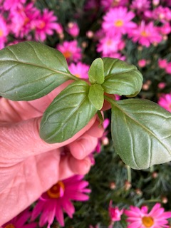
Basil
Ocimum bacilicum
  Annual
  Height: 6-36 inches
  Propagate: Seeds and Seedlings
  Light: full sun
  Preserve: freeze
  Uses: Pasta, Pesto, pizza, salad, and tomato dishes
Photo by H. Peacock Morrow
Basil is a Staple of Italian Cuisine
Notes:
Harvest Best used fresh. Harvest before flowering. Prune basil to first leaf bud below the flower to encourage further leaf production
Gardener’s Tips: Best used fresh or added towards the end of cooking

Slide 29
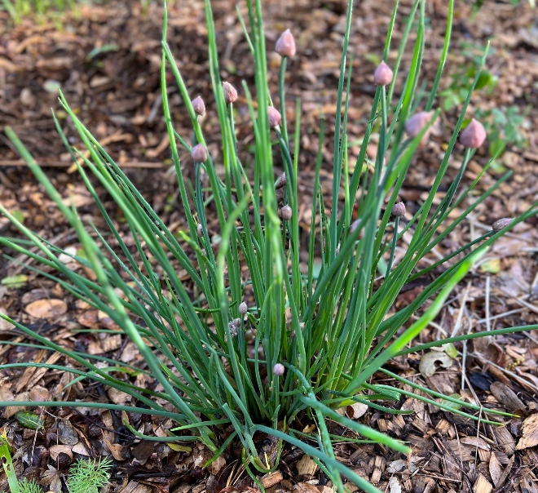
Chives
Allium sphenogram
  Bulb
  Height: to 12 inches
  Light: Full sun to part shade
  Preserve-chop and freeze
  Uses:
    flowers for garnish or in salads
    salad and salad dressing
    eggs
    potatoes
    seafood
Photo by B. Lantz
Notes:
This perennial herb has multiple petite, onion-like leaves and attractive pink blossoms that are a huge hit with pollinators. Just be aware that if you let the flowers go to seed, you’ll end up with enough plants to share with your entire neighborhood! You will likely only need two or three plants so remove flowers before those seeds have a chance to mature.
Since chive flowers are edible, you can use them in salads or to season a dish.

Slide 30
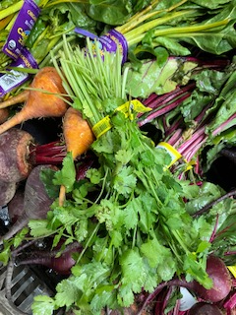
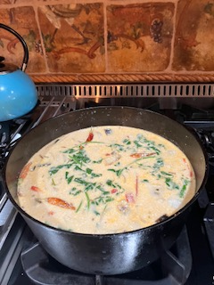
Cilantro
Coriandrum sativum
  Annual
  Height: height 10 to 12 inches
  Propagate: Seeds
  Light: semi-shade
  Preserve:
  Uses:
    Asian, Latin and African cooking
    Seeds used in baking and pickling
  Gardener’s Tips: Coriander (seeds) and Cilantro (leaves and stalk) come from the same plant.
  Beware it Bolts!
Photo by H. Peacock Morrow
Notes:
Harvest Cut leaves during growing season to produce second harvest; may go to seed after the second harvest especially in our warm summers

Slide 31
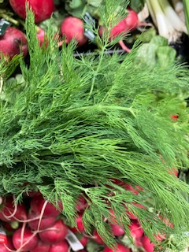
Dill
Anethum graveolens
  Biennial (cool season)
  Propagate- Direct seed into garden. Like cilantro, dill bolts quickly in hot weather.
  Soil-Acidic soil
  Space-Space 10 to 12 inches; height 3 to 5 feet
  Full sun
  Moderate water
  Harvest - harvest leaves before bloom. Harvest seeds as seed heads become brown and dry.
  Gardener’s Tips: More than just a pickle! Great with fish or potato salad
Photo by H. Peacock Morrow
Notes:
Self sows freely.
Good butterfly plant

Slide 32
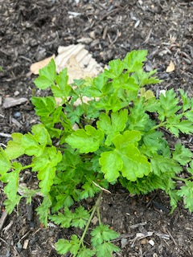
Parsley
Petroselinum crispum
  Biennial (cool season)
  Propagate- Sow seeds in spring and fall; may take 3 to 6 weeks to germinate.
  Space - Space 1 foot; height 1 to 2 feet
  Light-Full sun to part shade
  Harvest Begin harvesting leaves when they are about 8 inches long. Loses flavor when dried
  Gardener’s Tips:
    Flat or Curly?
Photo by H. Peacock Morrow
Notes:
When cooking, for better flavor Use Italian or Flat Leaf Parsley in your recipes and save the curly leaf for garnish or as a border in your garden!

Slide 33
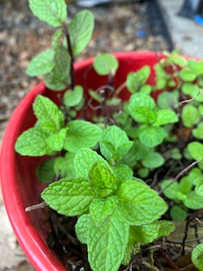

Mints
Mentha Species
  Perennial
  Propagate- propagate by stem cuttings or root division.
  Height: height 1 to 2 feet
  Light: Full sun to part shade
  Harvest - Harvest new growth for best flavor
  Gardener’s Picks: There are many varieties with different scents such as pineapple, orange, and spearmint. Harvest new growth for best flavor
  Mint is invasive and best grown in containers –do not use allow the plant to touch the ground!
Photos by H. Peacock Morrow
Notes:
Herbs that tend to spread, like mint and oregano can be grown in containers. The containers can be sunk into the ground, in the garden, or used as accent pots. Note: don’t let the tips of the plants hang over and touch the ground, or they will root, grow, and spread

Slide 34
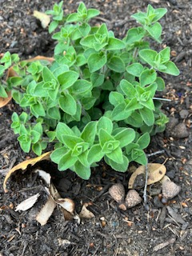
Oregano
Origanum vulgare
  Evergreen perennial (cool season)
  Propagate -Propagate from seeds, stem cuttings, or root division. Seeds germinate slowly!
  Space 1 foot; height 2 feet
  Light: Full sun
  Low water
  Blooms in summer
  Harvest -Harvest as plant begins to bloom
  Gardener’s Tips: Greek, Italian and Spicy
Photo by H. Peacock Morrow

Slide 35
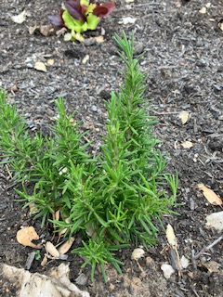
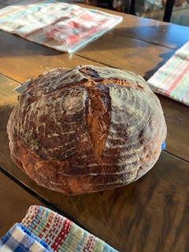
Rosemary
Rosmarinus officinalis
  Evergreen Shrub
  Propagate -Propagate prostrate rosemary by root division, and upright varieties from stem cuttings in the spring.
  Soil –Rich to average soil
  Space 1 foot; height 1 foot
  Full sun to part shade
  Low water
  Blooms inspiring and summer
  Harvest four- inch pieces from the top anytime
  Gardener’s Tips: Try UC Davis All-Star Rosemarinus officinalis ‘Barbeque’ as a skewer for BBQing!
Photos by H. Peacock Morrow
Notes:
U4-6' x 2-3'; profuse, clear blue flowers in summer; evergreen; strong, straight stems used as BBQ skewers; full sun; low water once established; good in containers with extra water; remarkable flavor and aroma for cooking.
se Rosemary in many dishes –my favorite! Chop the leaves and mix with kosher salt to add flavor to many dishes!

Slide 36
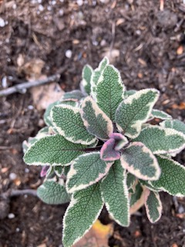
Sage
Salvia officinalis
  Perennial (cool season)
  Propagate by seeds, cuttings, layering, or root division.
  Soil -Rich, sandy soil
  Space 1 foot; height 2 feet
  Full sun
  Low water -requires excellent drainage to prevent root rot.
  Blooms in summer
  Harvest by snipping leaves
  Gardener’s Tips:
    Tricolor sage is a favorite for its beautiful color.
    Berggarten sage is a preferred variety for cooking.
Photo by H. Peacock Morrow

Slide 37
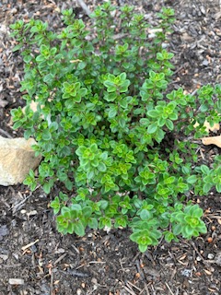
Thyme
Thymus species
  Evergreen Perennial (cool season)
  Propagate by stem cuttings
  Soil –Rich soil
  Space 1 foot; height 1 foot
  Full sun to part shade
  Low water
  Blooms in summer
  Harvest leaves before blossoms open
  Gardener’s Tips: Many species, and can range in height from 1” to 1’
Photo by H. Peacock Morrow
Notes:
Good ground cover or border plant

Slide 38
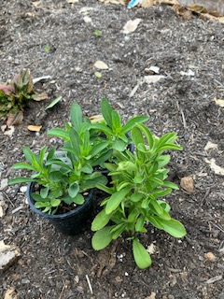
Unusual Culinary Herbs
Stevia
Stevia Redbaudiana
  Tender Perennial
  Propagate by stem cuttings, can be grown from seed
  Soil –Rich soil
  Space 1 foot; height 1 foot
  Water warm, moist and sunny conditions. Keep the soil evenly moist.
  Harvest the leaves and dry
  Gardener’s Tips: The leaves can be used fresh, dried, or ground as a sugar substitute to sweeten desserts, fruit, and drinks
Photo by H. Peacock Morrow
Notes:
prefers warm, moist and sunny conditions
cannot survive frost

Slide 39
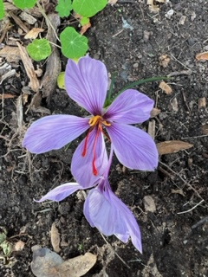
Unusual Culinary Herbs
Saffron
Saffron (Crocus Stativus)
  Corm (cool season)
  Propagate Plant bulbs in September where they will get sun when in bloom.
  Soil –Average Soil
  Space 12 bulbs per square foot; height 4 inches
  Light-Full sun to part shade
  Blooms in fall
  Harvest: The saffron derives from the stigma and styles — called threads — within the flower itself
  Gardener’s Tips: Saffron is very expensive due to the difficulty of harvesting it. Farmers must harvest the delicate threads from each flower by hand.
Photo by D.Crosby
Notes:
Saffron crocus is a corm grown for its stigmas

Slide 40
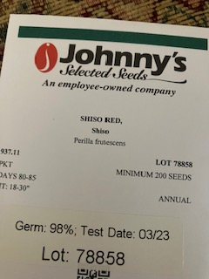
Unusual Culinary Herbs
Shiso
Perilla frutescens
  Annual
  Propagate Direct seed in spring after last frost
  Soil-medium to rich, sandy soil
  Space-6 to 12 inches apart
  Full sun
  Blooms in summer
  Harvest leaves may be harvested once the plants have become fully established
  Gardener’s Tips: Shiso is an aromatic herb commonly used in many Japanese dishes such as sushi, salads, tempura, noodles, etc. It has a unique fragrance and flavor.
Photo by H. Peacock Morrow
Notes:
Green and Red Shiso. Flavor is vibrant, herbaceous, and citrusy. Some also point out that it has hints of mint, basil, cloves, and cinnamon. Like most herbs, shiso does have a mildly astringent taste and bitter finish.

Slide 41
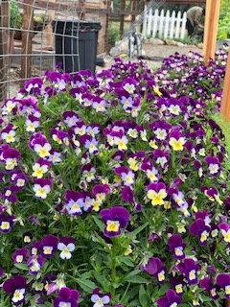
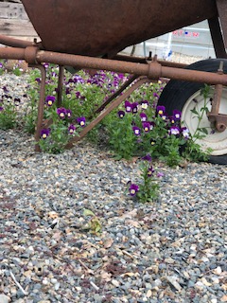
Unusual Culinary Herbs
Violets
Viola odorata and Viola tricolor
  Perennial (cool season)
  Propagate-Easily grown from seed and readily available in the nursery
  Space- Space 9 inches; height 8 to 10 inches
  Full sun to part shade
  Moderate water
  Blooms in winter and spring (treated as an annual)
  Harvest
  Johnny-jump-up flowers are edible (if pesticide free)
  Gardener’s Tips: may re-seed in your garden for years to come!
Photos by C. Johnsen
Notes:
Pic from the garden at Deercreek Farms
Reseeds readily in my garden
Great in salads or candied and used to decorate pastries or cakes.

Slide 42
Resources
  Landscaping with Herbs https://ucanr.edu/sites/sacmg/files/116769.pdf covers planning and planting an herb garden. (EHN 15)
  Culinary Herb Profiles https://ucanr.edu/sites/sacmg/files/116768.pdf shows a plant by plant profile of commonly used culinary herbs. (EHN 70)
  Integrating Culinary Herbs into the Garden https://ucanr.edu/sites/ucmgplacer/files/158599.pdf
  The Multi-Purpose Herb Garden https://ucanr.edu/sites/ucmgplacer/files/290859.pdf

Slide 43
Thank You!
Any Questions?
Master Gardener Hotline: (530) 889-7388
Rot Line: (530) 889-7399
Master Gardener Website: pcmg.ucanr.org
Evaluations, please!

