Slide 1
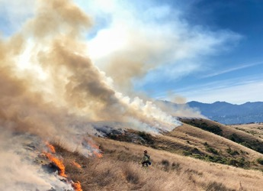

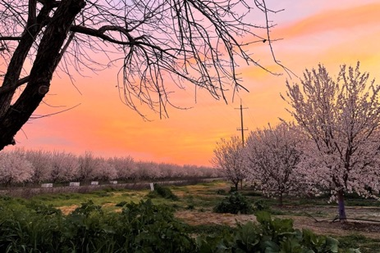
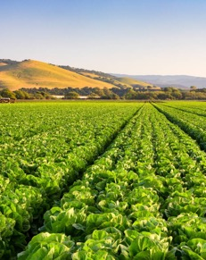
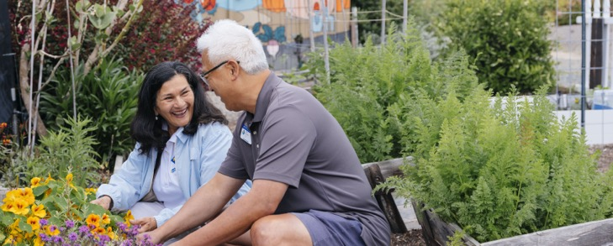

Bringing UC information and practices to local communities to improve their lives and livelihoods

Slide 2
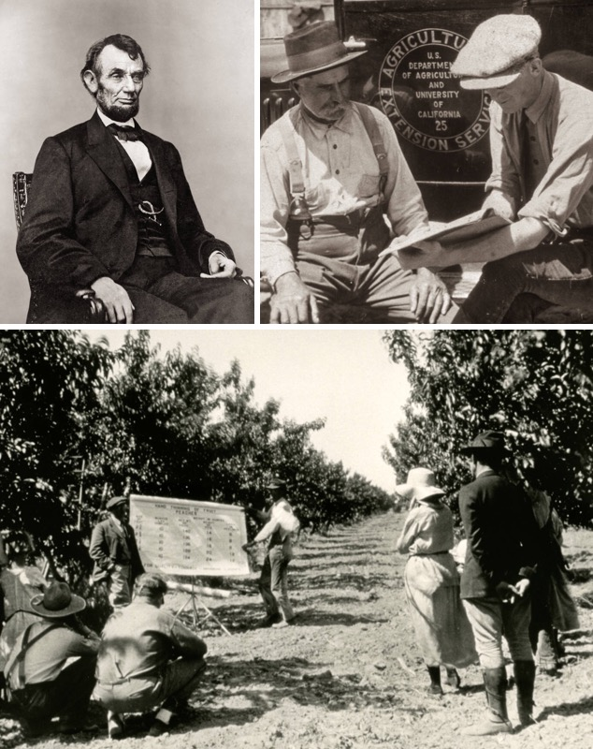
UC ANR Delivers California’s Land Grant Mission
Land Grant Universities established by Congress in 1862
The University of California created in 1868
Congress authorizes Agricultural Experiment Stations (AES) at Land Grants in 1887
Cooperative Extension established by Congress in 1914

Slide 3

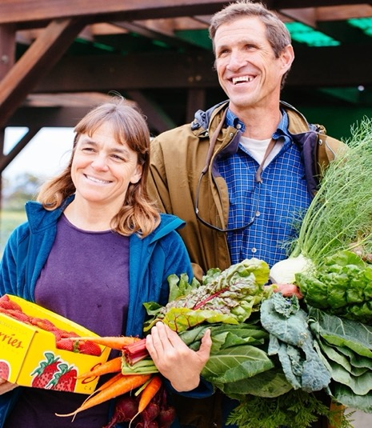
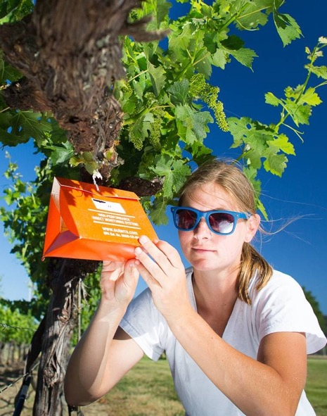


We bring UC to Californians by serving communities in all 58 counties.
UC ANR research & education programs support:
Sustainable, safe, and nutritious food
production and delivery
Economic success in a global economy
A sustainable, healthy, and productive environment
Science literacy and youth development

Slide 4
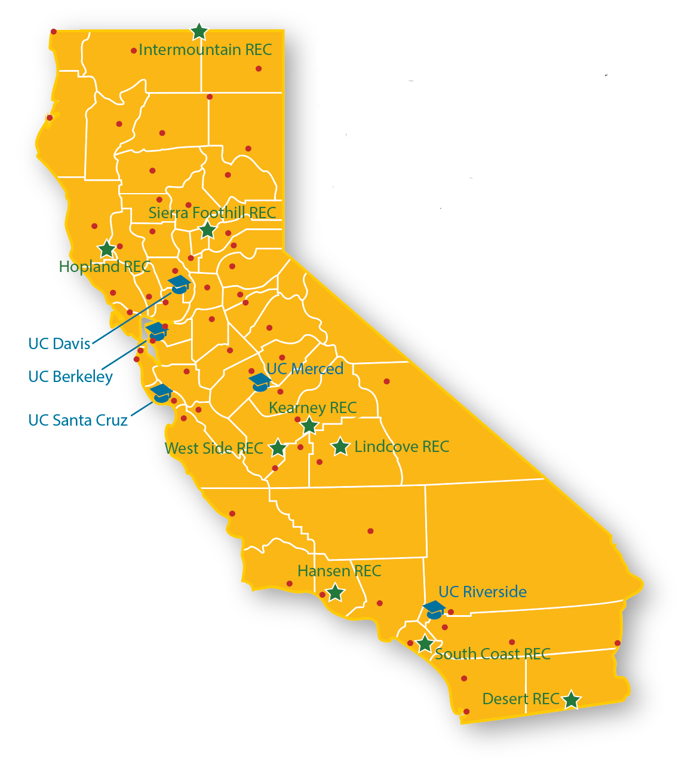
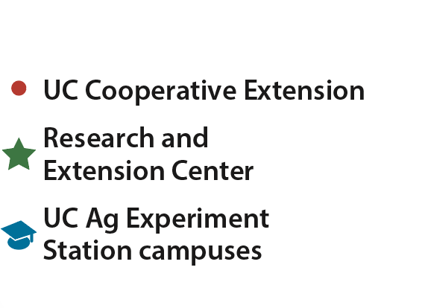

UC Cooperative Extension
150 Advisors conduct research in local communities
300+ Community Educators delivering programs
120 campus/county-based Specialists
13 Statewide Programs and Institutes
4-H Youth Development
Agricultural Issues Center
CalFresh Healthy Living, UC
California Institute for Water Resources
Expanded Food and Nutrition Education
Informatics and GIS
Nutrition Policy Institute
Sustainable Agriculture Research and Education
UC Environmental Stewards (California Naturalists & Climate Stewards)
UC Organic Agriculture Institute
UC Statewide Integrated Pest Management
UC Master Food Preserver
UC Master Gardener
Research and Extension Facilities
Nine Research and Extension Centers and Elkus Ranch Environmental Education Center: 12,500+ acres
235 research projects
Agricultural Experiment Station
560 researchers on 5 campuses
800+ research projects in partnership with land-grant partner USDA NIFA (2022)
Over 19,000 volunteers contribute 1.2M hours in donated public service

Slide 5

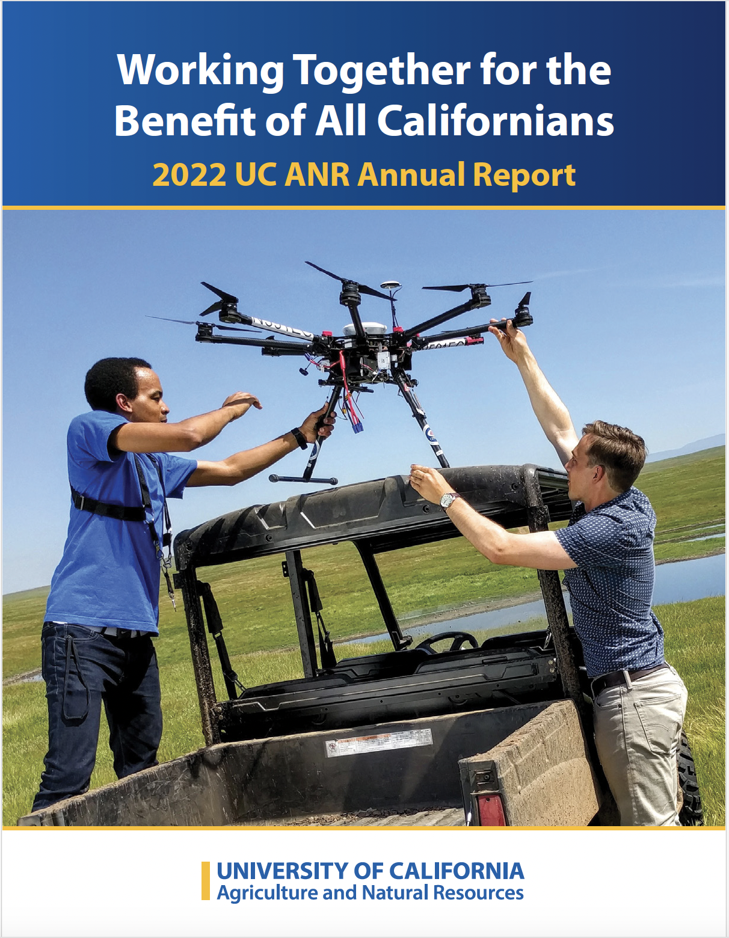





UC ANR Snapshot: 2022 Program Highlights
https://ucanr.edu/2022_Annual Report
19,300 trained volunteers delivered 1.2 million hours of public service
10 novel ideas led to patents issued
$33.48 estimated monthly food cost savings for 1,656 EFNEP families
1,210 policy engagement activities
467,950 adult and youth direct contacts/ educational exchanges
25,950 workshops, field days, courses & program meetings
3,020 publications and new educational materials produced

Slide 6
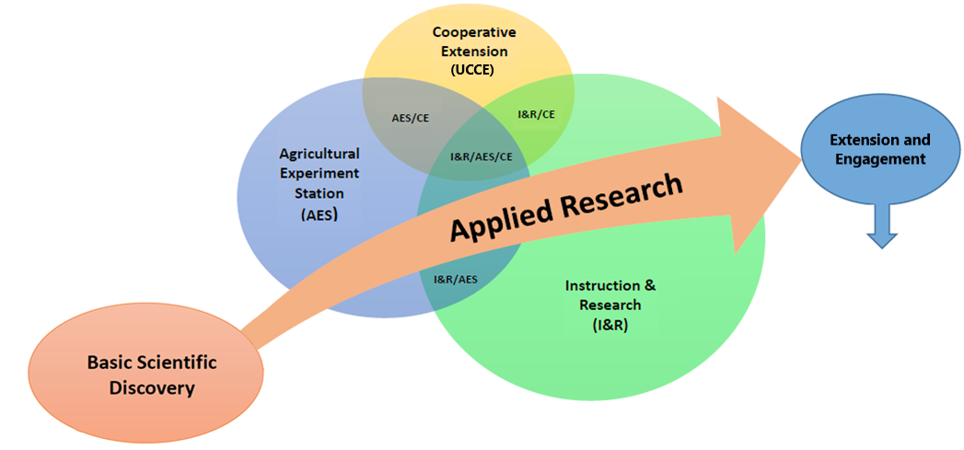
Enhance research excellence and ability to deliver science-based solutions through partnerships across UC system and beyond.
Translate mission-oriented research into policy and practice that solves community problems through stakeholder-driven and place-based collaborations.
Three Academic Mission Areas Working Together
Leverages the Mission-Oriented Research Continuum
Transdisciplinary Solutions to Complex Challenges

Slide 7
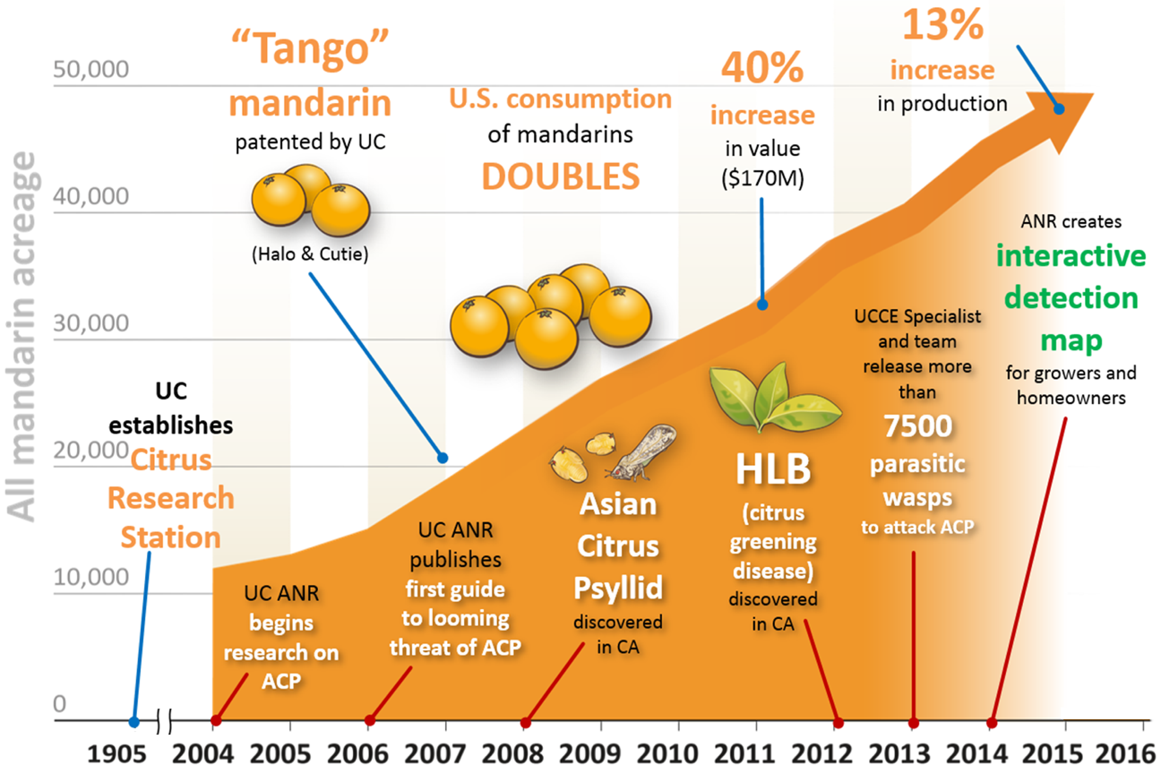
Example of Research and Extension: Fighting Huanglongbing
2018-2020
950% increased use of citrus materials tested by UC Citrus Clonal Protection Program
Developed antibody-based diagnosis using pathogen effectors as markers
Volunteers monitored IPM
in 224 citrus orchards to reduce pest populations
Advanced usage of Citrus Under Protective Screens (CUPS) to minimize use of fertilizer, water & pesticides

Slide 8

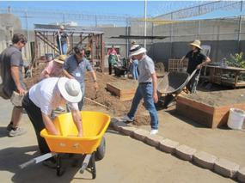

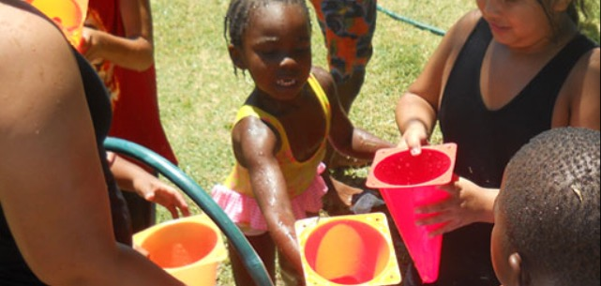
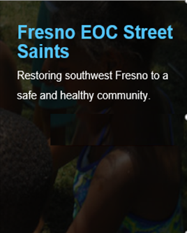

Example of Programs: Youth Development & Community Science
Engaging a diverse community to promote healthy communities, youth development and stewardship of California's natural resources through education and service.
Horticulture therapy program and Career Technical Education at Girls Rehabilitation Facility in San Diego

Slide 9







Supporting State Agency Missions through Partnerships
Joint research projects and subject matter experts
Training in pesticide safety, vegetation management, fire suppression, irrigation and more
Developing educational materials and programs
Mapping future fire probability under climate change scenarios to address public safety
Promoting use of agricultural lands for groundwater recharge and drought management
Providing evidence-based programs and teaching for SNAP-Ed and Women, Infants and Children (WIC)

Slide 10
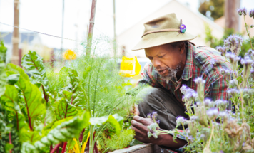
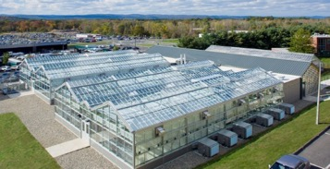
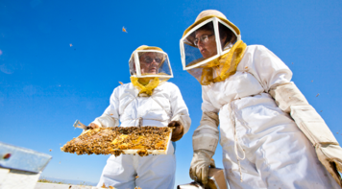
Public Values Condition Changes Measurable Impact
Assess California’s current and future needs, along with strengths and opportunities of UC ANR’s work, to better align our mission delivery to achieve maximum impact.
Promoting economic prosperity in California
Developing a qualified workforce for California
Safeguard abundant & healthy food for all Californians
Protecting California’s natural resources
Building climate-resilient communities & ecosystems
Promoting healthy people & communities
Developing an inclusive & equitable society
https://ucanr.edu/Public_Values/

Slide 11
UC ANR Strategic Plan
2020 – 2025
Designed to enhance operations, improve delivery of the mission and ensure the Strategic Vision is realized
UC ANR Strategic Vision 2040 is in development
Research and Extension
People
Financial Stability
Operational Excellence
Policy and Advocacy
View strategic plan

Slide 12
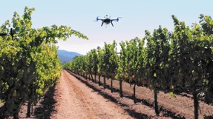

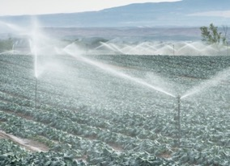
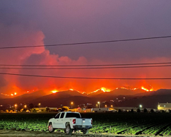


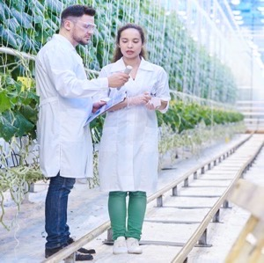
UC ANR Research & Extension Needed More than Ever
New Technologies, Crops and Tools Required
Food & Nutrition Systems are Fragile
Climate Change Impacts
Economic Disconnects
Disaster Response
  Need Solutions for:
  Worker & Community Well-being
  Industry Recovery, Resiliency & Compliance
  Market Competitiveness, Growth & Profitability

Slide 13
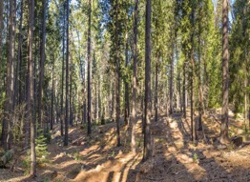
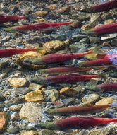

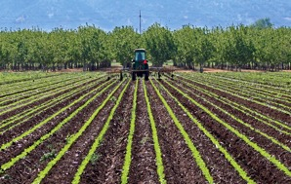
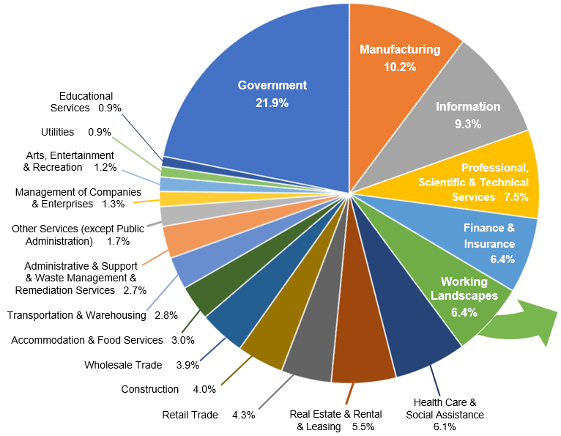


CALIFORNIA’S WORKING LANDSCAPE
A Key Contributor to the State’s Economic Vitality
NOVEMBER 2019
http://ucanr.edu/WorkingLandscapes
The 2018 California Economy
$4,015,337,714,945 —
just over $4 Trillion
$333 Billion Sales
Agriculture $263.5 B
Mining $32.2 B
Forestry $23.2 B
Outdoor Recreation $6.3 B
Renewable Energy $5.9 B
Fishing $1.7 B
1.5 Million Jobs
$85 Billion Earnings
SOURCE: Report by California Community Colleges Centers of Excellence using 2018 data from the North American Industry Classification System (NAICS)

Slide 14
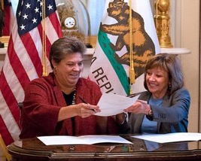
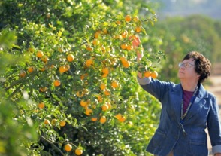
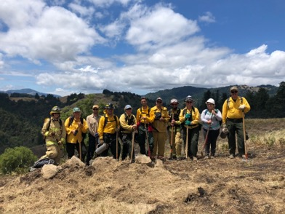


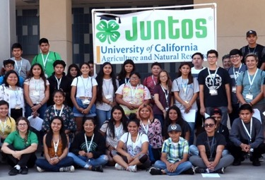
UC ANR Growing and Thriving in our Second Century
Develop new partners, non-traditional resources, improved visibility
Reach more Californians – expand number and diversity of audiences
Ensure delivery & services are relevant
Exploit new technology and methods; retool, recapitalize, reinvest in facilities and infrastructure
Deliver our mission – be a catalyst for positive change

