Slide 1
Vertebrate Pests Around the Garden and Home
Karey Windbiel-Rojas
Associate Director Urban & Community IPM, Area IPM Advisor (Sacramento, Solano, Yolo)
UC Statewide Integrated Pest Management Program

Slide 2
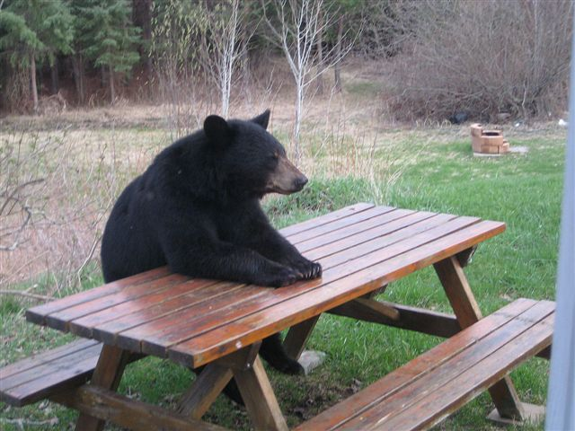
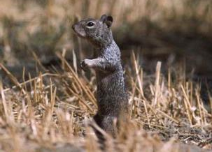
What Are Vertebrate Pests?
Nonhuman species of vertebrate animals that are currently troublesome locally, or over a wide area, to one or more persons, either by being a health hazard, a general nuisance, or by destroying food, fiber, or natural resources.

Slide 3
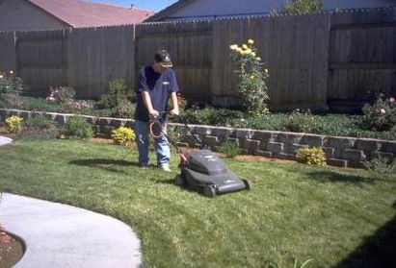
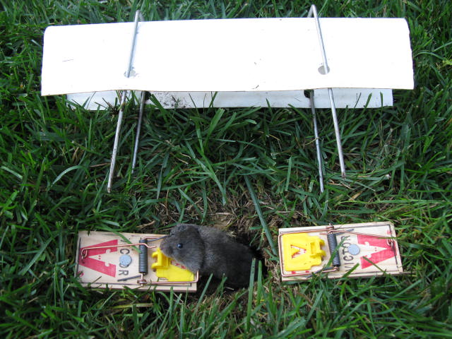
Current Control Strategies
Currently, we focus on an integrated approach that utilizes a number of strategies and tools to control vertebrate pests.
Photo courtesy of Steven Albano

Slide 4
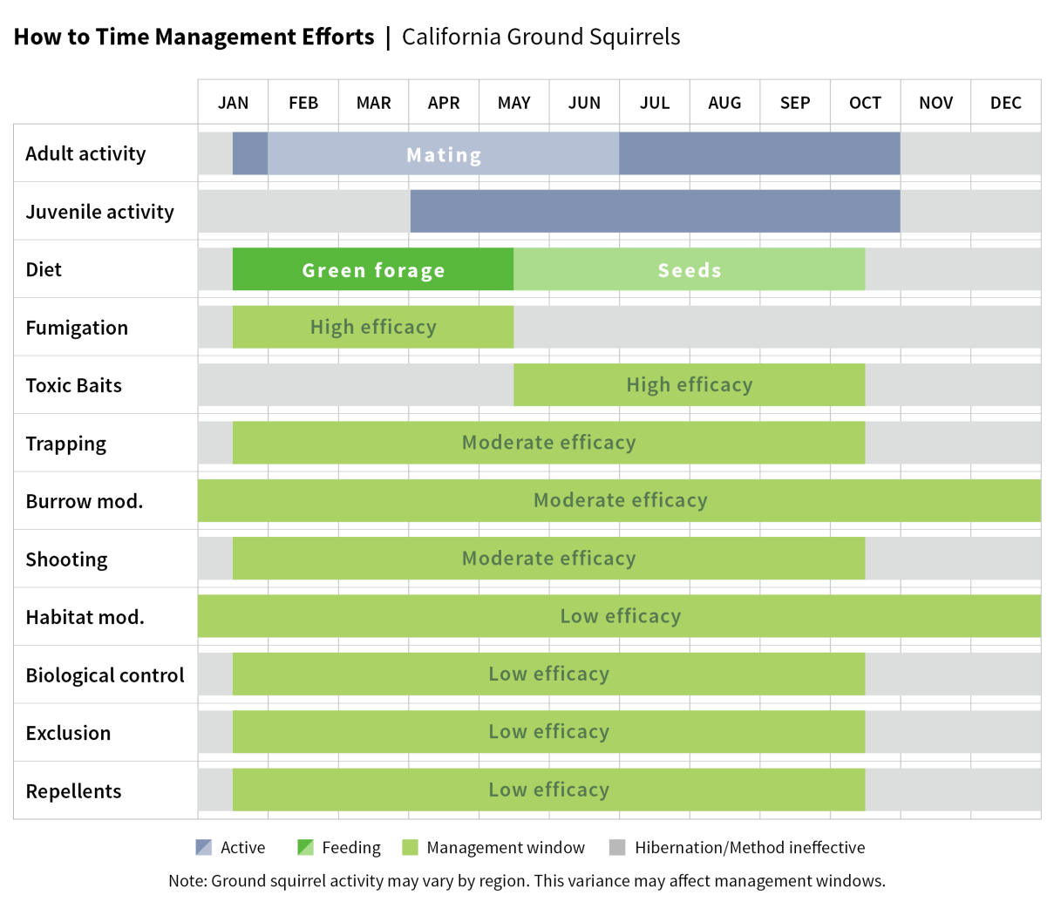
Importance of Biology/Ecology
Understanding the biology and ecology of vertebrate pests will guide management decisions.
Example:
  ground squirrels

Slide 5
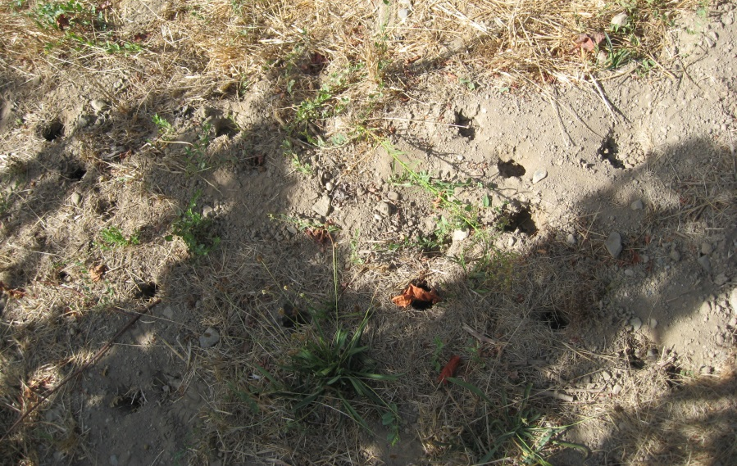
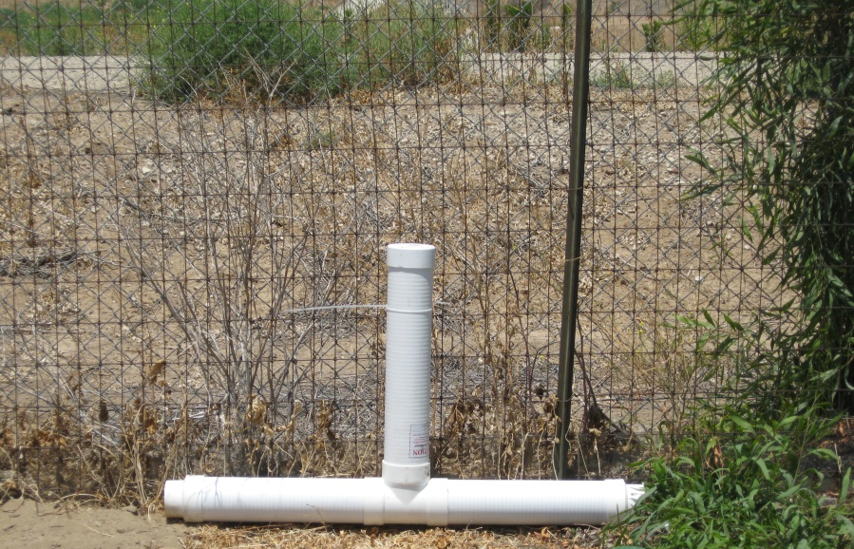
Management Strategy
Identify the vertebrate pest species.
Assess options for managing this species.

Slide 6
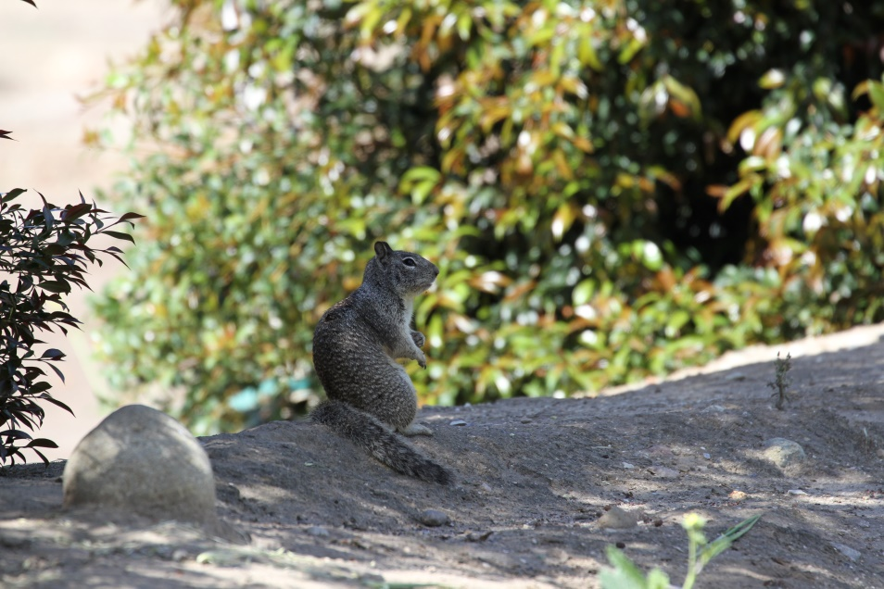
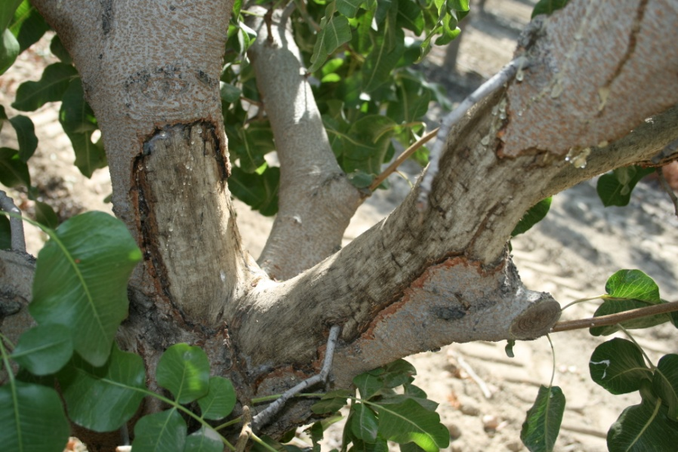
Species Identification – Ground Squirrels
Gray-brown fur with semi-bushy tail
Are social
Damage
  girdling of trees
  consumption of forbs and grasses
  chewing of irrigation lines
  abundant burrow openings

Slide 7
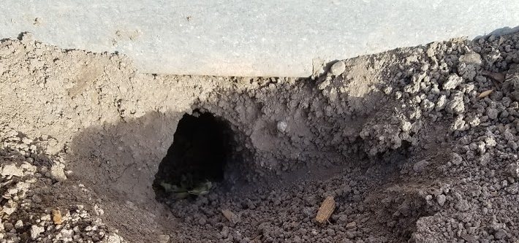
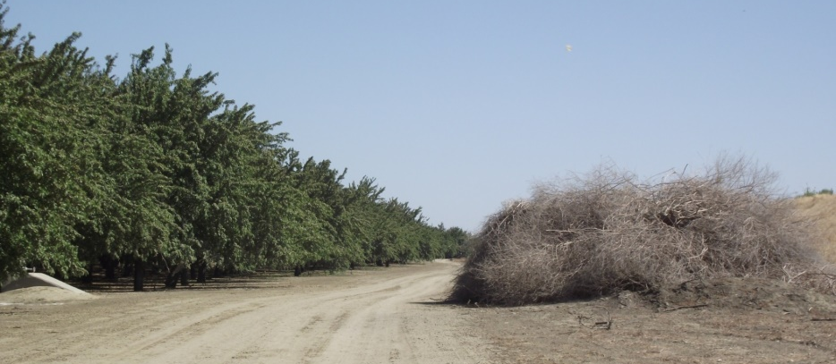
Species Identification – Ground Squirrels
Squirrels are active throughout the day and are frequently visible.
They prefer to burrow next to buildings, on field edges, and alongside fencerows and roadsides.

Slide 8
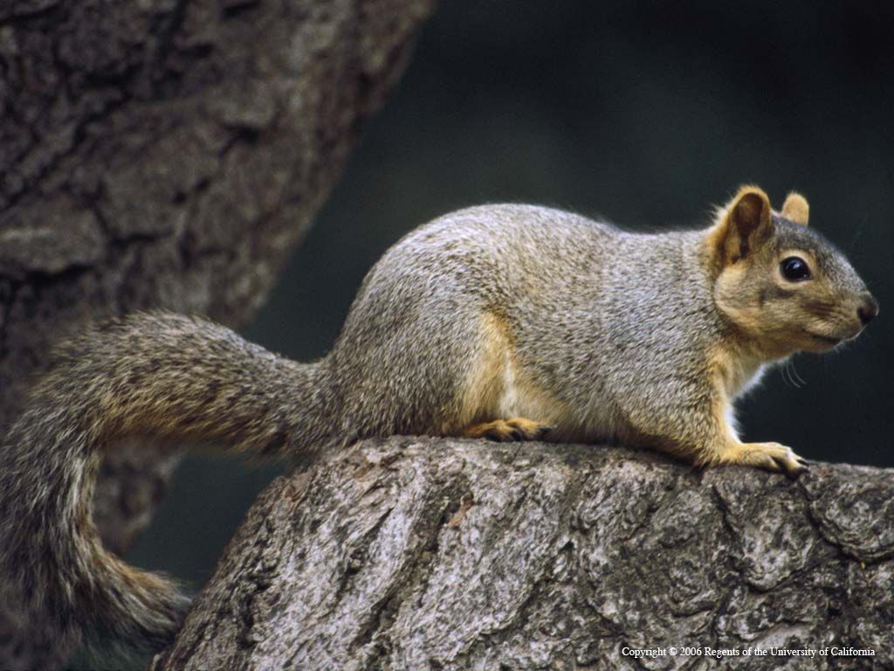
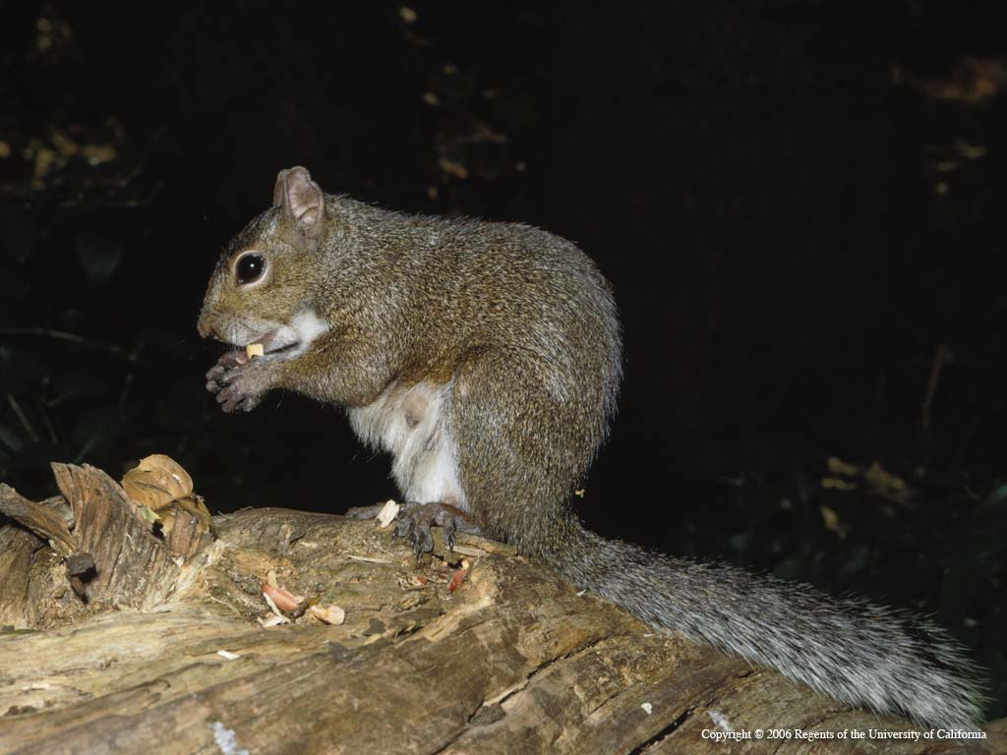
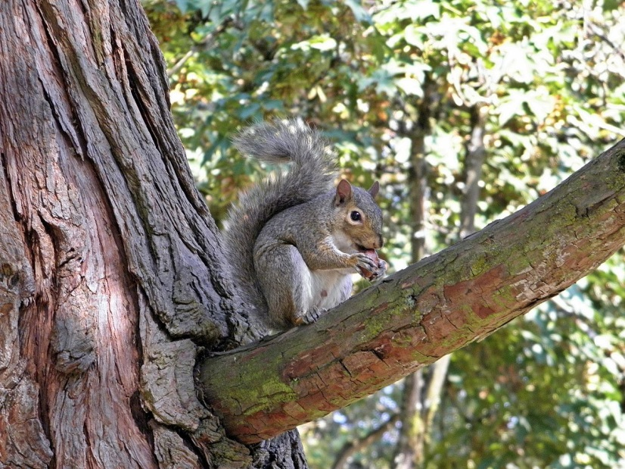
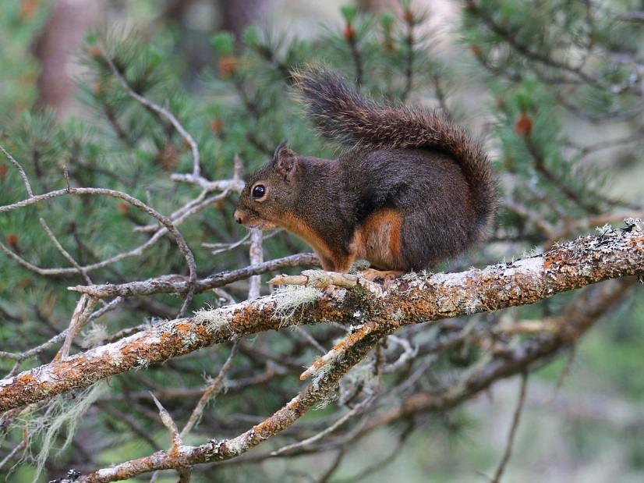
Species Identification – Tree Squirrels

Slide 9
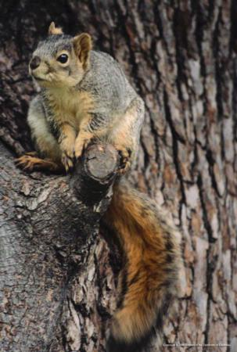
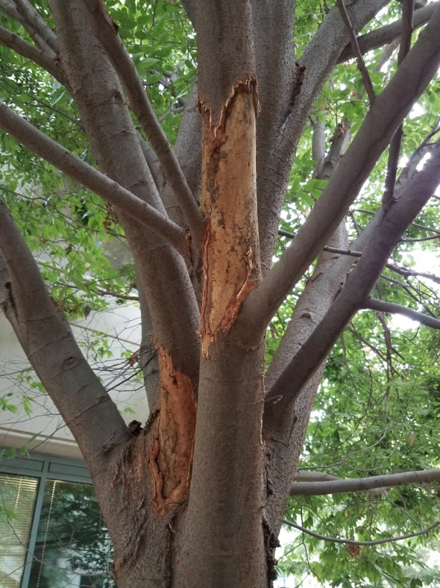
Species Identification – Tree Squirrels
Eastern fox squirrel causes the most damage.
Are diurnal.
Will consume fruits and nuts, dig holes in lawns, chew on cables, and nest in buildings.

Slide 10
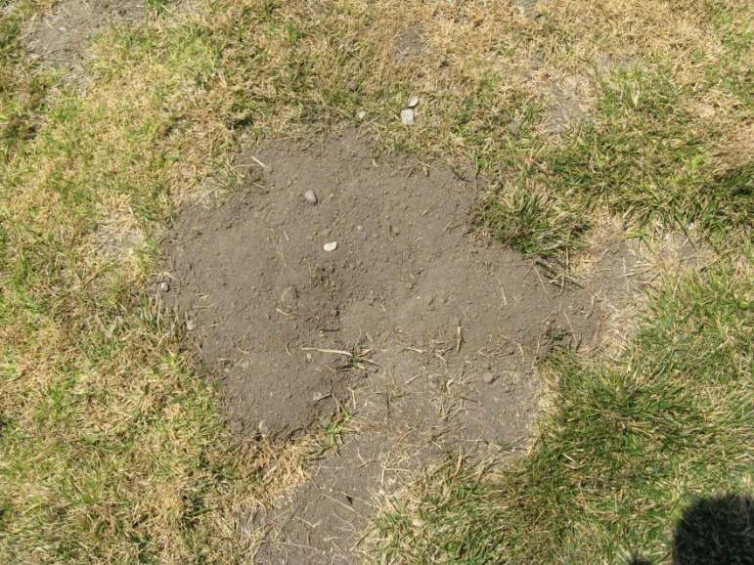
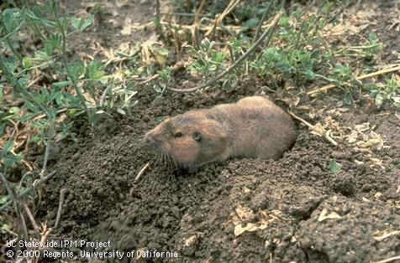
Species Identification – Pocket Gophers
Burrowing rodent about 6-8 in long; rarely seen above ground.
Gopher mounds are plugged and often fan-shaped.

Slide 11
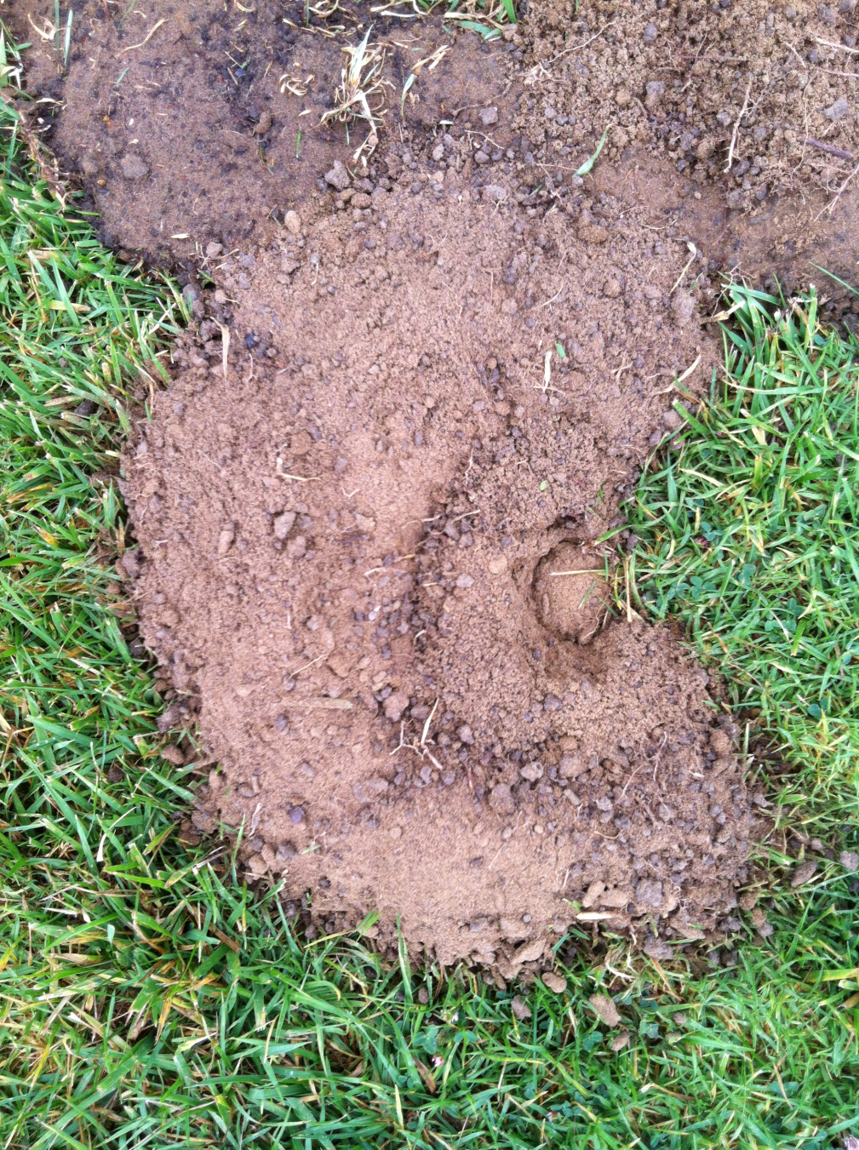
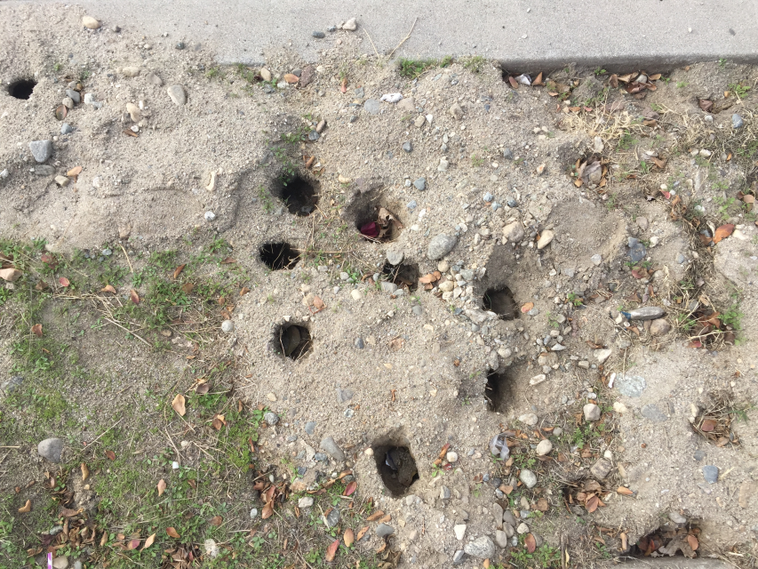
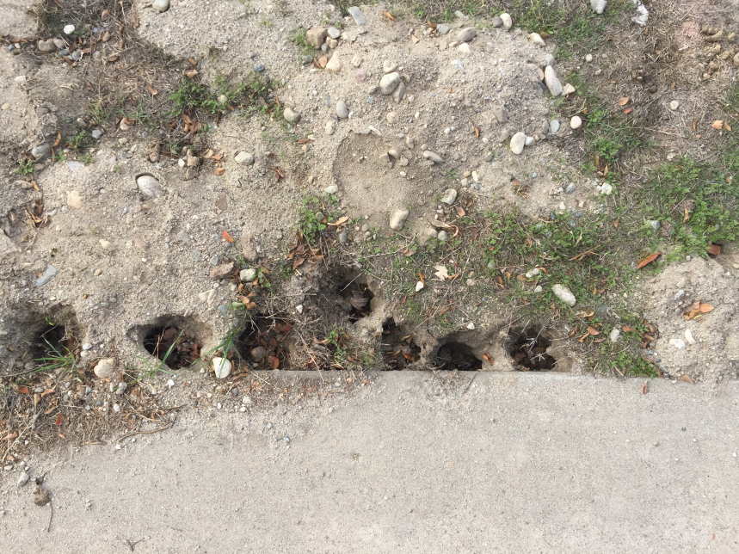

Slide 12
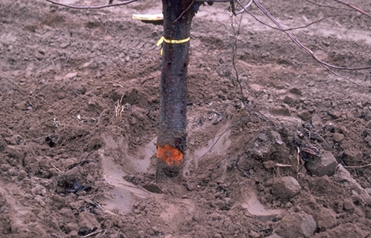
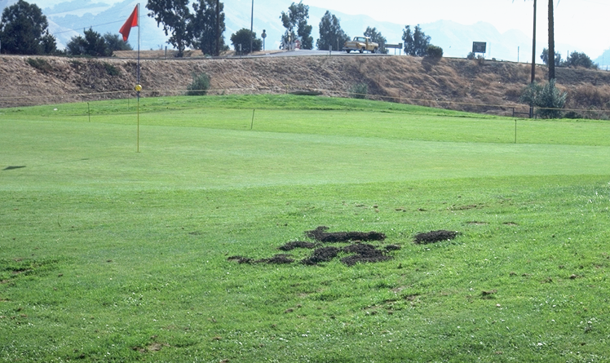
Species Identification – Pocket Gophers
They feed on taproots weakening and/or killing plants.
Then can girdle trees, particularly below ground.
Mounds can also kill plants and can create weed seed-beds.

Slide 13
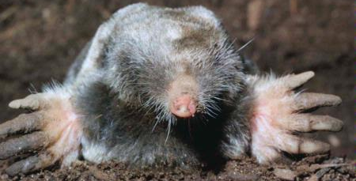
Species Identification – Moles
Are burrowing mammals with a pointed snout and broad feet that eat worms and insects.
As such, moles cause less damage to gardens than gophers, though linear ridges and mole mounds do cause damage.

Slide 14
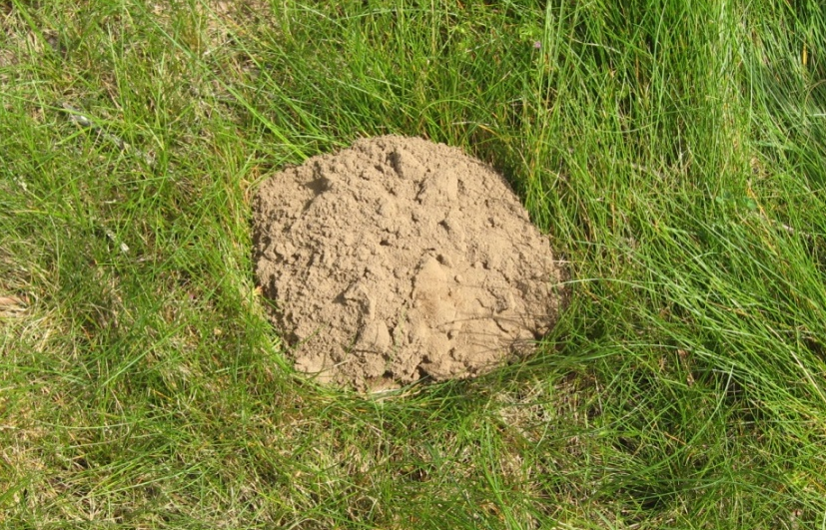
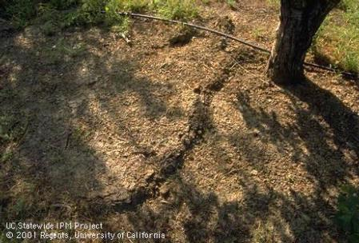
Species Identification – Moles
Mounds are volcano shaped with the plug in the center of the mound.
Can also be identified from raised earth indicating underground tunnels

Slide 15
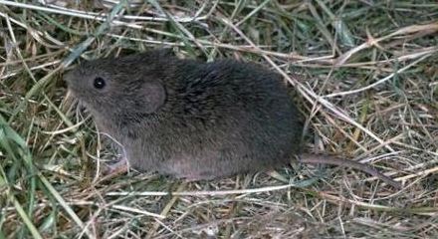
Species Identification – Meadow Voles
Have dark grayish brown fur and are 4 to 6 inches in length.
Populations tend to cycle, exhibiting irruptive growth patterns.

Slide 16
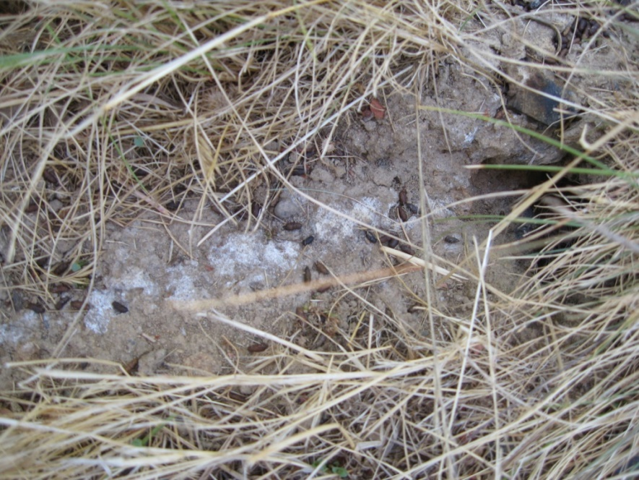
Species Identification – Meadow Voles
Dig shallow burrows and leave well-worn trails. Fecal pellets are often present,
Primary damage caused by girdling of stems, consumption of vegetation, and gnawing of cables, pipes, etc.

Slide 17
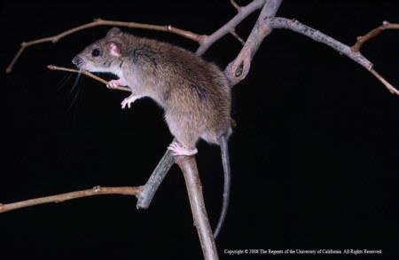
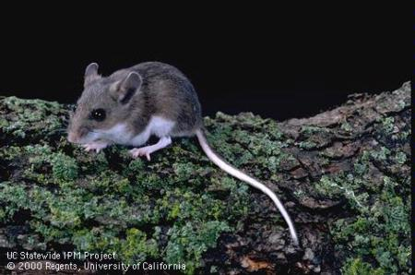
Species Identification – Other Rodents
Norway rats, roof rats, house mouse, deer mouse.
Primarily commensal rodents.
Can be difficult to control in some outdoor settings.

Slide 18
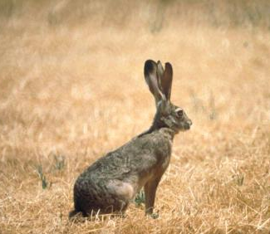
Species Identification – Hares & Rabbits
Jackrabbits are hares, but they are the most common rabbit-like pest in agricultural settings.
Are larger and have longer ears than cottontails.
Damage caused through foraging on stems and leaves of plants

Slide 19
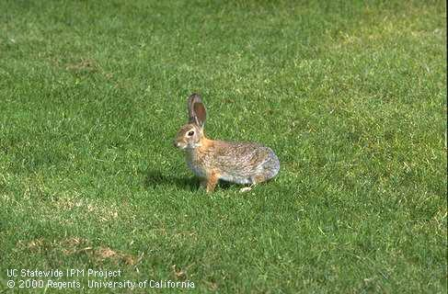
Species Identification – Hares & Rabbits
Cottontails are true rabbits.
They are smaller and have shorter ears.
Typically a bigger pest than jackrabbits in urban settings.

Slide 20
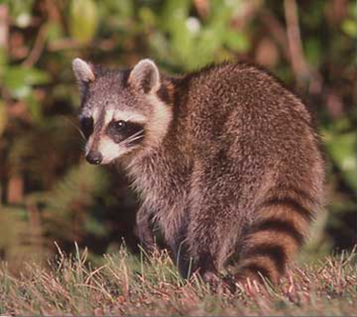
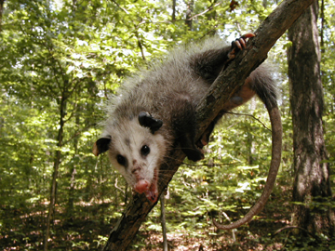
Species Identification – Raccoon and Opossum
Will eat fruits and vegetables.
Can get into garbage and pet foods.
Potentially transmit diseases.

Slide 21
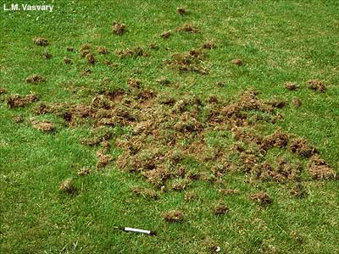
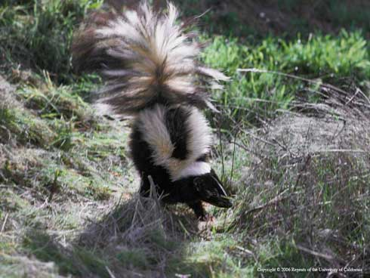
Species Identification – Skunks
Will dig holes looking for grubs and insects
Will spray
Will eat pet foods
Can transmit diseases

Slide 22
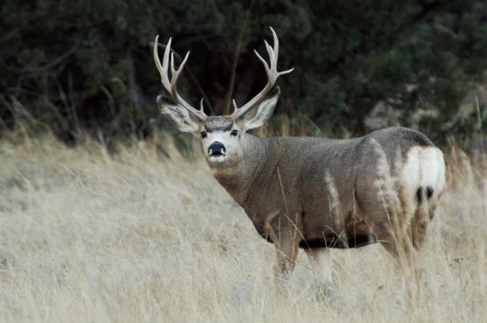
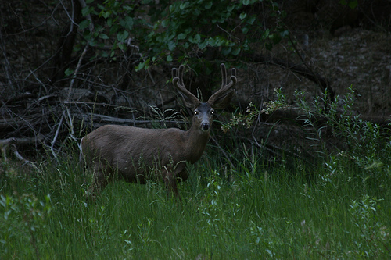
Species Identification – Deer
Can cause significant damage to gardens and landscaping, especially when in close proximity to forested and riparian areas.
Most damage will occur during dawn, dusk, and at night, so identification of footprints and scat may be needed to determine deer were the cause of damage.

Slide 23
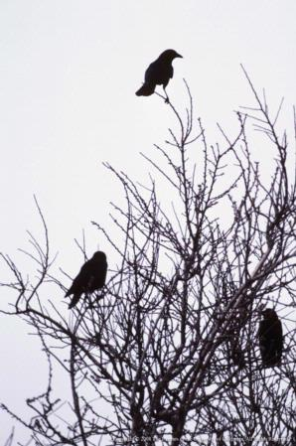
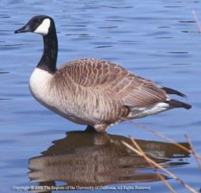
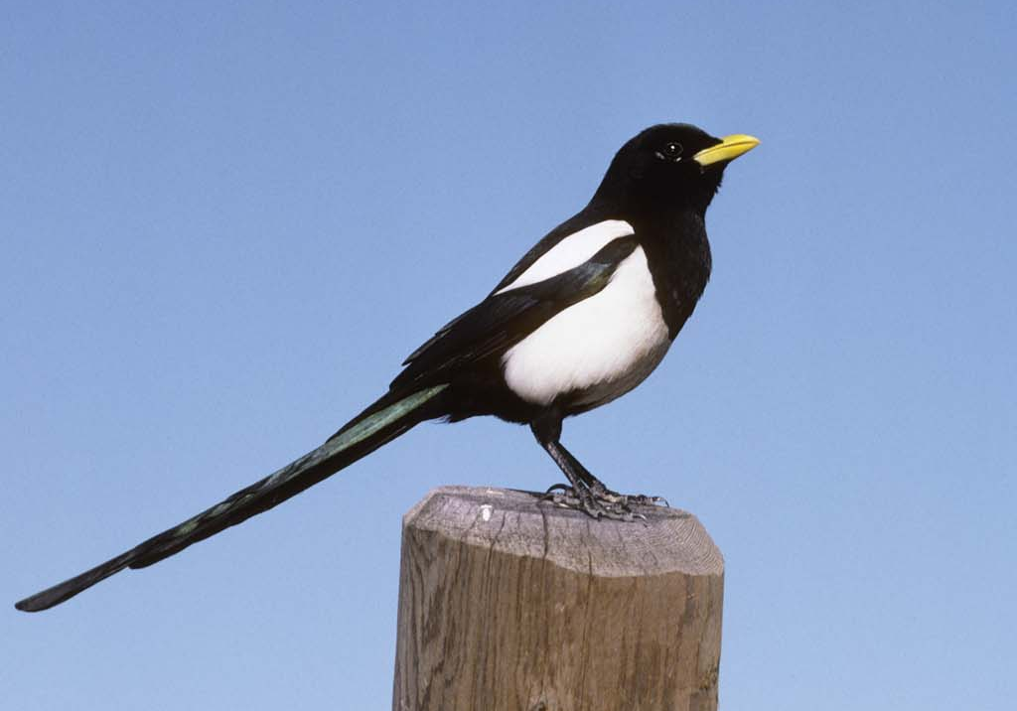
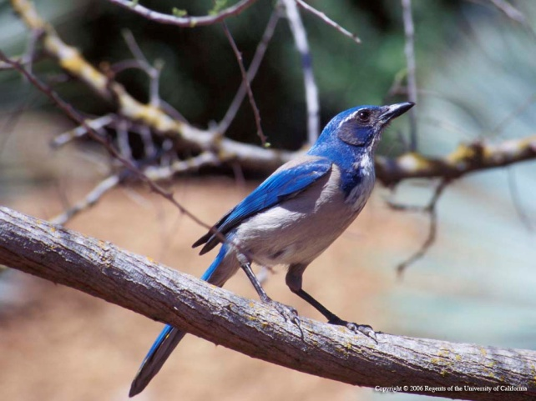
Species Identification – Birds
Birds can be pests in vegetable gardens.
These include ducks, geese, crows, magpies, starlings, house finches and scrub jays.

Slide 24
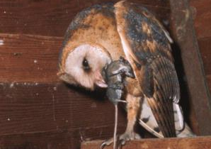
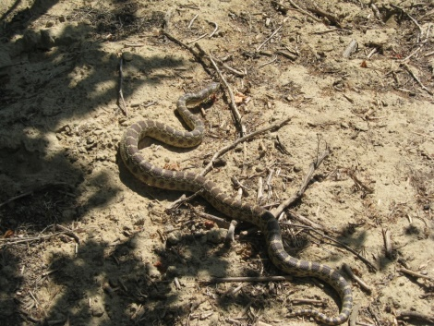
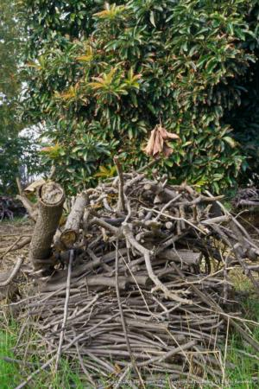
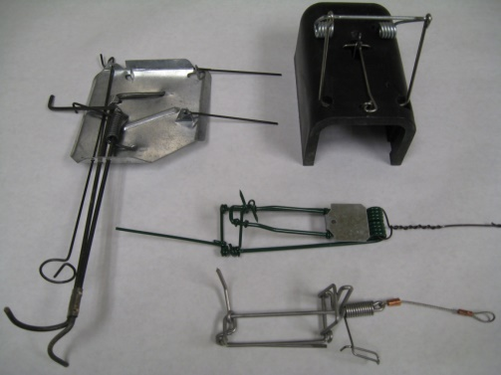
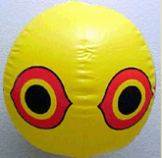
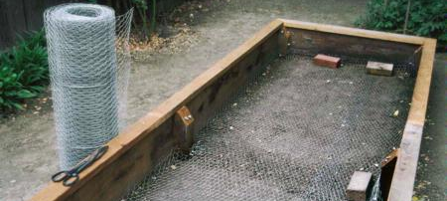
IPM for Vertebrate Pests
Biological control– natural predators
Cultural control– Modify habitat
Physical control– exclusion, trapping, frightening
Chemical control– repellents, rodenticides

Slide 25
What Control Options are Available?
 | Habitat modification | Baiting | Burrow fumigation | Trapping | Exclusion | Repellent | Frightening | Shooting
Pocket gopher | X | X | X | X | X
Ground squirrel | X | X | X | X |  |  |  | X
Meadow vole | X | X |  | X | X
Hares & rabbits | X | X |  | X | X | X |  | X
Tree squirrels | X |  |  | X |  |  |  | X
Deer |  |  |  |  | X | X |  | X
Birds | X |  |  | X | X | X | X | X

Slide 26
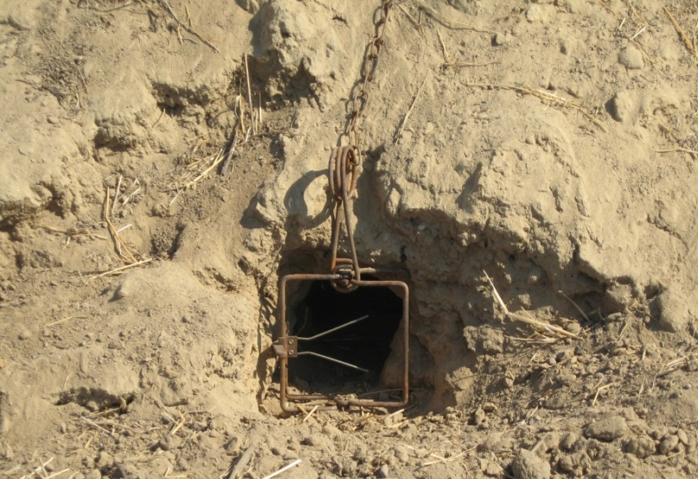

Control Options—Trapping
Body-gripping traps, box-type squeeze traps, snap traps, and pincer traps are common kill traps.
Wire cage traps are common live traps.
Live traps require euthanization of vertebrate pests.

Slide 27
Case Study Instructions
Sit with your pre-assigned vegetable group
Choose one of the vertebrate pest case studies from your folder and work on it with your group
Identify the cause of the problem and determine solutions
Go over the discussion questions with your group after completing your diagnosis and solutions for one case study
If you have time, you may work through another case study.
Ask your presenter if you have any questions or need help
Rely on UC ANR resources:
UC IPM Website ipm.ucanr.edu
Vegetable Pest Identification Card Sets
Wildlife pest control around homes and gardens
Notes:
Check your nametag for your assigned vegetable group.

