Slide 1
Facility Use Agreements
Everything You’ve Always Wanted to Know, and Some Information you Probably Won’t Care About
Presented by: Matt Rapparlie
Title: Risk Management Analyst
Date: December 6th, 2023

Slide 2
What is a Facility Use Agreement and Why Does it Matter?
Facility Use Agreements are a contract between us (UCANR) and the facility we are using. They lay out specific parameters for the use of a space and protect us from any unnecessary liability.

Slide 3
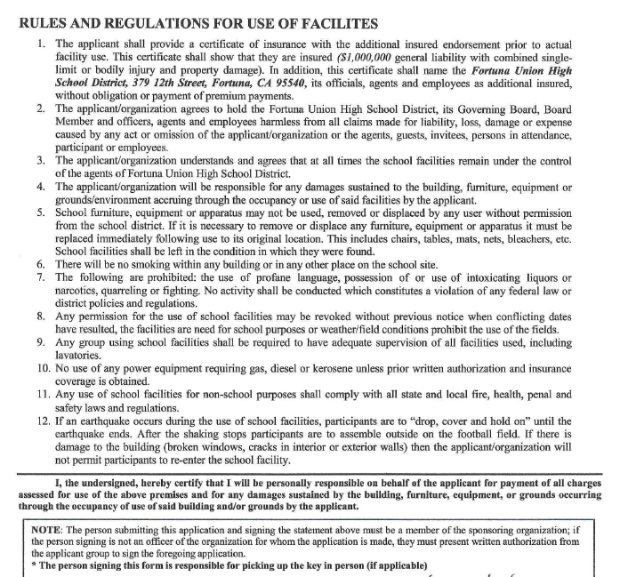

Facility Use Contract Example
Hidden in all that fine print is the information relevant to the certificate and the use of the facility.
This lets us know the insurance and other requirements for us to use the facility.

Slide 4
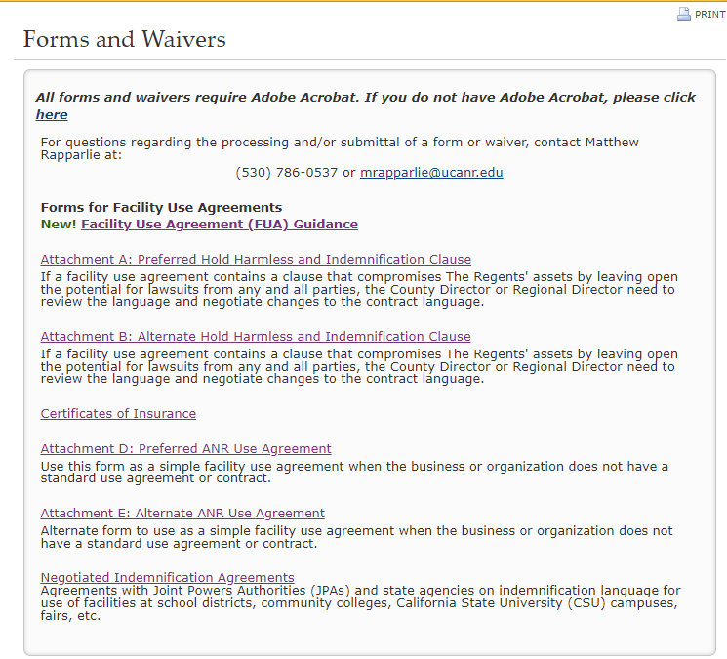
Attachments: What are they and when do you need them?
All of the necessary forms and waivers can be found at: https://ucanr.edu/sites/risk/Forms_and_Waivers/
We have created multiple, fillable attachments in order to amend contract language to suit the University’s preferred wording.
The way an agreement is worded will determine which attachment is to be used.
If you’re confused right now, don’t panic!

Slide 5
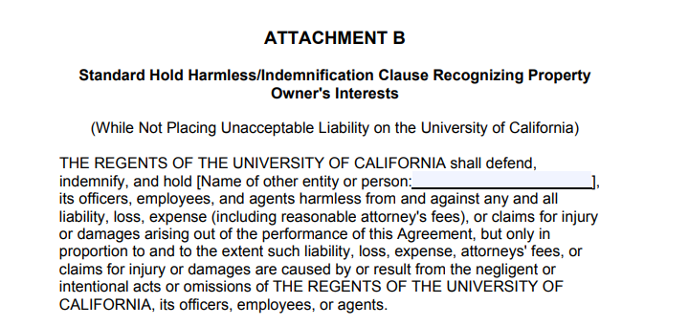
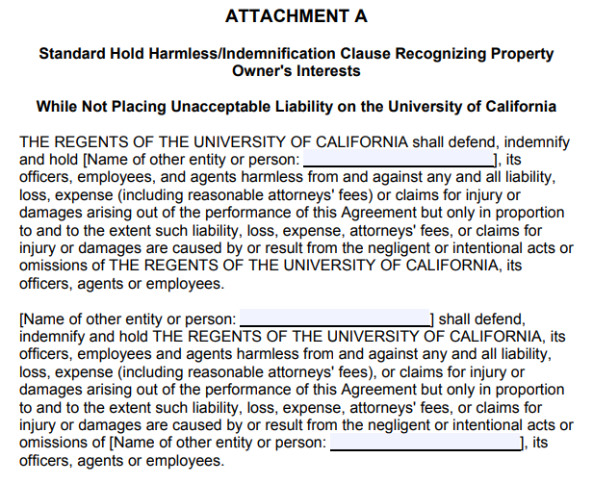
When To Use Which Attachment
Attachment A: Modify an existing contract with reciprocal indemnity.
Attachment B: Modify an existing contract with one sided indemnity.
Attachment D: Use for reciprocal indemnity if no contract exists.
Attachment E: Use for one sided indemnity if no contract exists.
*** You will primarily be using attachment B
There is a detailed workflow available here: https://ucanr.edu/sites/risk/files/351533.pdf

Slide 6
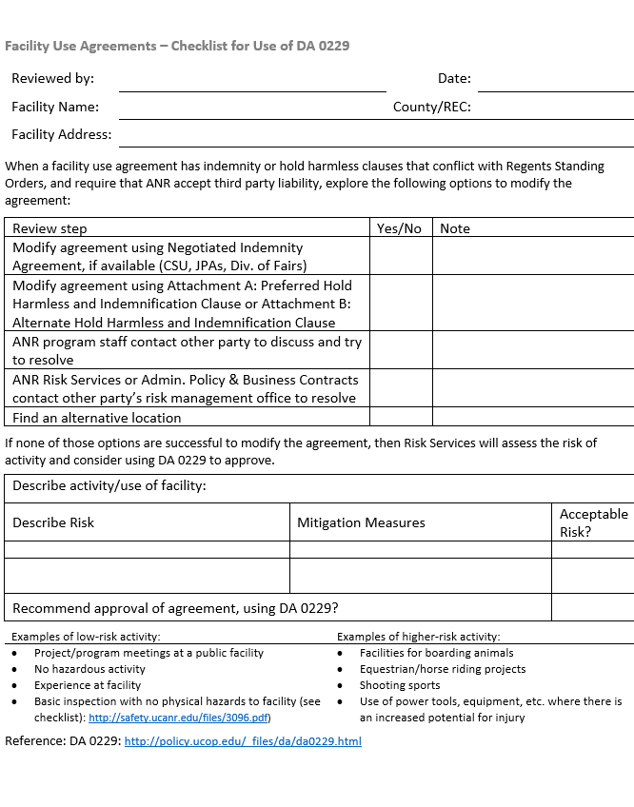
But what if the facility will not agree to our language?
If a facility will not accept our changes, we must complete the attached form.
This is a way of evaluating the potential risks associated with using the facility.
Once completed, you can forward to risk@ucanr.edu for approval

Slide 7
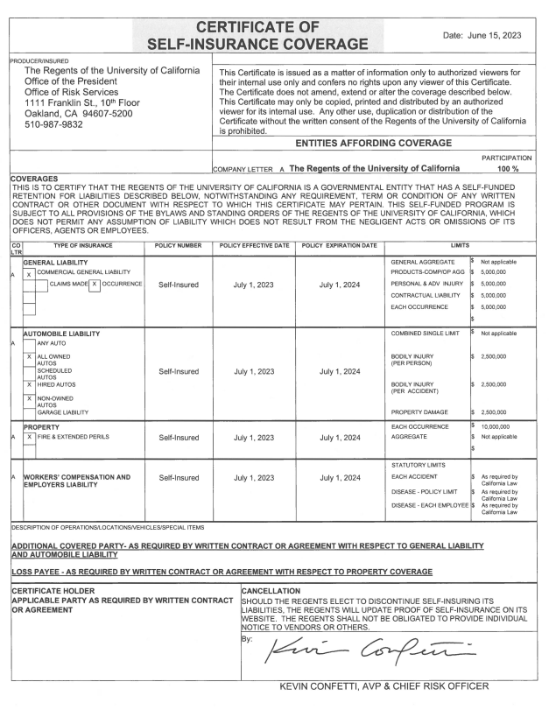

Insurance Certificates
If a location does not wish for an ‘additional insured’ endorsement, you can provide them with a generic certificate of insurance. This is available through the UCANR Risk site.
If the location is requesting to be added, or does not accept the generic certificate, you will have to submit a request through ‘Workflow’.
Once you submit, we will take care of the rest and get a custom certificate sent back to you as soon as possible.
Sample Additional Insured Endorsement Request:

Slide 8
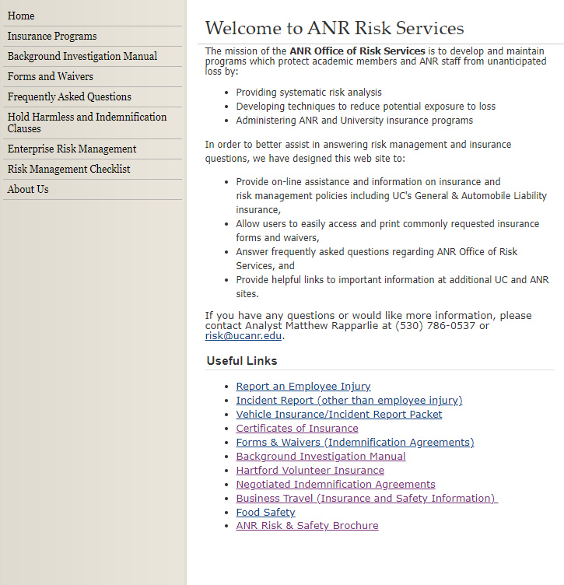
I’m Still Unsure, What Should I do?
Visit the Risk Services Website at ucanr.edu/sites/risk
If you ever have a question on what to do, you can email risk@ucan.edu
We’re here to help and answer any questions you may have.

Slide 9
Questions?

