Slide 1
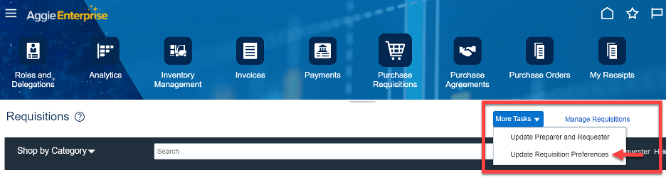
SCM – Requisition Preferences
The Requisition Preferences screen allows you to identify the default shipping and payment information that will default on each Requisition in Aggie Enterprise and must be completed before creating a Requisition.

Slide 2
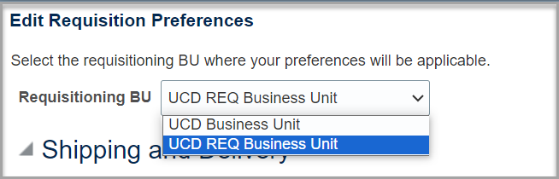
SCM – Requisition Preferences
Choose Requisition BU > UCD Req Business Unit. Without making this change, not all the Requisition features will correctly appear in Aggie Enterprise.

Slide 3
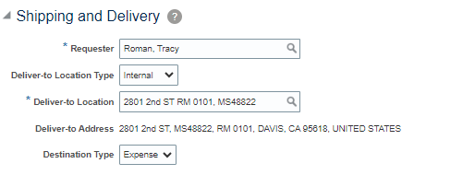
SCM – Requisition Preferences
In the Shipping and Delivery section:
Requester: Will be your name
Deliver-To Location : enter the street number. * Most locations affiliated with the university, both university-owned and leased buildings, are in the database. You can select a different delivery address for a specific order.
Destination Type: Expense

Slide 4
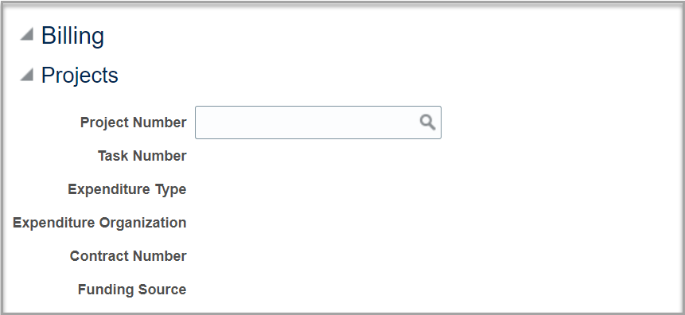
SCM – Requisition Preferences
This section is optional:
Projects section, expand the section and enter a Project if one will be used for billing purposes.

Slide 5
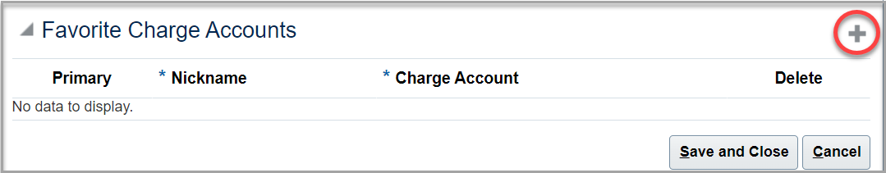
SCM – Requisition Preferences
This section is optional:
Favorite Charge Accounts section if a Project wasn’t entered in the Projects section. Click + to enter a chart string to be used for billing purposes. More than one chart string can be entered as necessary. If entering multiple chart strings, click + each time.

Slide 6
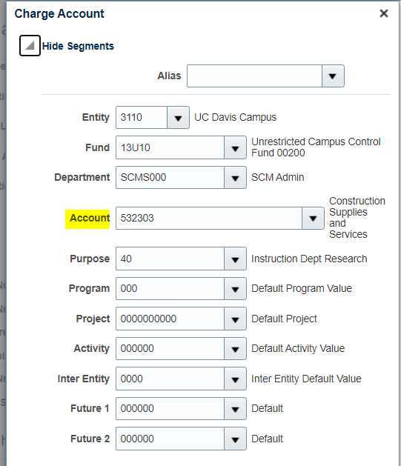
SCM – Requisition Preferences
Note that the 4th field, Account, is the equivalent of the Object Code used previously at UC Davis. This field will always be overridden by the Purchasing Category selected on the Requisition. For the default setting, you should select the category that represents the type of purchases you will usually make with that chart string:

Slide 7
SCM – Requisition Preferences
Note that the 4th field, Account, is the equivalent of the Object Code used previously at UC Davis. This field will always be overridden by the Purchasing Category selected on the Requisition. For the default setting, you should select the category that represents the type of purchases you will usually make with that chart string:

Slide 8
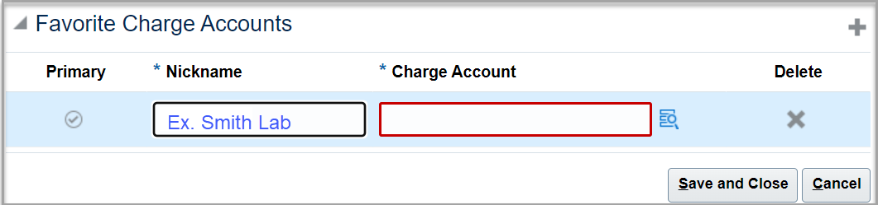
SCM – Requisition Preferences
The chart strings you plan to use in future Requisitions. When entering each line, enter a nickname, facilitating identification when selecting it in future Requisitions. As necessary, enter a different chart string(s) in a Requisition from what is set as the default(s).

