Slide 1
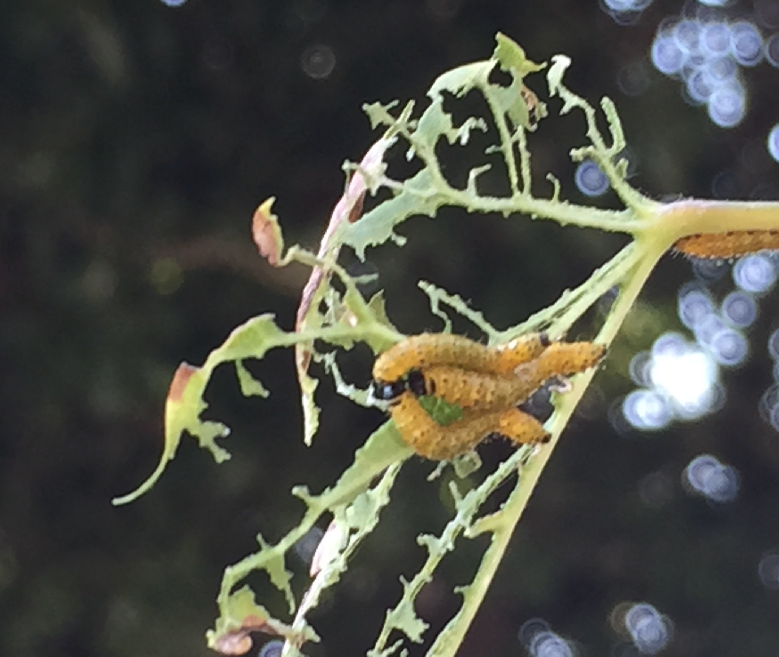
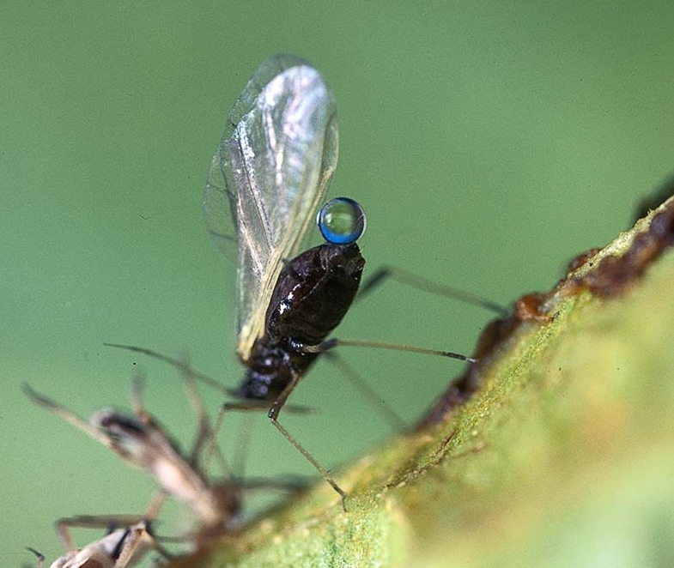
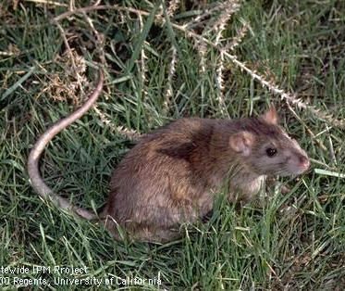

Diagnosing Plant Problems
Karey Windbiel-Rojas
Associate Director for Urban & Community IPM
Area Urban IPM Advisor-- Sacramento, Yolo, and Solano
UC Statewide IPM Program
UC Cooperative Extension
Notes:
This presentation will give you a brief introduction to identifying pests and other factors that cause damage to landscape plants.
Knowing the cause of damage is important for determining whether or not a pesticide is required and which one would be effective.

Slide 2
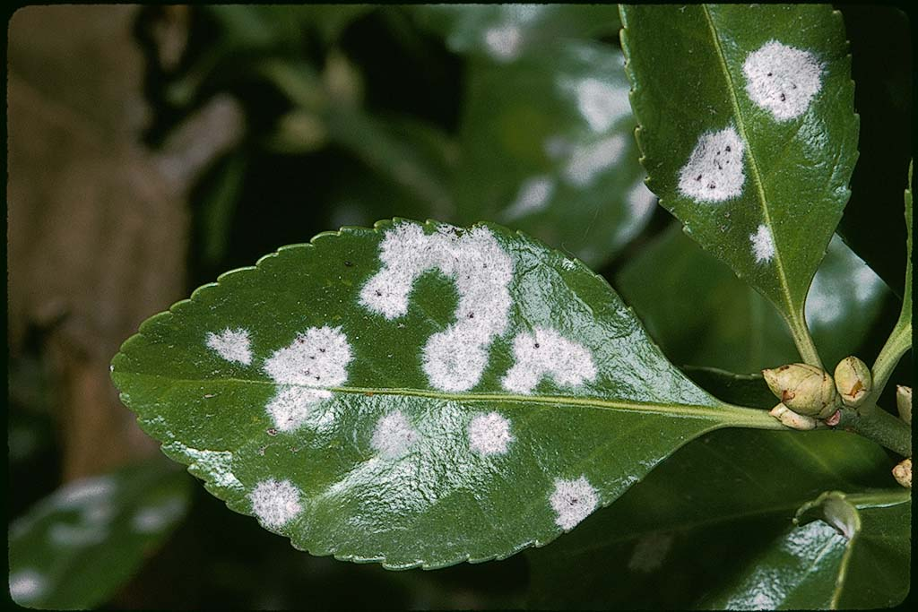
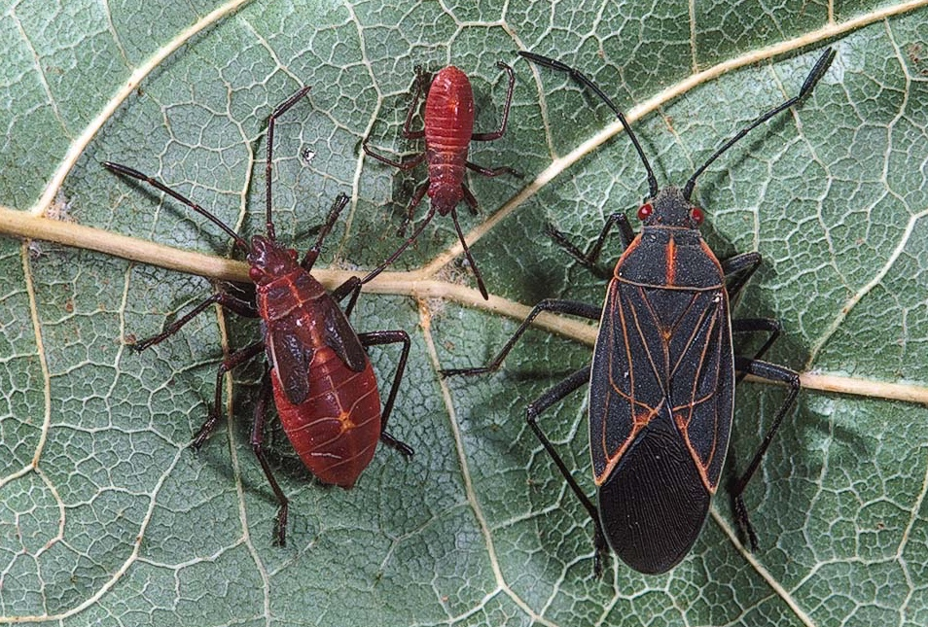
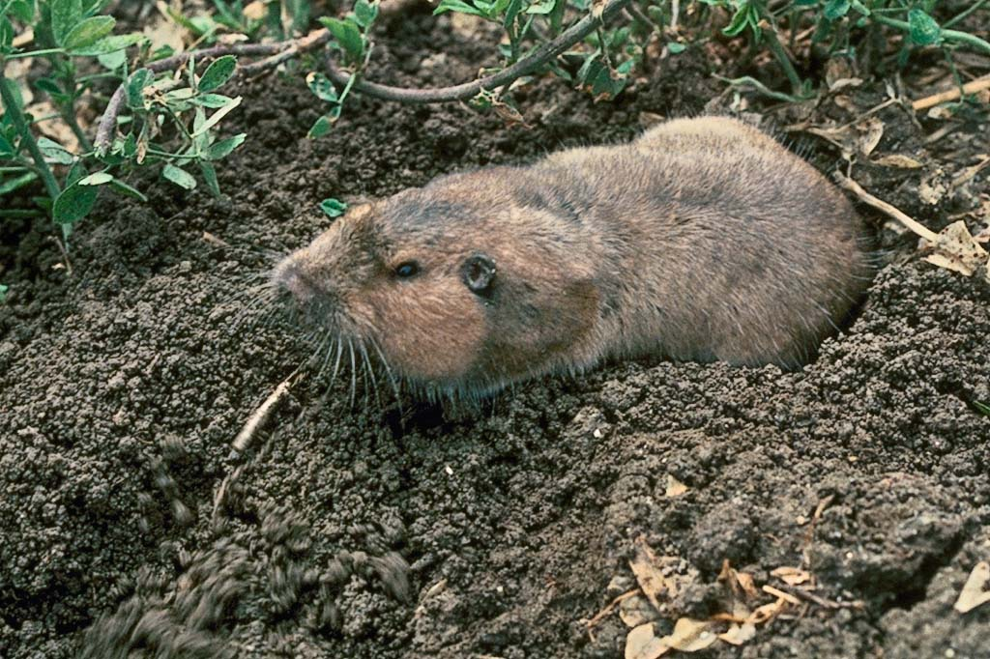
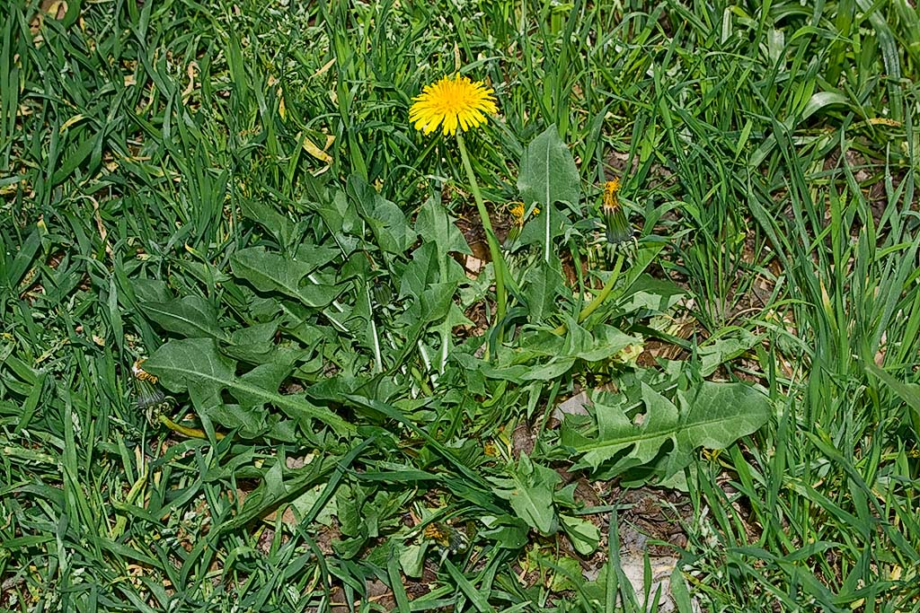
What pests can be found in garden and landscapes?
Plant pathogens
Invertebrates
Vertebrates
Weeds
Notes:
The most common groups of pests causing damage in landscapes are shown here, They include:
plant pathogens, which are microbes like fungi, bacteria or viruses that cause disease in plants,
invertebrates, which are animals without backbones, such as insects, mites and snails;
vertebrates including gophers and moles;
and weeds, which include any unwanted plants growing in the landscape.
Let’s talk about how to identify pests in each of these groups.

Slide 3
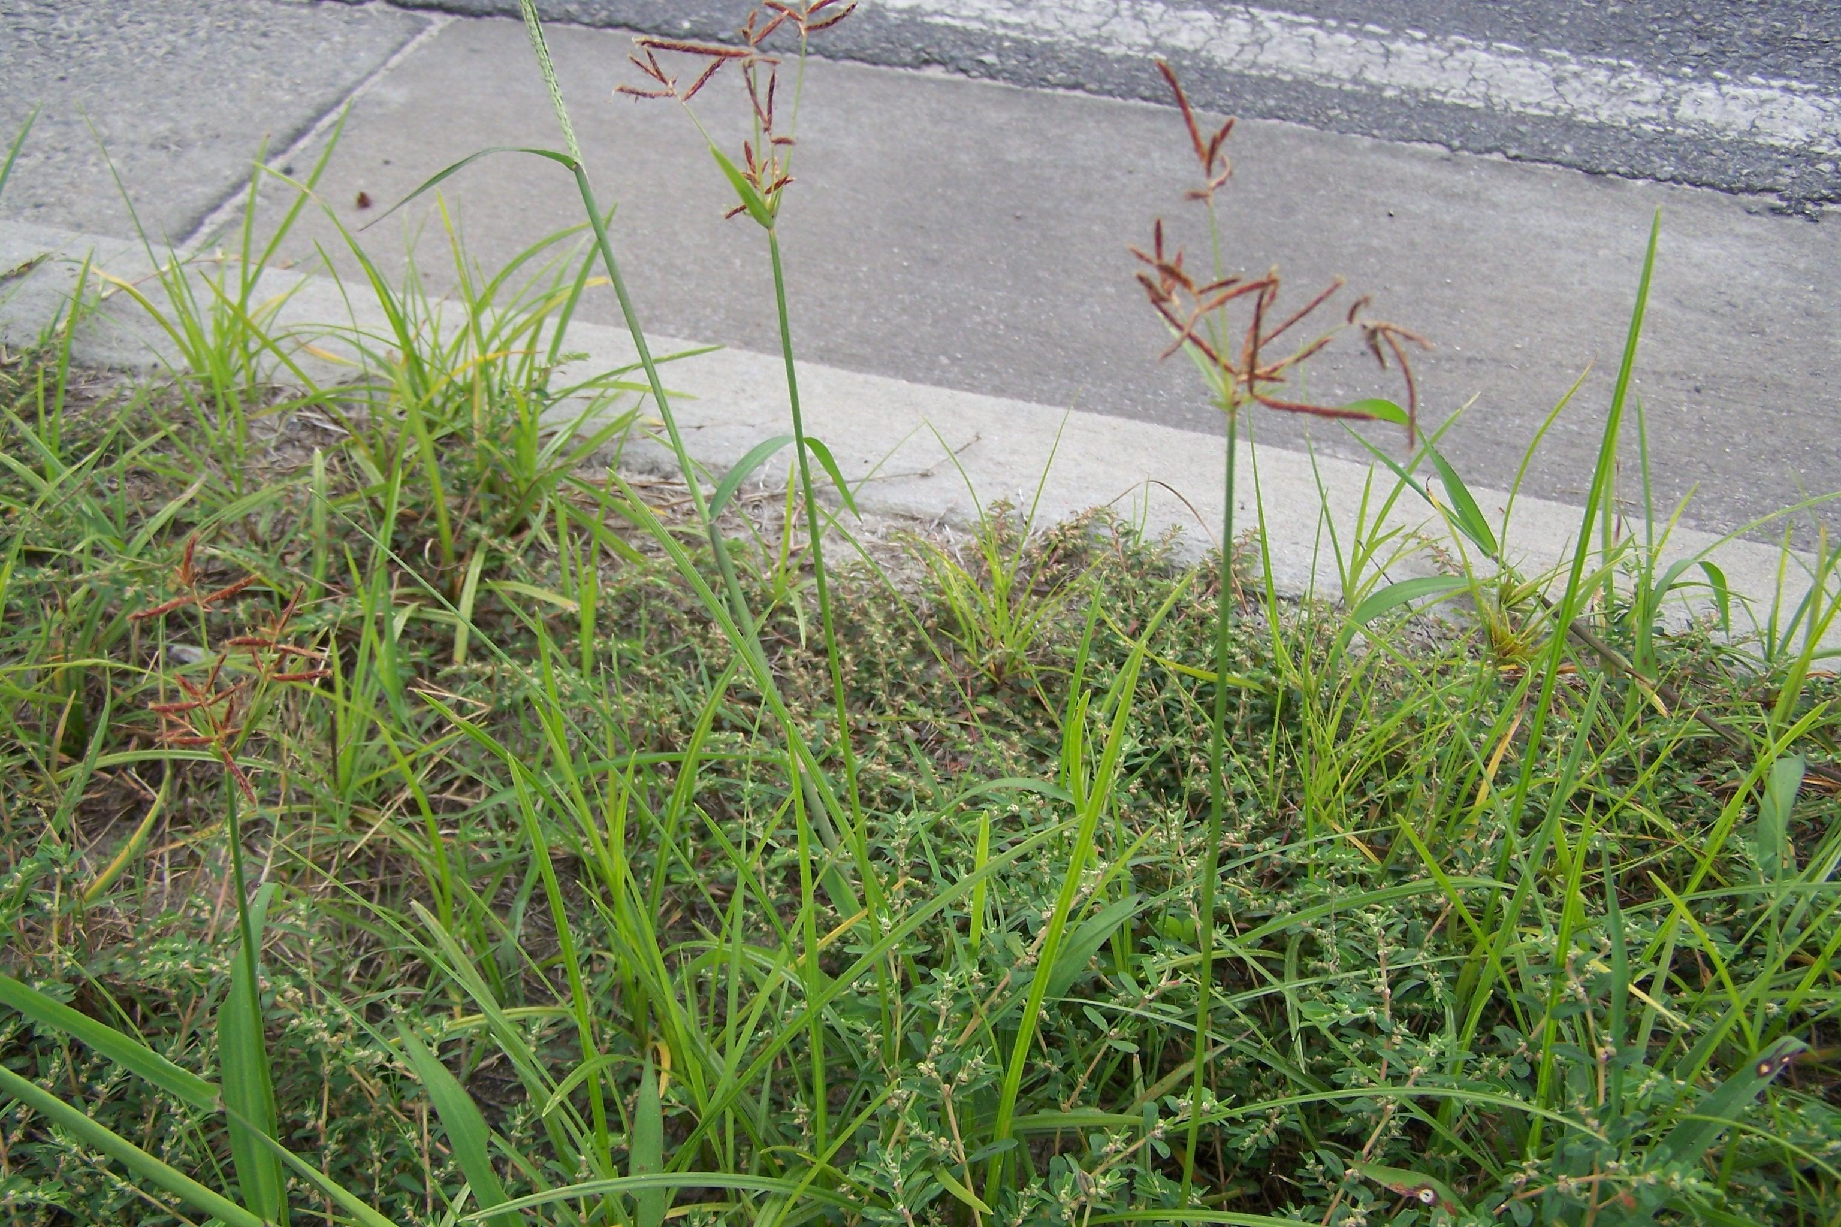
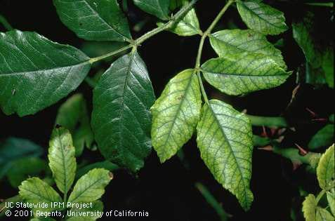
Damage in the landscape can have many causes
Living Pests
  Insects, mites, snails and slugs
  Rodents and other vertebrates
  Disease-causing microbes
  Weeds
Nonliving Abiotic factors
  Over- or under-watering
  Nutrient deficiencies
  Mineral toxicities
  Fertilizer damage
  Herbicide damage
  Mechanical injury
Purple nutsedge and other weeds crowding out turfgrass (Photo: University of Georgia)
Leaf discoloration due to iron deficiency
Notes:
When people see a plant that looks unhealthy, they often jump to the conclusion that it has been damaged by a pest. Pests are living organisms that damage plants and may include insects, rodents, fungi, bacteria or snails or slugs.
However, there are many non-living (or Abiotic) factors that damage plants as well. These include poor water management, nutrient deficiencies, mineral toxicities, fertilizer damage, herbicide damage or mechanical injury such as getting hit by a truck or root-pruning during construction.
In this presentation we will talk about the various causes of plant damage. In many cases, damage caused by one factor may look similar to that caused by something else.
In order to properly manage problems in landscapes, you must be able to identity the cause.

Slide 4
Look-alike damage
Peach Leaf Curl
Rosy Apple Aphid
Herbicide injury
Notes:
What do you think caused this damage? Do you know what kind of plant it might be?
Peach leaf curl on peach
Rosy apple aphids causing leaves to curl on apple; look inside leaves to see if you can find the pest
Herbicide (2,4_d) damage to sycamore leaves
Knowing the plant you are noticing damage on can help narrow down possible pests or problems
Not all pests attack all plants, like peach leaf curl
If you were to look inside the rolled up leaves you’d find aphids

Slide 5
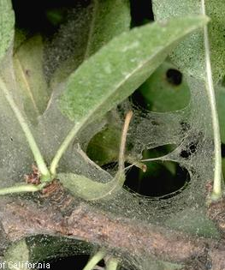
Look-alike damage
Spider mites
Rose leafhopper
Greenhouse thrips
Notes:
What do you think caused this damage? The same pest or something else?
Stippling or bleaching damage can be from different kinds of pests
Usually pests with piercing-sucking mouthparts, or rasping/scraping mouthparts like thrips
Webbing from two spotted spider mites almond– look for webbing, light spots on leaves, underside of leaves
Rose leafhopper on rose– look underside of leaf, cast skins may be present but no webbing
Greenhouse thrips on viburnum- no webbing, if you tapped this plant onto a sticky card or white paper the thrips would fall onto it

Slide 6
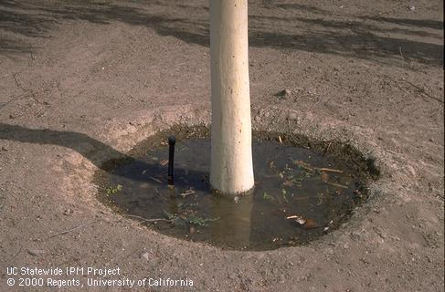
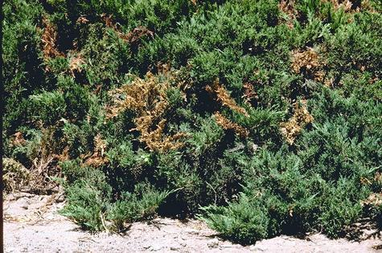
Diagnosing problems can be challenging but not impossible!
Poor cultural practices such as poor water management, improper mowing or pruning can pre-dispose plants to
pest damage
Damage may be due to two or more separate causes
Confirm cause of damage before treating
Standing water can predispose trees to crown diseases
Branch flagging in juniper may be caused by insects, pathogens, dog urine or a combination of factors. Find the pest to confirm.
Notes:
Diagnosing problems can be difficult.
Before treating for a pest, you need to confirm that the pest is causing the damage and also is still present.
Damage is often caused by poor cultural practices such as poor water management.
In order to diagnose a problem, you must have a history of fertilizer, herbicide and water application and also check carefully for signs of insects or pathogens.
If significant numbers of pests are not found, the problem was probably caused by an abiotic disorder. If damage symptoms develop suddenly and don’t spread over time, this can be another sign that the problem is not caused by living pests.
You may need to check a pest or plant problem identification book or internet site or take the problem to an expert to identify.

Slide 7
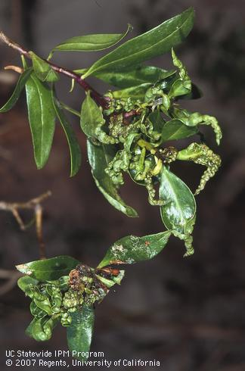
Steps to diagnosing
Define the problem
Host plant or where found
Look for patterns
Examine spread of problem
Determine likely cause of damage

Slide 8
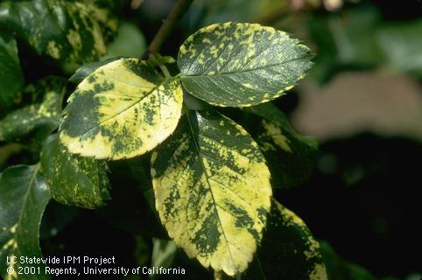
Define the Problem
Closely examine the entire plant and others around it.
Take note of all the signs and symptoms:
  Do they have brown spots, holes, chewed edges?
  Are they turning pale green or yellow?
  If plant has insects, examine the leaves with insects on them. Is more than one kind of insect present?

Slide 9
Sign vs Symptoms
The signs and symptoms of plant disorders are the appearance or manifestation of changes in the normal form and/or function of the plant. Signs and symptoms are usually the first indication you will notice in plant problems.
Signs:
Physical evidence of damage caused by biotic or abiotic agents.
Examples: pests are present, chewed leaves, spots, spores, fruiting bodies, chemical residue, bacterial ooze
Symptoms:
Visible response of a plant to biotic and/or abiotic factors that result in a change or abnormality in the plant.
Examples: galls, chlorosis, ring-spots, wilt, rot, ooze.

Slide 10
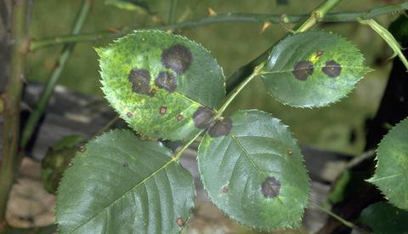
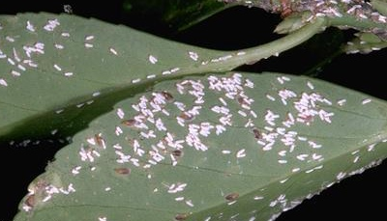
Host plant or location
What plant is damaged or where is the damage occurring in the lawn or landscape?
Not all pests attack all plants
Not all pests are found throughout CA

Slide 11
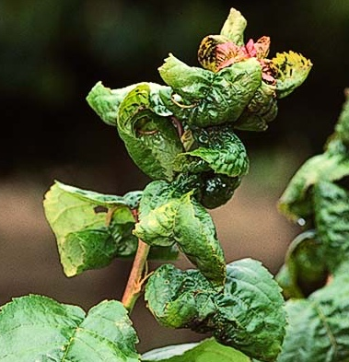
Look for Patterns
Do other plants have the same problem?
Problem in the same place or different locations?
Problem on all the same type of plant?
  Damage to all different types of plants in a particular spot can indicate nonliving factors.
  Damage to a few species of plants or only to plants of the same species can indicate living factors.
Observe where damage occurs on a plant.
  Are symptoms throughout the plant or localized?
Notes:
Do other plants have the same problem?
Problem in the same place or different locations?
Problem on all the same type of plant?
Damage to all different types of plants in a particular spot can indicate nonliving factors.
Damage to a few species of plants or only to plants of the same species can indicate living factors.
Observe where damage occurs on a plant.
Are the symptoms exhibited throughout the plant or are they localized?
Example: when the tops of plants wilt or die, one can generally infer that there is a problem with the root system. When the root systems of shrubs and trees are adversely affected by either too much or too little water, soil compaction, or root damage from construction activities, the damage generally shows up in the top or growing points.

Slide 12
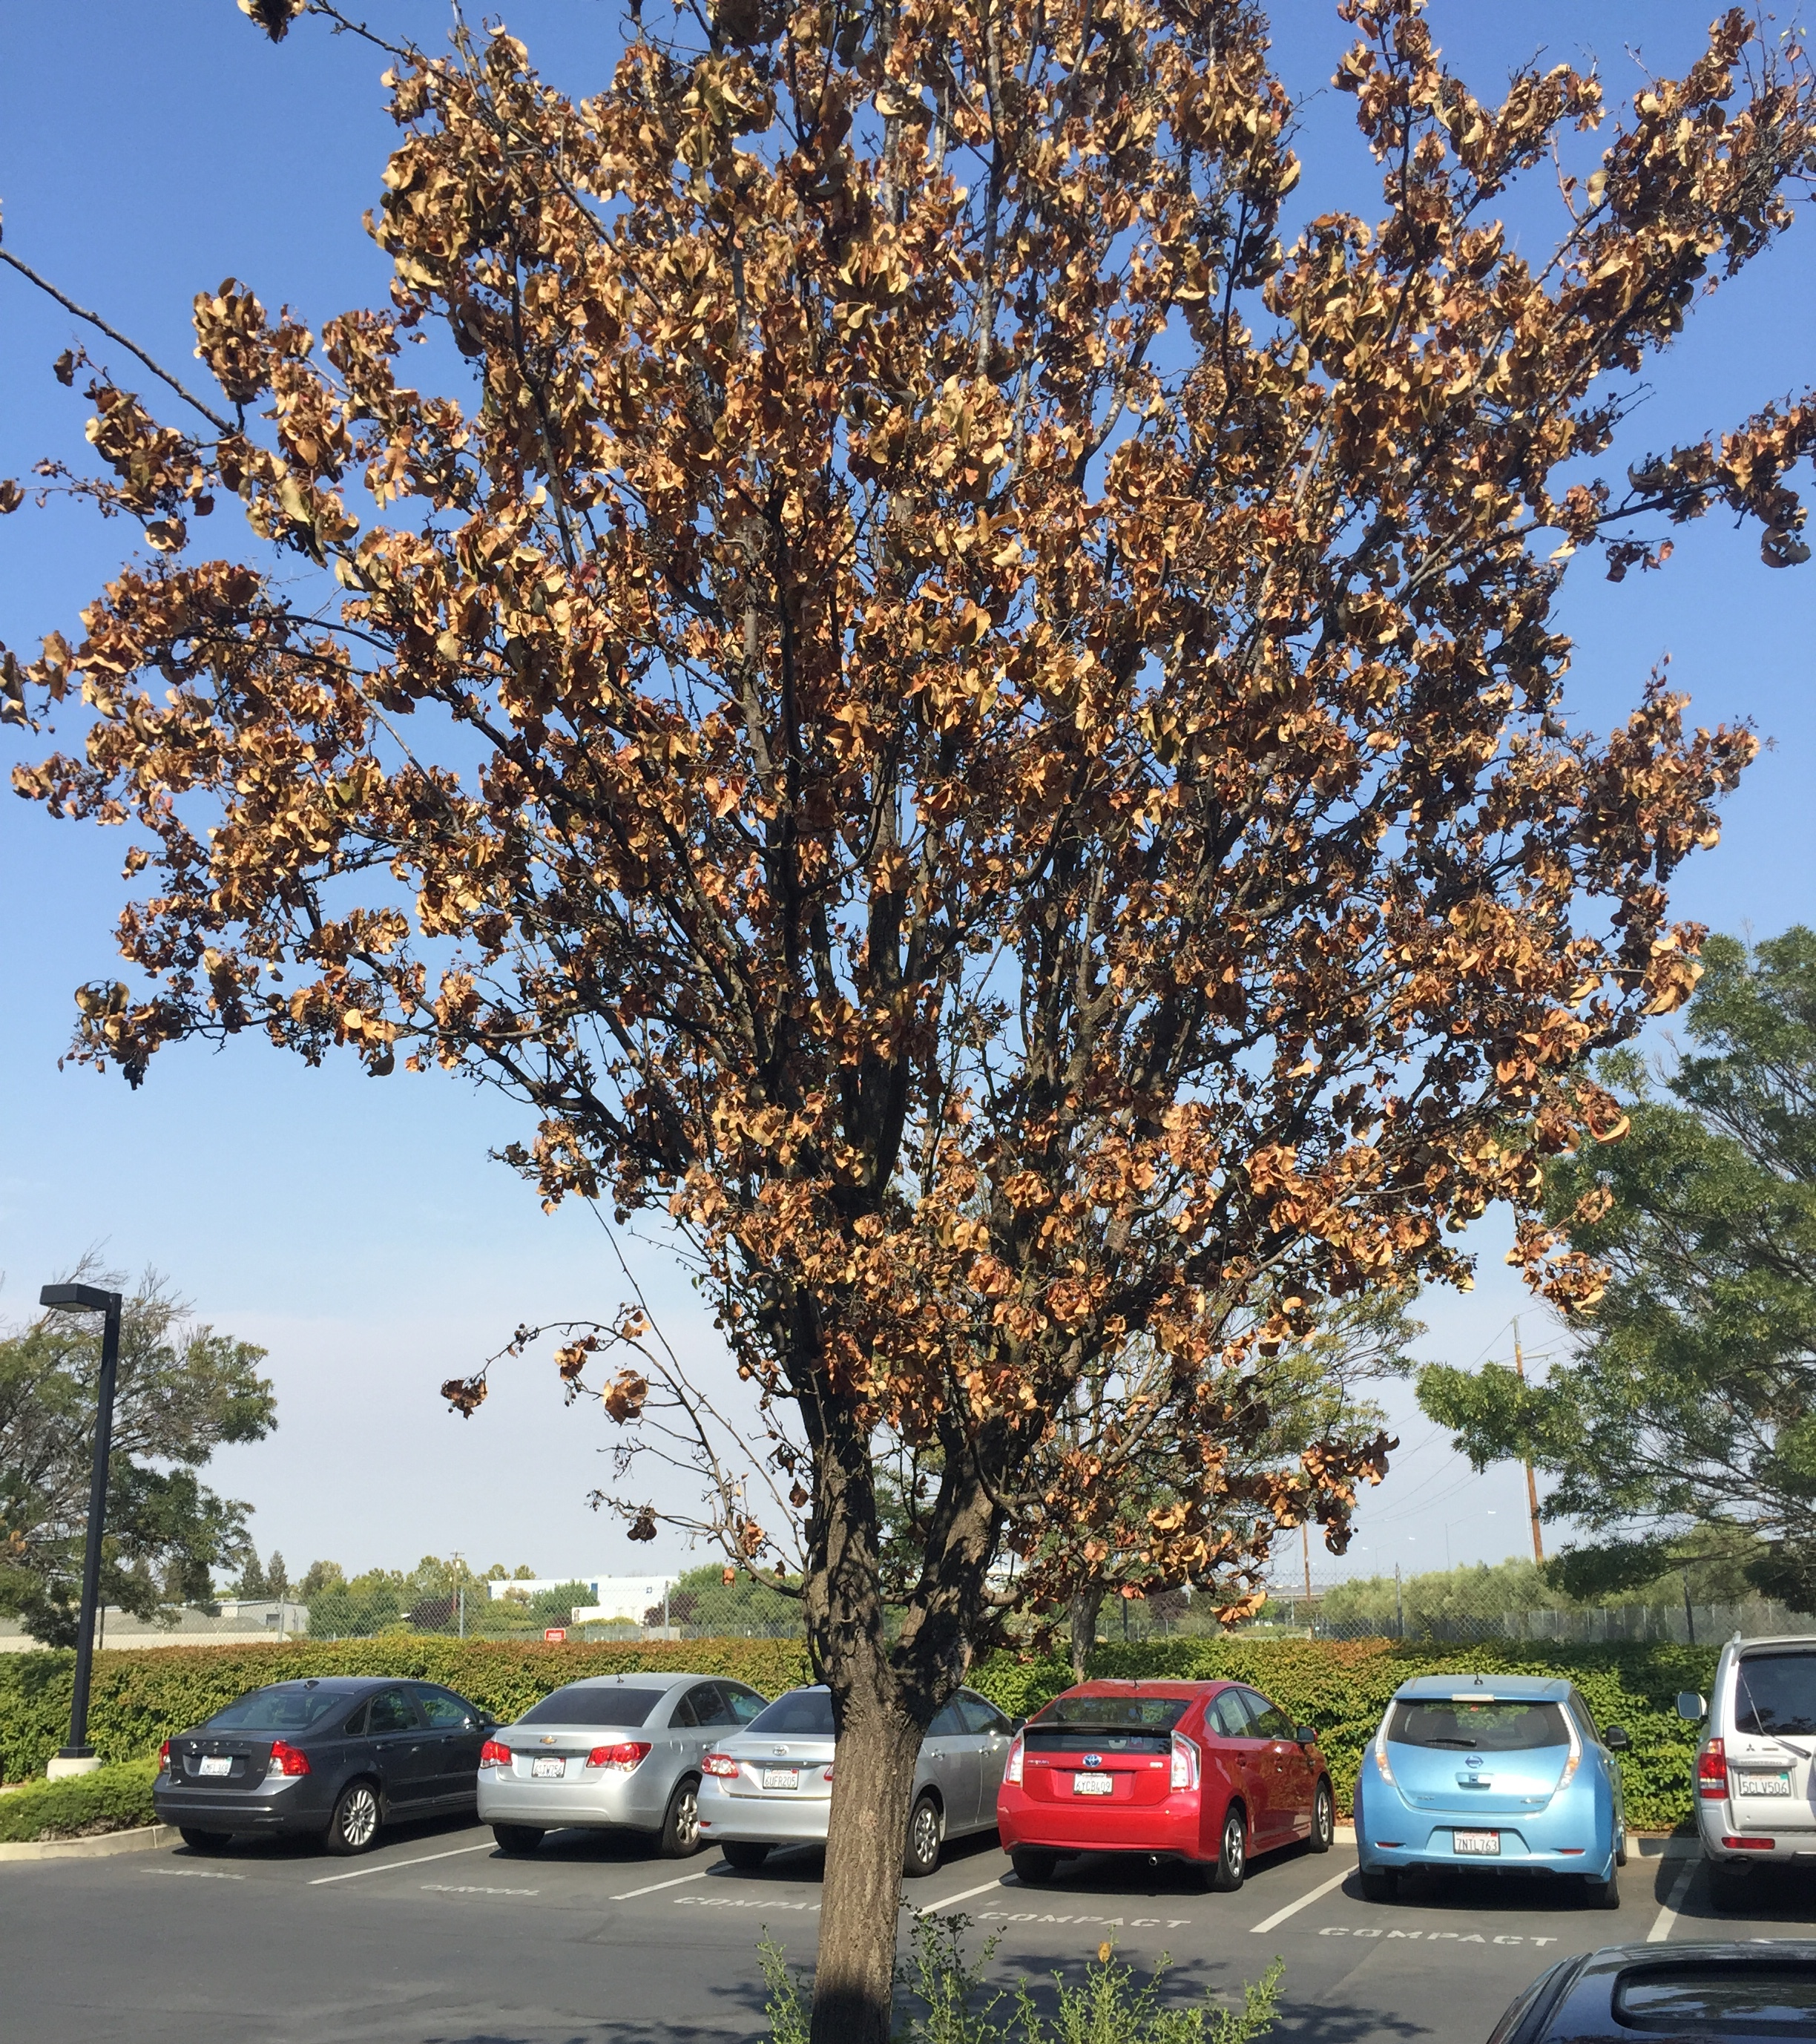
Examine spread of problem
Is the problem spreading gradually?
If problem occurred suddenly and remains in a particular spot or plant, this points toward nonliving factors.
Some diseases that can kill a plant within a short period of time (not common).
Notes:
Is the problem spreading gradually? This can indicate living factors.
If the problem occurred suddenly and remains in a particular spot or on a particular plant, this points toward nonliving factors.
There are, however, diseases that can kill a plant within a short period of time, although this is not common.

Slide 13
Determine likely cause of damage
Based on the pattern and spread, decide if the problem is more likely caused by
living factors or
nonliving factors.
If living, is the problem caused by a pathogen, insect, weed, or vertebrate pest?

Slide 14
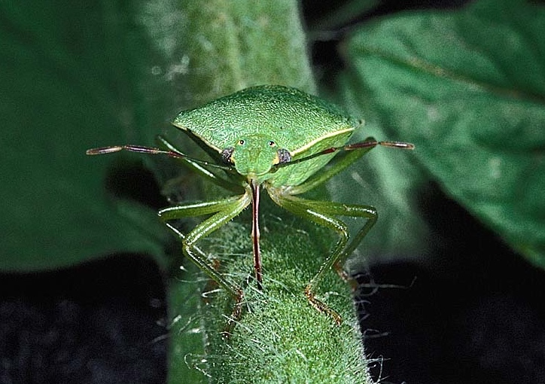
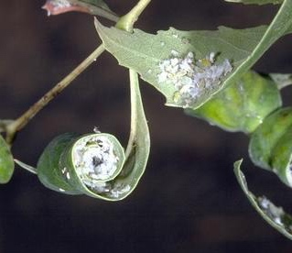
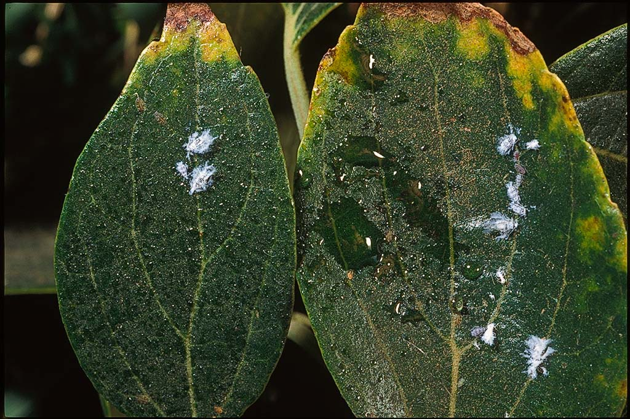
Diagnosing damage caused by insects: Sucking mouthparts
Insects with sucking mouthparts cause plants to discolor or become distorted. Some leave honeydew or sticky excrement.
Examples
  Aphids
  Leafhoppers
  Mealybugs
  Certain scales
  True bugs
  (like stink bugs)
  Whiteflies
Notes:
Sucking insects, like the stinkbug pictured here, have tubular mouthparts that they insert into the plant to suck up plant sap.
Insects with these types of mouthparts cause leaves to curl or discolor. They often leave honeydew or sticky black excrement spots.
They do not chew holes in leaves or other plant parts.
Insects with sucking mouthparts include aphids, leafhoppers, mealybuts, scales, truebugs such as stinkbugs, and whiteflies.

Slide 15
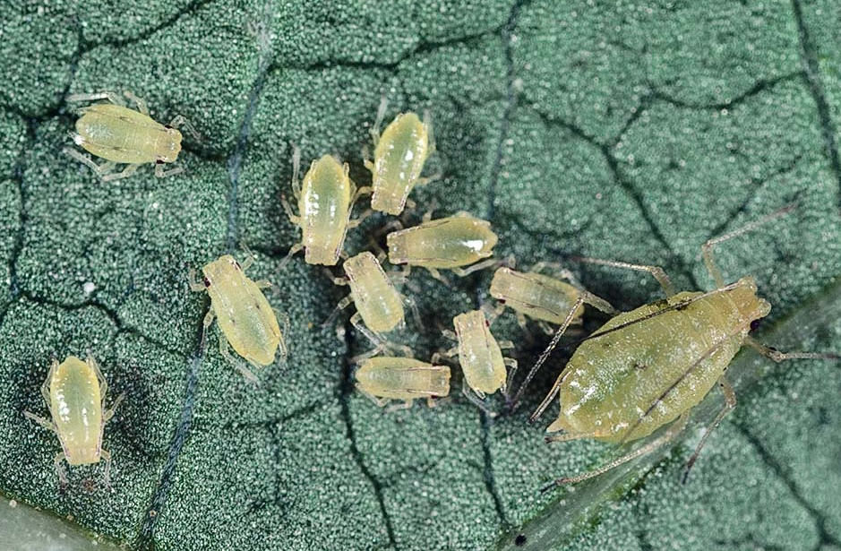
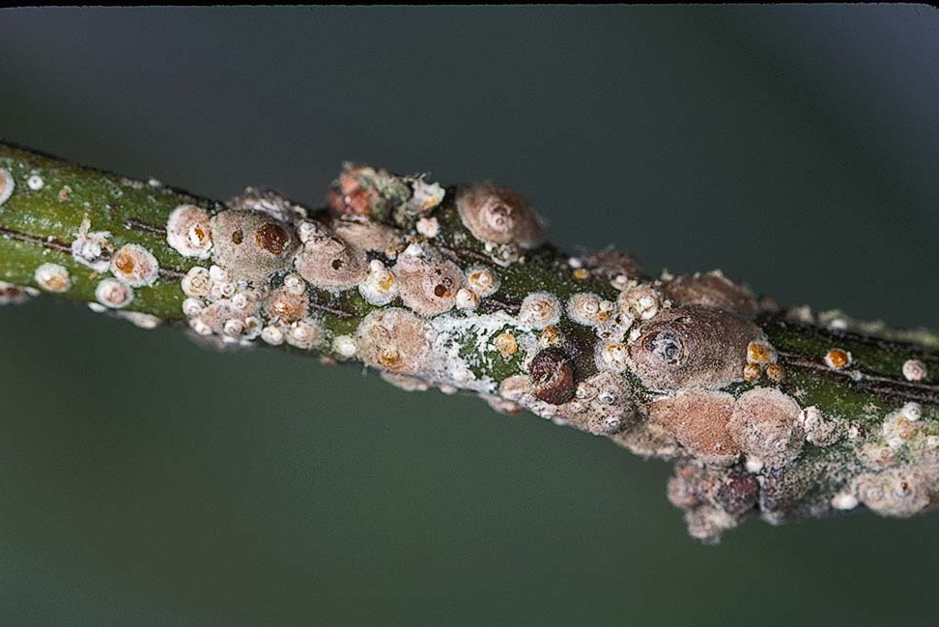
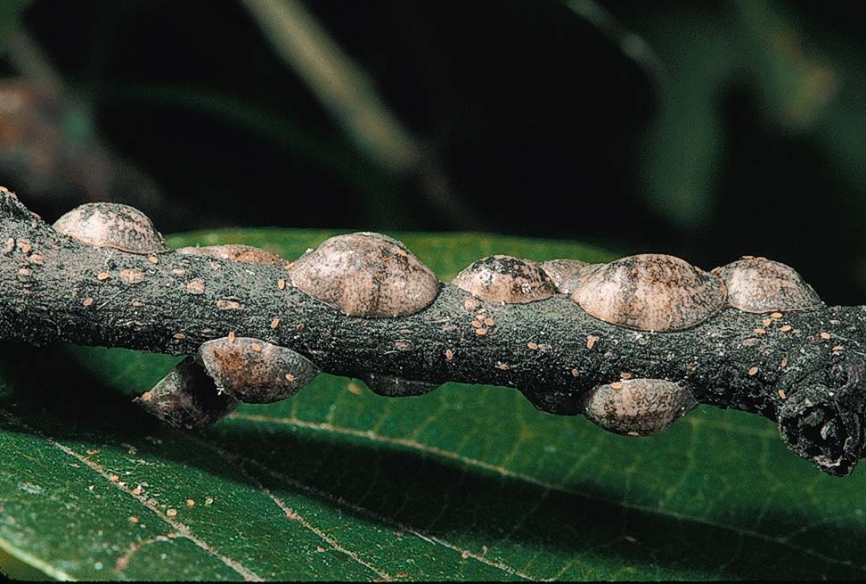
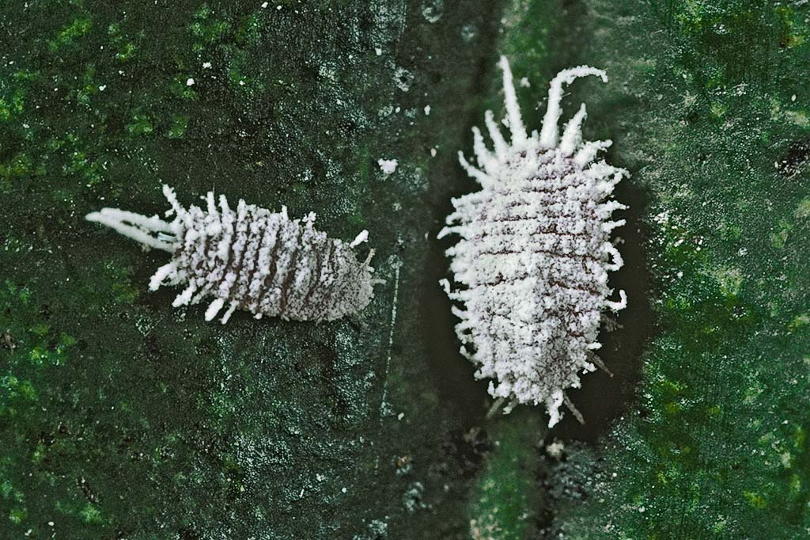
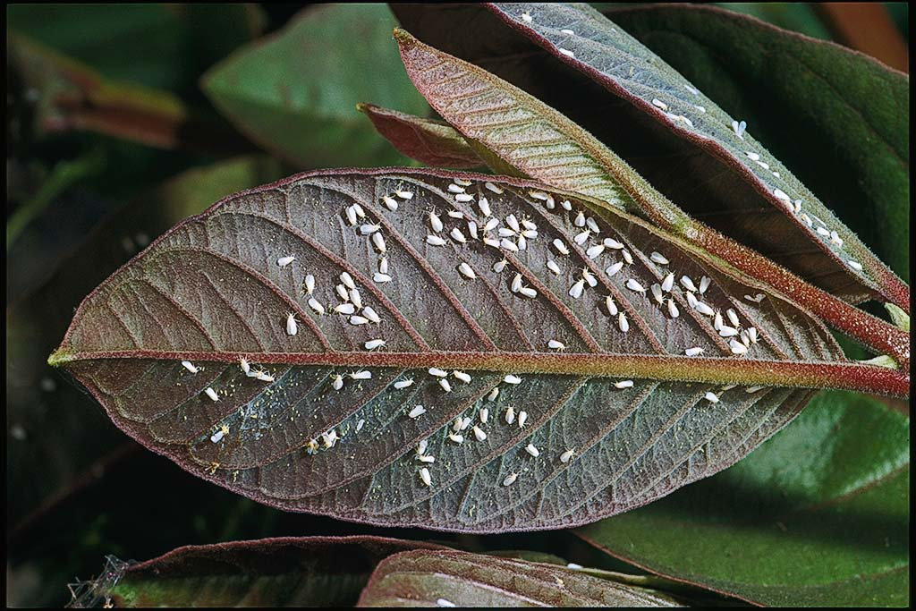
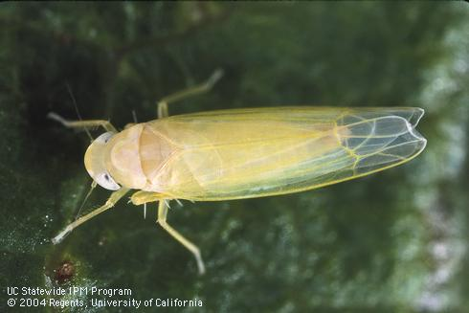
Common pests with sucking mouthparts
aphids
armored scales
soft scales
mealybugs
leafhoppers
whiteflies
Notes:
There are many types of insects with sucking mouthparts. Some of the most common are pictured here.
Aphids are small, pear-shaped insects that feed on many plants and produce a lot of honeydew.
Scale insects spend most of their lives hidden under a disk-like covering or scale. They have no visible antennae or legs and can not move most of the time. There are two major groups of scales. Armored scales are smaller and flattened. Soft scales are more bulbous and produce honeydew. Scales are mostly pests of trees and shrubs.
Mealybugs are waxy, segmented insects that feed on a variety of plants and produce honeydew.
Whiteflies are tiny insects. Adults have powdery white wings. Nymphs are oval and likke scales, don’t move very much. Whiteflies usually occur in groups.
Leafhoppers may cause yellow stippling on some plants but usually do not cause serious damage.

Slide 16
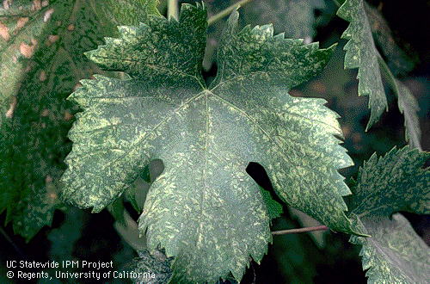
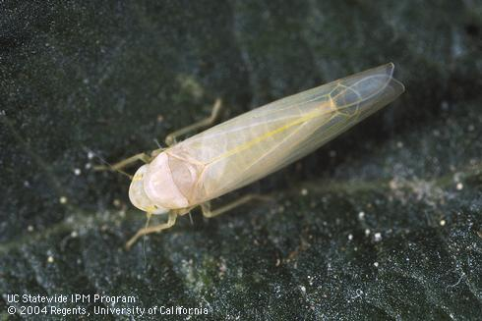
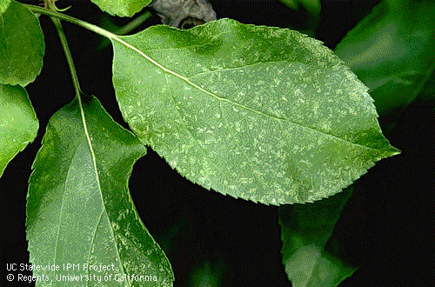
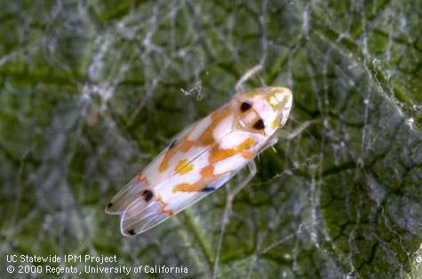
Piercing-Sucking Damage: Stippling
Apple leaf damaged by rose leafhopper
Grape leafhopper
Notes:
Dead plant cells resulting from feeding by piercing-sucking insects create tiny yellow dots, called STIPPLING

Slide 17
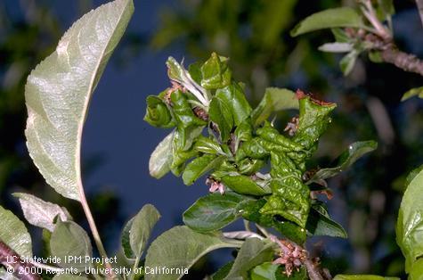
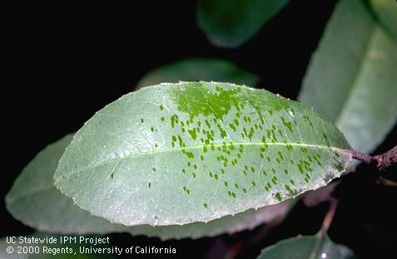
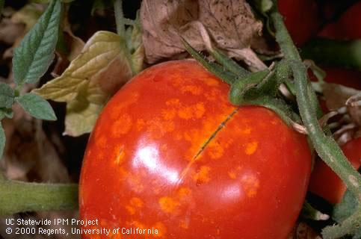
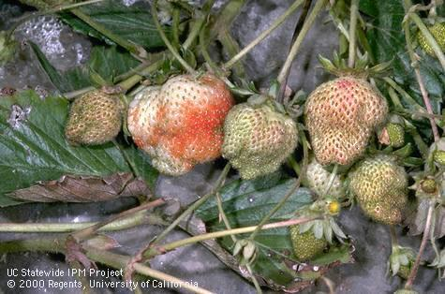
Sucking Damage
Leaf curling
Sticky droplets/honeydew
Blotching
Catfacing/distortion/discoloring
Notes:
Leaf curling
Blotching
Honeydew/frass - Can also vector plant diseases
Catfacing

Slide 18
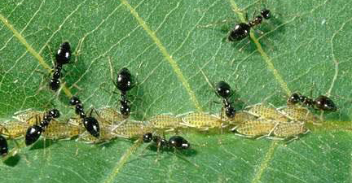
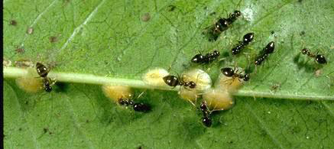
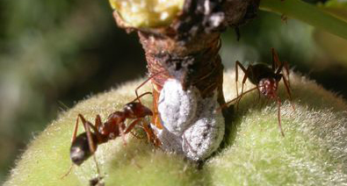
Some pests can indicate other pests.
See ants?
Ants tend honeydew-producing insects and feed on the sugary liquid. Presence of ants can alert you that other insects are present.
Aphids
Scales
Mealybugs

Slide 19
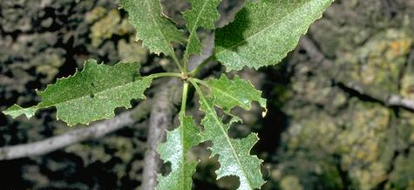
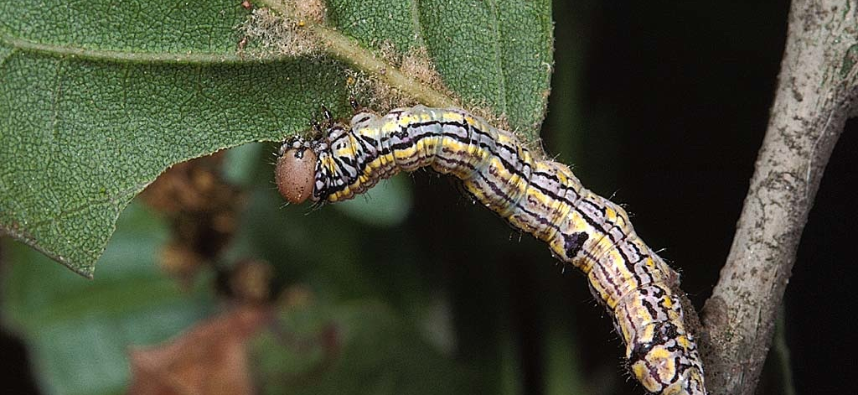
Chewing mouthparts
Insects with chewing mouth parts make distinct holes in fruit, leaves, flowers or stems.
Examples
  Beetles
  Caterpillars
  Grasshoppers
  Earwigs
Notes:
When trying to diagnose a problem caused by an insect pest, it is important to be aware of the type of mouthparts the insect has.
Insects with chewing mouthparts make distinct holes in fruit, leaves, flowers or stems.
Examples of insects with chewing mouthparts include beetles, caterpillars, grasshoppers and earwigs.

Slide 20
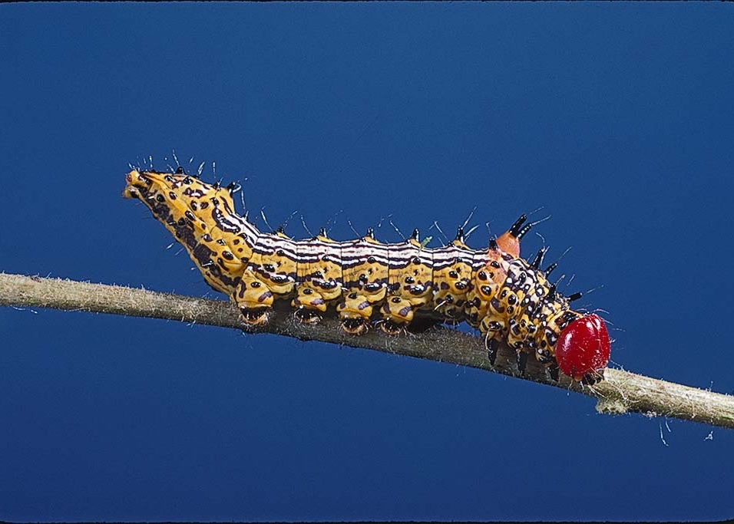
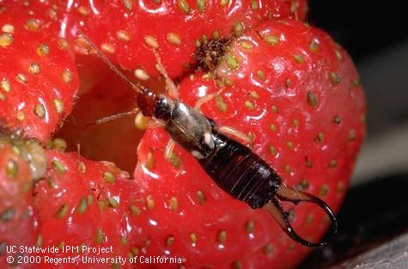
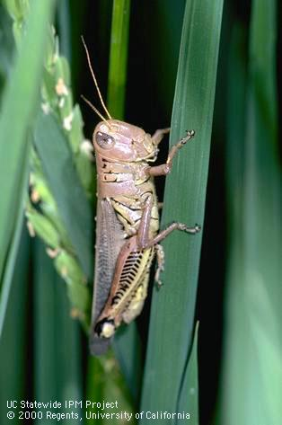
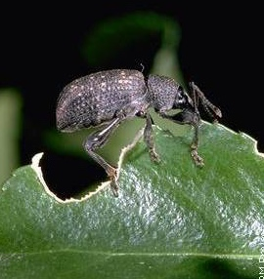
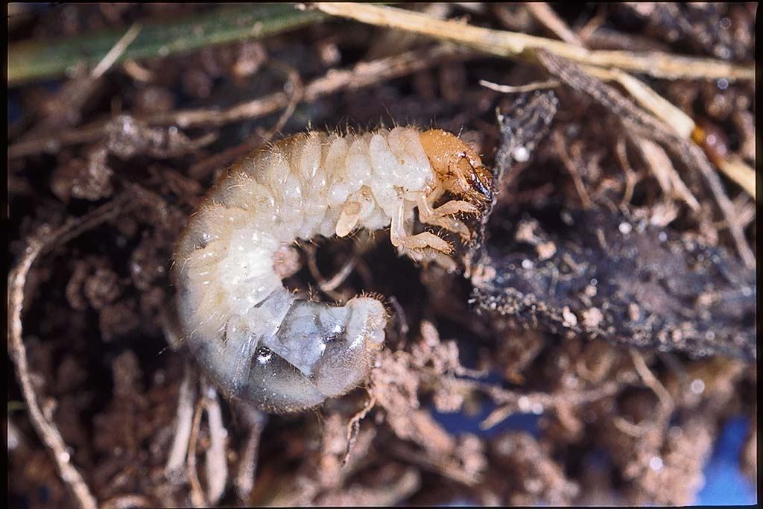
Common pests with chewing mouth parts
Redhumped caterpillar
Earwig
Black vine weevil
Lawn grub
Grasshopper
Notes:
Here are some common insect pests with chewing mouthparts that you should learn to recognize.
Caterpillars are the larvae or immatures of butterflies and moths. They come in many colors and sizes and may attack any succulent part of the plant including leaves, buds, flowers, fruit or roots.
Earwigs have pinchers at their tail end, but these cannot hurt people. They feed on leaves, shoots, flowers and soft fruit.
The black vine weevil adult feeds on leaves on plants such as rhododendrons. Its larvae feed on plant roots.
Lawn grubs are the larvae of beetles such as the mask chafer. Grubs feed on turf roots. Feeding can be so extensive that the lawn can be rolled up like a carpet.
Grasshoppers feed on a variety of plants and usually aren’t major pests except where landscapes are next to agricultural or uncultivated lands.

Slide 21
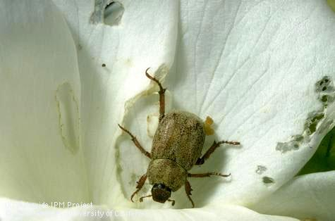
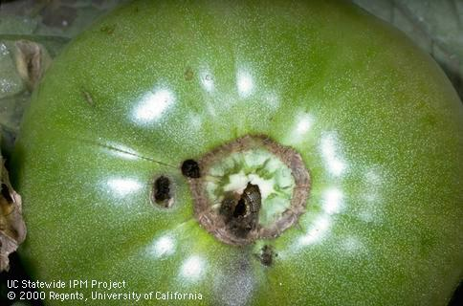
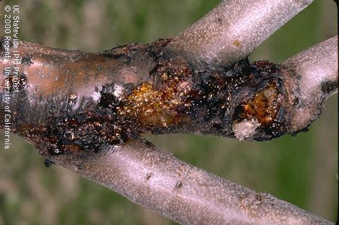
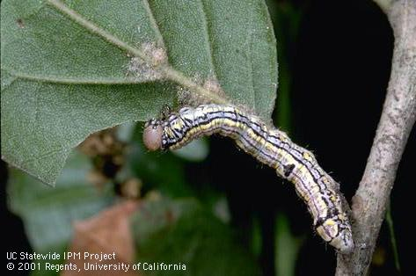
Chewing Damage
Hoplia Beetle
Fruitworm
California Oakworm
American Plum Borer

Slide 22
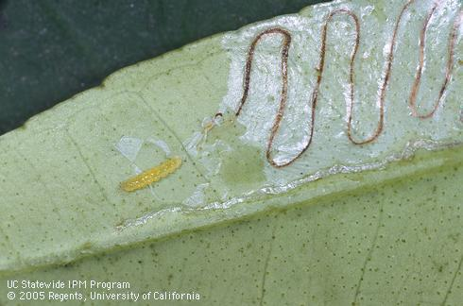






Chewing Damage
Leaf mining
Caused by developing larvae growing and tunneling inside leaf
Citrus leafminer, Phyllocnistis citrella (a moth)
Vegetable leafminer, Liriomyza sativae (a fly)
Boxwood leafminer (a fly midge)
Adult
Adult
Fully developed larva
Adult

Slide 23




Other invertebrate pests common in landscapes
Snails and slugs chew holes in leaves and fruit and leave mucous trails.
Spider mites suck fluids from plants, causing speckling and yellowing. Webs may also be present.
Notes:
Here are some other invertebrates that occur in landscapes that you should be able to recognize. These include
Ants—which serve many beneficial functions in the landscape such as eating some pests—but they also can be pests, especially when they protect aphids and other insects from their natural enemies.
Snails and slugs are molluscks. They chew irrgular holes in leaves and other succulent plant parts. They often feed at night but leave a silvery trail of mucous behind.
Spider mites are very tiny arachnids, which cause speckling on leaves. When there are lots of them, they often leave webbing, which is how they get their name “spider” mites.

Slide 24


Signs and Damage from Vertebrate Pests

Slide 25





Signs and Damage from Vertebrate Pests

Slide 26







Vertebrate Pests

Slide 27

Weeds: Distinguishing broadleaves, grasses and sedges
Broadleaf
Grass
Sedge
Notes:
Weeds are unwanted plants in the landscape. There are many, many weed species, but they can all be classified into one of 3 major groups:
Broadleaves have wide to narrow leaves with netlike veins.
Grasses have narrow leaves arranged in sets of two. Stems are rounded or flattened.
Sedges look like grasses. However, their leaves, and flowers are arranged in sets of 3 and their stems are triangular in cross section.

Slide 28



Vegetative reproductive structures make perennials difficult to control
Tubers—yellow nutsedge
Bulbs—bermuda buttercup
Notes:
There are several types of vegetative structures that allow perennial plants able to survive. All of these structures can also sprout new plants and help spread the weeds.
Yellow nutsedge has tubers, which grow from roots.
Bermuda buttercup or Oxalis has bulbs. New plants emerge from the bulbs each year

Slide 29


Chopping up vegetative reproductive structures can create new plants
Stolons—bermudagrass
Rhizomes—Johnsongrass
Notes:
Bermudagrass spreads through aboveground stems that grow horizontally. These are called stolons. If you chop them up, new plants can grow from the stolon.
Johnsongrass has underground stems that function in the same way. These underground stems are called rhizomes.
If you chop up these structures with a rototiller or hoe, you may create even more serious problems because new plants can grow from the vegetative structures.
They can also be moved with soil to infest new locations.

Slide 30


Plant pathogens:
Microorganisms that cause plant disease
VIRUS
Rose mosiac virus
FUNGUS
Rust on rose
BACTERIA
Fire blight
Notes:
Plant diseases can be caused by many microorganisms including viruses, fungi and bacteria.
These disease-causing organisms are called plant pathogens. Symptoms vary greatly depending on pathogen and plant but may include leaf discoloration or distortion, powdery growth or dieback of plant parts.
Some pathogens attack plant roots, trunks and crowns, causing wilting, dieback and death.

Slide 31
What is Plant Disease?
A plant disease is any abnormal condition that alters the appearance or function of a plant.
Biotic (infectious) diseases and abiotic diseases (disorders) occur.
Visible effects of disease on plants are called symptoms.
Physical evidence of the pathogen is a sign of a biotic plant disease.
Notes:
A plant disease is an abnormal condition that changes how the plant looks or grows.
Plants can get infectious diseases caused by a plant pathogen. Those can also called biotic diseases. Plants can also get abiotic diseases, also called abiotic disorders.
Some common plant diseases include fire blight and powdery mildew.
The symptoms of a plant disease are the visible effects of the disease and is the plant’s response to the pathogen. Symptoms are useful in diagnosing a disease but are not definitive. Many symptoms are common to more than one disease and symptoms can vary even with the same disease.
Examples of symptoms: tomatoes wilting on one side, canker on a tree trunk
Seeing the actual pathogen is called a sign. Examples of signs include powdery mildew spores and mycelium or rust pustules. Seeing physical evidence of the pathogen allows you to be more confident in your disease diagnosis.

Slide 32
What Causes Plant Diseases?
Fungi/Oomycetes: #1 cause of plant diseases
Bacteria: enter through wounds or openings in plants
Viruses/viroids: genetic material + protein coat
Nematodes: tiny soil-dwelling worms
Notes:
Infectious plant diseases are caused by microscopic pathogens. Most plant diseases are caused by fungi and oomycetes. Oomycetes were previously thought to be fungi but now known to be related to brown algae.
Other plant pathogens are bacteria which must enter the plant through wounds or other openings; viruses which are basically genetic material in a protein coat; and nematodes, which are tiny worms that live in the soil.
Nematodes are not quite microscopic. They are sometimes grouped with invertebrate pests like insects and mites.

Slide 33



Some diseases can only be identified positively by an expert
Symptoms often
general—such as yellowing, wilting,
plant decline
Microorganisms often
can’t be seen without
a microscope
Lab tests may be required
Learn how to handle samples to take to UCCE office or other experts
Powdery mildew spores
(magnified)
Notes:
Because the microorganisms causing plant diseases are so small, it is often difficult to identify the cause of the injury in the field.
Microorganisms often live inside the plant and cause general symptoms such as wilting that can be caused by a variety of organisms or abiotic factors.
Some plant pathogens can only be seen with a microscope or may require a laboratory test to positively identify them.
You may need to take samples to your University of California Cooperative Extension office or to other experts to diagnose the cause.

Slide 34

The Disease Triangle
Notes:
This diagram shows both the biotic disease triangle and the interaction between the host and the environment in an abiotic disease.
The disease triangle is a graphical representation of the concept that a plant disease caused by a pathogen will only develop if a susceptible plant, a pathogen that can infect that plant, and favorable environmental conditions occur simultaneously.
Not all plants are going to be susceptible to all pathogens.
The severity of the disease depends on the virulence and abundance of the pathogen, the susceptibility of the plant and the environmental conditions.
For example, powdery mildew on roses develops when there are many spores of the pathogen, when the rose variety is susceptible to powdery mildew and in shady areas when temperatures are moderate (60-80 degrees Fahrenheit).

Slide 35
Disease Cycle
Inoculation: when the pathogen contacts the host.
Penetration: when the pathogen enters the plant through wounds or natural openings in the plant like stomata or lenticels.
Infection: when the pathogen moves and grows through the plant host.
Dissemination: when the pathogen moves from plant to plant.
Overwintering: the pathogen’s survival mechanism when the host plant or environment is no longer conducive to the pathogen’s growth. This is a good time to try to control plant diseases.
Notes:
For an infectious disease to occur, a series of events called the Disease Cycle must occur.
Inoculation is when the pathogen contacts the host. If the environmental conditions aren’t right, the pathogen may die at this stage and not penetrate the host.
Penetration is the next stage. The pathogen can enter the plant through wounds or natural openings in the plant like stomata or lenticels. Some pathogens like powdery mildew and sooty mold remain on the surface of the plant.
Infection happens as the pathogen moves and grows through the plant host. This is the stage where you’ll start to see disease symptoms as the plant reacts to the presence of the pathogen.
Dissemination is when the pathogen moves from plant to plant. Pathogens can move in a number of ways, such as with the splashing of rain or irrigation water, wind, and in insect vectors. At this stage, you might see signs of the pathogen like spore structures.
Overwintering is the pathogen’s survival mechanism when the host plant or environment is no longer conducive to the pathogen’s growth. Many pathogens form resting structures at this time. This is a good time to try to control plant diseases.
This is a general example of the process.
Each pathogen/host combination has variations on this cycle. We’ll discuss one next.

Slide 36

Credit: Gwen Conville
Notes:
Let’s go over the disease cycle of anthracnose on walnuts. This fungal disease causes leaf blotches and spots and can also damage the nuts. While it generally doesn’t kill the tree, it can cause leaf drop.
This disease is initiated in the spring when wind blows the spores from dropped leaves and fruit onto new leaves and twigs. During the summer, the spores germinate and infect the plant. In fall, the leaves and nuts fall.
The fungus will overwinter in fallen leaves and nuts.
Clearing dead leaves and dropped walnuts in the winter will reduce the disease in the spring since it reduces the amount of inoculum.

Slide 37
How Plant Pathogens Spread: Inoculum
Inoculum: part of pathogen that can infect host plant, such as spores
May be produced on residues left in the garden
  In the soil
  In weeds or other plants in the area
  In or on the seed
  In soil sticking to equipment or tools
Carried by
  Wind or water
  Insect vectors
  Animals, birds, and people
Notes:
Inoculum is the part of the pathogen that can infect a plant.
Source of inoculum varies for each disease.
Cleaning up the garden at the end of the growing season is important since inoculum can remain in dead organic matter. Inoculum from plant pahogens can also be in the soil, on weeds, on seed, or on tools.
In the anthracnose disease cycle I just talked about, the pathogen spread via spores. Anthracnose spores are carried by the wind onto new leaves, twigs, and fruit.
Water, insects, and other animals, including people can also carry pathogen inoculum.

Slide 38


Common Plant Diseases in the Landscape
Notes:
Let’s talk about some common plant diseases in home. Most of these are fungal diseases.

Slide 39

Peach Leaf Curl
Caused by a fungus, Taphrina deformans
Host: peach and nectarine
Damage: leaf curl, reddish blistering, defoliation, fruit drop
Spread: water splash, rain
See Pest Notes: Peach Leaf Curl for more details
Notes:
Peach leaf curl is caused by a fungus, Taphrina deformans.
The only host plants for this disease are peach and nectarine. If you see this kind of symptom on another type of plant, you can rule out peach leaf curl.
The symptoms include puckered, twisted leaves that turn red and look blistered. The fungus spreads from leaf to leaf in waterdrops such as when it rains or during irrigation.
To prevent peach leaf curl, use resistant peach and nectarine varieties where possible. For nonresistant varieties, treat trees with a fungicide every year after leaves have fallen. Once you see the symptoms, it’s too late to manage the disease that year. Wait until the old leaves have fallen, then treat.

Slide 40

Anthracnose
Caused by various fungi
Hosts: both deciduous and evergreen trees and shrubs including sycamore, oak, ash, Chinese elm. Fruits, vegetables, turfgrass in some regions.
Damage: Leaf spot/blotches, blights, cankers, and twig dieback
Spread: wind-blown or rain splash
See Pest Notes: Anthracnose for more details
Notes:
Anthracnose is a general term and can be caused by various fungi. Many plants are susceptible to anthracnose, such as Chinese elm, sycamore, oak, ash, and even some fruits and vegetables. Most anthracnose diseases are minor on most of the host plants except for Chinese elm. Cankers caused by this fungus can girdle and kill Chinese Elm trees.
The symptoms of anthracnose vary depending on the plant and the weather but usually include some sort of leaf spot or cankers. As with many fungal diseases, this one is spread by rain splash but can also be wind blown.
Manage anthracnose by choosing plants that are resistant to anthracnose-causing fungi. Space the plants far enough apart to maximize air circulation and increase sunlight.
The photo shows leaf spots and a dead leaf on a sycamore tree that were caused by anthracnose.

Slide 41

Powdery Mildew
Caused by various fungi
Hosts: apple, rose, crape myrtle, sycamore, stone fruit, grapes, cucurbits
Damage: white patches on leaves and shoots, sometimes on fruit
Spread: wind, doesn’t need free water
Example: Powdery Mildew on grapes, caused by Uncinula necator
See Pest Notes: Powdery Mildew on Fruits and Berries for more details
Notes:
Powdery mildew is a very common disease, especially on cucurbits but fungi causing powdery mildew can also infect grapes, crape myrtle, roses, sycamore, and other plants. The distinctive fuzzy white patches on leaves, shoots, and fruits are actually the mycelium (branching cells) of the pathogen. This sign of the pathogen enables you to correctly identify this disease.
This fungus overwinters in leaf litter and is spread by wind.
The environment, as always with plant diseases, is critical. Unlike other fungal diseases, powdery mildew doesn’t need free water on the leaf to germinate. In fact, free water on leaves kills germinating spores and mycelium of some powdery mildew fungi. Overhead sprinkling can reduce powdery mildew by washing the spores off the plants but can make other plant diseases worse, so be aware of that. Instead, prevent powdery mildew by planting in sunny locations with space between plants for good air circulation.

Slide 42


Powdery Mildews
Powdery mildew on pea, caused by Erysiphe pisi
Powdery mildew on tomato, caused by Erysiphe lycopersici
Notes:
Here are some different symptoms of powdery mildew on pea and tomato. Those distinctive white patches commonly associated with powdery mildew are not present at this time so these symptoms could be mistaken for another disease.
The powdery mildews that affect artichokes, onions, peppers, and tomatoes produce yellow patches on leaves but little powdery growth.

Slide 43

Downy Mildews
Caused by oomycetes
Hosts: many vegetables
Signs and symptoms: patches of spores on the underside of leaves that start white and turn brown, purple, or black, yellow blotches on top that turn brown
Spread: wind
Conducive environment: cool and wet
Downy mildew on collard leaf, caused by Hyaloperonospora brassicae (=Peronospora parasitica)
Notes:
Downy mildew is caused by oomycetes, pathogens that are sometimes called “water molds.” They are not fungi. Many vegetable plants are susceptible to downy mildew including cucurbits, cole crops, lettuce, peas, spinach, onions and garlic, .
Typical symptoms of downy mildew include downy masses of spores on the undersides of affected leaves with irregular yellow patches on top. These chlorotic lesions later turn brown.
The spores can be spread by wind. This oomycete overwinters in old roots and needs cool, moist weather for infection and disease development to occur.
The photograph shows the brown irregular spots of downy mildew on a collard leaf.

Slide 44


Downy Mildews, continued
Downy mildew on cucurbits,
caused by Pseudoperonospora cubensis
Downy mildew on pea,
caused by Peronospora viciae (=pisi)
Notes:
Here are some different symptoms of downy mildew on cucurbit and pea. The cucurbit leaf on the left shows the characteristic angular leaf spots of downy mildew. The symptoms on pea is reminiscent of rust but the growth is more cottony.
Downy mildew occurs in the Sacramento, upper San Joaquin, Imperial valley, and in coastal areas. It attacks all cucurbits, but cucumber is the most commonly infected.
Information about cucumber downy mildew: http://ipm.ucanr.edu/PMG/GARDEN/VEGES/DISEASES/cudowneymildew.html
Information about pea downy mildew: http://ipm.ucanr.edu/PMG/GARDEN/VEGES/DISEASES/peadownymildew.html

Slide 45

Powdery Mildew or Downy Mildew?
Collect information
  Cool, wet or warm, dry weather?
  Symptoms mostly underside of leaves or both?
Photo by Scot Nelson, Flickr, via CC BY-SA
Notes:
You might confuse downy mildew and powdery mildew. However, the two diseases differ in several important ways so you’ll need to collect some information.
Powdery mildew thrives in warm weather whereas downy mildew is a cool weather disease.
Downy mildew produces spores mostly on the undersides of leaves and only after rain or very heavy fog. Spores disappear soon after leaves dry out. Powdery mildew does not require water on the leaf surface for spore formation, and the powdery growth appears on both sides of leaves.
This photo of a brassica plant shows powdery mildew spots.

Slide 46

Rusts
Caused by various fungi
Hosts: roses, rhododendron, stone fruit, caneberries, incense cedar, pine, grasses
Damage: pustules on leaves, leaf drop, stunts shoot growth, lesions on fruit, galls on shoots
Spread: wind, water splash
Example: Rust on roses, caused by Phragmidium mucronatum
See Pests of Landscape Trees and Shrubs for more detail.
Notes:
Rusts are caused by various fungi which are very specific to their hosts.
Those host plants include roses, caneberries, rhododendron, stone fruit, pine, and even grasses.
The pustules are formed of masses of rust spores, which are the infectious part of the pathogen. This is a sign of the disease, not a symptom.
The spores can be disseminated by wind and water splash.
The photograph shows yellow-orange rust pustules on the top and bottom of rose leaves.

Slide 47

Viruses
Viruses don’t reproduce without a host, submicroscopic particles
Symptoms: mosaic pattern on leaves, vein clearing, ringspots, necrosis, stunting. Sometimes NO symptoms.
Spread: insect, grafting, propagation, soil-borne fungi
Example: Cucumber mosaic disease (aphid vector)
See Pests of Garden and Small Farm for more details
Notes:
Plant viruses, just like human viruses, require a host to reproduce. They are submicroscopic so you will only see symptoms, not signs.
Plant viruses cause an array of patterns on leaves and flowers, as well as necrosis and stunting. In some cases, there will be no symptoms. Some plant viruses are spread by humans through grafting and propagation. Others are spread by insects or soil-borne fungi.
This photo shows virus-induced patterns on a cucumber leaf. The leaf turns yellow then the edges of the leaves become brown and necrotic.
Manage plant viruses with the use of virus-tested planting stock and resistant varieties.

Slide 48
Nematodes
Nematodes are tiny, almost microscopic roundworms
  Sometimes plant parasitic and attack roots
  Some attack pest insects or plant parasitic nematodes
Hosts: many ornamentals, fruit and nut trees, and vegetables
Damage: slows plant growth, reduces yield, wilting, premature leaf drop, galls (swellings) on roots
Spread: in infested soil, need moisture
Example: Root Knot Nematode (Meloidogyne incognita) on tomato
See Pest Notes: Nematodes for more details
Notes:
Nematodes are tiny roundworms that are sometimes plant parasites. They live in the soil and attack the roots of susceptible plants. There are also nematodes that attack pest insects or other nematodes.
Many plants are susceptible to nematode infection, like ornamentals, vegetables, and fruit and nut trees.
The photograph shows the characteristic root galls caused by the nematodes burrowing into and feeding on the roots. The nematodes slow plant growth, reduce yield, and can cause wilting and leaf drop.
Management of nematodes is difficult. They spread in infested soil, so the most reliable management practices are preventive, including sanitation and choice of resistant plant varieties.

Slide 49

Preventing and Managing Plant Diseases
Prevention
  Resistant varieties
  Sanitation
Management
  Pruning
  Water management
  Pesticides for foliar diseases
Notes:
I’ve quickly covered some of the more common plant diseases. Most of the time, it’s best to prevent disease in your garden with resistant varieties and by keeping your garden clear of pathogen inoculum.
A few techniques that work well for managing plant diseases are pruning, water management, and in the case of some foliar diseases like peach leaf curl, the use of pesticides.

Slide 50

Abiotic Disorders
(Noninfectious diseases)
See Pests of Landscape Trees and Shrubs for more detail.
Notes:
Abiotic disorders are noninfectious diseases. That is, there is no pathogen involved.
Most common abiotic disorders are due to issues with the soil.

Slide 51

Irrigation: Too Much and Too Little
Moisture imbalance most important abiotic disorder
Both can cause crown dieback of trees
Deficit: wilt, fade, tip dieback, premature leaf drop
Excess: not enough oxygen for roots
Notes:
Moisture imbalances can both mimic and trigger plant diseases.
Both can cause crown dieback of trees – because there aren’t enough roots to feed the leaves.
Mild & prolonged deficit: reduced growth, tip dieback, wilting, fading and premature leaf drop
Chronic deficit: you could see salt buildup leading to leaf margin necrosis and branch dieback.
Excess water: Too much can lead to aeration deficiency. Roots that are too wet don’t get enough oxygen, killing them which increases disease susceptibility
The branch dieback in the photo was caused by the tree not receiving enough water over a long time.

Slide 52

Blossom End Rot
Hot, dry weather
Tomatoes, peppers, squash
Water + calcium deficiency
Sunken, leathery lesions on blossom end
Notes:
During hot weather, tomatoes, peppers, and squash are susceptible to blossom end rot. A small spot will enlarge into a sunken, leathery lesion on the bottom of the fruit as seen in this photo. This disorder occurs when not enough water can move through the plant, leading to a calcium deficiency in the fruit. Anything that causes the roots to be unable to take up enough water for the rapidly growing plant can lead to blossom end rot.

Slide 53

Nutrient Problems
Macronutrients (Nitrogen, Phosphorus, Potassium)
  N: plants grown in containers or sandy soil, esp. fruit and nut trees, palms. Check plant roots and soil conditions.
Micronutrients (Boron, Calcium, Copper, Iron, Manganese, Magnesium, Sulfur, Zinc)
  Most garden soil has adequate levels of micronutrients
  Adverse soil conditions inhibit nutrient uptake
Notes:
Adding too much fertilizer or chronic underirrigation can cause salts to build up in the soil. You might see tip dieback, burn, and other symptoms.
Of the macronutrients nitrogen, phosphorus, and potassium, nitrogen is the most common deficiency.
Fruit and nut trees, palms, plants in containers can become nitrogen deficient.
The micronutrients Iron, Manganese and Zinc are most common micronutrient deficiencies.
Most garden soils have enough of these micronutrients but sometimes, the conditions in the soil inhibit the plant roots from taking them up.
So before adding N fertilizer or any other nutrient, make sure the soil is draining properly and the plant roots are healthy.
Photo shows Iron deficiency: yellowing leaves with dark green veins.

Slide 54

Sunburn/scald
Exposure to excess solar radiation
Injury most severe on south and west sides of plant
Bark discolored, cracks, cankers
Foliage glazed, silvery, reddish-brown
Notes:
Sunburn may look like a plant disease if all you have is a leaf. Find out what the rest of the plant and surrounding plants look like. Sunburn is caused by too much sunlight on a plant so you’ll see it most severely on west and south sides of the plant, on the bark or leaves.
The reddish-brown shiny spots on the leaves in this photo is a typical symptom. You could also see sunburn on fruit or bark. Bark will become discolored and may crack or develop cankers.
You might notice almond growers in California painting the trunks of their trees white. This is to prevent sunburn. You can do the same with your own garden trees if they are exposed to intense sunlight. Paint tree trunks of young trees with interior white latex paint that has been diluted by half with water.

Slide 55
Is it a Disease or a Disorder?
Symptoms: Distorted, curled, swollen, or galled leaves
Some possible causes:
  Insect damage
  Herbicide toxicity
  Nutrient deficiencies
  Taphrina species fungi
Notes:
Is this a disease or a disorder? The photo shows leaves that are distorted and curled with swollen, red galls.
Some possibilities based on these symptoms include insect damage, herbicide toxicity, nutrient deficiency, or the peach leaf curl fungus, Taphrina deformans.
Find out what kind of plant this is and that will help you determine the cause of the symptoms.
In this case, it’s a peach leaf which points us to the peach leaf curl disease.

Slide 56

How to Distinguish
Plant Diseases from Abiotic Disorders
Host plant, including cultivar
Environmental conditions
Other nearby plants affected
Symptoms over time
Notes:
Host plant, including cultivar: knowing this will narrow down the possibilities and allow you to use the online tools more effectively.
Are the symptoms typical of the cultivar and not an actual problem?
Age? Is the plant reaching the end of its lifespan? Are the symptoms typical for the age of this plant and not indicative of a problem?
In preferred location? Is the plant in need of more or less sun? Is it overcrowded?
Environmental conditions
Watering: too much or too little can lead to problems.
Fertilization: symptoms could indicate nutrient deficiencies or toxicity
Sunlight: if the plant is getting too much sun, the symptoms could be sunburn, not a disease
Other nearby plants affected
Same species or different? Usually, disease will only affect a single species and abiotic disorders will affect more than one.
One location or spread out? Symptoms that are spread out tend to be abiotic
Symptoms over time: diseases tend to progress slowly and abiotic disorders can appear “overnight.”

Slide 57
Tips for Distinguishing Diseases and Disorders
Disease
Disorder
Signs of a living pest like a mushroom or spores
Symptoms develop slowly and get worse over time
Symptom uneven
Symptoms on one type of plant or closely related plants
No sign of a pest
Symptoms develop suddenly over whole plant
Symptom consistent on plant and similar plants
Symptom on unrelated plants
Notes:
It may seem hard to distinguish a biotic infectious disease from an abiotic noninfectious disease so let me break it down with some tips.
If you see mushrooms or spores, it’s a disease. No sign of a pest? Could be a disorder or a disease.
Symptoms developing slowly and getting worse over time points to a disease. Symptoms that develop suddenly over the whole plant could be a disorder.
A symptom that is unevenly distributed on the plant could be a disease, but a symptom consistently spread over the plant and similar ones may be a disorder.
Symptoms on just one plant species or closely related plants could be a disease but if the symptom is on unrelated plants, it’s probably a disorder.

Slide 58

ipm.ucanr.edu
Notes:
Learn about resources you can use to make good management decisions for IPM programs.
The University of California IPM web site contains information on how to manage hundreds of landscape pests and weeds.
You can choose from a list of plants to find management information on pests specific to each plants.
The web site also includes a comprehensive guide for managing healthy lawns with a minimum of pesticides.

