Slide 1
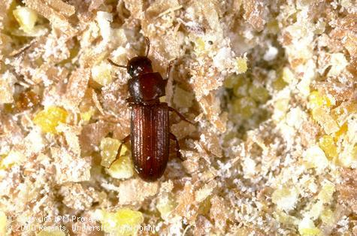
Household & Indoor Pests
Karey Windbiel-Rojas
UC Statewide IPM Program

Slide 2
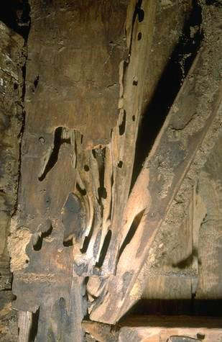
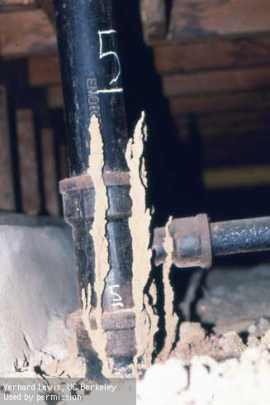
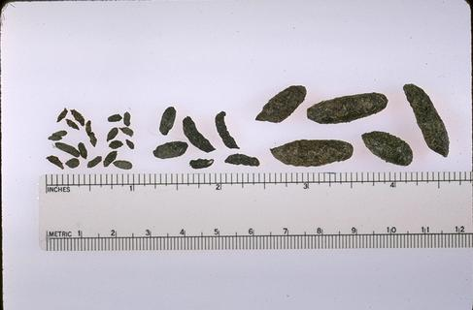
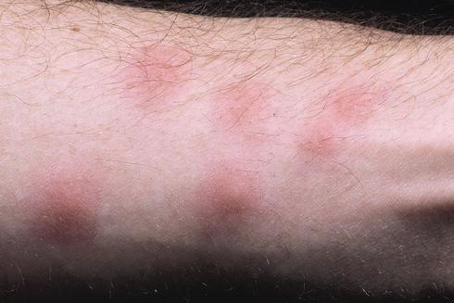
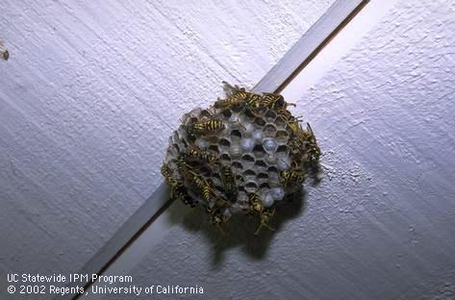
Household & Indoor Pests
Signs and Symptoms
Vertebrate?
Invertebrate?
Nuisance?
Damage causing?
Notes:
Droppings of house mouse (left), roof rat (center), and Norway rat (right).

Slide 3
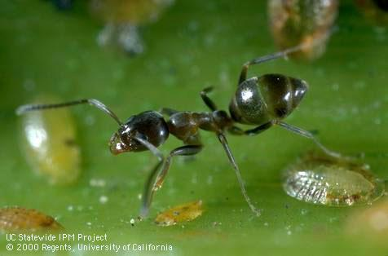
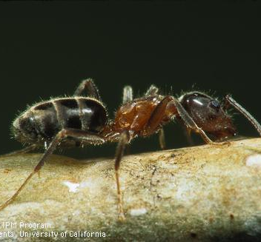
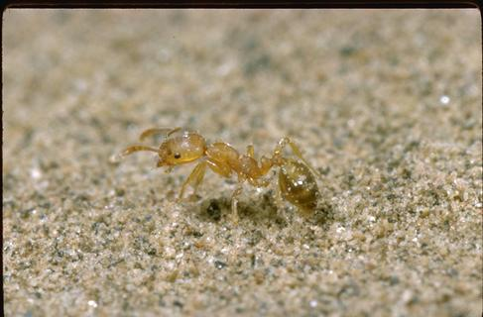
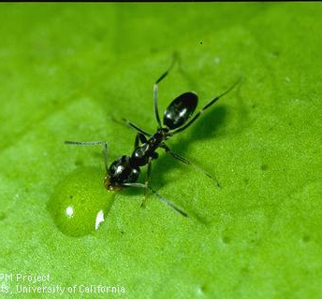
Pest ants: Hymenoptera: Formicidae
Notes:
Clockwise from top left: Argentine ant, odorous house ant, velvety tree ant, pharaoh ant. All four species exist as household pests in California, though certain species may dominate certain areas.

Slide 4
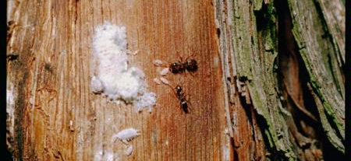
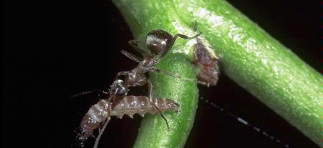
Ants outside
Important predators, scavengers
But…
  ‘farm’ honeydew-excreting garden pests such as aphids, scales, mealybugs, whiteflies, psyllids
  Interfere with natural enemies
  Often find their way inside the home, office, or structure
Notes:
Ants are important generalist predators, such as this native gray ant attacking a peach twig borer larva. They also maintain and protect colonies of honeydew-producing insect pests, however, interfering with other natural enemies such as parasitic wasps.

Slide 5
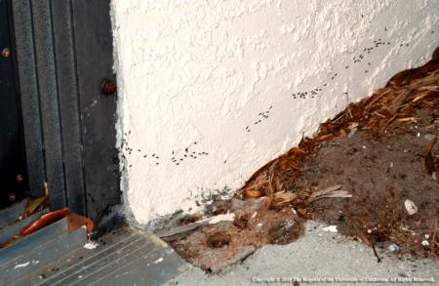

Why do ants invade indoors?
Water, shelter, moderate temperatures
Uncontained/unsealed food resources
Notes:
Ants invade usually during hot and dry periods or during cold and wet periods, to escape such environmental extremes and to access unprotected resources.

Slide 6

IPM for ants
  Identification is critical
  Outdoor or indoor resident?
  Exclusion is key
  Remove food and water sources

Slide 7
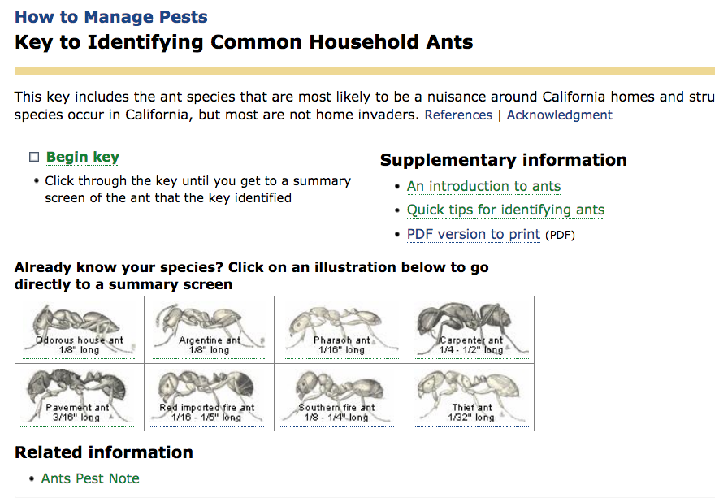
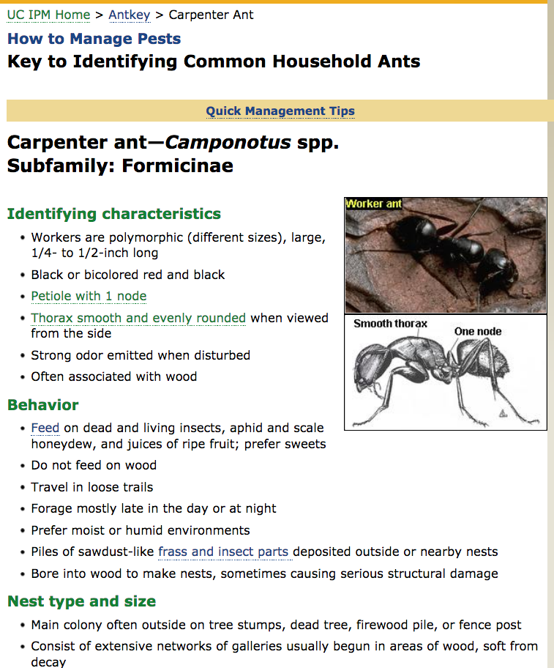

Slide 8
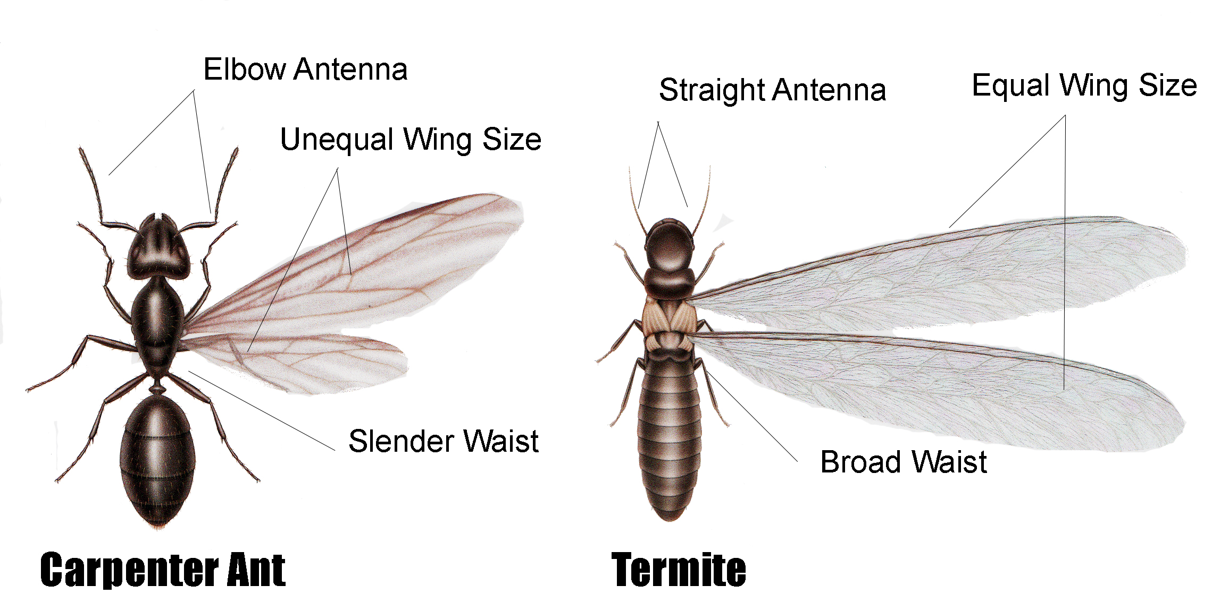
Is it an ant or a termite?
Antennae: elbowed vs. string-of-beads
Constriction in abdomen (‘waist’)?
Wings: different sizes or all same size?
Wing veins: reduced or many (net-like)?
Notes:
It is important for Master Gardeners to be able to distinguish between winged ants and winged termites since ant management can be a do-it-yourself job while termite management usually requires a pest management professional (PMP).

Slide 9
Termites: Blattodea (formerly Isoptera)
Subterranean: Reticulitermes (and others)
Most common and smallest termite in urban CA
Nests in soil (except for carton nests)
Drywood: Incisitermes
Common in parts of CA
Nests in wood (difficult to detect)
Dampwood: Zootermopsis
Largest and least common pest termite
Nests in buried or wet wood

Slide 10
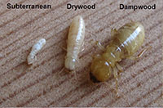
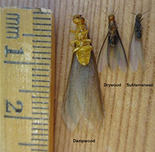
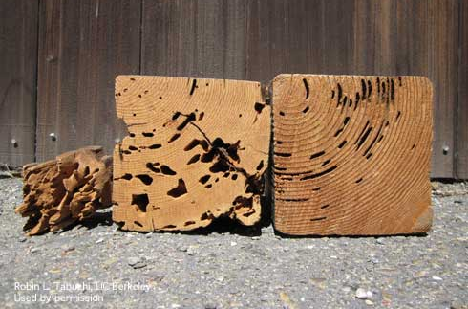
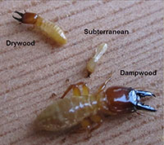
Damage to wood by dampwood (left); drywood (center); and subterranean termite (right).
Notes:
Top photo: Worker cast
Bottom photo” Soldier cast
Right photo: Reproductives
Damage to wood by dampwood, Zootermopsis nevadensis, (left); drywood, Incisitermes minor, (center); and subterranean termites, Reticulitermes hesperus (right).

Slide 11
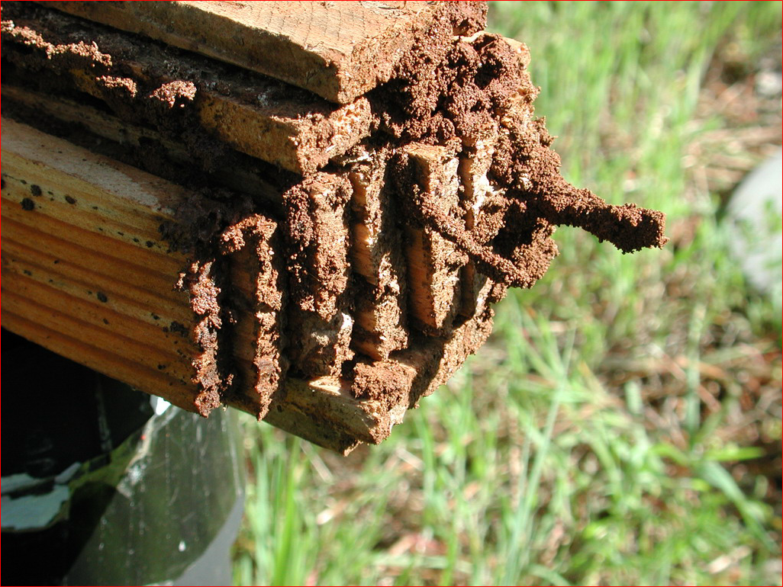
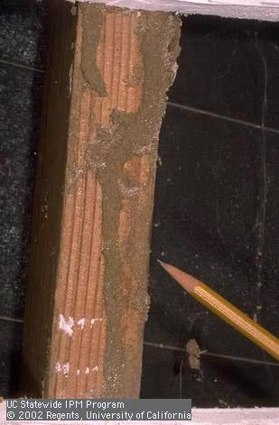
Subterranean termite signs
Notes:
Subterranean termites must bring moisture with them, from the soil and insulated by transported soil particles, as they forage. Therefore, mud tubes and extruding muddy frass are important diagnostic signs for this species.

Slide 12
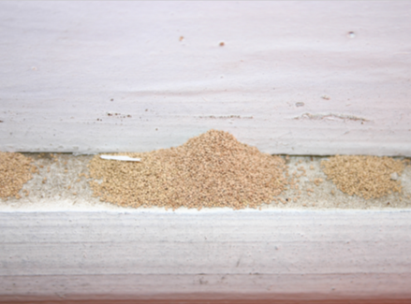
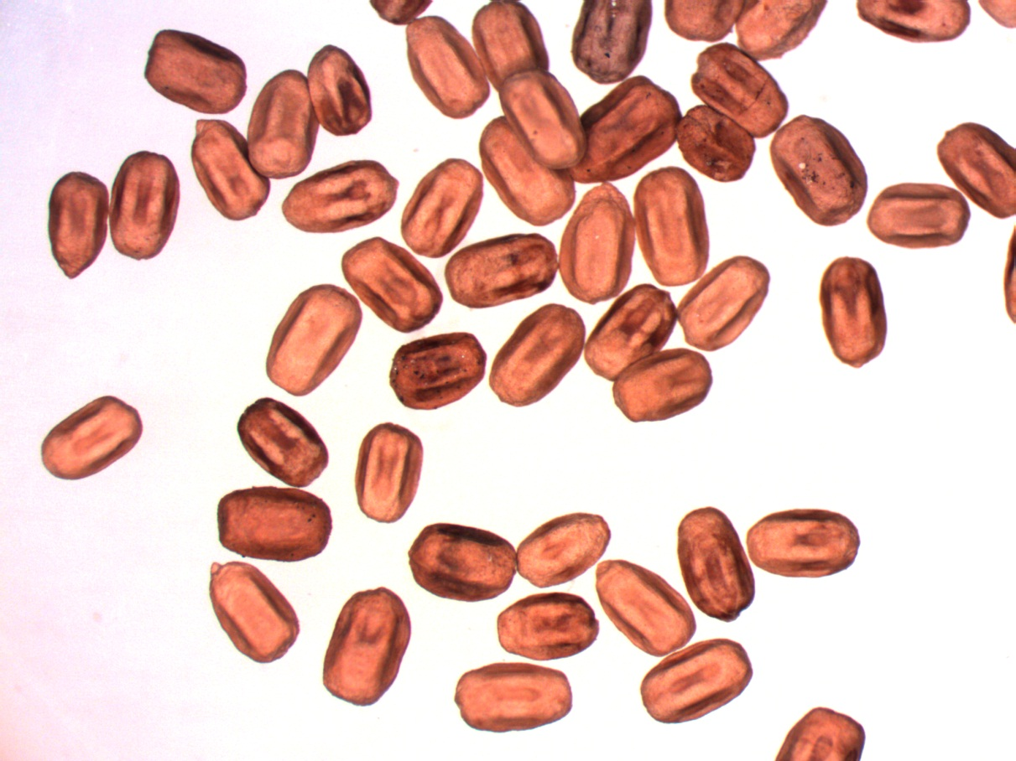
Drywood termite signs
Notes:
The key diagnostic sign for drywood termites is the accumulation of pellets, compressed fecal materials which are pushed out of the colony’s galleries as termites feed and develop. These pellets are about one millimeter or less in length, cylindrical, and characterized by six longitudinal ridges, giving the pellets a hexagonal cross section.

Slide 13
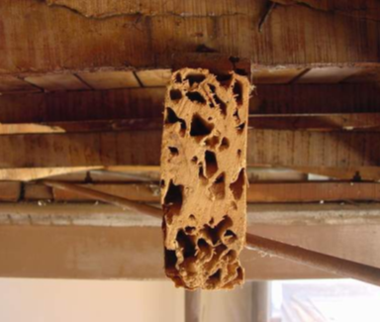
Drywood termite damage
Consume wood along and across grain
Notes:
Drywood termites indiscriminately consume wood, both along and across the grain (growth rings), so damage is amorphous rather than striated as in sub termites.

Slide 14
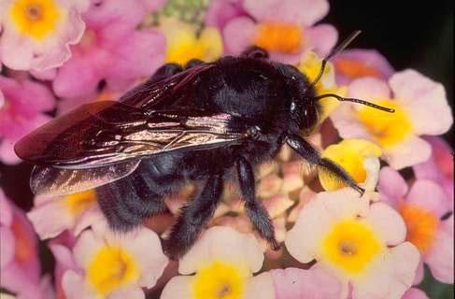
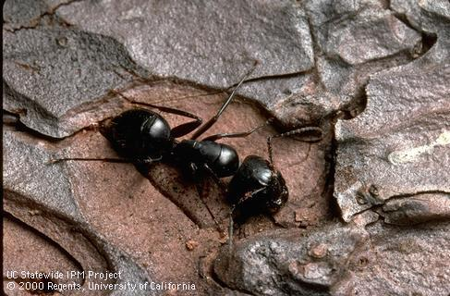
Minor wood-destroying pests
Carpenter bee:
  Large diameter (1/2”), tubular holes.
  Prefer softer woods.
  Prevention is best management tactic.
Carpenter ant:
  Large ants, conspicuous trails, copious frass.
  Exclusion and baits.
Notes:
Both of these minor pests damage wood through nest excavation activities rather than by feeding. Carpenter bees make long tubular holes in wood in which they construct numerous individual brood chambers. Entry can be prevented by sealing all cracks and crevices and by screening (metal) or chemically-treating all exposed structural softwood. Some tolerance of carpenter bees may be warranted since infestations rarely lead to severe damage. Additionally, these bees are important native pollinators. Carpenter ants are large and usually conspicuous. Their excavations are evident by accumulation of copious sawdust-like frass at the nest entrance. These ants can be excluded from structures in a similar manner as carpenter bees. They can also be managed using insecticidal bait stations. It is important to remember that carpenter ants serve as beneficial predators and scavengers in our landscapes.
Carpenter bee Pest Note: http://www.ipm.ucdavis.edu/PMG/PESTNOTES/pn7417.html
Carpenter ant Pest Note: http://www.ipm.ucdavis.edu/PMG/PESTNOTES/pn7416.html

Slide 15
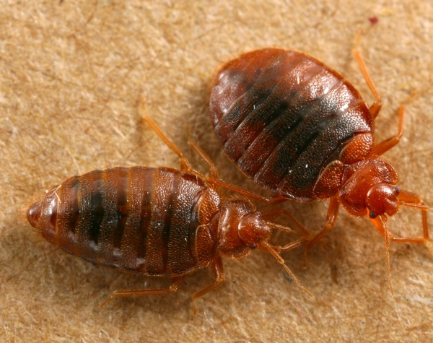
Bed bugs: Heteroptera: Cimicidae

Slide 16
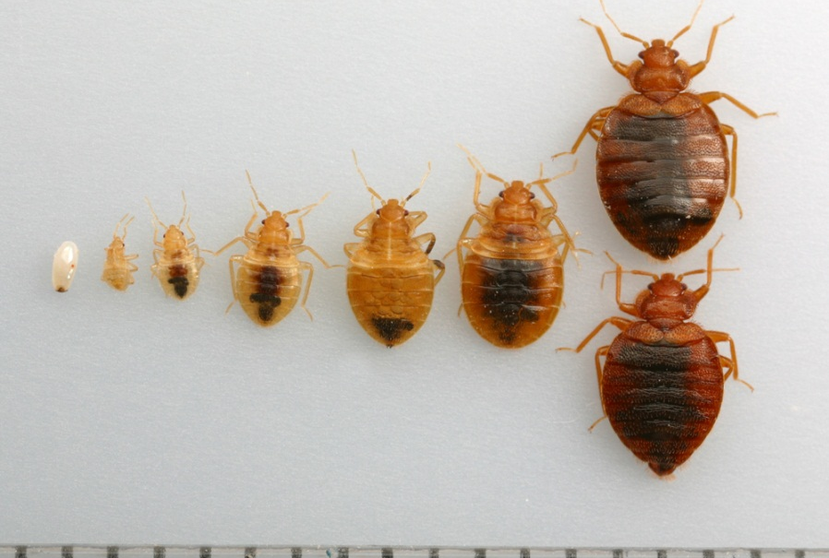
Bed bug biology
Life cycle: egg, 5 nymphal instars, adults
All obligate blood feeders
Nest parasites (harborages within ~6’ from host)
NOT KNOWN to vector human pathogens
Notes:
Bed bugs are true bugs, sinilar to stink bugs and assasssin bugs. As nest parasites, they do not live on their hosts but rather harbor in areas near where their hosts are expected to spend long periods in a sedentary state. At this point, transmission of disease in humans by bed bugs has never been demonstrated.

Slide 17
Nonchemical tactics
Disposal of infested items (clearly marked)
Clutter management
Barriers (encasements, interceptors)
Laundering (heat is most important)
Vacuum (provide HEPA filter)
Steam
Heat (> 45ºC or > 115ºF, 2 – 4 hours min.)
Cold (below freezing, at least five days)

Slide 18
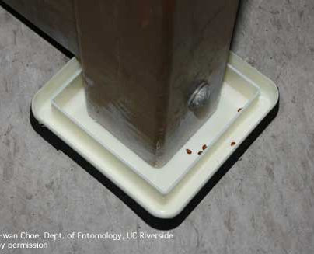

Slide 19

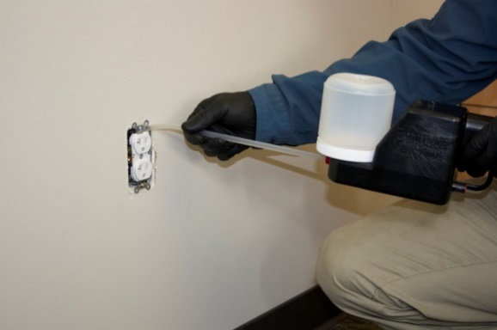
Chemical control of bed bugs
Retail products unlikely to completely control infestations
  Mostly ‘contact only’ materials
  Desiccants can help, if applied correctly
  No proven ‘repellents’ available
  ‘bug bombs’ can be dangerous!
Most of the effective materials are only available to pest management professionals

Slide 20
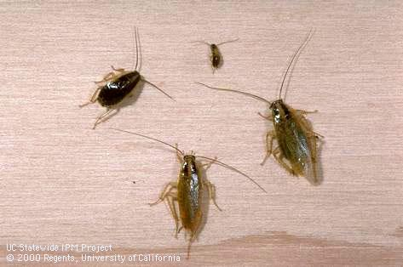
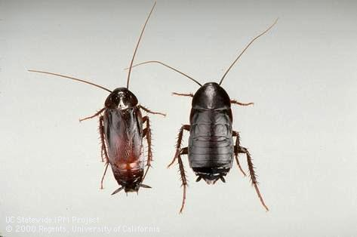
Cockroaches
Indoor resident or outdoor invader?
German cockroach, adults: ½ inch
Oriental cockroach, adults: 1 ¼ inch

Slide 21
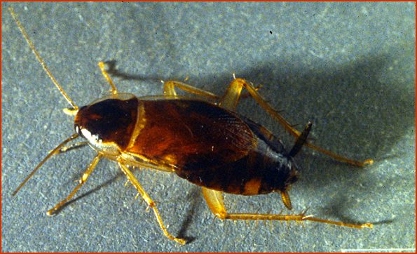
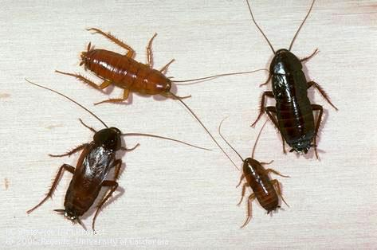
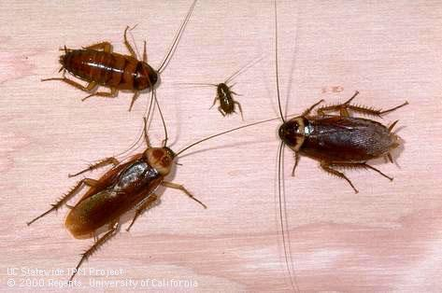
Household cockroaches
Outdoor invaders
Oriental
Smokybrown
American
Turkestan
Field
3-lined
Indoor species
German
Brownbanded
Notes:
The other four species almost always originate from outside areas, and have entered the home through cracks and crevices. These outdoor invaders are the largest species in the state and tend to be the most conspicuous. Management for indoor vs. outdoor species is quite different.

Slide 22
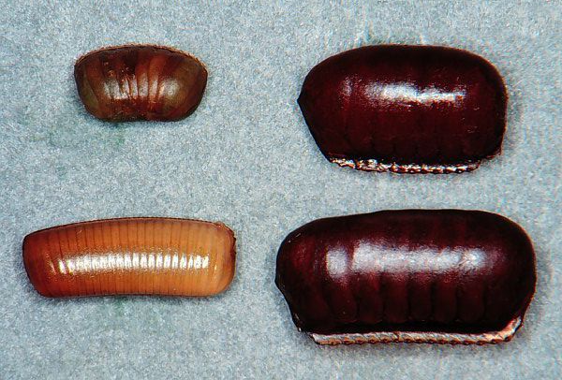
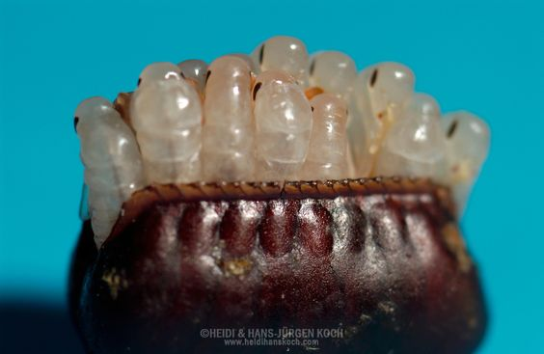
Cockroach Growth and Development
      Cockroach eggs are inside an egg case and insects hatch inside and emerge as immatures (nymphs).
Egg cases (ootheca) from different cockroach species.
Egg cases open at the seam like a purse and the nymphs emerge
Notes:
1

Slide 23

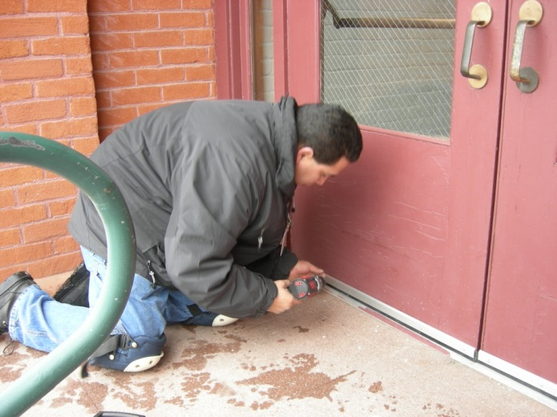
IPM for cockroaches
Indoor species
  Sanitation, food containment, moisture management
  Gel baits
Outdoor species
  Exclusion: door sweeps
  Landscape / habitat / moisture management
  Tolerance?
  Granular baits or sprays

Slide 24
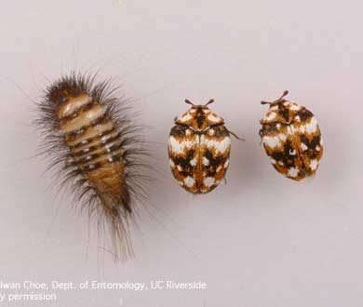
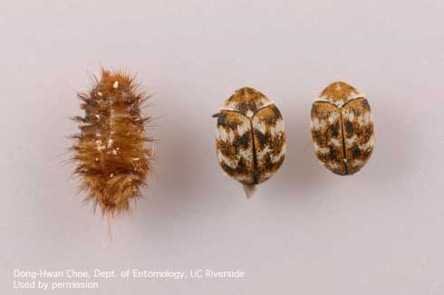
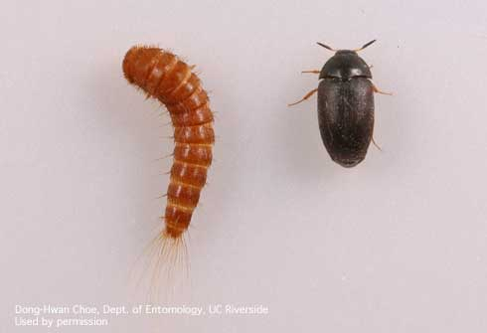
Carpet beetles
Adult carpet beetles are small (about 1/8 to 1/10 inch long) and have round bodies and short antennae. They range in color from black to a mix of white, brown, and yellow, depending on the species and age.
Larvae are slightly longer than adults and look like fuzzy or hairy maggots.
In California, there are three common species: the varied carpet beetle, the furniture carpet beetle, and the black carpet beetle.

Slide 25
Carpet beetles
Carpet beetle adults are pollen feeders and are found on flowers with abundant pollen.
People often bring carpet beetles into their homes on cut flowers from the garden–- Check flowers before bringing in!
Adults can fly in through open windows or doors–- Exclusion is important!

Slide 26
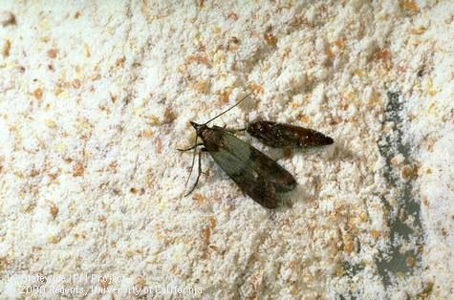
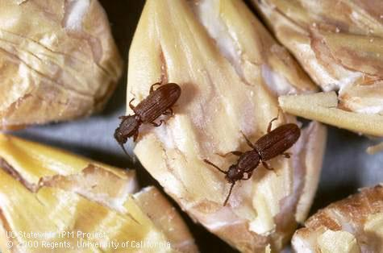
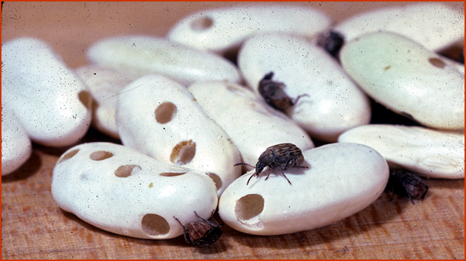
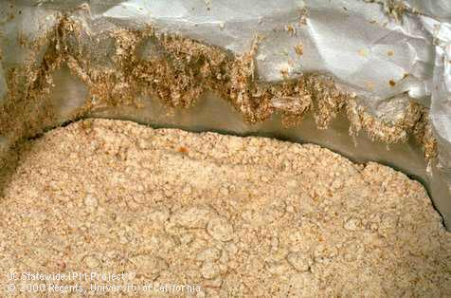
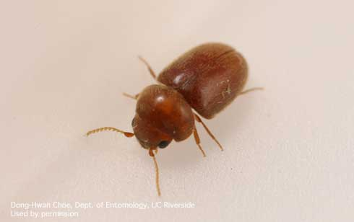
Pantry pests
Indian meal moths
Sawtoothed grain beetle
Cowpea weevil
Indian meal moth webbing
Drugstore and cigarette beetles
Red flour beetle
Notes:
Pantry pests, attacking our stored food products, are among the most common pests members of the public inquire about, according to Master Gardener hotline volunteers. Management is straightforward and can be a do-it-yourself job. The main pantry pests include the Indian meal moth and various species of beetles. Clockwise form top left: Indian meal moth adult, adult bean weevils, adult sawtoothed grain beetles, flour beetle larva.

Slide 27
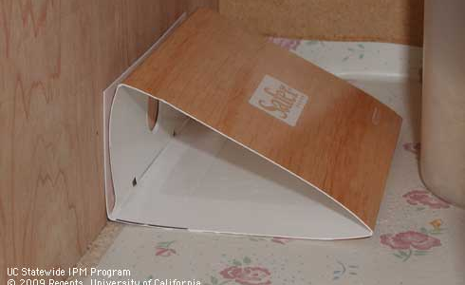
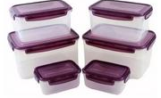
IPM for pantry pests
  Throw out infested food
  Clean up cabinets and storage areas with vacuuming, soap and water
  Use pheromone traps to detect Indian meal moth infestations
  Store food in tightly-sealed containers
  Freeze bulk purchases for five days or so before placing in cupboard

Slide 28
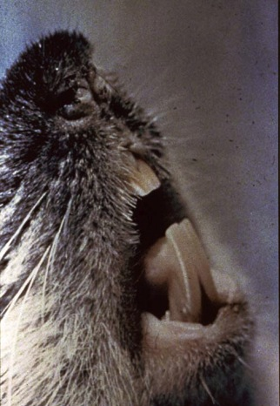

What is a Rodent?
Gnaw constantly to create holes and pathways
  Wood, plastics, hoses, sheetrock, copper, wires, etc.
Most active during the first two hours after dusk
Make lots of babies fast
Travel the same paths nightly, staying close to walls or items that give them cover
Notes:
28
Rodents are gnawing animals. They gnaw wood, wires, and other rough materials. The term "rodent" comes from "rodentia"—gnawing animals. Rodents are some of the most successful mammals (success in this case means living long enough to produce offspring). They are a formidable opponent.
Understanding rodent behavior is the key to controlling them. Knowing that they are active at night and are good reproducers is important (rodent problems must be acted upon quickly).
Trainees may have stories about rodents’ gnawing abilities (concrete, trash cans, cupboards, wires). Despite the myth, rodents are not likely to start gnawing on a smooth surface. This is why good repairs (no cracks, bumps, or uneven edges that promote gnawing) are essential to rodent control and can have an impact.
Suggestion: Have the trainees share some stories and lead into a brief discussion/ review of exclusion. The conclusion should be that anything used to exclude rodents should be able to hold up to and not encourage their gnawing. Since they are persistent, it is best to trap (and kill) the rodents and make repairs.

Slide 29

Rodents are Health Hazards
Carry infectious diseases
May cause asthma attacks
Bite
Damage food and property
Can attract other pests
Are repulsive
Notes:
29
Rats and mice carry various infectious diseases, including Salmonella and Lymphocytic Choriomeningitis (LCMV) a serious disease for pregnant women. Mice leave little drops of urine wherever they go. Mouse urine can trigger asthma attacks in sensitive people.
Rats may bite people when threatened. Babies are especially at risk since the rat may be in the crib with them, feeding on spilled milk.
Both rats and mice instinctively gnaw on things. This is damaging to property and can be dangerous if gnawing results in wires sparking and starting a fire.

Slide 30


Rodent Identification
Young Rat
large
large
FEET
HEAD
1/4"
3/4"
small
small
House Mouse
Notes:
The droppings (feces) of mice differ from those of rats. Knowing the difference can help determine if the pest in question is a mouse or rat. Control of each will differ. Droppings can help trainees find nests or burrows because they are left in areas of high activity. Rodents communicate by smelling chemicals in droppings.
Adults can be distinguished by size, but it can be difficult to tell an adult mouse from a baby rat. The feet and head of mice seem in proportion to their bodies and their tails are thin and long, while the rats have hind feet and heads that seem larger than they should be and thick tails that are shorter than their bodies. Mice are not small rats and mice do not become rats when they go outdoors.

Slide 31
Rats & Mice
Rodents, but Different
Rats
Mice
Mostly outdoors
Cautious (paranoid)
Food: 0.5–2.5 oz daily
Drink 1 ounce of water daily
Entry size: quarter (1/2” gap)
Travel up to 450 feet from their burrow
Mostly indoors
Curious/cautious
Food: 0.1 oz daily
Rarely drink
Entry size: dime (1/4” gap)
Travel 10-30 feet from their nest
Notes:
If you have flip chart paper, see how much the audience knows about Rats vs mice. Click for suggested responses
Rats can squeeze through a ½" gap, such as under a door. A quarter can be used for a visual to remember the size hole a rat can use to enter buildings.
The larger the rat, the more food they require.
Rats can go 3–4 days without food, but only 1–2 days without water. They eat 3–5 ounces per day (a soda is 12 ounces, so a little less than the weight of a half-full soda can). They prefer to stick to a few feeding locations and eat 2 meals a day.
Young or small mice can fit through a gap as narrow as ¼" and a hole the size of a dime.
Mice can go a month without drinking…they get most of their water from food. They like to nibble many times during the night. They need less than an ounce of food per day.
1/10 oz. is just under 3 grams
The main point of rodent food: Rodents have similar nutritional requirements to humans and, like us, prefer fresh food. Knowing what a particular rodent is eating tells you what to use for bait on a trap.
Have trainees grab a pen or a pencil and look at the blunt/ eraser end. This is the size of the gap that a mouse could fit through. Contrary to popular myth, mice and rats do have bones, but they are very flexible. If they can get their head through a hole, they can push the rest of their body through. Have trainees look around the room or think of areas where they spend time. How many exterior doors could you shove a pencil under?
Ask: What else could fit through a hole this size? Answer: Cockroach. Note that the exclusion methods used for rodents will often work for cockroaches, too!
Limiting rodents’ access to food is critical, and their feeding behavior (where/when they are feeding) needs to be remembered when setting traps.

Slide 32

Where Rats Live
Norway Rat Burrow
Exterior: Burrows, usually around trash
  Travel 150-450 feet from burrow; prefer to live close to food and water
Crawl spaces become infested if food trash collects along the exterior
Indoors: trash rooms, wall and ceiling voids, concrete hollow block walls, and other nooks
Notes:
32
We’ll talk first about rats:
Because it is a constant battle to exclude rodents, it is best to exclude and trap at the same time.
Rats love to burrow, usually outdoors, and prefer to live in secluded areas. If there is plenty of food available, however, they will burrow and nest inside buildings. Rats will travel further than mice for sustenance, but still prefer to stay within 150 feet of their burrow if possible. Unlike mice, rats need to drink water daily.
Norway rat burrows are usually 1–3 feet deep and have at least two entrances. The main hole (2–4" across) and one or more bolt-holes (three or more feet from the main entrance and may be small and well camouflaged). Burrows are often found under plantings and groundcover; near trash areas or outdoor trash cans; and under concrete slabs, tires, sheets of plywood, or other debris on the ground. Outdoor vending machines and other food sources are also popular places for Norway rats to be found. Eliminating debris and trash is a crucial part of control. Doing so will make new burrows easier to spot and discourage rats from setting up shop.
Roof rats prefer to nest in secluded areas above ground in such places as attics, soffits, overhead garage storage, in the vine cover of fences or buildings, and in wood piles or other stored materials where harborage can be found. They favor dense non-deciduous trees or trees with hollow cavities and the crowns of palm trees, especially when old fronds are not removed. Roof rats sometimes burrow in the ground, especially in hot, dry environments. In these areas, they may use trees, materials stored on the ground, concrete slabs, and sidewalks to support shallow burrows. Because they are often living overhead between floors or above false ceilings, there is less chance signs of roof rat tracks, urine, and droppings will be seen.
Action should be taken when evidence of even one rat is seen.

Slide 33

Where Mice Live
Nests:
Walls
Beneath refrigerators and stoves
Inside stoves
Cabinets, closets
Couches & chairs
Stored cardboard boxes
Ceiling
Mouse nest in a hat
Notes:
33
Rodents will often nest near a heat source.
Mice will nest in insulation, old clothes, cars, boxes, shoes…many things. They live and eat in a 10 square foot area, so if there is food available they will nest.

