Slide 1
Good Bugs in Gardens & Landscapes
Karey Windbiel-Rojas
Associate Director for Urban & Community IPM
UC Statewide IPM Program
Notes:
Welcome to today’s presentation on Biological Control.

Slide 2
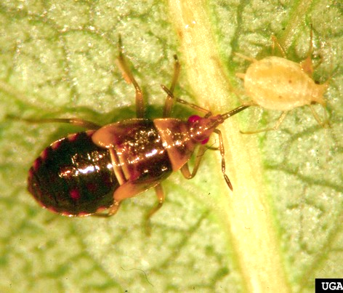
What is biological control?
The use and action of naturally occurring parasites, pathogens, and predators in managing pests and their damage
An important concept in Integrated Pest Management (IPM)
Natural enemies are the agents of biological control
  Other terms: good bugs, beneficials, biocontrol
Minute pirate bug feeding on green peach aphid
Bradley Higbee, Paramount Farming, Bugwood.org
Notes:
So, what is biological control?
It is the action of beneficial organisms such as parasites, pathogens, and predators- generally refereed to as natural enemies- and these organisms help to manage pests and their damage
This form of control is essential to IPM and non-chemical management of pests as it poses fewer risks to human and environmental health
Biological control is primarily used to control insect pests but it can also be used to control other pests like weeds, diseases, and animal pests
Natural enemies are the agents of biological control
These living organisms control pests and other insects by preying or feeding on them, preventing them from reproducing, or parasitizing them
They include predators, parasites, and pathogens
And are often referred to as beneficials or good bugs

Slide 3
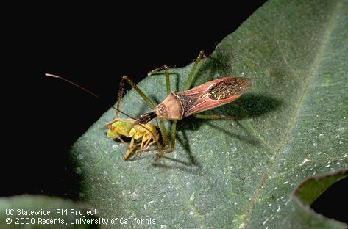
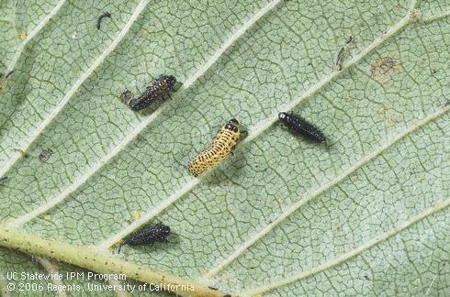
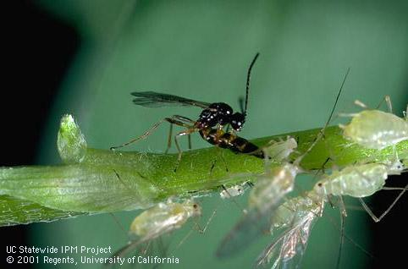
Types of natural enemies
Predators: kill and feed on prey
  Lady beetles, lacewings, reptiles, birds, spiders
Parasites/parasitoids: live and feed inside of or on host
  Parasitic wasps and flies
Pathogens: infect and kill host
  Bacteria, fungi, viruses
Predator
Pathogen
Parasitoid
Notes:
Predator: Adult assassin bug, Zelus sp. feeding on lygus bug
Pathogen: Bacillus thuringinesis (Bt) infected elm leaf beetle larvae turn black.
Parasitoid: Adult female Aphidius species laying her egg in an aphid.

Slide 4
Predators
Kill and feed on many prey
Adults, immature stages (larvae or nymphs) are predaceous
  Immature stages are often aggressive feeders
Yes, biocontrol is done by birds, mammals, reptiles, and amphibians too!
Notes:
Predators kill and feed on several to many individual prey during their lifetimes.
Many species of amphibians, birds, mammals, and reptiles prey extensively on insects. Predatory beetles, flies, lacewings, true bugs, and wasps feed on various pest insects or mites. Most spiders feed entirely on insects.
The larvae of most natural enemies are aggressive feeders of pests. Most adult predators feed on pollen and nectar, rather than pests, but some may be predaceous as both adults and larvae, such as lady beetles.

Slide 5
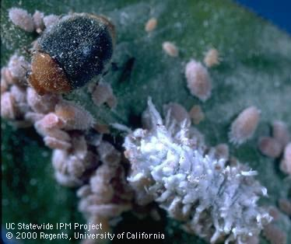
Generalist or specialist?
Generalist predators: feed on a wide variety of pests; may feed on other beneficials and pests
Specialist predators: feed on only one or a few closely related species
Mealybug destroyer adult and larva
Notes:
When we talk about predators, there are two main kinds
Generalists are those that feed on a wide variety of pests. They may eat both beneficial insects and pests. However, pests usually have a higher presence than natural enemies so it is not very likely for these generalist predators to have a negative impact on natural enemy populations.
Specialist predators will feed on only one or a few closely related species. This photo shows the mealybug destroyer lady beetle adult and larva. Notice how the larva resembles mealybugs? That’s because this predator is specialized to feed on mealybugs, hence its name.

Slide 6
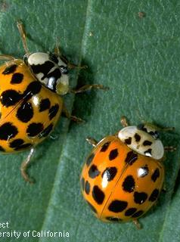
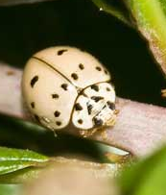
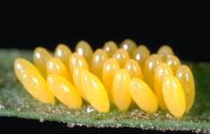
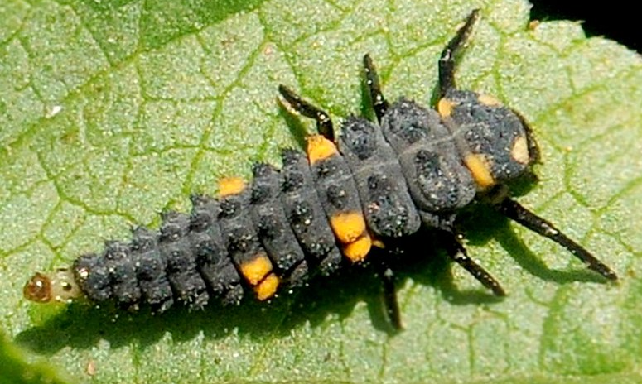
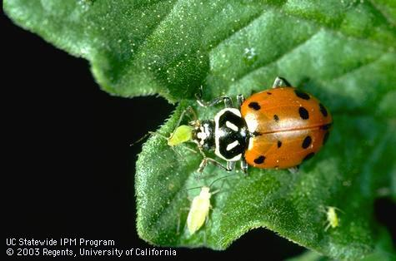
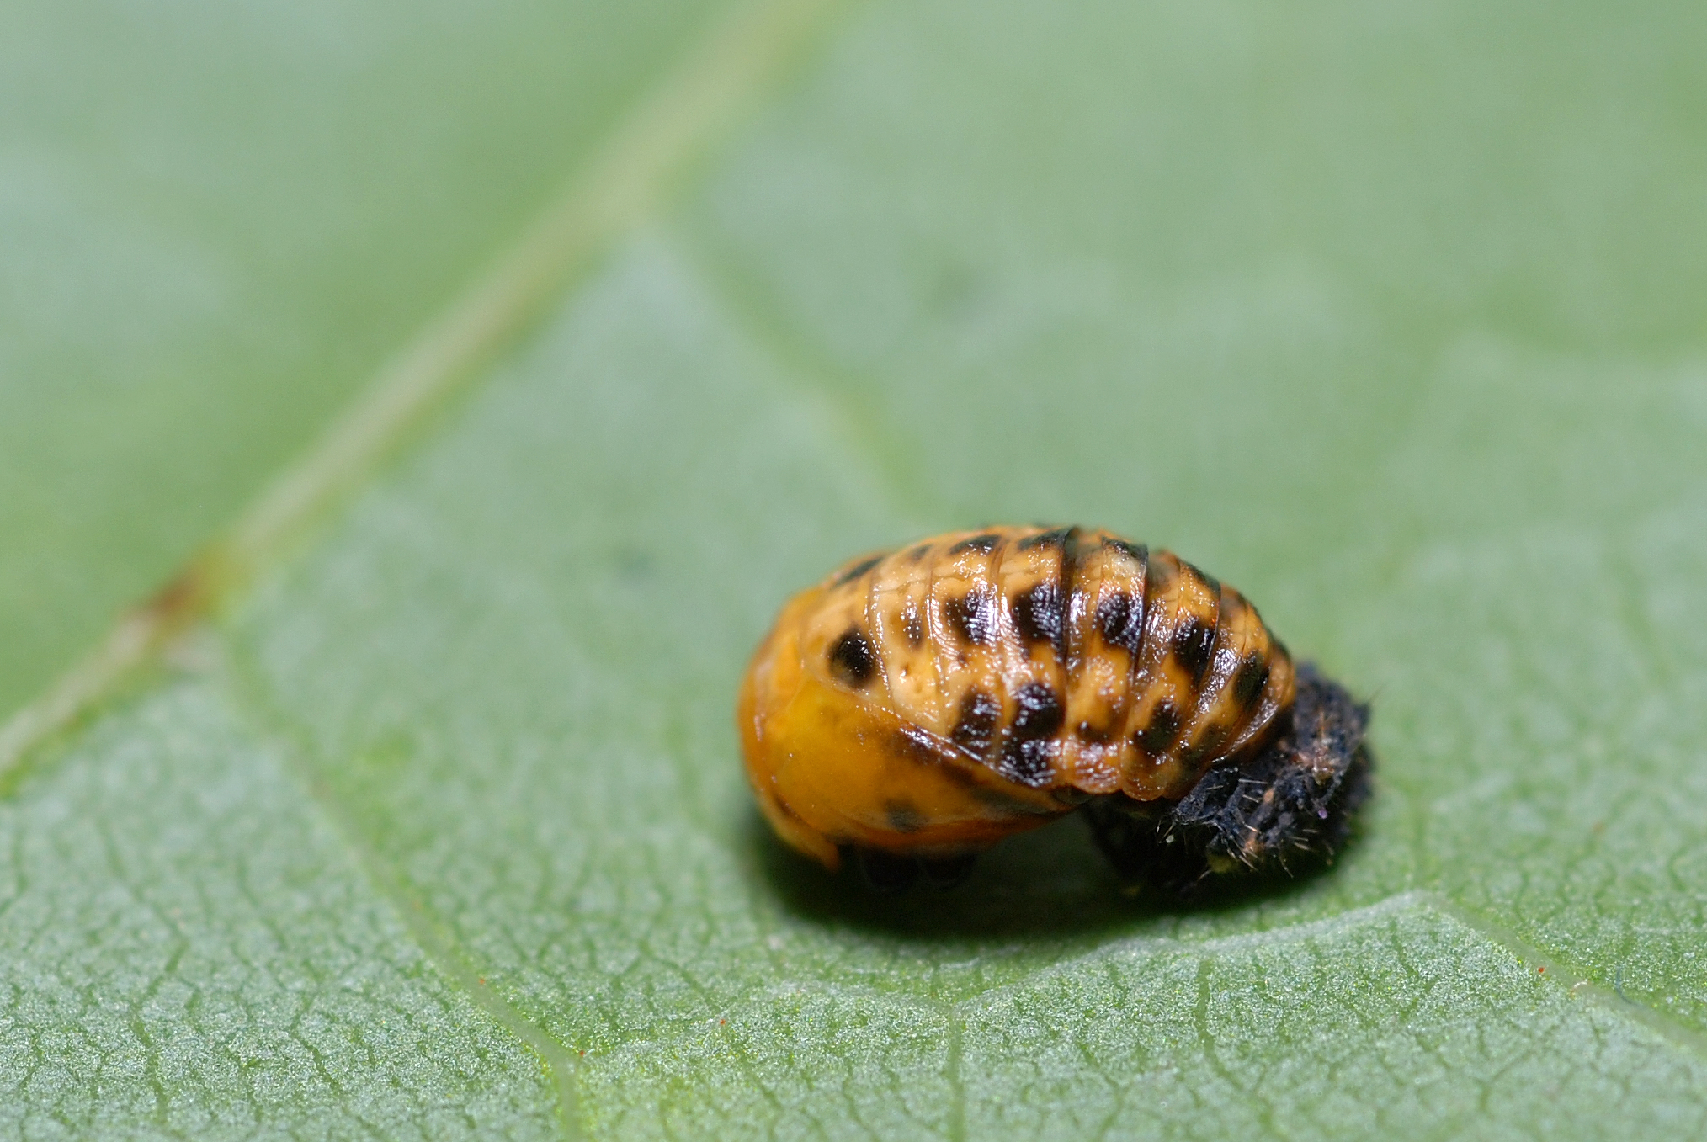
Lady beetles (ladybugs)
Some are generalist predators
  Eat aphids, mites, psyllids, scales, and whiteflies
Multicolored Asian lady beetle
Ashy gray lady beetle
Eggs
Larva
Pupa
Convergent lady beetle
Notes:
Ladybugs, or more correctly lady beetles are mostly generalist predators- they eat a wide variety of insects
But some, like the mealybug destroyer we just talked about, are specilists
Important to know what ladybeetle lifecycle looks like – people often mistake larva for pests!
The multi-colored Asian lady beetle can be seen in the top left photo. You can ID this lady beetle by looking for the dark M on its thorax (head area)
The ashy gray lady beetle is pictured on the top right
And on the bottom, we have the very commonly seen convergent lady beetle feeding on aphids. You can ID this lady beetle by looking for the converging white lines on its thorax

Slide 7
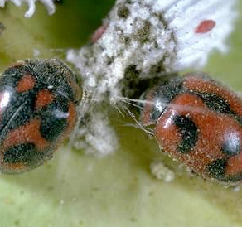
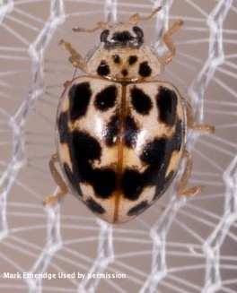
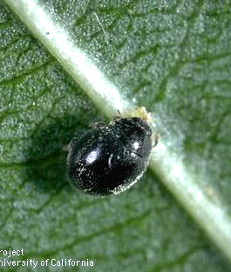
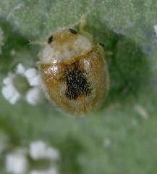
Lady beetles
Specialist predators
  Spider mite destroyer: spider mites
  Fungus-feeding: powdery mildew
  Vedalia beetle: cottony cushion scale
  Whitefly predator: whiteflies
Vedalia beetle
Fungus-feeding lady beetle
Whitefly predator
(Clitostethus arcuatus)
Spider mite destroyer
Notes:
While some lady beetles are generalist predators and feed heavily on aphids, others are very specialized predators of other pests
For example, the mealybug destroyer is specialized to feed on mealybug adults, eggs, and nymphs
As we saw earlier, their larva are white and waxy, resembling mealybugs
The fungus-feeding lady beetle pictured in the top right feeds only on powdery mildews and other fungi
Vedalia beetles are specialist predators of cottony cushion scale
Lastly, the whitefly predatory beetle feeds exclusively on whiteflies

Slide 8
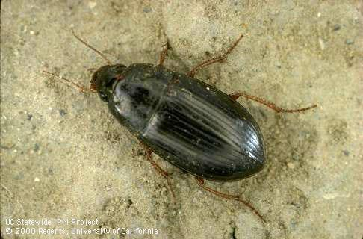
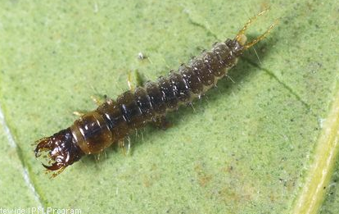
Predaceous ground beetles
Generalist predators
  Millipedes, snails, slugs, caterpillars (grubs), root-feeding insects
Colors vary from black to brightly colored
Found in compost piles, mulch, leaf litter, and along the soil surface
Ground beetle adult
Predatory ground beetle larva
Notes:
There are many species of ground beetles that prey on soil and ground dwelling insects such as millipedes, caterpillars, snails, slugs, and root-feeders
Predaceous ground beetles can vary in color, but most are black to dark reddish brown
They are mostly active at night and rarely fly
You can find them in compost piles, leaf litter, mulch and under objects on the soil and rocks, especially in moist locations.
https://ipm.ucanr.edu/natural-enemies/predaceous-ground-beetles/

Slide 9
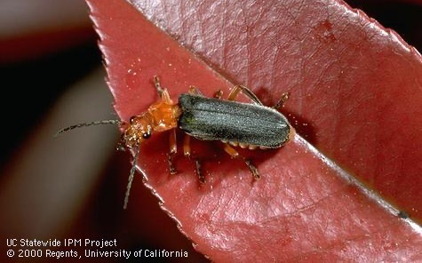
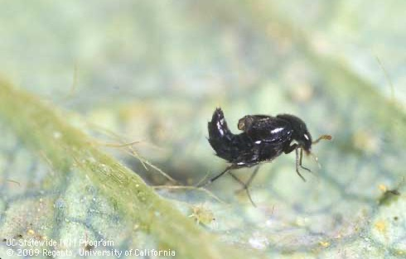
Other Beetles
Soldier beetles feed on soft bodied insects and ground-dwelling invertebrates
Rove beetle feeds on spider mites

Slide 10
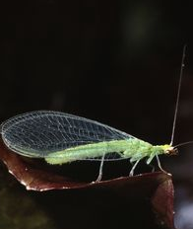
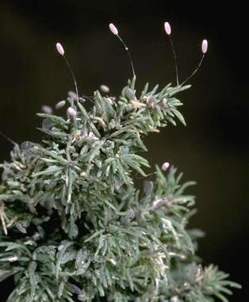
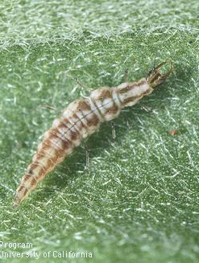
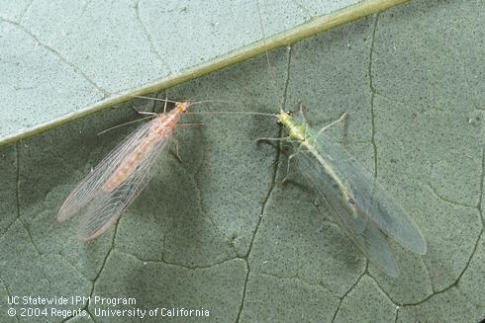
Lacewings
Generalist predators
  Aphids, mites, caterpillars, scales, mealybugs, psyllids, thrips
Larva are most predaceous
Brown lacewing adults are predatory, but only some green lacewing adults are
Green lacewing adult
Green lacewing eggs
Lacewing larva
Brown lacewing adult
Notes:
Lacewings are another generalist predator. They feed on smaller, soft-bodied insects like aphids, mites, thrips, and psyllids
Green lacewing lay eggs on slender stalks brown lacewings do not
Their alligator-like larvae are voracious insect and mite predators
Some green lacewing adults will feed on other insects, but others will only feed on pollen
Brown lacewings are about half the size of green lacewings, do not lay their eggs on stalks, and the adults are also predaceous
Rather the whitish, oval eggs are laid buds, in crevices and pits of bark, or on twig crotches or tips where they are easily overlooked.

Slide 11
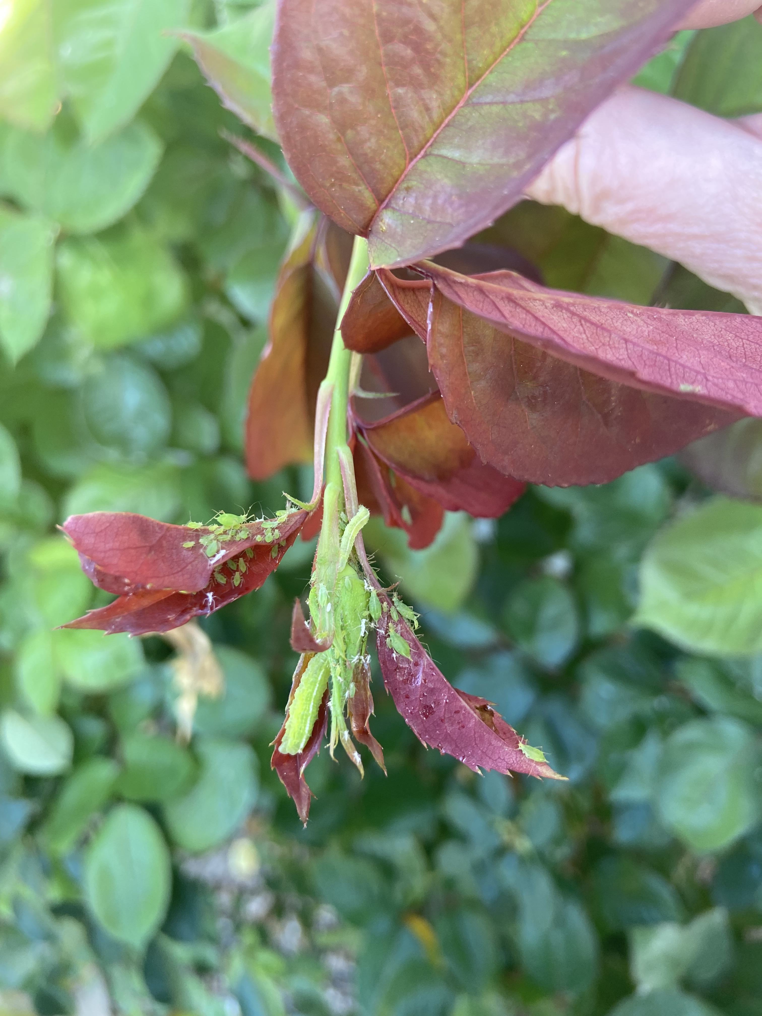
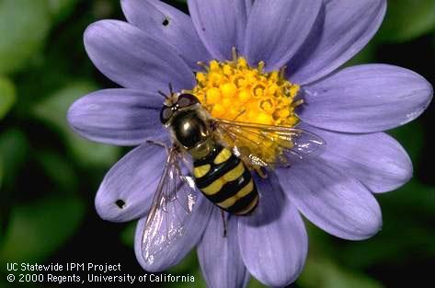
Syrphid flies
Predators
  Aphids, mealybugs
Adults resemble bees and feed on pollen and nectar
Larvae feed on aphids and mealybugs
Notes:
Predators whose larvae feed on aphids and mealybugs, and lack true legs
Adult syrphid flies often resemble bees with striped on their bodies.
Adults feed on pollen and nectar, and are sometimes called flower flies or hover flies

Slide 12
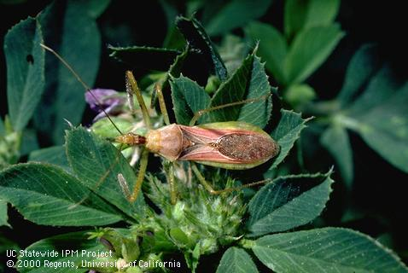
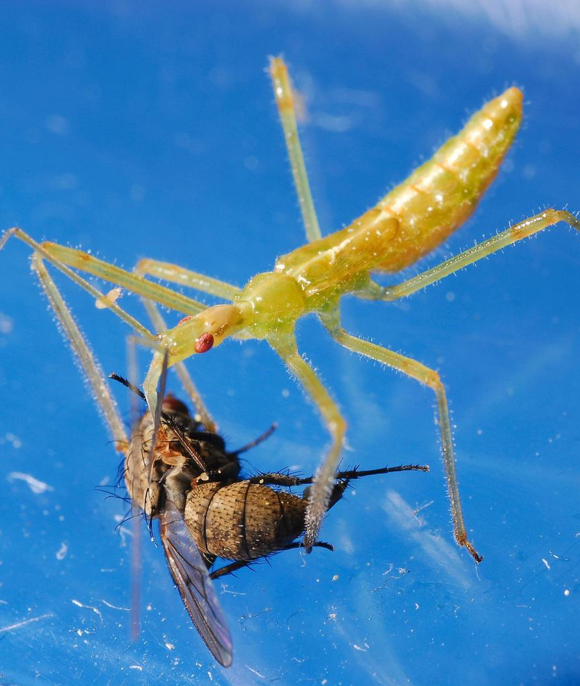
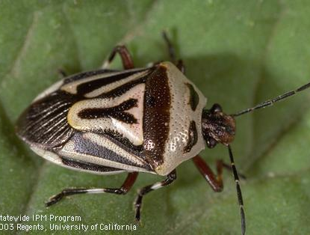
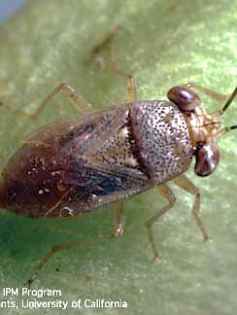
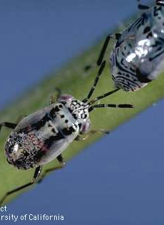
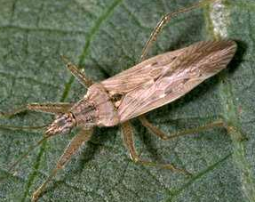
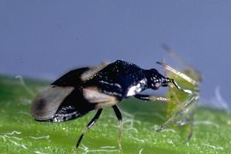
True bugs (Heteroptera)
Generalist predators
  Caterpillars, beetles, mites, aphids
Needle-like mouthparts suck fluids out of prey
Joseph Berger, Bugwood.org
Adult assassin bug and nymph
Twospotted stink bug
Damsel bug
Adult bigeyed bug and nymph
Minute pirate bug
Notes:
True bugs are a large order of insects.
They include generalist predators, like the ones pictured here, but also pest insects like stink bugs, leaffooted bugs, and bed bugs
True bugs have need-like mouthparts that they use to suck fluids out of prey
Some common true bug predators are pictured here
Largest and most common to see are assassin bugs

Slide 13
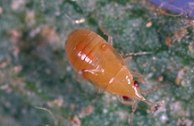
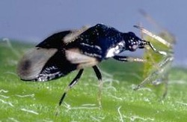
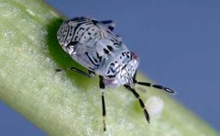
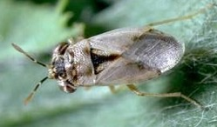
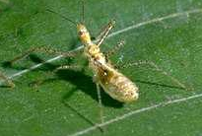
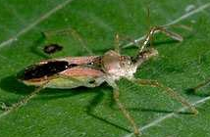
True bugs
Minute pirate bugs (Anthocoridae) prey:
aphids, mealybugs, mites, psyllids, small caterpillars, scales, thrips, and whiteflies
Bigeyed bugs (Geocorinae) prey:
other bugs, flea beetles, small caterpillars, and mites
Assassin bugs (Reduviidae) stalk:
caterpillars, leafhoppers, various small to medium, mobile insects
(Nymph) Minute pirate bug (Adult)
(Nymph) Bigeyed bug (Adult)
(Nymph) Assassin bug (Adult)
9
Notes:
Predatory true bugs (Heteroptera order)
Prey on a great variety of invertebrates. Develop through 3 life stages: egg, nymph (usually 5 instars), and adult.
Minute pirate bugs (Anthocoridae family) - Adults and nymphs eat thrips, all stages of mites, insect eggs, aphids, mealybugs, psyllids, whiteflies, and small caterpillars. If feeding on mites, minute pirate bugs consume 100 or more in a lifetime. Nymphs are pear-shaped, yellow to orangish, and. have distinctly red eyes. Females typically insert their eggs into plant tissue.
Bigeyed bugs (Geocorinae subfamily of Lygaeidae) - Adults and nymphs actively search low-growing plants for prey, including other bugs, insect eggs, flea beetles, small caterpillars, and mites. They are tiny (1/6 inch long or less) and have a wide head with prominent bulging eyes.
Assassin bugs (Reduviidae family) - Both adults and nymphs feed on caterpillars, leafhoppers, and a variety of other small- to medium-sized, mobile insects. Adults and nymphs stalk or lay in wait for prey, which they impale with their extended, needlelike beak.
Photos: Minute pirate bug, Orius tristicolor (top); Bi eyed bug, Geocoris punctipes (middle); Assassin bug, Zelus renardii (bottom)
More information online:
http://www.ipm.ucdavis.edu/PMG/NE/minute_pirate_bug.html
http://www.ipm.ucdavis.edu/PMG/NE/bigeyed_bugs.html
http://www.ipm.ucdavis.edu/PMG/NE/assassin_bugs.html
http://www.ipm.ucdavis.edu/PMG/NE/damsel_bug.html
13

Slide 14
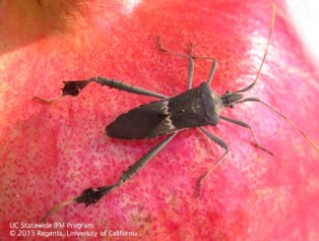
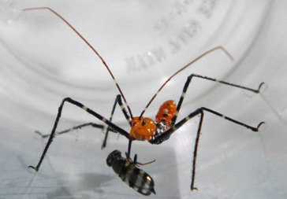
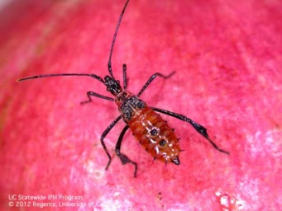
Look-alike insects
Predators
Herbivores
Good
Bug
Bad
Bug
Assassin bug adult and nymph
Leaffooted bug adult and nymph
(Photographs by D. Haviland)
Photograph by Megha Kalsi, University of Florida.

Slide 15
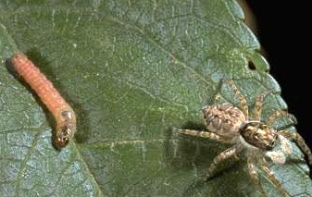
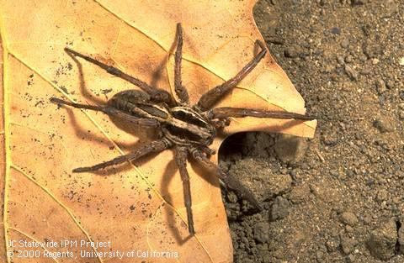
Spiders
Jumping spider and Oriental fruit fly larva
Generalist predator, mostly beneficial
Feed on other spiders, insects, and arthropods
Arachnids not insects
Some spin webs, others do not
Wolf spider
Notes:
Spiders are generalist predators that feed on a wide variety of insects, other spiders, and arthropods
Because they have 8 legs, they are arachnids and not insects
Some spiders will use webs to catch their prey, others like jumping spiders and wolf spiders stalk and hunt down their prey

Slide 16
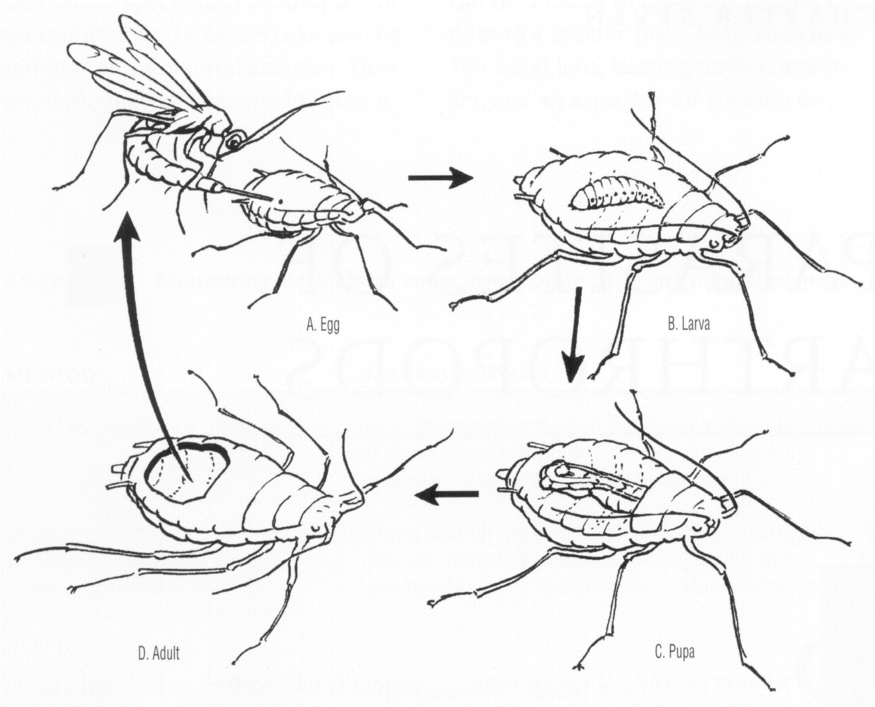
Parasites (parasitoids)
Life cycle of a parasitic wasp inside of an aphid
Live and feed in or on a host/prey
Kill their host
Mostly wasps and flies
Notes:
Although the term “parasite” is used here, true parasites (e.g., fleas and ticks) do not typically kill their hosts. Species useful in biological control, and discussed here, kill their hosts; they are more precisely called “parasitoids.”
Insect parasites can develop on the inside or outside of the host’s body, or eggs
Most parasitic insects are very tiny flies or wasps
The life cycle graphic is for an aphid parasite
An adult parasite lays an egg inside a live aphid. The egg hatches into a parasite larva that grows as it feeds on the aphid's insides. After killing the aphid, the parasite pupates. An adult wasp emerges from the dead aphid, then flies off to find and parasitize other aphids.

Slide 17
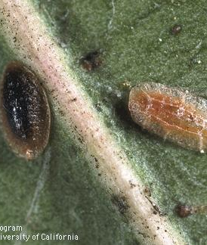
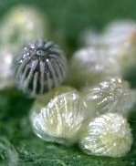
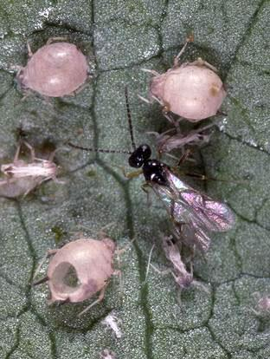
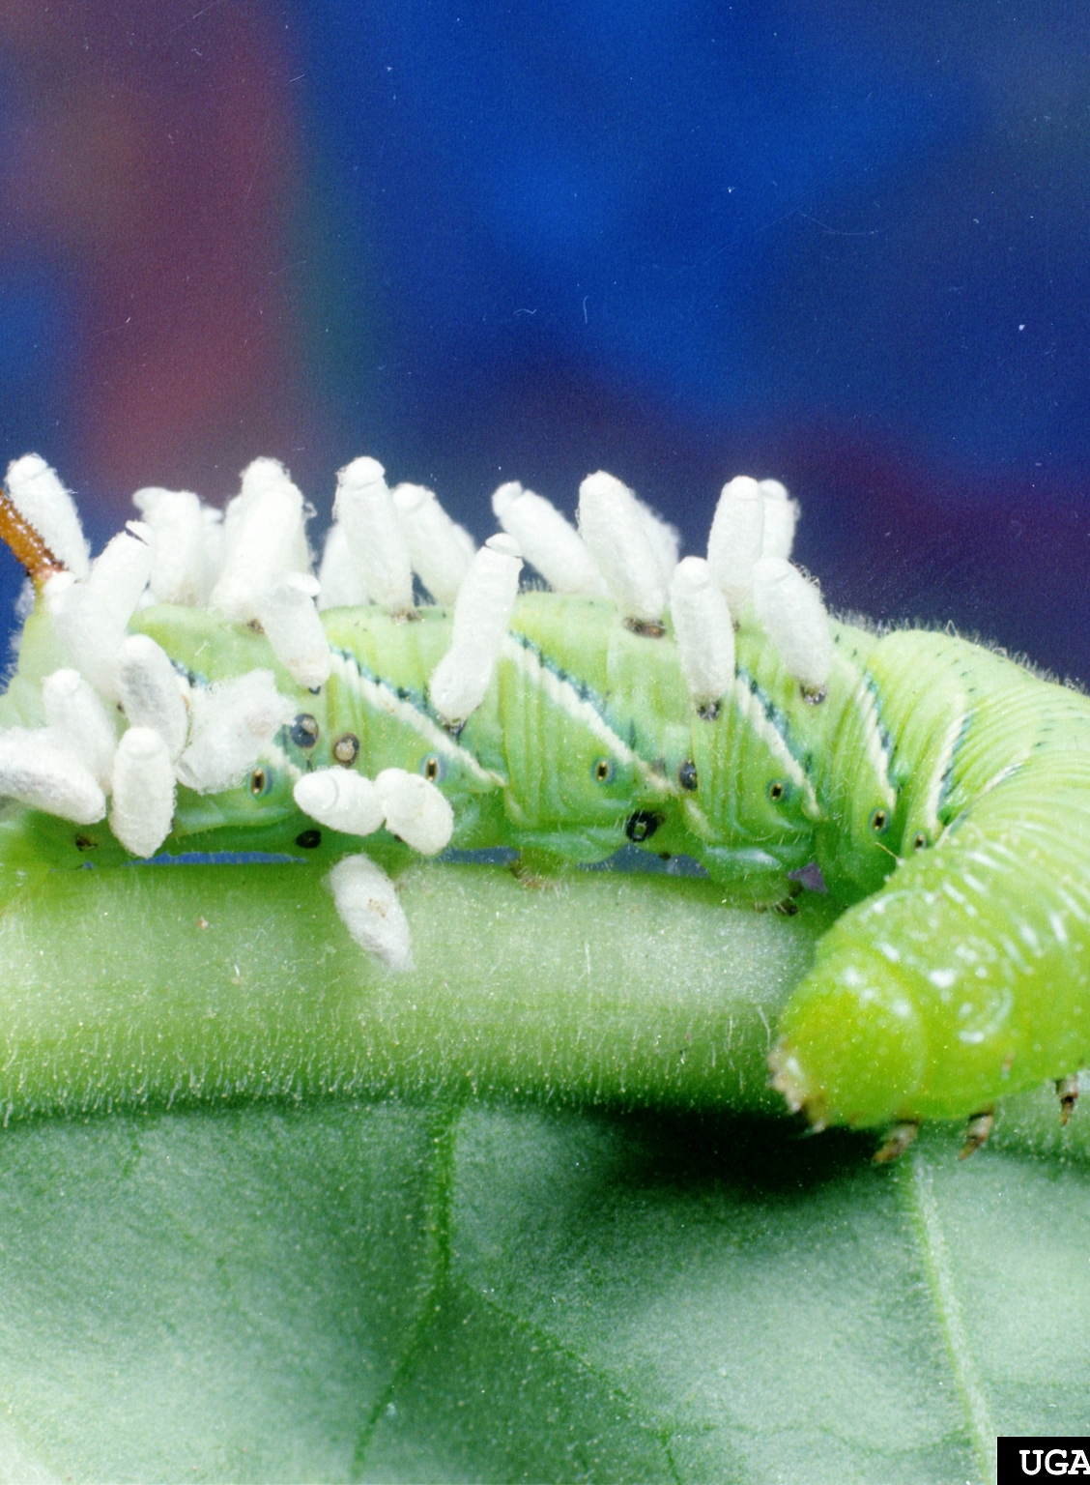
Signs of parasitization
Dark parasitized egg
More obvious to see than the parasitoids themselves
Parasitized hosts or eggs often discolored, darker than normal
May see pupal cases
Exit holes chewed by emerging parasites
Black parasitized scales
Clemson University - USDA Cooperative Extension Slide Series , Bugwood.org
Mummies/exit holes
Pupal cases on caterpillar
Notes:
Because parasitoids are often tiny flies and wasps, it’s hard to see them
You can tell parasitoids are present by looking for signs of parasitization
When insects or their eggs are parasitized, they often change color, like you can see in the top two photos where the black scales on the left have been parasitized, and the black eggs on the right have also been parasitized
Sometimes you may notice the pupal cases of parasites on the outside of the host, like is the case for the hornworm on the bottom right, and many other caterpillars.
Parasitoids may lay multiple eggs into larger hosts like caterpillars, but more often only lay one egg in their host.
And other times you will see the mummified hosts with exit holes where the parasite has left the host’s body
In the bottom left photo, you can see parasitized aphids. After being parasitized they often bloat and turn a bronze color. You can see the parasitoids exit holes in some of them.

Slide 18
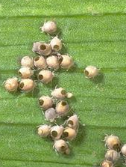
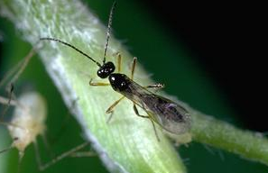
Aphidius spp.
Parasitic wasp that feeds mostly on aphids
  Causes aphid mummies
Egg is laid inside of aphid, then larva feeds inside of aphid
Aphid mummies
Notes:
Aphidius parasitoids feed on many kinds of aphids
After they lay their eggs inside of an aphid host, the larva kills the aphid and causes its skin to become crusty and puffy (mummified). The wasp then pupates into an adult that chews a rounded hole and emerges from the mummy.
The most obvious evidence these tiny parasitoids are present is that several days after being parasitized the aphid becomes a crusty, puffy, smooth mummy that is brown, gold, or tan colored

Slide 19


Encarsia formosa
Parasitic wasp of whiteflies
Eggs are laid into whitefly nymphs
Adults also feed on whiteflies
Black parasitized whitefly nymphs
Notes:
Encarsia formosa is a whitefly parasitoid, specifically for greenhouse whiteflies
The parasitoid lays its eggs inside of greenhouse whiteflies
As a result, the whitefly changes from a pale color to black as the wasp develops inside
In addition to the whiteflies killed by parasitization the adult female wasps feed blood of whiteflies.
The female wasp punctures whitefly nymphs with her ovipositor and consumes their body contents

Slide 20


Trichogramma spp.
Parasitic wasp of insect eggs
  Especially fruit worm and codling moth, but hundreds of others
Parasitized eggs become black
Adults also feed on eggs
Adult wasp laying egg into codling moth egg
Black parasitized egg next to a normal hatched egg
Notes:
Trichogramma parasitoids are tiny wasps that parasitize eggs of various insects, especially moths
Upon parasitization, the host’s eggshells turn dark black
Each Trichogramma female can parasitize about 100 host eggs.
Additional eggs are killed by the female wasps feeding on them.

Slide 21


Tachinid flies
Tachinid fly approaching a saltmarsh caterpillar
Parasitoid of immature beetles, grasshoppers, caterpillars, and true bugs
Some species lay eggs on the host, others within the host or on leaves to be eaten by host
Tachinid fly eggs on caterpillar head
Notes:
Tachinids are the most important of the parasitic flies that provide biological control of beetles, caterpillars, grasshoppers, true bugs, and other insects
They insert an egg into the host's body or glue eggs on the host's body. Others lay eggs on plants that hatch after they are consumed by the plant-feeding host insect. Others lay eggs into soil if a soil-dwelling insect is the host (e.g., root-feeding white grubs).

Slide 22

Pathogens
Infect and kill host species
  Bacteria
  Fungi
  Viruses
  Nematodes
Many are naturally occurring
Bagrada bug infected by Beauveria bassiana
Notes:
The last type of biocontrol are pathogens
These microorganisms infect and kill host species and include bacteria, fungi, viruses, and nematodes
Many pathogens are naturally occurring, but some beneficial pathogens are commercially available as biological or microbial pesticides

Slide 23

Bacillus thuringiensis (Bt)
A naturally occurring soil bacterium
Bt. ssp. israelensis: mosquito larvae and fungus gnat larvae
Bt. ssp. kurstaki and aizawai: caterpillars
Acts as a stomach poison
Bacillus thuringinesis (Bt) infected elm leaf beetle larvae turn black
Notes:
Bacillus thuringiensis is a naturally occurring soil bacterium that acts as a gut toxin or stomach poison to the insects that feed on it
After being infected with Bt, insects will stop feeding and become relatively immobile- dying within several days
Some may become discolored and shrivel up
There are 3 subspecies of Bt commonly found on store shelves, and they each control a different pest
Bacillus thuringiensis ssp. aizawai targets the larvae of moths and butterflies (caterpillars)
Bacillus thuringiensis ssp. israelensis targets the larvae of certain flies such as mosquitoes and fungus gnats
Bacillus thuringiensis ssp. kurstaki also targets caterpillars

Slide 24


Beneficial nematodes
Microscopic, soil-dwelling roundworms
The nematode and an associated bacteria kill the host within several days
Kill caterpillars and grubs
A healthy lawn grub (left) and a grub infected by nematodes (right).
Notes:
Nematodes are tiny, often microscopic roundworms
They occur in moist soil
Beneficial nematodes can enter into insects’ bodies and introduce a deadly bacteria
They infect soil-dwelling insects like caterpillars and grubs
https://ipm.ucanr.edu/TOOLS/TURF/PESTS/innem.html

Slide 25

Beauveria bassiana
A fungal pathogen
  Causes white muscadine disease
Infects soft-bodied insects
  Aphids, whiteflies, thrips, grubs, weevils, certain beetles, certain true bugs (bed bugs!)
The fungal spores penetrate the skin of insects
Beauveria bassiana infecting a root weevil
Notes:
Beauveria bassiana is a fungal pathogen that causes "white muscadine" disease in insects.
When the spores contact a susceptible insect, they germinate and grow through the insect's cuticle (skin) and body.
The fungus produces toxins which drain the insect of nutrients, eventually killing it.

Slide 26
Use of biological pesticides
Biological or microbial pesticides are derived from microorganisms that cause disease only in specific insects
Fewer risks to natural enemies
May require extra care when handling or storing
Should be used with same caution as traditional pesticides
Notes:
Many of the pathogens mentioned in the previous slides are available for purchase online
We call these biological or microbial pesticides because they are derived from microorganisms
These pesticides pose fewer risks to natural enemies since they are often very specific, killing only a specific type of insect
Microbial pesticides, like biocontrol agents such as lady beetles, are living organisms
Because of this they often have very specific handling and storage instructions
Failure to follow these instructions can result in killing the biocontrol agents or reducing their effectiveness
When using any pesticide, even if it is natural, always read the label and use caution to prevent harm to yourself and the environment

Slide 27

How to encourage predators & parasitoids
Control ants
Limit pesticide use
Create environments where natural enemies can thrive
Notes:
Let’s take a look at how we can encourage biocontrol or natural enemies
First and foremost, we want to use Integrated Pest Management (IPM) to control pests using nonchemical methods or using least toxic pesticides
Next we want to create environments where natural enemies can survive and thrive
And lastly, we’ll want to control ants
We will go into more detail on each of these in the following slides

Slide 28



Control ants
Argentine ant that has captured an adult parasitic wasp to protect nymphs of Asian citrus psyllid.
Ants feed on honeydew produced by certain insect pests.
  Aphids, scales, mealybugs, whiteflies
Will attack natural enemies that try to prey on honeydew producing insects
Hose pests off plants
Use outdoor ant baits
Honeydew on a leaf
Notes:
The last thing you can do to protect and encourage natural enemies and biocontrol is managing ants
Ants will protect, or farm, honeydew producing insects on plants
Insects like aphids, scales, mealybugs, and whiteflies feed on plant sap and as a result excrete honeydew – a sticky, sugary substance
Ants are attracted to this honeydew and will protect those pest insects from natural enemies
Spay plants with a strong stream of water to knock the ants off
Use outdoor ant bait stations
Read the UC IPM Pest Notes on Ants to learn more about their management indoors and outside

Slide 29


Limit Pesticide Use
Reduce pesticide usage, especially broad-spectrum products
Use nonchemical IPM methods
    Cultural
    Biological
    Physical
    Chemical: less-toxic pesticides
Give plants the appropriate amount of water
Cover plants with insect netting while young
Notes:
As mentioned earlier in this presentation, biological control is a key component of integrated pest management or IPM
IPM is a way to effectively manage pests using methods that pose less risks to people and environment
Pesticides may be used in certain situations, but for the most part IPM focuses on nonchemical control options
These include biological control- using or relying on natural enemies
Cultural control which includes practices that reduce pest establishment, reproduction, dispersal, and survival. For example, changing irrigation practices can reduce pest problems, since too much water can increase root disease and weeds.
And using physical controls that kill a pest directly, block pests out, or make the environment unsuitable for it. This can include row cover or insect netting that keeps pests off young plants.

Slide 30

Use less toxic pesticides
Many pesticides can kill both pests and natural enemies
Use selective, less toxic products when needed
Apply in ways that protect natural enemies
  Don’t spray plants in bloom
Notes:
Broad-spectrum insecticides can harm targeted pests, but also natural enemies
Pesticide products referred to as less toxic pesticides cause fewer injuries to people and organisms other than the target pest
When pesticides are necessary, lesser toxic insecticides should be a first choice
These products include many microbial pesticides, like Bacillus thuringiensis (Bt), naturally derived products, and other selective pesticides
To ensure that any pesticide is used as intended and without harm to other organisms, always read and follow the product label
The label can provide important information and warnings, such as advising against spraying plants in bloom as doing so can harm pollinators and natural enemies

Slide 31

Create habitat
Insectary plants provide pollen and nectar to predators and parasites
Provide habitat and food to encourage and sustain natural enemies
Notes:
Another important way to encourage natural enemies and biocontrol is to create habitat for these predators and parsites
Many natural enemies need pollen and nectar to survive and reproduce
Providing them with food and shelter will promote biocontrol, meaning more natural enemies will occur naturally in your garden and released or store-bought ones will stick around longer
Choose plants that flower sequentially or at different times of they year to provide year-round food sources
Some plants may be host plants, or preferred by certain natural enemies

Slide 32

Hands-on Activity
Viewing natural enemies
Rotating through 4 stations
Worksheet with questions
Extra credit: How should you take care of the ladybugs for sale in the store? What do you tell customers to help make release more successful?

Slide 33

Storing and releasing ladybugs
Always store ladybugs in the refrigerator
Tell customer to keep in fridge until they are ready to release.
When released outside they will quickly fly away or disperse, esp. when sunny
Release at dusk
Spray a little sugar water at base of plant with aphids
Make sure customers know what the life stages look like
https://www.flickr.com/photos/81622431@N00/2546715965
Notes:
Many predators and parasitoids are available for purchase online or at garden centers
The release of these natural enemies is often best done in greenhouses or large fields where there are plenty of host/prey
Store-bought natural enemies will not stay in the area they were released, especially if there is not sufficient food for them
The storage and release requirements for natural enemies varies depending on the species
Failure to adhere to the specific handling and care requirements for them will result in poor, ineffective biological control
Store-bought natural enemies may be expensive

