Slide 1


Make the 4-H Connection

Slide 2

What Is 4-H?
4-H is an educational program of the University of California Cooperative Extension Service.
This youth development program is made available through a partnership of county, state and federal governments.
Notes:
2. County = Board of Supervisors, State = University of California, Federal = U.S.D.A.

Slide 3


The 4-H Mission
The 4-H program is dedicated to providing opportunities for young people to develop leadership and management skills, positive self-esteem, effective communication skills, a solid sense of personal responsibility and the ability to make sound decisions.
The life-skills learned in 4-H enable youth to become productive, well-informed, self-reliant responsible adults.
Notes:
Engage implies that youth are partners in the process

Slide 4

4-H Motto:
“To Make the Best Better”
4-H Colors:
  The 4-H colors are green and white. Green is nature’s most common color and represents youth, life and growth. White symbolizes purity and high ideals.
4-H Slogan:
  “Learn by Doing”

Slide 5


Slide 6
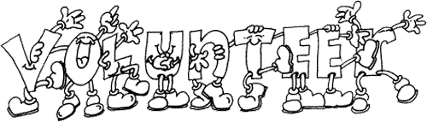
Del Norte County 4-H Program Support
Staff:
  County Director – Yana Valchovic
  (707-445-7351)
  4-H Program Rep – Kaylin Nylander
  (707-445-7351)
  Del Norte Secretary – Jacki Bennett
    (707-464-4711)
Adult volunteers:
  Community Club Leaders
  Project Leaders

Slide 7

4-H Membership
Primary members:
  5 years old by January 1st of the program year
Regular members:
  9 years of age by January 1st of the program year
Fee: $20.00 enrollment for the year
  $62.00 is the actual enrollment fee, but 4-H Council covers the remaining $42.00.

Slide 8

Minimum Expectations of Youth
Attend 75% of club/project meetings
Enroll in at least one 4-H project
Complete one community service activity
Complete one Annual Project Report Form.

Slide 9
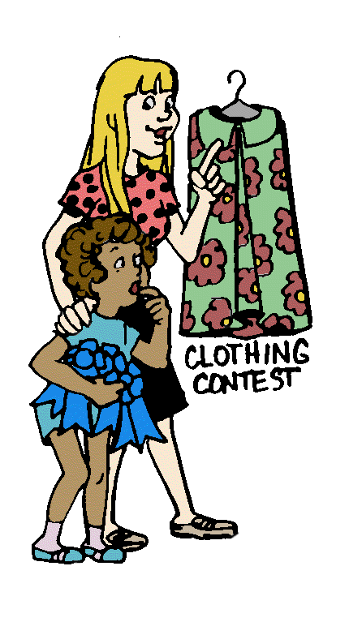

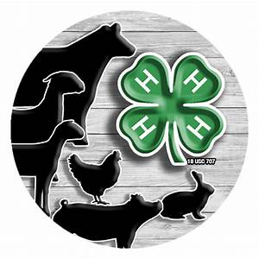
4-H Projects
At least six hours of planned work in an area that interests the 4-H member
Guided by a volunteers who are the project leaders
Aimed at planned objectives that can be attained and measured
Summarized by some form of record keeping (Annual Project Report).
Notes:
4-H Projects consist of:
Meetings
Field Trips
Related activities led and supervised by the project leader

Slide 10


Available 4-H Projects
Available 4-H
Projects
Ages 5 and Above:
Goats-Pygmy
Bucket Calf (Therapeutic)
Pets & Small Animals
Rabbits
Guinea pigs (Cavies)
Poultry & Game Birds
Clover Sprouts (Primary Members)
Outdoor Adventure
Arts & Crafts
Leathercraft
Cake Decorating
Photography
Gardening (Vegetable Gardens & Crops)
Marine Biology
GIS/GPS
Ages 9 and Above:
Goats-Dairy
Goats-Market
Cattle-Dairy
Cattle-Beef
Horses & Ponies (Equine)
Sheep
Swine
Surf Camp
Archery (Shooting Sports, $5.00 per project meeting)
Air Rifle (Shooting Sports, $5.00 per project meeting)
Sewing (Clothing & Textiles)
Crocheting (Fiber Arts)
Foods - cooking & preservation
Fine Arts
Robotics

Slide 11
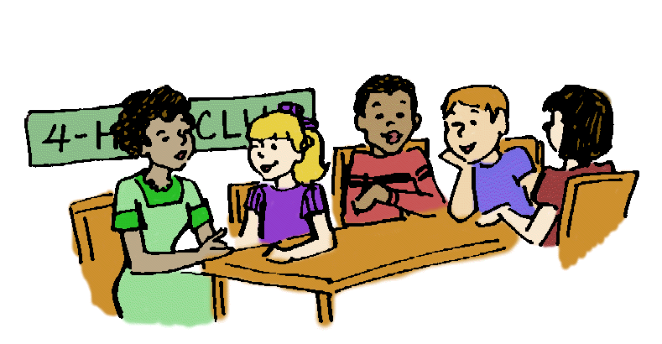
Community Clubs
A community club is a way of providing 4-H members with opportunities to learn and practice specific skills. Club meetings give members a chance to take on responsibility and to practice citizenship, leadership and democratic procedures – all learned by doing.
Most of the monthly announcements about what is going on in 4-H are giving at the Community Club meetings. Also, for our countywide events to happen 4-H members need to step up and apply to be event chairpersons. The 4-H program is for the youth and run by the youth, with help from our
volunteers.
Notes:
Operated primarily by volunteers (Community club leaders and project leaders)
Have a monthly meeting that are conducted by youth members (officers)

Slide 12
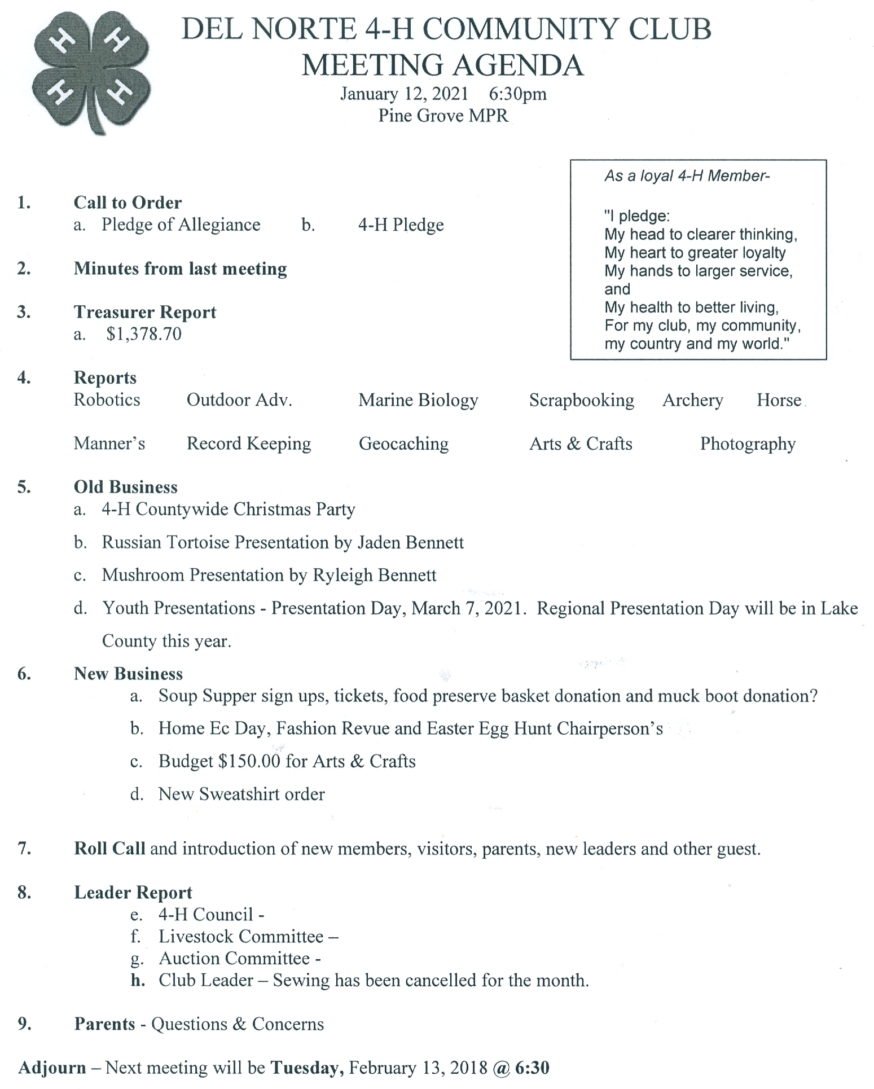
Community Club Agenda

Slide 13
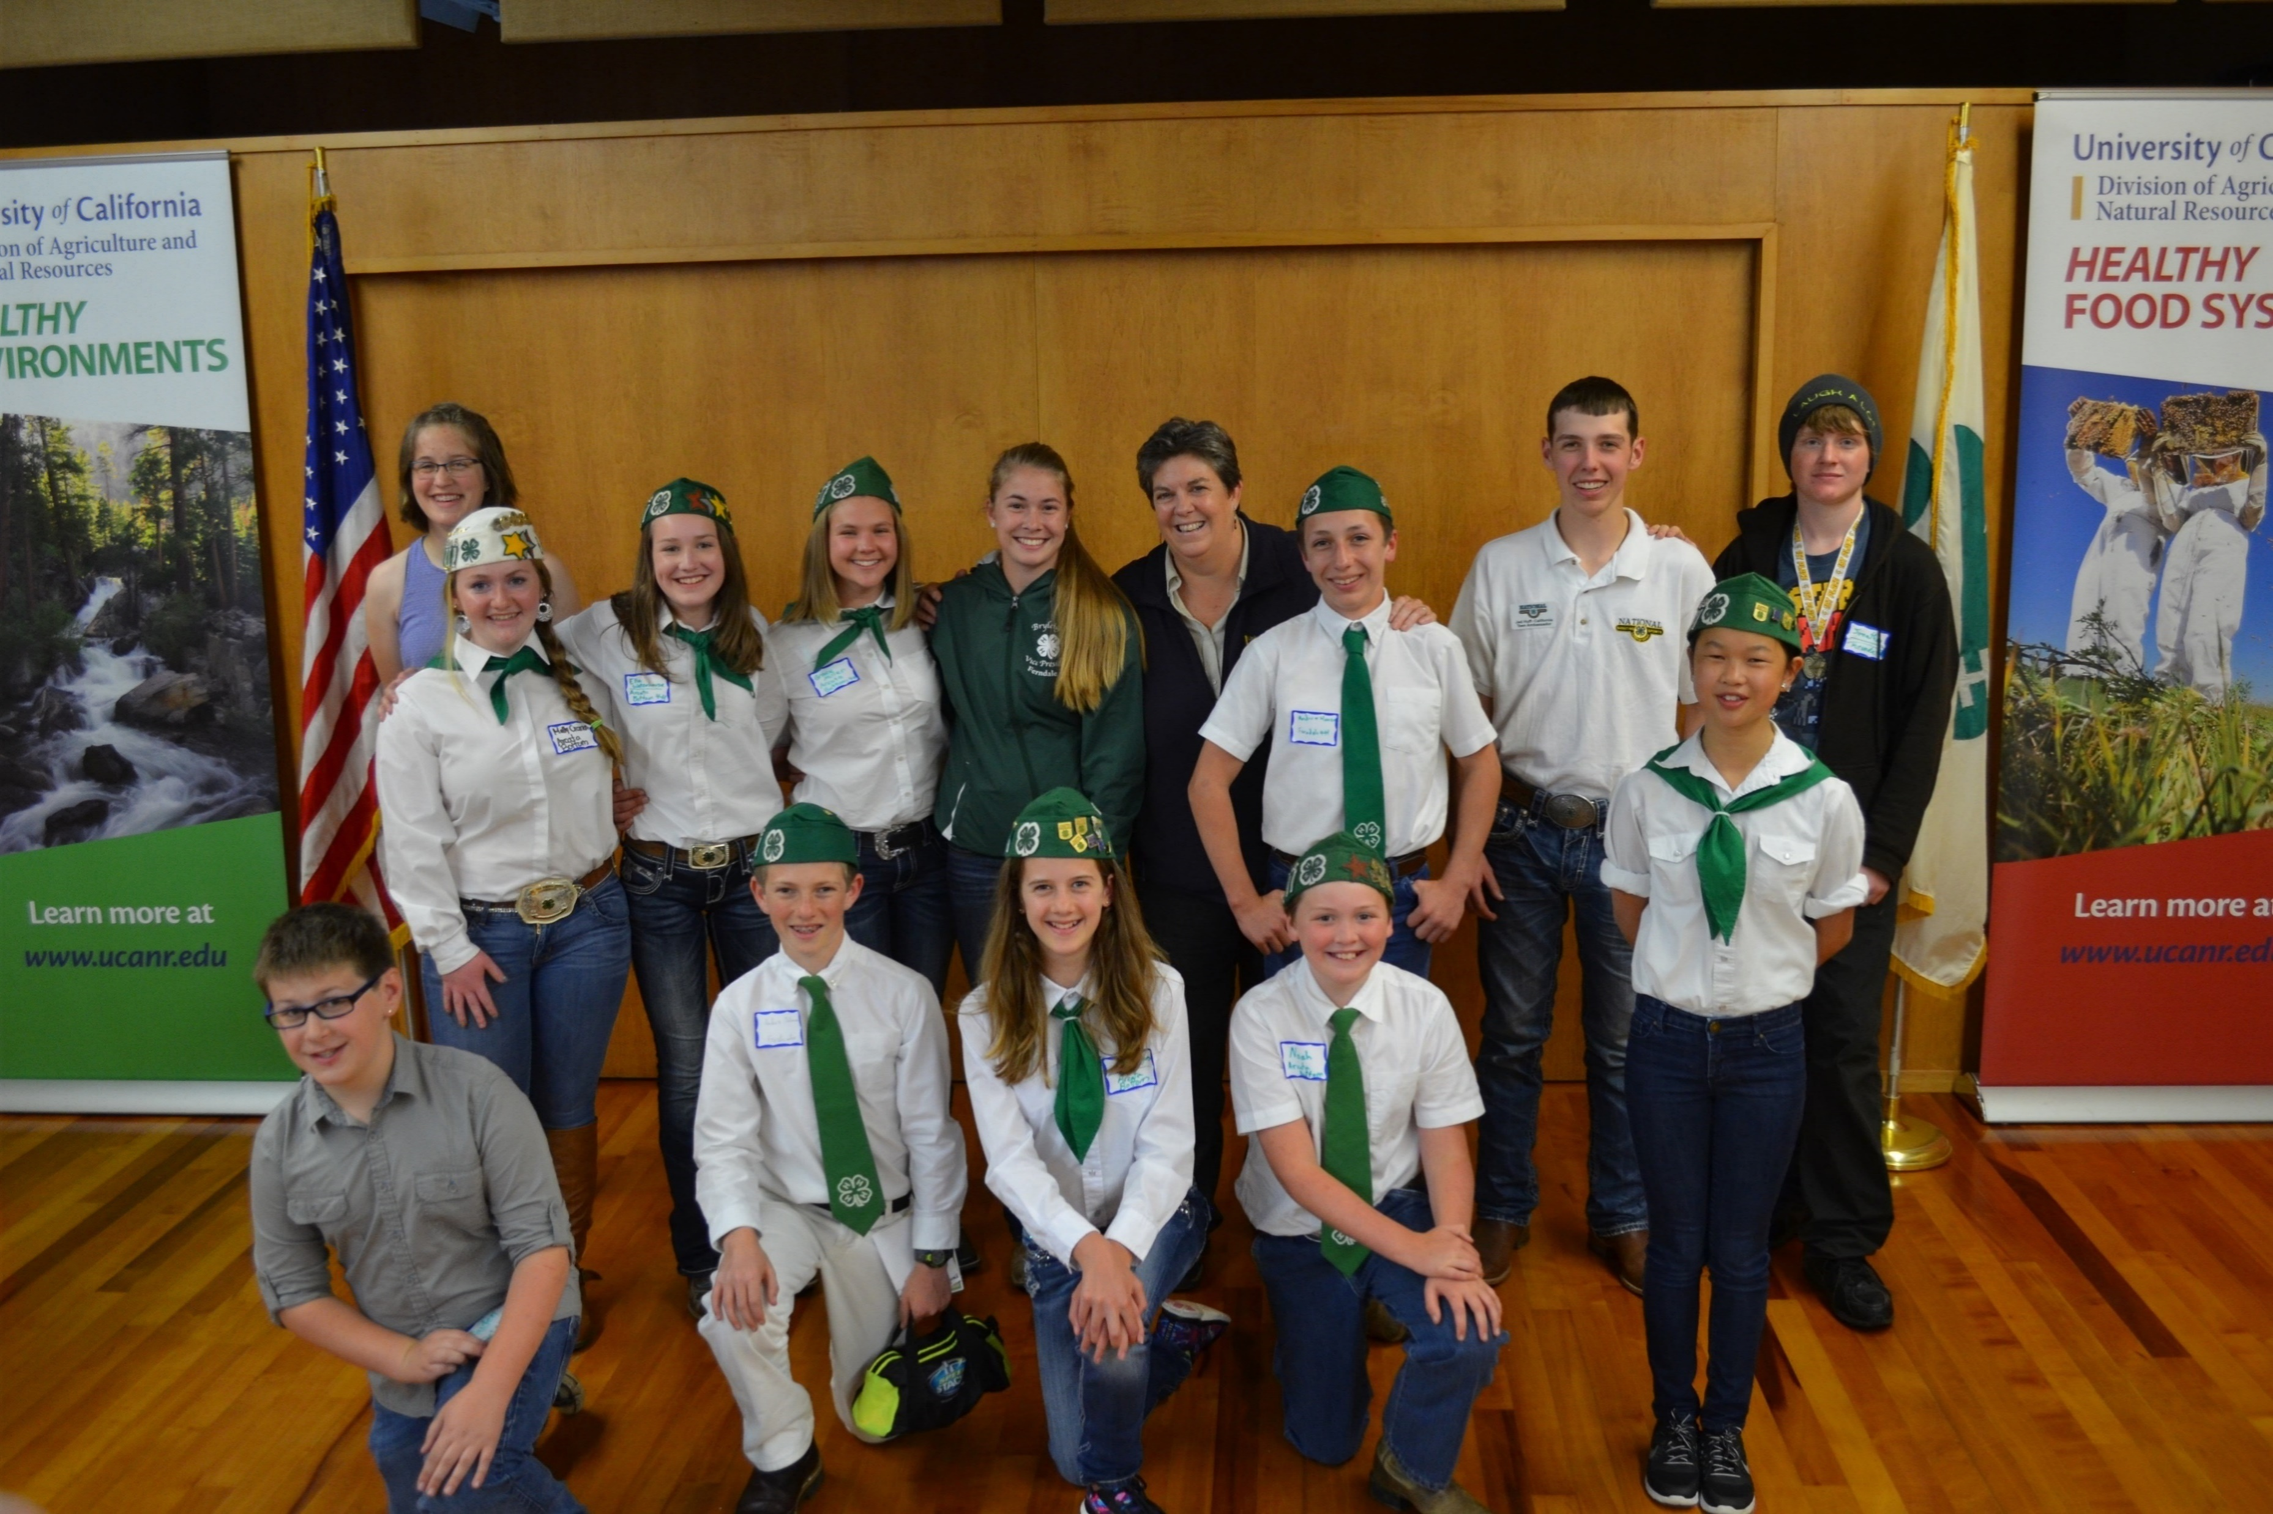

Community Club List
Del Norte 4-H Community Club
Elk Valley Swine/Pig Irons 4-H Community Club
Wild River 4-H Community Club

Slide 14

Other Youth Opportunities
Holding a Leadership Position
  Club Level – officer positions
  County Council Level –
  officer positions
  Event Chairperson
Serving on an Event Committee
Attending County Events
  Veteran’s Day Parade
  4-H Christmas Party
  Soup Supper – Annual 4-H Countywide Fundraiser
  Home Ec Day
  Presentation Day & Regional Presentation Day
  Fashion Revue
  4-H Easter Egg Hunt
  4th of July Parade

Slide 15
4-H Soup Supper
Annual Fundraiser
Saturday, March 16th, 2024
Annual countywide fundraiser – this fundraiser is what helps the
4-H Council pay the $42.00 of your yearly 4-H enrollment fee, fund our countywide 4-H events and prizes youth receive at events. Also these funds support purchase of pins, trophies and buckles.
We sell tickets for a soup dinner and have a silent and live auction.
Ways to help:
  Sell tickets
  Make a donation.
  Request donation items, services and soup.
  Pick up donation items.
  Sign up to help at the event – many hands makes light work.

Slide 16
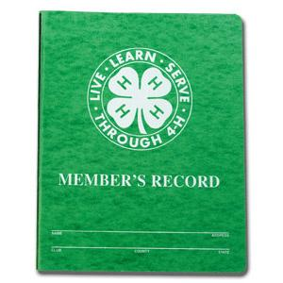
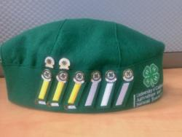
Record Books and Awards
Record Books:
  Youth keep track of what they did, what they learned and where they did for each project on an Annual Project Report Form (APR). If your youth turns in one APR at the end of the program year they will receive a year pin and stripe. If they want to earn their Stars, they will need to turn in a completed Record Book.
Awards:
  Year Pin and Stripe
  Proficiency pins: Community Service, Judging, Presentation & Project Level Proficiency Pins.
  Record Book Pins
  Stars: Bronze, Silver, Gold & Platinum

Slide 17
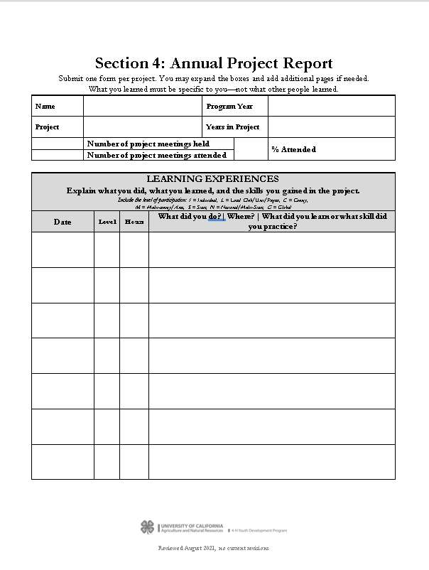
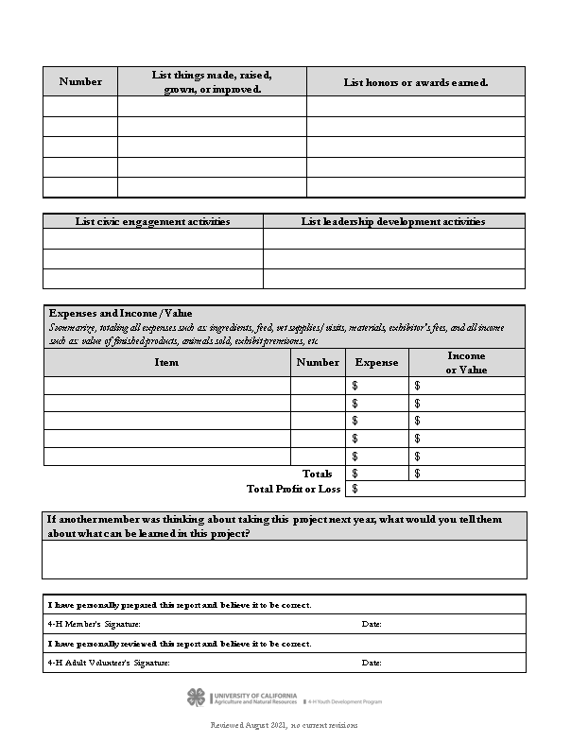
Annual Project
Report Form

Slide 18
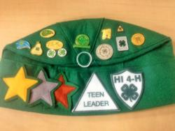
Star Rankings
Personal Development Report (PDR)
1. 4-H Projects Completed
2. 4-H Project Skill Activities
3. 4-H Event Attended
4. Leadership Development
5. Citizenship & Community Service
6. Communication Skills
7. Honors and Recognition
8. Lifestyle Activities
Bronze Star: Complete at least 5 of the 8 PDR categories
Silver Star: Complete at Least 6 of the 8 PDR categories
Gold Star: Complete at least 7 of the 8 PDR categories
Platinum Star: Complete at least 7 of the 8 PDR categories.

Slide 19
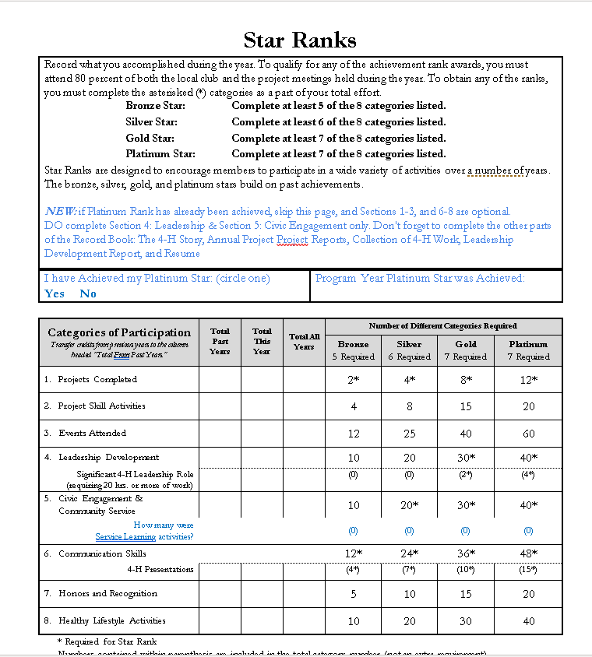
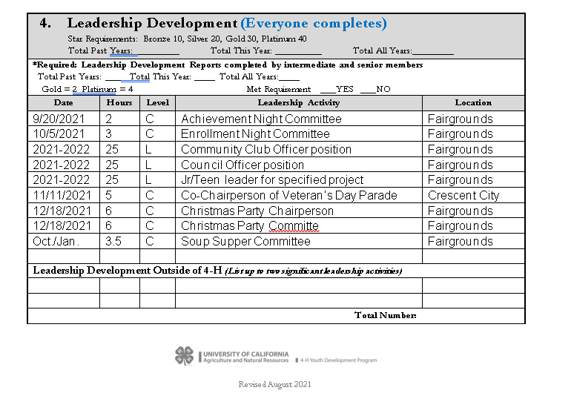
Personal Development Report Form

Slide 20

Ways for Parents to get Involved
Projects at the county level
Projects in the community club
Become a project leader
Participate in 4-H Council

