Slide 1
FFY 24
Adult Direct Education Evaluation
Mid-Year Check-In
March 19, 2024
Hosted by:
Amanda Linares

Slide 2


Access the recording & slides
Find the webinar recording and this slide deck on the
Adult Direct Education Evaluation Website

Slide 3
Objectives
Provide a quick refresher on the FFY 24 evaluation project and related timelines
Review results from FFY 23
Provide insight on FFY 25
Info gathering
Answer questions

Slide 4
Evaluation Project Refresher

Slide 5
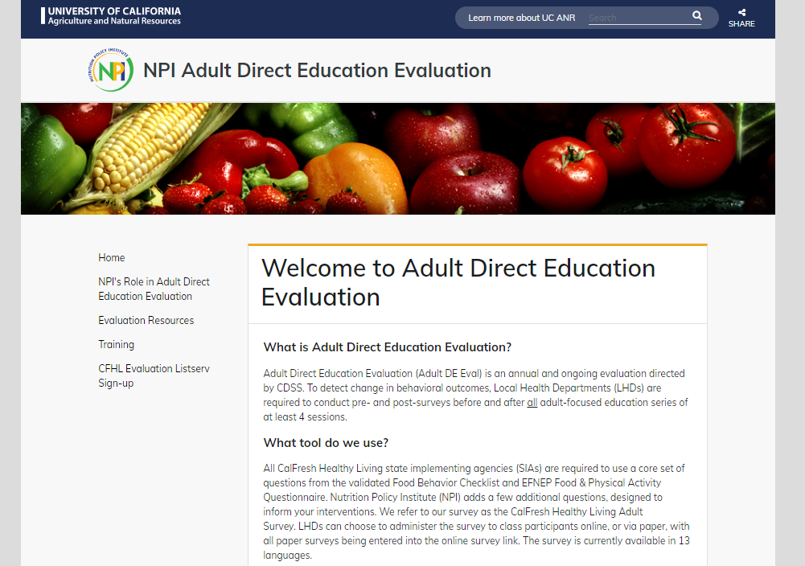
Adult DE Eval Resources
Contact: Amanda Linares
amlinares@ucanr.edu
Website: https://ucanr.edu/sites/http___ucanredu_sites_adultDE//
Listserv:
https://ucanr.edu/sites/LHDEvaluation/Evaluation_Project_Listserv_Signup/IOE_AdultDE_listserv/

Slide 6
Do I need to evaluate?
You need to evaluate if you deliver any adult DE that has 4 or more sessions, over 4 or more weeks
This applies to all program activities delivered, i.e., not a sample
Requirement applies to all series-based (4+ session) nutrition and/or PA-focused curricula

Slide 7
Curriculum | Lessons | Curriculum cont'd | Lessons
A Taste of African Heritage | 6 | Fresh from the Garden | 12
Around the Table | 6 | Healthy, Happy Families | 8
Around the Table: Nourishing Families | 6 | Making Every Dollar Count | 8
Bingocize™ | 24 | Matter of Balance (MOB) | 8
Cell-Ed Eat Healthy, Be Active Community Workshops | 6 | MyPlate for My Family Education Toolkit | 4
Cell-Ed Eat Smart, Live Strong: Nutrition Ed for Older Adults | 4 | Nutrition 5 Class Series | 5
Chronic Disease Self Management Program | 6 | Parent Lesson Plans: Advocating for Healthier School Environments | 4
Cooking for Health Academy | 6 | Plan, Shop, Save and Cook | 4
Cooking Matters (national) | 6 | Seniors Eating Well | 9
Create Better Health | 8 | Staying Healthy through Education & Prevention (STEP) | 9
Eat Healthy, Be Active Community Workshops | 6 | Tai Chi for Arthritis | 12
Eat Smart, Live Strong: Nutrition Education for Older Adults | 4 | Tai Chi: Moving for Better Balance (a.k.a. Tai Ji Quan) | 48
Eating Smart, Being Active | 9 | Telephonic Health Coaching Intervention Toolkit | 6
Enhance® Fitness | 4+ | Turtle Island Tales Family Wellness Program | 12
Everybody Loves Line Dancing | 6 | TWIGs: Teams With Inter-Generational Support | 30
Faithful Families Eating Smart and Moving More | 9 | UCCE Connects to You! | 10
Families Eating Smart and Moving More | 21 | Walk with Ease | 18
Fit & Strong! | 24 | Young at Heart | 4+
Food Smarts for Adults | 3-6

Slide 8
How do I evaluate?
Administer a pre-test before the DE series begins
All participants present that day
Administer a post-test after the DE series is complete
All participants present that day
Participants completed surveys online?
You’re done!
Participants completed surveys on paper?
Enter them into the online link
Surveys are never entered into PEARS

Slide 9
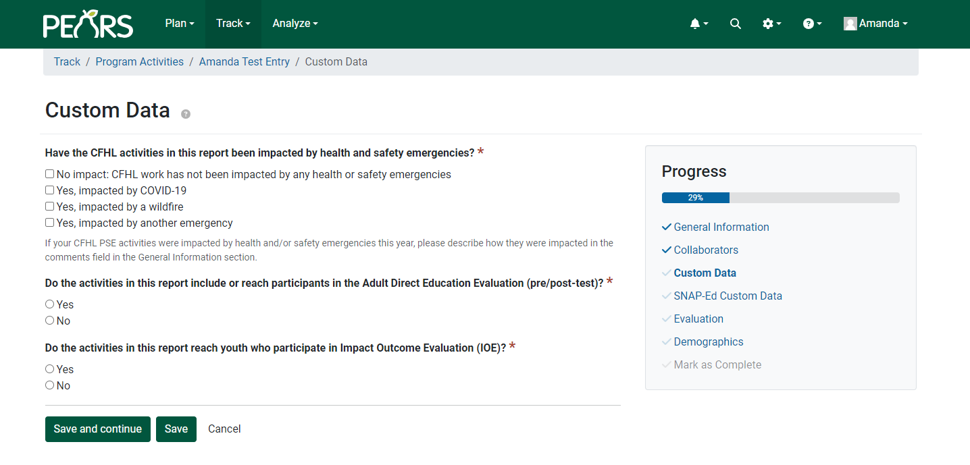
How do I identify Adult DE Eval in PEARS?

Slide 10
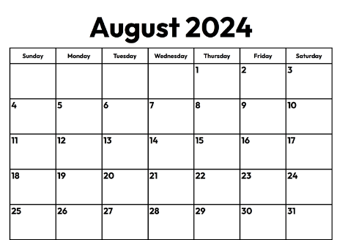

FFY 24 Evaluation Timeline
The online survey will close on August 30th
All paper surveys must be in by this date
Series that cannot be post-tested by 8/30 are not subject to evaluation
No evaluation required 8/30-mid-October

Slide 11
FFY 23 CFHL Adult Survey Statewide Results

Slide 12
FFY 23 Statewide Data Collection
111 PEARS Program Activities from 24 LHDs
17 unique curricula delivered
n = 531 matched pre/post (on average, < 5 matches per program activity)

Slide 13

Caution!
We are unable to access control or comparison groups, i.e., groups taking a pre/post survey but not receiving CFHL direct education.
As such, findings shown here cannot be attributed to the intervention itself.

Slide 14
Demographic Characteristics (n=531)
* AIAN = American Indian or Alaska Native
NHPI = Native Hawaiian or Pacific Islander
ª reported at pre-test
*AIAN: American Indian or Alaska Native
NHPI: Native Hawaiian or Pacific Islander

Slide 15
Fruit Consumption Behaviors
Average Fruit Consumption (n=513)
There was a statistically significant increase in fruit consumption from pre to post
Mean change from pre to post: 0.4 p-valueª: < 0.0001
Average daily fruit consumption increased by 0.4 cups.
The proportion of participants who reported often or always consuming more than one type of fruit each day increased from 39% to 56%.
Consume More Than 1 Kind of Fruit (n=517)
p-value^{b}: < 0.0001
ª Paired T Test adjusting for clustering was conducted. Statistical significance set at p-value < 0.05
^{b} Wilcoxon Signed Rank test adjusting for clustering was conducted. Statistical significance set at p-value < 0.05

Slide 16
Vegetable Consumption Behaviors
Average Vegetable Consumption (n=511)
There was a statistically significant increase in vegetable consumption from pre to post
Mean change from pre to post: 0.3 p-valueª: 0.0003
Average daily vegetable consumption increased by approximately 1/3 cup.
The proportion of participants who reported often or always consuming more than one type of vegetable each day increased from 46% to 62%.
Consume More Than 1 Kind of Vegetable (n=517)
p-value^{b}: < 0.0001
ª Paired T Test adjusting for clustering was conducted. Statistical significance set at p-value < 0.05
^{b} Wilcoxon Signed Rank test adjusting for clustering was conducted. Statistical significance set at p-value < 0.05

Slide 17
Beverage Consumption Behaviors
Consume Fruit Drinks, Sports Drinks, & Punch (n=528)
There was a statistically significant decrease in sugary drink consumption from pre to post
p-valueª: < 0.0001
The proportion of participants who reported not consuming fruit drinks, sports drinks, and punch increased from 28% to 40%.
The proportion of participants who reported not consuming soda increased from 34% to 49%.
Consume Regular Soda (n=526)
p-valueª: < 0.0001
ª Wilcoxon Signed Rank test adjusting for clustering was conducted. Statistical significance set at p-value < 0.05

Slide 18
Food Shopping & Resource Management Behaviors
Reads Nutrition Facts Label When Food Shopping (n=514)
There was a statistically significant increase in the use of the nutrition facts label.
p-valueª: < 0.0001
The proportion of participants who reported often or always using the nutrition facts label when shopping increased from 37% to 57%.
Runs Out of Food Before the End of the Month (n=520)
p-valueª: 0.2572
There was no significant change in the proportion of participants who reported running out of food by the end of the month.
ª Wilcoxon Signed Rank test adjusting for clustering was conducted. Statistical significance set at p-value < 0.05

Slide 19
Potential Focus Areas for CFHL Programming
The survey asks questions to help identify opportunities to reach participants and their families in other settings with CFHL programming.
Half of the participants have a child who attends a K-12 school
Out of those, 41% of the participants have a child who attends before or after school program
The majority of participants shopped at a large grocery store in the past month
Have a Child Who Attends K-12 School (n=501)
Places Where the Household Shopped for Food Last Month (n=521)
Have a Child Who Regularly Attends Before or After School Program (n=246)

Slide 20
LHD-level Results
Adequate sample (30+ matches) for analysis and data dissemination product for 3 LHDs
All LHDs receive a matched dataset
Data products are in your LHD Evaluation OneDrive folder
If you don’t have edit access to your LHD’s folder, obtain PD permission and email EvaluateSNAPEd@ucanr.edu

Slide 21
FFY 25: What’s next?

Slide 22
Modular Survey
CCC is validating a modular survey, expected to go into use next year*
Modular, meaning…
FV module
SSB module
PA module
FRM module
Approach still TBD, but each curricula could be matched with modules that target the intended outcomes
* Timing of validation completion could affect ability to (optionally) evaluate Sept 1 - mid-Oct

Slide 23
Poll Question
Q: As a rough estimate, how many of your CFHL Adult Surveys are administered on paper?
None or very few
Some (~1/4)
Half
Most (~3/4)
All or nearly all

Slide 24
Survey Translations
We currently offer the survey in 13 languages, but to our knowledge, only English, Spanish, and Chinese have been used in FFY 22/23
So far this year, PEARS indicates adult direct education was delivered in the following languages:
English/Spanish
Farsi = 8 program activities
Russian = 1 program activity
Thai = 1 program activity
Using responses from the PEARS Adult DE Eval custom question, none of these (Farsi/Russian/Thai) were evaluated via Adult DE Eval
Additionally, of the ~1000 survey responses so far, none are in a language other than English or Spanish

Slide 25
Poll Question
Q: Do you ever administer the survey in a language other than the language used to deliver the education?
Yes, we administer the survey in languages that are not the language in which we delivered DE
No, we do not administer the survey in languages that are not the language in which we delivered DE

Slide 26
Poll Question
Q: If you administer the survey in languages other than English/Spanish, do respondents primarily complete the survey online, on paper, or a mix of both?
We don’t administer the survey in languages other than English/Spanish
Online
Paper
Mix of both

Slide 27

Questions?

