Slide 1
Tomato Mastery: The Art & Science of Growing Delicious Tomatoes
Presented by Master Gardeners of Placer County
Notes:
Created: 1/23/2019
Created by: David Warman
Audience: Home Gardeners
Publicity: This class is dedicated to one of our summer favorites, the tomato!
Learn about planting, growing, and caring for this delicious staple as well as how to control problems before they happen.
Let us help you grow the ultimate tomato – firm and juicy, sweet, and tangy.
Update History:
Updated on 11/18/2020 by David Warman.
David Warman, updated for Zoom presentation on 2/13/2021. Photo by D. Warman.
David Warman, 2/18/2023, updated title for RUEC presentation.
Barbara Villareal, March 2024, presented at RUEC.

Slide 2
Who Are Master Gardeners?
Master Gardeners of Placer County
Extend research-based, sustainable gardening and composting information
Present accurate, impartial information to home gardeners
Encourage public to make informed gardening decisions

Slide 3
Who Are Master Gardeners?
Where to find us…
Online, in the Media, and Special Publications
Hotline: Call (530) 889-7388 or submit your questions online
Website: pcmg.ucanr.edu
Facebook, Instagram, X, YouTube
Gold Country Media monthly column
Curious Gardener quarterly newsletter on our website
Gardening Guide and Calendar
Notes:
X = Twitter

Slide 4
Who Are Master Gardeners?
Where to find us…
Workshops, Fairs and Festivals, and Special Events
Speakers by Request
Workshops (various venues, check website)
Farmers’ Markets (seasonal: Auburn, Lincoln, Roseville)
Fairs and Festivals Booths (varies)
Garden Faire (April)
Mother’s Day Garden Tour (May)
Notes:
Garden Faire – April 13, 2024

Slide 5
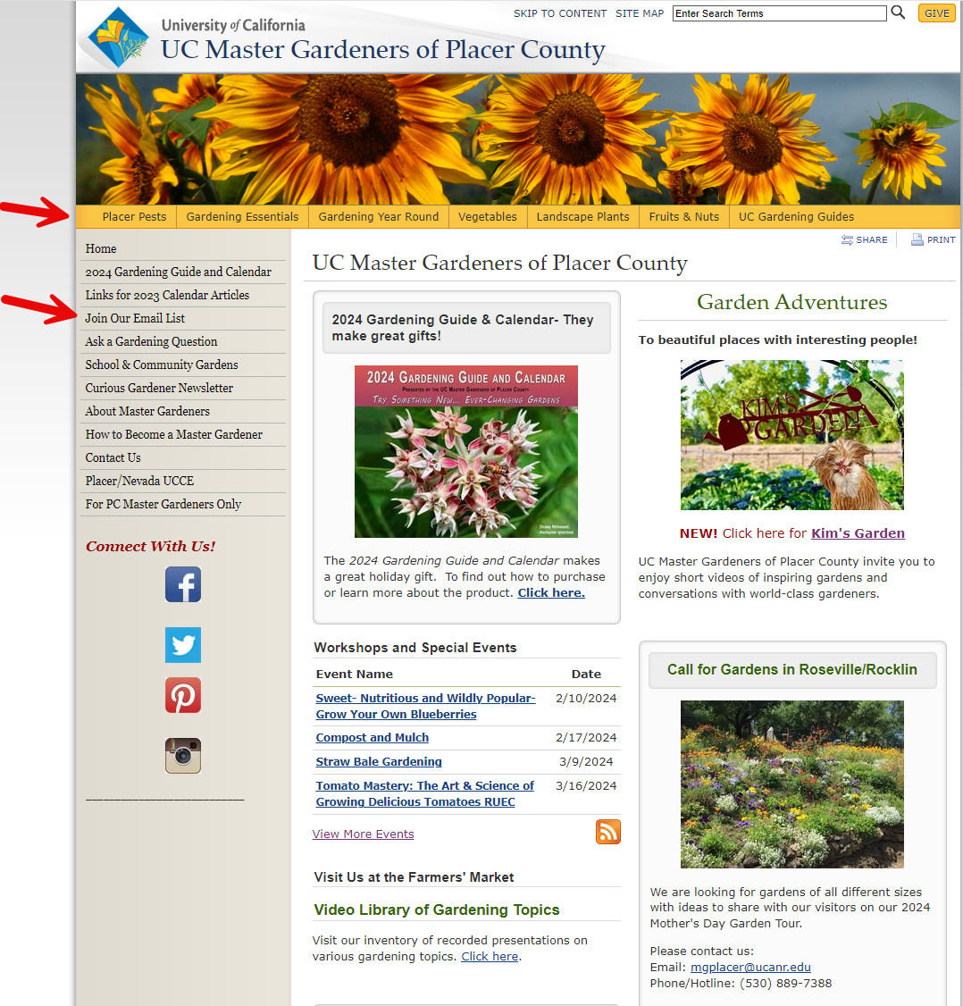
pcmg.ucanr.edu
Notes:
Yellow Menu are drop downs to more information.
Join Our Email List for subscription to our quarterly Curious Gardener Newsletter.

Slide 6
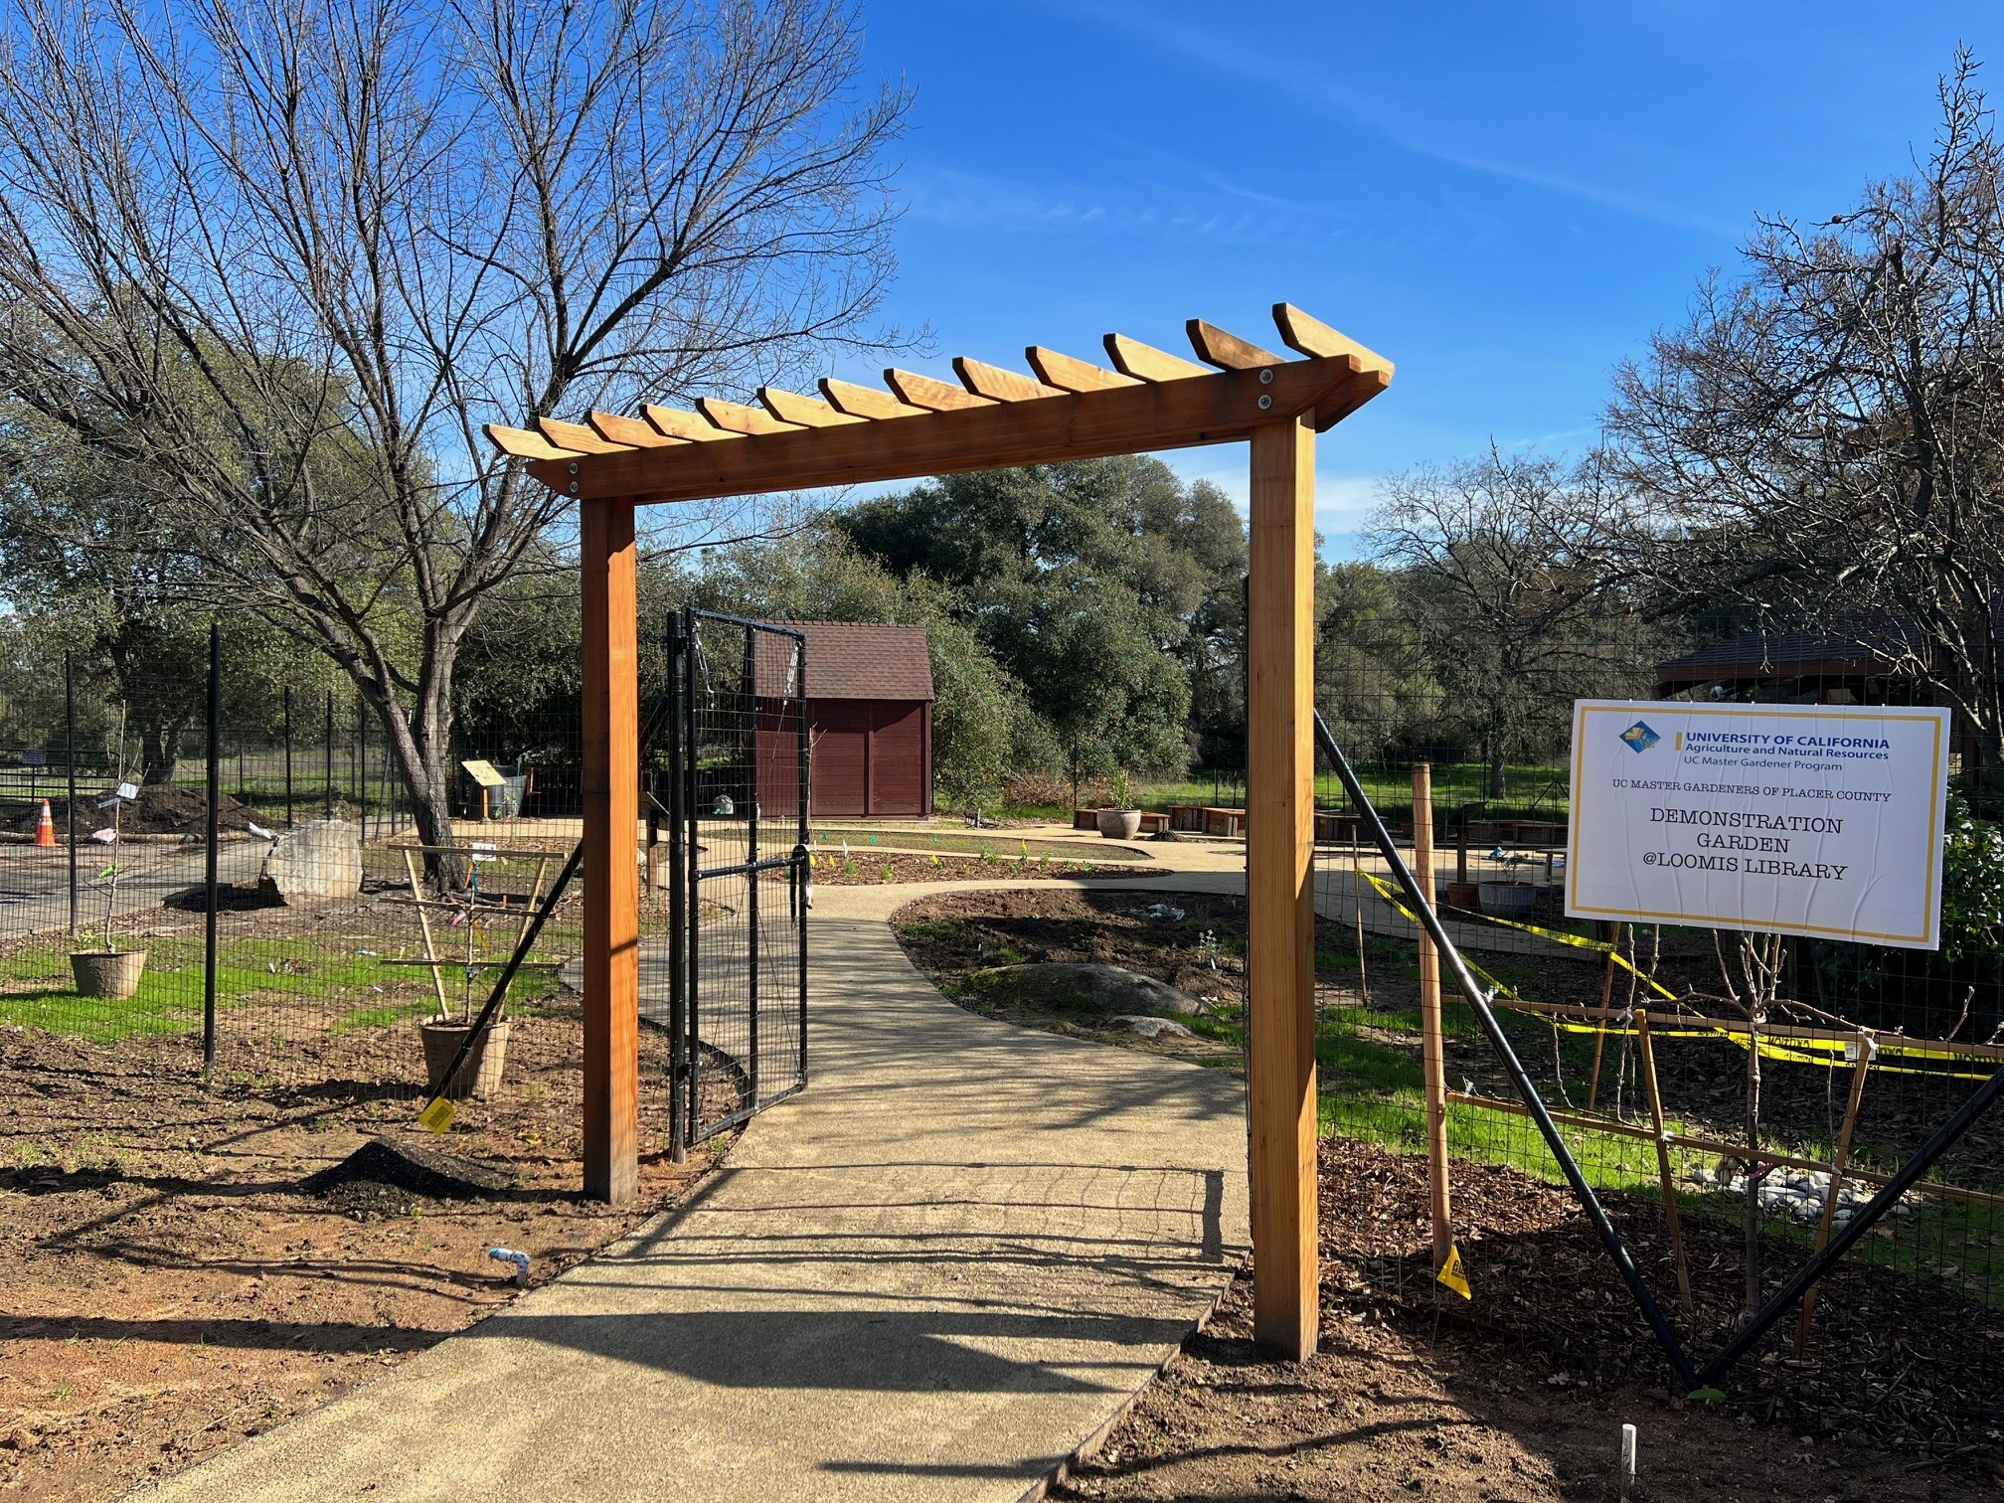
Demonstration Garden Progress
Major infrastructure completed
Garden beds weeded and planted
Irrigation installed
Shed built and painted
Notes:
A Master Gardener Demonstration Garden is being built in Loomis, CA behind the library off of Horseshoe Bar Rd. It will be another location to show and tell the public about home gardening.

Slide 7
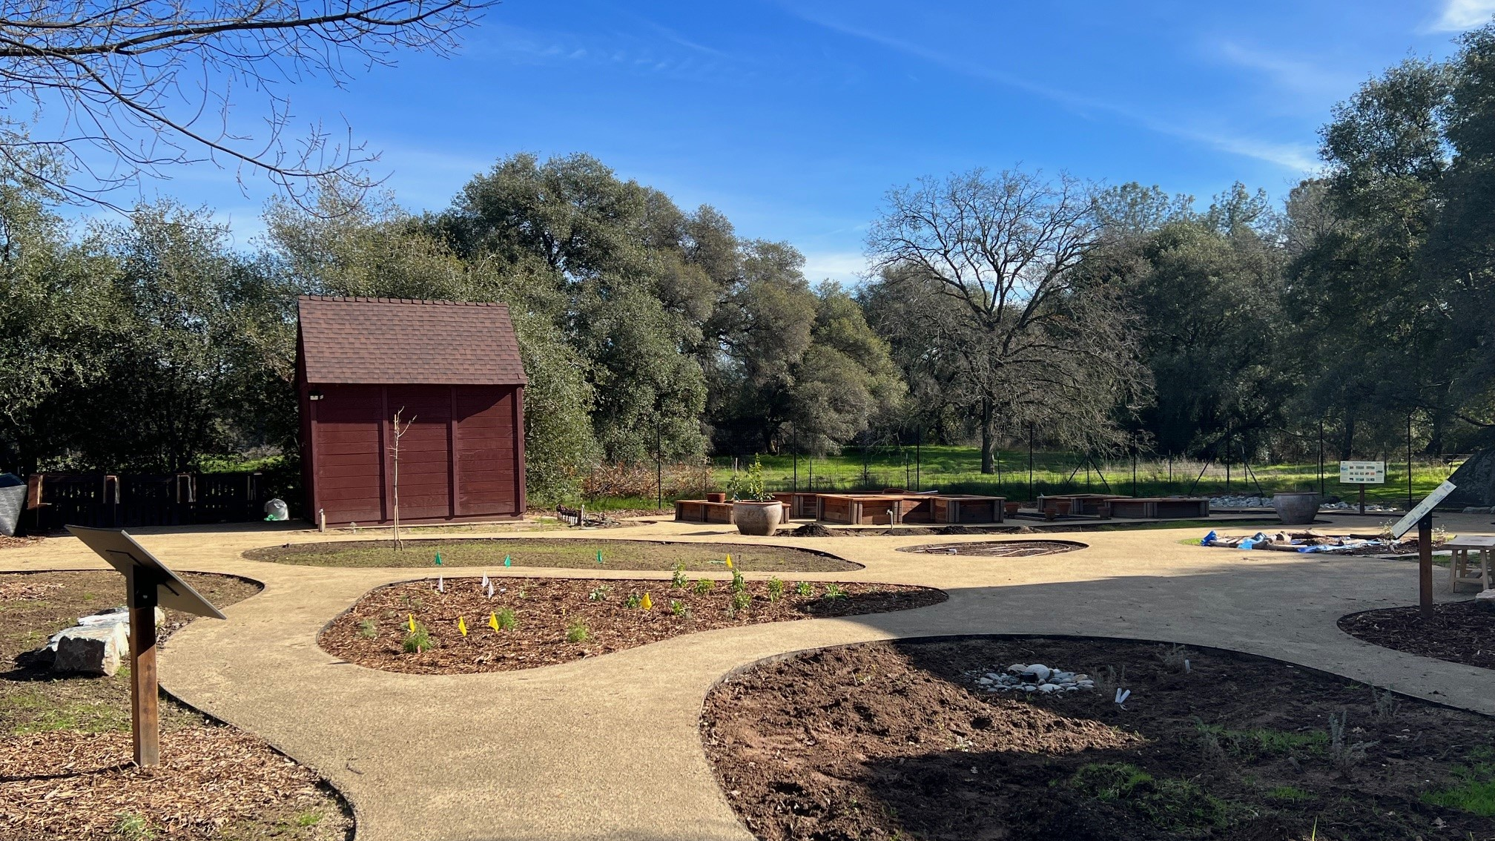
Ribbon Cutting Ceremony
March 27, 2024
Notes:
Ribbon Cutting Ceremony is scheduled for March 27, 2024. Keep an eye on our website and social media for more details and time.

Slide 8
RAISE YOUR HAND IF YOU HAVE
Have you ever grown tomatoes?
Have you ever grown tomatoes from seed?
Have you ever had tomato blossom end rot?

Slide 9
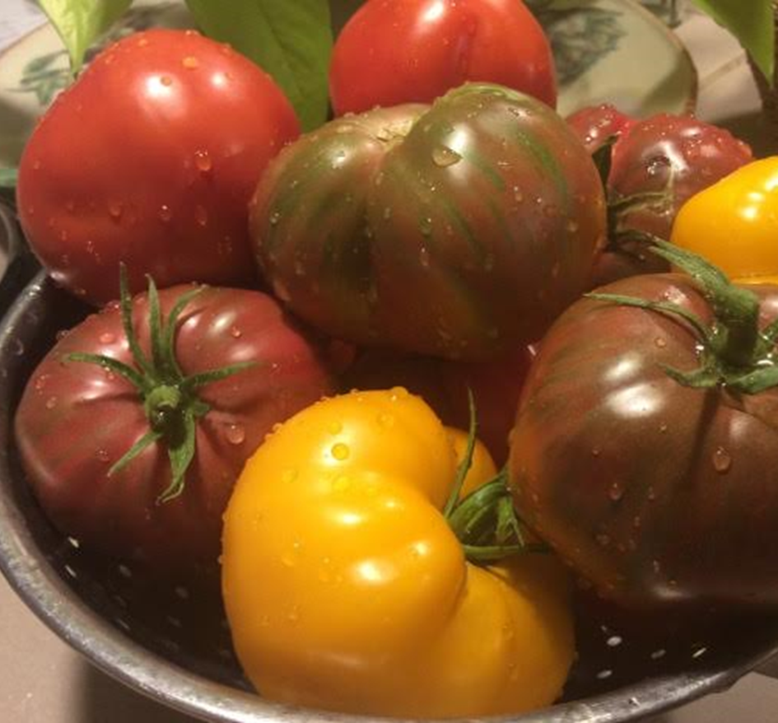
Agenda
Tomato facts
Starting from seed
Planting techniques
Maintenance
Other Considerations
Pests & Problems
Favorites
Notes:
Agenda

Slide 10
Tomato Facts
Nightshade Family of Plants: Solanaceae (Peppers, Potatoes, Eggplant)
Originally known as “love-apple” plant.
Originally thought to be poisonous.
Botanical fruit although many consider it a vegetable.
Notes:
Tomatoes in the Home Garden: https://ucanr.edu/sites/ucmgplacer/files/158610.pdf
Pub Number 31-159
Is the tomato a fruit or a vegetable?
-Botanically, a tomato with its ovary, together with its seeds, of a flowering plant. Therefore, it is a fruit.
-But by US tariff laws, a tomato is considered a vegetable. The applicable law defines produce by its use and not its scientific classification.

Slide 11
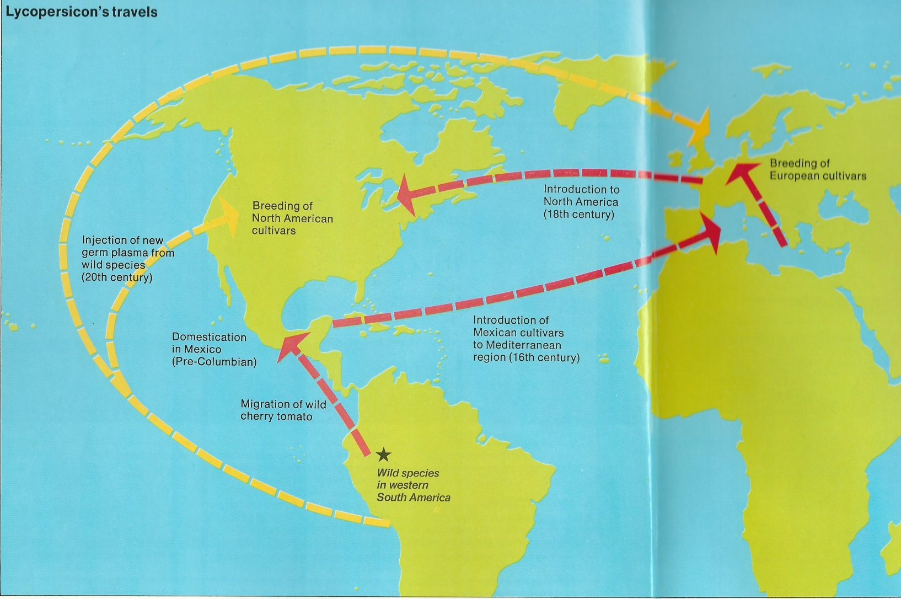
Tomato – The World Traveler
Notes:
See Nevada County MG YouTube and Publication 31-159
The tomato is a native to South America and confined to a narrow coastal region in the northwestern corner of the continent from Ecuador to northern Chile.
- In the 16th and 17th centuries, early explorers brought the tomato back to European populations, where it was received with mixed emotions.
- Many potential plant propagators that had previous knowledge of the nightshade family were familiar with their toxicity, making tomatoes slow to catch on.
- Today, the tomato is the most popular garden vegetable in the U.S.
- Some experts believe it is the single most important horticultural crop on the global scale.

Slide 12
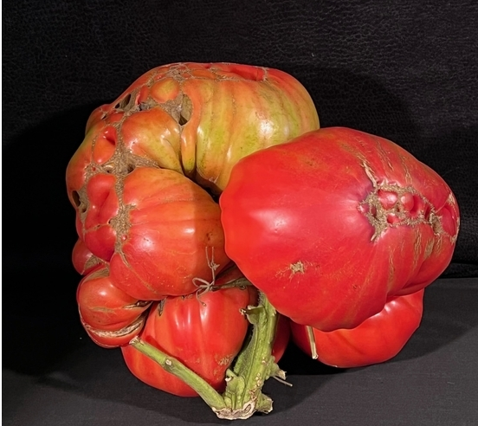
World Record Tomato Guess This Tomato’s Weight?
11.65 lbs.
Notes:
Grown by Del & Julie Faust in Stillwater, Minnesota in October 2022. Possibly Beefsteak variety. Guess this tomato’s weight?
Click the screen for answer to bounce in → 11.65 lbs.
https://www.guinnessworldrecords.com/world-records/heaviest-tomato

Slide 13
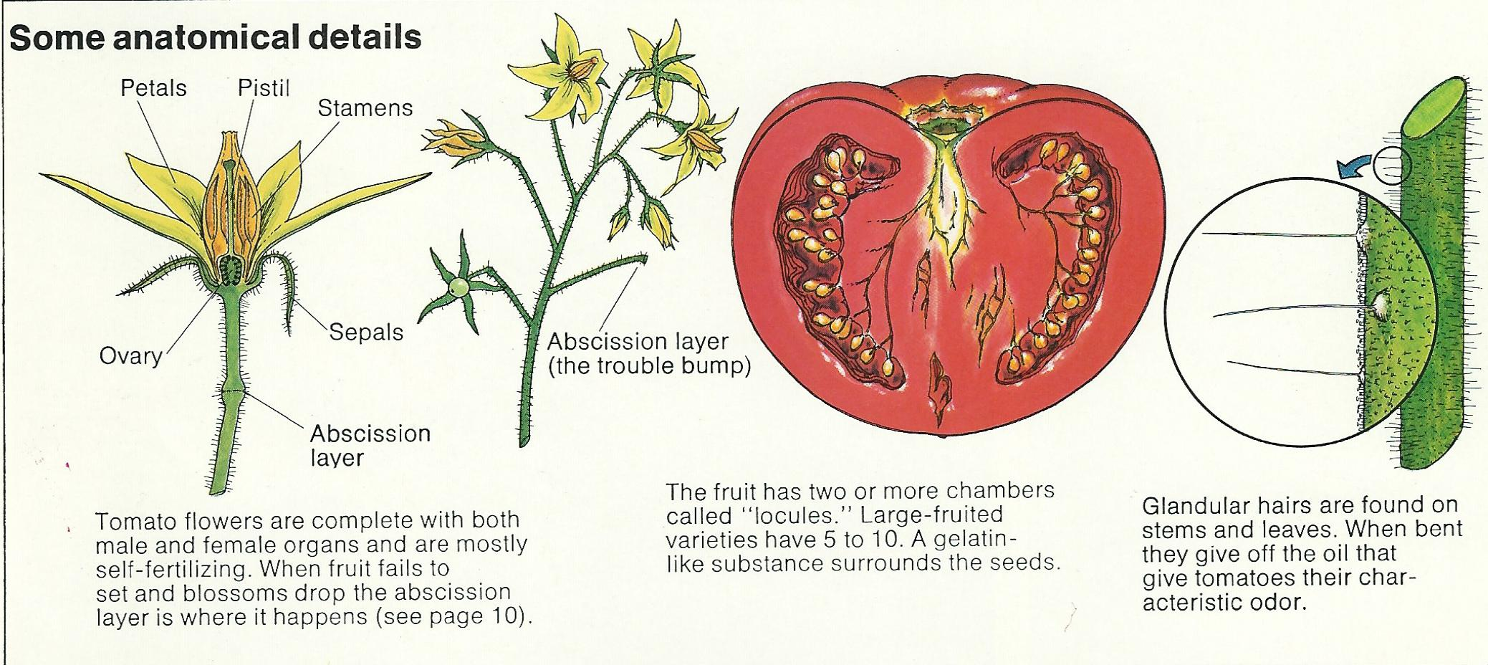
Anatomy of a Tomato
Notes:
Flower has both male (stamen) & female (pistil) parts.
Wind or shaking the flower will fertilize the flower for fruit to set.
Point out seeds in cross section of tomato picture, later discuss seed saving.
Glandular hairs on stems give off a characteristic odor.
Photo: Nevada County MG presentation

Slide 14
Heirloom vs. Hybrid What’s Going On?
Heirloom
Introduced more than 50 years ago
Must have a history of its own
Hybrid
Cross-pollinated with human intervention
Not true to type
Bred for specific improvements
Notes:
Let’s talk about different types of tomatoes.
Heirloom are grown for:
- better taste
- less than perfect bright red uniform shape
- seeds have been collected by families and passed down
Hybrid:
- developed after WWII for mechanical harvesting with a thicker skin that holds up during shipping to market
- developed for resistance to diseases and pests
Source: https://sacmg.ucanr.edu/What_are_Heirloom_Tomatoes/

Slide 15
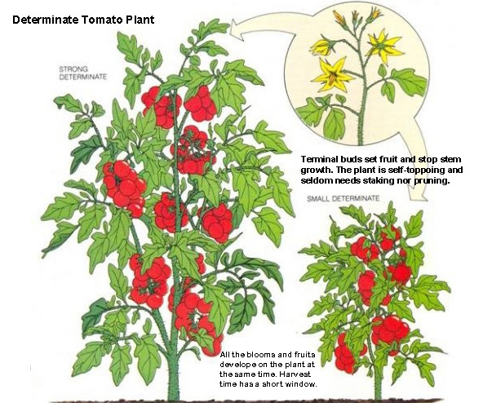
Determinate (Bush)
Notes:
- Determinate grows to a certain size and produces tomatoes all at once.
- Harvest time is short, good choice for canning.
- Also good for containers.
- Variety examples: Ace, Roma, Celebrity, San Marzano, Amish Paste.
https://ucanr.edu/blogs/blogcore/postdetail.cfm?postnum=16937

Slide 16
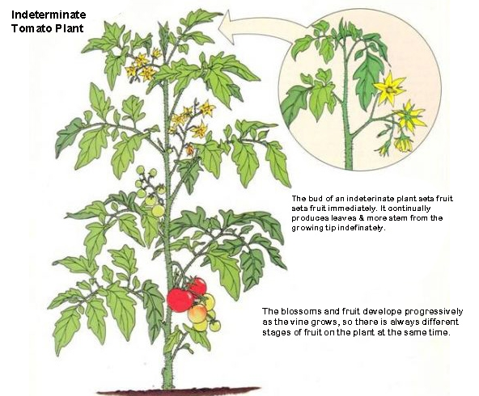
Indeterminate (Climbing)
Notes:
- Indeterminate continues to grow all season long until killed by frost.
- Vining because they continue to flower and bear fruit over the season.
- At my house will continue through November.
- Variety examples: Sun Gold, Super Sweet 100, Brandywiine.
https://ucanr.edu/blogs/blogcore/postdetail.cfm?postnum=16937

Slide 17
Starting From Seed
Read seed package!
Work backward from anticipated planting date.
Use seed starting mix – not potting soil.
Moisten soil and gently tamp.
Place seeds in cells, blocks, or open flats.
Cover with plastic or dome to retain moisture.
Notes:
Why grow from seed? More varieties (SHOW the catalogs)
NOTE flip to next slides to explain each agenda item.
For following slides: https://ucanr.edu/sites/ucmgplacer/files/171555.pdf

Slide 18
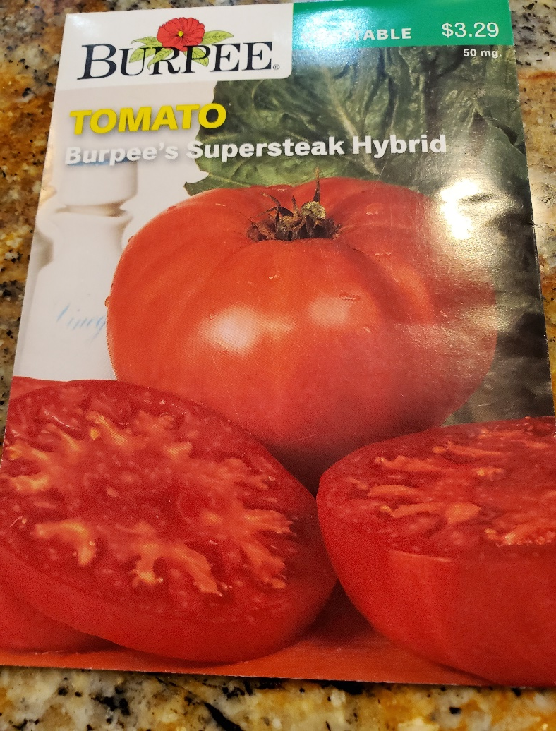
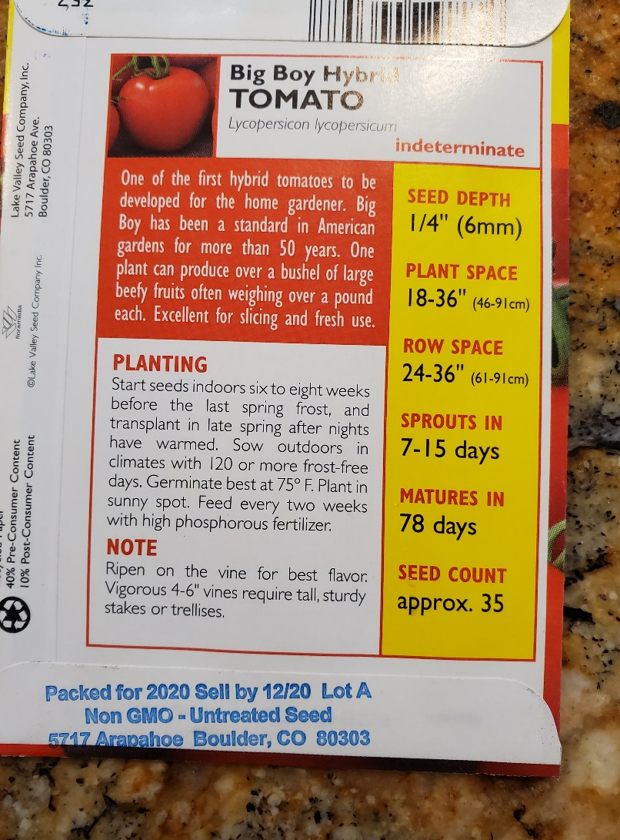
Read Your Seed Packet
Notes:
Point out: ideterminate, seed depth, spacing, matures in (from when you put it in the ground is 78 days to have a fresh tomato)
Photo: D. Warman

Slide 19
Work Backward from Anticipated Planting Date
Proposed Planting Date – May 1
Start Seeds six to eight weeks prior to May
Start seeds – first two weeks of March
Start Seeds | Interval | Planting Date
March 2 - 16 | 6 – 8 weeks | April 27 – May 11
Sow seeds ¼ inch deep in clean, seed starting mix
Keep warm – about 70-80 F until they emerge
Notes:
https://anrcatalog.ucanr.edu/pdf/8159.pdf
Make sure before planting, your typical frost date has past of when you plan to plant them.

Slide 20
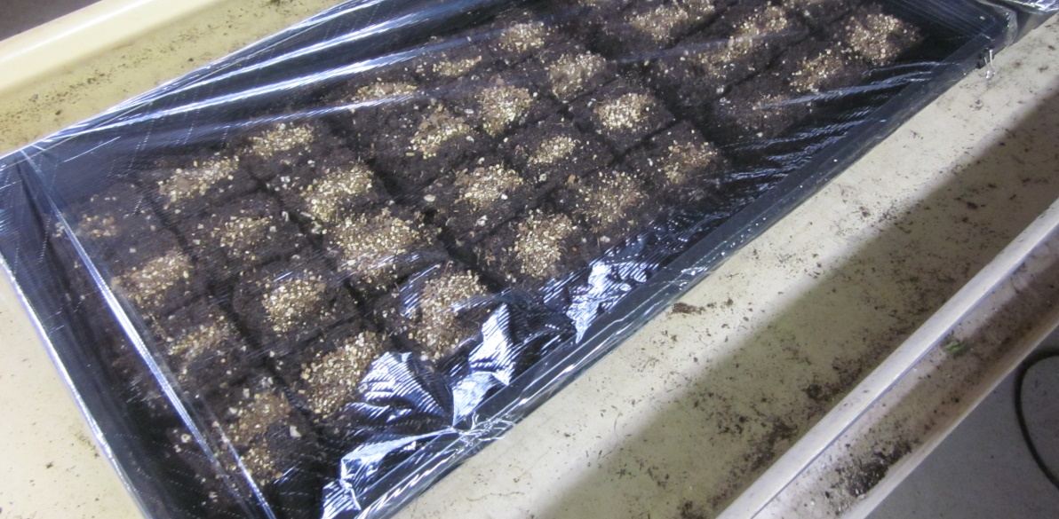
Cover to Retain Moisture
Notes:
After planting, cover with dome or plastic to retain moisture.
Photo by D. Warman.

Slide 21
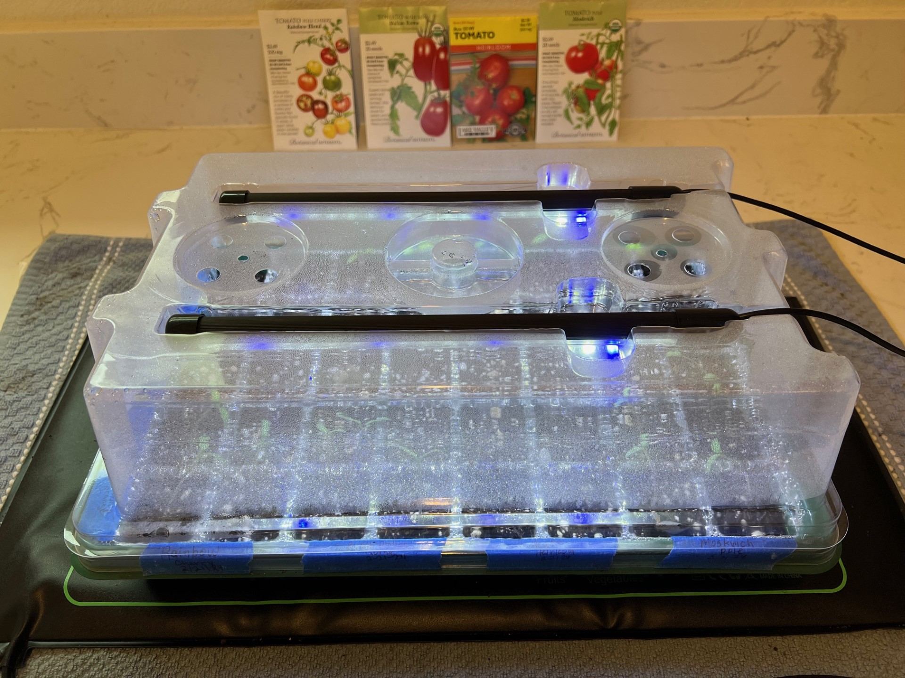
Heat Mat & Light (Optional)
Notes:
Helpful, but not required: Add heat mat (heats the soil assisting with germination) & light (helps with growth).
Photo by B. Villareal.
https://mg.ucanr.edu/Gardening/Vegetable/Preparing/EarlyStart/

Slide 22
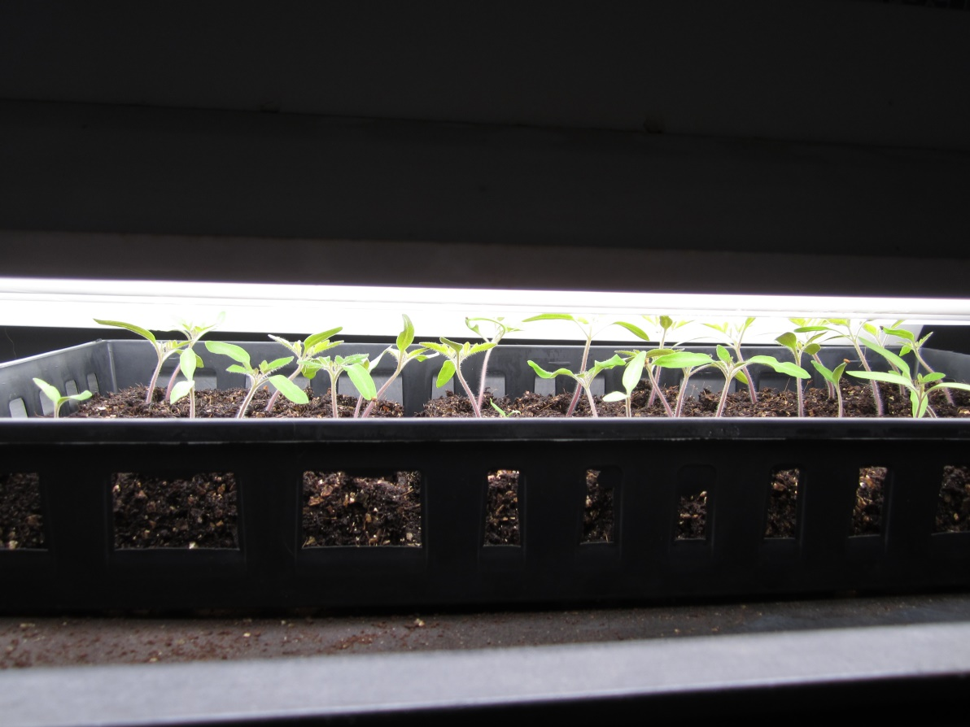
They’ve Started to Sprout!
Notes:
Photo by D. Warman.

Slide 23
They’ve Started to Sprout!
Remove dome to prevent damping off
Provide light 12 hours/day if possible
“Pot up” as after true leaves appear
Maintain proper moisture
Notes:
NOTE flip to next slides to explain agenda.
For following slides: https://ucanr.edu/sites/ucmgplacer/files/171555.pdf

Slide 24
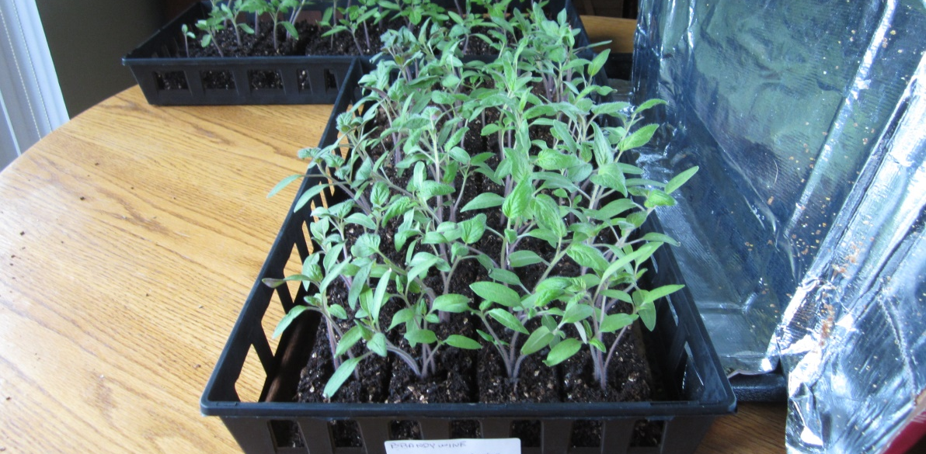
Remove the dome to prevent damping off!
Notes:
Damping off is a disease of seedlings caused by several different fungi and fungus-like organisms. Seedlings need air!
Photo by D. Warman.

Slide 25
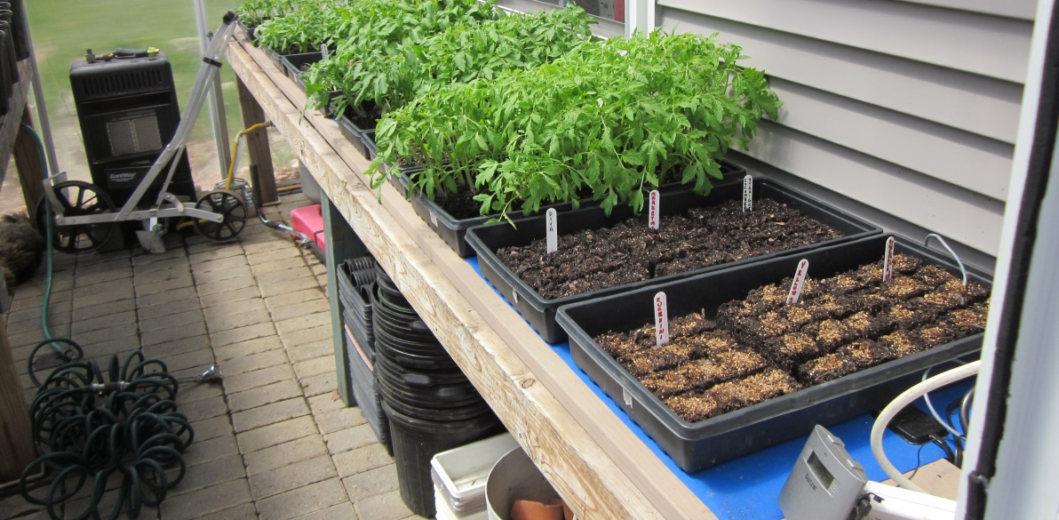
Provide light, 12 hours/day
Notes:
Timers work well.
Photo by D. Warman.

Slide 26
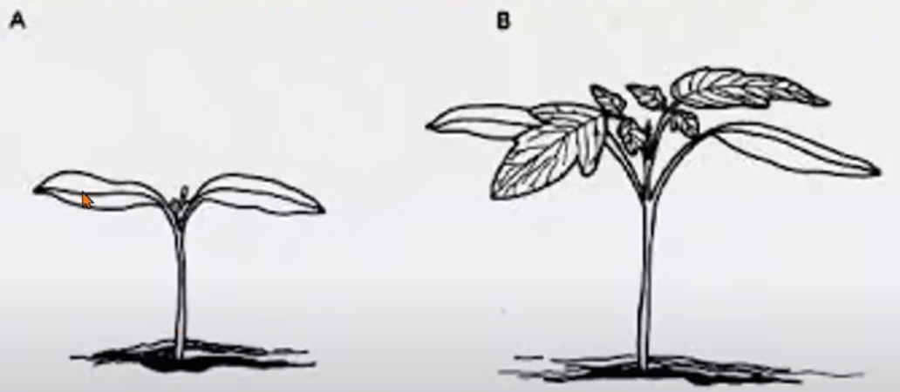
Pot Up After True Leaves Appear
Notes:
Maintain moisture and move from grow cell to 4 inch pot after true leaves appear (point to true leaves).

Slide 27
Planting Outside
Hardening off
Preparing the bed - Compost
Spacing
Deep Planting
Support
Mulch
Notes:
NOTE flip to next slides to explain agenda
For following slides: https://ucanr.edu/sites/ucmgplacer/files/171555.pdf

Slide 28
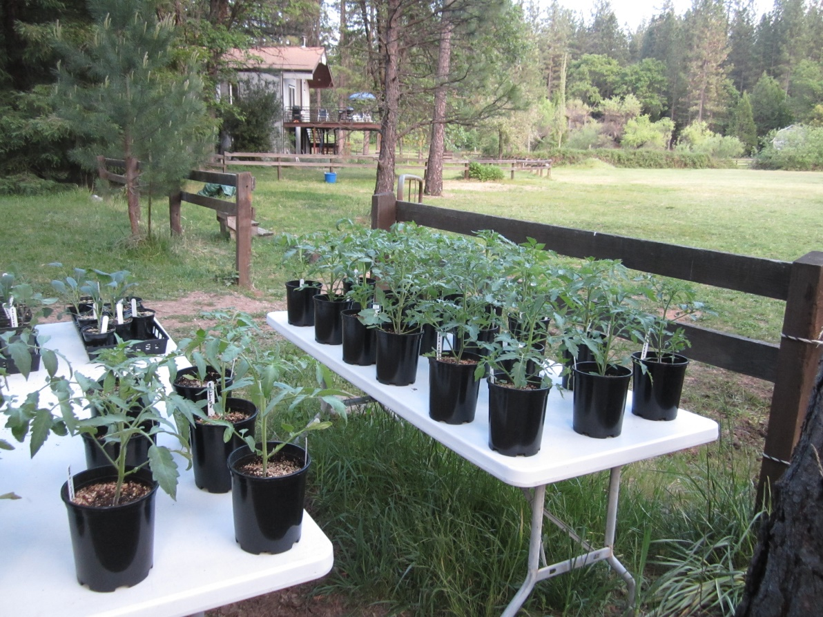
Hardening Off
Start Slowly
1st day set outside in the shade next to the house. Bring them in at night.
Raise exposure gradually.
Monitor seedlings.
Leave outside when above 50 degrees F overnight.

Slide 29
Preparing the Bed
Remove weeds
Add organic matter
aged animal manure, peat moss, compost, or
residue of a cover crop (green manure)
Work in the soil up at least six inches
Allow soil to sit for at least a week before planting
Notes:
Soil Test: either through a lab or inexpensive test kit you can find at any nursery. Lab will be most accurate; test kit will provide approximate nutrient content.
https://ucanr.edu/sites/ucmgplacer/files/166281.pdf
https://ucanr.edu/blogs/CCMGBlog/blogfiles/38756.pdf

Slide 30
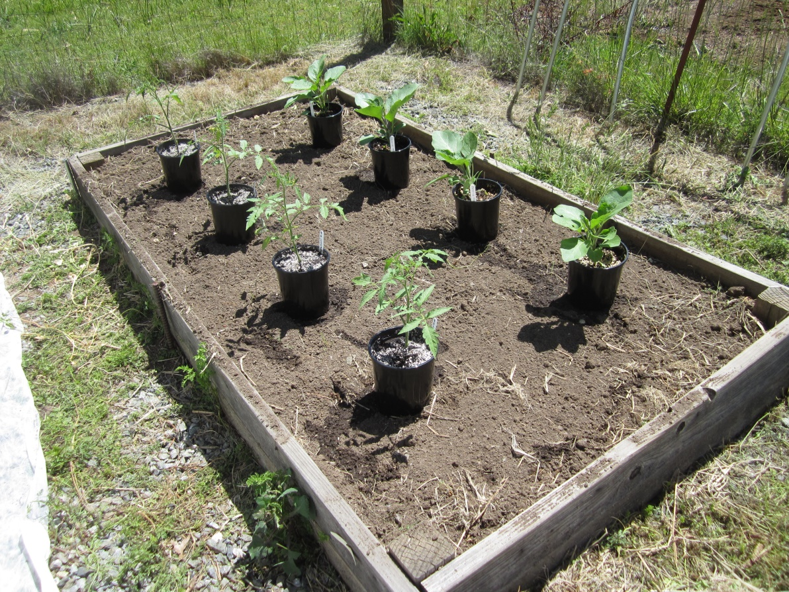
Spacing
Determinate – 3 feet apart
Indeterminate - 4 feet apart
Notes:
Why proper spacing is important:
Better airflow
Better sun exposure
Access to nutrients
Mitigation of pests and diseases
Photo by D. Warman.

Slide 31
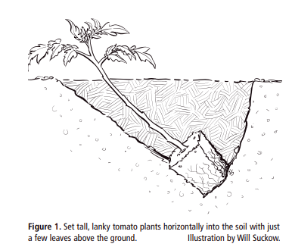
Deep Planting
Notes:
Transplants should be about 6 to 8 inches, tall, hardened-off, stocky and with healthy green leaves.
Water 2 hours before planting in the afternoon to minimize water loss during cooler overnight hours.
Pinch off lower leaves so when buried, roots will form.
Set plant into soil horizontally with few sets of top leaves showing. This will give the plant a solid foundation.
Growing Tomatoes in the Home Garden, https://anrcatalog.ucanr.edu/pdf/8159.pdf

Slide 32
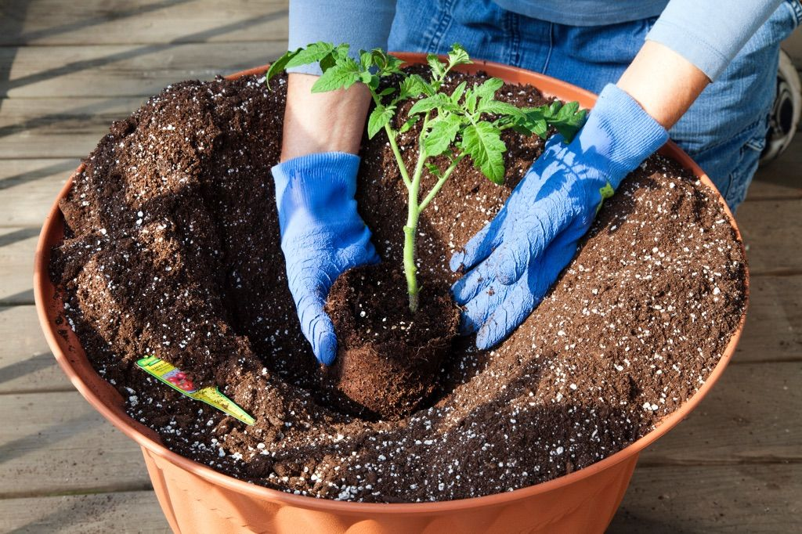
Planting Deep
Notes:
Container planting.
Photo: D. Warman

Slide 33
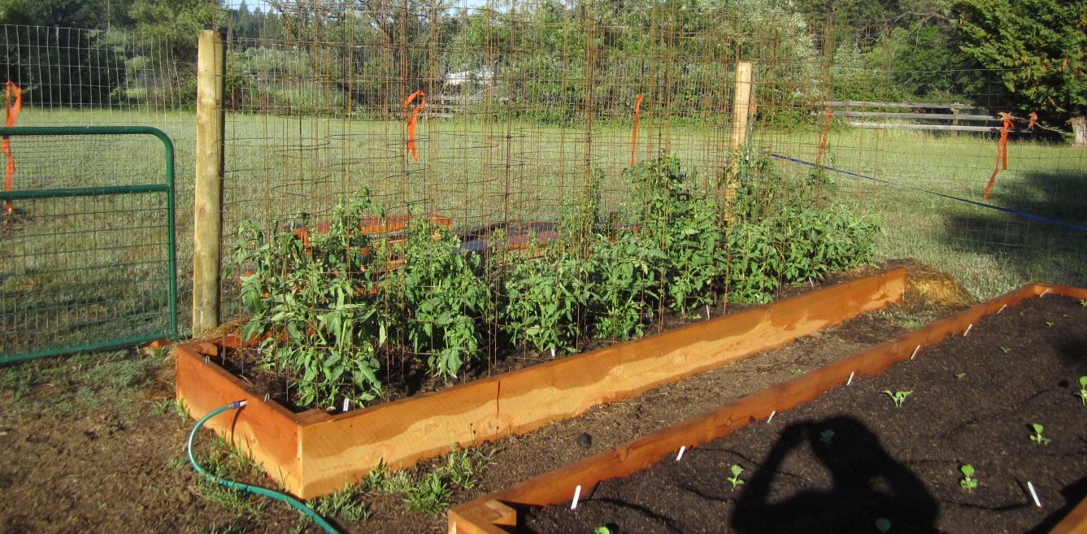
Support - Cage
Notes:
Various support structures.
Photo by D. Warman.

Slide 34
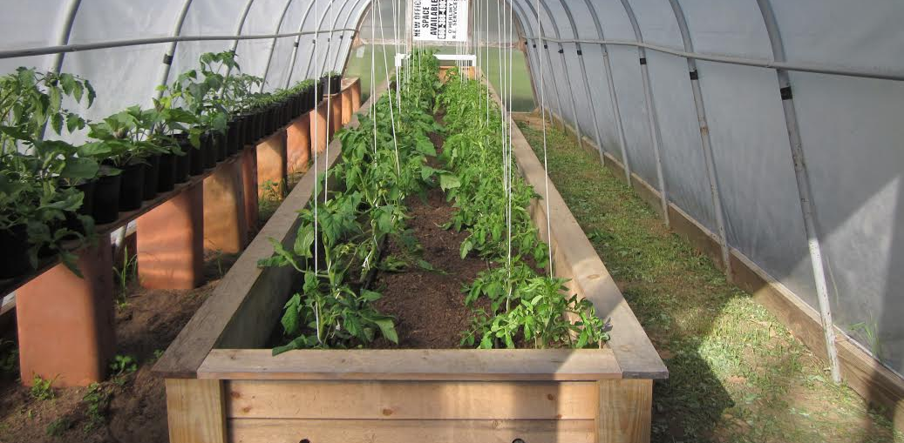
Support - Skywire
Notes:
Various support structures.
Photo by D. Warman.

Slide 35
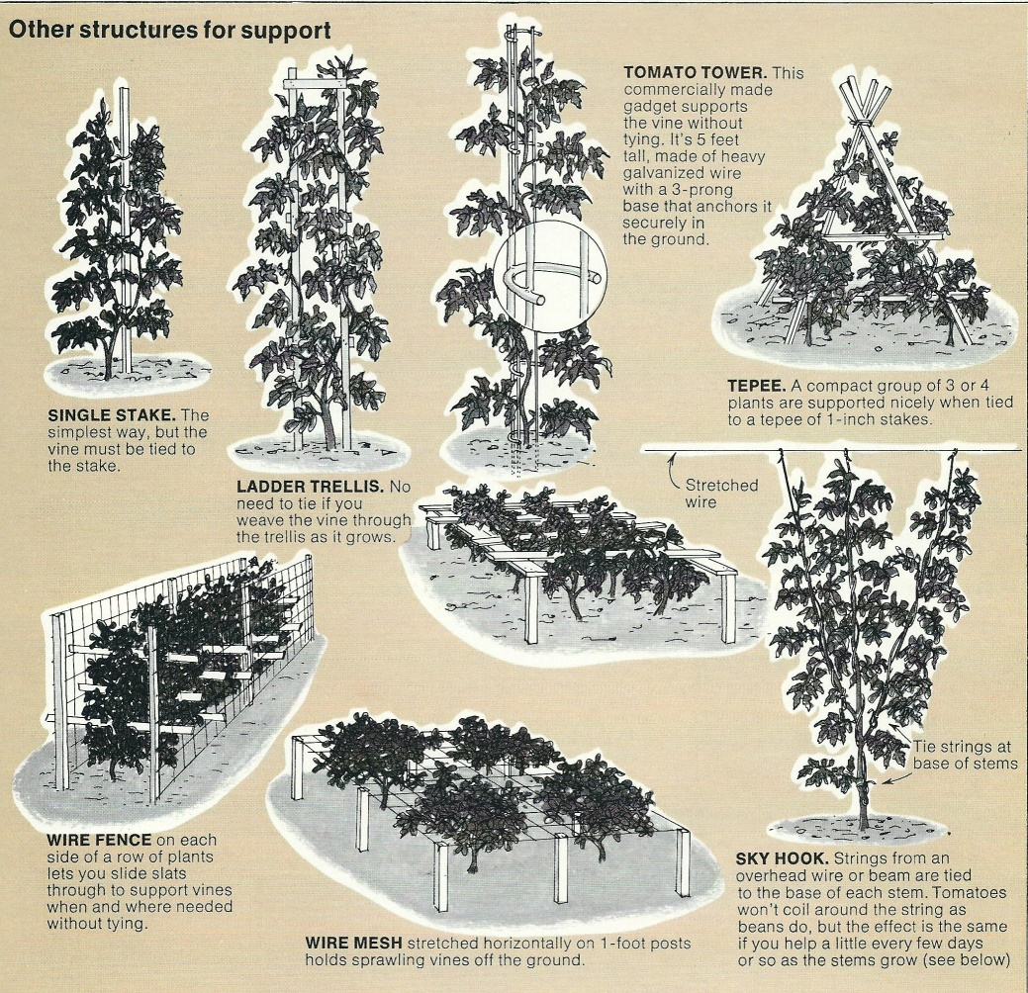
Support – Stakes and More
Notes:
Various support structures.

Slide 36
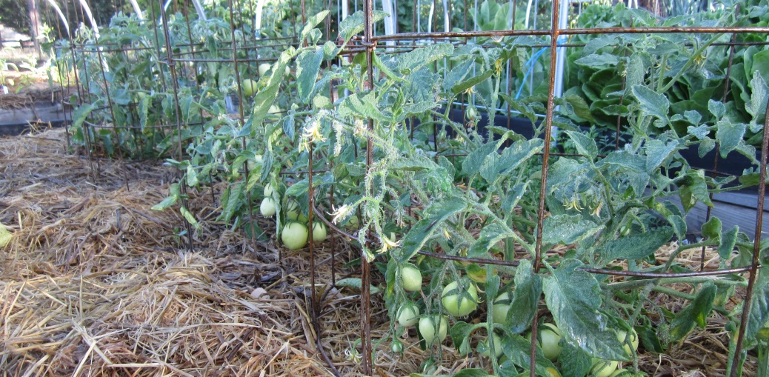
Mulch
Notes:
A layer of mulch 3 to 4 inches deep (compost or straw) will help:
- reduce soil moisture fluctuations
- moderate soil temperature
- discourage weeds
Photo by D. Warman.

Slide 37
Maintenance
Watering
Fertilizing
Pruning
Notes:
See: https://ipm.ucanr.edu/home-and-landscape/tomato/cultural-tips/index.html?src=307-pageViewHLS#:~:text=Pruning%20tomato,-Pruning%20is%20not&text=Plants%20with%20two%20or%20more,the%20others%20as%20they%20develop.

Slide 38
Watering
Water deeply by drip or soaker hose to encourage deep roots. Furrow irrigation works also but is more work.
Avoid wetting the foliage or fruit.
Deep moisture will keep your plants healthy and protect from thrips.
Notes:
https://ipm.ucanr.edu/home-and-landscape/tomato/cultural-tips/index.html?src=307-pageViewHLS#:~:text=Pruning%20tomato,-Pruning%20is%20not&text=Plants%20with%20two%20or%20more,the%20others%20as%20they%20develop

Slide 39
Choosing a Fertilizer
Organic | Inorganic
Manures & Compost (plus bone meal, cottonseed, & fish emulsion) | Chemical Products includes: Nitrogen (N) + Phosphorus (P) + Potassium (K)
Supplies plants with essential nutrients | Fast acting & low in cost
Improves soil structure | Acidifies the soil
The choice is up to you!
Notes:
Every time you take something away from the soil, you must give something back. Otherwise, you are literally stunting growth.
https://ipm.ucanr.edu/home-and-landscape/tomato/cultural-tips/index.html?src=307-pageViewHLS#:~:text=Pruning%20tomato,-Pruning%20is%20not&text=Plants%20with%20two%20or%20more,the%20others%20as%20they%20develop

Slide 40
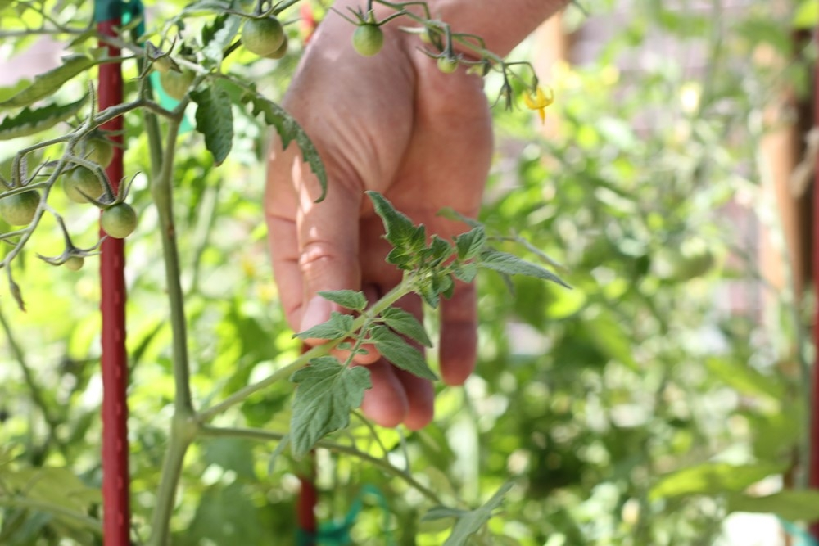
Pruning: The Secret to Bigger & Tastier Tomatoes
Two or more stems produce more tomatoes
Removing suckers after two leaves develop
Remove dead, diseased or crossing over branches.
Keep branches off the ground
Notes:
Remove suckers are the stems/leaves that grow out of the “V” junctions on plants so that energy is funneled into production of larger fruits rather than leaves.
This keeps the the plant tidy and increase air circulation.
Photo: https://ucanr.edu/blogs/USS//blogfiles/71284_original.jpg
https://ucanr.edu/News/?routeName=newsstory&postnum=57078

Slide 41
Other Considerations
PH of soil
Tomatoes prefer PH from 6.0-7.0
Location and orientation of bed
East/west with at least 6-8 hours of sun
Avoid cold micro-climates
Crop rotation
Avoid planting tomatoes in same location each year to reduce disease & pests.
Don’t follow plants from the same family (eggplant, peppers, potatoes, tomatillo)
Notes:
PH – use your soil tester mention in previous slide.
Location/orientation – raised bed should get equal amounts of sun
Crop rotation – enhances soil fertility and prevent insect and disease pests isolating pests from food source
https://ipm.ucanr.edu/agriculture/tomato/crop-rotation/

Slide 42
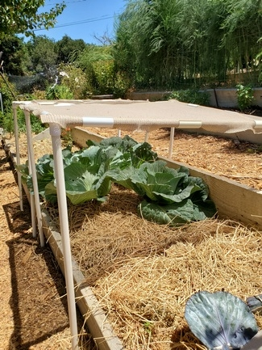
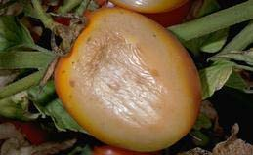
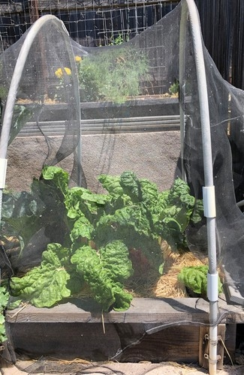
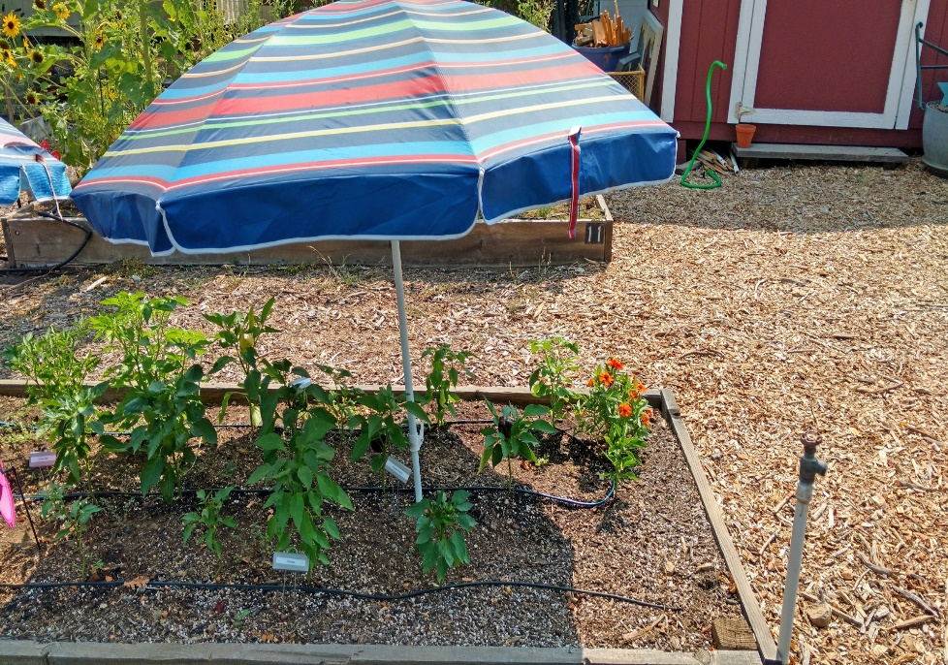
Shade Cloth Examples
Provide partial shade during most intense sun part of the day to avoid sunscald.
PVC table like structure
Notes:
https://ipm.ucanr.edu/PMG/GARDEN/VEGES/ENVIRON/tomsunscald.html
https://ucanr.edu/blogs/blogcore/postdetail.cfm?postnum=55005
Photos: Master Gardener Sara H., IPM, & Master Gardener Wendy Powers

Slide 43
Pests and Problems
Vertebrate Pests
Insects
Diseases/Environmental Problems

Slide 44
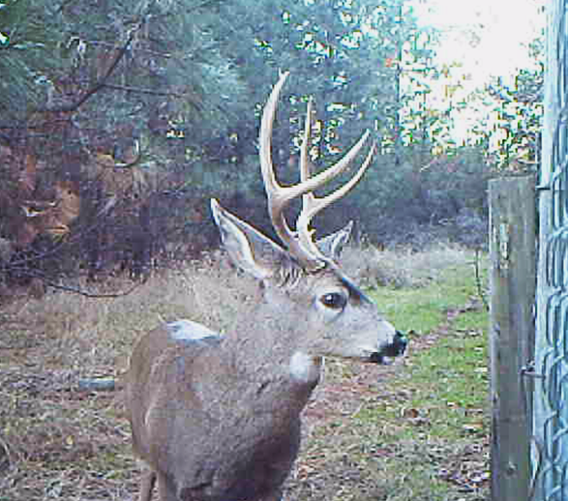
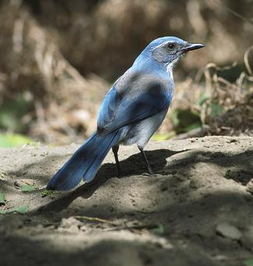
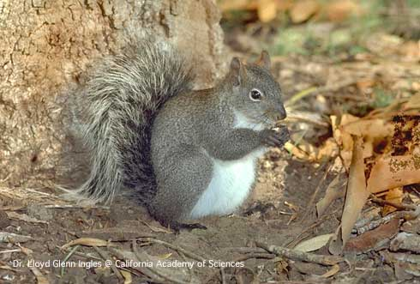
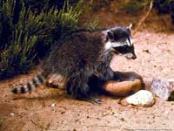
Vertebrate Pests
Notes:
We have a separate presentation on Vertebrate Pests on our YouTube channel called From Bambi to Thumper Zoom Workshop: An Integrated Strategy for the Management of Vertebrate Pests.
For these pests basically use fencing and netting.
Photos from: https://ipm.ucanr.edu

Slide 45
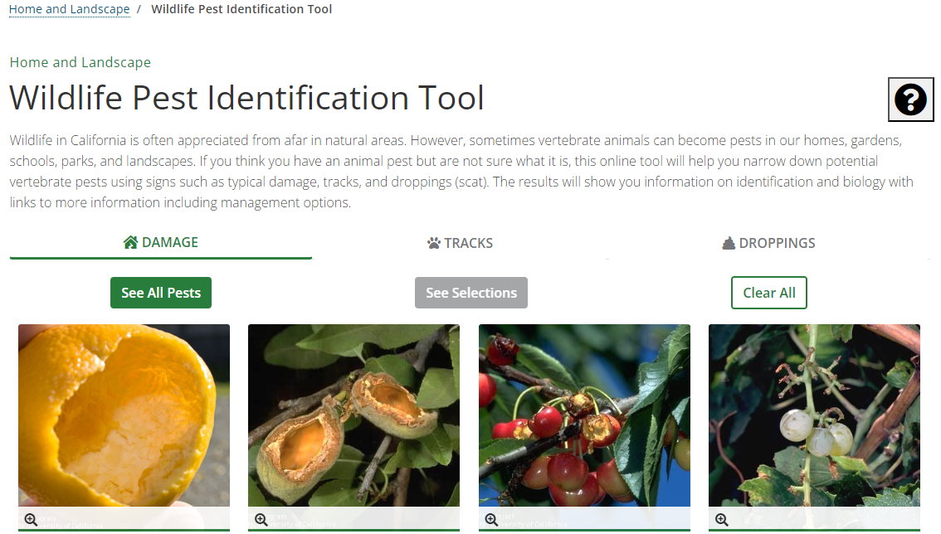
Wildlife Pest Identification Tool https://ipm.ucanr.edu/home-and-landscape/wildlife-pest-identification/
Notes:
https://ipm.ucanr.edu/home-and-landscape/wildlife-pest-identification/
Demonstrate using tool after pasting URL in browser. Make it interactive with audience choosing Damage, Tracks and Droppings, then show result by choosing See Selections, then Potential Pests. But we have no instruction to deal with these guys. Should we develop slides or skip?

Slide 46
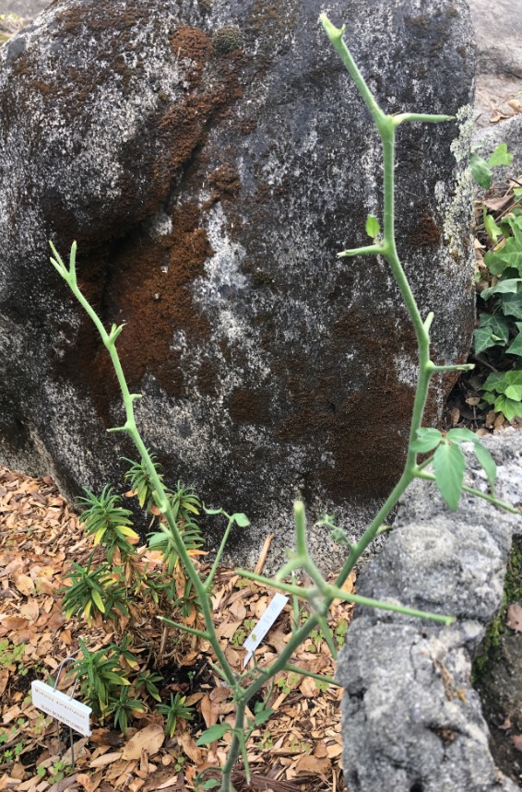
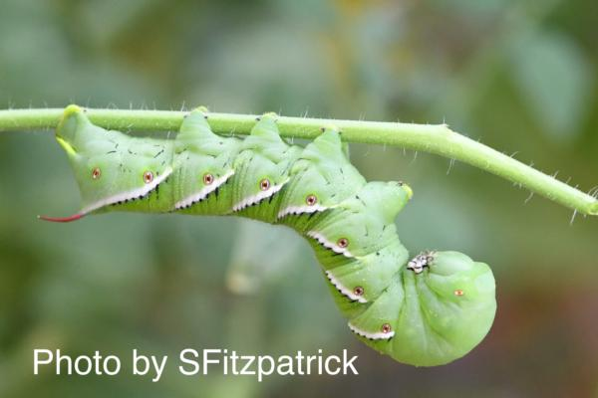
INSECTS The Dreaded Hornworm!
Notes:
https://ipm.ucanr.edu/agriculture/tomato/hornworms/
Feed on blossoms, leaves and fruit.
Photos from S. Fitzpatrick & B. Villareal

Slide 47
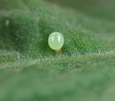
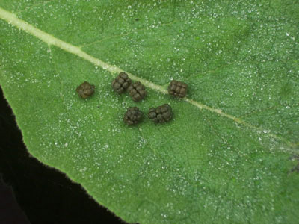
Signs of Invasion
Notes:
Hornworm eggs and poop. You’ll probably see the poop before you see the eggs.
Photos from IPM.ucanr.edu

Slide 48
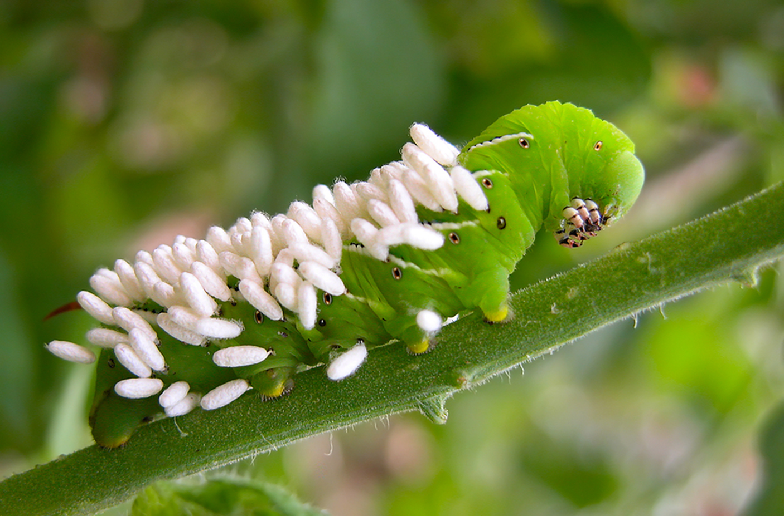
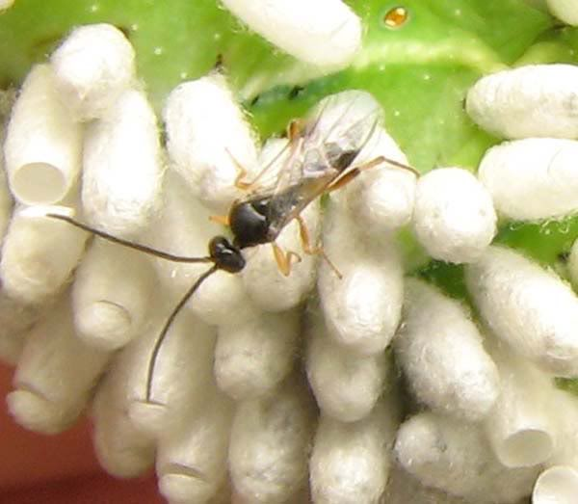
We Have an Ally! The Brachonid Wasp
Notes:
Brachonid Wasp lays their eggs on the hornworm and the eggs begin to devour the hornworm. If you see this in your garden, leave it be. The wasp is a great thing to have in your yard. Otherwise, hand pick off the hornworm and dispose in garbage.
Photos from IPM.ucanr.edu

Slide 49
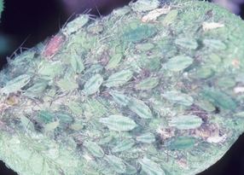
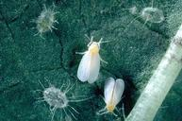
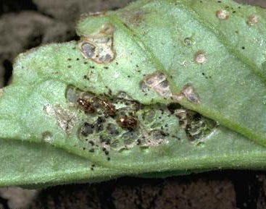
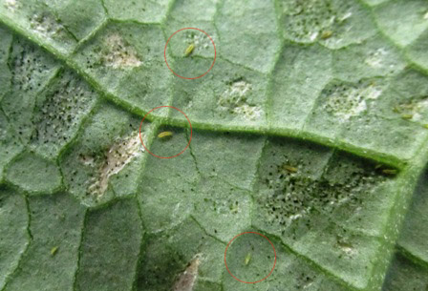
Less Common Tomato Pests
POTATO APHID
FLEA BEETLES
THRIPS
WHITEFLIES
Notes:
Photos from IPM.ucanr.edu

Slide 50
Less Common Tomato Pests
Insect Pest | Natural, Less Toxic Insecticide
Potato Aphid | Insecticidal Soap Pyrethrin Neem Oil Extract
Flea Beetle & Thrips | Insecticidal Soap Pyrethrin Neem Oil Extract
Whitefly | Insecticidal Soap Neem Oil Extract
Tomato Fruit Worms & Hornworms | Bacillus Thuringiensis (B.t.) Spinosad Pyrethrin Neem Oil Extract
Notes:
Neem Oil Extract seems to be the common less toxic insecticide for all tomato pests.
https://ipm.ucanr.edu/agriculture/tomato/

Slide 51
Tomato Diseases
Verticillium and Fusarium Wilt
Tobacco Mosaic Virus
Damping Off
Powdery Mildew
Blossom End Rot
Notes:
Common tomato diseases. See next slide for photos.

Slide 52
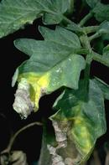
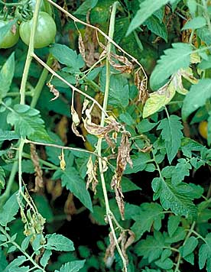
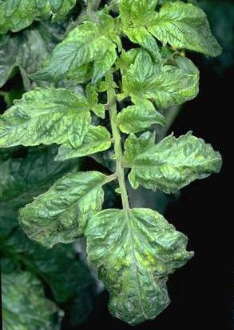
Fungus and Virus Diseases
VERTICILLIUM WILT
FUSARIUM WILT
TOBACCO MOSAIC VIRUS
PURCHASE RESISTANT VARIETIES OR MAKE SURE TO KEEP YOUR SOIL HEALTHY. REMOVE DEBRIS, SOLARIZE BEFORE PLANTING, ETC.
Notes:
Verticillium or Fusarium wilt, seldom kills tomato plants, but reduces their vigor and yield.
https://ipm.ucanr.edu/agriculture/tomato/verticillium-wilt/
https://ipm.ucanr.edu/agriculture/tomato/fusarium-wilt/
https://ipm.ucanr.edu/agriculture/tomato/tobacco-mosaic/

Slide 53
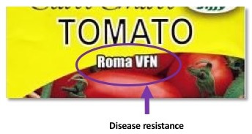
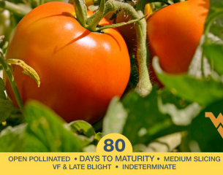


Notes:
Check your seeds packets that are resistant to Fusarium, Verticillium and Tobacco Mosaic Virus (TMV).

Slide 54

Damping Off
SPORES ARE PRESENT IN ALL SOILS. USE STERILIZED SEED STARTING SOIL INDOORS. FAST GROWING SEEDS IN WARM SOIL ARE LESS SUSCEPTIBLE.
Notes:
Constricted or damaged stems when seedlings.
Photo: D. Warman

Slide 55

Powdery Mildew
AIR CIRCULATION, DRY LEAVES, FULL SUN, RESISTANT VARIETIES.
CATCH EARLY WITH OIL, SULFUR, SERENADE.
Notes:
Prevent watering overhead.
https://ipm.ucanr.edu/agriculture/tomato/powdery-mildew-on-field-grown-tomatoes/

Slide 56

Blossom End Rot
Blossom end rot results from a low level of calcium in the fruit and water balance problem in the plant.
Notes:
Resulting from calcium deficiency in the soil or too much water in the soil so the plant can’t take up the calcium. Consistent watering should avoid this. Use a timer for regulated watering.
https://ipm.ucanr.edu/PMG/GARDEN/VEGES/ENVIRON/blossomendrot.html#:~:text=Blossom%20end%20rot%20results%20from,dries%20out%20nor%20remains%20saturated.

Slide 57

Tomato Quiz
What should the outside evening temperature be before planting your tomato starts?
How far apart should you plant your tomato starts for good air circulation?
What dreadful worm should you watch for on our tomato plants?
Notes:
50 degrees F
3 feet for determinate
4 feet for indeterminate
Hornworm

Slide 58






Our Favorites!
Black Krim
Limmony
San Marzano
Brandywine
Cherokee Purple
Sun Gold
Notes:
Photos: Seed catalogue.

Slide 59






More Prize Winners!
Black Cherry
Jasper
San Pierre
Kellogg’s Breakfast
Mortgage Lifter
Pink Berkeley Tie Dye
Notes:
Photos: Seed catalogue.

Slide 60

Why We Like Them!

Slide 61

Why We Like Them!
Notes:
Photo by D. Warman.
v

Slide 62

Why We Like Them!
Notes:
Photo by D. Warman.

Slide 63

Why We Like Them!

Slide 64


Slide 65
Resources
Tomatoes in the Home Garden, Publication Number 31-159
https://ucanr.edu/sites/ucmgplacer/files/158610.pdf
Growing Tomatoes in the Home Garden, Publication 8159
https://anrcatalog.ucanr.edu/pdf/8159.pdf
Harvesting Seeds From the Garden
https://anrcatalog.ucanr.edu/pdf/8159.pdf
UC IPM Cultural Tips for Growing Tomato
https://ipm.ucanr.edu/home-and-landscape/tomato/cultural-tips/index.html?src=307-pageViewHLS

Slide 66
Thank You!
Any Questions?
Master Gardener Hotline: (530) 889-7388
Master Gardener Website: pcmg.ucanr.edu
Evaluations, please!

