Slide 1




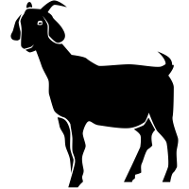
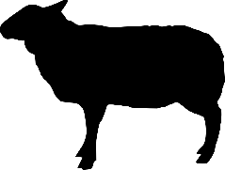
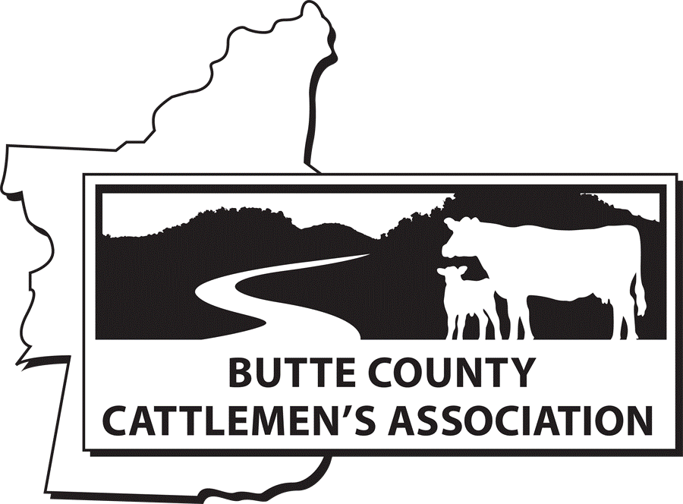

Grazing for Fire Prevention
Principles
Implementation
Effectiveness
Partners

Slide 2
California Career Technical Education Model Curriculum Standards
E. Forestry and Natural Resources Pathway, including
E4.0 Explore rangeland management,
E9.0 Explore the role of fire in natural resource management
  Expose students to the use of livestock as a tool to reduce fire risks.
  Knowledge of vegetated landscapes
  Understanding benefits and challenges of grazing to reduce fire fuels
  Principles of how to implement grazing for fire prevention
  Recognize elements of fire behavior
  Learn about where grazing is used as a tool to reduce fire fuels

Slide 3
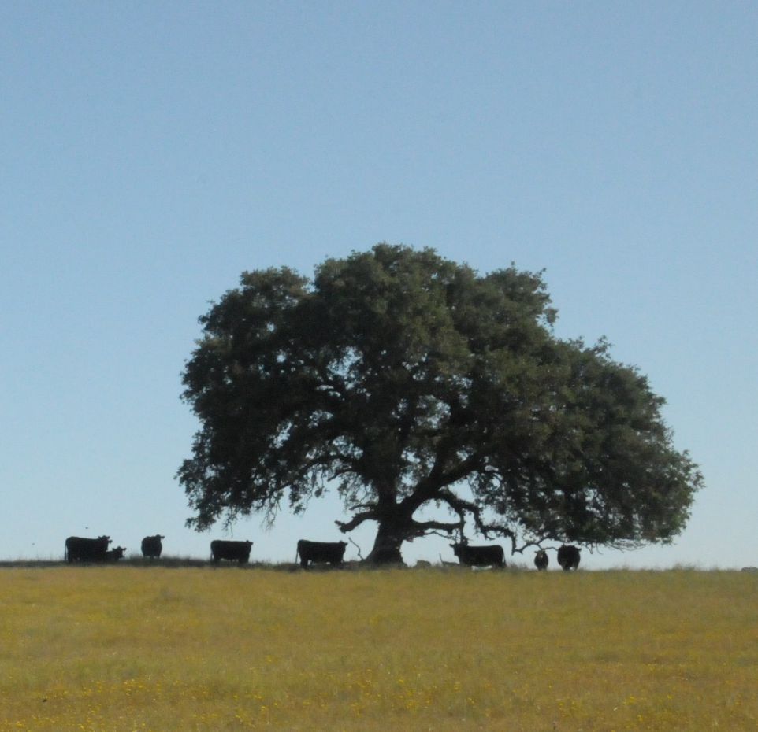
Overview
Rangelands
Principles of Grazing
Infrastructure
Key Considerations
Resources
Case Examples

Slide 4
Tyles of Rangeland
Land on which the indigenous vegetation is predominantly grasses, grass-like plants, forbs, or shrubs and is managed as a natural ecosystem. If plants are introduced, they are managed similarly. Rangeland includes natural grasslands, savannas, shrublands, many deserts, tundras, alpine communities, marshes and meadows.
SOURCE: Society for Range Management. 1998. Glossary of terms used in range management, fourth edition. Edited by the Glossary Update Task Group, Thomas E. Bedell, Chairman.

Slide 5
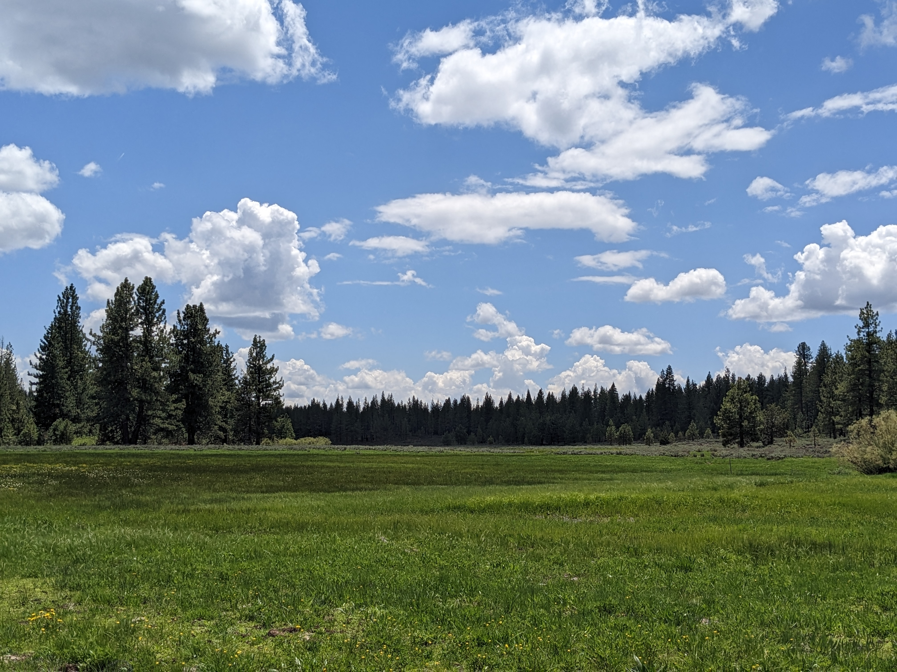
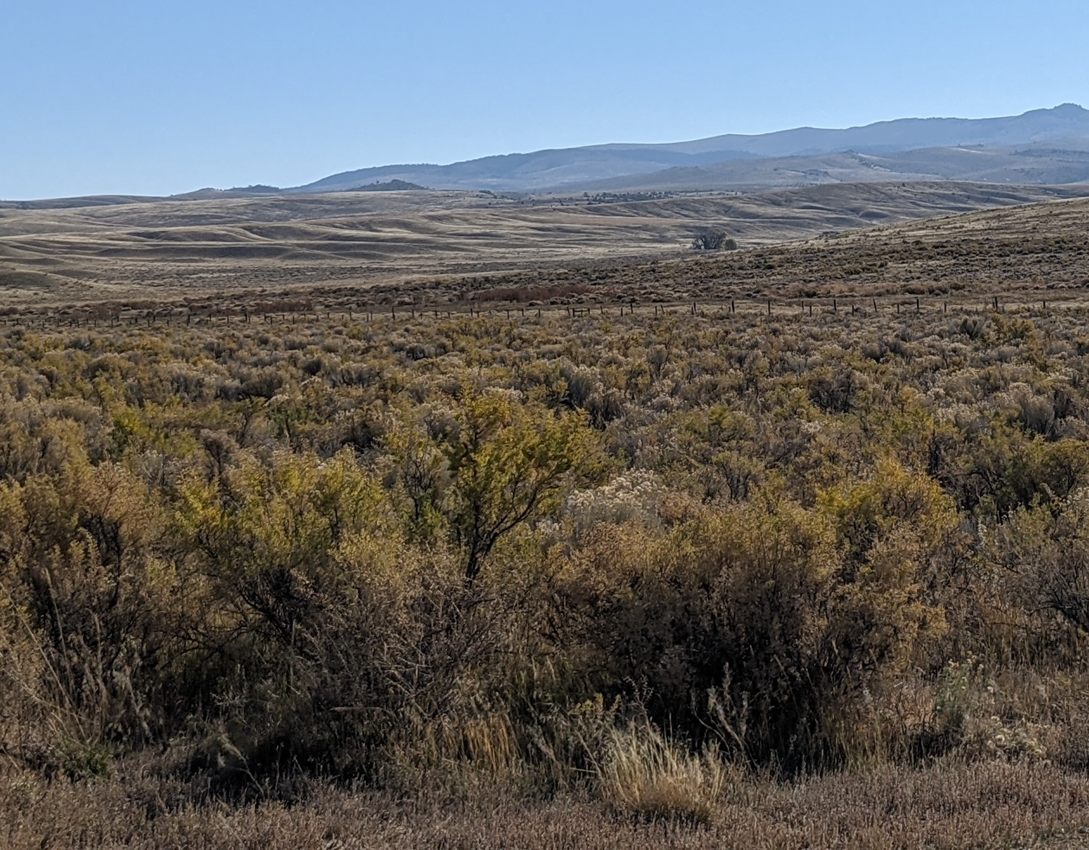
Examples of Rangelands
Meadow - Area composed of one or more plant communities dominated by herbaceous species that use surface or shallow ground water. May have woody vegetation like trees and shrubs, but it is not dominate.
Shrubland
Marsh
Shrubland - Area where vegetation is dominated by woody plants generally less than 9 feet in height
Savanna
Grassland

Slide 6
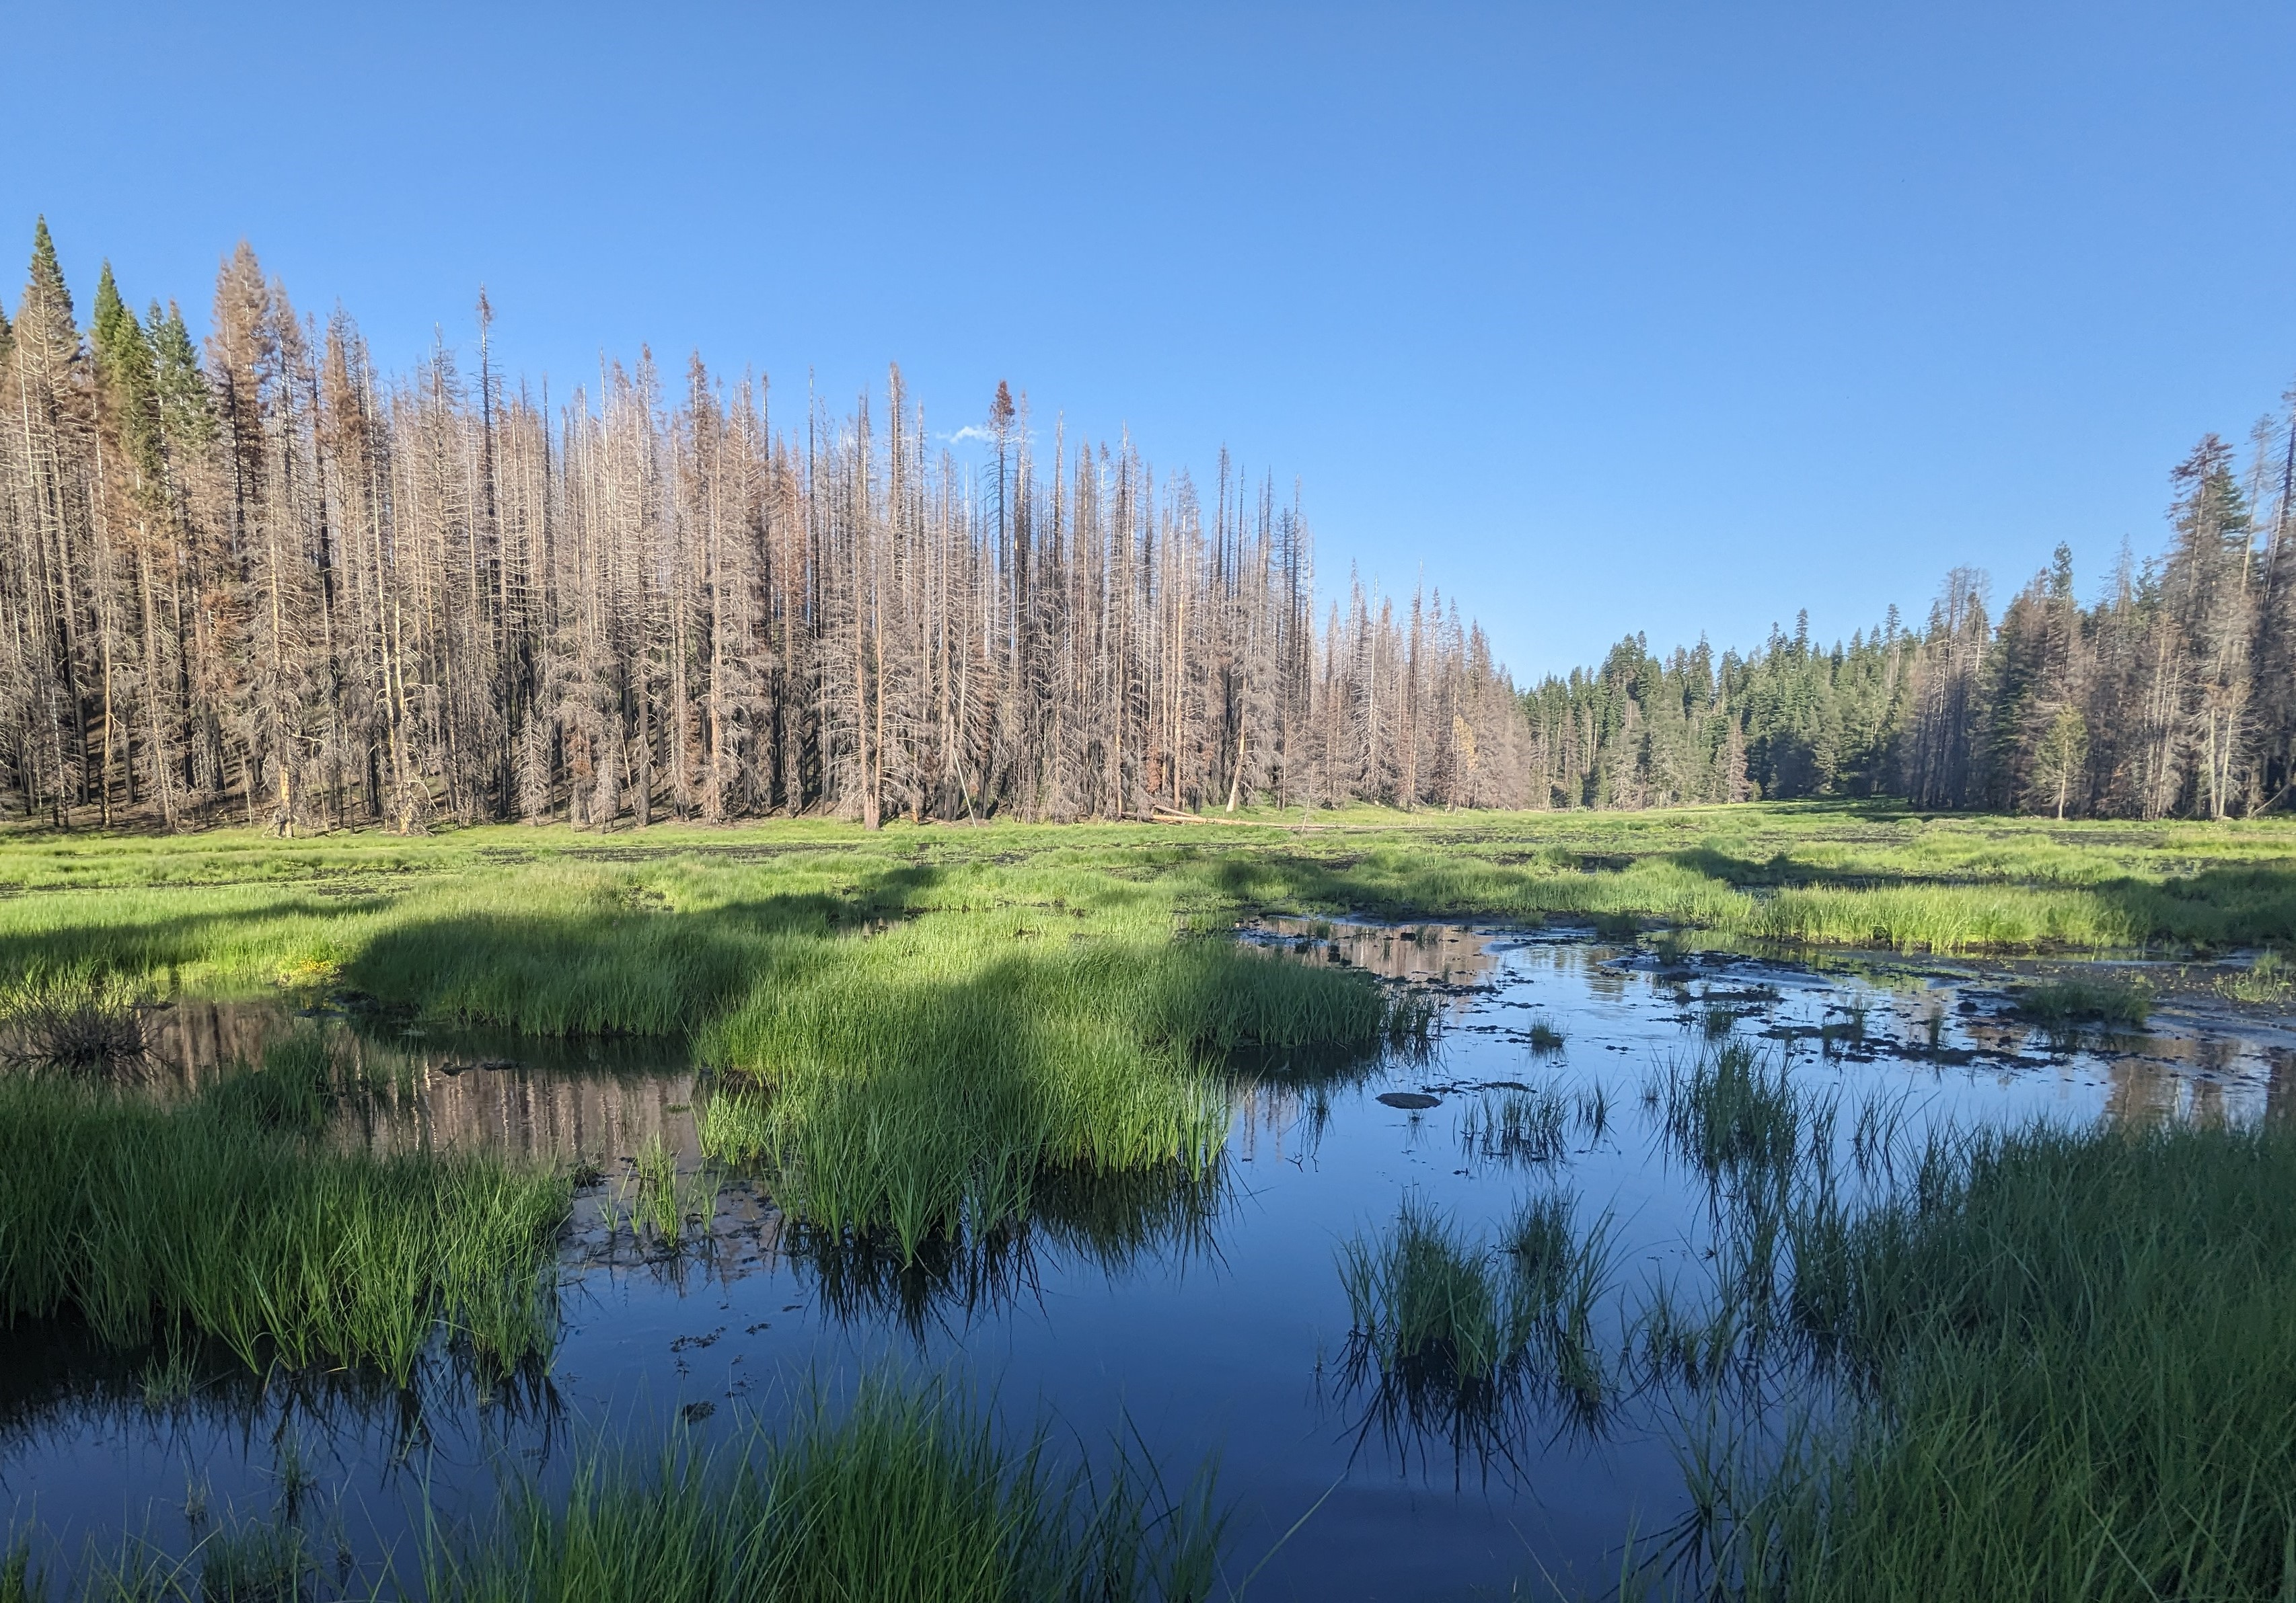
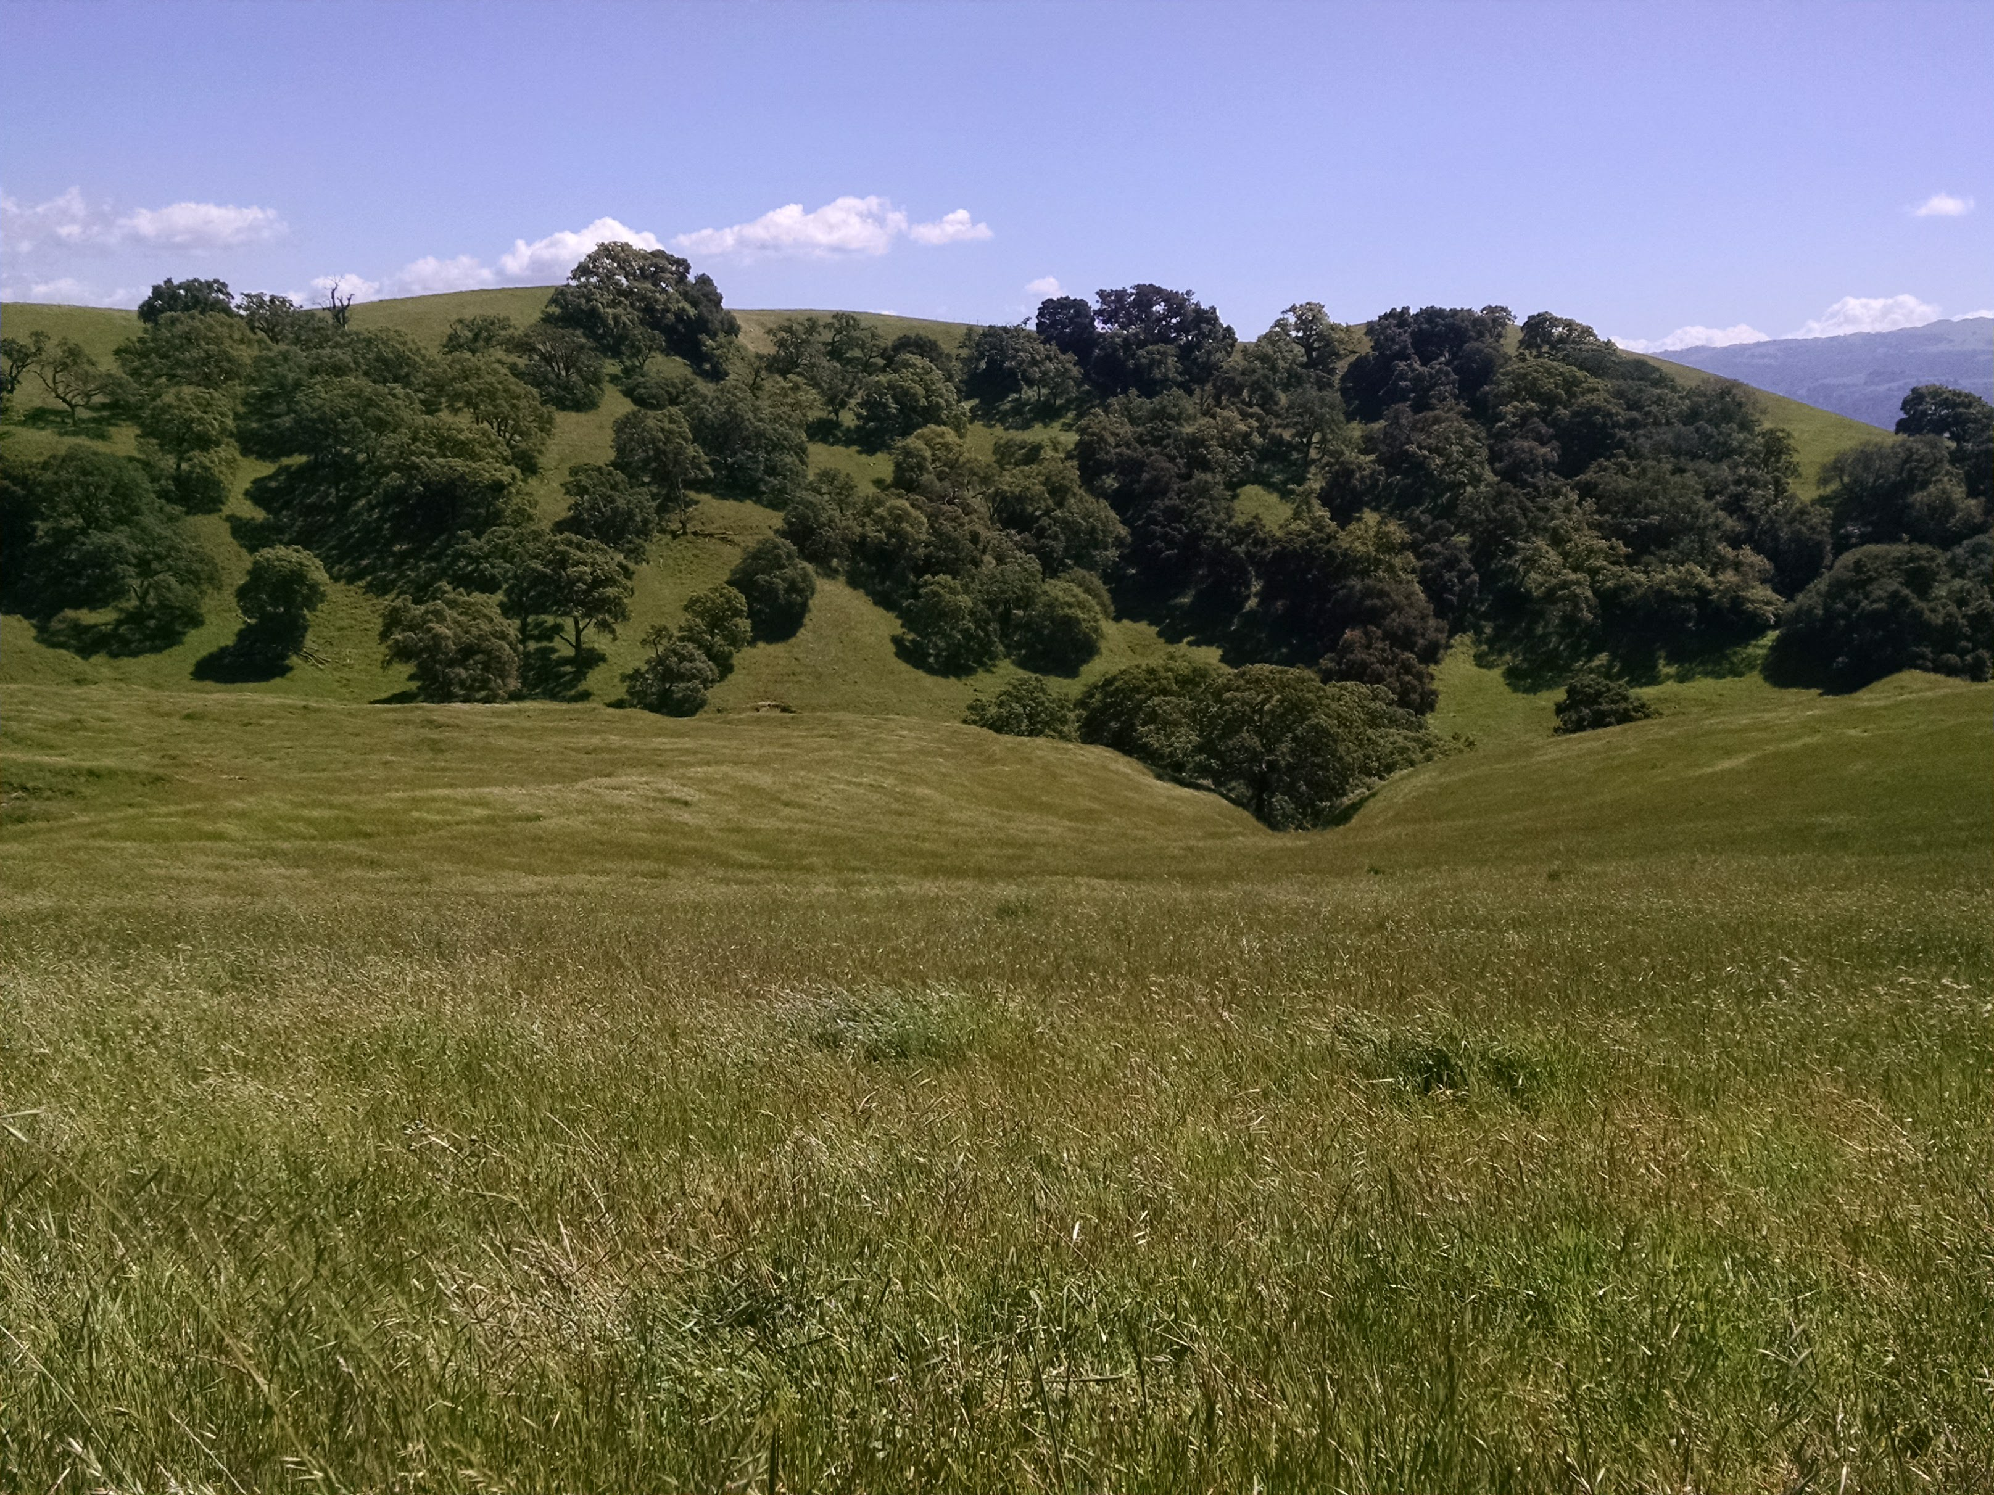
Examples of Rangelands
Marsh - Wetlands that are frequently or continually inundated and are dominated by herbaceous plant species adapted to these hydrologic conditions.
Savanna - Grassland area that contains small shrubs and a few trees.

Slide 7
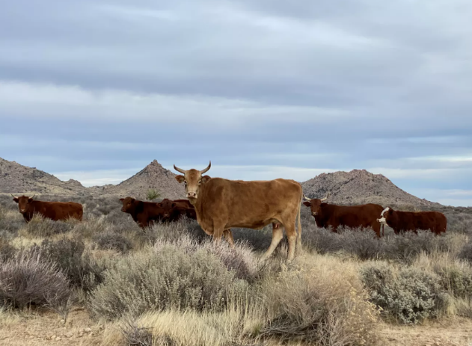
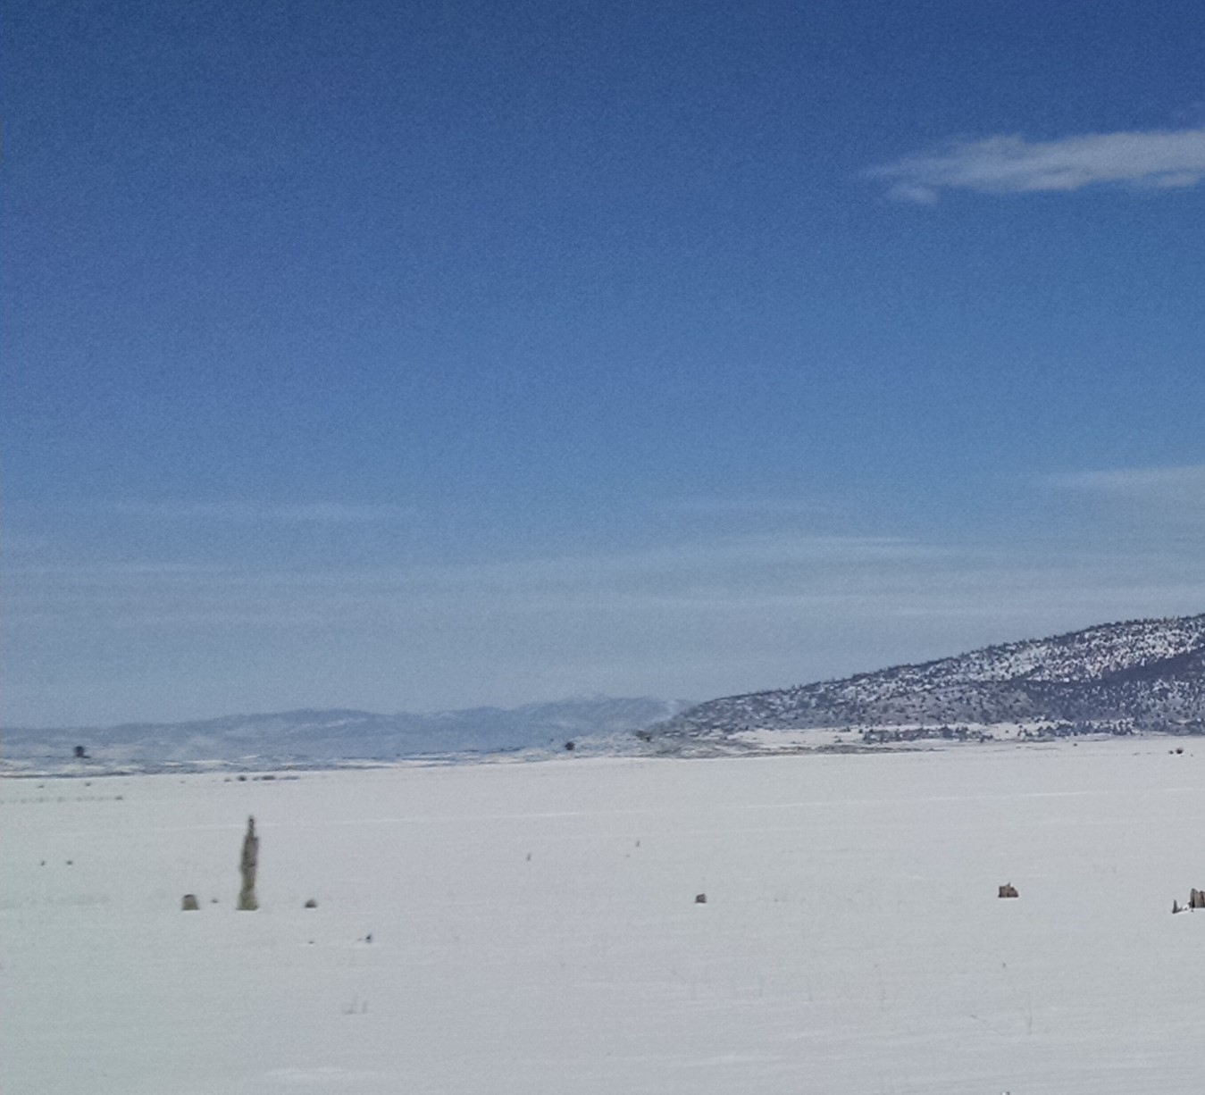
Examples of Rangelands
Desert - Area that is extremely dry with sparse vegetation and well adapted plants that is receiving no more than 10 inches of precipitation a year.
Tundra - An area with frigid temperatures, short growing seasons, and little precipitation.
Photo Credit: Roche

Slide 8
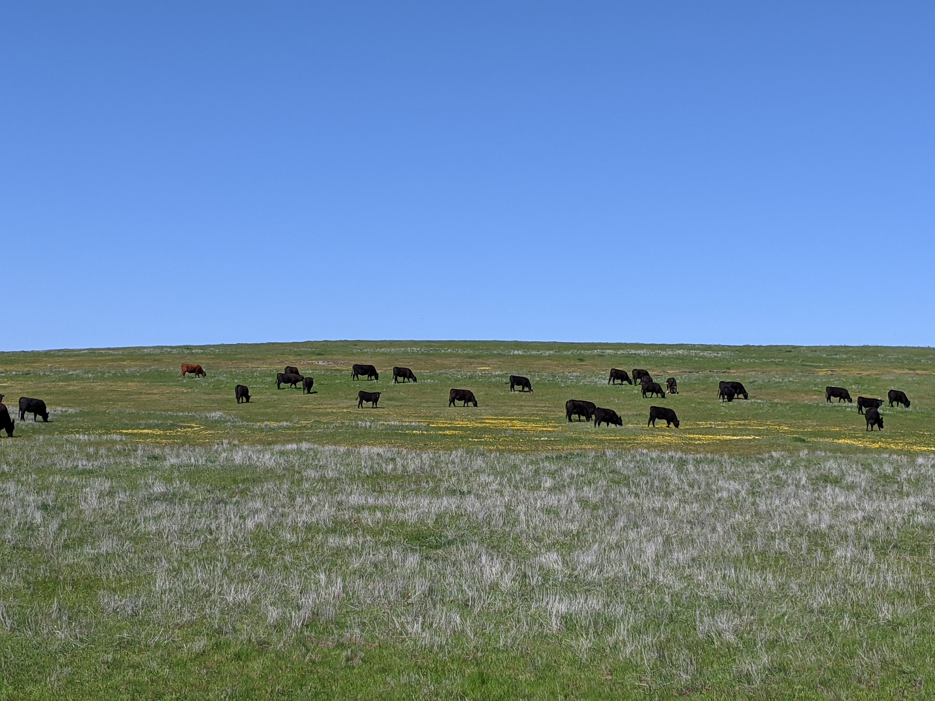
Examples of Rangelands
Grasslands - Area in which the vegetation is dominated by a nearly continuous cover of grasses.

Slide 9
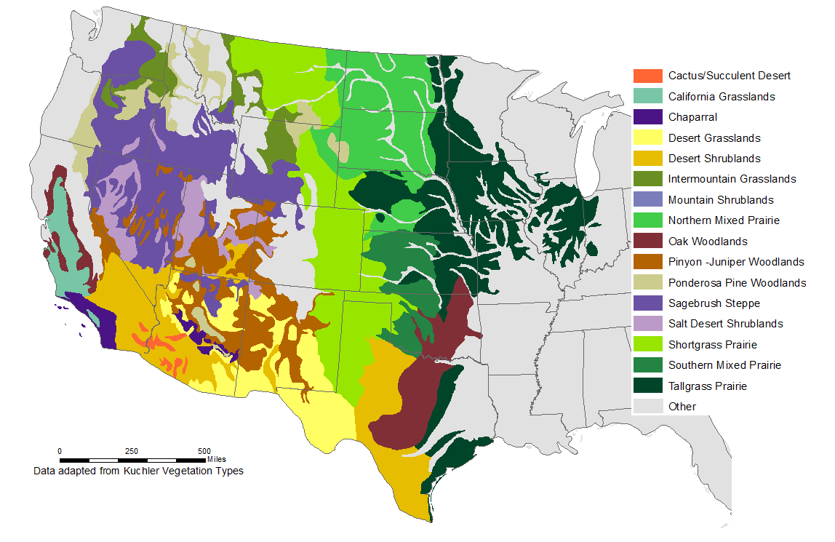
Western Rangelands
Leslie Roche, Ph.D. UC Davis
Notes:
Grazing to reduce fire fuels loads can be use in various landscapes – like rangelands
Rangelands are incredibly biologically diverse-- arid deserts and shrublands to mesic grasslands and woodlands
Very simplified map
Grazing is a tool to mange these lands to promote wildlife diversity, reduce fire fuels and support local rural economies - ranchers – through beef, lamb, goat production
**Time note guide for map coloring exercise

Slide 10
California Public vs Private Rangelands
57 million acres of rangelands (54% of state)
  34 million acres are grazed
  22 million acres are privately owned
  35 million acres of public lands
Public Land Managers
  US Forest Service
  Bureau of Land Management
  CA Department of Fish and Wildlife
  CA State Parks
  Local entities such as parks and water districts, etc.
Leslie Roche, Ph.D. UC Davis

Slide 11

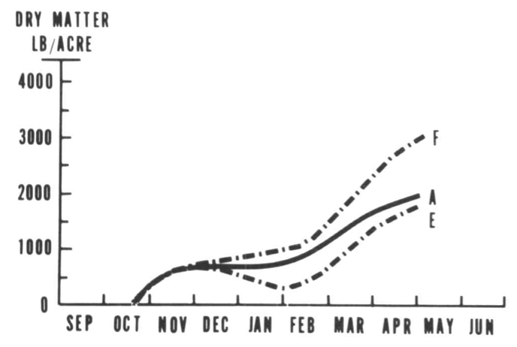



California's Forage Calendar
Most Palatable Grass
  Annual vegetation growth varies based on rainfall, location, and temperature.
Source: George, Clawson, Menke and Bartolome. Rangelands. 1985 (17-19)

Slide 12
Grazing for Fire Prevention
Principles
Implementation
Effectiveness
Partners
Notes:
Today’s presentation is the start of a conversation.

Slide 13
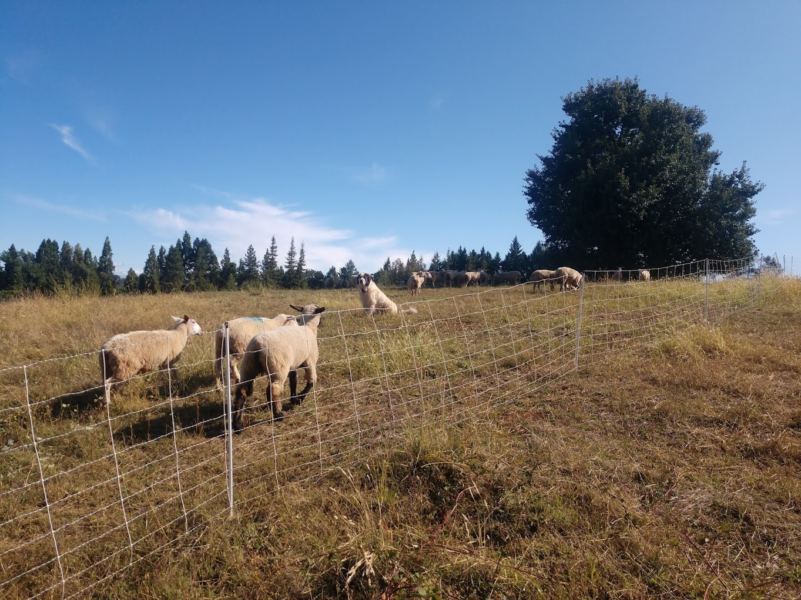
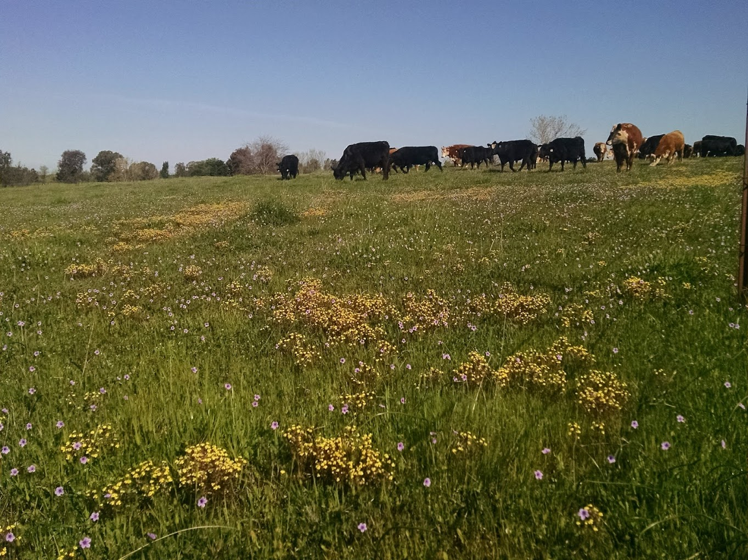
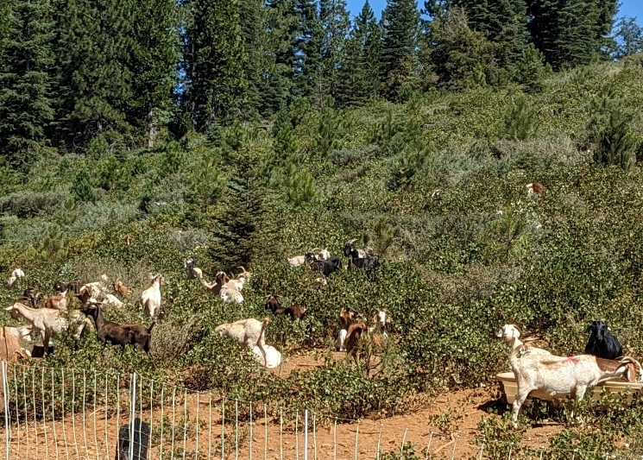
Livestock Grazers
Notes:
Typical livestock grazing is sheep, goats, cattle
Type of livestock dependent on infrastructure , size of property and vegetation you want controlled

Slide 14


Forage Preferences
Brainstorm Session
Notes:
Brainstorm slide

Slide 15

Preferences of Livestock Grazers
Grass
and other fine vegetation
Brush
Notes:
Defining the type of livestock is important to meet objectives, specific consideration of livestock foraging behavior.
Cattle and sheep are a good selection to manage fine vegetation like grasses
If property is predominately brush, consider using goats as they are browsers and consume a higher percentage of foliage from shrubs

Slide 16
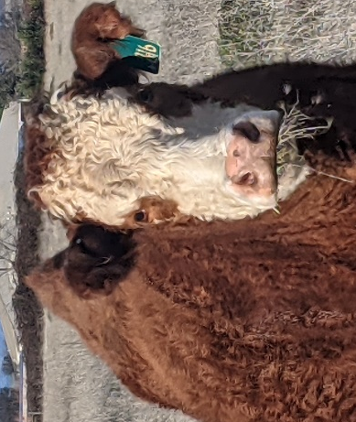
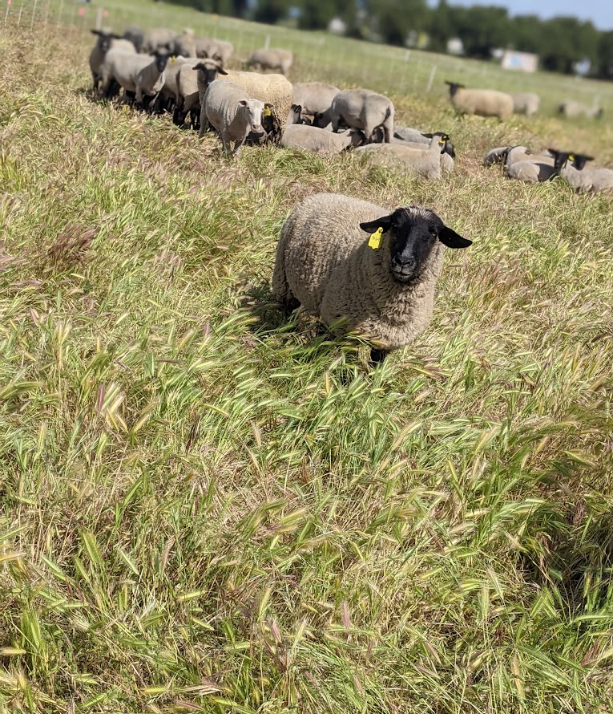
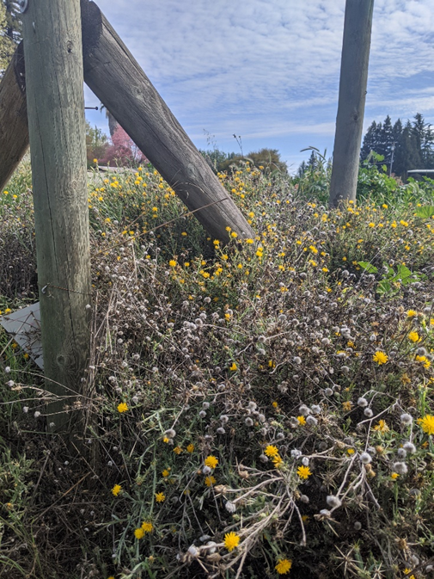
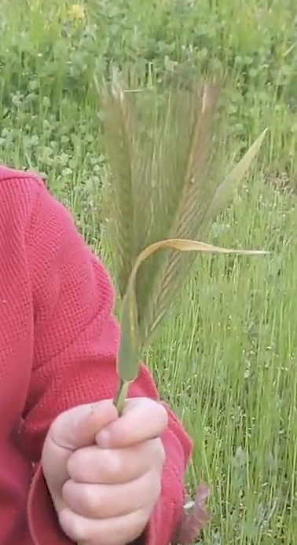
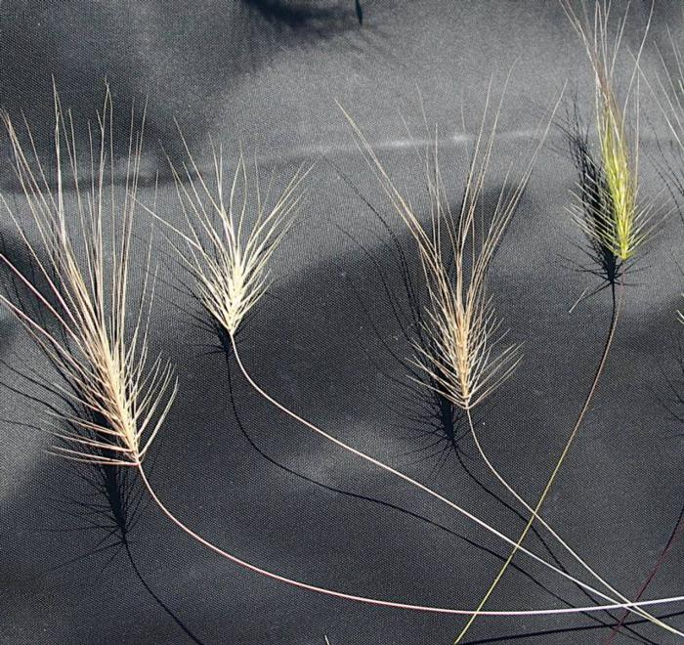
Fire Fuels Livestock Graze
Grasses such as Medusahead, wild oats and foxtail.
Starthistle before flowering.

Slide 17
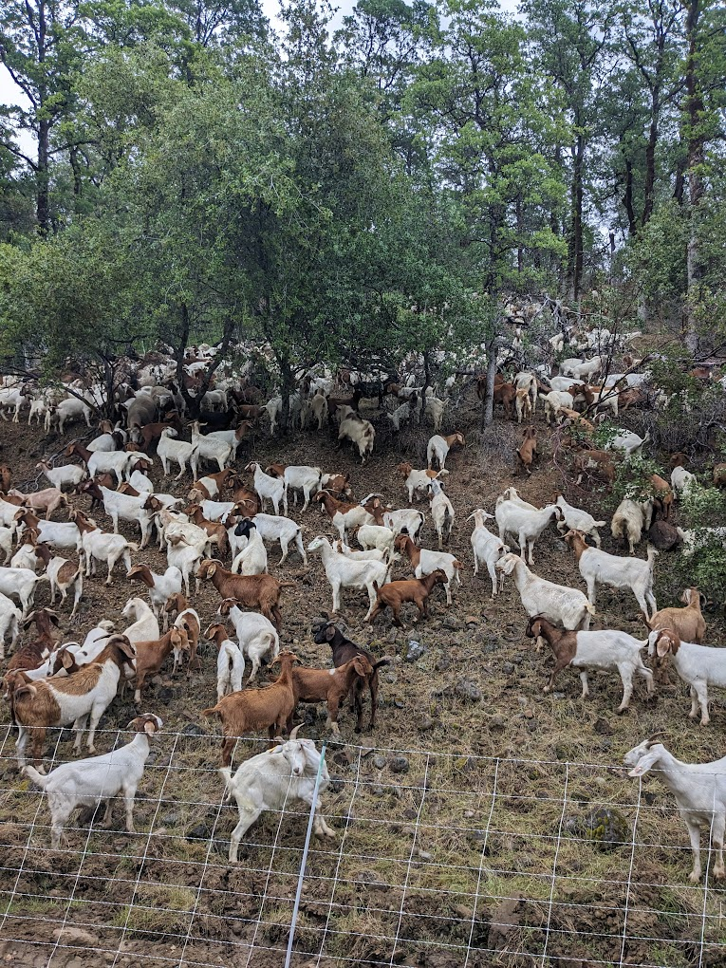
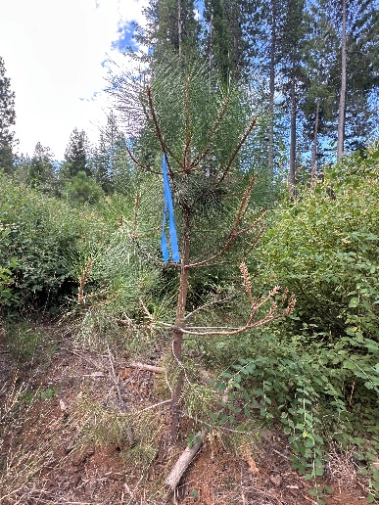
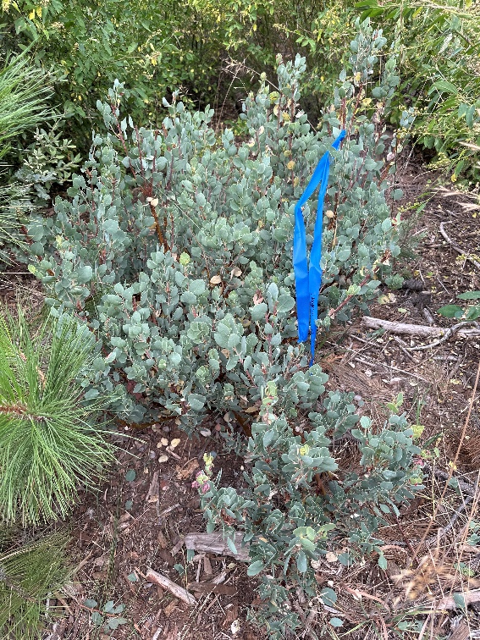
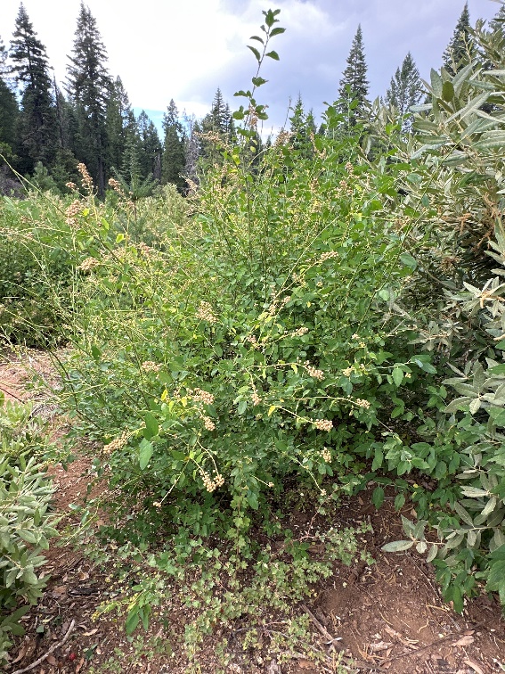
Fire Fuels Livestock Graze
Starthisle when flowering, deer brush, poison oak, blackberry, manzanita, pine, etc
Notes:
A few types of plant species that are on rangeland include

Slide 18
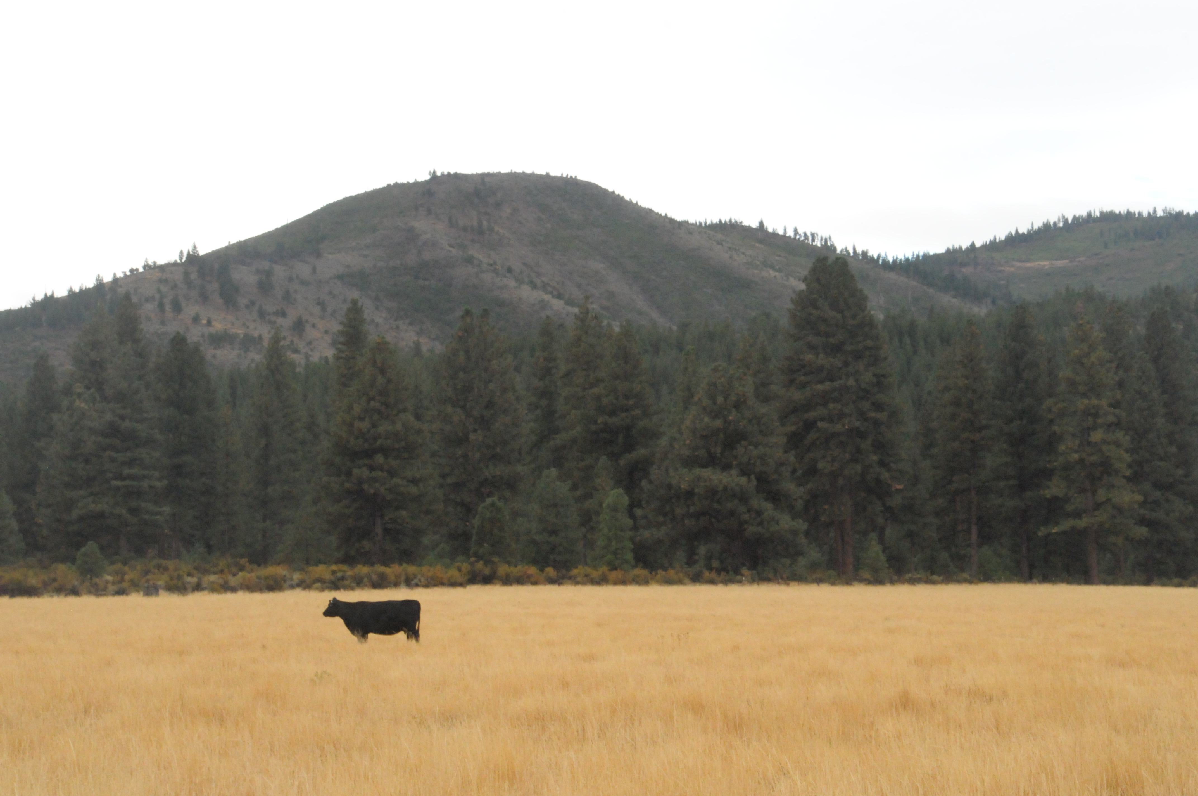
Managing Vegetation With Grazing
Prescribed grazing is the controlled implementation of the timing, frequency, and intensity of grazing to achieve specific goal(s).
Notes:
Prescribed grazing is the controlled implementation of the timing, frequency, and intensity of grazing to achieve specific goal(s).
Today’s conversation is about the specific goal of “reducing fire fuel loads”

Slide 19
Prescribed Grazing Program Elements
Property owner and manager must define:
  Type of livestock (e.g., cattle, sheep, goats)
  Number of livestock (stocking density – head/acre)
  Duration of grazing (stocking rate – head/acre/year)
  Seasonal timing of grazing (e.g., spring, summer, etc)
  Frequency of grazing (e.g., 1X, 2X per growing season)
  Spatial distribution of grazing (e.g., fences, water)
L.M. Roche
Notes:
Property owner and manager define when developing YOUR managed grazing program
Type of livestock (e.g., cattle, sheep, goats)
dependent on infrastructure , size of property and personal preference species
Main goals? Species of control - last webinar targeted grazing shared a lot of people look at “goats” when in fact sometime sheep may be a better option
Access to what animals – or purchase with background
Number of livestock (stocking density – head/acre)
Duration of grazing (stocking rate – head/acre/year)
4. Seasonal timing of grazing (e.g., spring, summer, etc)
Everyone wants animals June 1st when grass starts turning brown, but you can reduce fire fuel loads year round on a lot of the valley and foothill landscapes
Season long grazing – Nov-May
Or Year round grazing – unique situation – see this often in coastal landscapes or mixed use in foothills with reliable water supplies
CO BENEFITS WE WILL talk about later
Frequency of grazing (e.g., 1X, 2X per growing season)
Pastures to create rotation? Or come in to reduce thatch accumulation,
Ongoing maintenance - after camp fire you could see new grass cover in March, brush is already back 2 years later
Spatial distribution of grazing (e.g., fences, water)
Exterior
Interior – electric fencing?
Water
Multiple variables can influence where the grazing will congregate – forage, shade, water, fences. – These factors become more influences the larger the parcel size
BEFORE you start a grazing program you will want to clearly identify these factors

Slide 20
Grazing for Fire Prevention
Principles
Implementation
Effectiveness
Partners

Slide 21
Where might grazing be used to reduce fire fuels?
Brainstorm Session
Notes:
Brainstorm slide

Slide 22
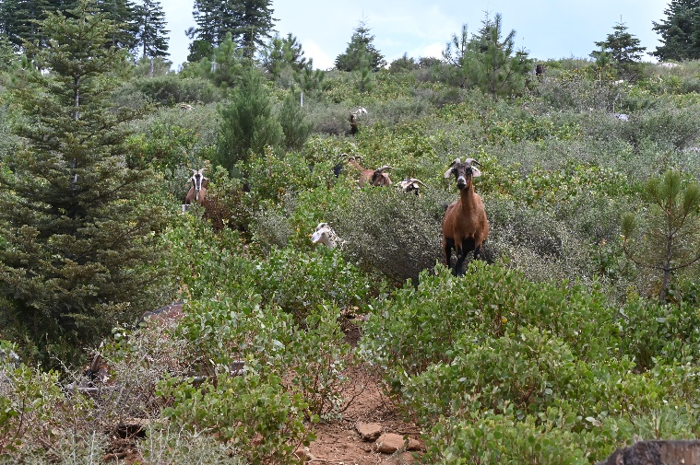
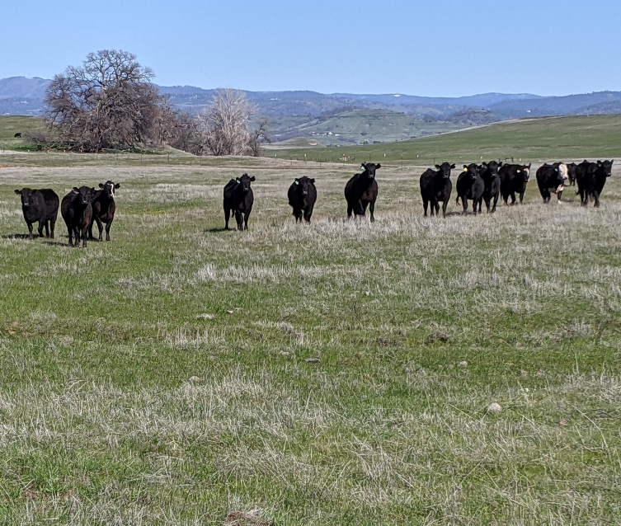
Where is there grazing to reduce fire fuels?
Vast Open Grasslands
Oak Woodlands
Forests
Wetlands – Refuges
Riparian Areas
Wildland Urban Interface
**Here are just a few examples to build on discussion.

Slide 23
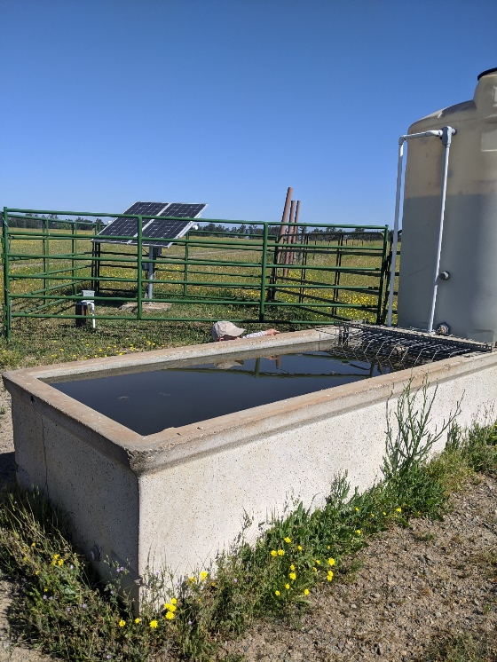
Infrastructure
Fencing
Drinking water
Supplemental feeding
Shade/shelter
Facilities
Dependent on parcel size and livestock species

Slide 24
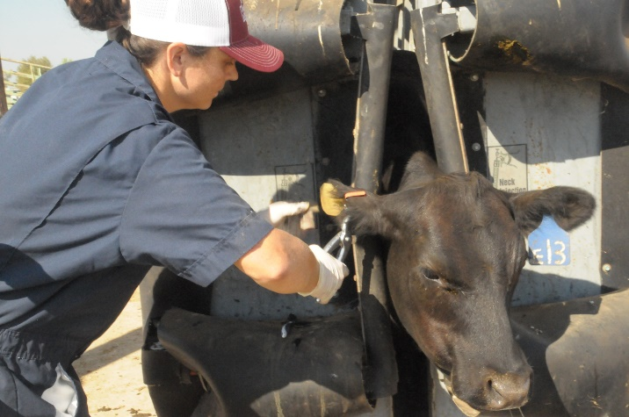
Key Considerations
Nutritional requirements
Supplemental feeding
Animal health
Plant health
Mitigate potential negative impacts
Emergency Plan
Lease/Contract/Agreement
Notes:
Nutritional requirements ‐ vary annually (e.g., breeding, gestation, lactation, growth)
Supplemental fending – season, situation
drought, under estimate production, having livestock year round
Animal health (e.g., poisonous plants, vaccinations, predators),
Plant requirements to conduct critical functions (e.g., photosynthesis, reproduction)
Mitigate potential negative impacts of animals on soils, erosion , riparian areas – water quality
Emergency Plan – fire, PG&E power shutoffs – water well, flood, freeze - impact growth and animal health
Lease/Contract/Agreement – terms and conditions of responsibility, insurance and goals.
Lease out/contract grazing - Communication between landowner and grazing operator is paramount
- Communication is key!

Slide 25
Grazing for Fire Prevention
Principles
Implementation
Effectiveness
Partners

Slide 26
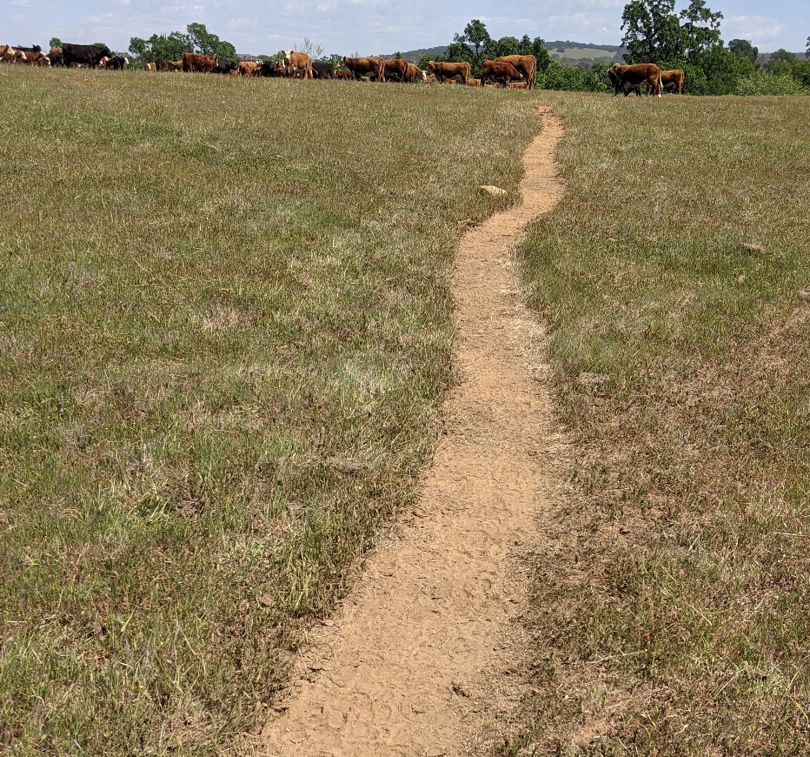
Grazing potential to mitigate wildfire intensity and frequency
Creates Gaps in Fuel Continuity
  Herbivory – livestock consuming vegetation and preventing it from being within flame length
  This includes indirect breaks in vegetation that can come from livestock trails, roads, dozer lines put in by ranchers, etc.

Slide 27
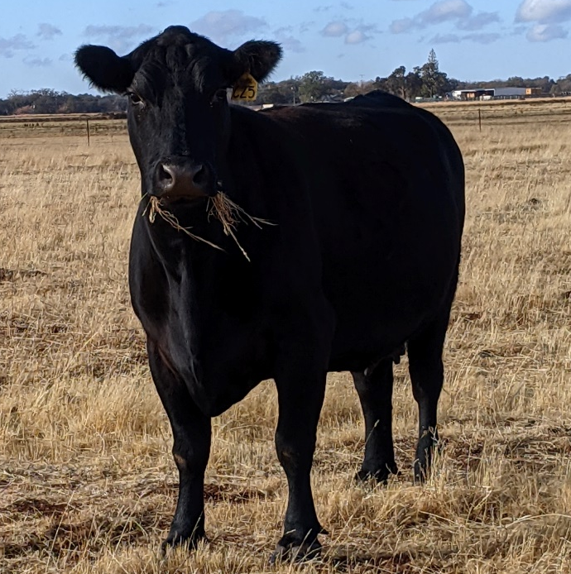
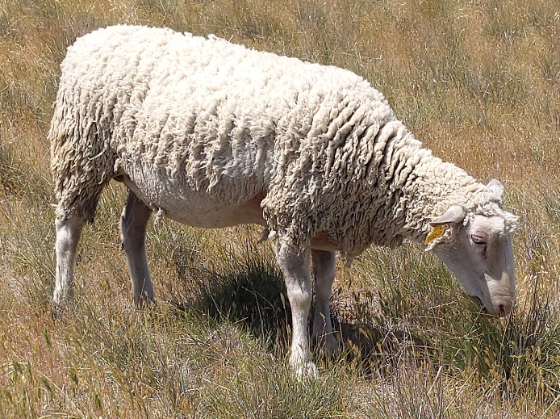
Grazing potential to mitigate wildfire intensity and frequency
Reducing fuel biomass
  Research estimates 596 lbs per acre removed by cattle grazing each year in California.

Slide 28
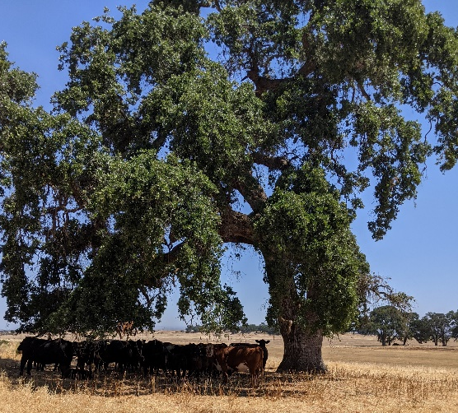
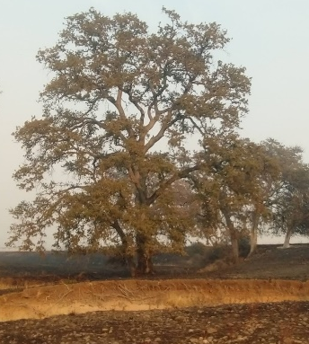
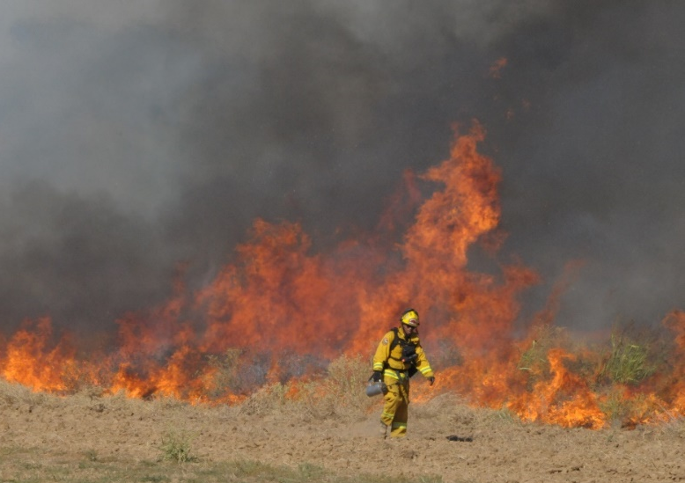
Grazing potential to mitigate wildfire intensity and frequency
Remove ladder fuels that can take ground/grass fire to tree fire
Reduce wildfire flame length
Decrease rates of spread
Notes:
Additionally, grazing is important to reducing flame length, particularly underneath trees – called ladder fuels.
The reduction or elimination of ladder fuels can reduce the likelihood of trees catching fire and contributing to a crown fire
Crown fires are when the trees tops are on fire rather than the vegetation on the ground.

Slide 29
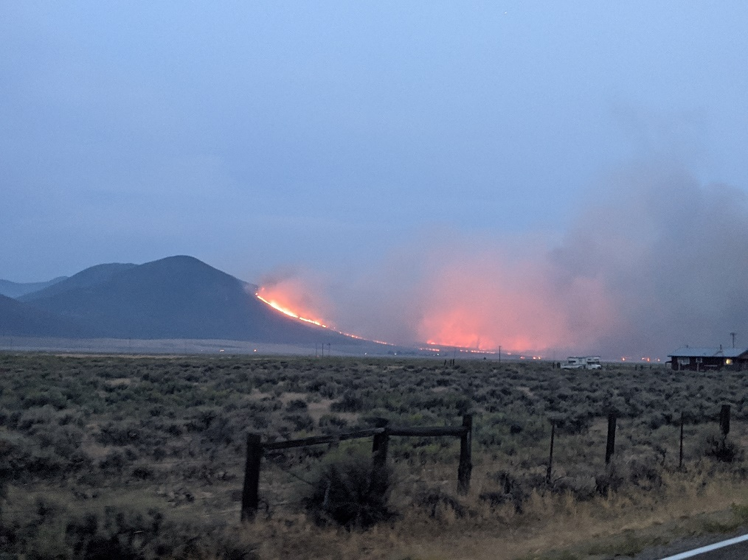
Co-Benefits from Grazing
Significant reductions in CO₂ emissions from wildfires
Notes:
Reducing fuels with grazing can mitigate wildfire intensity and frequency providing significant reductions in CO2 emissions from wildfires.

Slide 30
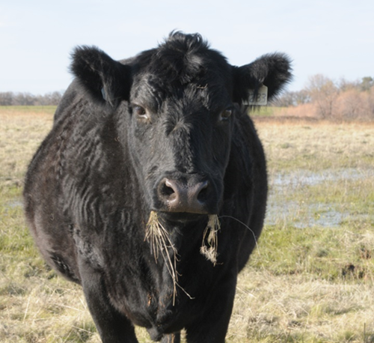
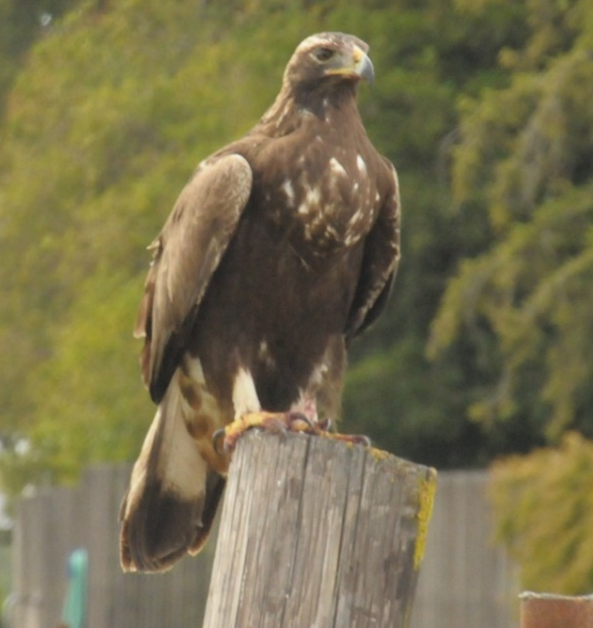
Co-Benefits from Grazing
Invasive Species control “Timing”
  Yellow Star thistle
  Brush
Wildlife Habitat
  Raptor, borrowing owls, grassland birds
  Butterflies
  Kit Fox
Local Foods
Local Economy
Notes:
Primary goal of prescribed grazing is reducing “1 hour fine fuels” vegetation – but that are other co-benefits if you considering timing and implementation that RESEARCH has found – just to highlight a few
Invasive Species control “Timing”
Yellow Star thistle
Brush
Wildlife Habitat - reducing thatch – vegetation cover
Raptor, borrowing owls, grassland birds – removing thatch so they can see pray and burrowing owls so they can see predators
Butterflies - promote habitat by reducing non native annuals, promoting key native plants
Kit Fix – prefer grazing landscapes
Vernal Pools
Unique ecosystems
**picture of cow eating dry medusahead with a vernal pool behind
reduce Non native annual grasses, promote native vegetation endemic to vernal pool ecosystems
Local Foods
Local Economy

Slide 31
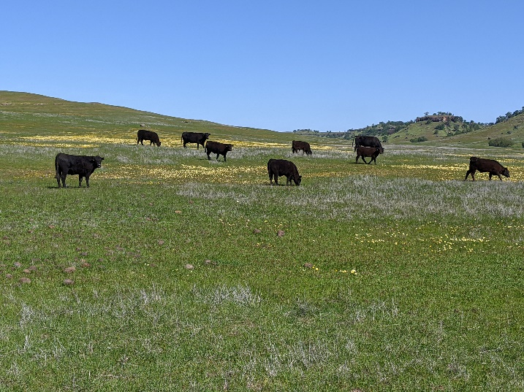
Challenges with Targeted Grazing
Balance healthy land and healthy animals
Bare ground = invasive weeds
Soil stabilization
Erosion control
Notes:
Wrapping up our foundational principles section - we are creating fire resistant landscapes with livestock grazing
**Understand that livestock grazing is not Fire Proof the goal is to reduce fire fuel loads while
Balancing healthy land and healthy livestock grazing animals
If we take off to much cover – it will lead to bare ground – creating a prime opportunity for invasive weeds to flourish – counter to mission
You want to leave cover to promote good grasses and forages, soil stabilization and prevent erosion.
Balancing act – need Flexible as a grazer and flexible as a landowner
Last Seminar –Quote- No place that we graze that wont burn when we are done….it will all carry a fire, but what we are doing with our grazing animals is changing the characteristics of the fire. Brad Fowler
3rd speaker today

Slide 32
Fire Resistant – NOT Fire Proof
No place that we graze that will not burn when we are done….it will all carry a fire, but what we are doing with our grazing animals is changing the characteristics of the fire.
- Brad Fowler
Notes:
Quote for a targeted grazer - No place that we graze that wont burn when we are done….it will all carry a fire, but what we are doing with our grazing animals is changing the characteristics of the fire. Brad Fowler
3rd speaker today

Slide 33
Grazing for Fire Prevention
Principles
Implementation
Effectiveness
Partners
Notes:
Today’s presentation is the start of a conversation.

Slide 34
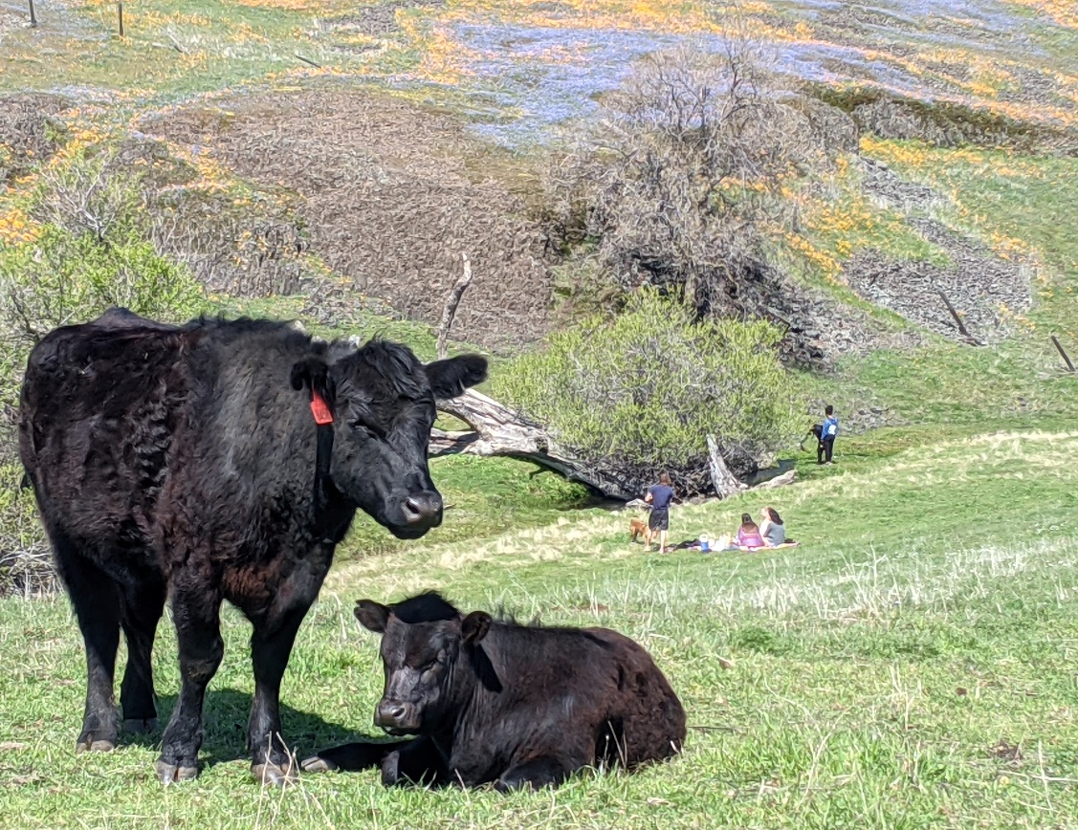
Case Example
California Department of Fish and Wildlife
Table Mountain Ecological Reserve in Oroville, California
Grazing to reduce fire fuel and control invasive weeds to promote wildflowers.

Slide 35
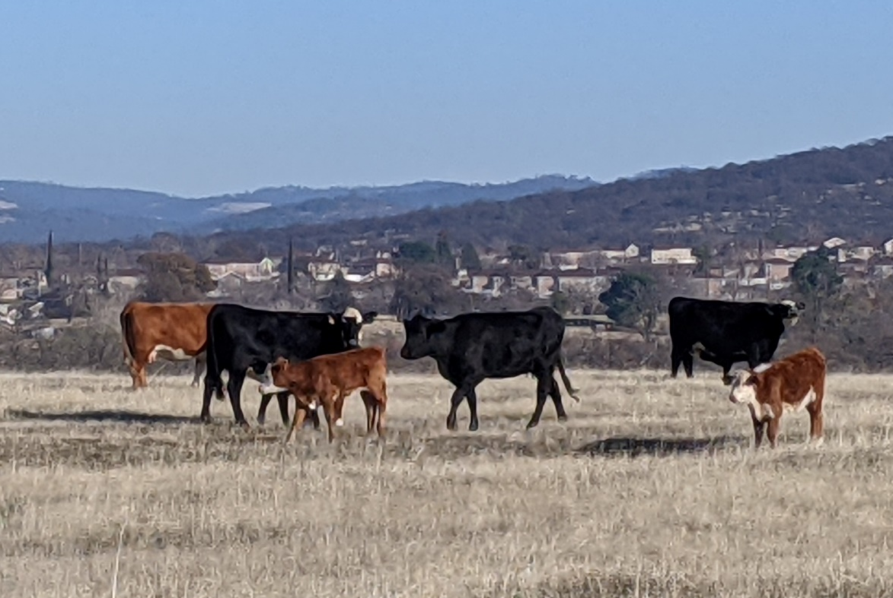
Case Example
Department of Defense
Beale Air Force Base
Marysville, California
Grazing to reduce fire fuels, control invasive weeds, and support wildlife habitat.

Slide 36
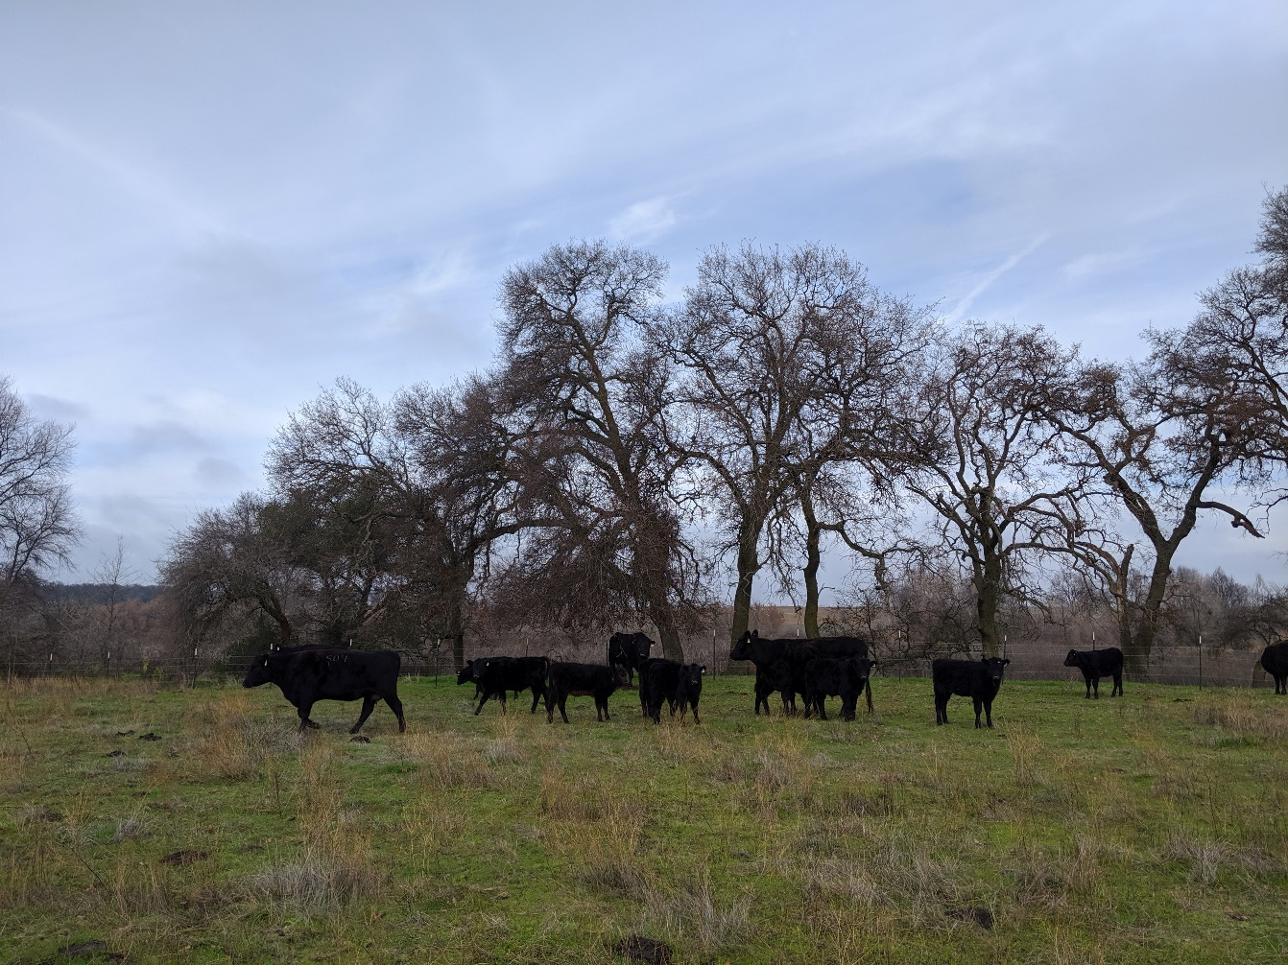
Case Example
Placer Land Trust
Lincoln, CA
Grazing to control invasive weeds promoting vernal pool ecosystems, burrowing owl habitat, raptors and more.

Slide 37
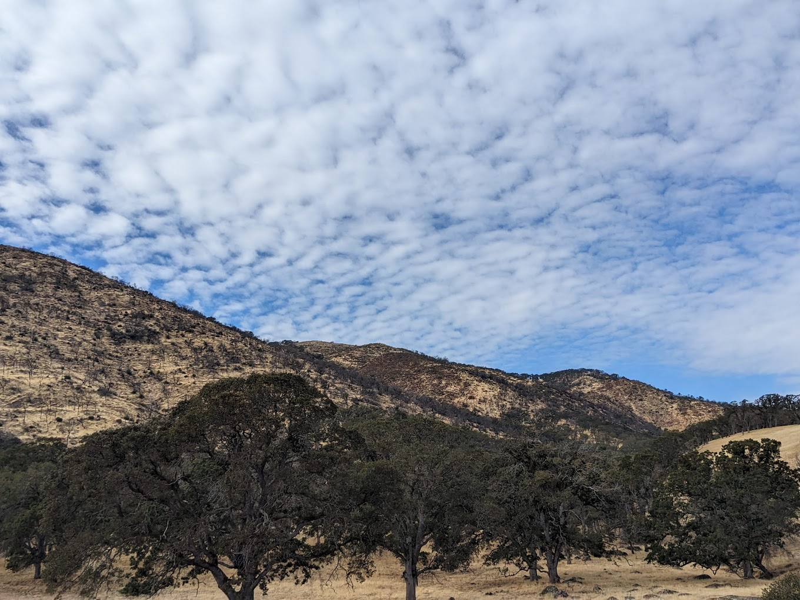
Case Example
East Bay Regional Parks
Round Valley Regional Preserve
Brentwood, CA
Grazing to control invasive weeds promoting wildlife habitat in conjunction with recreation.

Slide 38
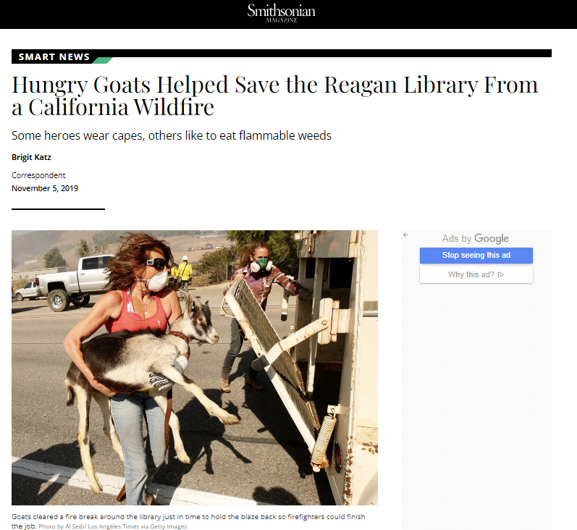
Case Example
Notes:
https://www.smithsonianmag.com/smart-news/hungry-goats-helped-save-reagan-library-california-wildfire-180973461/

Slide 39
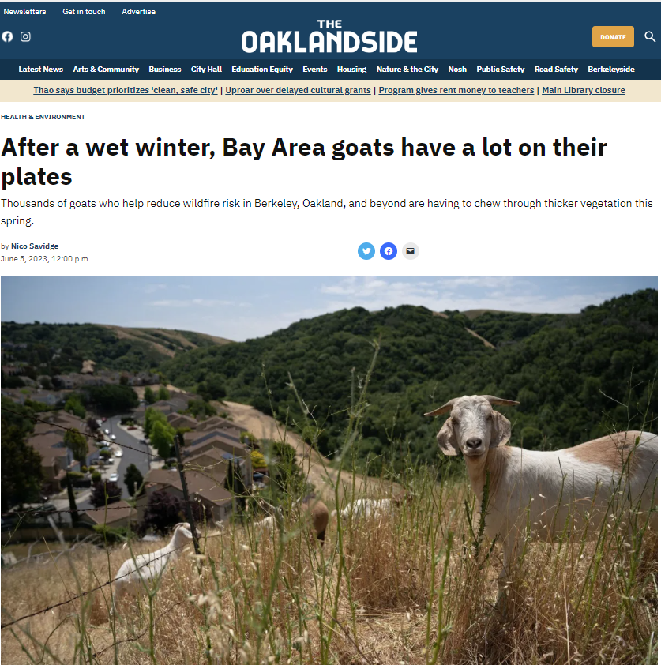
Case Example
Notes:
https://oaklandside.org/2023/06/05/after-a-wet-winter-bay-area-goats-have-a-lot-on-their-plates/

Slide 40
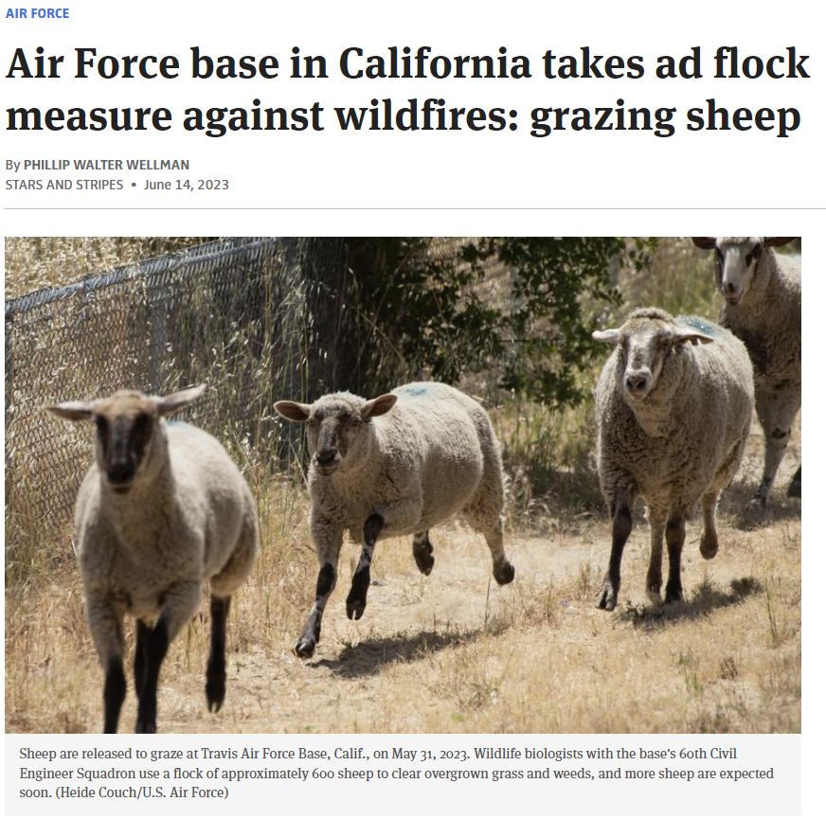
Case Example
Notes:
Sheep at Travis Air Force base in Fairfield, California https://www.stripes.com/branches/air_force/2023-06-14/sheep-fires-travis-air-force-10433404.html

Slide 41
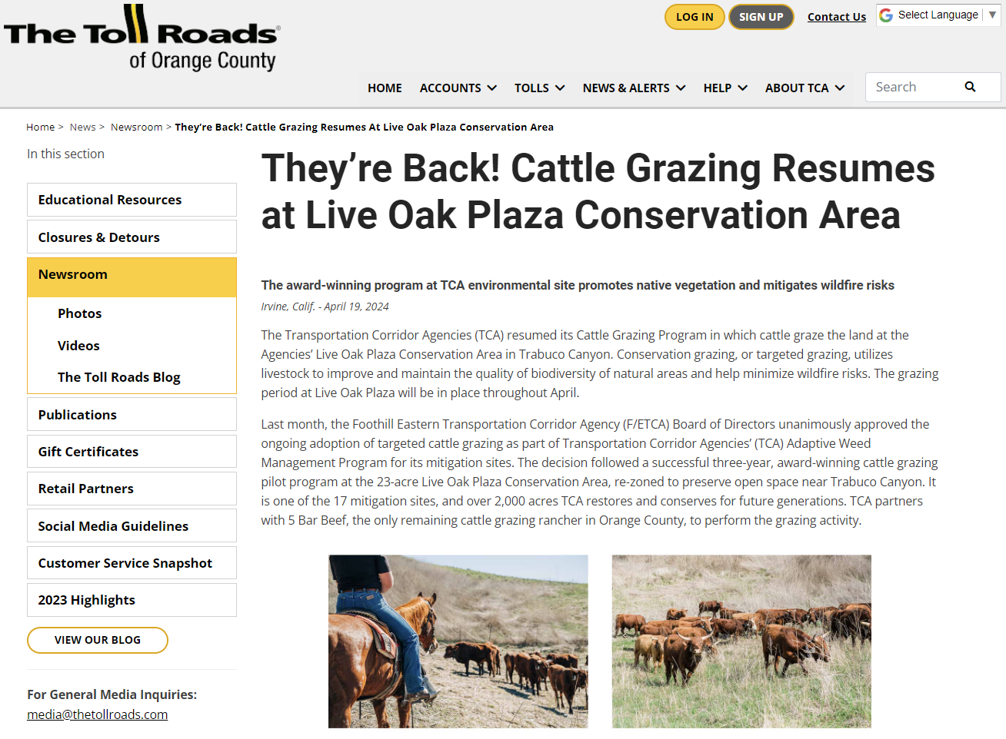
Case Example
Notes:
Sheep at Travis Air Force base in Fairfield, California https://www.stripes.com/branches/air_force/2023-06-14/sheep-fires-travis-air-force-10433404.html

Slide 42
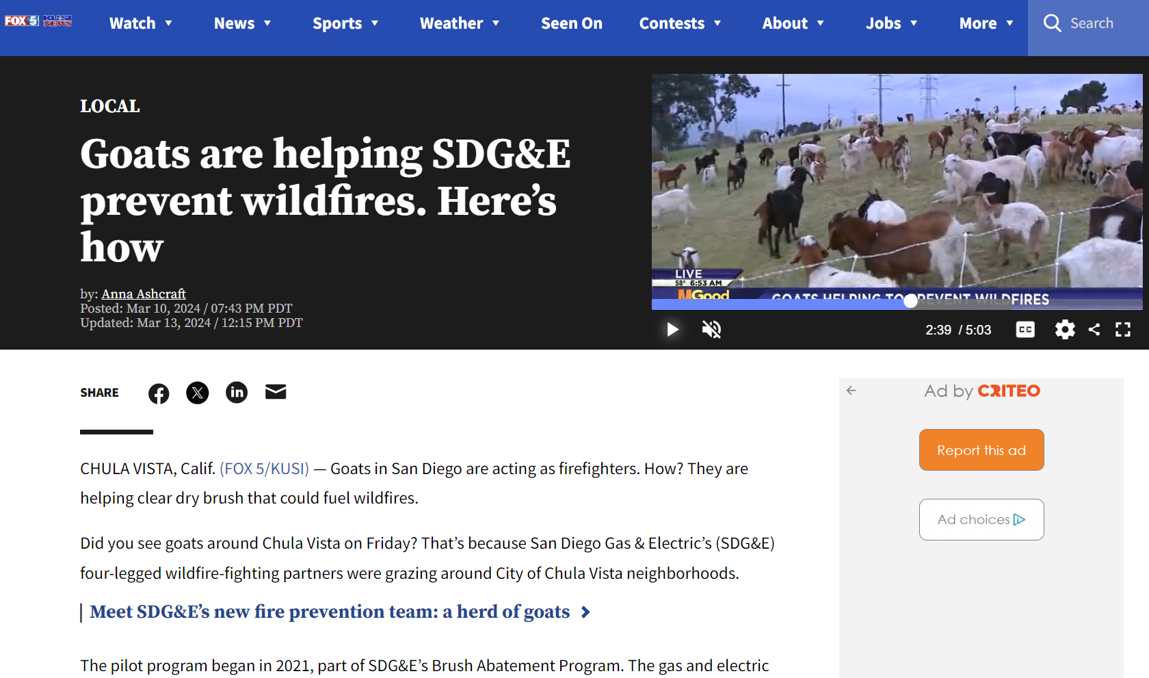
Case Example
Notes:
Sheep at Travis Air Force base in Fairfield, California https://www.stripes.com/branches/air_force/2023-06-14/sheep-fires-travis-air-force-10433404.html

Slide 43
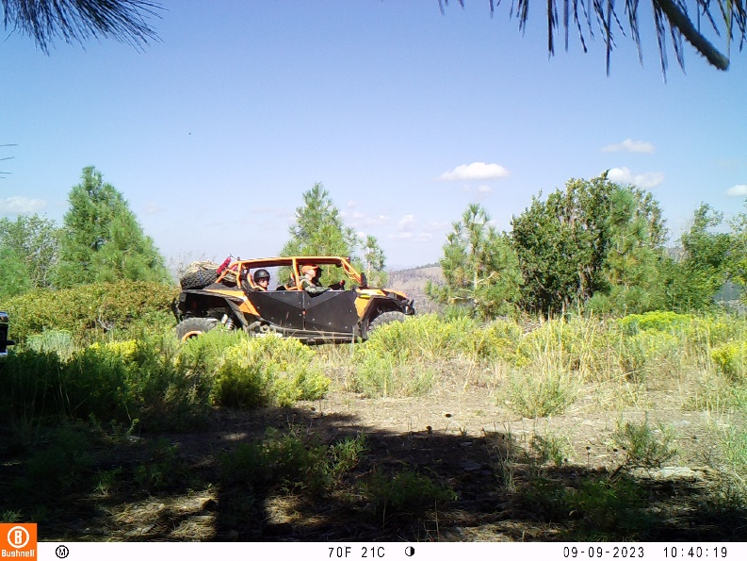

Rangeland Trivia –
Who has the right-of- way?

Slide 44

Rangeland Trivia – Who has the right-of- way
Per vehicle code 21759, the driver of any vehicle approaching any horse drawn vehicle, any ridden animal, or any livestock shall exercise proper control of his vehicle and shall reduce speed or stop as may appear necessary or as may be signaled or otherwise requested by any person driving, riding or in charge of the animal or livestock in order to avoid frightening and to safeguard the animal or livestock and to insure the safety of any person driving or riding the animal or in charge of the livestock.
Please be patient and courteous around livestock!

Slide 45


Rangeland Trivia –
Importance of these images?

Slide 46

Rangeland Trivia –
Importance of these images?
Guard Dogs
Toxic Plants

Slide 47
Resources
Cooperative Extension Advisor
Universities
Resource Conservation District
Natural Resources Conservation Service
Fire Safe Council
More!
Notes:
There is a growing list or resources, technical service producers that assist with the implementation of targeted grazing to reduce fire fuels including –
Cooperative Extension Advisor
Universities
Resource Conservation District
Natural Resources Conservation Service
Fire Safe Council
More!

Slide 48


Experiment with Fire Board
Goal: Demonstrate fire fuels on rangelands
Supplies Needed: Fire board, matches, mister fan with batteries and water, fire extinguisher, needle nose pliers, water supply, safe location with no wind, non-flammable clothing and personal protective gear.
Experiment 1 place matches in all holes
Experiment 2+ Use different variables to create different fire scenarios.
Variable Ideas:
  Slope (add a brick under board on one end)
  Wind (use fan)
  Humidity (fan water mister)
  Fuels (matches density and spacing)
Hint: Do not let matches completely burn. Putting out early will make match removal easier. Use needle nose pliers if they burn to short.
Click here for guide online with additional details

Slide 49
Recap
Types of rangelands
Principles of grazing
Infrastructure needed for grazing
Key considerations when using grazing
Resources to help with grazing management
Case examples of where grazing is reducing fire fuels

Slide 50
Unit Review Choice Board
Grazing for Change Read booklet and provide 10 bullet points of lesson learned from additional reading | Grazing in Action Look up a news article or paper on grazing to reduce fire fuels. Write about the 5 w’s – Who, What, When, Where and Why | Poster Create poster with 8 elements on grazing. Must include color, graphics, and facts.
Fact Sheet Create a fact sheet on Toxic Plant, include scientific name, picture, 3-5 sentences, and source of information. | Social Media Create a fake post on the value of grazing to reduce fire fuel loads. Must include picture and source of picture. | Flip Book Create a flip book on Grazing to reduce fuels with 4 to 6 categories

Slide 51
Expanded Learning

Slide 52
Grazing for Fire Prevention
Principles
Implementation
Effectiveness
Partners
Notes:
Today’s presentation covered the principles of grazing to reduce fire fuels, implementation, effectives and showcased partners

