Slide 1
FFY 25 Eating & Activity Tool for Students Survey Administration Training
July 16, 2024
Hosted by:
Amanda Linares

Slide 2


Access the recording & slides
Find the webinar recording and this slide deck on the IOE Website

Slide 3
Training Objectives
Become familiar with the Eating & Activity Tool for Students (EATS) and the options for administering
Understand survey administration protocols and best practices
Know how to navigate the website and locate survey administration resources
If applicable, feel confident you can train survey administrators not in attendance today, e.g., classroom teachers

Slide 4

Agenda
Announcements
Recap IOE Process & Timeline
Eating & Activity Tool for Students, Protocol & Administration Best Practices
Online Resources
Next Steps & Key Takeaways
Q & A

Slide 5

Announcements

Slide 6
Upcoming Dates
IOE Quarterly Call
  Tuesday, October 15th at 10am
  Pre-register: https://ucanr.zoom.us/meeting/register/tJIqfuGqrjkiGtKggwJ8MOPpZkMl9LaEbQBq
Cross-Project Office Hours
  September 19th at 11am
  Pre-register: https://ucanr.zoom.us/meeting/register/tJMudOyvrzksE9MfRBm0dE16ohHJ9AD80LJF
Amanda Vacation
  July 17th-28th
  For anything critical, email EvaluateSNAPEd@ucanr.edu
  Non-critical items, wait until I return

Slide 7
NPI’s Annual TA & Training Survey
When: June 17th-
July 31st
Where: https://ucanr.co1.qualtrics.com/jfe/form/SV_0diyh5QzX7RlnFk
What: Take a ~15 minute survey to help NPI best support your evaluation!

Slide 8
How we used results from last year:
IOE
Student Unique ID Organizer
EATS migration to S123
Updated infographic design
PEARS
Mastering PEARS Videos
PEARS Site Search Tool
Retail Reach Web Tool
Community-level Survey Preview
Organizational-level Survey Preview
SLAQ
OAQ Training
LHD-level SLAQ Change Reports
LEAP Awards and Digital Promotions Package
School/OST SLAQ release timing
Cross-Project
FFY 23 Statewide Data Brief Reports
Data Storytelling Toolkit
Re-vamped LHD Connect and All-LHD Call updates
LHD Evaluation website improvements

Slide 9
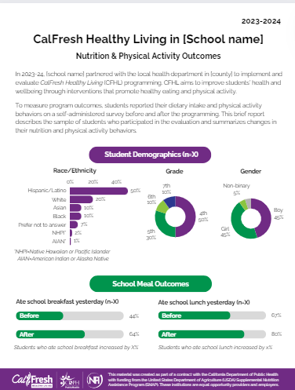
Coming Soon: Site-Level Infographics
https://ucanr.edu/sites/LHDEvaluation/NPI_LHD_Evaluation_OneDrive/
If you are unable to access:
Existing users: Email EvaluateSNAPEd@ucanr.edu for access
New users: Obtain PD approval, then email EvaluateSNAPEd@ucanr.edu for access
Target Release: Late August

Slide 10

IOE Process
& Timelines

Slide 11
Welcome to FFY 25 IOE!
Impact Outcome Evaluation aka “IOE”
IOE = Evaluation of school-based interventions (that typically include series-based direct ed)
IOE ≠ Not evaluation of direct ed
IOE = Evaluation on full school year timeline for all i.e., pre/post, beg/end of year regardless of DE timing
IOE is required of all LHDs conducting series-based (3+) DE in school/afterschool with grades 4-12

Slide 12
Site requirements by funding tier
Funding Tier | Number of Schools* | Students per school** (Matched) | Or | Students per afterschool** (Matched)
5 | 5 | 30 (At least 2 classrooms) |  | 30 (Or max students attending)
4 | 4
3 | 3
2 | 2
1 | 1
* If you do not plan to conduct series-based DE in the number of schools required by your funding tier, you can evaluate in the max number of schools in which you do have applicable intervention.
** Required sample for site-level and state-level analysis.

Slide 13

IOE Timeline
Mar.–June
Engage school(s) for next FY
Plan intervention
June–Aug.
Identify classrooms/teachers
Train survey administrator(s)
Complete Planning Worksheet
Aug.–Oct.
Turn in Planning Worksheets/get links
Pre-test students*
Sep.–May
Conduct intervention (timeline variable)
Apr.–June
Post-test students
Update Planning Worksheet
Turn in all deliverables by June 30th
We are here!
* If your site(s) engage in September’s RYD activities, be sure to pre-test BEFORE!

Slide 14
Why conduct IOE?
Two purposes of IOE →
Continuous improvement (local)
Overall impact (statewide)
Evaluation requirements should not dictate intervention!

Slide 15
IOE Participation
Identify your sites, classrooms & intervention
1
Complete a Planning Worksheet, share it with me & receive site links
2
Pre- and post-test 2+ classrooms/site at beginning & end of school year using EATS
3
Update Planning Worksheet & complete surveys by June 30th annually
4

Slide 16
IOE Participation
Standardized evaluation timeline
Full school year evaluation, regardless of DE timing
Pre-test: Aug-Oct, Post-test: Apr-Jun
Pre/post target is within 6 weeks of the first/last day of school
Site requirement dictated by your LHD funding tier
1-5 sites
Or max number of sites with series-based DE
Not required to remain in same sites year-to-year
But you can!
If you are, be sure to share infographic early

Slide 17
Alternative Interventions
Though your series-based DE may make IOE a requirement for you, we can assist you in evaluating alternative school-based interventions as part of IOE, if desired.
Example: Single-session DE + robust PSE efforts

Slide 18

FFY 25 EATS, Protocol & Best Practices

Slide 19

Eating & Activity Tool for Students
24
Qs to assess behaviors before/after intervention
4 demographic (data card)
15
dietary intake
3
PA behavior
14/24
validated from SPAN

Slide 20
Eating & Activity Tool for Students
Survey is available:
Online (Survey123) or paper
Online recommended
English and Spanish
Supporting materials include:
Detailed survey administration protocol
Abridged protocol i.e., Survey Essentials Guide
Parent Opt Out Form (REQUIRED)

Slide 21
FFY 25 EATS Modifications
No major changes
Slight wording change to improve readability
Removal of diet soda question
Addition of Middle Eastern or North African
Replacement of race/ethnicity Other with I don’t want to answer (alignment with youth data card)
Emphasis on LHD/sub administration (when feasible)

Slide 22

Survey Administrator
Preferred: LHD and/or subcontracted CFHL staff
Typically, better trained on protocol
  Prevents data loss
  Improves data quality
If classroom teacher is only feasible option, ensure they are trained!
  Student unique identifier assignment
  Opt out form distribution
  Opt out (parent/student) tracking
  Days surveying is allowed

Slide 23
Best Practices for Teacher Administration
Develop a timeline and plan together! Establish the pre and post dates upfront.
Discuss roles and responsibilities. Even if a teacher is administering you can assign student IDs and maintain tracking (opt out) sheet.
Familiarity prior to administration
  Anticipate questions students may ask, e.g., race/ethnicity
  ID 999 to “test” survey
Flexible training is ok!
  Recorded training (this one or short version)
  One-on-one using protocol, essentials guide, slides

Slide 24

Helping Students Identify Race/Ethnicity
American Indian or Alaska Native (North, Central or South American)
Asian (Chinese, Korean, Vietnamese, Filipino, Cambodian, Hmong, Indian, Thai, etc.)
Black or African American (Middle/South African countries not counted as MENA)
Hispanic or Latino (Mexican, Cuban, Puerto Rican, South or Central American)
Native Hawaiian or other Pacific Islander (Guamanian, Samoan, etc.)
Middle Eastern or North African (Lebanese, Iranian, Egyptian, Israeli, etc.)
White* (European)
*Includes Armenian

Slide 25
Student Unique Identifiers
To maintain our Exempt status with the Institutional Review Board, NPI cannot collect student identifying information like student names or their school-issued ID numbers.
Thus, you will need to collect your data de-identified.
To do this, you will assign each student a unique identifier.

Slide 26
Student Unique Identifiers
Unique student IDs must:
Have 3 digits*
Be numeric only*
Not contain leading zeros, e.g., 001
Not be duplicated within a school site
* Avoid using 999

Slide 27
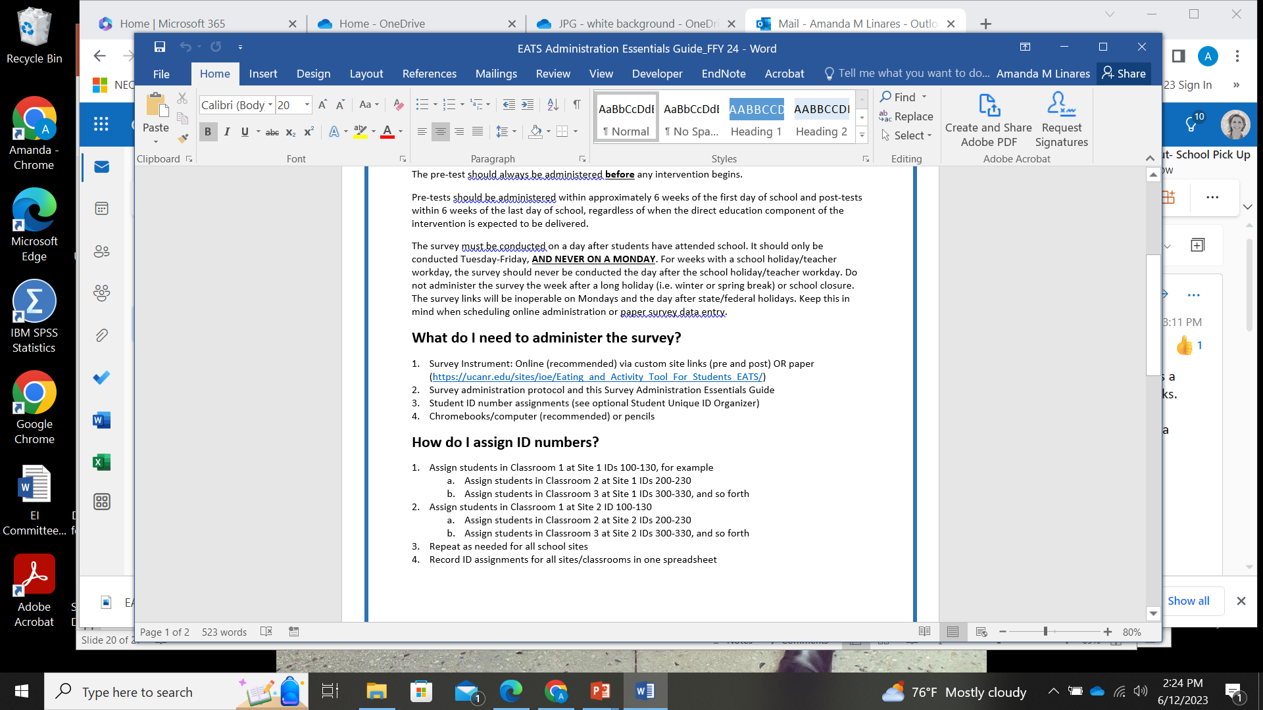
Recommended Approach
← Included in the Survey Essentials Guide!
Easily keep track of IDs with the Student Unique ID Organizer!

Slide 28
Consent
Consent
Parent
Opt Out Form sent home two weeks before pre-test
Student
First page of survey

Slide 29
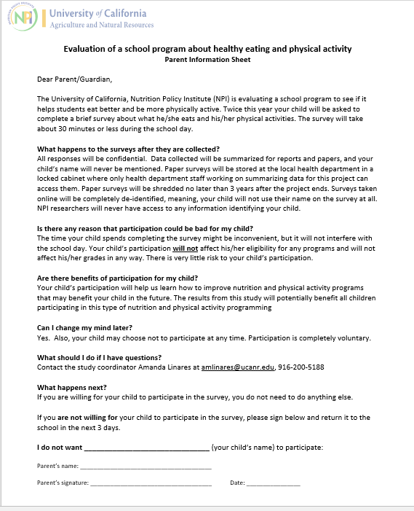
Parent Opt Out Form
Send home with all students who will be administered EATS at least two weeks prior to pre-test
Paper or parent communicator app, e.g., Parent Square
Do not survey students who return a signed form
Be mindful of when you send it out, i.e., not with other forms requiring a signature
No need to distribute at post-test
No need to receive a form back from all parents

Slide 30
Parent Opt Out- Languages
Arabic
Armenian
Chinese (traditional)
Korean
Pashto
Russian
Spanish
Vietnamese
Farsi
Punjabi
Send me an email if you’d like to request additional languages!

Slide 31
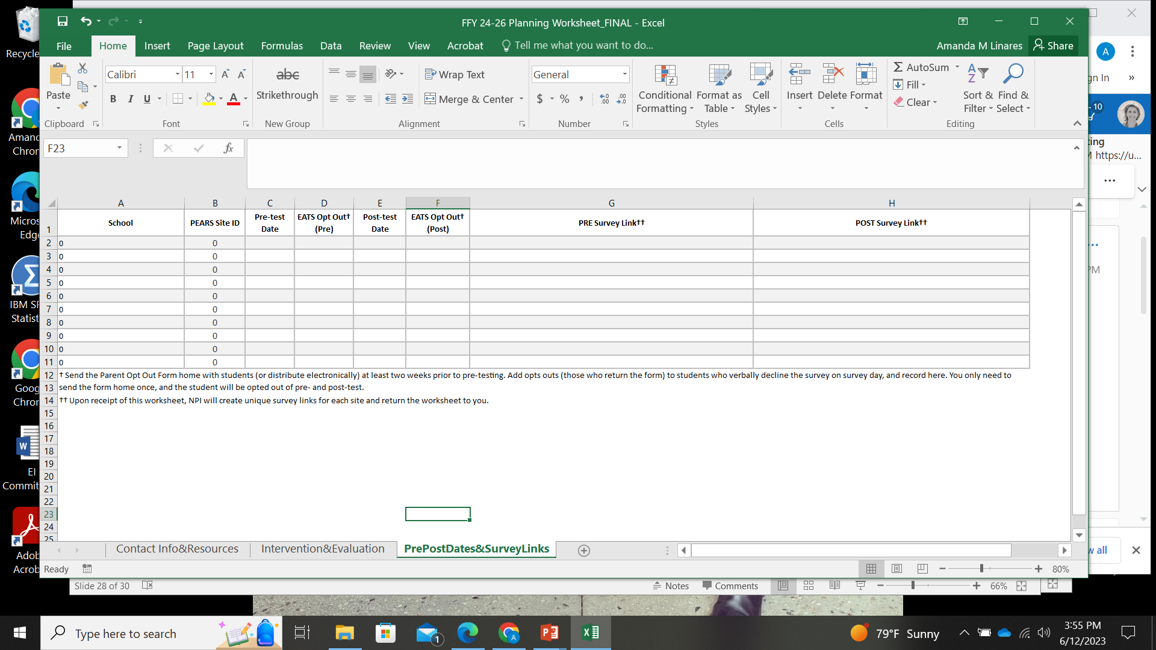
Recording Opt Outs
Opts outs must be collected and recorded on the Planning Worksheet.
If classroom teachers/district staff are administering, be sure they track this!

Slide 32
When to administer
The survey is intended to capture student eating and physical activity behaviors on a regular school day!
Because questions ask about yesterday, the survey must be done Tuesday through Friday.
EATS should never be given on a day following a school holiday or the week after a full week break from school.

Slide 33
Survey Links
Separate pre and post links, custom to each school
LHD, school name, PEARS site ID, and pre/post are embedded in each link and auto-populate in the survey
Embedded data cannot be edited
Use full link
Paper surveys are also entered into your site-specific links
Survey data are never entered into PEARS
https://survey123.arcgis.com/share/aac4e09b19a245129e269e876885df93?field:LHD=test&field:SchoolName=test&field:SiteID=999&field:PrePost=1
*Links close Friday 4pm - Monday 4pm and over winter holiday

Slide 34
Survey Links
You can use link shortening tools, e.g., Bitly or TinyURL
Be sure to test it first!
You can switch methods!
Pre to post or between schools
Look for auto-population of embedded data

Slide 35
Let’s take a look at the survey and protocol…

Slide 36

Online
Resources

Slide 37

Next Steps
& Takeaways

Slide 38
Complete a Planning Worksheet
The latest version of the Planning Worksheet is available on the website: https://ucanr.edu/sites/ioe/files/398504.xlsx
Grab a new one for FFY 25!
Complete and send to me (or add to LHD OneDrive folder) between now and October
I will return it to you with pre and post links

Slide 39
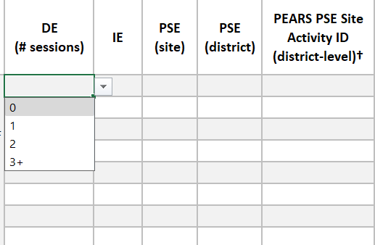
Updated FY 25 Planning Worksheet
To identify alternative interventions the worksheet now asks for the number of sessions of DE: 0, 1, 2, 3+

Slide 40
Key Takeaways for Success
Plan early! Plan to survey on a day when students were in school the previous day and week.
1
Don’t forget! Parent Opt Out Forms should go home at least two weeks before pre-testing.
2
Train EATS administrators! Especially on unique ID assignment, which days to survey, and tracking opt outs.
3
Distribute the correct link! Be sure to distribute the link that corresponds to the given survey time point and do not truncate links.
4
Track/log opt outs on survey day! Collect and log parent and student opt outs the day of, rather than trying to recall this info in June.
5

Slide 41

Communication is key
Having technical difficulties?
Trouble connecting with your teachers?
Any other issues that will affect the evaluation you had planned?
If yes, let’s discuss before the end of the year!

Slide 42
Stay Informed
Join the listserv
1:1 planning meeting with me
Next Quarterly Call: Tuesday, October 15th at 10am
  Pre-register: https://ucanr.zoom.us/meeting/register/tJIqfuGqrjkiGtKggwJ8MOPpZkMl9LaEbQBq

Slide 43

Questions?

