Slide 1
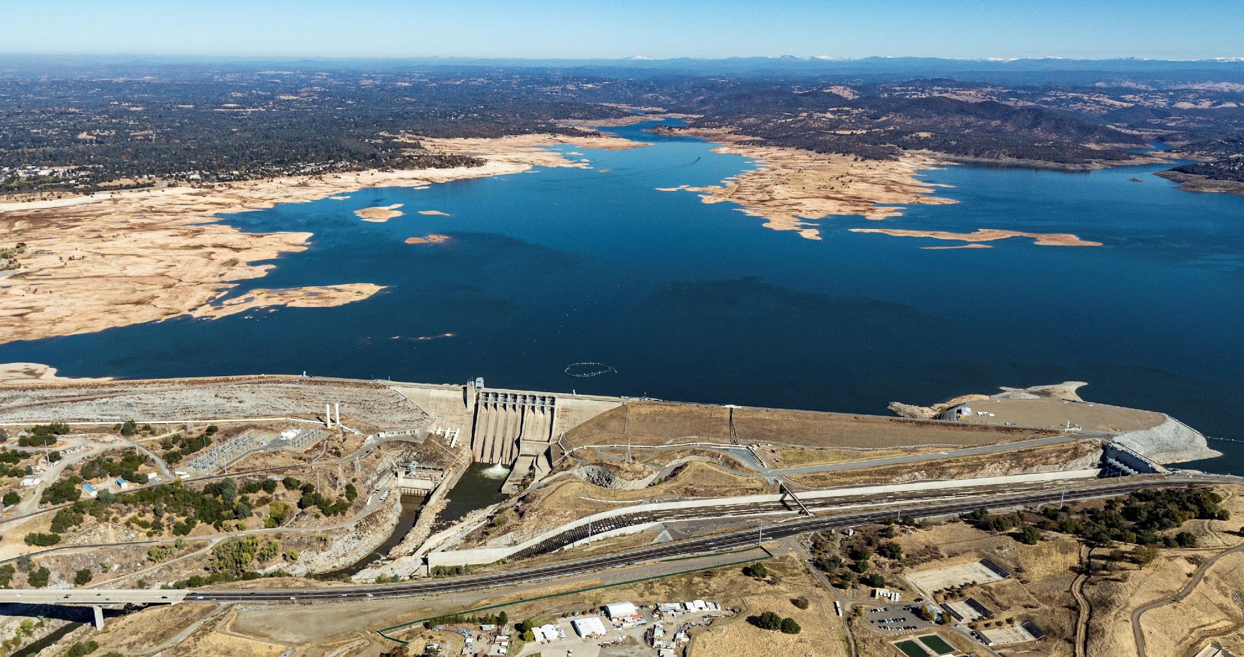
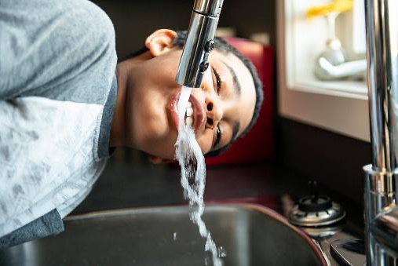

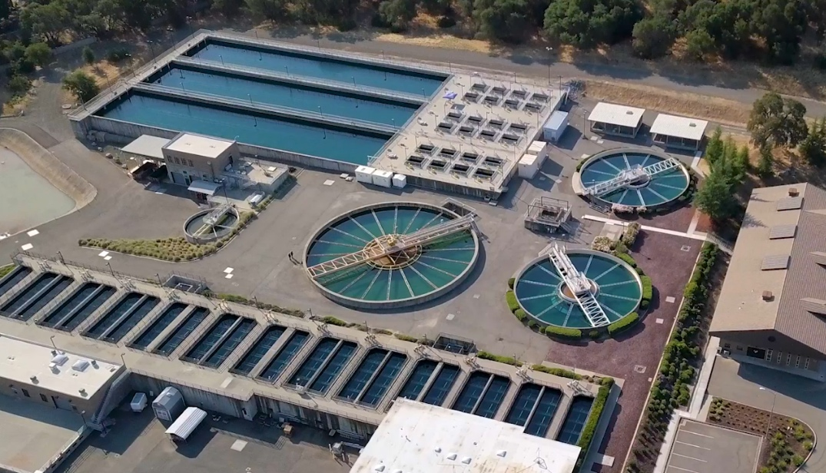


CA Department of Water Resources
Know Your Water
Saving Water and Protecting Watersheds
Notes:
Melissa Kinsey, Utility Exploration Center, ruec@roseville.ca.us
Matt Ocko, Stormwater Management, stormwater@roseville.ca.us

Slide 2

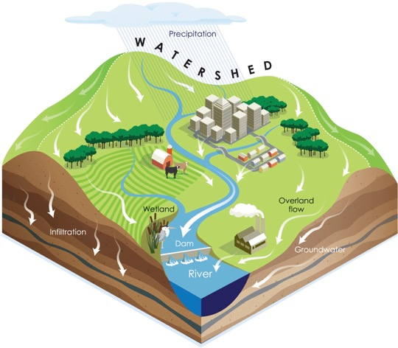
What is a watershed?
The land that all water flows across on its way to the lowest point.
Come in many sizes
Watersheds - Be Water Friendly
Notes:
Water sheds are defined as a land area that drains and stores water. These are vital in moving rainfall and snowmelt into area creeks, streams, and rivers. Watersheds range in size, small watersheds surrounding creeks and streams drain into progressively larger watersheds channeling water to the reservoirs, bays, and oceans.

Slide 3
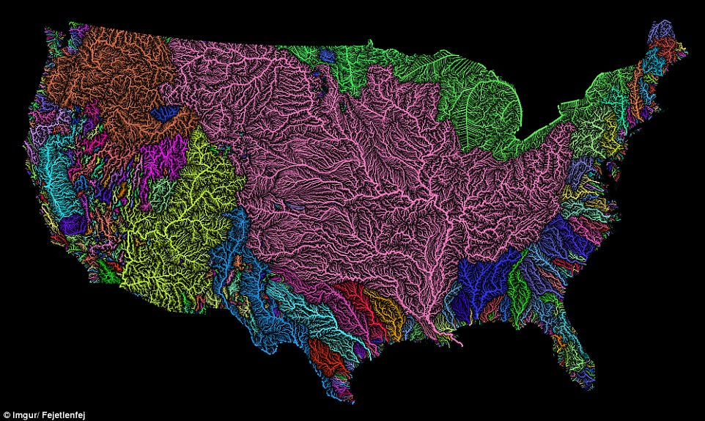
Notes:
United States watersheds
https://images.app.goo.gl/25ExAUnz2Z7D46NTA

Slide 4
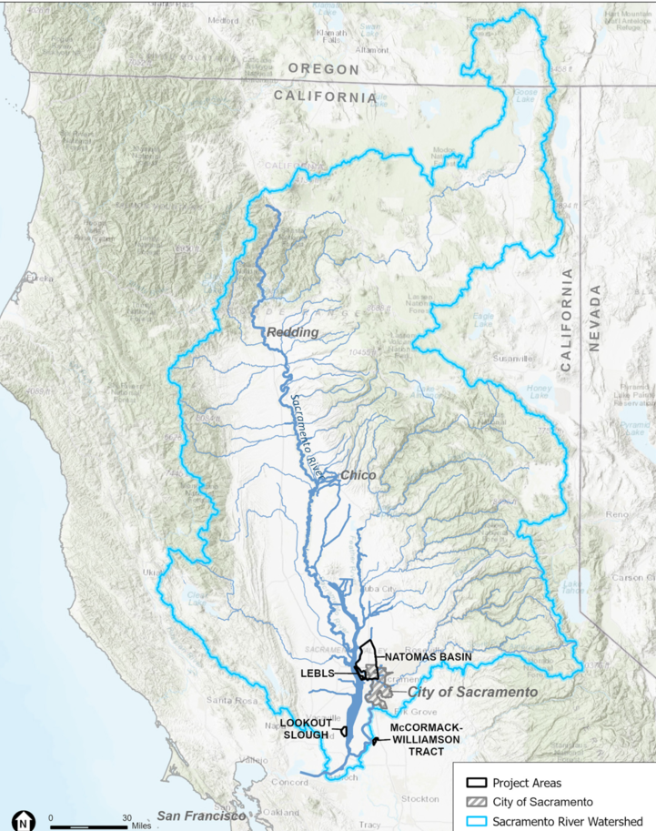

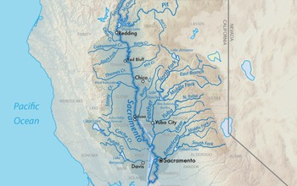
Sacramento River Watershed
Notes:
Sacramento River watershed is the largest watershed in our state. Most of us are connected by this watershed. It begins all the way up north in Oregon at Goose Lake, as well as the headwaters for the Sacramento River north of Redding and Lake Shasta.

Slide 5
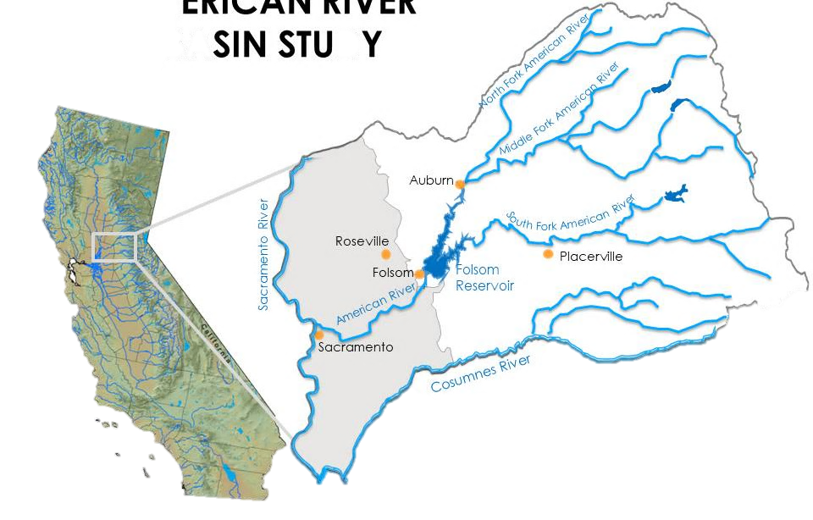
American River Watershed
The North Fork of the American River is 85 miles long and its watershed encompasses 287 square miles.
The shortest of the three branches, the Middle Fork of the American River is 65 miles long, and its watershed covers 312 square miles.
The South Fork of the American River is 90 miles long, with an 850-square-mile watershed.
The American River watershed covers 1900 square miles of the Tahoe and El Dorado National Forests, including the Granite Chief Wilderness and Desolation Wilderness.
Notes:
In Roseville we rely on the American River watershed as our primary drinking water. Folsom Lake is fed by 3 forks of the American River, all snowpack and runoff from the Sierra Nevada Mountains.

Slide 6
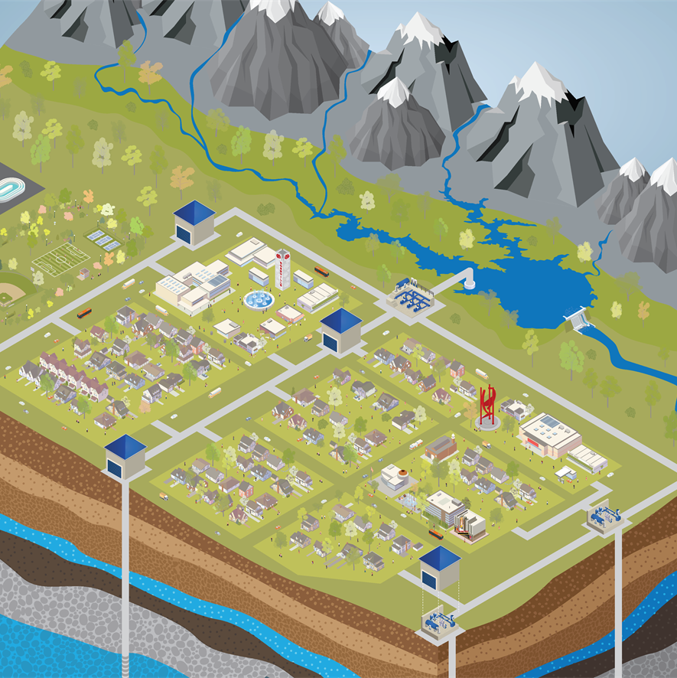
Surface water and groundwater
Watersheds include water flowing above ground such as streams and rivers
They also include water flowing below ground in the soil and gaps between rocks underground
Surface water and groundwater are interconnected
As much as 60% of stream flow comes from groundwater
Polluted surface waters can contribute to groundwater contamination
Notes:
Watersheds include surface water and groundwater that are interconnected, flowing together from higher elevations to lower elevations. Surface water flows above ground, like streams and rivers, while groundwater flows underground in the soil and through gaps between rocks under the surface. Polluted surface waters can contribute to ground water contamination, with as much as 60% of stream flow coming from groundwater.

Slide 7
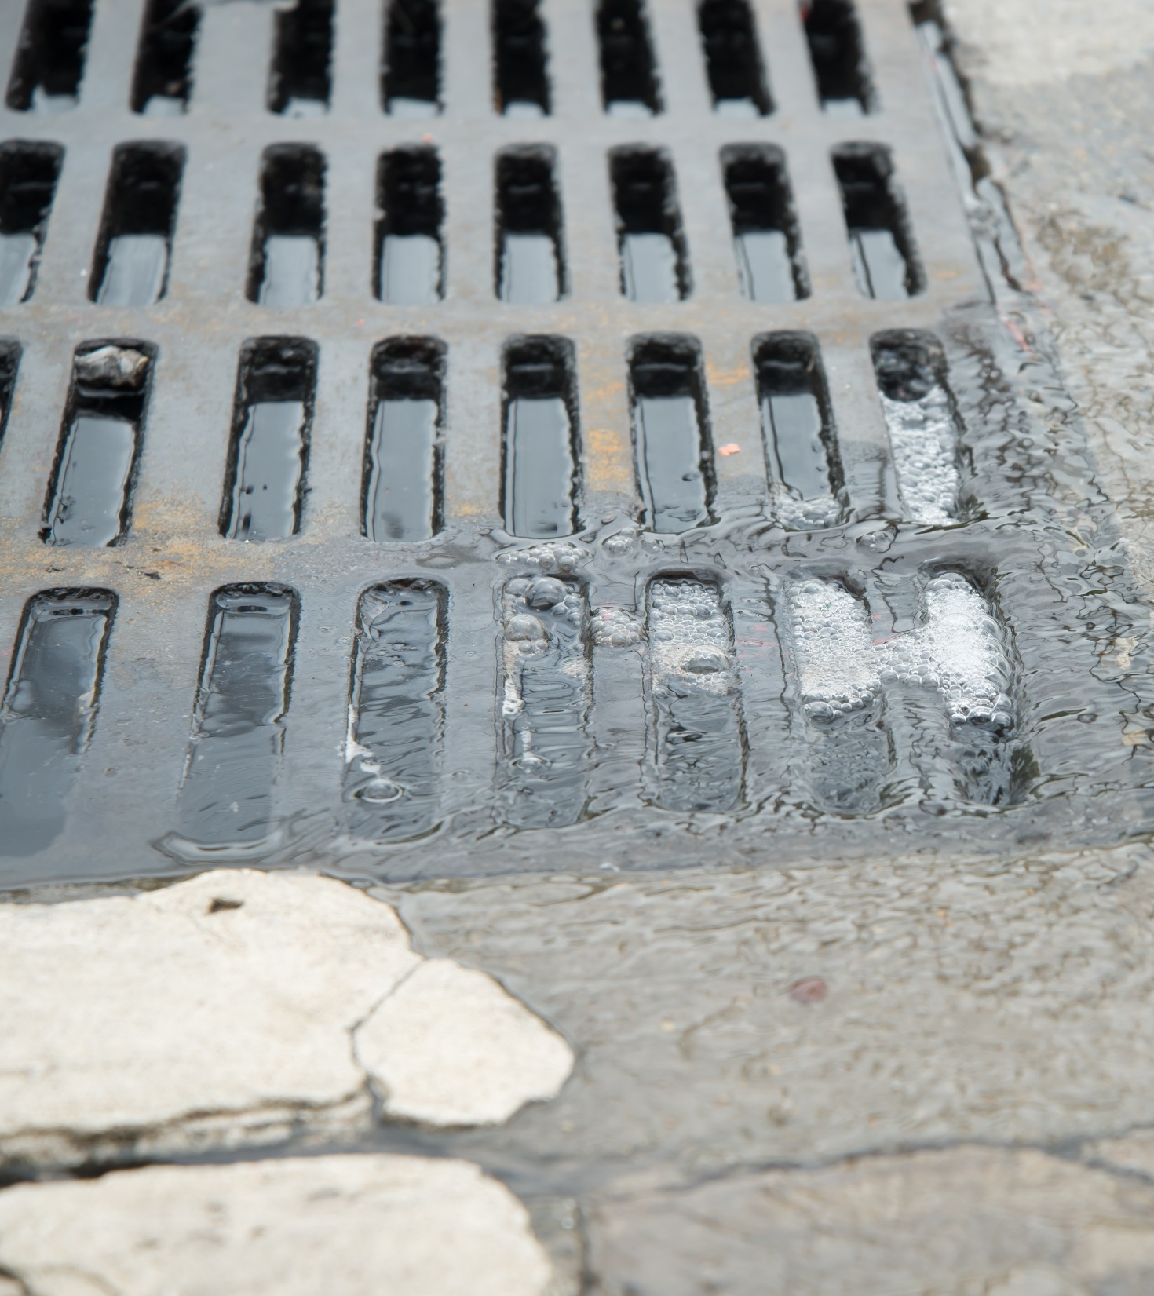
Surface water vs stormwater?
Every time it rains, water flows down the gutter into the storm drain and out to the creek, untreated.
Other sources called “non-stormwater runoff” come from a variety of places, such as over watering a lawn, hosing down a driveway, and even washing a car.
Notes:
Stormwater refers to the runoff and drainage that occurs during rainfall or following any precipitation event including snowmelt. Whereas surface water means the natural drainage systems, including the beds and boundaries of receiving waters. Examples of surface water are streams, rivers, sloughs, wetlands, and lakes.

Slide 8
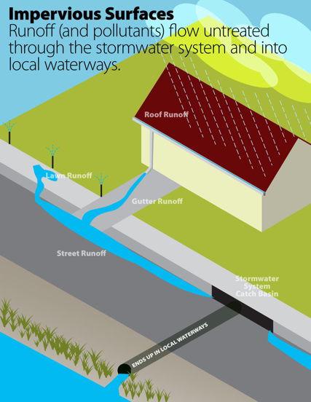
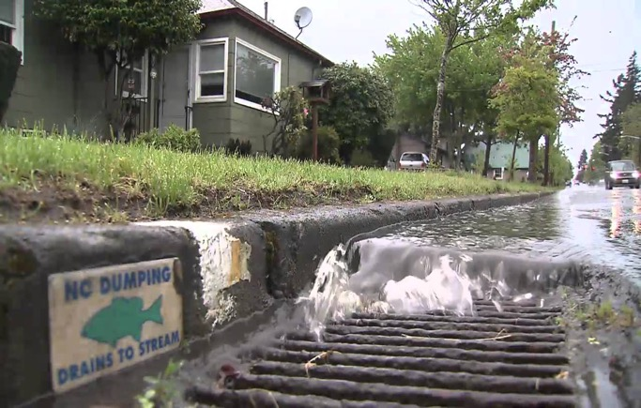
Stormwater is untreated water running off or draining from our landscapes, plus all the fertilizers, pesticides, sediments, dog waste, etc., which drains to the street storm system.
UNTREATED
Notes:
In urban areas stormwater includes water draining from our landscapes. This untreated water can contain fertilizers, pesticides, dog waste, and other sediment. These pollutants drain to the street storm system and into local waterways. Impervious surfaces, like driveways and rooftops, create more runoff.

Slide 9
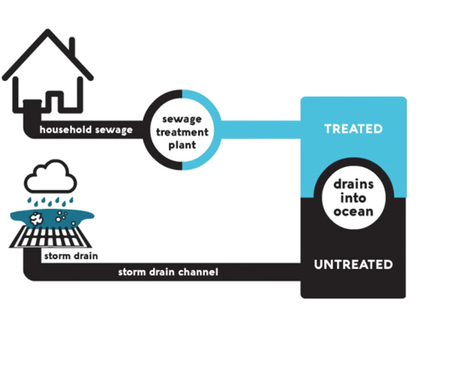
Where do drains flow?
Drains in homes and buildings are treated at wastewater treatment plants.
Runoff and any water outside enter stormdrains to prevent flooding and are not treated.
Notes:
We all must be aware of where the drains flow in order to protect our waterways. Wastewater treatment plants differ from the stormwater drainage system. In our homes and offices, the water that drains from our sink, tubs, and toilets flows to a wastewater treatment plant to be treated and filtered.
The stormwater system drains runoff water from driveways, streets, and through gutters where it may have picked up pollutants. The stormwater runoff is not treated and instead flows directly to a lake, river, or ocean.
Even water treatment plants cannot filer out every chemical.
https://h2oc.org/resources/runoff-101/sanitary-sewer-vs-storm-drain/

Slide 10
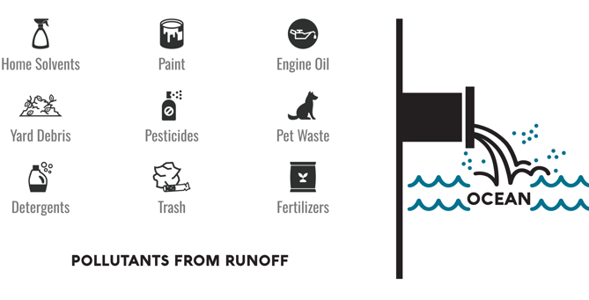
Nonpoint source pollution
Most common type of water pollution
Comes from a variety of sources, difficult to pinpoint
Examples:
Overfertilizing/overwatering your lawn
Inappropriately using pesticides/fertilizers
Washing or draining polluted water in your yard (pool, car wash, etc.)
Leaving pet waste to decompose
RIVER
CREEK
LAKE
Notes:
It is difficult to pinpoint the source of the pollution as this is a cumulative effect of small amounts of contaminants gathered from a large area. There are a variety of possible sources in and around our homes and neighborhoods.
Resources
https://h2oc.org/resources/runoff-101/what-are-common-pollutants/
https://www.epa.gov/nps

Slide 11
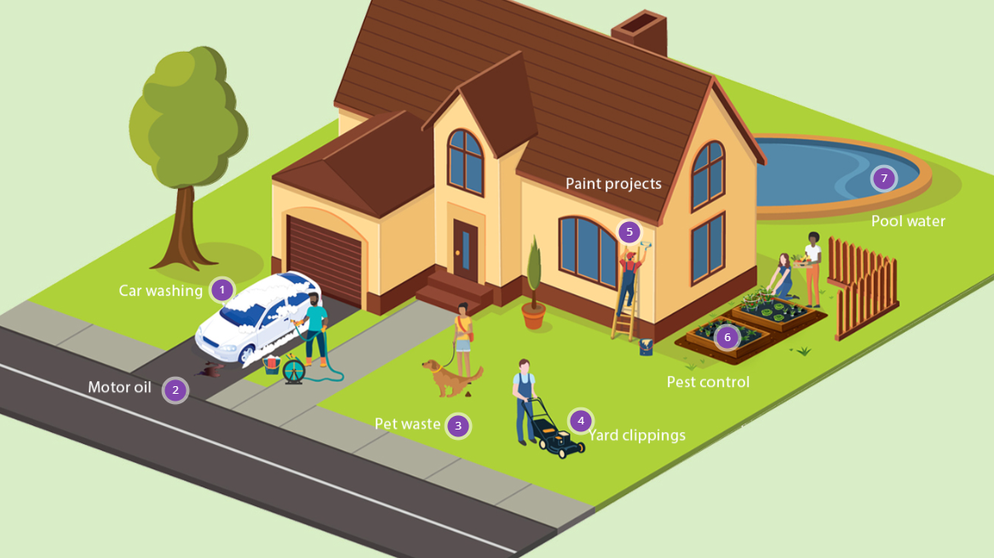
Notes:
This graphic shows many paths by which pollutants can be carried with stormwater runoff and into our water ways. By visiting the Roseville Stormwater website, you can explore ways to protect our local watershed.
https://www.roseville.ca.us/cms/One.aspx?portalId=7964922&pageId=16948126

Slide 12
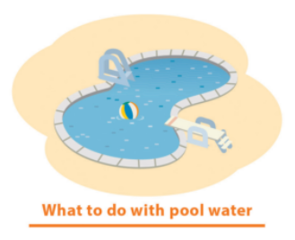




Make small changes to reduce pollution
Notes:
Examples of ways to protect found on the previous slide website

Slide 13
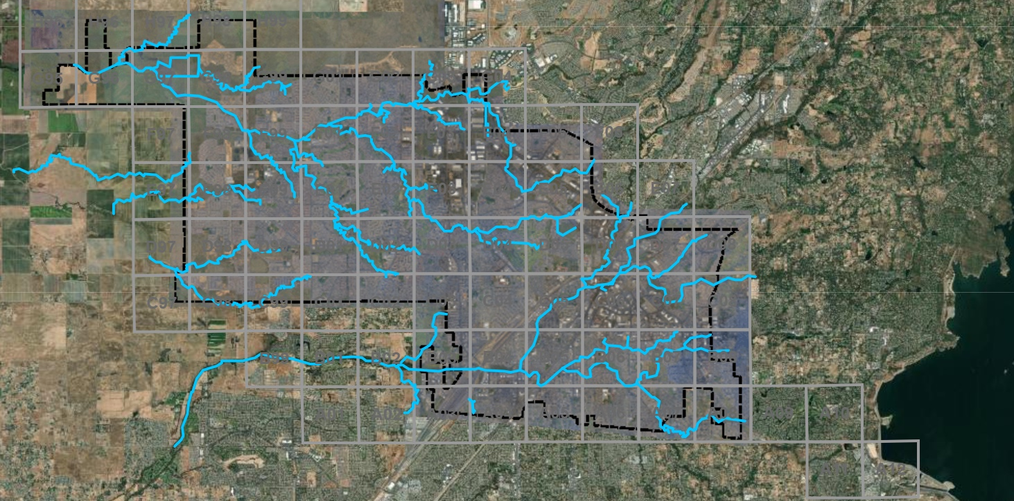
Creeks in Roseville
Notes:
City of Roseville boundary and creek, there are 2 creek watersheds.
Dry Creek (southern portion of map) – perennial /year round creek
Pleasant Grove Creek system (northern) – seasonal creek

Slide 14
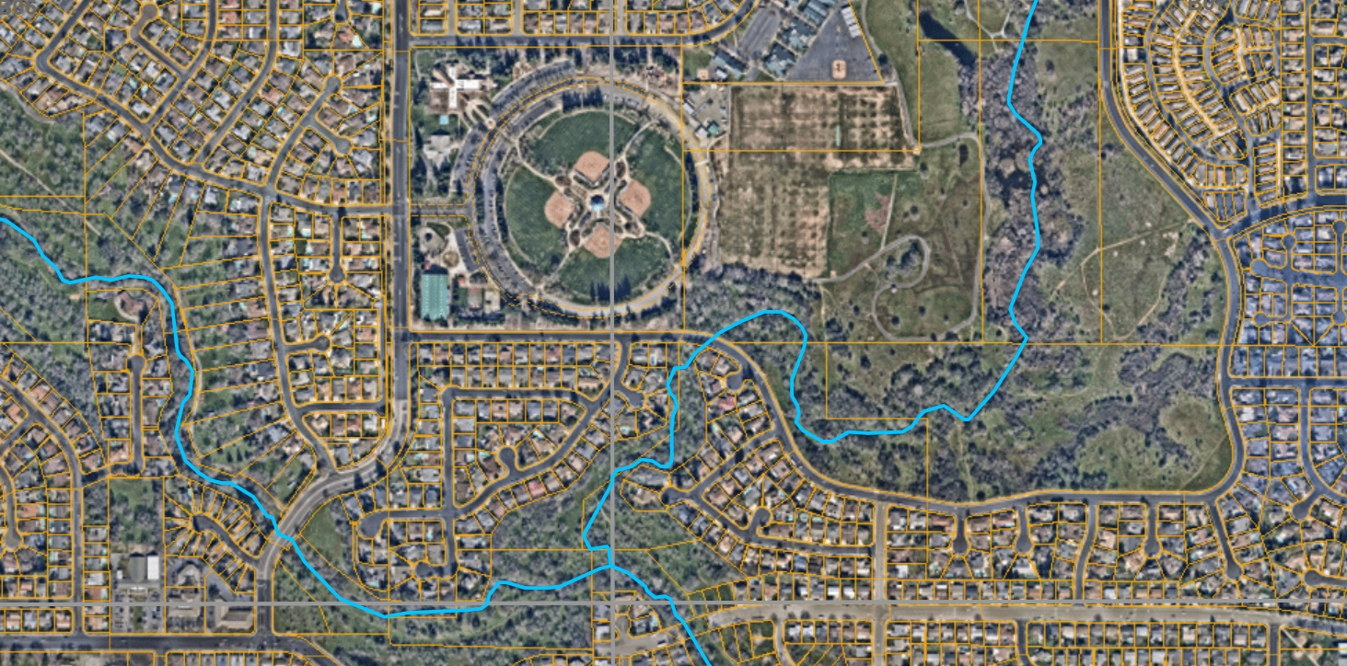
Maidu Regional Park
Notes:
Where we are today, and the watershed near us

Slide 15
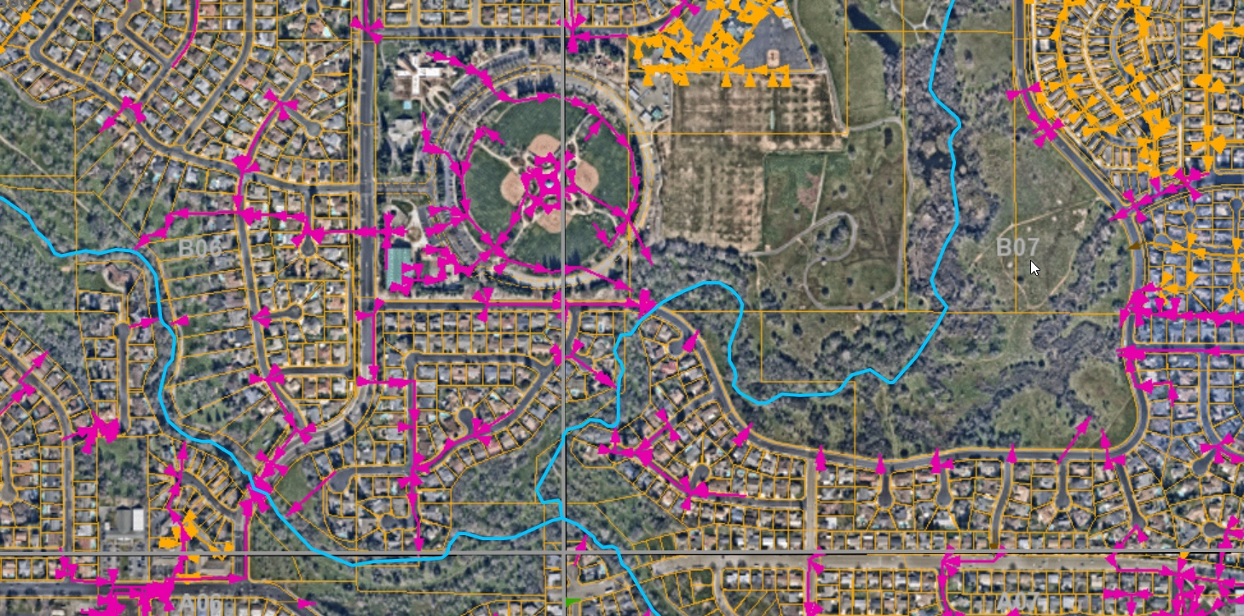
Stormwater Inlets and Flow
Notes:
GIS map of the stormdrain inlets (magenta and orange) with arrow for the direction of the water flowing toward it’s outlet (release to creek)

Slide 16
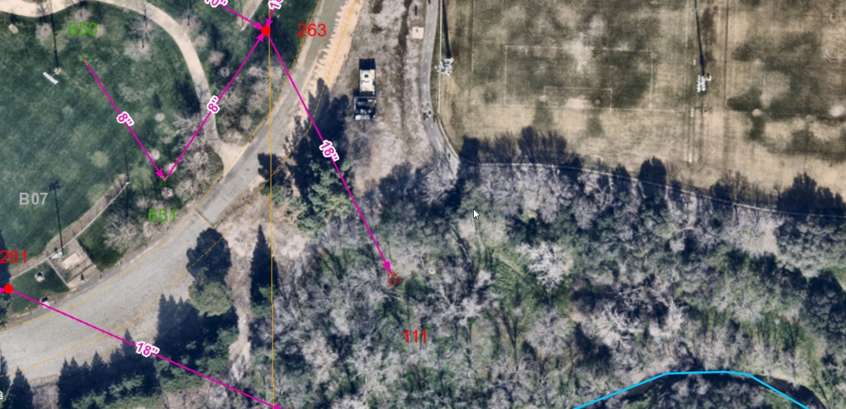
Outfall & Creek
Notes:
Zooming into closer to the closest creek outflow from where we are today

Slide 17
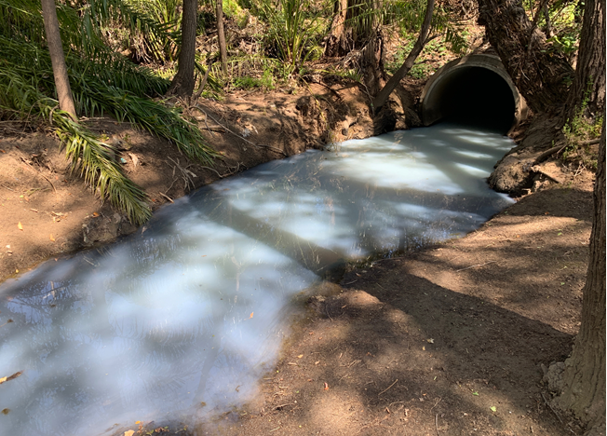
Notes:
Example of what happens when pollutants enter our stormdrain system. Barrels of solvent uncovered were filled with water when a fire sprinkler system burst in the middle of the night. Water flowed outside the building and into the stormdrains contaminating this creek. The creek was dammed, the source identified and both working parties (utility and business owner) worked to clean it up. Water was removed by a vactor truck and soil escavated.

Slide 18
What is a Pyrethroid?
Pyrethroids are man-made pesticides that are similar to pyrethrum, a natural pesticide that comes from chrysanthemum flowers. They are effective at killing insects by making their nervous systems hypersensitive to stimuli from sensory organs.
Pyrethroids are generally harmless to humans at household concentrations, but they can be toxic to insects like bees, dragonflies, mayflies, and gadflies. They can also be toxic to aquatic organisms, especially fish.
Pyrethroids are hydrophobic and can be dispersed via dust and suspended sediments in water. They don't dissolve well in water, but instead tend to bind to sediment.
Notes:
Pyrethroids are found in the seasonal creek in West Roseville. Originally created from chrysanthemum flowers, pyrethroids have been synthesized to now be very harmful to our aquatic environments. Only water from the landscaping is keeping the creek flowing so the concentration of pollutants is very high. One of the biggest pollutants found is Pyrethoids which is many ill effects on our benthic (bottom of the waterway) creatures.

Slide 19
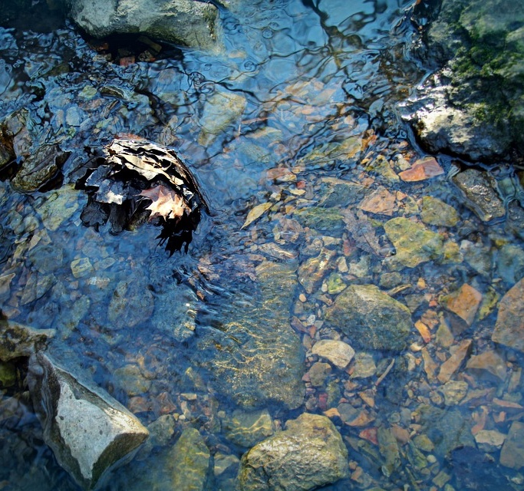
Pyrethroid Impacts to Aquatic Life
Acute toxicity: causing death to aquatic organisms, including fish, insects, crustaceans, and amphibians at higher concentrations.
Sublethal effects: behavioral changes
Growth effects: slows growth and lowers survivability.
Oxidative stress: can alter DNA, proteins, and lipids in fish cells.
Endocrine disruption: mimicking or blocking normal hormone function
Suppressed immune systems

Slide 20

What can you do to help?
Follow IPM tactics
Notes:
UCANR IPM graphic from Santa Barbara County
https://cesantabarbara.ucanr.edu/Strawberry_Production/?blogpost=28210&blogasset=63881

Slide 21
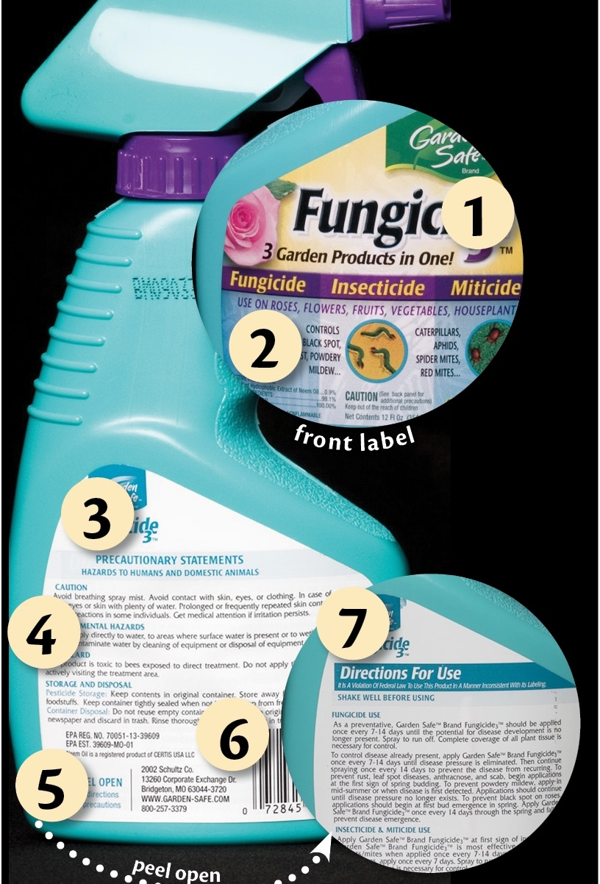
What can you do to help?
Always read labels
Notes:
UCANR Pests in the Urban Landscape, Reading Pesticide Labels
https://ucanr.edu/blogs/blogcore/postdetail.cfm?postnum=30243

Slide 22

What can you do to help?
Be an advocate: Tell your neighbors, friends, and community
Notes:
Tell the world! ☺

Slide 23
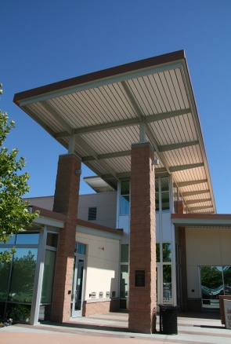

Questions?
Learn more at
https://www.roseville.ca.us/government/ departments/environmental_utilities/ programs/stormwater_management
Or at the Utility Exploration Center
roseville.ca.us/explore

