Slide 1
Mosquitoes and public health pests
Breakout Session
Advanced IPM Training for UC Master Gardeners, August 2024
Mary A. Sorensen, PhD, BCE

Slide 2
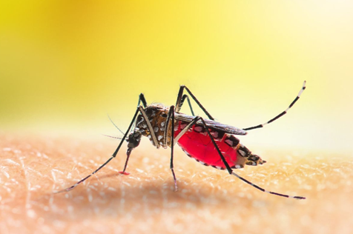
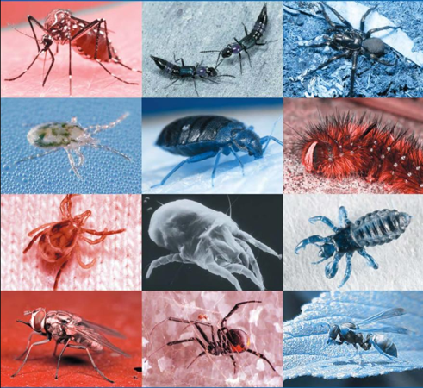
Public Health Pests
Transmit pathogens, bite, sting, contaminate food/environment, cause allergies, or otherwise impact the health of human populations
Some examples
  Mosquitoes, ticks, rats and mice, mites, cockroaches, lice, bed bugs, kissing bugs, blackflies, biting midges, house flies, filth flies, fleas, yellowjackets, ants, spiders, scorpions, centipedes

Slide 3
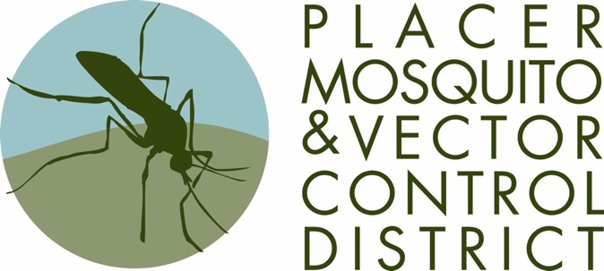
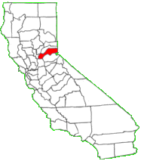
Placer Mosquito and Vector Control District
Special District serving Placer County
Founded 2001
22 full time employees
Mosquitoes, ticks, yellowjackets, other services

Slide 4
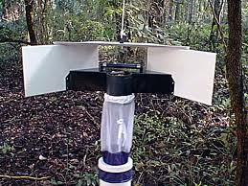
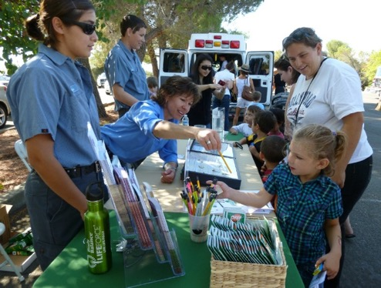
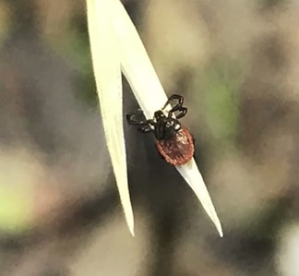
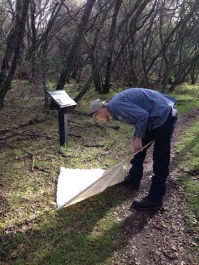
Placer Mosquito and Vector Control District
Mosquito surveillance, pathogen testing, control
Tick surveillance and pathogen testing
Yellowjacket surveillance and nest control
Public engagement and education

Slide 5
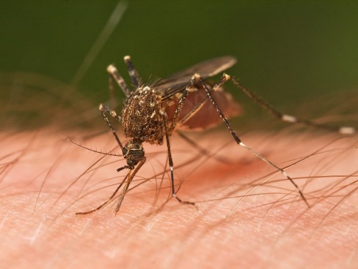
~ 2500 in the world
~ 150 in the US
> 50 in California
> 30 species in Placer County
Mosquitoes
Not all mosquito species are of public health importance

Slide 6
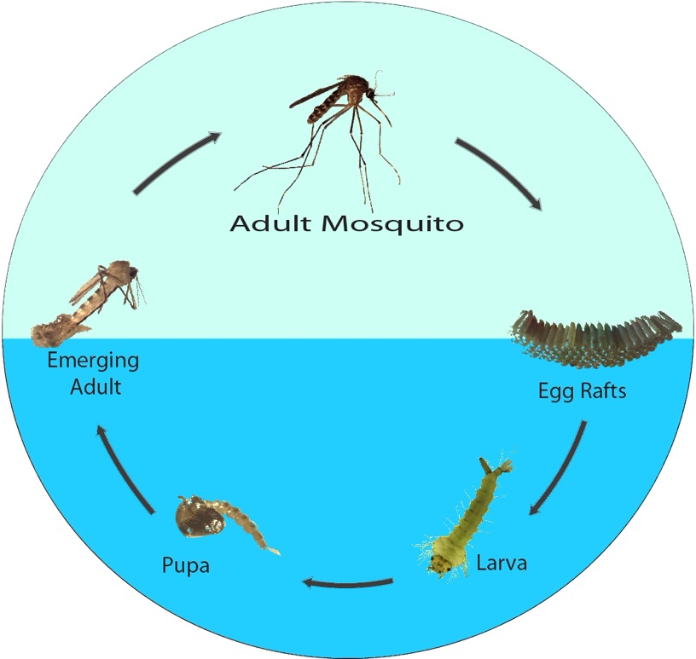
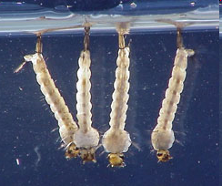
Mosquitoes
    Egg (laid on or above water)
    Larva (four instars, omnivorous detritivores, wriggle to surface to breathe)
    Pupa (nonfeeding, also must surface to breathe)
    Adult (only females are bloodfeeding, may overwinter)
Notes:
Mosquitoes require water to complete their development. Female mosquitoes lay their eggs singly, or in groups, on or in or near water, or in a place that is likely to flood. The larva hatches out into the water. The larvae of most mosquito species hang out near the water’s surface, where they breathe through a tube called a siphon located at the end of the abdomen. If a predator approached, the larvae dive deeper into the water in a characteristic wiggling or flipping movement, then slowly float back up to the surface. Larvae use brush-like filtering mouthparts to feed on microorganisms and small organic debris in the water. Pupae, like larvae, are aquatic and tend to float near the surface of the water. The adult mosquito emerges from the water’s surface, mates, the females takes a blood meal, and the cycle begins again.

Slide 7
Mosquitoes are flies
Only females feed on blood
Not all mosquito species bite people, or require blood
Find hosts by CO2, odors, heat, other cues
Bites cause itching and swelling, and can transmit disease
Mosquitoes

Slide 8
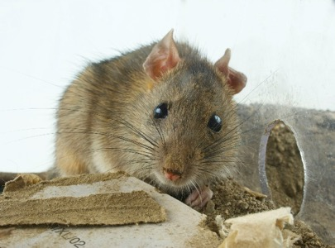
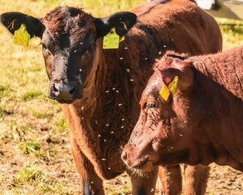
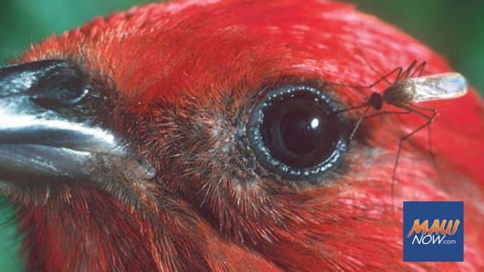
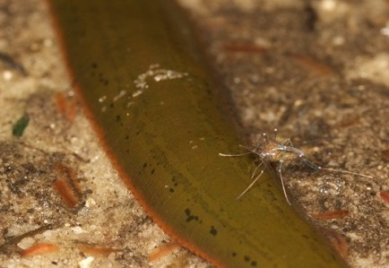
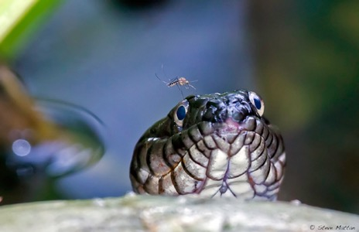
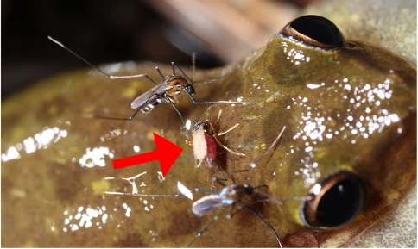
Mosquitoes
Reeves et al. 2018
Reeves et al. 2018
Notes:
Here are a few examples of mosquitoes feeding on animals other than people!

Slide 9
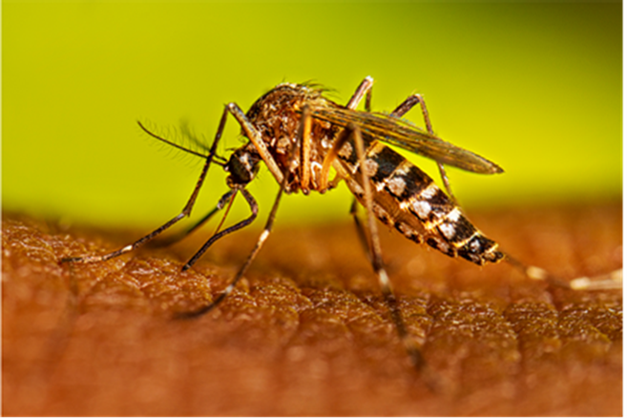
Needle-like mouthparts inject anesthetic, may transmit disease
Mosquitoes
Notes:
The mosquito mouthparts are long and narrow, like a straw, but they are actually even more complex. When a mosquito bites, it first injects the host with saliva that contains anesthetic-like compounds and anticoagulants. If the mosquito is carrying a pathogen, the injection phase of the bite is how the pathogen is transferred to the host. The itchy bumps we associate with mosquito bites are the body’s reaction to that injected foreign material.

Slide 10
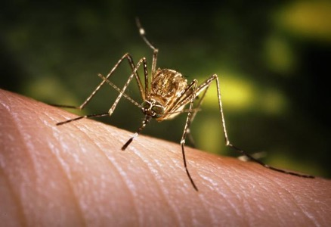
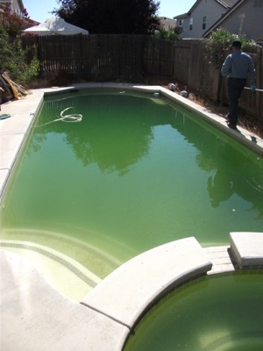
Important vector of West Nile virus in California
Larvae found in wide range of sources, including agricultural sources
Prefer to feed on birds
Mosquitoes
Culex tarsalis
Western encephalitis mosquito

Slide 11
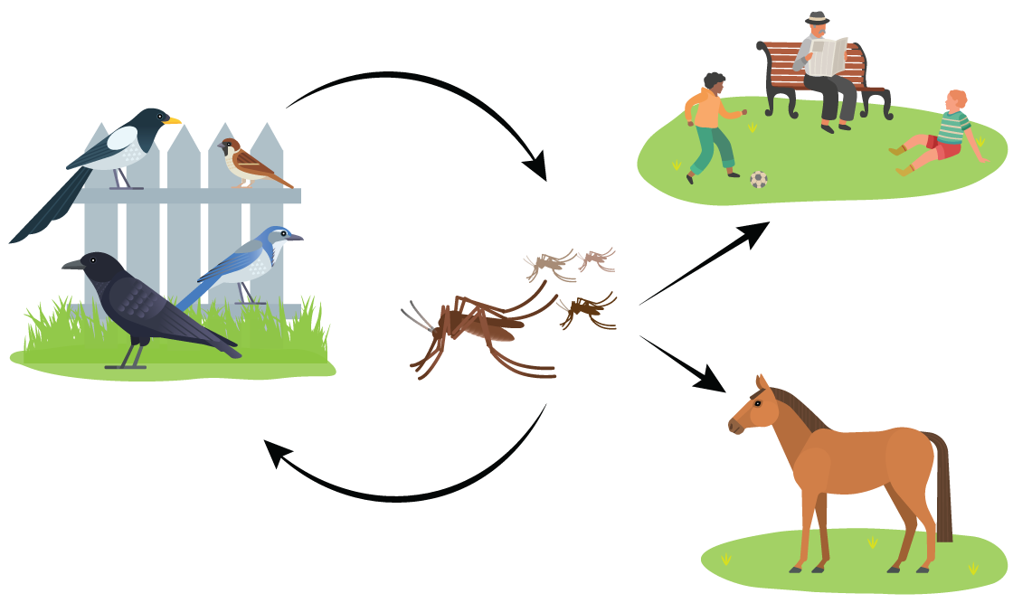
West Nile virus
Mosquitoes

Slide 12
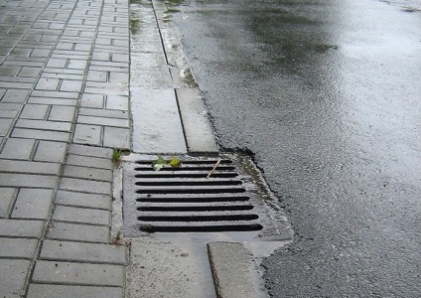
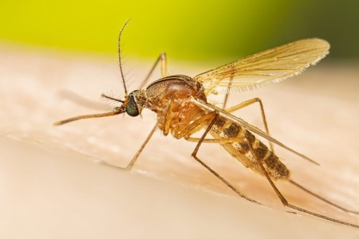
Important vectors of West Nile virus in California
Larvae found in wide range of sources, including urban sources
Prefer to feed on birds
Mosquitoes
Culex pipiens
Northern house mosquito
Culex quinquefasciatus
Southern house mosquito

Slide 13
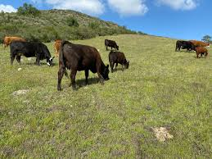
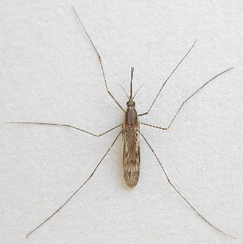
Historical vector of malaria in California
Larvae found in larger water bodies with algal growth, including rice fields
Prefer to feed on large mammals
Mosquitoes
Anopheles freeborni
Western malaria mosquito
Notes:
There hasn’t been a locally-acquired case of malaria in California since the 1980s, and a lot of people don’t know that malaria used to be a big problem in our state. A combination of advances in mosquito control and in medicine led to malaria disappearing from California.

Slide 14
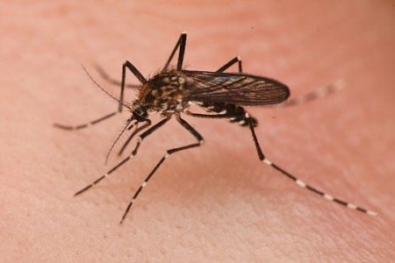
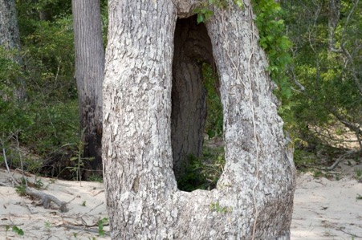
Larvae occur in water-filled cavities in trees, often oak trees
Vector of canine heartworm
Prefer to feed on mammals
Mosquitoes
Aedes sierrensis
Western treehole mosquito

Slide 15
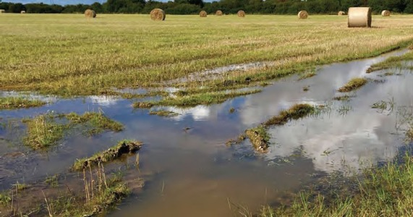
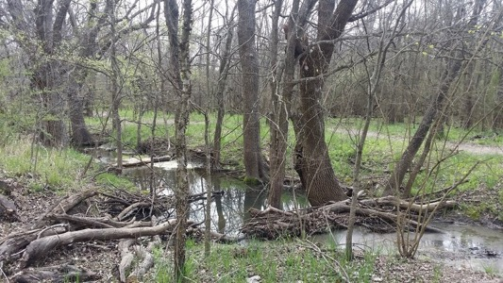
Eggs remain dormant in soil
Hatch when conditions are ideal for each species
May emerge in large numbers
Most species prefer to feed on mammals
Spring, summer/fall, saltmarsh, snowmelt
Mosquitoes
Aedes spp.
Floodwater mosquitoes
Notes:
Floodwater Aedes are a huge group of diverse species, that have a few characteristics in common. Females of these species use chemical cues to lay their eggs on dry ground that will be flooded in the future.

Slide 16
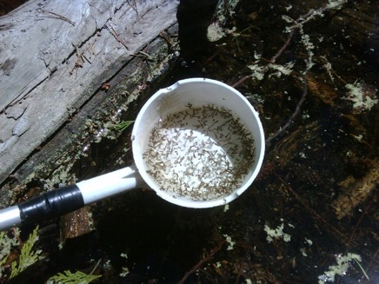
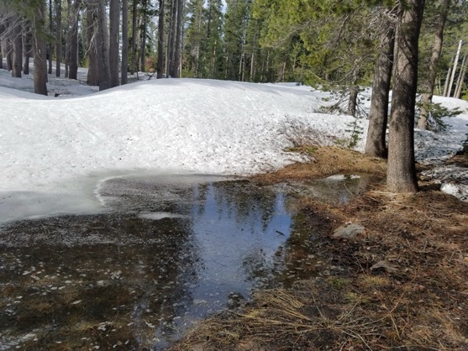
Eggs remain dormant in soil
Larvae develop at low temps
May emerge in large numbers
Prefer to feed on mammals
Mosquitoes
Aedes spp.
Snowmelt mosquitoes

Slide 17
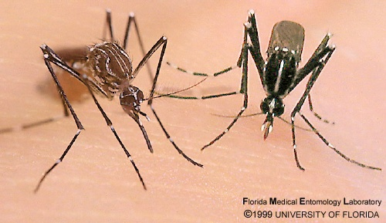
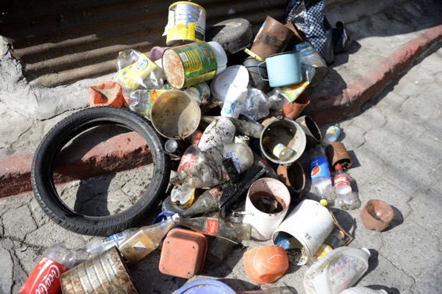
Invasive species
Container breeders
Anthropophilic (habitat and feeding)
Vectors of dengue, chickungunya, Zika, other diseases
Mosquitoes
Aedes aegypti
Yellow fever mosquito
Aedes albopictus
Asian tiger mosquito
Aedes notoscriptus
Australian backyard mosquito

Slide 18
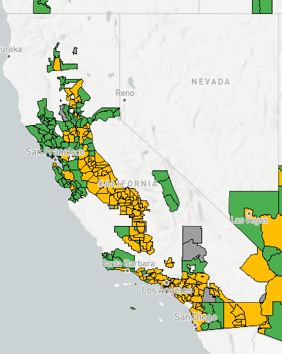
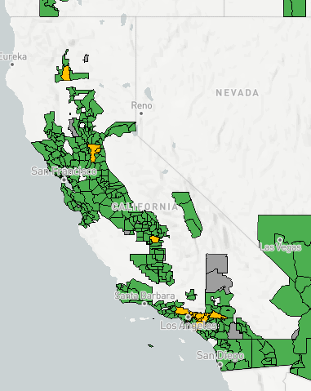
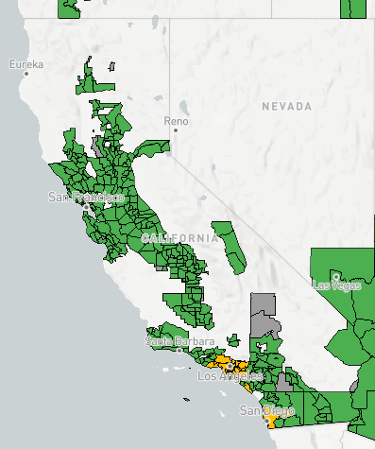
Mosquitoes
Aedes aegypti
Yellow fever mosquito
Aedes albopictus
Asian tiger mosquito
Aedes notoscriptus
Australian backyard mosquito
Notes:
Current maps of invasive mosquito detection in California can be found at https://maps.vectorsurv.org/invasive/?&species=albopictus

Slide 19
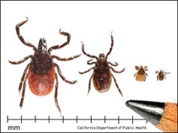
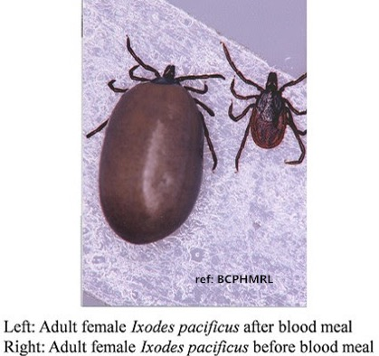
Lyme disease vector in the Western US
Bites may occur year-round, but highest risk in winter and spring
Ticks
Ixodes pacificus
Western blacklegged tick

Slide 20
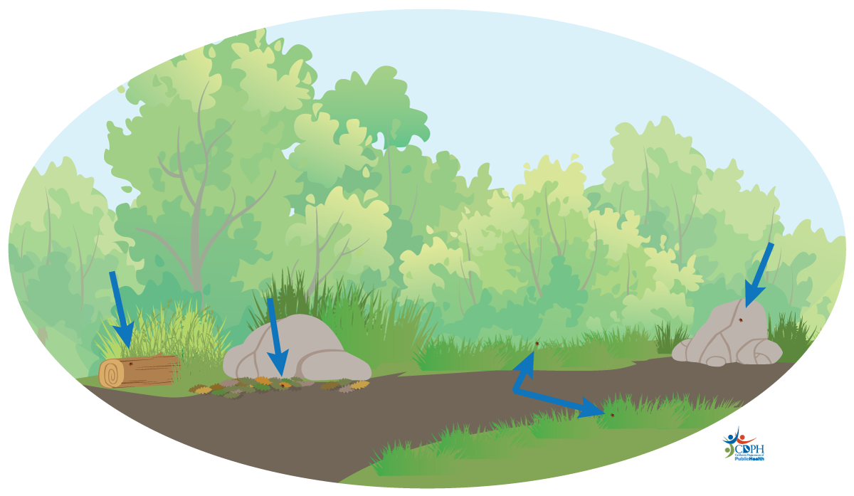
Mixed oak grassland, low to mid elevation
Adults more often found on grass, nymphs on rocks and logs
Ticks
Ixodes pacificus
Western blacklegged tick

Slide 21
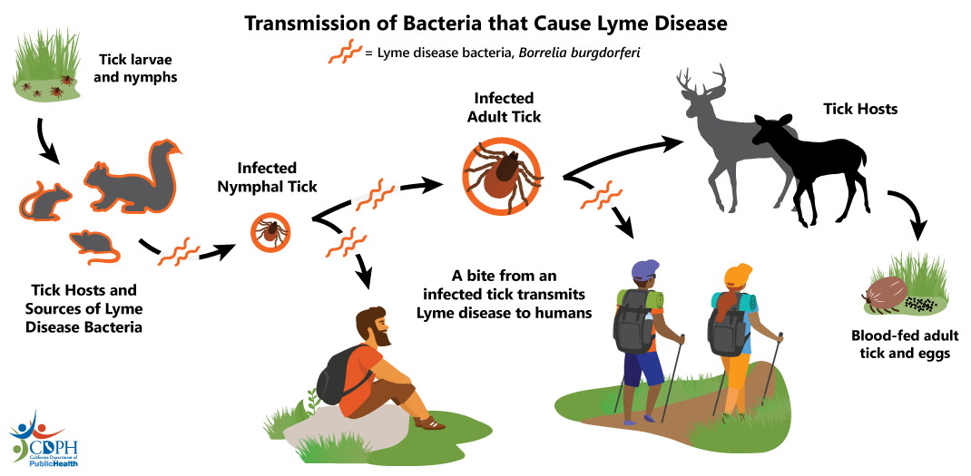
Ixodes pacificus
Western blacklegged tick

Slide 22
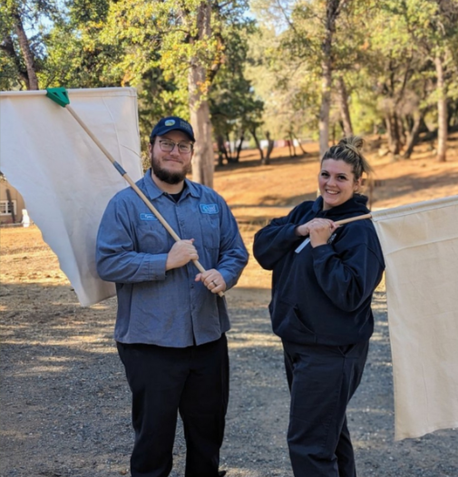
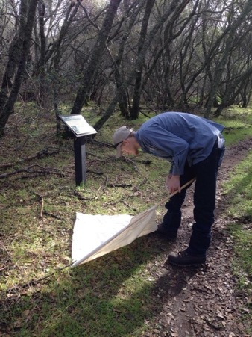
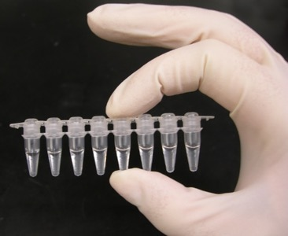
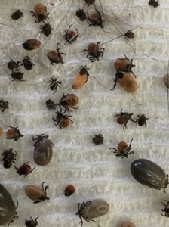
Ticks – MVCD activities
Tick surveillance
Pathogen testing

Slide 23

Ticks – what residents can do
Property management
  Keep grass short
  Remove debris
  Exclude wildlife

Slide 24
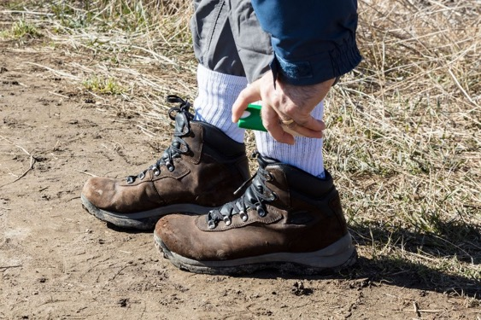
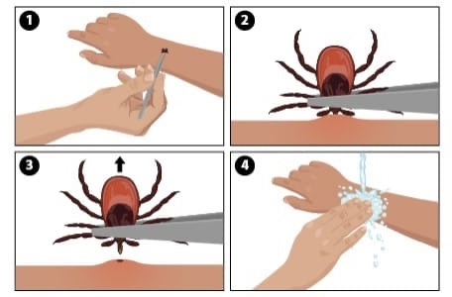
Ticks – what residents can do
Personal protection
  Repellent
  Long pants/sleeves
  Bathe after visiting tick habitat
  Tick checks
  Remove ticks promptly
  See physician for any symptoms up to one month after tick exposure
Notes:
After tick exposure, monitor for symptoms for up to 30 days. Most tick-borne illnesses include achiness and other flu-like symptoms and include a rash. Although many cases of Lyme present with a very distinctive “bulls eye” rash, the rash is not present in all cases and may not be visible in others. If symptoms are present, see a physician and explain history of tick bite or spent time in tick habitat. Tick bites, particularly from the smaller stages of the tick lifecycle, can sometimes go undetected.

Slide 25
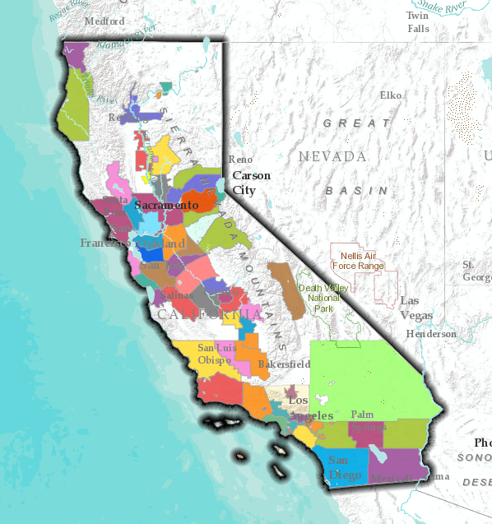

Mosquito and Vector Control in California
More than 60 similar agencies
Special districts, county departments, etc.
Protecting public health
Primarily mosquitoes, also other vectors
Targeted IVM based on area-specific needs
Partnerships with CDPH, University of CA, PacVec, others

Slide 26
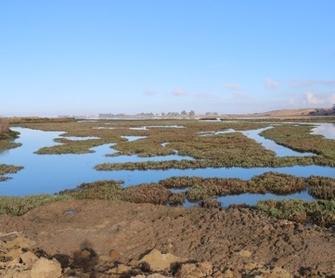
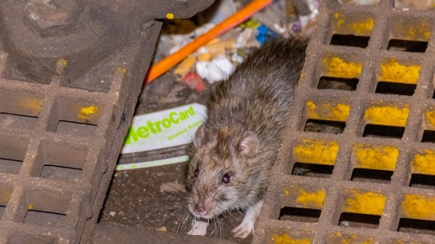
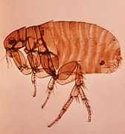



Mosquito and Vector Control in California
Services targeted to area-specific public health
  Rodent control
  Opossums and flea-borne typhus
  Urban infrastructure, stormwater
  Wetlands
  Yellowjackets
Notes:
Local vector control agencies serve the public and follow integrated vector management principles by tailoring their programs to local needs.

Slide 27
Mosquitoes – MVCD activities
Integrated Vector Management (IVM)
Biological, ecological knowledge
Reduce public health risks
Efficient, sustainable
Protecting public health and the environment

Slide 28


Mosquitoes – MVCD activities
Mosquito Life Cycle
Integrated Pest Management
Reduces Immediate public health
Adulticides
Larvicides
Biological Control
Source Reduction
Prevents Public Health Threats

Slide 29





Mosquitoes – MVCD activities
Inspection

Slide 30




Mosquitoes – MVCD activities
Adult Mosquito
Surveillance

Slide 31



Mosquitoes – MVCD activities
Pathogen testing

Slide 32




Mosquitoes – MVCD activities
Source Reduction

Slide 33





Mosquitoes – MVCD activities
Biological Control
mosquitofish
(Gambusia affinis)

Slide 34




Mosquitoes – MVCD activities
Larvicide

Slide 35




Mosquitoes – MVCD activities
Adulticide

Slide 36


Mosquitoes – MVCD activities
Insecticide Testing
  Resistance
  Efficacy

Slide 37

Mosquitoes – what residents can do
Source reduction
“dump and drain”

Slide 38



Mosquitoes – what residents can do
Keep pools, fountains, and ponds in good working order
Clean and replace birdbath water 2x/week
Remove saucers under plants
Prevent standing water in yard drains
Consider mosquitofish

Slide 39



Mosquitoes – what residents can do
Exclusion - home

Slide 40




Mosquitoes – what residents can do
Spatial repellents

Slide 41





Mosquitoes – what residents can do
Personal protection

Slide 42

Mosquitoes – what residents can do
Personal protection
EPA Registration Number!
Notes:
An EPA registration means that the product is 1) safe and 2) effective. Always follow the label instructions.

Slide 43



Mosquitoes – what residents can do
Report mosquito problems
https://www.mvcac.org/

Slide 44

Questions?
Find your local vector control agency
mvcac.org
Notes:
Go to mvcac.org to search for the vector control agency that serves your area.

Slide 45



UC IPM mosquito resources
Notes:
https://ipm.ucanr.edu/PMG/PESTNOTES/mosquitoes.html

Slide 46



UC IPM mosquito resources: videos
Notes:
https://www.youtube.com/watch?v=H128XY3yFHY

