Slide 1
FFY 25
CalFresh Healthy Living Adult Survey Administration Training
September 17, 2024
Project Coordinator:
Amanda Linares, amlinares@ucanr.edu

Slide 2


Access the recording & slides
Find the webinar recording and this slide deck on the Adult DE Eval Website

Slide 3
Objectives
Understand if your LHD should be participating in Adult DE Evaluation
Identify which of your DE series should be evaluated and when to evaluate them
Be able to select the administration approach that is best for your audience
Feel confident administering the survey

Slide 4

AGENDA
Evaluation requirement
Who should evaluate
Evaluation timeline
Survey administration
Data dissemination
Wrap up

Slide 5
What is the evaluation requirement?
CDSS requires all adult DE of 4+ sessions conducted over 4+ weeks be evaluated using a core set of validated questions
FBC + EFNEP PA
Modular survey validation is still in progress
(Catholic Charities)
Possibly ready for FFY 26

Slide 6
Do I need to evaluate? Ask yourself…
Q: Do we deliver any series-based DE* to adults that contains 4 or more sessions conducted over 4 or more weeks?
A: If yes, evaluate!
*Applies to all program activities delivered, i.e., not a sample

Slide 7
Curriculum | Lessons | Curriculum cont'd | Lessons
A Taste of African Heritage | 6 | Fresh from the Garden | 12
Around the Table | 6 | Healthy, Happy Families | 8
Around the Table: Nourishing Families | 6 | Making Every Dollar Count | 8
Bingocize™ | 24 | Matter of Balance (MOB) | 8
Cell-Ed Eat Healthy, Be Active Community Workshops | 6 | MyPlate for My Family Education Toolkit | 4
Cell-Ed Eat Smart, Live Strong: Nutrition Ed for Older Adults | 4 | Nutrition 5 Class Series | 5
Chronic Disease Self Management Program | 6 | Parent Lesson Plans: Advocating for Healthier School Environments | 4
Cooking for Health Academy | 6 | Plan, Shop, Save and Cook | 4
Cooking Matters (national) | 6 | Seniors Eating Well | 9
Create Better Health | 8 | Staying Healthy through Education & Prevention (STEP) | 9
Eat Healthy, Be Active Community Workshops | 6 | Tai Chi for Arthritis | 12
Eat Smart, Live Strong: Nutrition Education for Older Adults | 4 | Tai Chi: Moving for Better Balance (a.k.a. Tai Ji Quan) | 48
Eating Smart, Being Active | 9 | Telephonic Health Coaching Intervention Toolkit | 6
Enhance® Fitness | 4+ | Turtle Island Tales Family Wellness Program | 12
Everybody Loves Line Dancing | 6 | TWIGs: Teams With Inter-Generational Support | 30
Faithful Families Eating Smart and Moving More | 9 | UCCE Connects to You! | 10
Families Eating Smart and Moving More | 21 | Walk with Ease | 18
Fit & Strong! | 24 | Young at Heart | 4+
Food Smarts for Adults | 3-6

Slide 8
Do I need to evaluate?
Annually, we will check PEARS program activity entries against surveys collected
Your LHD Project Director received an email in August if applicable (4+ session) curricula were listed in your IWP

Slide 9
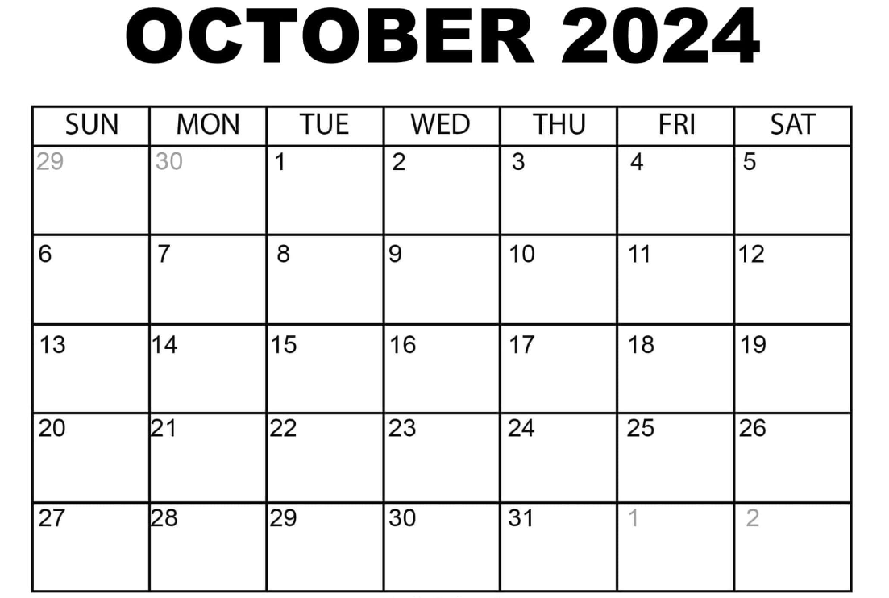
Evaluation Timeline
The online survey will open on Wednesday, October 16th, coinciding with the opening of PEARS
You must enter a Program Activity before you can begin surveying/data entry (online only)
Data collection will end (online survey closes) on August 29th

Slide 10
Evaluation Timeline FAQs
Q: What if my class begins and ends in the current FY, but the survey is closed?
A: Last day of August through mid-October will be a down period. You are not required to evaluate any series during this time, and we have already begun working with the current FY data.
Q: What if my class can pre-test before the survey closes, but not post-test?
A: You do not need to evaluate the series.
Q: What if we want to evaluate a series that spans FYs?
A: You can evaluate if you are able to use paper surveys (from the new FY, pre and post). You must split the series into two Program Activities in PEARS, one in the old FY and one in the new. Use the new FY Program Activity ID to enter both pre and post surveys in the new FY online survey. Alternatively, you can choose to not evaluate this series.

Slide 11

CalFresh Healthy Living Adult Survey

Slide 12
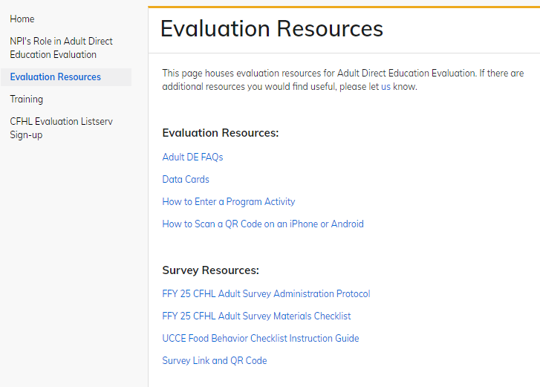
Annual survey updates
Expect all local evaluation instruments (e.g., Adult Survey, SLAQ, EATS) to have at least minor annual updates.
~20% of survey entries this past year utilized the previous year’s survey!
Always check the website for the new FY survey before you begin evaluating.
Adult DE Eval website is updated annually for the next FY on Sept 1.

Slide 13
FFY 25 CFHL Adult Survey
 | Pre-test* | Post-test
8 questions from the validated Food Behavior Checklist | X | X
3 questions from the validated EFNEP Food & Physical Activity Questionnaire | X | X
3 questions from NPI (food shopping, child school/OST/ECE, zip code) | X
3 demographic questions (age range, gender, race/eth) | X | X
*Paper versions are available in Pre and Post, and Post omits Qs 12-14. There is one survey link and Qs 12-14 are automatically skipped if a respondent selects Post.

Slide 14
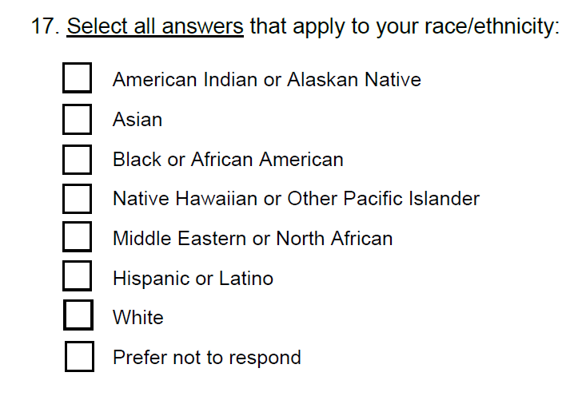
Race/Ethnicity Data Collection
Addition of Middle Eastern or North African
Hispanic or Latino no longer its own question

Slide 15
How to Administer
Administer a pre-test before the DE series begins
All participants present that day
Administer a post-test after the DE series is complete
All participants present that day
Participants completed surveys online?
You’re done!
Participants completed surveys on paper?
Enter them into the online link
Surveys are never entered into PEARS

Slide 16
Sample size requirements
None (per CDSS)
<5 matches per program activity on average
NPI will analyze data at LHD-level with ≥30

Slide 17
When to Administer
Any day of the week
For in-person or virtual series
For all applicable DE series (no sampling)
Any time of day

Slide 18
What materials do I need?
Survey: Online link/QR code or paper
Protocol and Materials Checklist
Online capable device or pencils/pens
ONE* PEARS Program Activity ID
If using paper, you will need this for data entry!
* All (any age/grade or setting) series-based direct education should be entered as a single PEARS Program Activity

Slide 19
What languages are available?
English
Spanish
Arabic
Armenian
Chinese
Farsi
Khmer
Hmong
Russian
Somali
Tagalog
Thai
Vietnamese

Slide 20
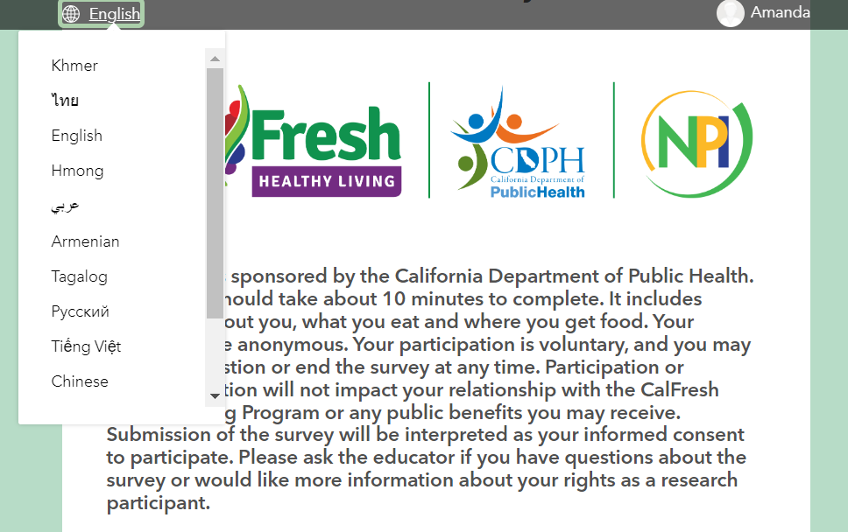
Survey Languages
Participants can toggle between languages as needed
We will maintain 13 languages this year, but use data from this survey and PEARS to determine languages for modular survey

Slide 21
IMPORTANT! PEARS Program Activity IDs
PEARS Program Activity IDs are how we identify the DE received
To match pre/post, the same Program Activity ID must be used
All series-based DE should be entered under a single Program Activity ID
Program Activity ID ≠ Site ID
Program Activity ID should be 6 digits >853000

Slide 22
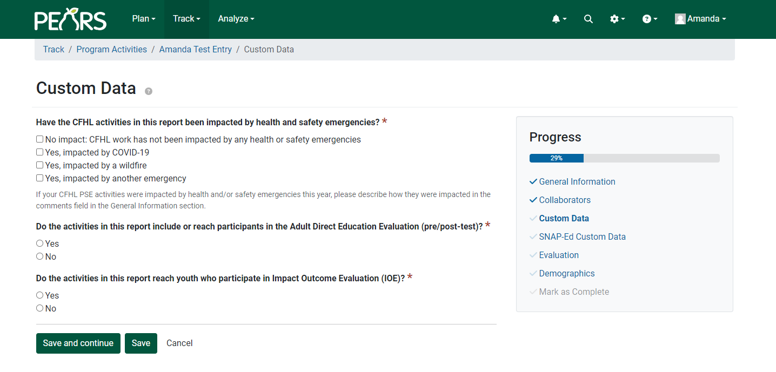
How to note Adult DE Eval activities in PEARS*
* Survey data will never be entered in PEARS, only Survey123.

Slide 23
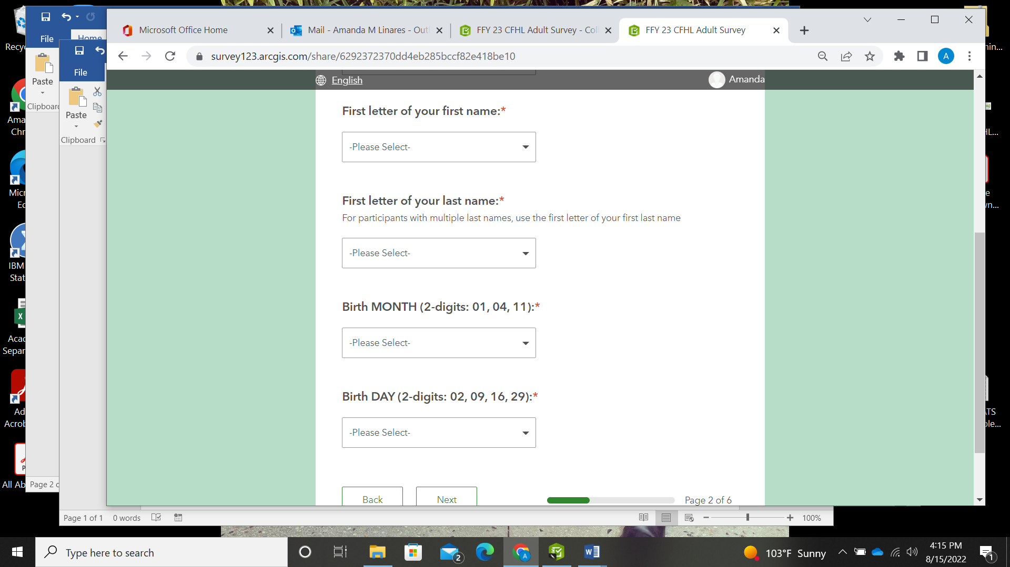
Participant IDs
Unique identifiers are how we match pre- and post-tests
Created from 4 questions:
  First letter of first name
  First letter of last name
  2-digit birth month
  2-digit birth day
Concatenated with Program Activity ID to eliminate the chance of duplicates

Slide 24
3 common errors in FFY 24 surveying
Using the incorrect (e.g., previous FY) or non-matching (at pre and post) Program Activity ID
01
Using the wrong FY’s survey
02
Selecting (respondent or staff entering paper surveys) the wrong survey timepoint (pre vs. post)
03

Slide 25
Let’s take a look at the survey & protocol…

Slide 26
Data Dissemination
FFY 24
Your cleaned, matched data will be returned to you in an Excel file with codebook
If sample allows (>30), we will create an LHD-level infographic (NEW Canva template!)
Data will be available in your LHD Evaluation OneDrive folder by November
Data are also included in the Data Storytelling Toolkits

Slide 27
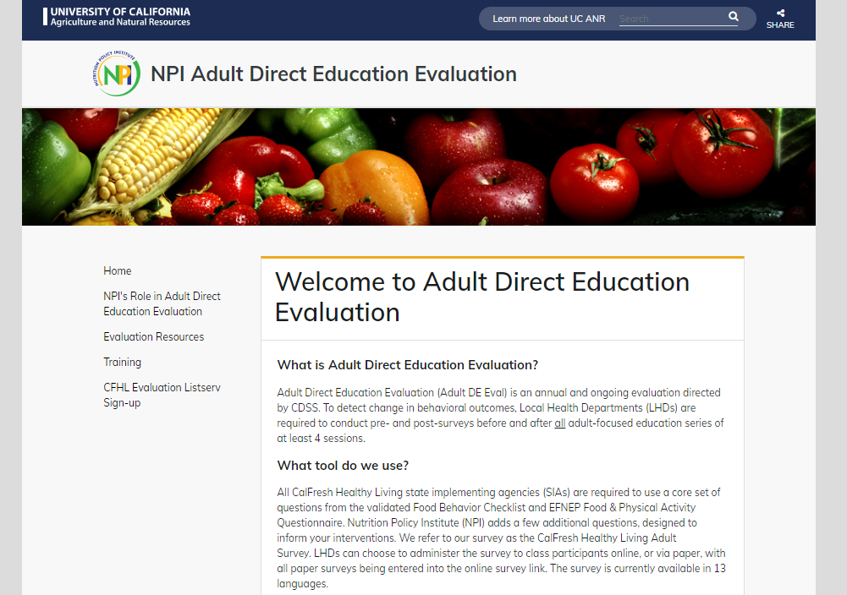
Resources
Paper surveys
Protocol
Materials Checklist
Survey link/ QR code
Website is fully updated for FFY 25!

Slide 28
Website changes
UC ANR websites are transitioning this fall and winter!
SiteBuilder → Drupal
We don’t expect disruption in functionality, however, if at any time, you have issues downloading materials, just email me for them.

Slide 29
Resources
Project contact: Amanda Linares, amlinares@ucanr.edu
Website: https://ucanr.edu/sites/http___ucanredu_sites_adultDE//
Listserv: http://eepurl.com/hHyX4f

Slide 30
Questions?
REMINDER!
Next Adult Direct Education Evaluation call will be held in March

