Slide 1


Advanced IPM Training – Irvine 2024
Know your water
Esther (Mosase) Lofton
Urban Watershed Resilience Advisor
South Coast REC, Irvine, CA
Serving Orange, LA, Riverside & San Bernardino
September 25th, 2024
South Coast Research & Extension Center - Irvine, CA

Slide 2





01
Where does your water come from?
Concept of watersheds
02
Outline
03
Sources, Fate, and Transport of pollution
x
Hands-on activities
Why should you care?
04
05
What you can do to help

Slide 3

Where does your water come from?
01

Slide 4
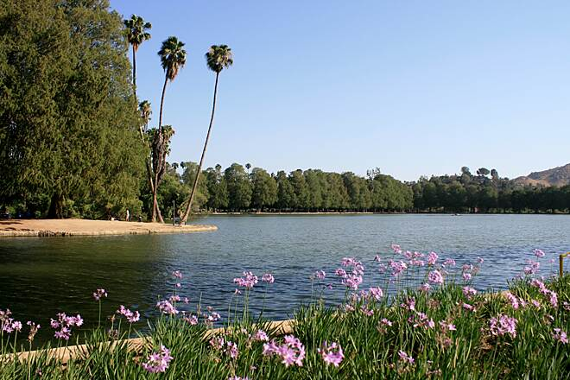
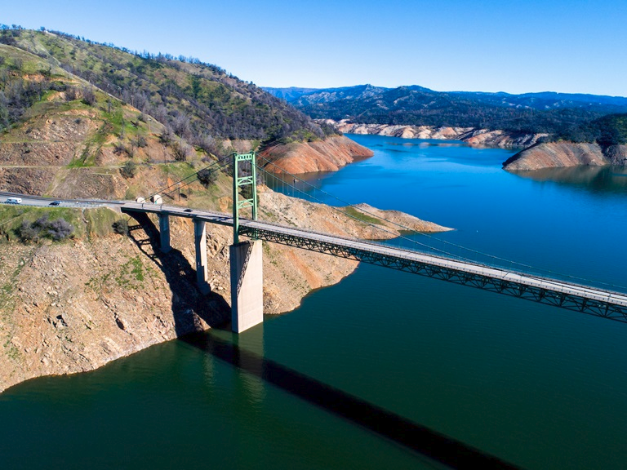
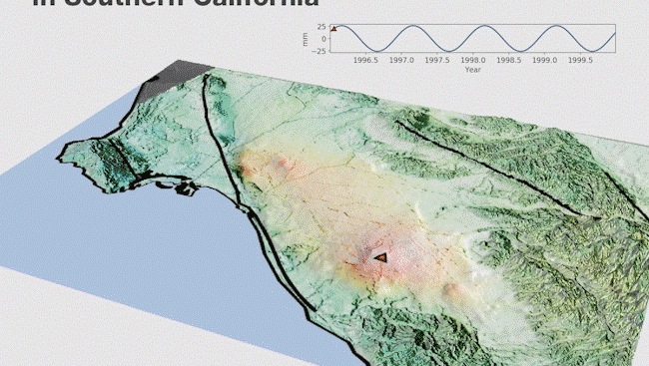
Water Sources in SoCal
Local Surface water
  Includes reservoirs, lakes, and rivers within the region.
Groundwater
  Aquifers store water underground, providing a crucial source, especially during droughts.
Notes:
Southern California's water supply comes from a variety of sources. Let’s break them down;

Slide 5
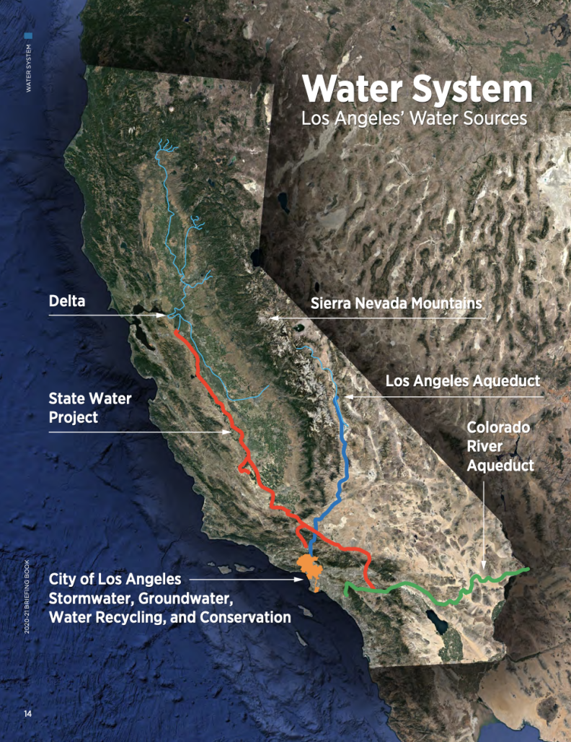
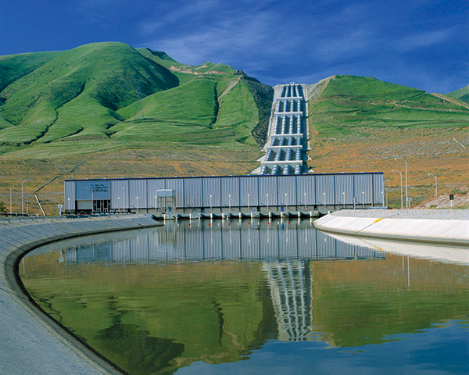
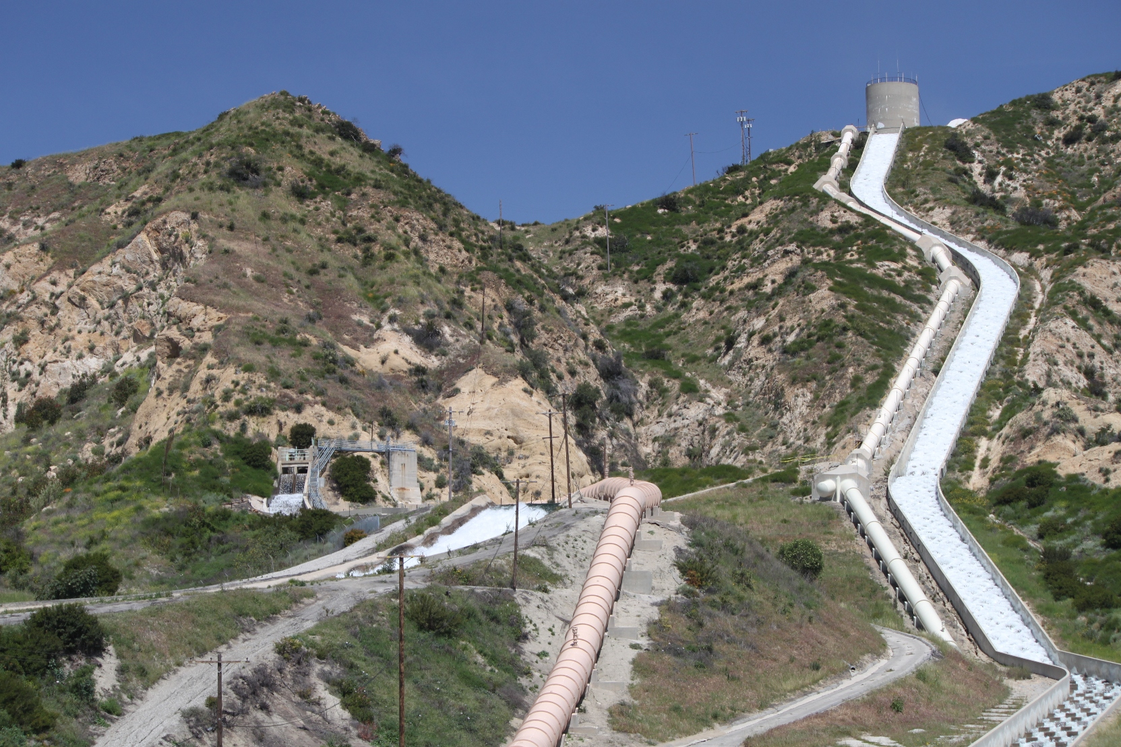

Water Sources in SoCal
3. Imported Water
  Colorado River Aqueduct
    Transports water from the Colorado River.
  State Water Project (SWP)
  Brings water from Northern California.
  Los Angeles Aqueduct
  Channels water from the Eastern Sierra Nevada.
- Los Angeles Aqueduct: Channels water from the Eastern Sierra Nevada.
Notes:
Each source is vital to our water supply but also faces challenges, such as drought, overuse, and environmental changes.

Slide 6
Orange
LA
Know your water
How much in % is your county water Sources?
Riverside
SB

Slide 7
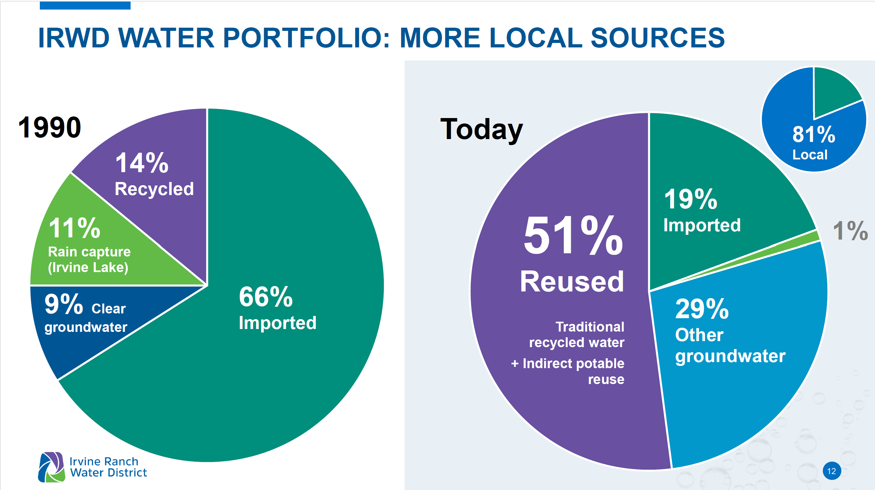
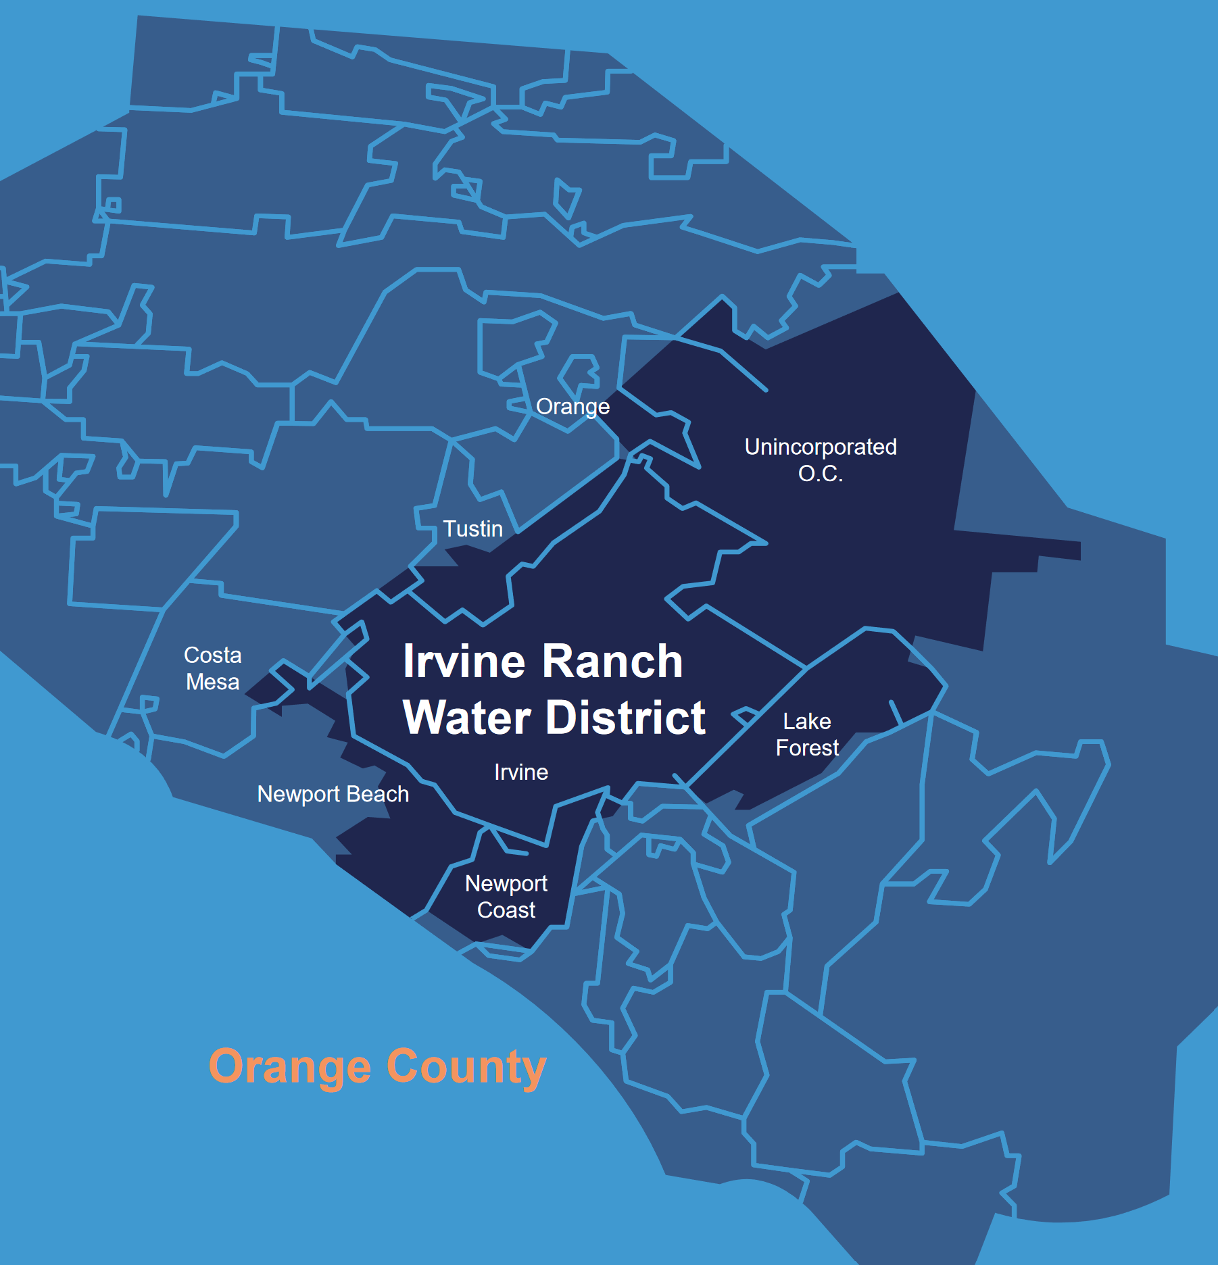
IRWD Water portfolio
More than half of IRWD’s supply comes from treating, purifying, and reusing water that goes down customers’ drains.
That includes:
IRWD recycled water for irrigation and other uses (26%)
Drinking water from OCWD’s Groundwater Replenishment System (25%)
Notes:
Indirect Potable Reuse (IPR) is the planned use of recycled water to replenish drinking water supplies with a suitable environmental barrier. There are two types of IPR projects: Groundwater Replenishment Reuse Projects (GRRP) and Surface Water Source Augmentation Projects (SWSAP).

Slide 8
Understanding Watersheds!
02

Slide 9
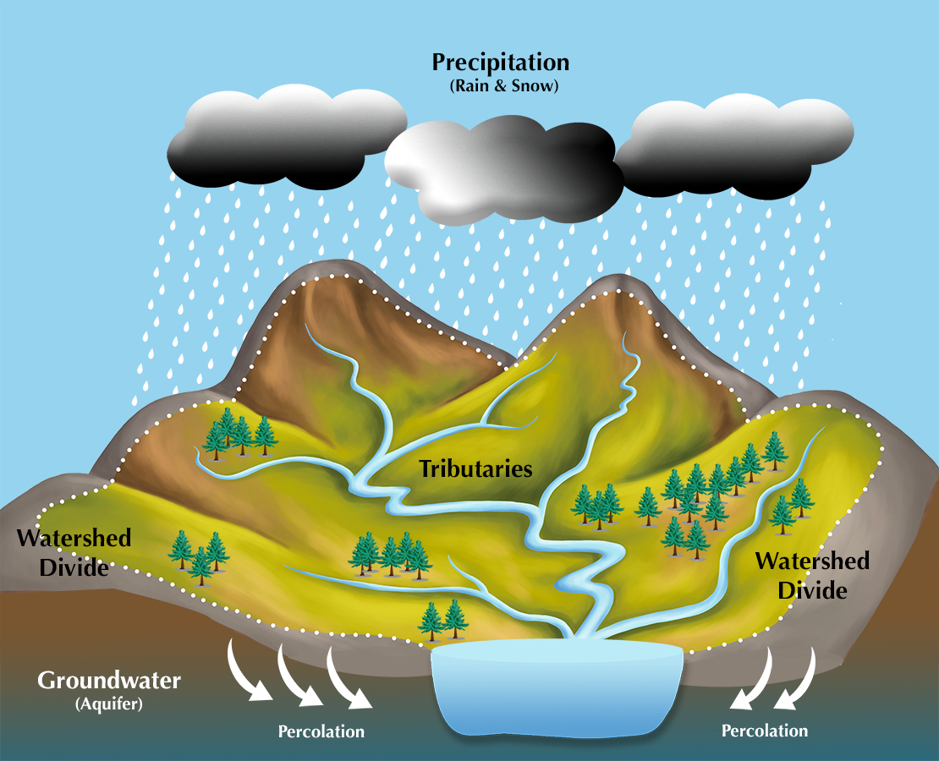
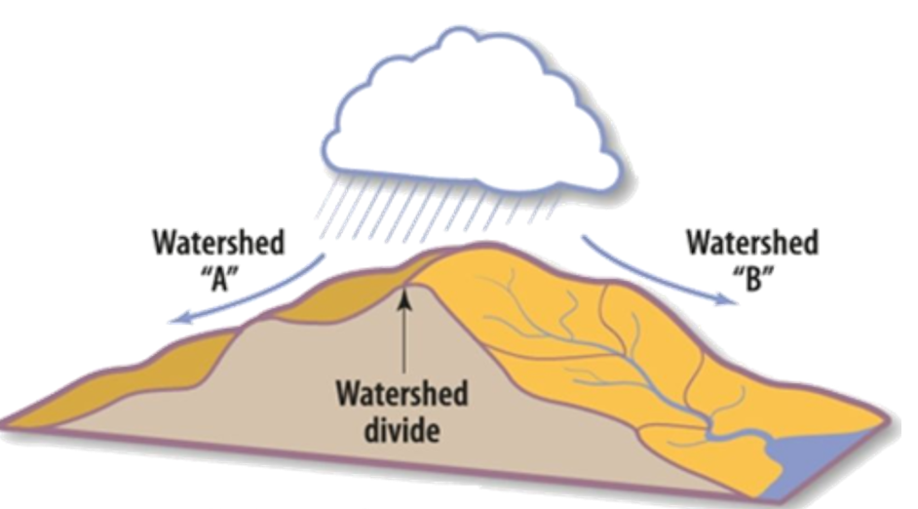
Watershed & Key Concepts
  What is a watershed?
  an area of land where all precipitation collects and drains into a common waterway
Watershed Boundaries:
  high points and ridges
Water Flow:
  Water flows downhill from higher elevations to lower areas,

Slide 10
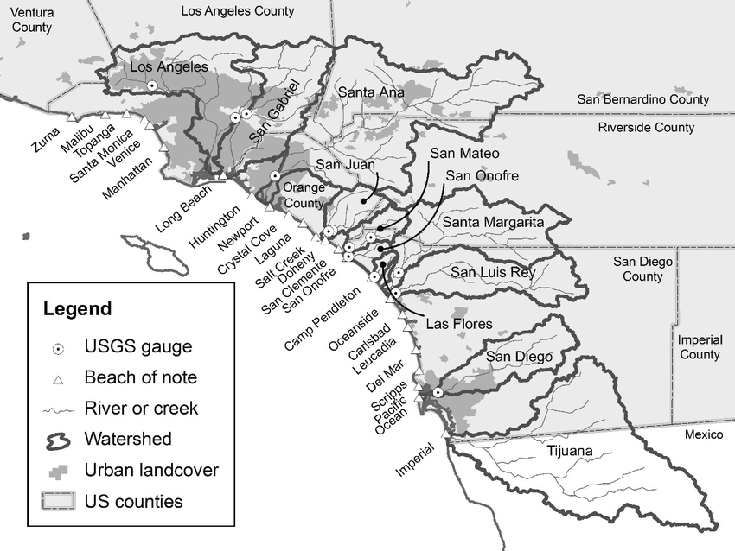





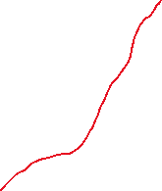







Watershed & Key Concepts
  Every stream, tributary, or river has an associated watershed …
  … and small watersheds connect to become larger watersheds.
  Small watersheds nested in larger watersheds are called subwatersheds

Slide 11



SoCal watersheds
Water from different watersheds do not mix …
  … unless they are nested watersheds
Notes:
Southern California includes several major watersheds, such as the Santa Ana River Watershed and the Los Angeles River Watershed.

Slide 12
The importance of watersheds
  critical for capturing, storing, and distributing water.
  maintain ecosystems and habitats.

Slide 13
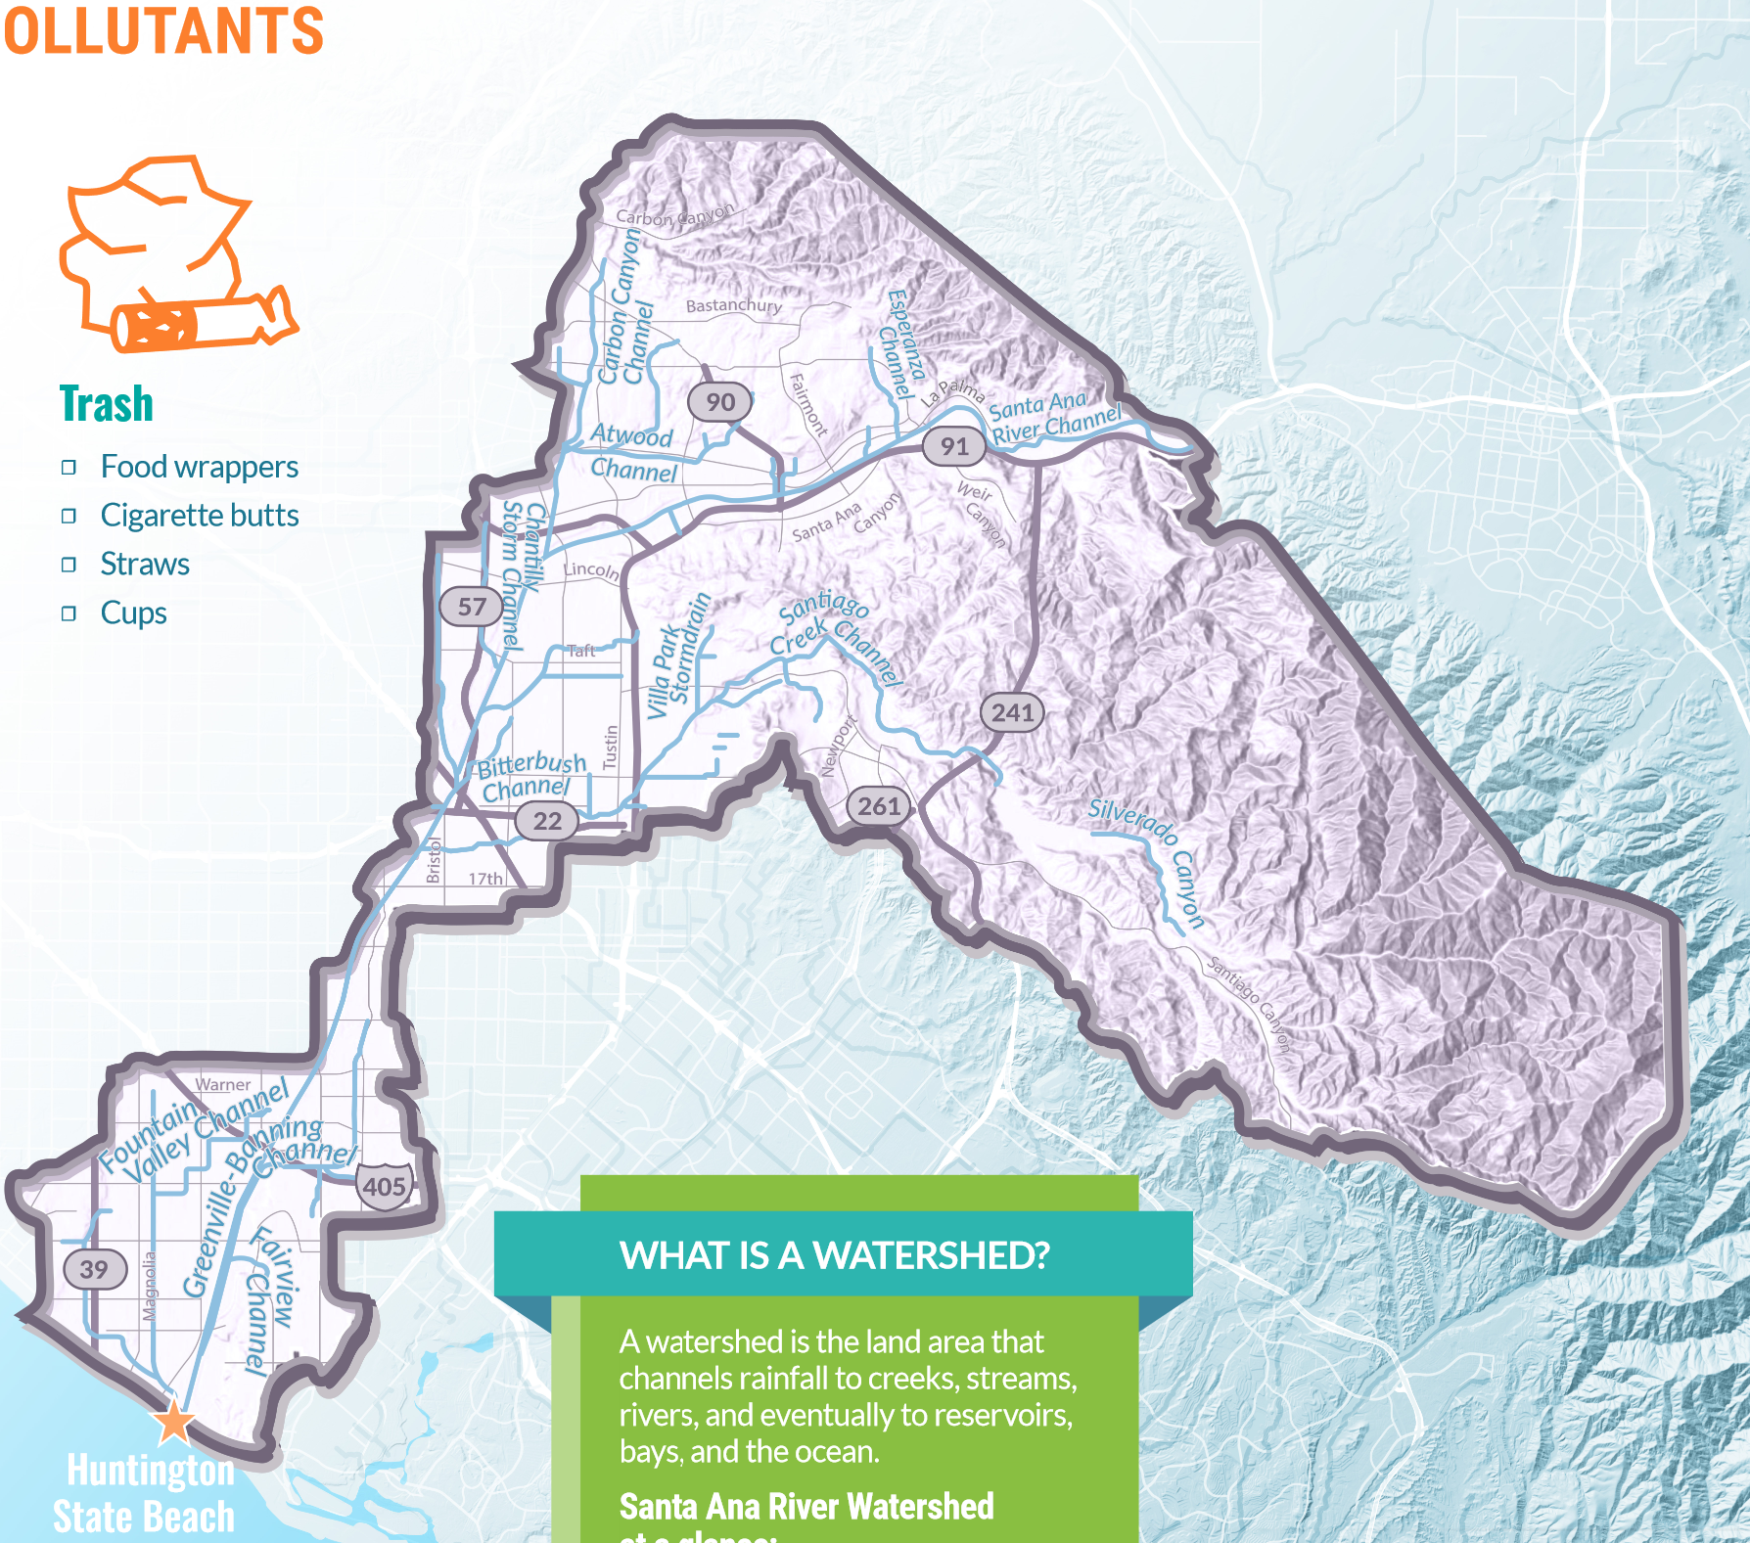
Santa Ana Watershed
Cities in the Watershed:
• Yorba Linda
• Brea
• Placentia
• Villa Park
• Orange
• Anaheim
• Garden Grove
• Santa Ana
• Fountain Valley
• Costa Mesa
• Newport Beach
• Huntington Beach
Quick Glance
2,650 square miles (210 in OC)
Begins in the San Bernardino Mountains
Discharges to the Pacific Ocean at Huntington State Beach

Slide 14

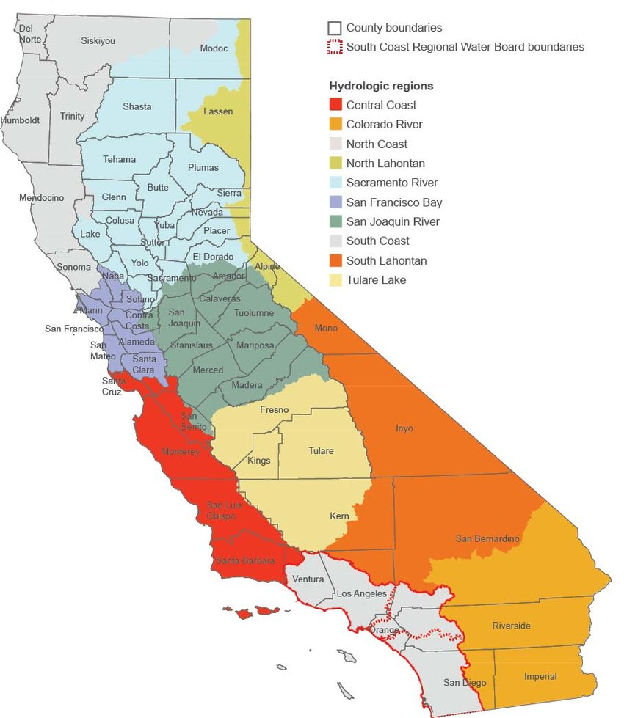
Hydrological Subregions
All water drains to the sea.
The region extends from Ventura to San Diego
Notes:
California can be divided into hydrologic subregions. Each of our local watersheds drain to and have a direct impact on the region and the state as water moves to reservoirs and oceans.

Slide 15
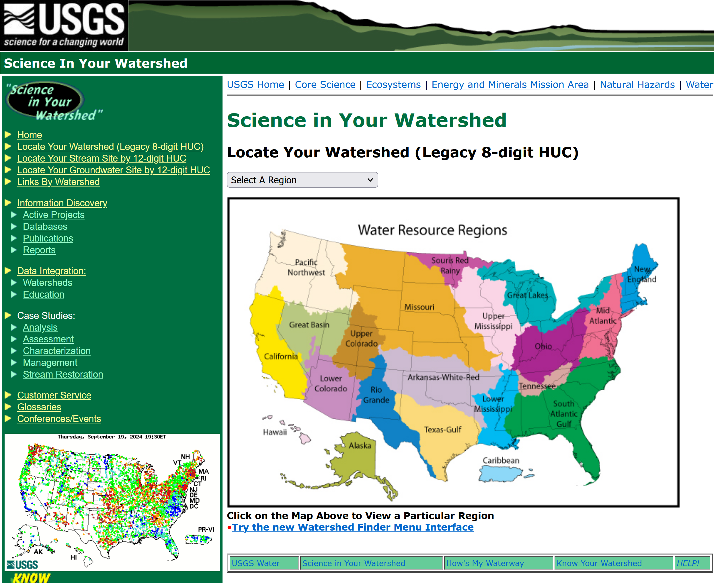
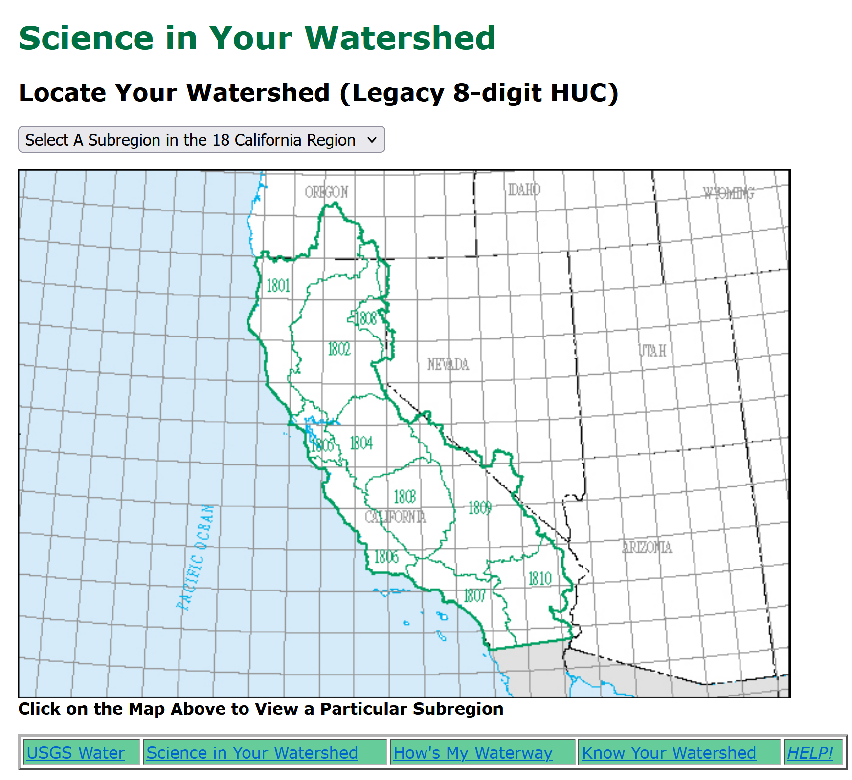
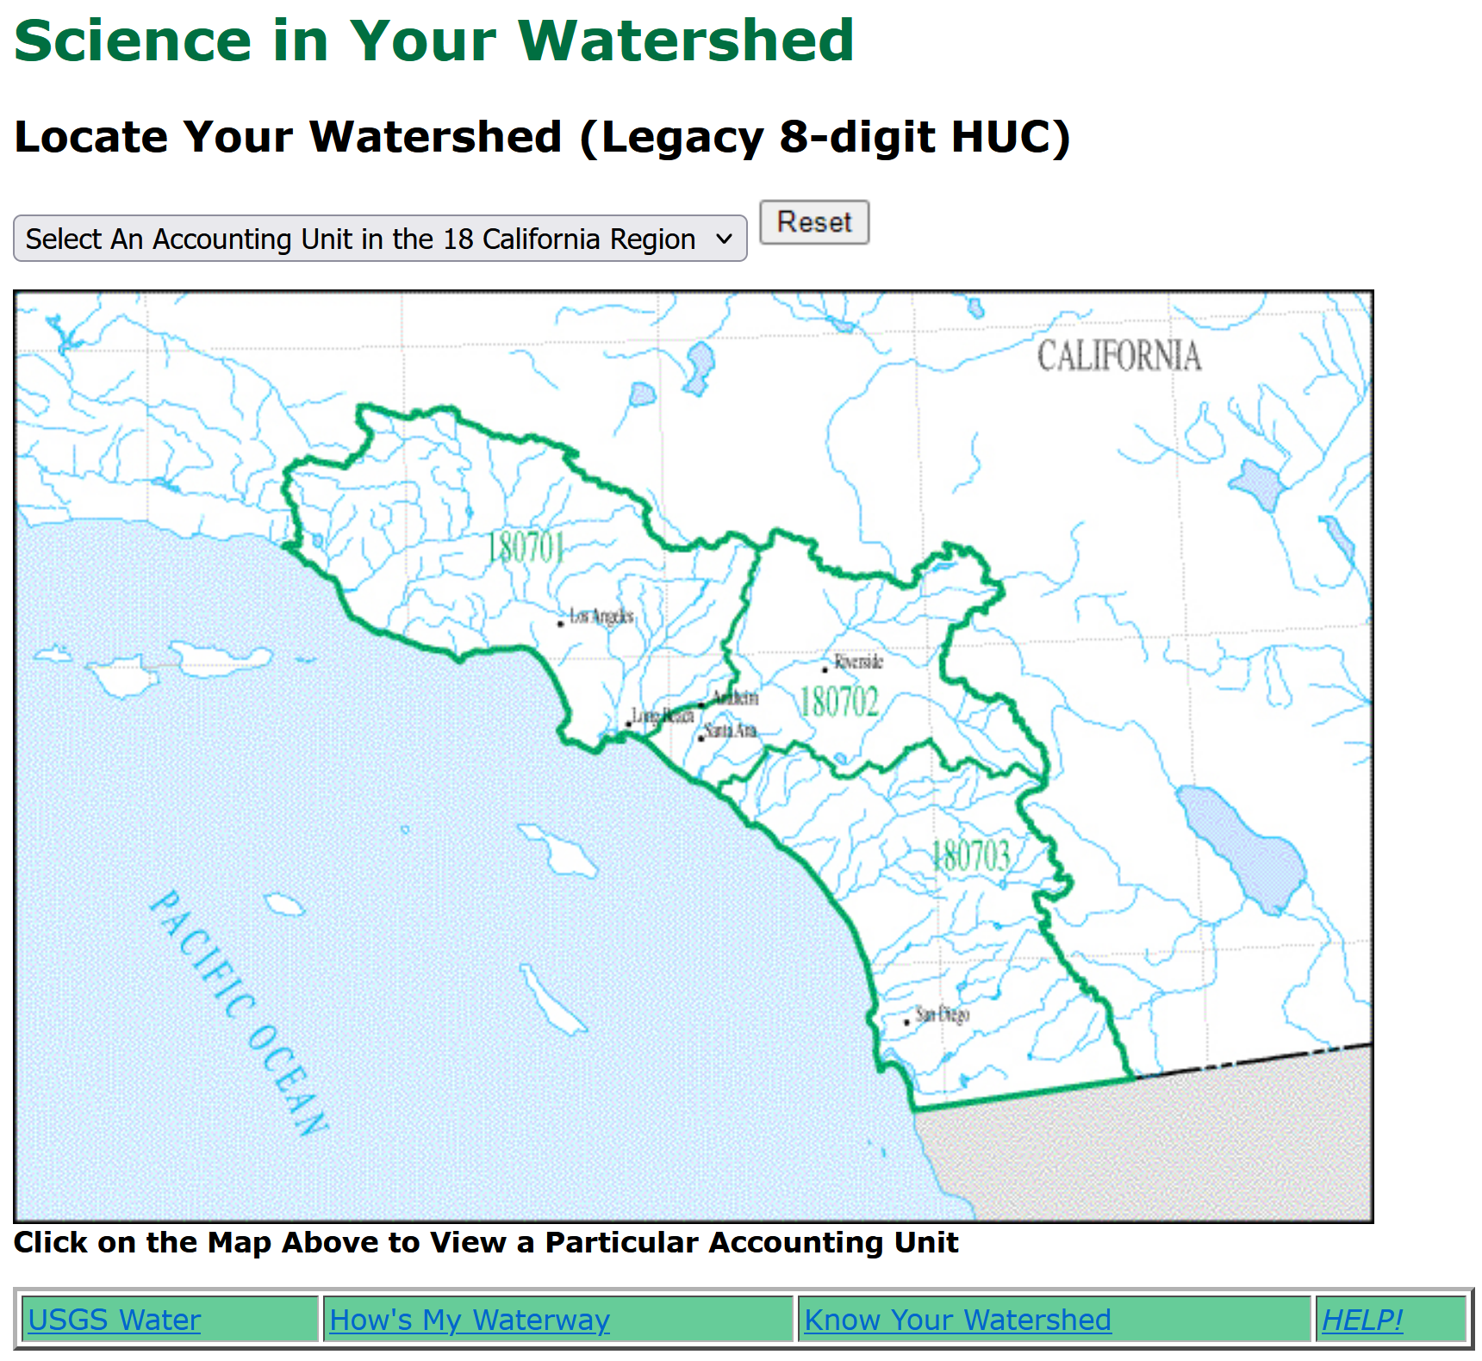
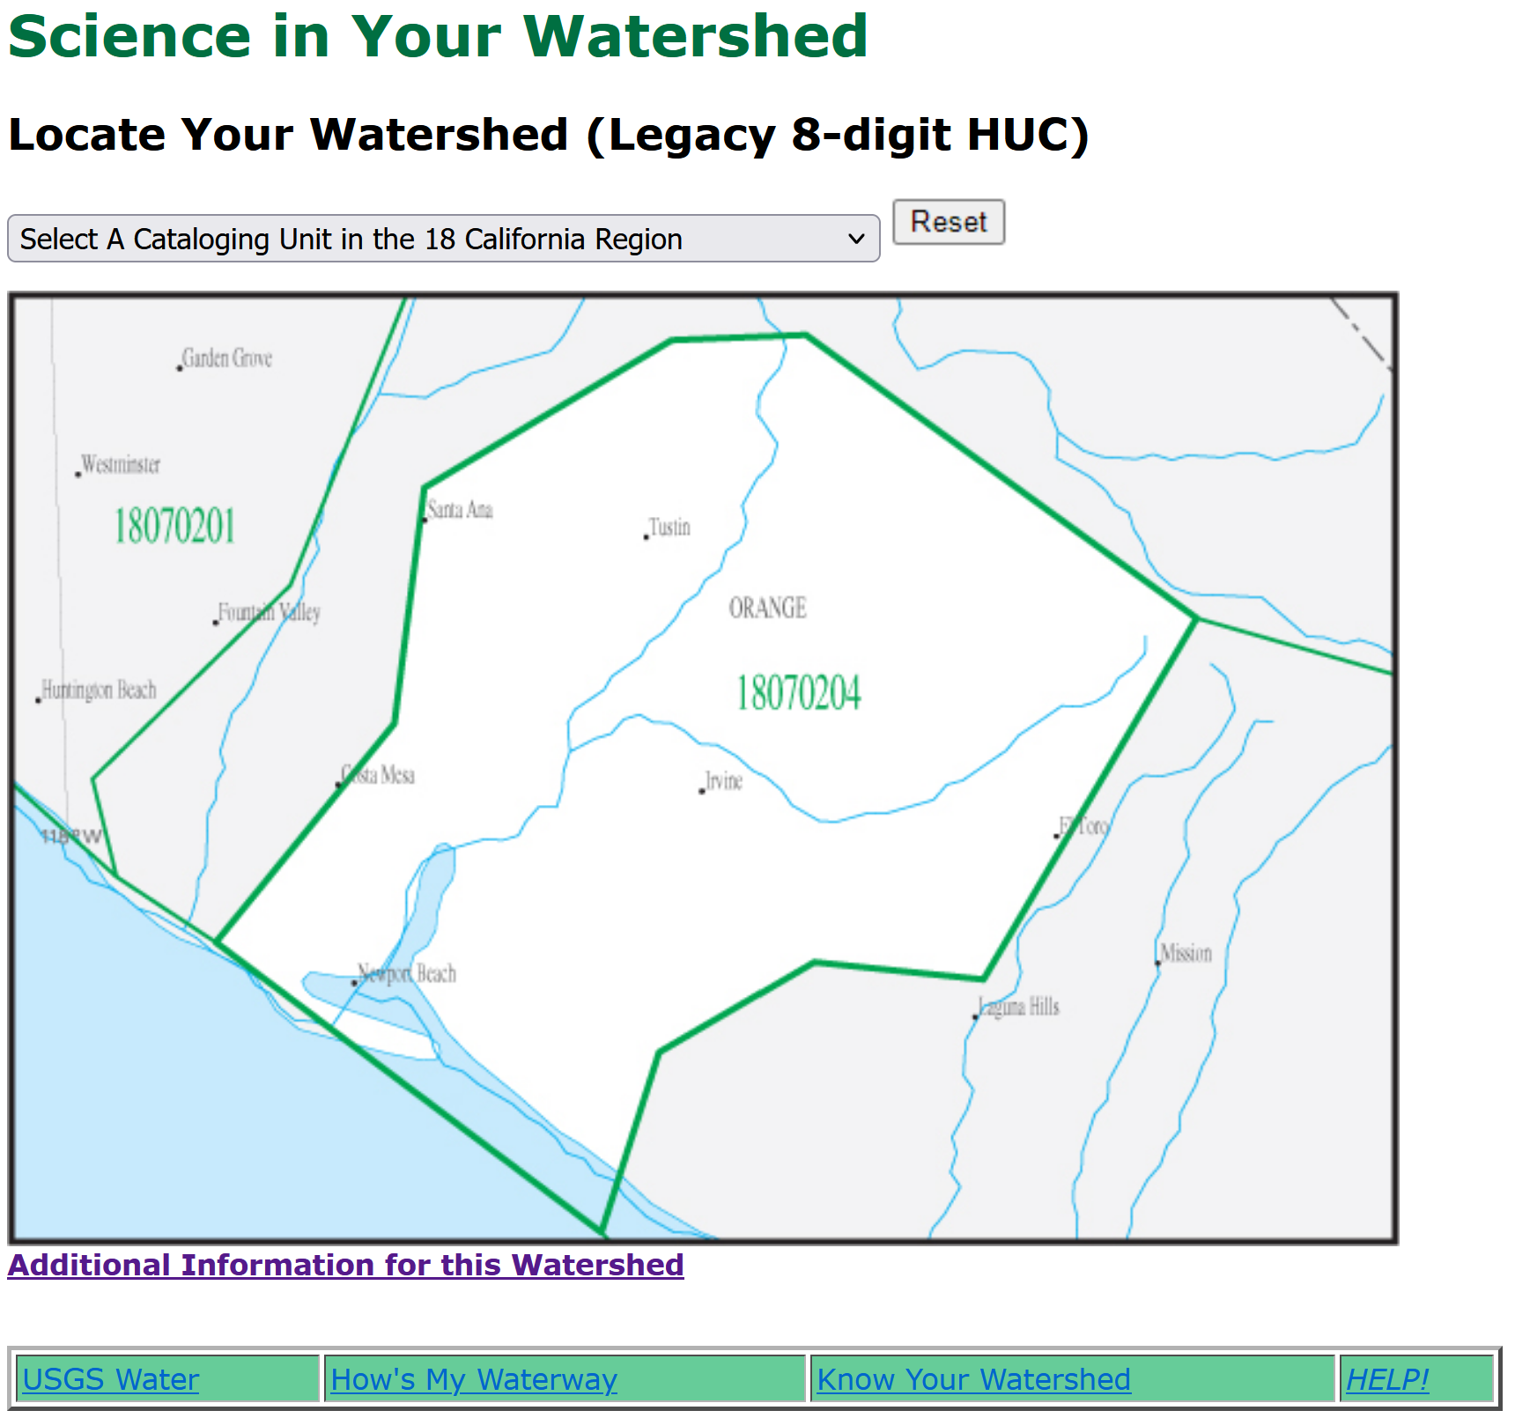
Do you know your watershed?
https://water.usgs.gov/wsc/map_index.html
Notes:
Use this resource to locate your local watershed and connect larger watersheds.

Slide 16
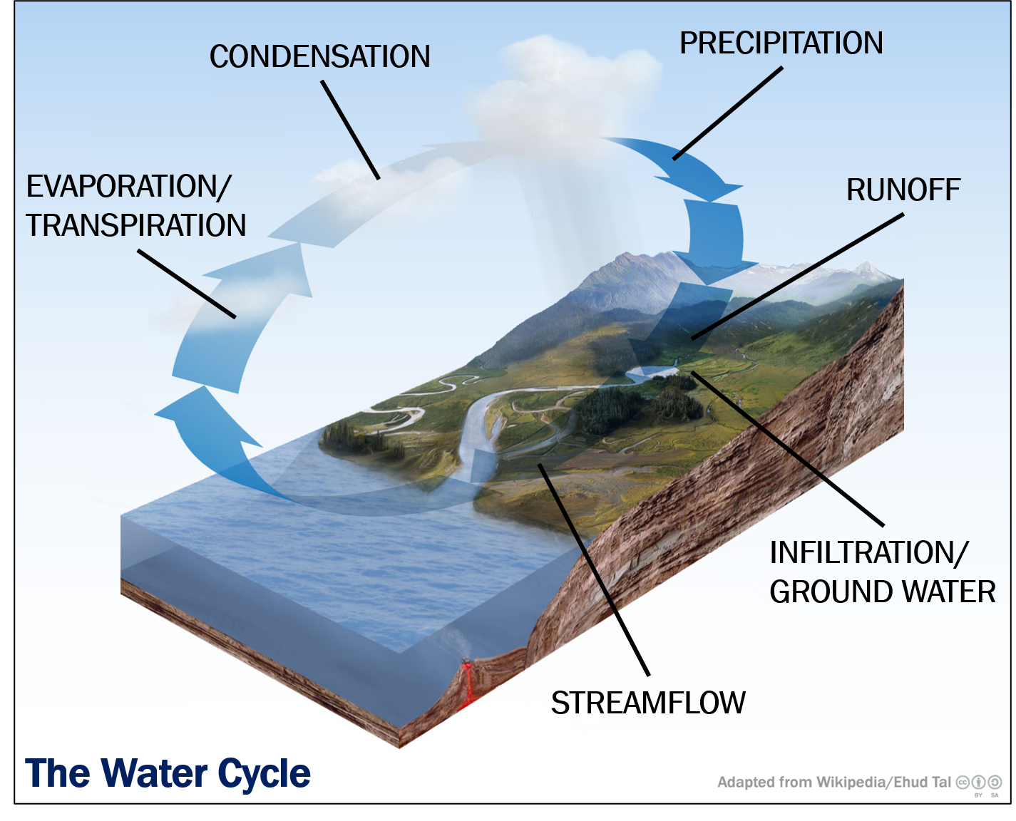
How Does Water Flow?
Water in a watershed follows a predictable path
Notes:
Understanding this flow helps us manage water resources and predict how pollution can travel through the watershed.

Slide 17
Sources & Transport
03

Slide 18
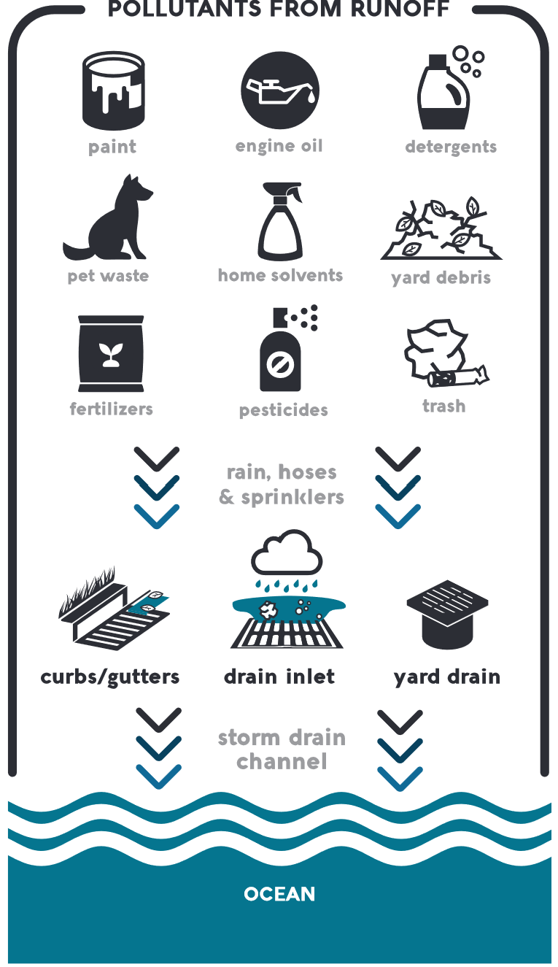
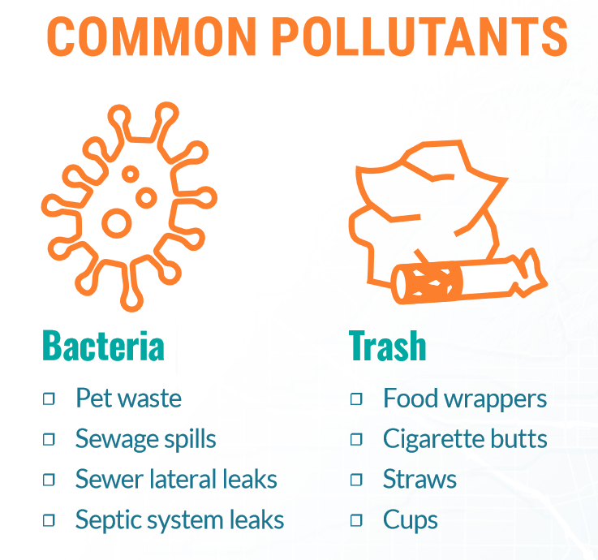
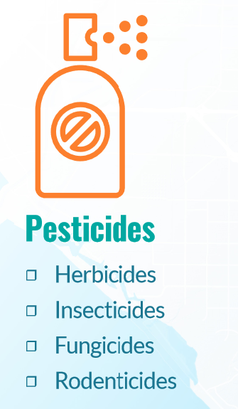
How Pollution Enters Waterways
Pollution can enter waterways through various sources:
Point Source Pollution
  Direct discharges from identifiable sources such as factories, sewage treatment plants, and storm drains
Non-point Source Pollution
  Diffuse sources such as agricultural runoff, urban runoff, and atmospheric deposition.
Notes:
Once pollutants enter the waterways, they can be transported downstream, impacting water quality and ecosystems far from the original source.

Slide 19
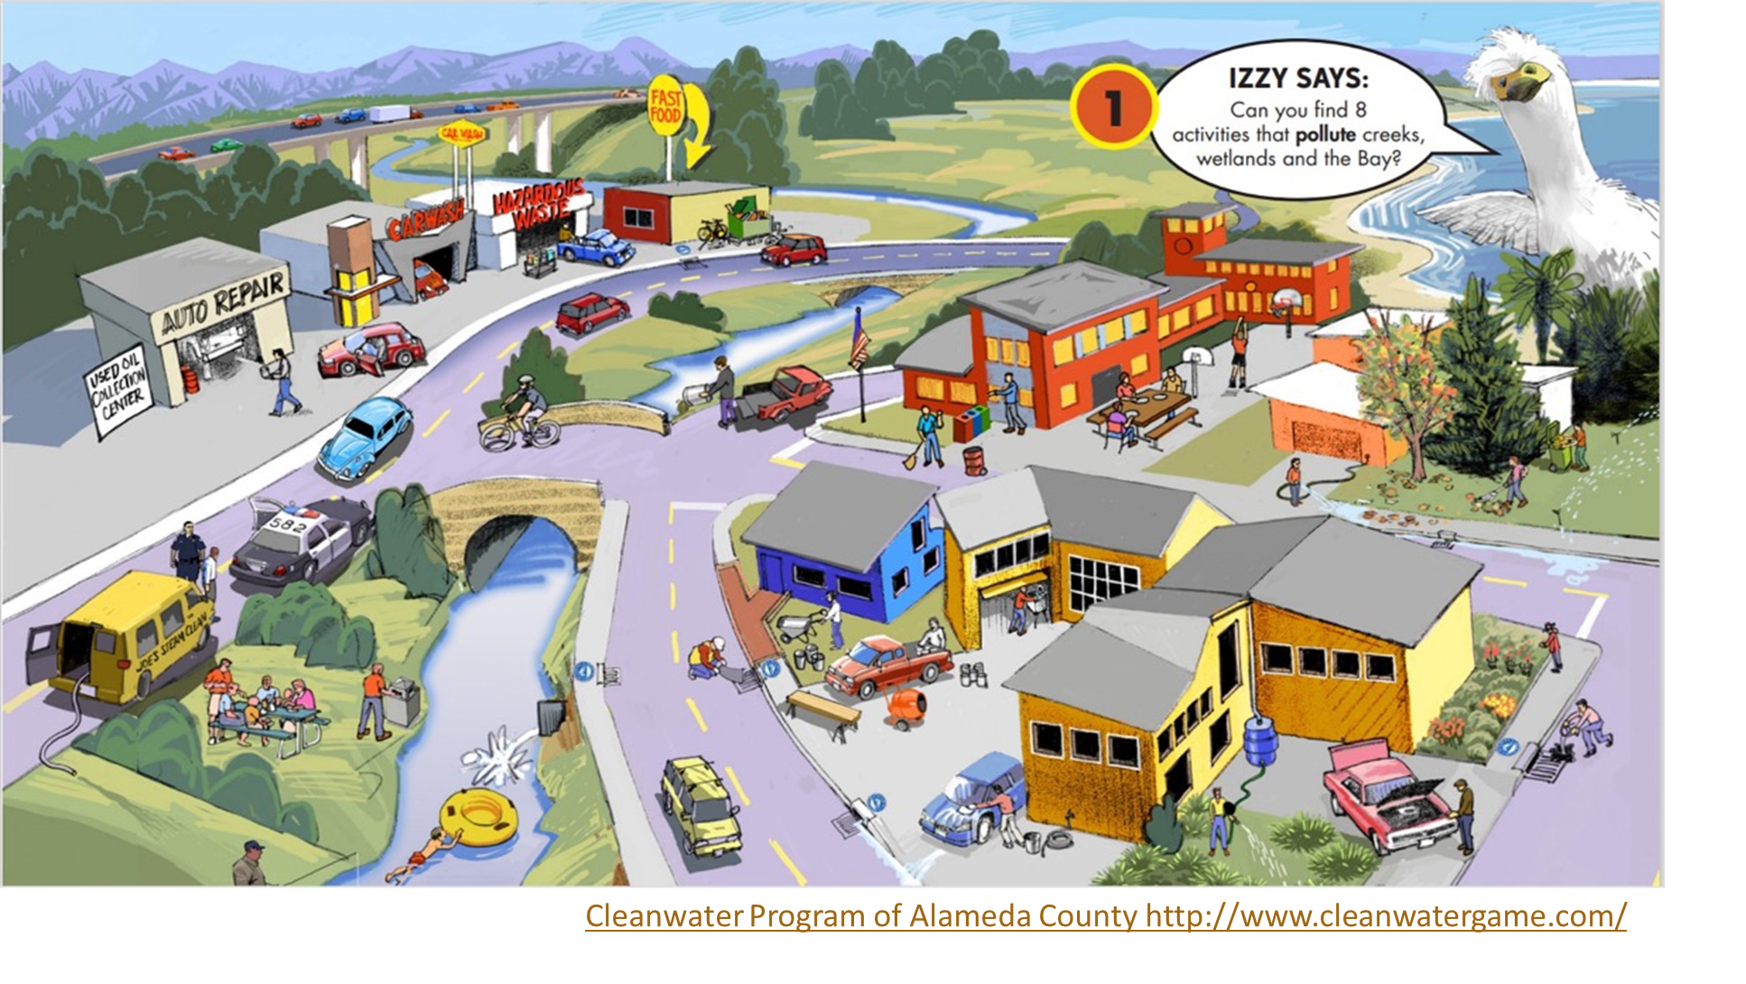
Identify pollutants
Cleanwater Program of Alameda County http://www.cleanwatergame.com/

Slide 20
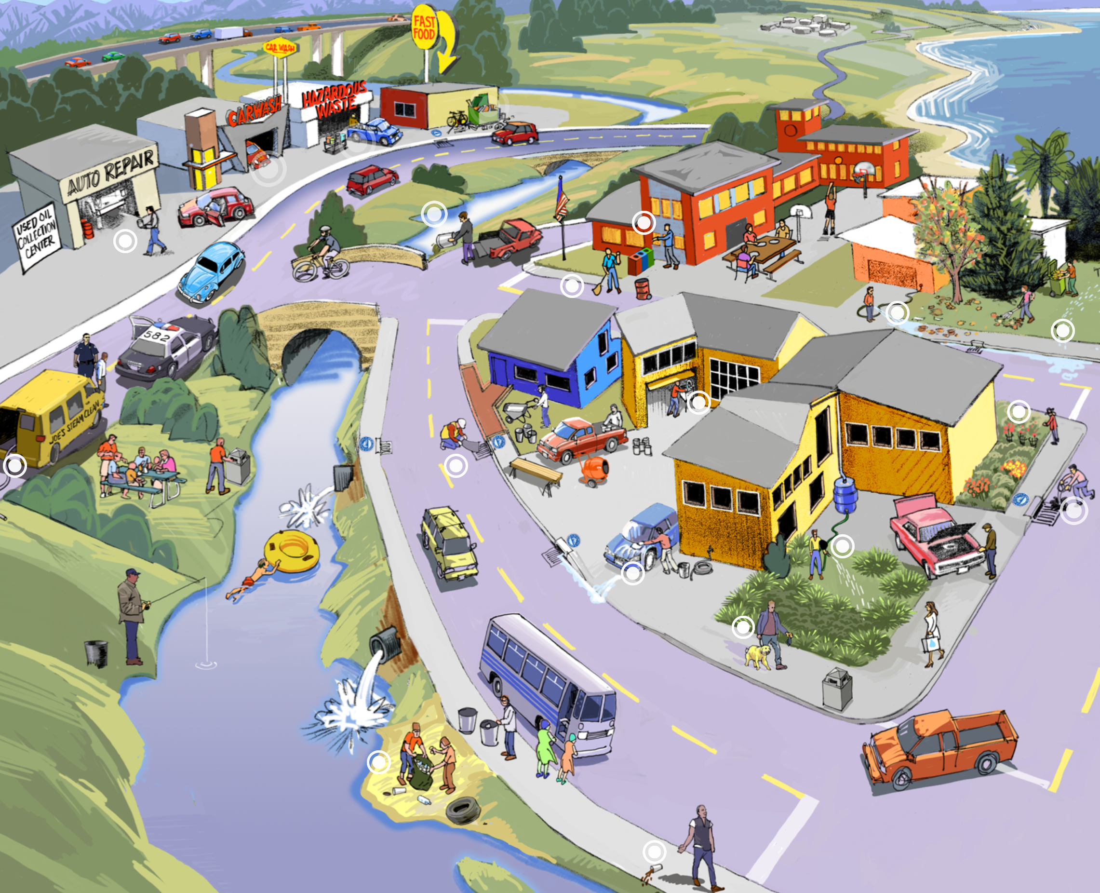

Identify pollutants
Cleanwater Program of Alameda County http://www.cleanwatergame.com/

Slide 21

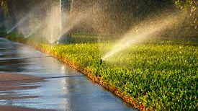
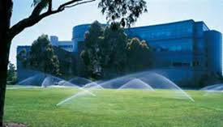
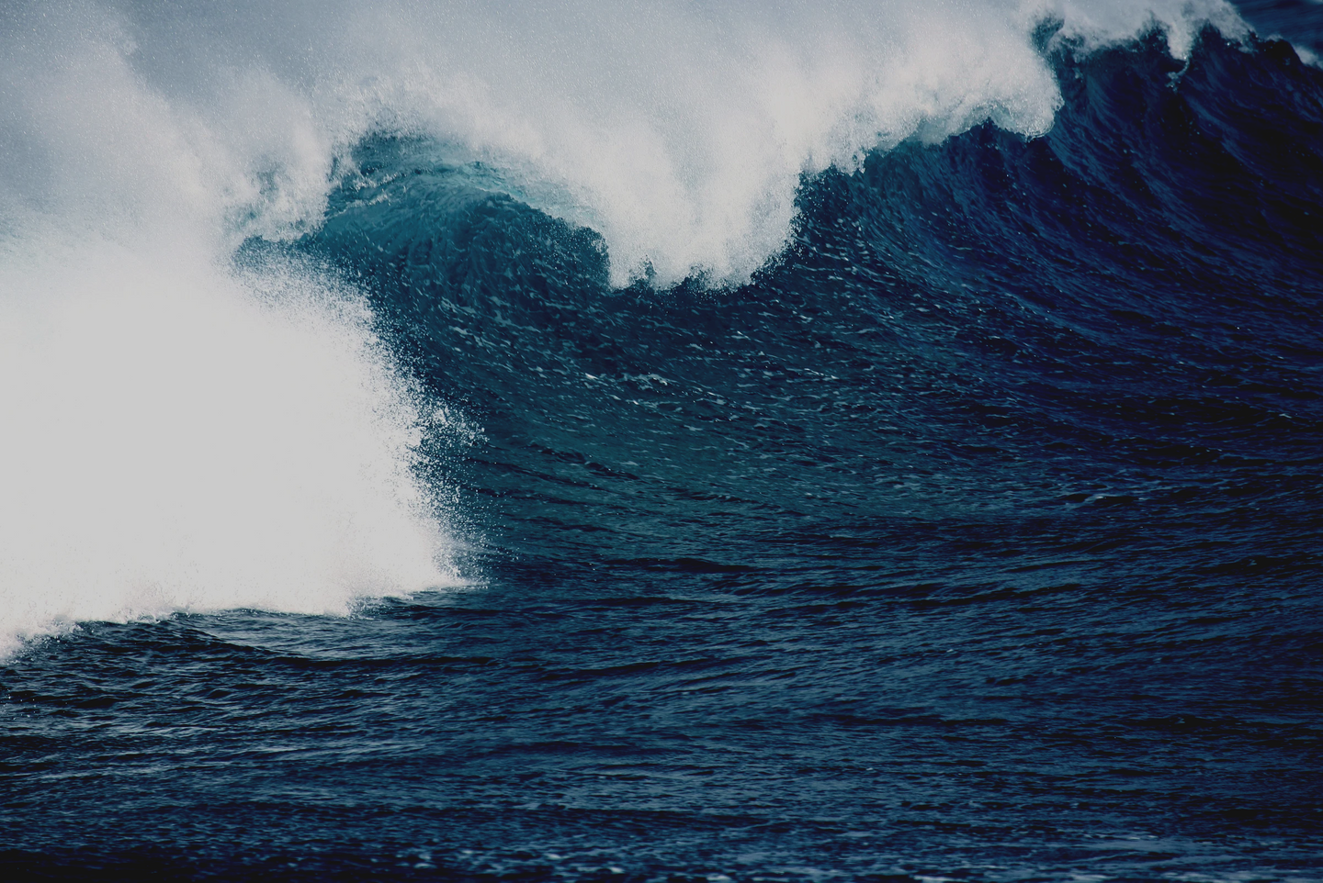
Residential Areas
Homeowners often use pesticides and fertilizers on lawns, gardens, and landscaping.
Improper application or overuse can lead to being washed off by rain or irrigation.
.
Commercial Properties
Businesses, particularly those in landscaping and pest control, frequently apply pesticides.
Parking lots and landscaped areas can contribute to runoff during rain events.

Slide 22
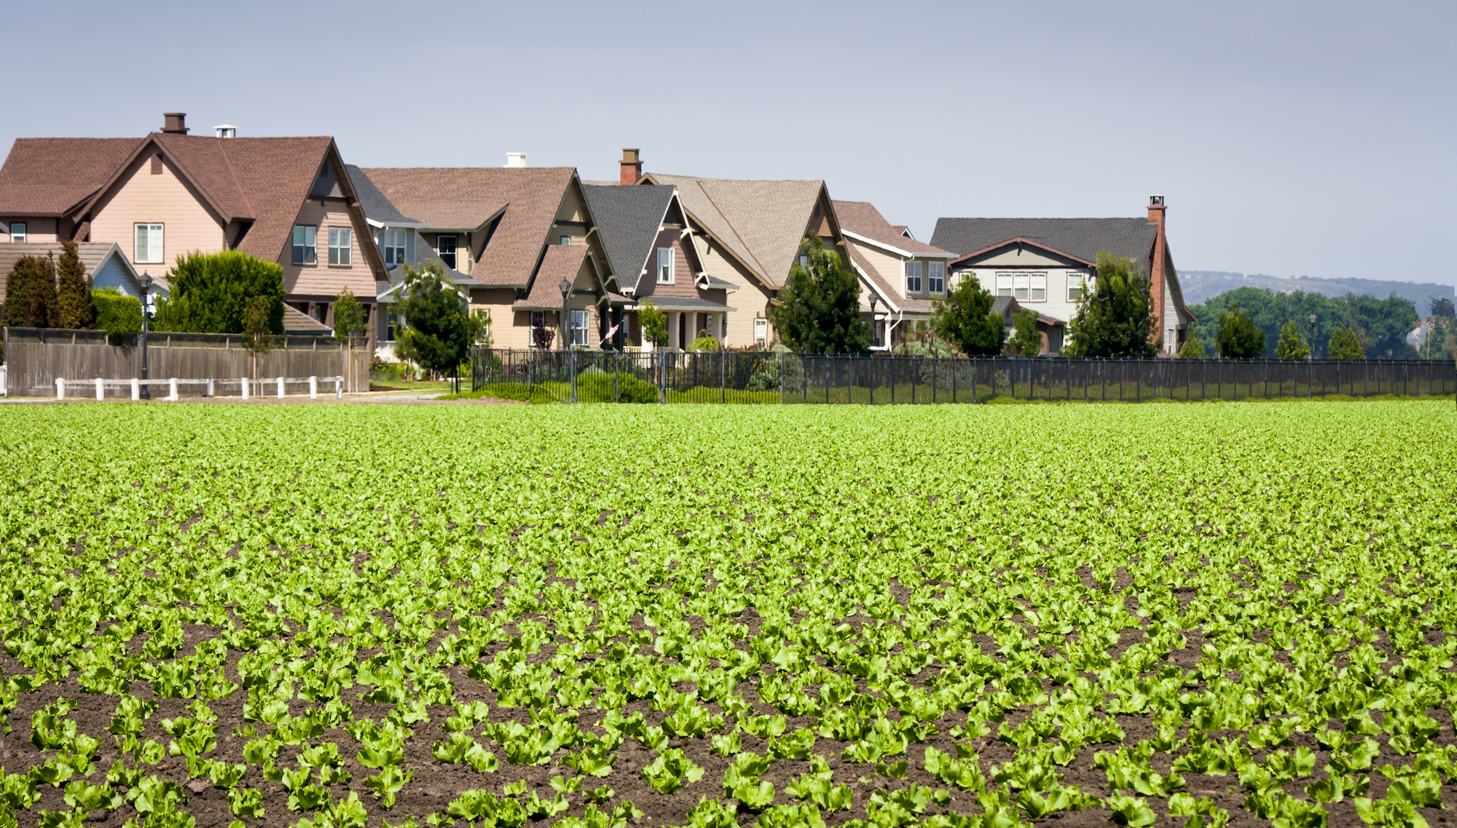
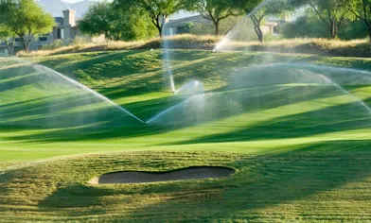
Agricultural Land Near Urban Areas
Agricultural fields adjacent to urban areas can contribute pesticides and nutrients to urban streams and rivers.
Irrigation runoff and stormwater can carry pollutants from fields into urban drainage systems.
.
Public Spaces
Parks, golf courses, and other public green spaces often use pesticides for maintenance.
These areas can be significant sources of pesticide runoff during storms.

Slide 23
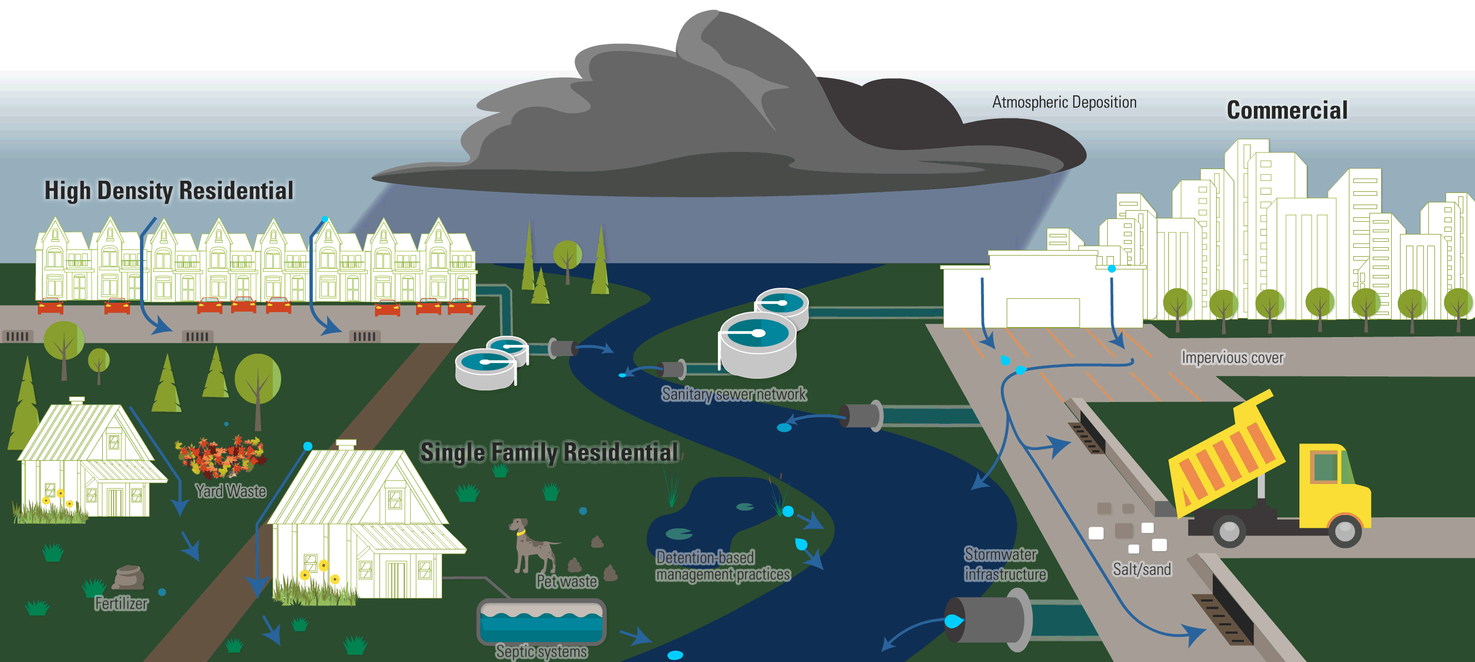
Transport of Pollution Downstream
Pollution picked up by stormwater is transported through watersheds to our receiving waters via the storm drain system
What is stormwater?
runoff during and following precipitation and snowmelt events, including surface runoff and drainage.

Slide 24

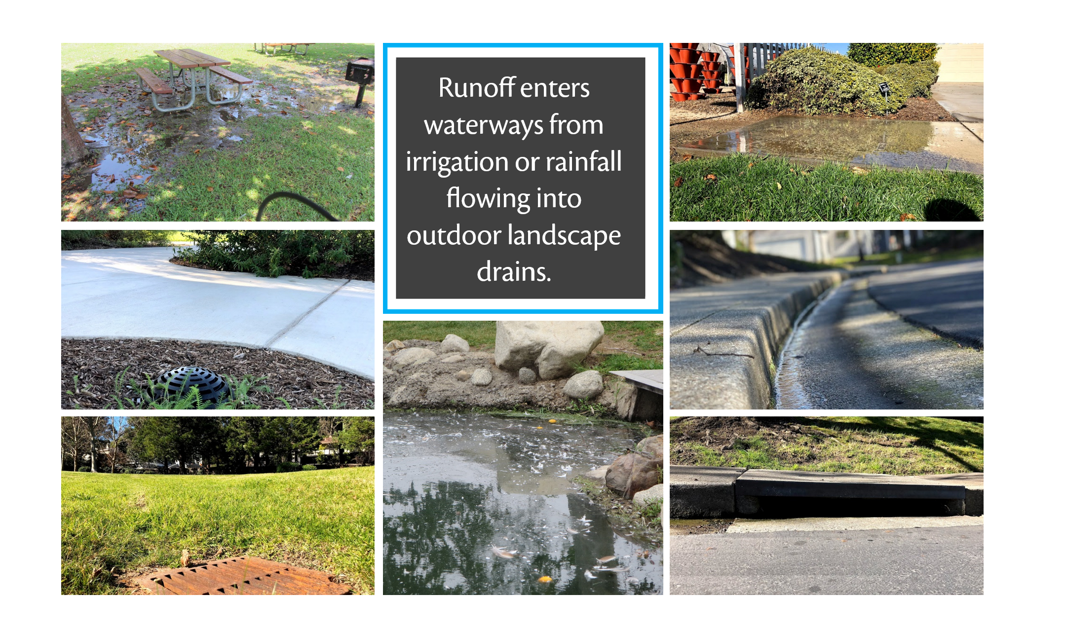
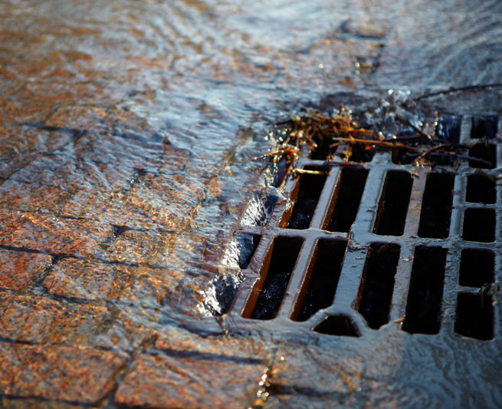
Some examples of storm drains!

Slide 25

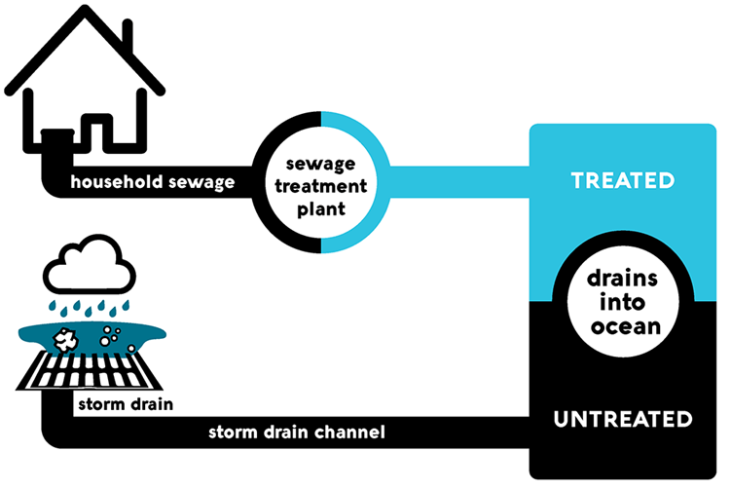
Are any of these waters treated before they are released into the ocean?
Challenge

Slide 26
The waterways
Yes, for household sewage &
No for stormwater
The storm drain system collects excess runoff from paved streets, parking lots, sidewalks, and roofs and discharges it to our waterways
Answer

Slide 27
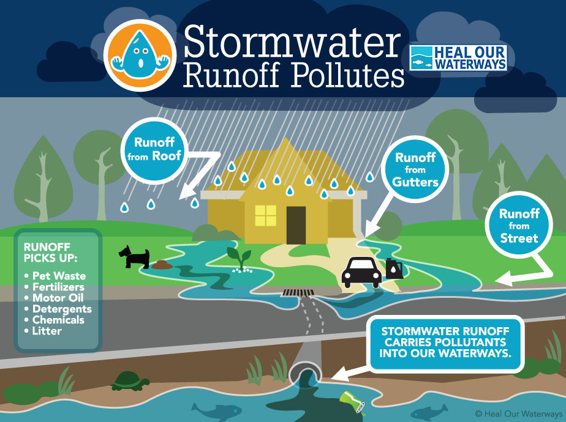
Stormwater
pathways
Is it treated?
UNTREATED
UNTREATED
UNTREATED
UNTREATED
UNTREATED!!!
UNTREATED
Urban runoff is not treated
UNTREATED
UNTREATED

Slide 28
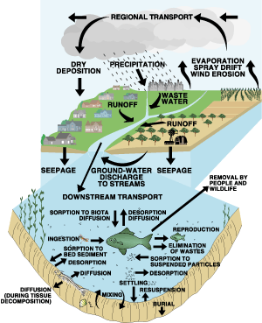
Other forms of Transport
Leaching: Pollutants can percolate through the soil profile, reaching groundwater.
Atmospheric Transport: Pollutants can volatilize and enter the atmosphere
Adsorption/Desorption: Pollutants can adhere (adsorption) to soil particles and organic matter or detach from these particles (desorption) and become mobile again

Slide 29
Pesticide monitoring in SoCal
Detections were based on;
  1. > 10% exceeding their lowest
  USEPA aquatic life water benchmark
  OR
  2. Percentage of sediment detections exceeding their sediment LC 50
The Lethal Concentration (LC50) is an estimate of the product concentration that would kill 50% of the exposed specimens for the specified exposure period.

Slide 30
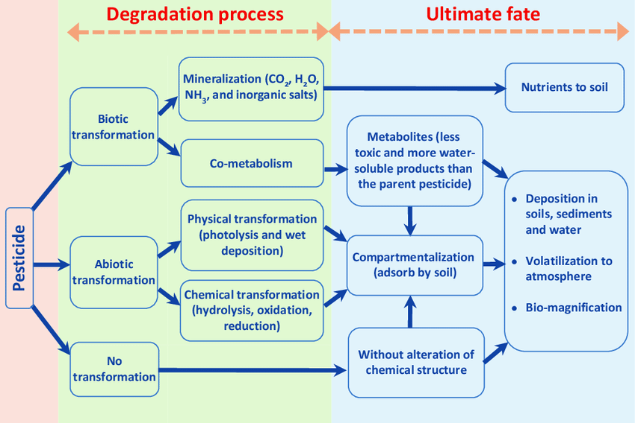
Fate of pesticides
What happens to the pesticide in soil, water, and air after being released into the environment

Slide 31
Pesticide | Use | Half-Life (days)
Glyphosate | Broad-spectrum herbicide (agriculture, residential, public spaces) | 2-197 (avg. 47)
2,4-D | Herbicide for broadleaf weeds (lawns, agriculture, roadways) | 1-14 (avg. 7)
Imidacloprid | Insecticide (agriculture, residential, commercial landscapes) | 48-190 (avg. 120)
Carbaryl (Sevin) | Insecticide (agriculture, gardens, residential) | 1-84 (avg. 10)
Chlorpyrifos | Insecticide (agriculture, citrus, almonds, grapes) | 7-120 (avg. 30)
Bifenthrin | Insecticide (agriculture, residential, commercial landscapes) | 7-240 (avg. 60)
Pyrethroids | Insecticides (agriculture, residential, commercial landscapes) | 7-28 (avg. 10)
Half-Life
The half-life of a pesticide is the time required for half of the pesticide to break down or degrade in the environment

Slide 32
On-hands Activity #1
x1

Slide 33
# 1 Reading Pesticides labels

Slide 34
Why should we care?
03

Slide 35


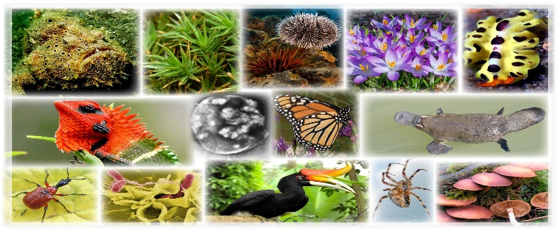
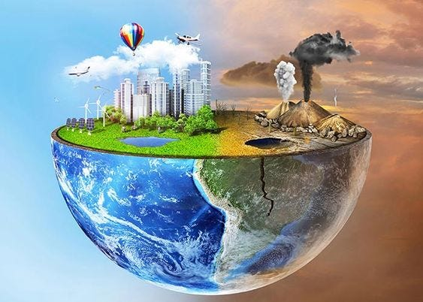

We care because …
Pesticides do not just harm the organisms that they are designed to control. They also have a major impact on non-target organisms, including people.
Impacts Health
Pregnant mothers and children
Decreases biodiversity
Impacts water, soil and air
Drains the economy
Exposure can cause
fertility and reproductive issues
Diabetes, Obesity
Degenerative diseases such as cancers, asthma
Pesticides have been linked to declines in bees & pollinators, beneficial insects, birds, mammals, aquatic animals and non-target plants
Runoff contaminates surface & groundwater.
Soil micro-organisms are poisoned, affecting soil fertility, and drift & volatilization contaminates rain, air, and fog
Pesticides cause illness and injury, resulting in lost workdays.
Exploitative markets keep users on the pesticide treadmill that result in resistance and incorrect use
This group is particularly sensitive as exposure can cause childhood cancers, neuro-developmental issues, and other disorders

Slide 36
Pesticide | Use | Half-Life (days) | Notes
Glyphosate | Broad-spectrum herbicide (agriculture, residential, public spaces) | 2-197 (avg. 47) | Binds to soil, reducing mobility but increasing persistence.
2,4-D | Herbicide for broadleaf weeds (lawns, agriculture, roadways) | 1-14 (avg. 7) | Relatively mobile, can leach into groundwater.
Imidacloprid | Insecticide (agriculture, residential, commercial landscapes) | 48-190 (avg. 120) | Highly soluble, leaches into groundwater, risk to non-target organisms.
Carbaryl (Sevin) | Insecticide (agriculture, gardens, residential) | 1-84 (avg. 10) | Moderately mobile, can affect aquatic life.
Chlorpyrifos | Insecticide (agriculture, citrus, almonds, grapes) | 7-120 (avg. 30) | Persistent, risks to health and wildlife, use restricted.
Bifenthrin | Insecticide (agriculture, residential, commercial landscapes) | 7-240 (avg. 60) | Highly toxic to aquatic life, binds to soil, reduced mobility.
Pyrethroids | Insecticides (agriculture, residential, commercial landscapes) | 7-28 (avg. 10) | Highly toxic to aquatic life, binds to soil and organic matter.
Examples
Impact of few individual pesticides

Slide 37
We care because …
Pollutants impact water
Runoff contaminates surface & groundwater.
Our hands-on activity will be to determine water quality collected from different land uses in the watershed.

Slide 38
On-hands activity # 2
x2

Slide 39
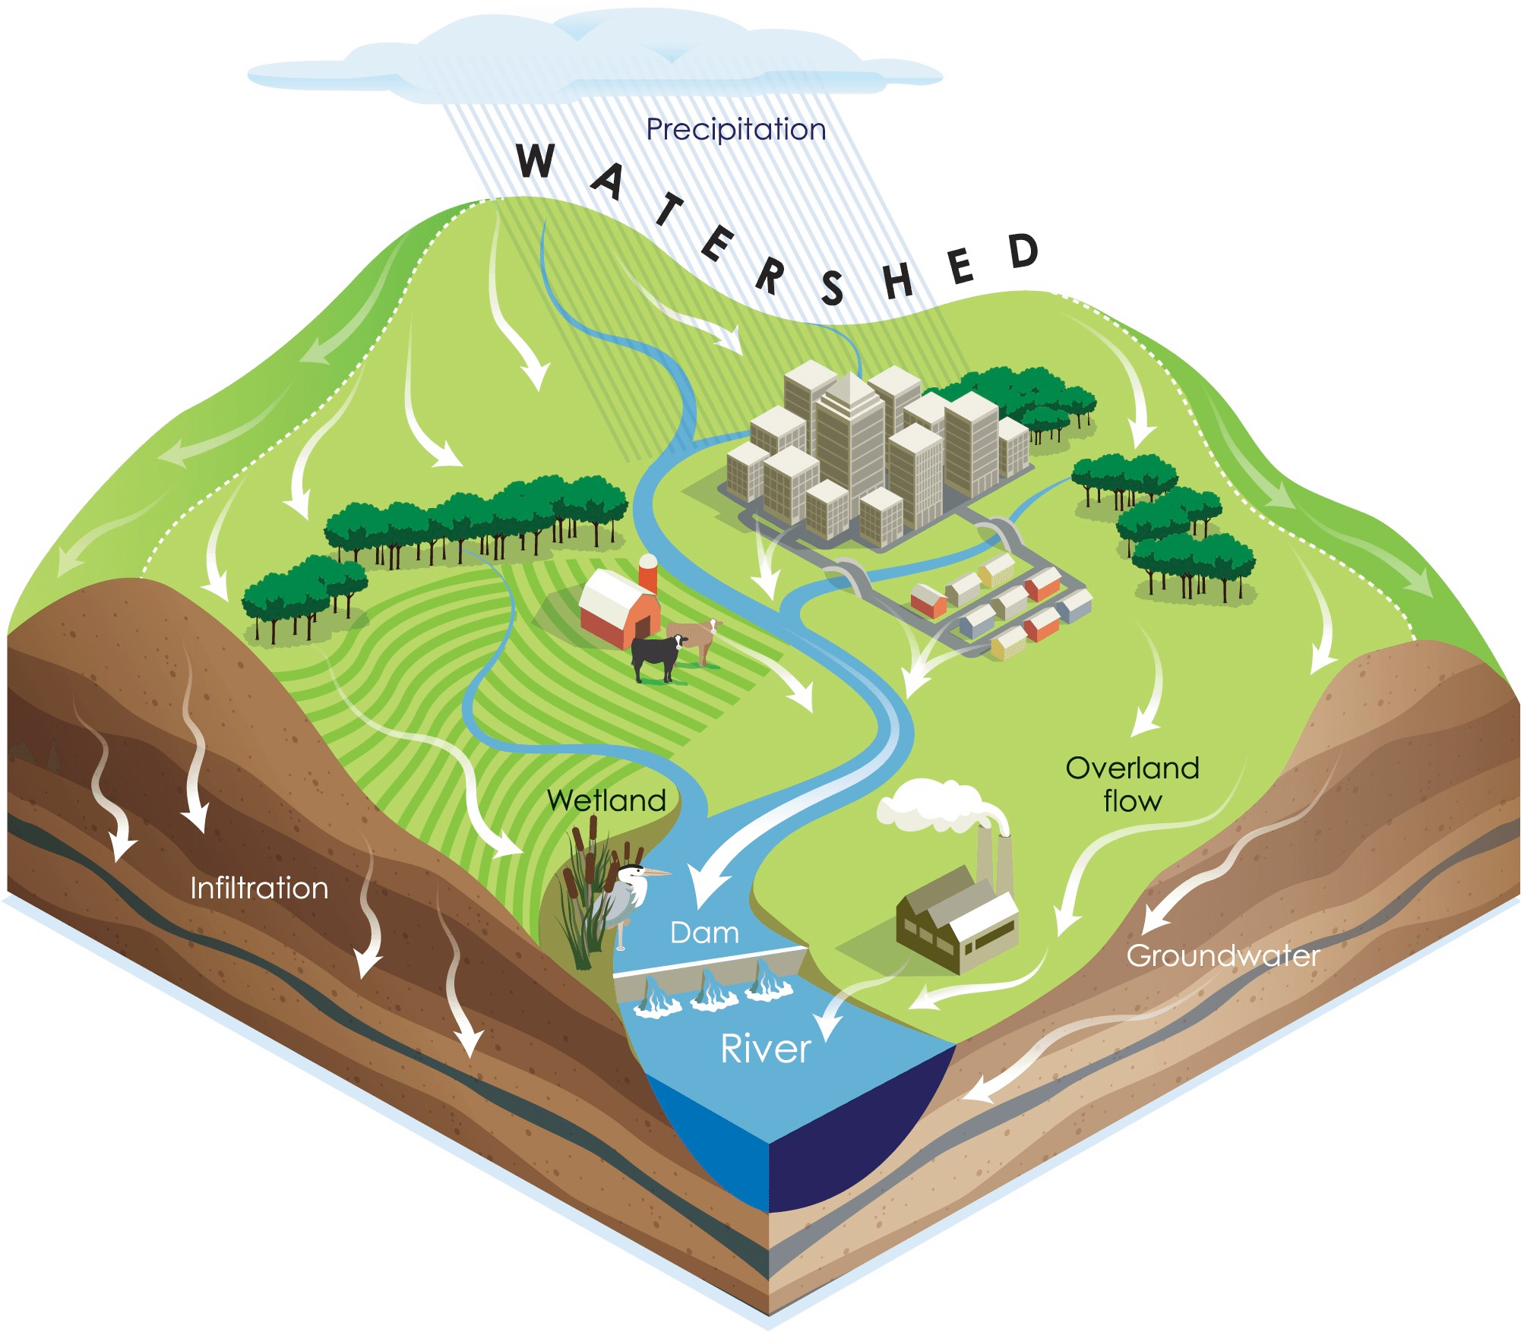

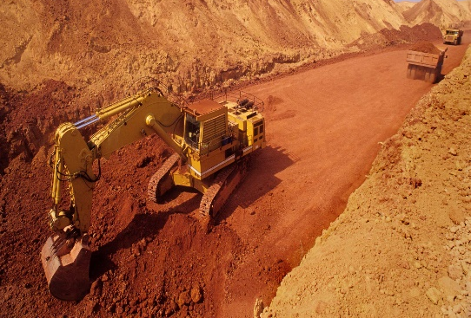


Water Quality tests
a
Why the activity?
helps you understand the quality of local water sources and identify potential pollutants.
b
c
a = mine
b = Undisturbed forest
c = Agriculture/animal farm

Slide 40

Land Use Scenarios
b. Undisturbed forest
c. Farm
a. Mine
Largest mining facility in Waterville Watershed
Uncovers metals and minerals using bulldozers and drills to move soil and rock
Has a road that passes over the creek, it connects the digging site to the processing plant
Hiking trail in the Watershed.
It is in a protected nature preserve and is only accessible by foot traffic (no bikes or cars).
Horses and dogs are not allowed on this path.
The trail crosses the stream once where a log bridge has been placed.
Largest farm in the Watershed
Known for raising open-pasture dairy cattle that
are free to roam and graze the property
Grows feed crops like wheat and hay. There is a barn for animals and crop storage on the property
Signs of erosion, such as soil in the curbs, indicate pesticides bound to the soil could move off the landscape and enter gutters and storm drains

Slide 41
Water Quality Parameters
Nitrates
Temperature
Dissolved Oxygen (DO)
Ph

Slide 42
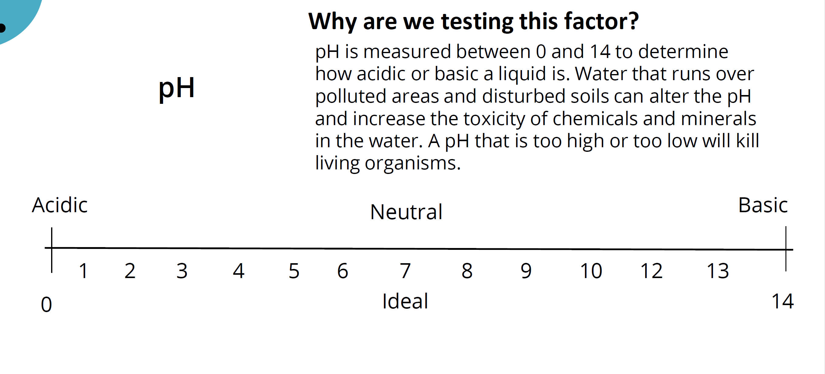
Signs of erosion, such as soil in the curbs, indicate pesticides bound to the soil could move off the landscape and enter gutters and storm drains

Slide 43
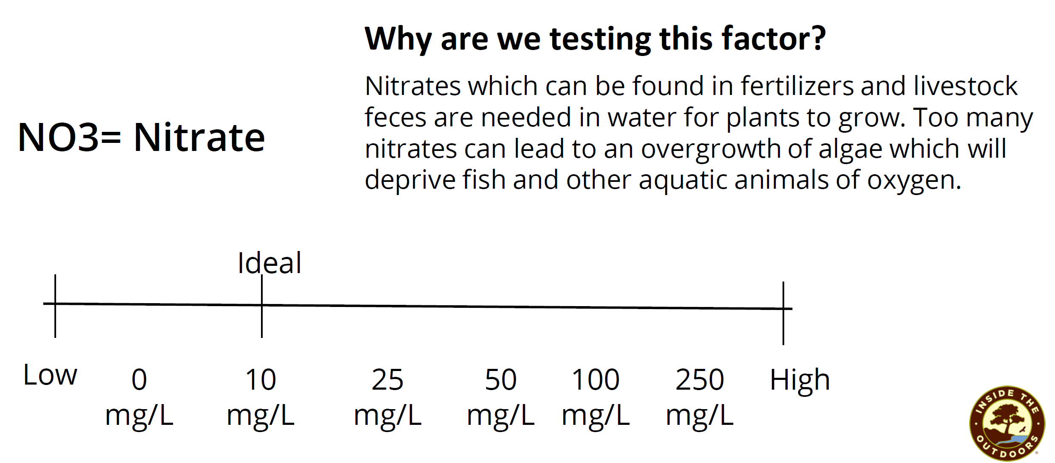
Signs of erosion, such as soil in the curbs, indicate pesticides bound to the soil could move off the landscape and enter gutters and storm drains

Slide 44
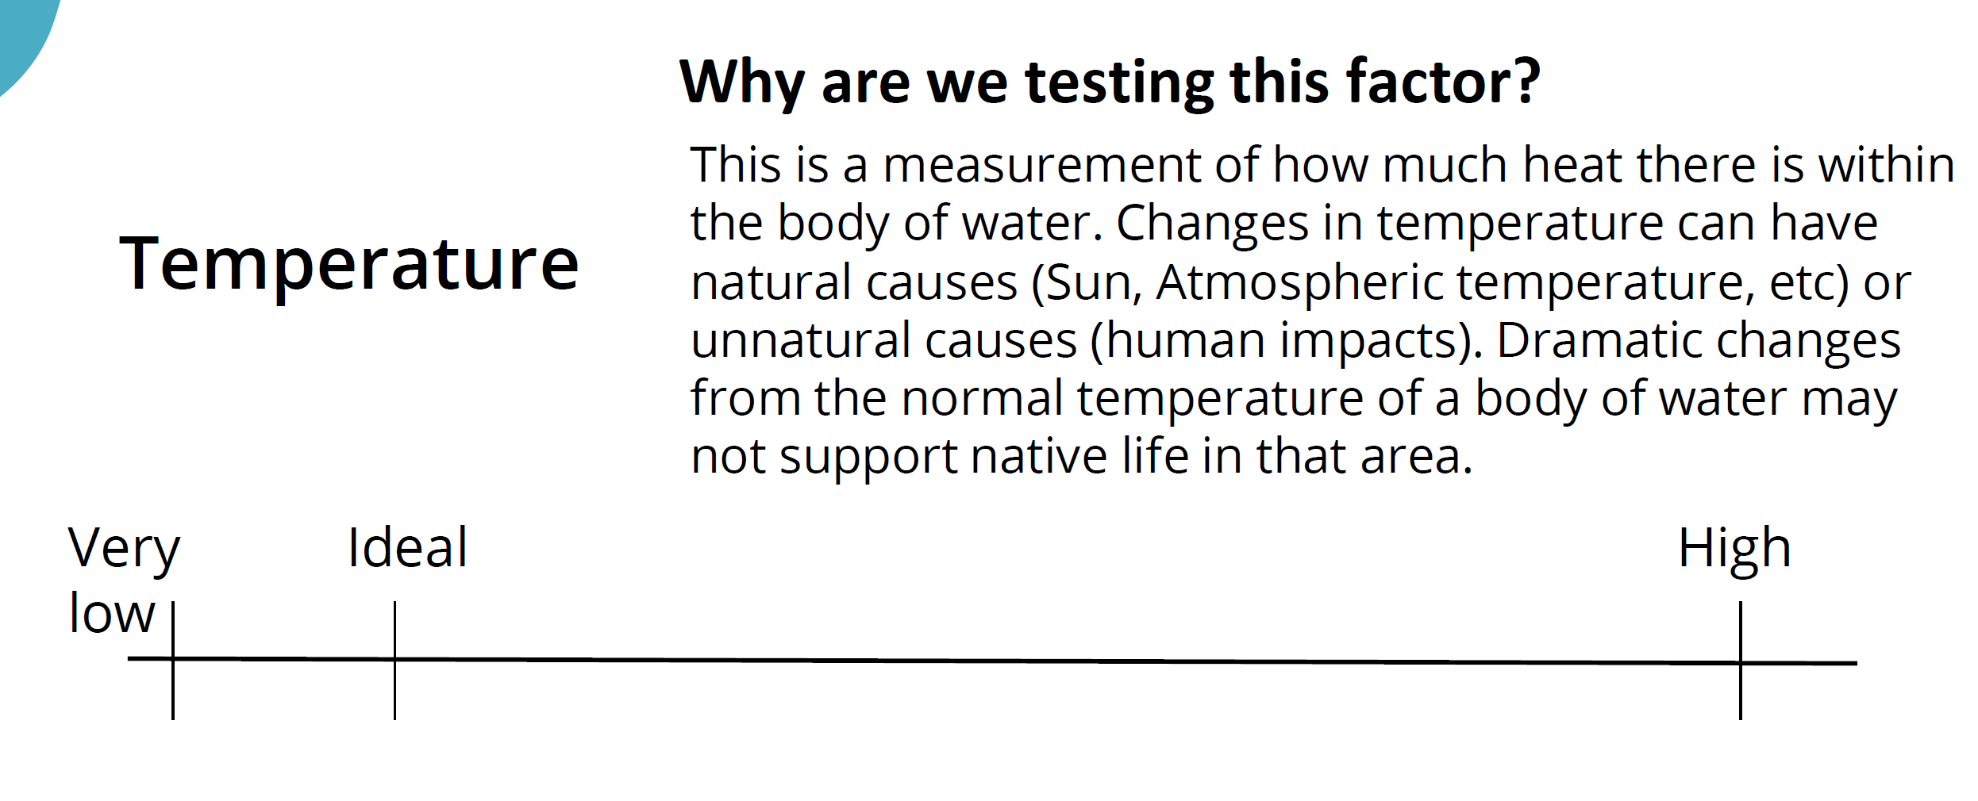
Signs of erosion, such as soil in the curbs, indicate pesticides bound to the soil could move off the landscape and enter gutters and storm drains

Slide 45
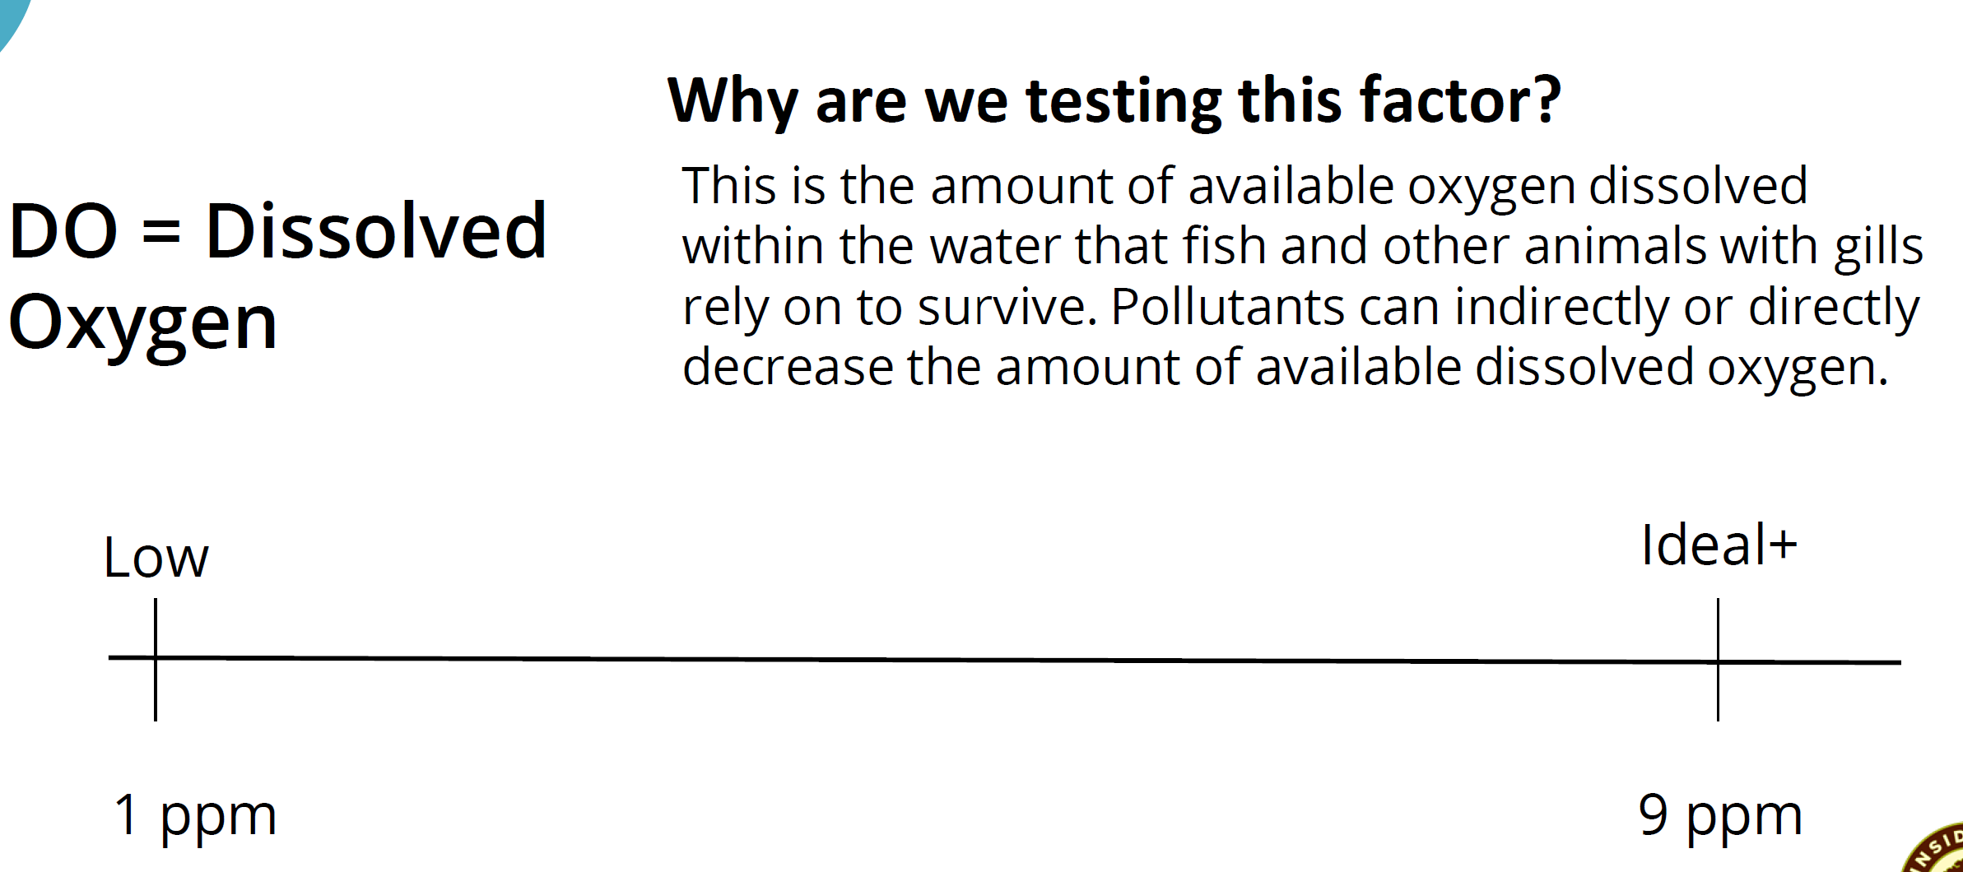
Signs of erosion, such as soil in the curbs, indicate pesticides bound to the soil could move off the landscape and enter gutters and storm drains

Slide 46
Water Quality Tests
a
b
c
Land use types
a = Mine
b = Undisturbed forest
c = Ag/animal farm

Slide 47
Water Quality Activity
Signs of erosion, such as soil in the curbs, indicate pesticides bound to the soil could move off the landscape and enter gutters and storm drains

Slide 48
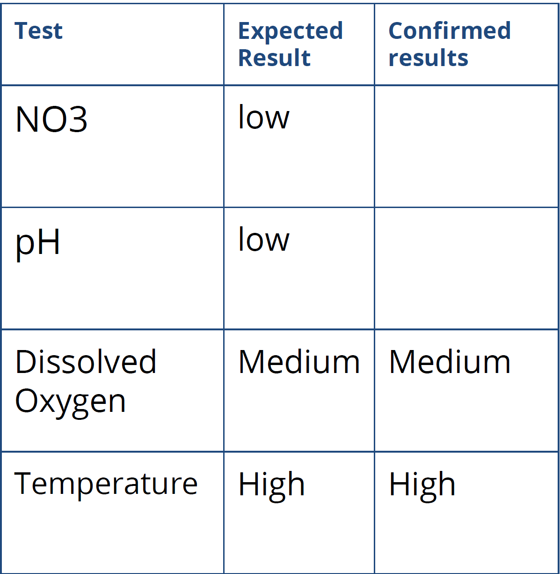
Results
a. Mine

Slide 49
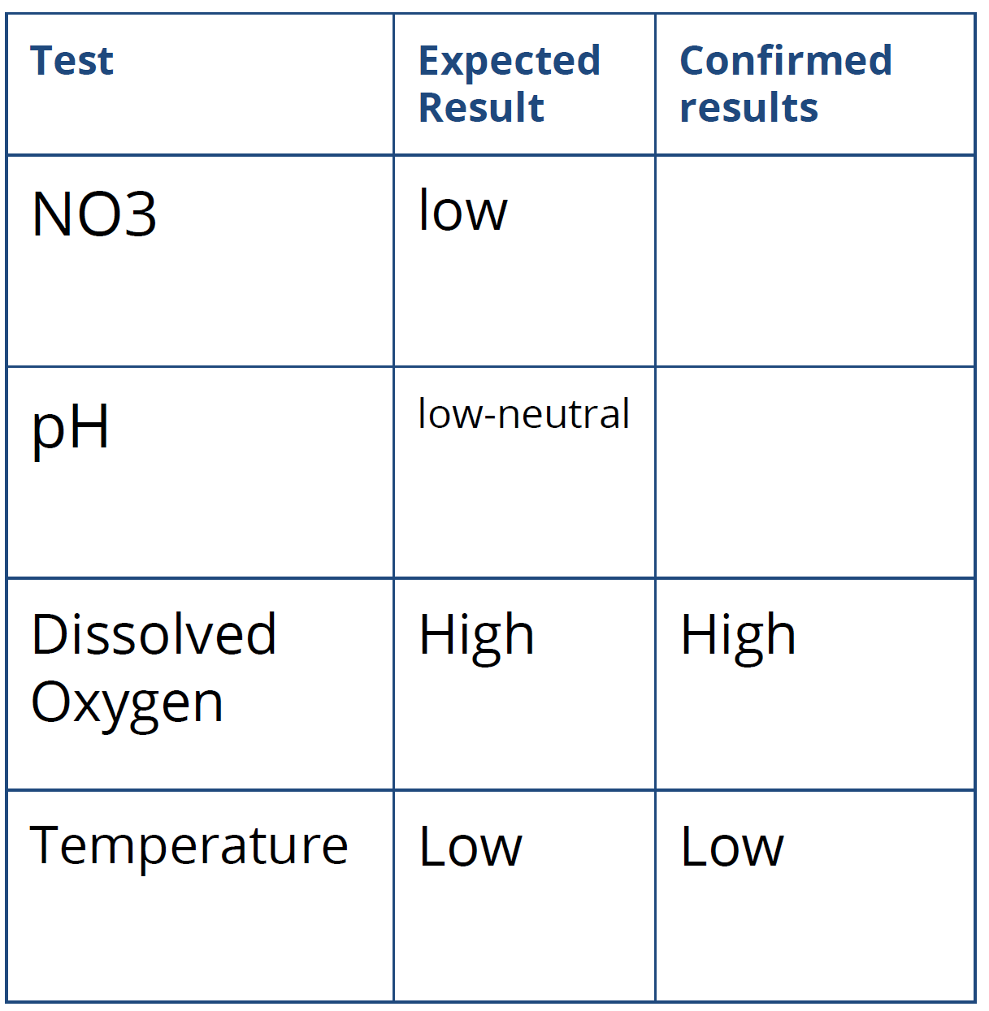
Results
b. Forest

Slide 50
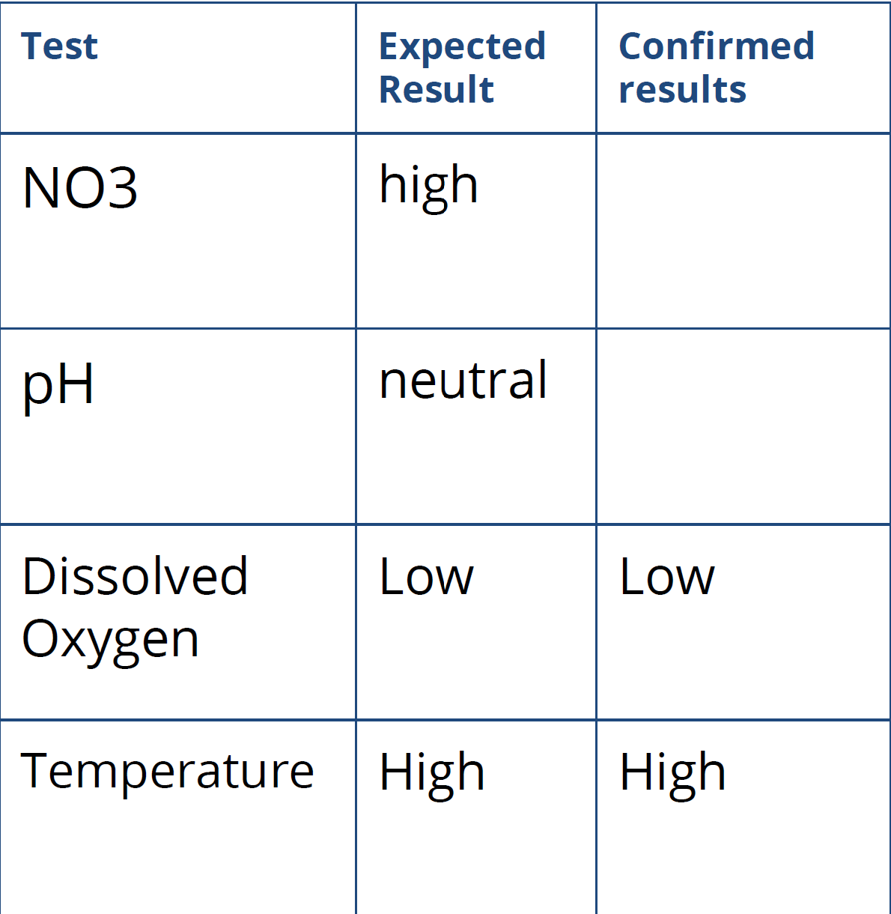
Results
c. Farm

Slide 51
What can you do to help?
04

Slide 52
Things you can do as an individual
Water use efficiency & Conservation
Reduce Pollution
Community involvement
Use water-efficient appliances and fixtures.
Fix leaks promptly.
Install drought-tolerant landscapes
Use smart irrigation systems.
Properly dispose of chemicals and household waste.
Use fertilizers and pesticides sparingly.
Pick up pet waste to prevent pathogen runoff.
Participate in local clean-up events.
Advocate for sustainable water policies.
Support watershed protection initiatives.
Educate others about the importance of water conservation.
Stay informed about local water issues and solutions.

Slide 53
If you are a homeowner, landscaper, or HOA…,

Slide 54
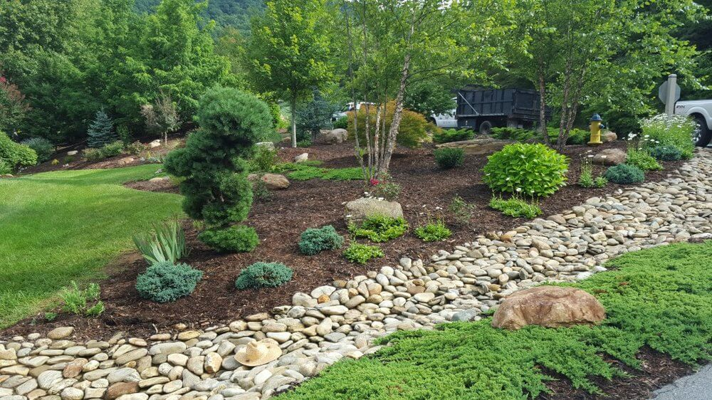
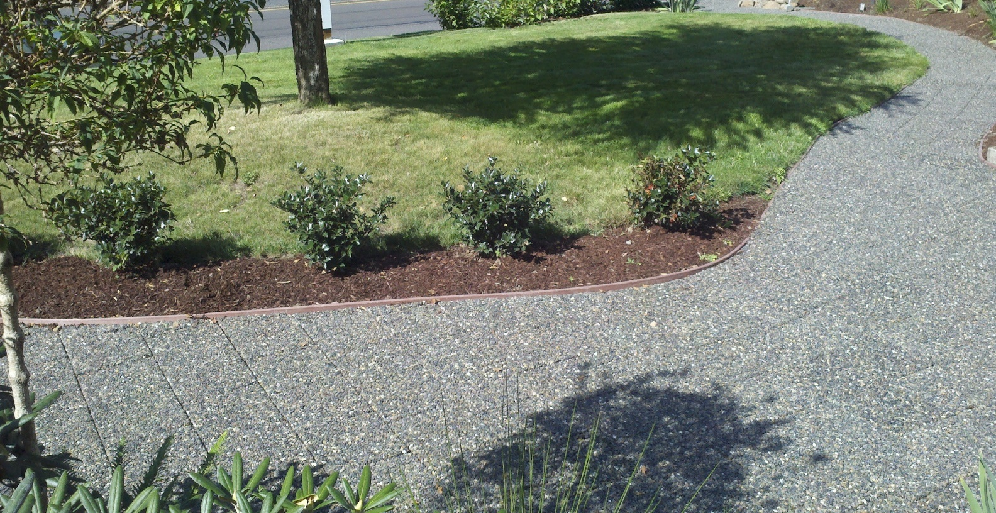
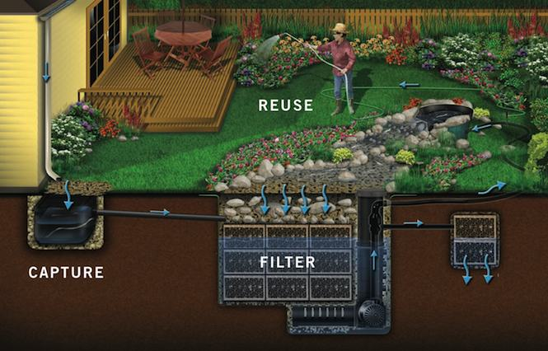
Runoff Relief or Reuse
Capture runoff
Runoff Treatment
Stormwater Reuse
Landscape features like dry creek beds and rain gardens allow stormwater to infiltrate instead of runoff
Localized filtration and treatment systems remove pollution before dry weather runoff enters receiving waters
Captured dry weather runoff can be treated and reused as recycled water

Slide 55



Community-Based Efforts
Education & Outreach
Behavior Change Research
Pollution Prevention
Raise knowledge and awareness regarding stormwater pollution through events, ad campaigns, and social media
Work with the community to stop stormwater pollution before it starts
Understand the barriers and benefits of adopting stormwater-safe behaviors

Slide 56
Resources
SoCal "Breathing" Water
  https://www.caltech.edu/about/news/animation-based-satellite-data-shows-socal-breathing-water-83080
ANR SoCal Water Resources
  https://ucanr.edu/sites/urbanwatermgmt/
OC Watersheds & Stormwater Program
  https://ocerws.ocpublicworks.com/
  https://h2oc.org/
Presentation on watersheds, water quality, and case studies
https://www.conservation.ca.gov/dlrp/Educational%20Documents/California%20Watersheds.pdf
https://oceanservice.noaa.gov/facts/watershed.html
https://www.waterboards.ca.gov/water_issues/programs/stormwater/

Slide 57





Esther Lofton
Email;
enmosase@ucdavis.edu
Phone number;
858-282-5637

