Slide 1
IOE Quarterly Call
October 15, 2024
Hosted by:
Amanda Linares

Slide 2


Access the recording & slides
Find the webinar recording and this slide deck on the IOE Website

Slide 3

Agenda
Announcements
  Upcoming dates
  FFY 25 progress
  TA & Training Survey
Recap IOE process & timeline
FFY 24 preliminary statewide results
PEARS Program Activity entries
Q & A

Slide 4

Announcements

Slide 5
Upcoming dates
IOE Quarterly Call
  Tuesday, January 21st at 10am
  Pre-register: https://ucanr.zoom.us/meeting/register/tJYtde-orTIsG9X2yaOHQqeu5hZEFNGSnCfM
Cross-Project Office Hours
  Thursday, December 12th at 11am
  Pre-register: https://ucanr.zoom.us/meeting/register/tJcof-qhpzwpHtLkSBUyjapZ2RfPUuij5PMS#/registration
EATS Pre-test closure: TBD

Slide 6
Poll- What’s your pre-testing status?
All of our sites are pre-tested.
Some, but not all of our sites are pre-tested.
We’ve identified our sites, but none are pre-tested.
We haven’t yet identified our sites.

Slide 7
FFY 25 Progress
Target → At least 30 matched pairs in each of 69 schools
Planning Worksheets → 27 LHDs in 90 schools
As of 10/15:
3,031 completed pre-tests from 17 LHDs 45 schools

Slide 8
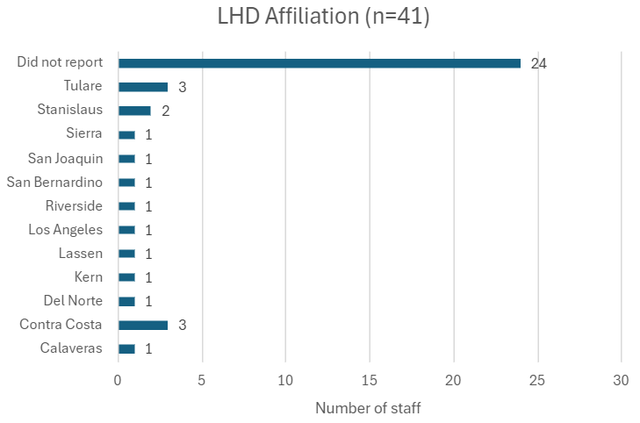
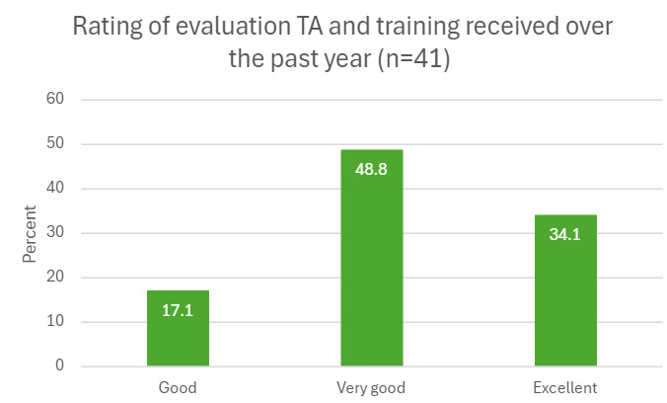
TA & Training Survey results summary

Slide 9
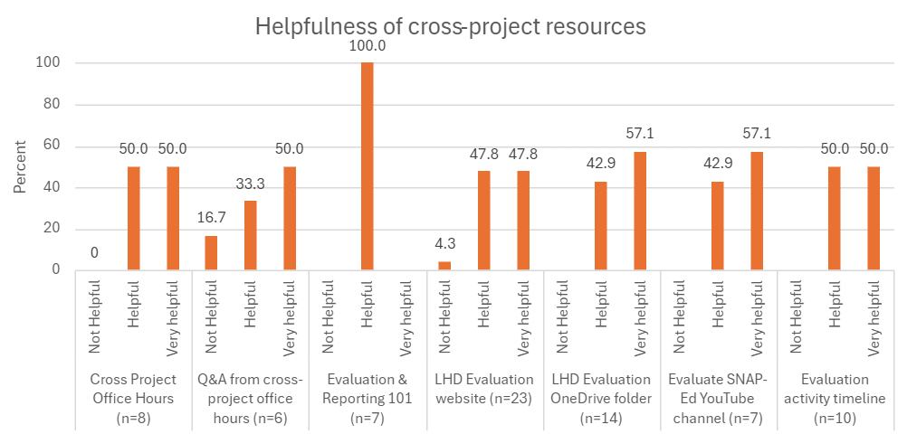
TA & Training Survey results summary

Slide 10
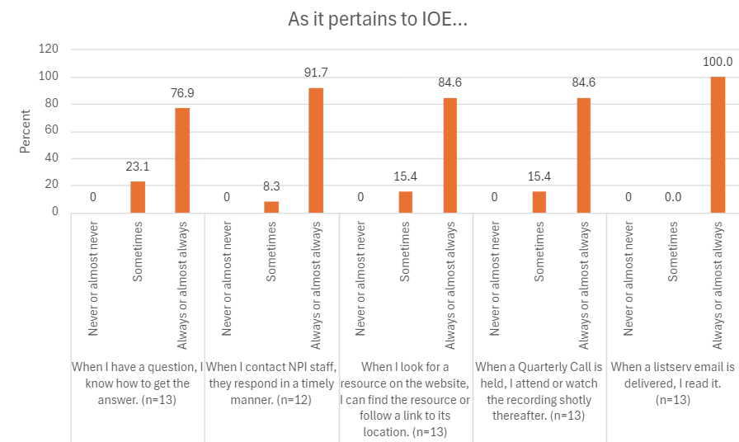
TA & Training Survey results summary

Slide 11
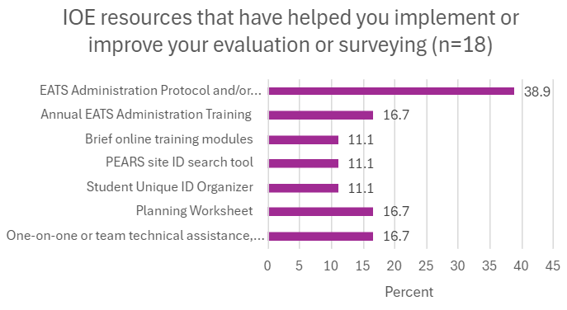
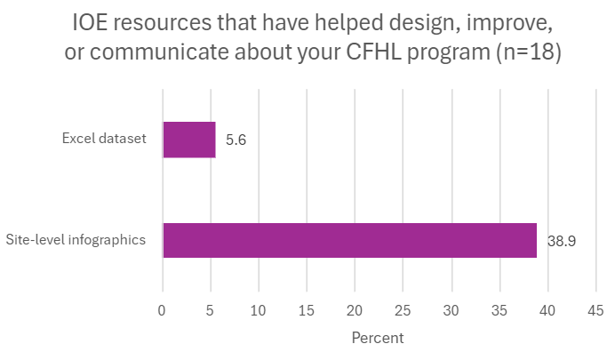
TA & Training Survey results summary

Slide 12
Planned improvements
LHD Evaluation website improvements
Continuing LHD Evaluation OneDrive build out
Refined QAQC processes (all projects)
Improved Data Storytelling Toolkits (Jan)

Slide 13
New! Better QAQC process
Data quality checks for IOE include:
  Was the survey taken on an appropriate day/week/month?
  Are participant IDs duplicative or used incorrectly?
  Are custom links truncated, i.e., is school, PEARS ID, or timepoint missing?
Typically resolved via email; NPI staff will notify you of any issues, and though you may not be able to "fix" them, it can help improve future data collection
Emails go out monthly

Slide 14

IOE Process
& Timelines

Slide 15
Why conduct IOE?
Two purposes of IOE →
Continuous improvement (local)
Overall impact (statewide)
Evaluation requirements should not dictate intervention!

Slide 16
IOE Participation
Identify your sites, classrooms & intervention
1
Complete a Planning Worksheet, share it with me & receive site links
2
Pre- and post-test 2+ classrooms/site at beginning & end of school year using EATS
3
Update Planning Worksheet & complete surveys by June 30th annually
4

Slide 17

IOE Timeline*
Currently here
Mar.–June
Engage school(s) for next FY
Plan intervention
June–Aug.
Identify classrooms/teachers
Train survey administrator(s)
Complete Planning Worksheet
Aug.–Oct.
Turn in Planning Worksheets/get links
Pre-test students
Sep.–May
Conduct intervention (timeline variable)
Apr.–June
Post-test students
Update Planning Worksheet
Turn in all deliverables by June 30th
*Full school year pre/post timeline regardless of when DE component occurs

Slide 18

FFY 24 Preliminary Statewide Results

Slide 19
FFY 25 statewide sample
Matched data from 3,880 students at 88 schools
  65 schools (or OSTs from a single district) had sample ≥ 30
  26 schools (30%) had at least PSE + DE
  Top 3 DE: Let’s Eat Healthy, Food Smarts, Yummy
  Top 4 PSE: Food quality, gardens, nutrition marketing, food procurement

Slide 20
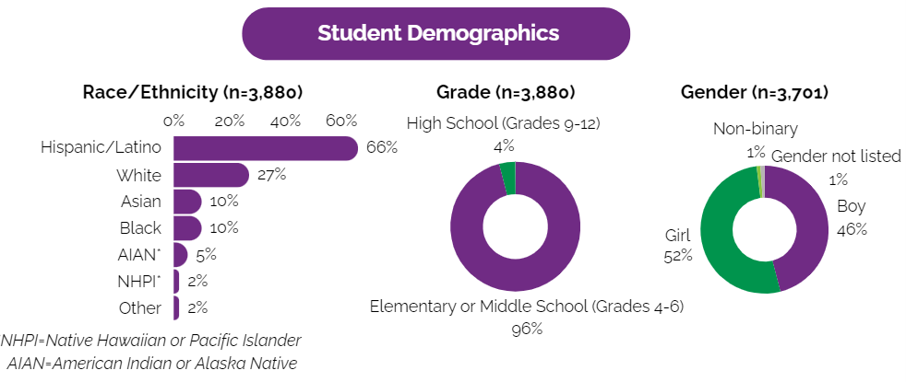
Statewide infographic: https://ucanr.edu/sites/ioe/files/401176.pdf

Slide 21
Beverage intake
Outcome | Intervention Group |  |  |  | t test statistic | Pr > |t|
 | n | Mean Pre-test | Mean Post-Test | Mean Change (95% CI)
Water intake | 3846 | 2.37 | 2.42 | 0.05 (0.01, 0.09) | 2.43 | 0.017
SSB intake, including flavored milks | 3527 | 2.30 | 2.15 | -0.16 (-0.28, -0.03) | -2.52 | 0.013
SSB intake, excluding flavored milks | 3593 | 1.76 | 1.68 | -0.09 (-0.2, 0.02) | -1.57 | 0.119
Fruit drinks and sports drinks | 3793 | 0.74 | 0.70 | -0.04 (-0.09, 0.01) | -1.63 | 0.106
Regular soda | 3799 | 0.44 | 0.45 | 0.01 (-0.03, 0.04) | 0.28 | 0.779
Energy drinks | 3789 | 0.13 | 0.14 | 0.01 (-0.02, 0.03) | 0.50 | 0.616
Sweetened coffee/tea | 3783 | 0.47 | 0.41 | -0.05 (-0.09, -0.02) | -3.01 | 0.003
Flavored milk | 3784 | 0.55 | 0.48 | -0.08 (-0.12, -0.04) | -4.30 | <0.001

Slide 22
Fruit & vegetable intake
Outcome | Intervention Group |  |  |  | t test statistic | Pr > |t|
 | n | Mean Pre-test | Mean Post-Test | Mean Change (95% CI)
Fruit intake, including 100% fruit juice | 3742 | 2.55 | 2.79 | 0.24 (0.16, 0.32) | 5.98 | <0.001
Fruit intake, excluding 100% fruit juice | 3805 | 1.74 | 1.91 | 0.18 (0.12, 0.24) | 5.67 | <0.001
100% fruit juice | 3795 | 0.81 | 0.88 | 0.06 (0.03, 0.1) | 3.44 | 0.001
Vegetable intake, including beans | 3515 | 2.92 | 3.43 | 0.51 (0.34, 0.67) | 6.13 | <0.001
Vegetable intake, excluding beans | 3589 | 2.63 | 3.10 | 0.47 (0.32, 0.62) | 6.23 | <0.001
Starchy vegetables | 3795 | 0.68 | 0.80 | 0.12 (0.07, 0.17) | 4.94 | <0.001
Orange vegetables | 3782 | 0.57 | 0.67 | 0.1 (0.06, 0.15) | 4.39 | <0.001
Salad/Green vegetables | 3799 | 0.68 | 0.83 | 0.15 (0.11, 0.2) | 6.99 | <0.001
Other vegetables | 3788 | 0.70 | 0.80 | 0.1 (0.06, 0.15) | 4.45 | <0.001
Beans | 3775 | 0.29 | 0.33 | 0.04 (0.01, 0.07) | 2.58 | 0.011

Slide 23
Physical activity
Outcome | Intervention Group |  |  |  | t test statistic | Pr > |t|
 | n | Mean Pre-test | Mean Post-Test | Mean Change (95% CI)
Days with 60+ minutes MVPA | 3880 | 4.08 | 4.35 | 0.28 (0.17, 0.39) | 5.19 | <0.001
Days with physical activity class like PE | 3880 | 2.40 | 2.47 | 0.07 (-0.08, 0.22) | 0.92 | 0.359
Outcome | n | Baseline (%) | Follow-Up (%) | Percent Change (%) | Adjusted p-value
Spent half or more of PE class being physically active | 3116 | 77.92 | 82.45 | 5.81 | 0.003

Slide 24
How will we use the data?
N-PEARS
CDSS data shells (all SIAs aggregated)
State-level infographic
Dose and/or latent class analysis
In progress (FFY 22):
Student and school characteristics modify the impact of SNAP-Ed on student dietary and physical activity outcomes (Public Health Nutrition- under review)
Similar to the above, but diving deeper into intervention combinations, i.e., control vs. education interventions w/ PSE vs. education interventions w/o PSE

Slide 25

IOE & PEARS

Slide 26
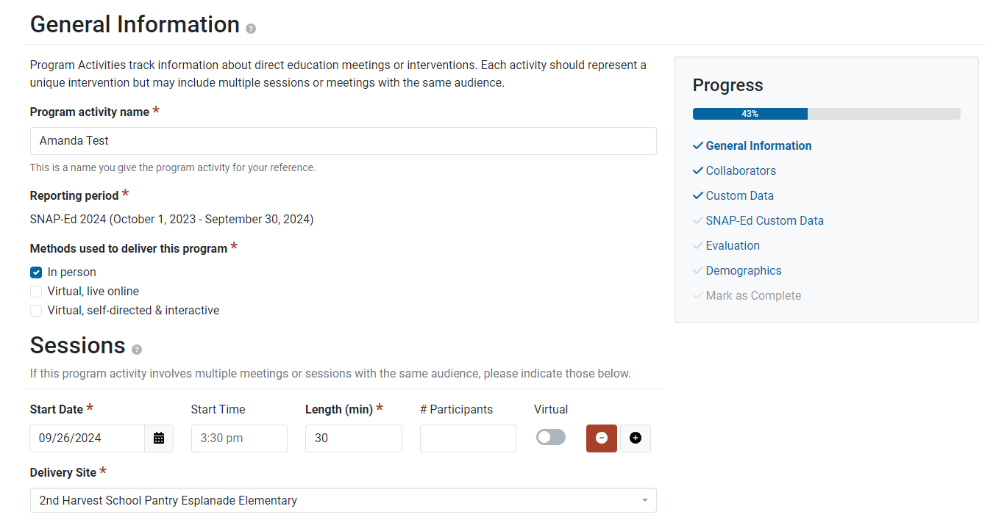
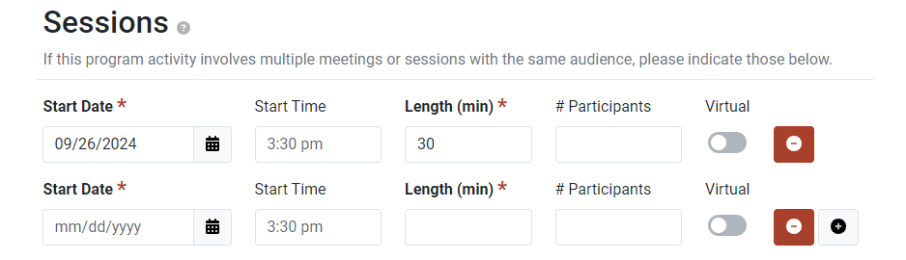
Entering series-based DE
Series-based direct education should always be entered as a single Program Activity!
Click the “+” under Sessions to add a session.
There is no need enter your pre or post survey as a session (unless it occurs on the same day as a lesson).

Slide 27
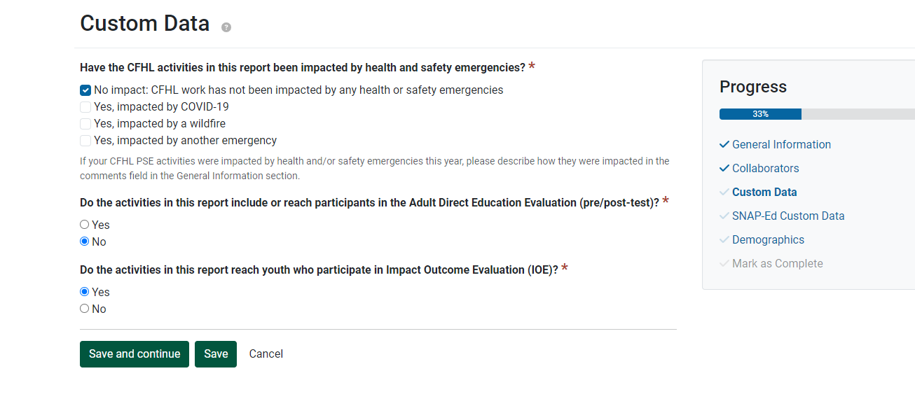
Identify your Program Activity as IOE

Slide 28

Additional resources
~4 min Mastering PEARS video
https://www.youtube.com/watch?v=VRM1le1TuWU&list=PL3_GCOmyKJRZcNqAL455praN2GPbqmc7U
Leah’s Pantry- PEARS Lessons 2 & 3: 30 min mark (~10 min)
https://cfhlstatewidetraining-leahspantry.talentlms.com/learner/courseinfo/id:627

Slide 29
Stay Informed
Join the listserv
1:1 planning meeting with me
Next Quarterly Call: Tuesday, January 21st at 10am
  Pre-register: https://ucanr.zoom.us/meeting/register/tJYtde-orTIsG9X2yaOHQqeu5hZEFNGSnCfM

Slide 30

Questions?

