Slide 1


Slide 2
We are the Nutrition Policy Institute, and we help to understand whether the CalFresh Healthy Living program works. CalFresh Healthy Living teaches young people about healthy eating and physical activity, with the goal of helping students stay healthy. Our program is funded by the USDA and run by the California Department of Public Health. The program is free to your school. To find out how well our lessons work, we ask that you complete this survey. However, completing the survey is voluntary. Voluntary means you can agree or not agree to complete it. It is up to you. You may also skip questions you do not want to answer, but we hope that you will answer all of them. Any information about who you are will be kept secret. We will not share your name or ID number.
If you have any questions about the survey, just ask us!

Slide 3
ID Numbers
If you are using ID numbers, make sure it is only 3 digits and that no other student in the class has the same ID number you do!

Slide 4
Survey Directions
Where you see a bubble (O), please select only one best answer,
Where you see a box (☐), please select all the answers that are true for you.

Slide 5
First, we’re going to as you about yourself.

Slide 6
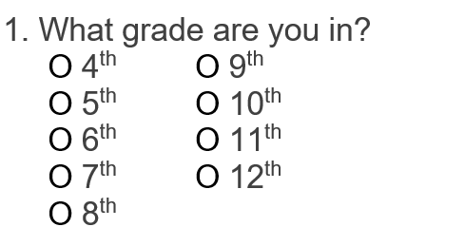

Slide 7
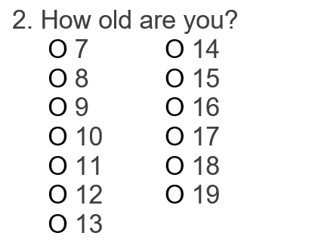

Slide 8
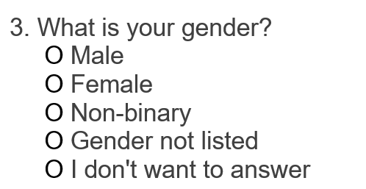

Slide 9
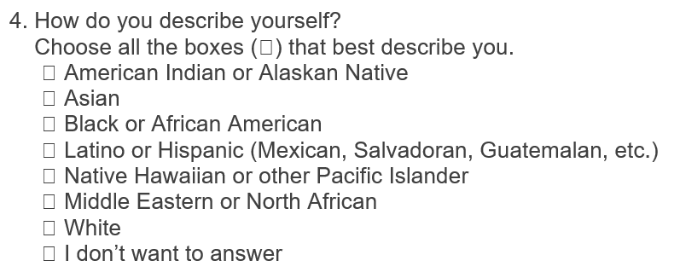

For help with race and ethnicity, see the next slide!

Slide 10
Help with race and ethnicity:
American Indian or Alaska Native (North, Central, or South American Origin)
Asian (Chinese, Korean, Vietnamese, Filipino, Cambodian, Hmong, Indian, Thai, etc.)
Black or Africa American (Middle and southern African countries not counted as MENA)
Hispanic or Latino (Mexican, Cuban, Puerto Rican, South or Central American)
Native Hawaiian or other Pacific Islander (Guamanian, Samoan, etc.)
Middle Eastern or North African (Lebanese, Iranian, Egyptian, Israeli, etc.)
White (European, includes Armenian)

Slide 11
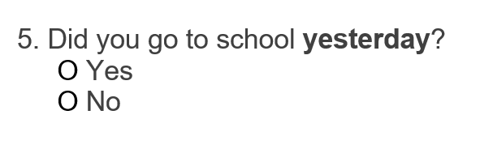

Slide 12
Now, we’re going to ask you about what you eat.

Slide 13
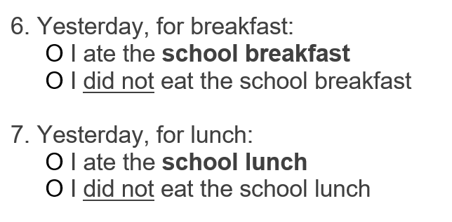
This is only referring to the meal provided by the school, and not food you brought from home.

Slide 14
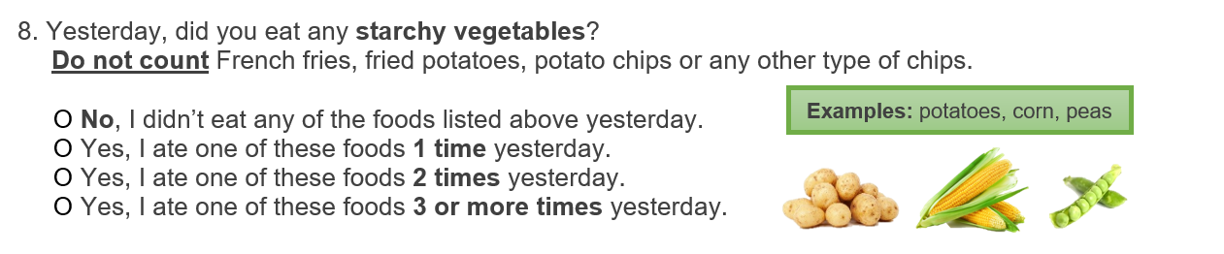
Don’t include orange sweet potatoes (yams) here.
You can count those in the next question!

Slide 15
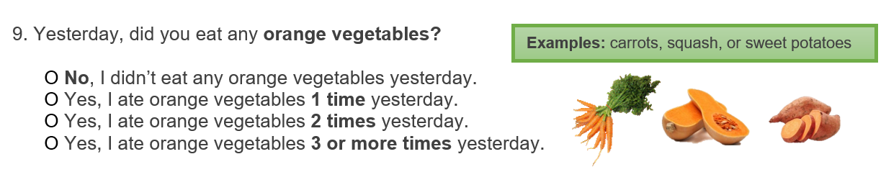

Slide 16
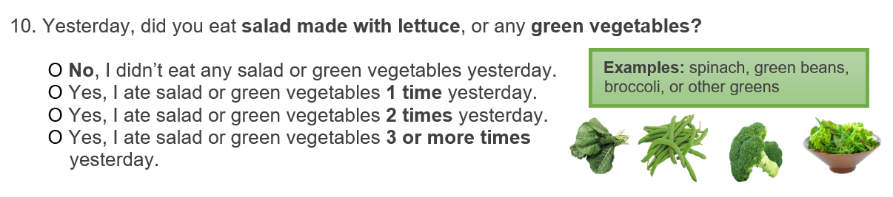
If you ate other leafy greens that are not listed, include them! However, don’t include most other green vegetables besides broccoli and green beans. We will count those next.

Slide 17
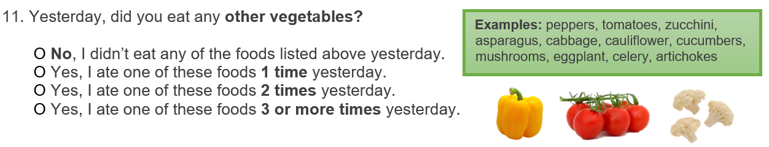
Include any vegetables that were not included in the other vegetable questions.
Also include green vegetables not listed in the last question.

Slide 18
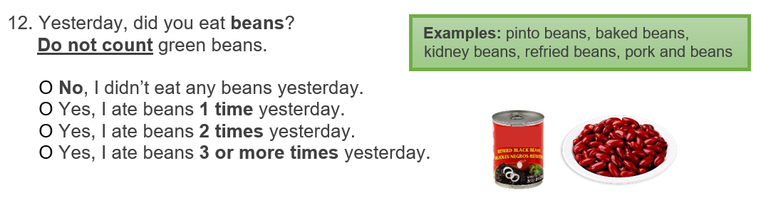
Include beans prepared any way (whole, refried, etc.). Just don’t include green beans!

Slide 19
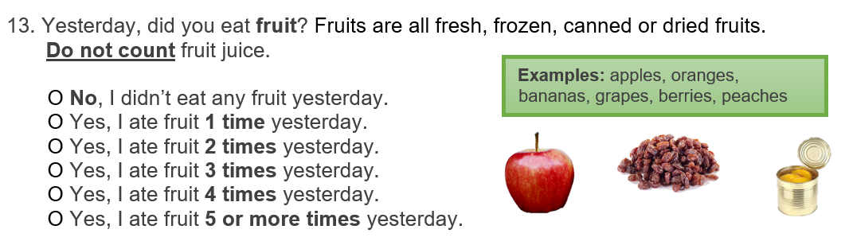

Slide 20
Next, we’re going to ask about what you drink.

Slide 21
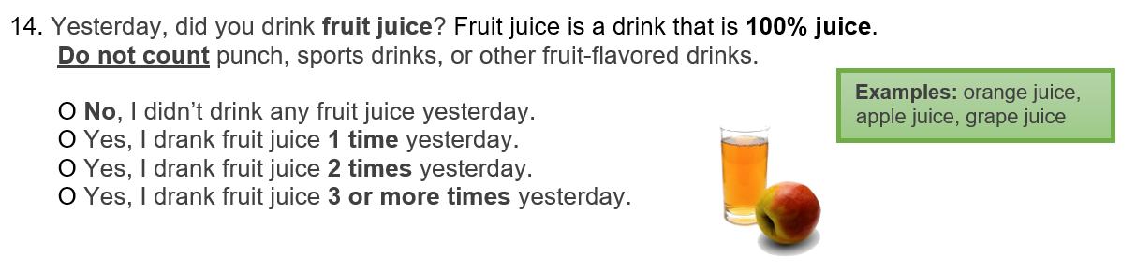
100% juice refers to beverages that are pure fruit juice with no added sugar or anything else.

Slide 22
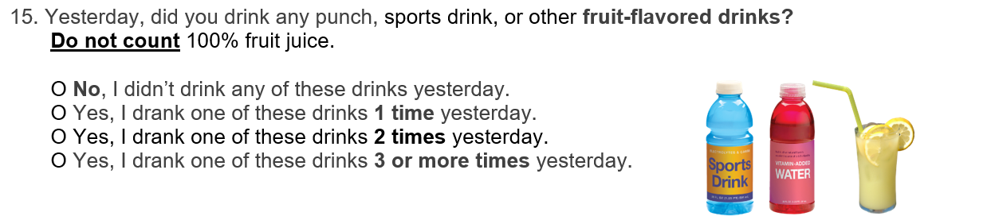
Include drinks even if they contain juice but are not labeled 100% juice. Include fruit-flavored waters if they have added sugar. Don’t include anything with 0 calories or artificial sweetener.

Slide 23
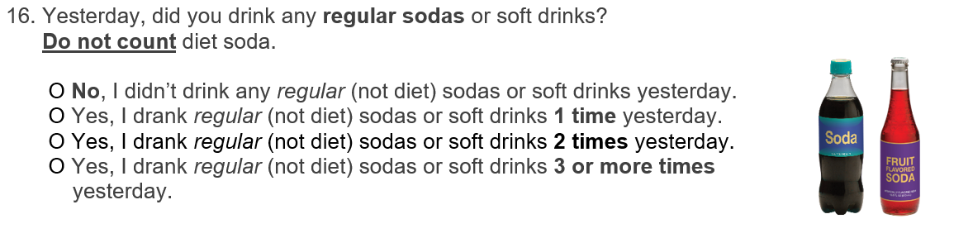
Don’t count diet or “zero” sodas.

Slide 24
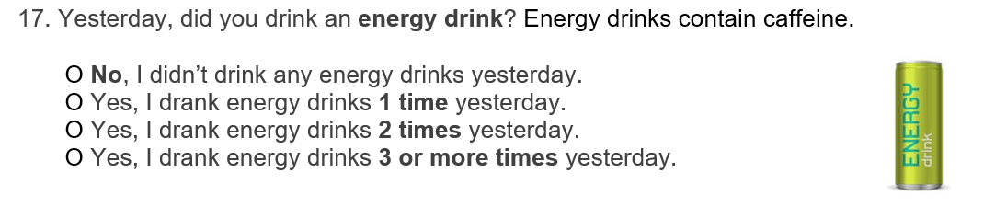

Slide 25
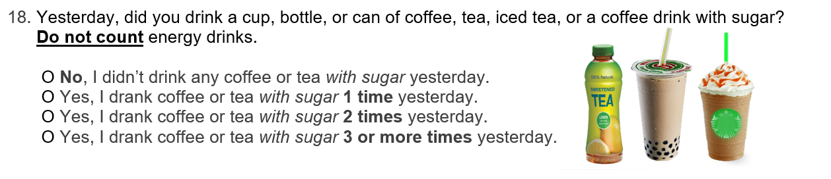
Include blended drinks like you may get at a coffee shop. Include sweetened teas like boba or bubble tea. Also include bottled coffee and tea drinks that have sugar.

Slide 26
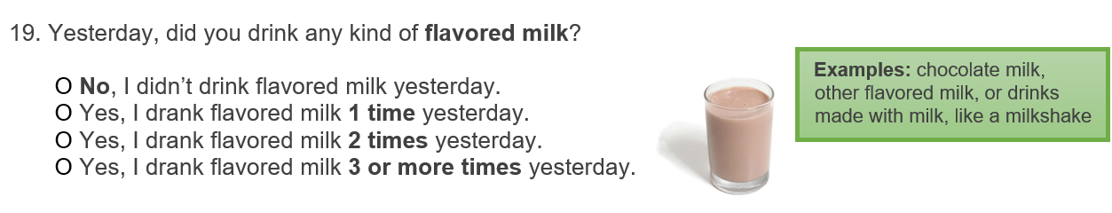
Don’t include regular white milk here.
Do include any milk or milk-containing (dairy or non-dairy) beverage that is flavored.

Slide 27
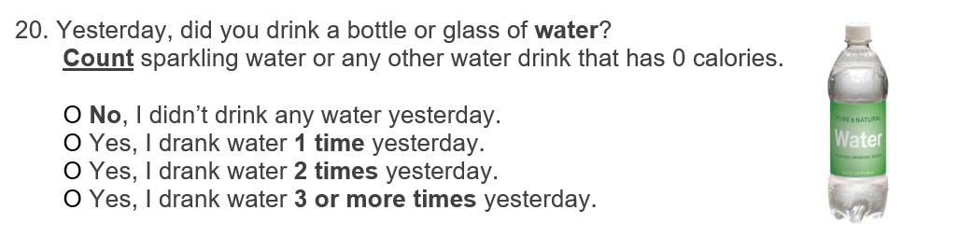

Slide 28
Finally, we’re going to ask about your physical activity.

Slide 29
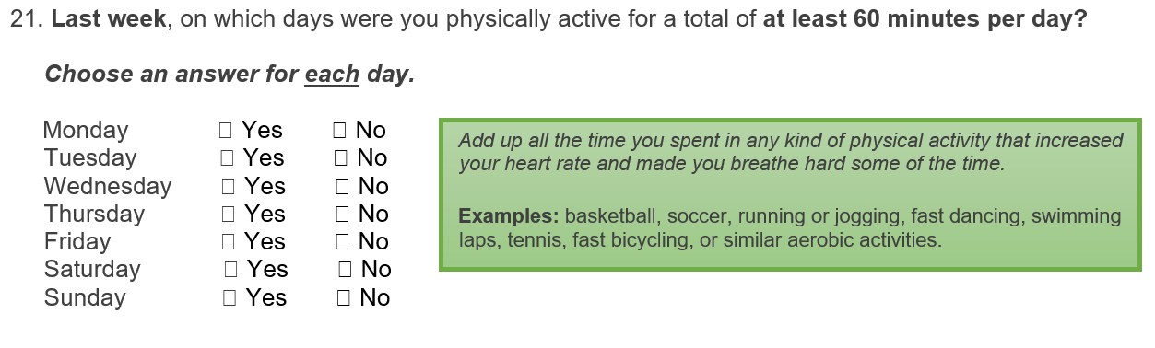
Add up all your activity throughout the day. This doesn’t have to be 60 minutes all at one time.
Include physical activity before school, during school, after school, and in the evening.
Include activities like PE and sports.

Slide 30
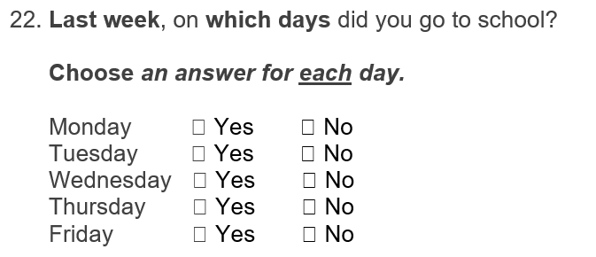
Select either yes or no for each day of the week.
Only if you can’t remember should you leave the boxes blank.

Slide 31
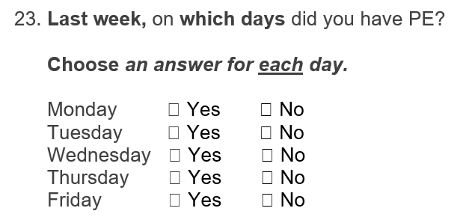
Select either yes or no for each day of the week.
Only if you can’t remember should you leave the boxes blank.

Slide 32
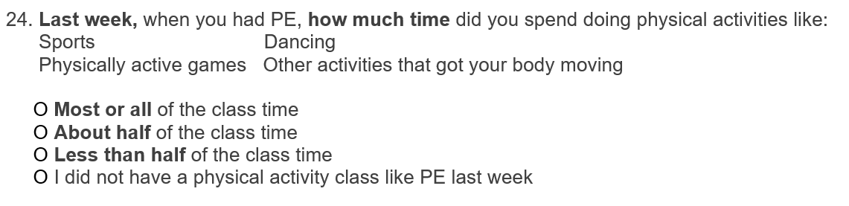

Slide 33
You are all done.
Thank you for taking the time to take this survey!

