Slide 1
ServiceNow Overview at UC ANR

Slide 2
Agenda
Zendesk Replacement
About ServiceNow
Employee Center
Human Resources (HR) Tickets
Information Technology (IT) Tickets
Tracking Tickets
Training Resources

Slide 3
UC ANR ServiceNow Implementation
As part of our initiatives to enhance customer service, UC ANR will implement ServiceNow for IT and HR as we move away from Zendesk
  Currently, both the HR and IT teams utilize separate instances of Zendesk as the main intake ticketing system/communication platform
  While this system has served us well initially, it has become clear that this structure no longer serves our evolving needs
  We have been preparing to implement a unified ticketing system, providing you with a new customer-centered experience and a single, user-friendly dashboard for UC ANR employee needs

Slide 4

What is ServiceNow?
ServiceNow is a leading digital workflow cloud-based platform that streamlines and automates various business processes, enhancing efficiency and productivity.
As part of the UC ANR implementation, we will be utilizing:
  HR Service Delivery (HRSD)
  IT Service Management (ITSM)
More Information:
  ITSM - https://www.servicenow.com/products/itsm.html
  HRSD - https://www.servicenow.com/products/hr-service-delivery.html

Slide 5
Why ServiceNow?
Based on UC ANR customer feedback and system analysis, ServiceNow was selected for reasons that included:
  Single Platform Convenience: Easily track and manage all your IT and HR tickets in one location, ServiceNow’s Employee Center
  Improved Visibility: Keep up to date with the status of requests, from submission to resolution
  Scalability: Platform that can grows with UC ANR needs
  UC ServiceNow partnership and collaboration

Slide 6
Functional Overview
Employee Center - Provides a single unified portal for organizational-wide service delivery, enabling organizations to easily scale their service solutions across IT and HR
Quicklinks and Knowledge Base – Provides commonly used links and future source of HR and IT knowledge base articles related to services that are addressed by ServiceNow
My Requests - Shows open and closed requests and incidents for the logged in employee
My To-dos - Displays all open and completed to-dos for an employee in one place. To-do’s may be approvals or action items, including tasks related to cases or individual tasks.

Slide 7
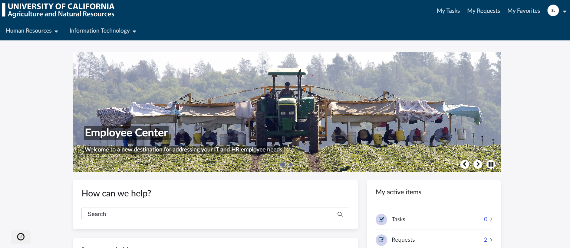
Employee Center
Preview of the UC ANR Employee Center
UC ANR ServiceNow will be provided upon Go-live

Slide 8
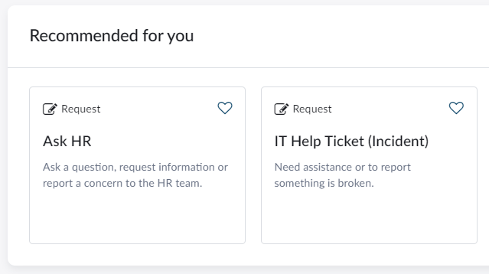
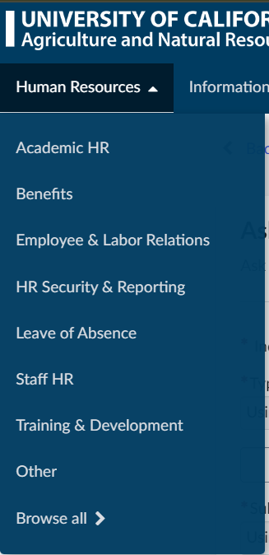
Submitting HR Requests
HR Requests may be submitted via the “Employee Center” by following:
Log in to the UC ANR Employee Center.
Use the Human Resources Navigation or select ‘Ask HR’ request button.
Form opens and complete requested information.
Click 'Submit’ to create ticket.
Request may still be submitted by email at humanresources@ucanr.edu, in some circumstances.

Slide 9
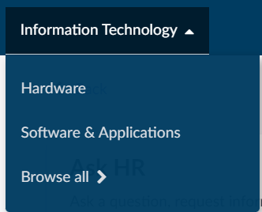
Submitting IT Incidents
IT Help tickets may be submitted via the “Employee Center” by following:
Log in to the UC ANR Employee Center.
Use the Information Technology Navigation or select ‘IT Help Ticket’ request button.
Form opens and complete requested information.
Click 'Submit’ to create ticket.
Request may still be submitted by email at help@ucanr.edu, in some circumstances.

Slide 10
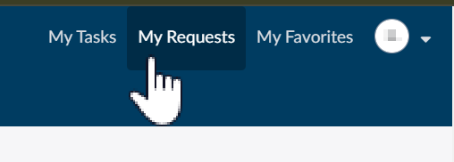
Tracking ServiceNow Tickets
For UC ANR employees to view the status of tickets, the Employee Center can be used
  Log into UC ANR Employee Center
  Select My Requests on top right
  View Submitted Requests
Similar to Zendesk, ServiceNow ticket updates will get emailed to your inbox

Slide 11
Training - Getting Support and Additional Resources
Training Materials:
  Website has been updated with information on the ServiceNow Go-Live at www.ucanr.edu/sites/servicenow
Office Hours:
  When:
    June 13th 2:00-2:30pm
    June 18th 2:30-3:00pm
  How to Join:
  https://ucanr.zoom.us/j/91385989113?pwd=M2VwZHN1VzVDbVhQTEdjM3FOOTNwUT09
  Meeting ID: 913 8598 9113
  Passcode: 570931

Slide 12
Go-Live & Questions
We are starting the transition from Zendesk to ServiceNow on the evening of June 21st
Any questions, please feel free to contact:
  Email HR: humanresources@ucanr.edu
  Email IT: help@ucanr.edu

