Slide 1
Impact Outcome Evaluation Quarterly Call
January 21, 2025
Hosted by Amanda Linares

Slide 2


Access the recording & slides
Find the webinar recording and this slide deck on the IOE Website

Slide 3

Agenda
Upcoming dates
FFY 25 progress
Project timeline
  Post-testing
  Planning Worksheets
NPI updates & data releases
Q & A

Slide 4
Upcoming Dates
Thursday, March 20th: NPI Cross-project Office Hours
Tuesday, April 1st: EATS post-test opens
Tuesday, April 15th: Next IOE Quarterly Call
Monday, June 30th: Post-tests and Planning Worksheets due

Slide 5

FFY 25 Progress
Today 6,659 pre-tests…
  from 102 schools
  representing 33 LHDs
Last year 5,262 pre-tests…
  from 92 schools
  representing 28 LHDs
7 new LHDs this year & earliest we’ve ever completed pre-testing!

Slide 6

IOE Timeline
Pre-tests complete
Intervention ongoing
Scheduling post-tests
Updating Planning Worksheet
Currently here
Mar.–June
Engage school(s) for next FY
Plan intervention
June–Aug.
Identify classrooms/teachers
Train survey administrator(s)
Complete Planning Worksheet
Aug.–Oct.
Turn in Planning Worksheets/get links
Pre-test students
Sep.–May
Conduct intervention (timeline variable)
Apr.–June
Post-test students
Update Planning Worksheet
Turn in all deliverables by June 30th

Slide 7

Post-test reminders
No post-testing (including paper) prior to April 1st.
Schedule post-tests early, as spring is often more hectic.
  Standardized state testing in the spring.
  Consider spring break- do not post-test the week following spring break.
DE must be complete before post-testing.
Post-test closures
  Tuesday, May 27th

Slide 8
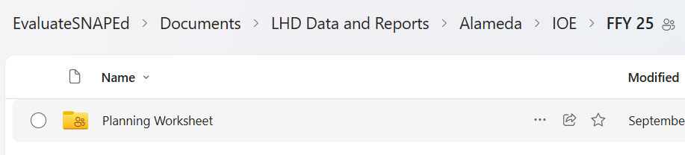
Planning Worksheets
This is a living document!
Keep Planning Worksheets up-to-date as you go.
  Log pre and post dates, keep track of your opt outs, add PEARS PSE Site Activity ID.
Please update the version in your OneDrive folder: IOE > FFY 25 > Planning Worksheet

Slide 9
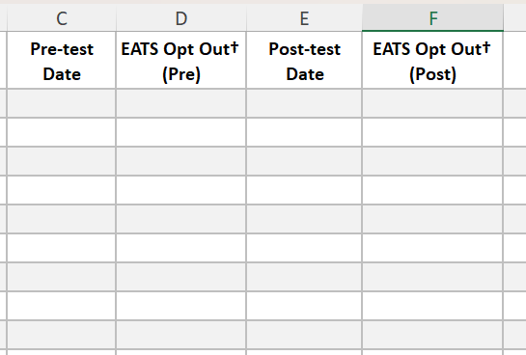
Opt outs
Parent opt out form
+
Student opt out (day of)
=
EATS Opt Out
Note: Only need to send the parent opt out form home at pre-test

Slide 10
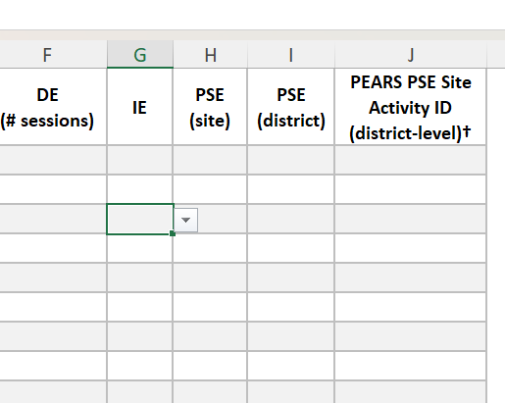
PEARS PSE Site Activity ID (District-level)
What is this and why do you need it?
For our dose analysis, each school site will have a calculated intervention “dose score”, however, this does not capture any district-level PSE work.
Note: You would only add this after your district-level PSE intervention has been entered into PEARS.

Slide 11
Updates & new data releases
LHD landing page overhaul and project website alignment
Leaders in Eating & Activity Practices (LEAP) Awards
FFY 24 LHD Data Briefs:
  At a Glance
  Educational Activities
  PSE Change Efforts
  Partnerships & Multi-Sector Coalitions
  Program Effectiveness
FFY 24 Data Storytelling Toolkits
Coming tomorrow!
Coming tomorrow!

Slide 12

Questions?

