Slide 1
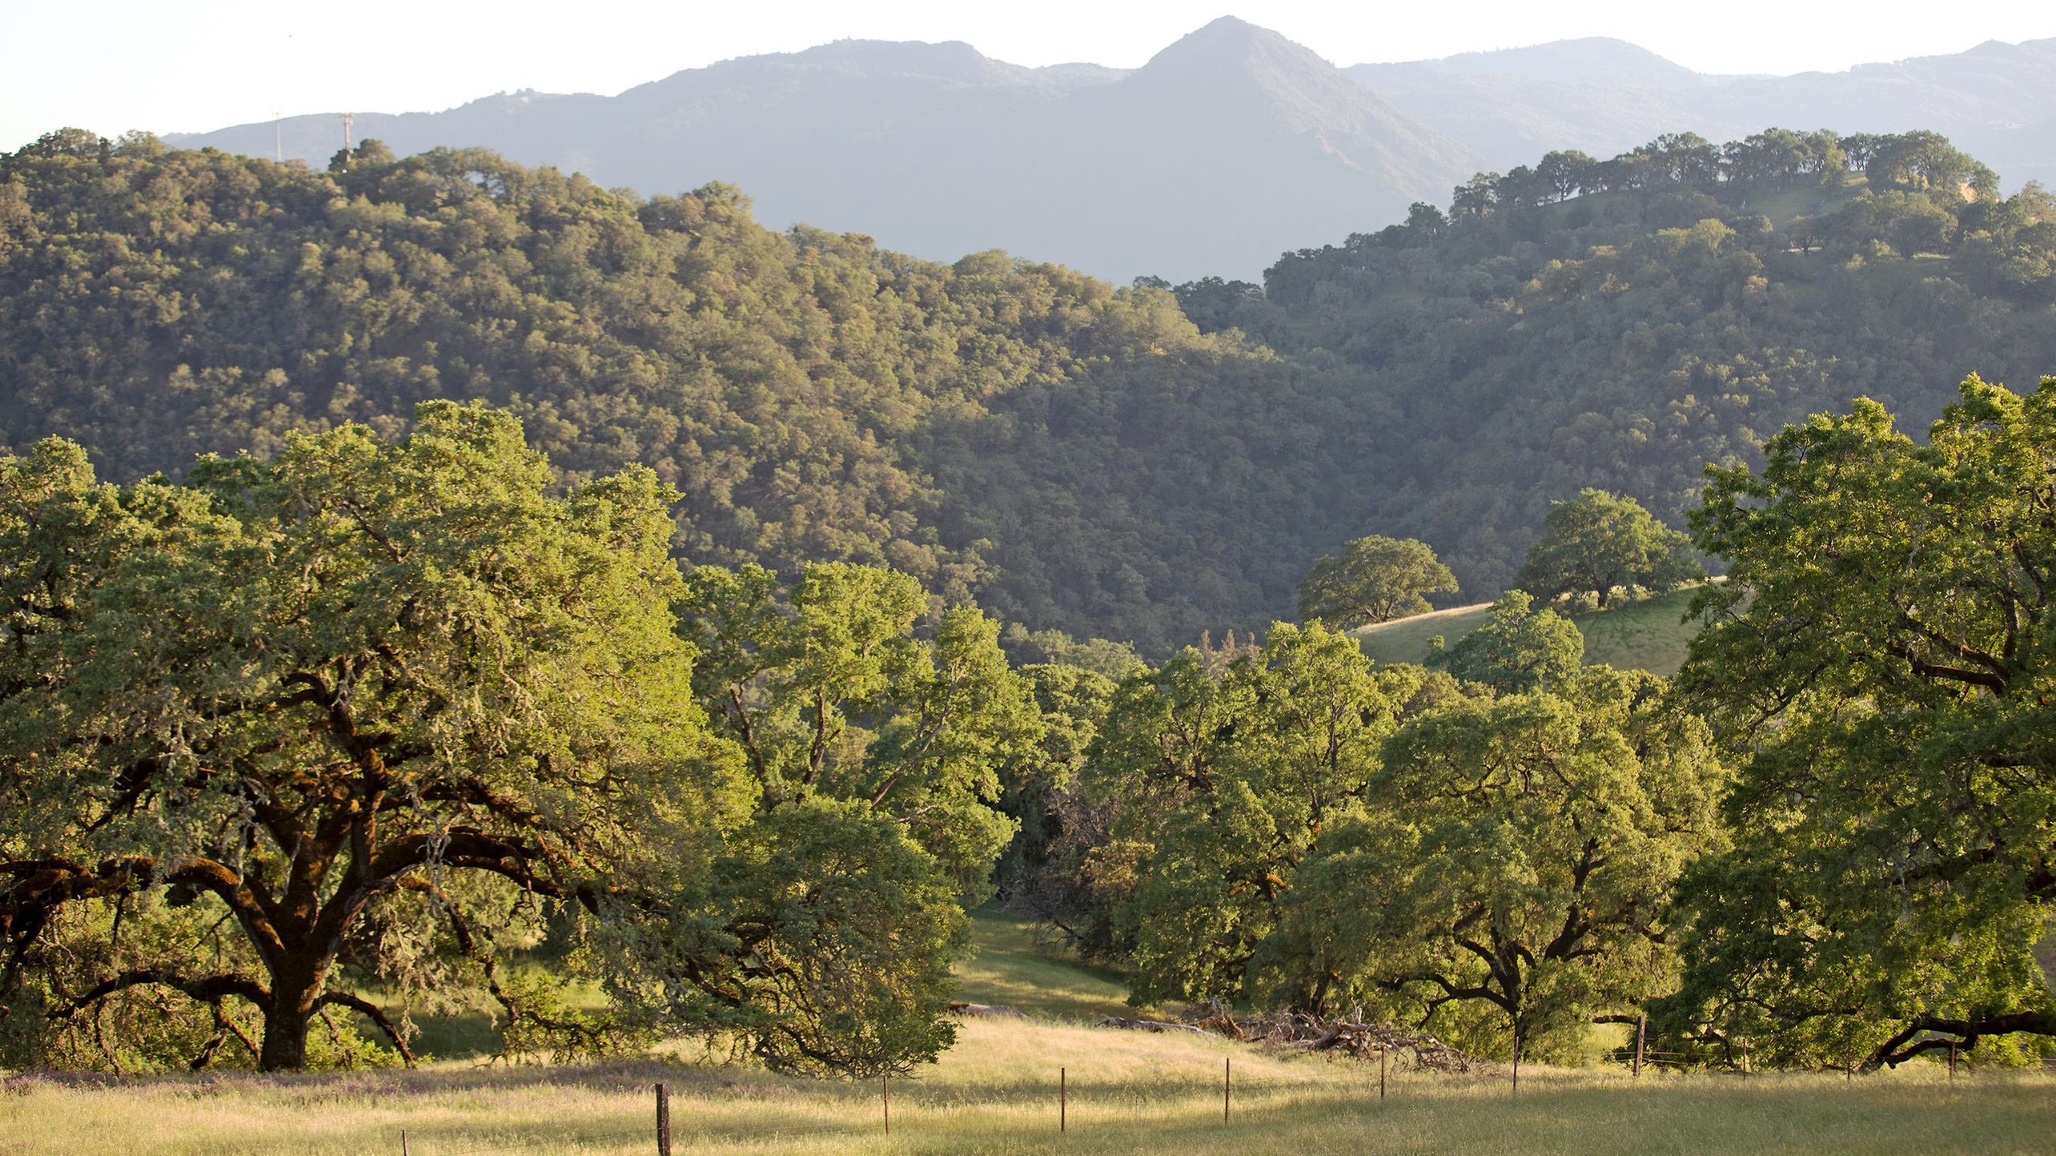

Hub of Working Lands
Concept for Feedback
Based at the Hopland and Sierra Foothill RECs
Draft Mission: Maintain and enhance ecosystem integrity and support working landscapes through applied research, adaptive management, and educational activities.

Slide 2
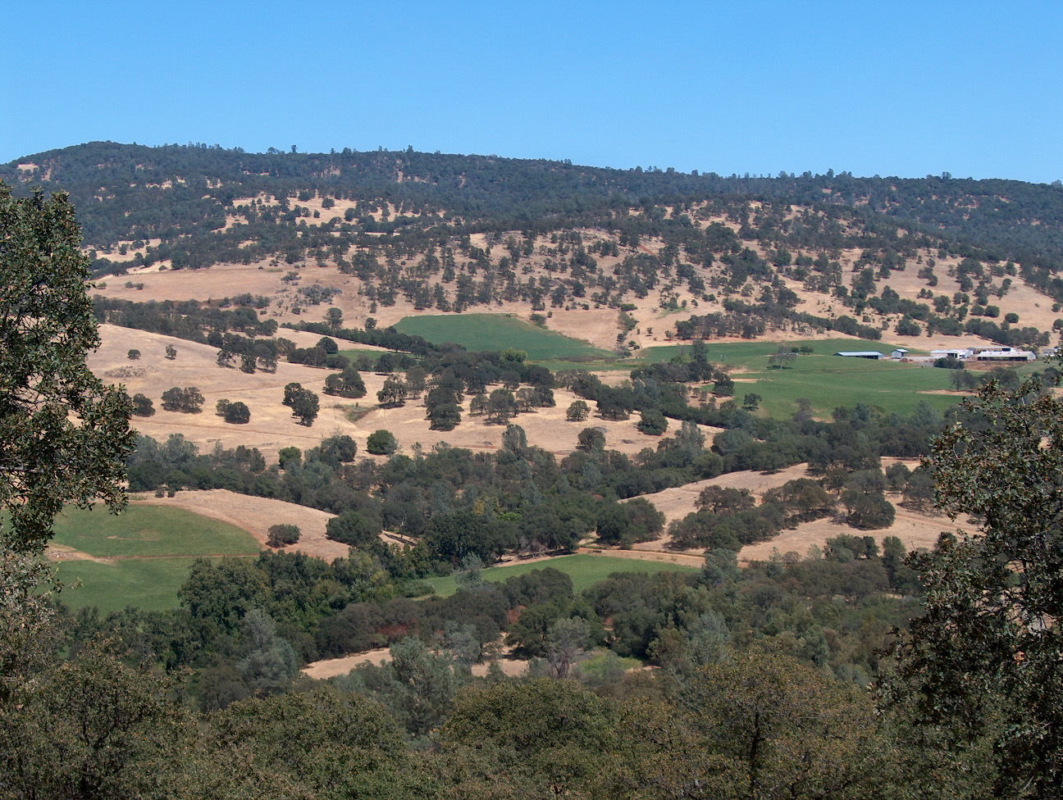
Sierra Foothill REC (SFREC)
Assets Onsite:
Skilled staff for field work, fabrication, data collection and cattle work
5,721 acres of diverse rangelands, oak woodlands, riparian areas
160 acres of irrigated pasture
UC Davis Animal Science owned cow/calf herd
Weaned and Yearling leased cattle available for research projects
Conference Center and overnight accommodations
Specialized equipment, workrooms, vehicles, warehouses, barns, animal handling facilities
Access to Yuba River
42 acres of recently planted blue oaks
Infrastructure for studying a warmer, drier climate
Nearby:
UCCE Advisors:
  Yuba/Sutter: Livestock and Natural Resources, Forestry and Dairy
  Placer/Nevada: Livestock and Natural Resources, Forestry, Environmental Horticulture and Statewide Fire Coordinator
  Butte: Livestock and Natural Resources, Forestry
Relationships with NRCS, CalFire & Farm Bureau
UC Davis
CSU Chico
Butte and Yuba Community Junior Colleges

Slide 3
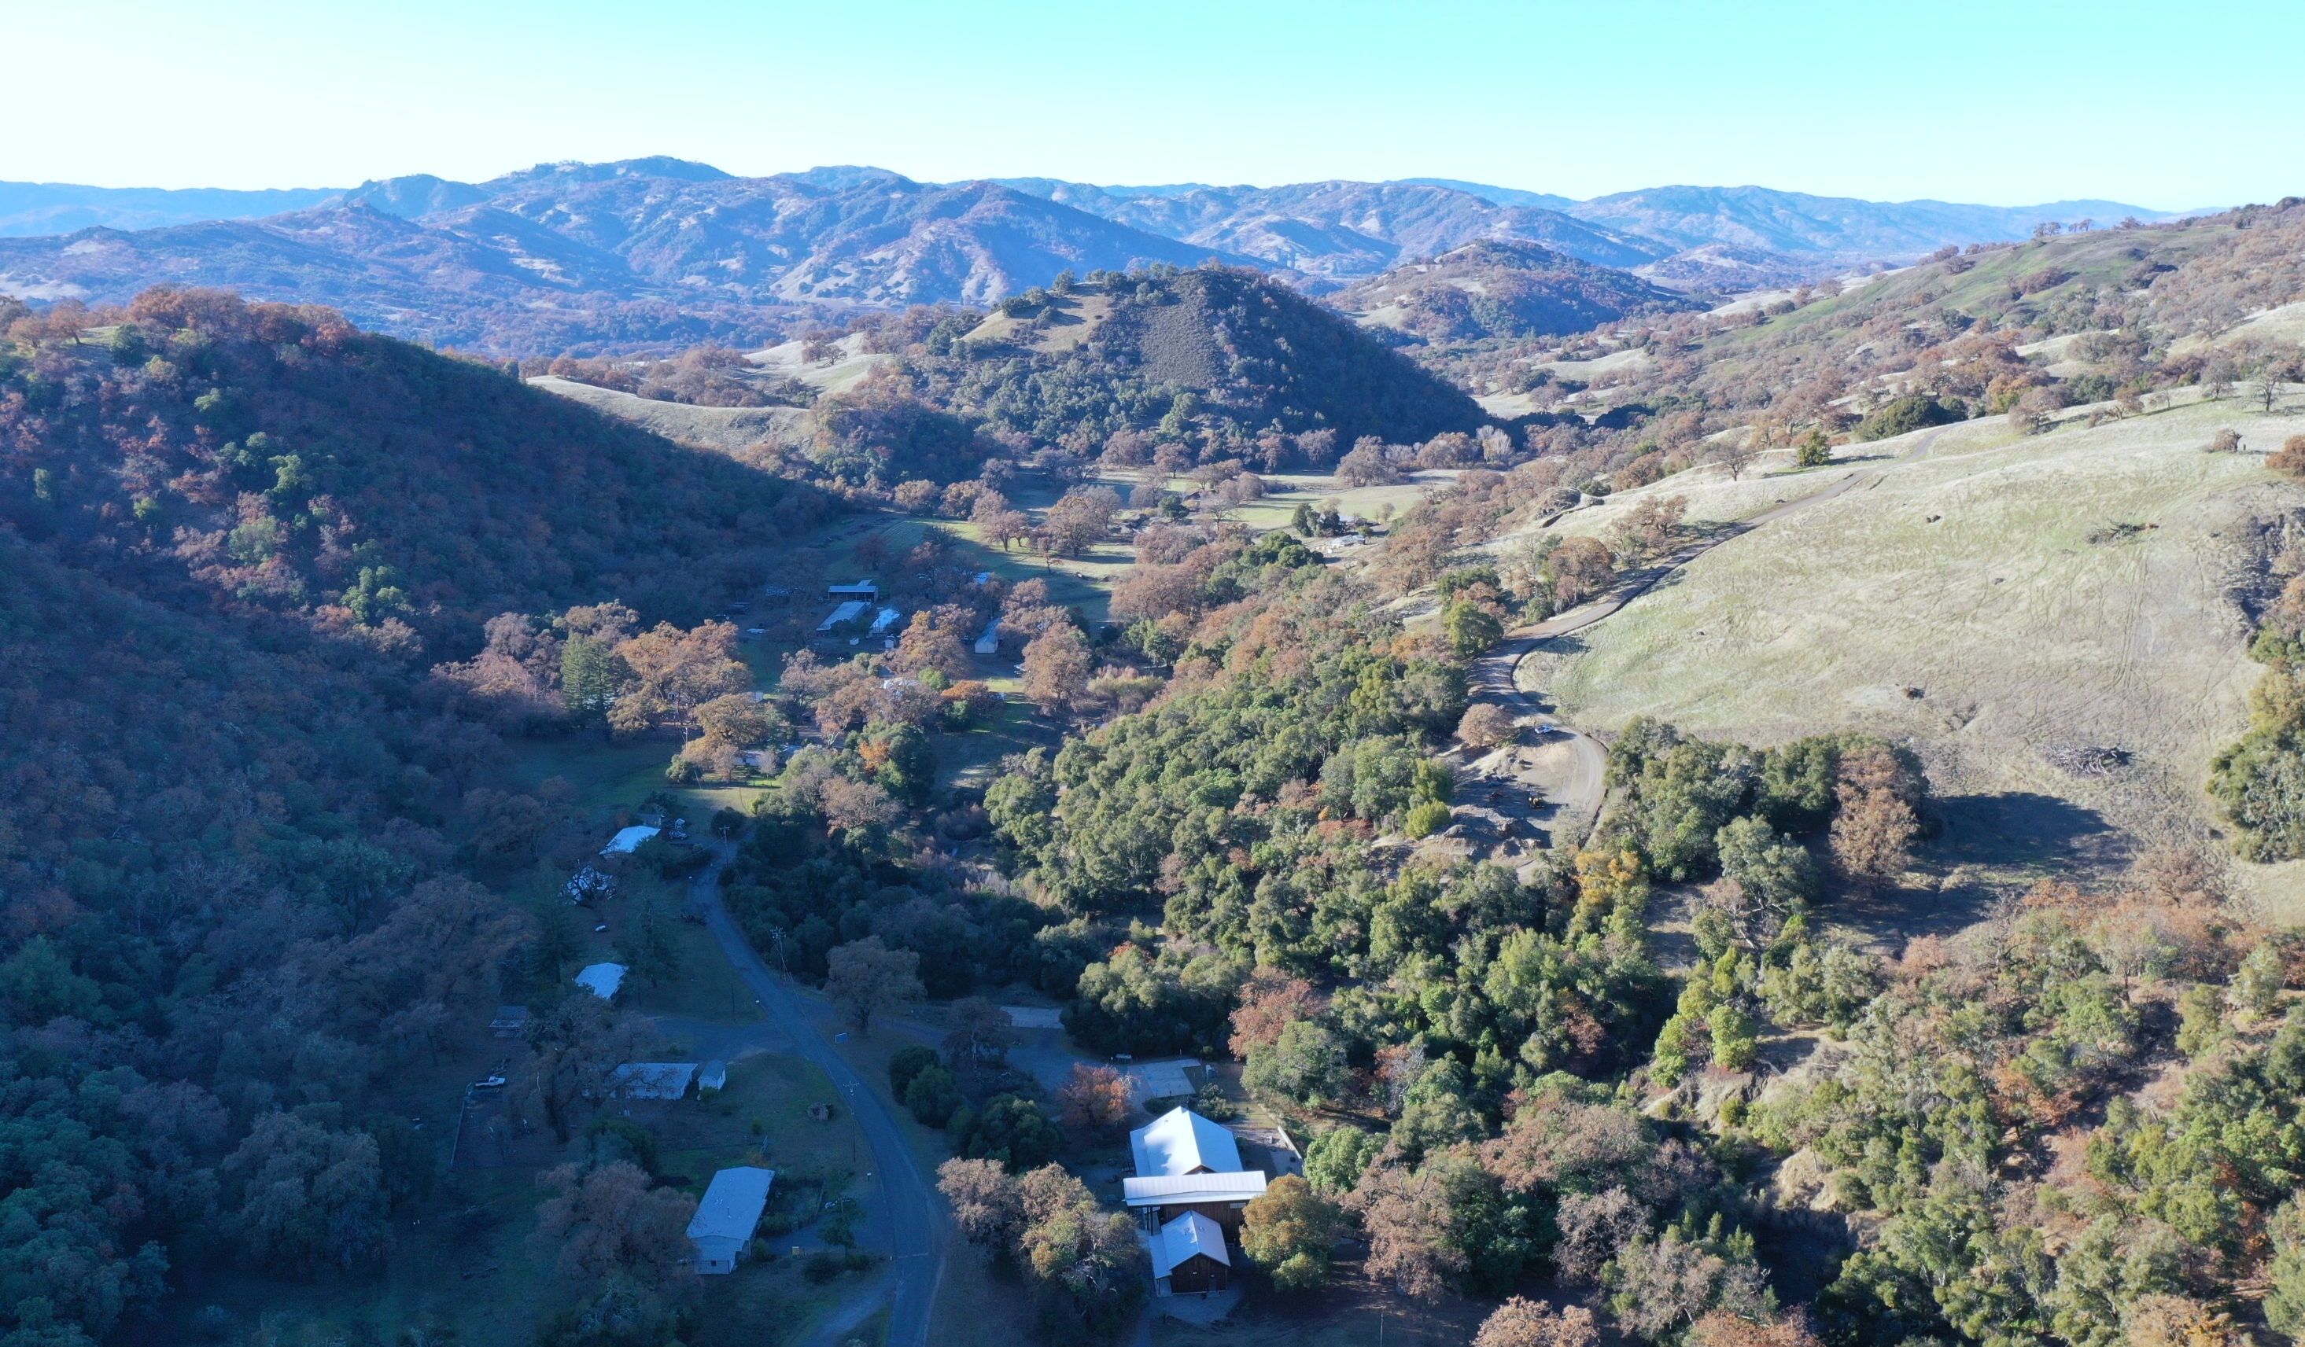
Hopland REC (HREC)
Assets Onsite:
Skilled staff for field work and extension events
5,358 acres of diverse rangelands, oak woodlands, riparian areas
Sheep flock
Cattle leases
Conference Center
Onsite accommodations
Equipment, lab, workshops, vehicles, warehouses, barns
CalFire Vegetation Management Plan
UCCE Advisors: Beneficial Burning and Tribal Land Stewardship, Integrated Vineyard Systems
UCCE Specialists: Conservation Science, Oak Woodland Management and Conservation (coming 2024)
Nearby:
UCCE Advisors:
  Mendocino/Lake: Forestry, Diversified Ag Systems, Water Policy and Climate Change, Food Systems, IPM, Livestock and Natural Resources (coming 2024), 4H (coming 2024 or 2025)
  Sonoma: Livestock and Natural Resources, Fire, Specialty Crops, Dairy
UC Natural Reserves: Angelo (Laytonville), McLaughlin (Clearlake)
Established relationships with key organizations: Resource Conservation District, CalFire, Farm Bureau, County Board of Supervisors, Pepperwood Preserve, Junior Colleges in Mendocino and Santa Rosa

Slide 4
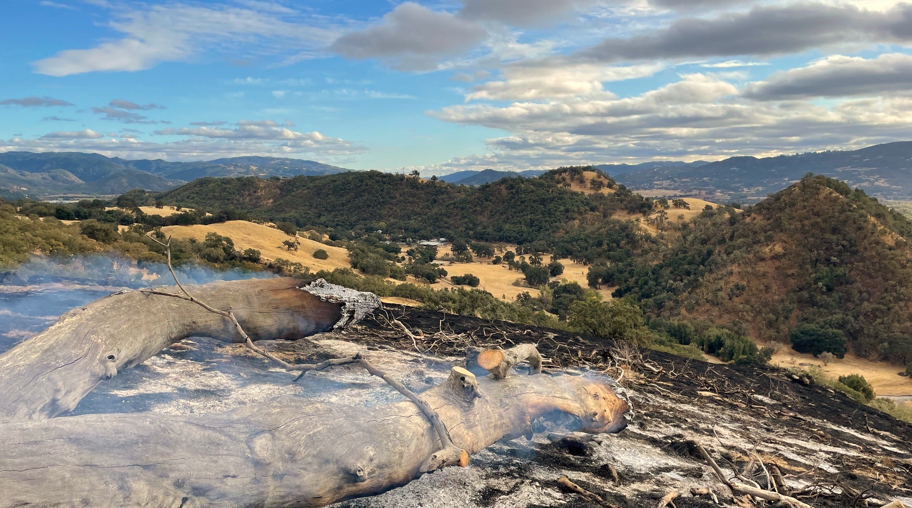
The Question
How do we most effectively leverage the assets of the Hopland and Sierra Foothill Research and Extension Centers to:
Support our academic communities, both in the field and on campuses, in conducting relevant research studies?
Develop multi-disciplinary collaborations to work on complex issues facing our working lands and those whose livelihoods depend, both directly and indirectly, on functional ecosystems?
Ensure that the knowledge gained through these studies reaches the communities who most need that information?
Provide channels through which the needs of our regional communities can reach researchers to inform their future research programs?

Slide 5
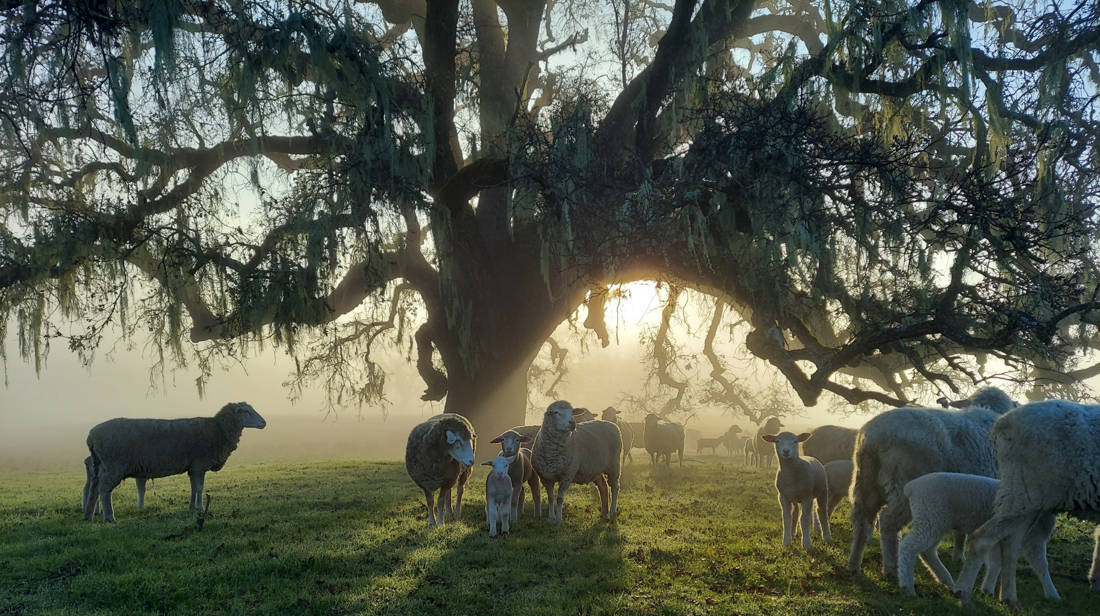
Hub Of Working Lands (HOWL) Interconnected Disciplines
HOWL
Livestock Production
Rangeland Management
Fire Ecology
Infrastructure Development
Soil Ecology and Chemistry
Crop Production
Wildlife Ecology and Management
Biodiversity Conservation
Oak Woodland Management
Watershed Management
Economic Development

Slide 6
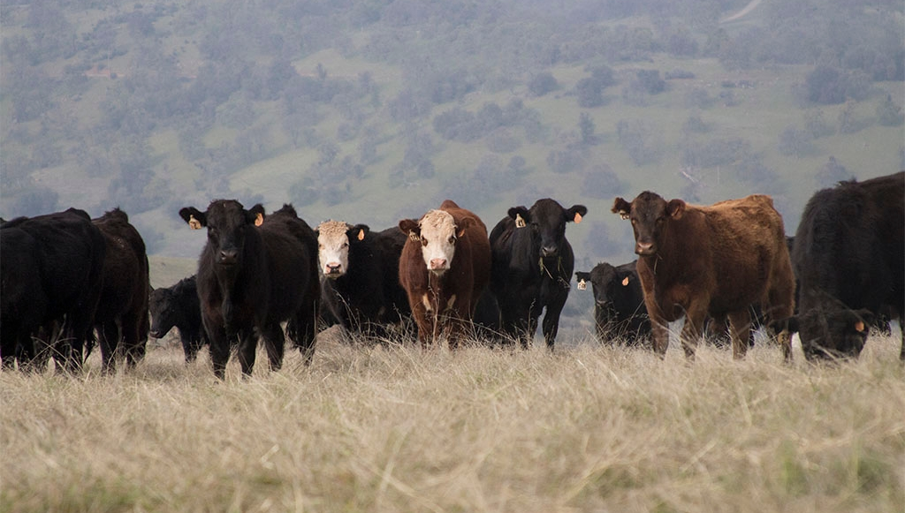
Proposed Features and Benefits of HOWL
Data Management Officer
Assists in making raw and analyzed data accessible through collaboration with original researchers
Organizes existing data sets from RECs, translating from original medium to digital format
Creates and maintains portal to cohesive and searchable database of information from projects
Collaborative Network Access
Organized in person and virtual events to bring multi-disciplinary groups together to discuss current and future collaborative projects
REC personnel provide individualized introductions to relevant academics, agencies, and regulators to enhance campus-based academic ability to form key relationships
Online portal provides HOWL researchers access to and information about key researchers, past projects, and stated needs by relevant communities and organizations
Multi-site Support from REC Staff
Comprehensive and expanding network of potential off-REC locations for research sites, organized by available resources and site attributes, to allow remote research to find locations for multi-site research projects
REC-based, trained personnel available to travel off-site and conduct field work for convenience and to ensure data parity through same methodology

Slide 7
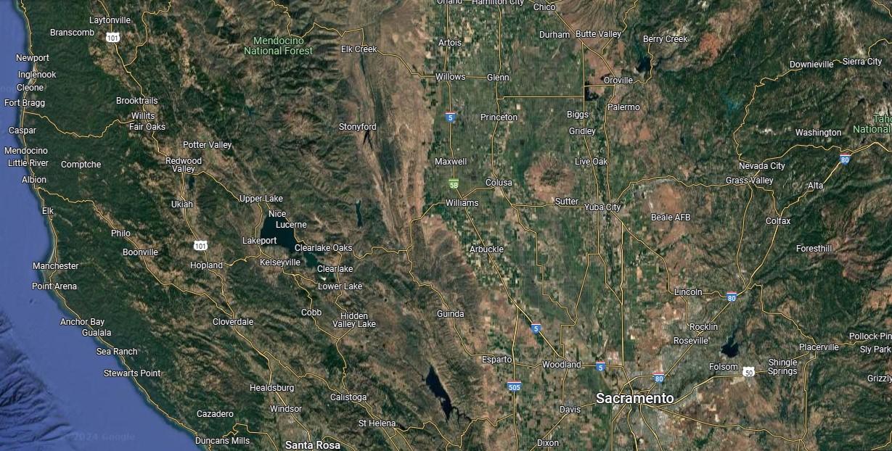
Angelo Coast Range Reserve
Sierra Foothill REC
Hopland REC
McLaughlin Natural Reserve

Slide 8
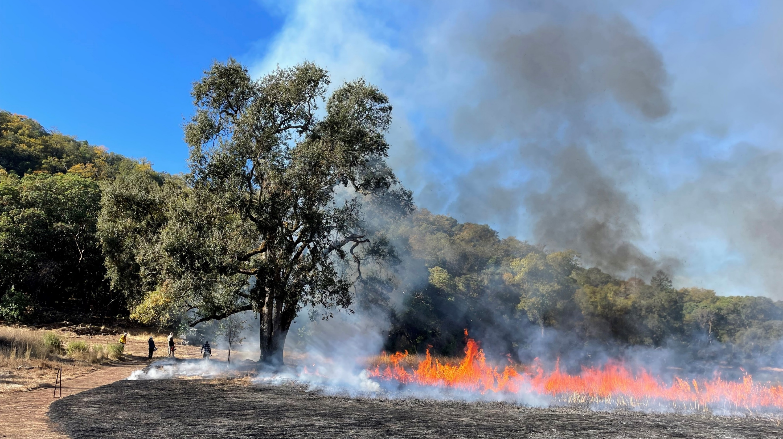
Other Potential HOWL Features and Benefits to Consider
Community Education Specialist (CES) at SFREC
  Like an existing CES at HREC, this position could help develop extension programs and events at SFREC to ensure academics are supported in providing community education, logistical and marketing and evaluation
Site Parity between HREC and SFREC
  Multiple species of livestock
  Matching equipment in field and lab
  Similar rate and fee charges
  Matching ability to conduct prescribed burns – CalFire, burn boss
UC Rangelands and Natural Resources Specialist at SFREC
  This position, which would have statewide responsibility, would help support UCCE’s network of Livestock and Natural Resource Farm Advisors in the broad area of natural resources by providing professional training, collaborating on research and extension projects and possibly funding opportunities.
Unified process to engage with HOWL
  One application and approval process for dual-REC projects
  One project management portal for communicating project requests
  Budget planning template tool
  Still retain individual REC process for projects occurring only at SFREC or HREC

Slide 9
The Request
Please provide your input on the HOWL concept by completing the following survey:
  https://ucanr.co1.qualtrics.com/jfe/form/SV_bwShjbfMlMr7fiC
  This survey link is also included in the email you received, along with a copy of the Power Point for reference.
Complete the survey by February 5th for your input to be included in plan development.
Thank you!

