Slide 1
L2 4-H Epidemiology
PROJECT ORIENTATION
Public Health Process
Notes:
Team Builder: Super hero power - draw or act and share. - 10 minutes

Slide 2
Overview
Zoom/Technology
Ice Breaker
Pre-Evaluation
Group Agreements
Graphic Novel

Slide 3
Group Agreements
Be kind
Be respectful to others’ opinions
Work together
Support each other
Have fun!
Participate

Slide 4
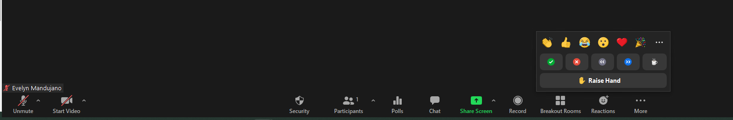
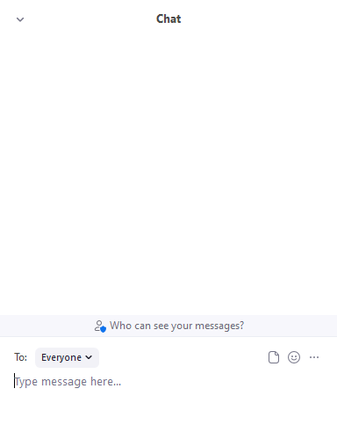
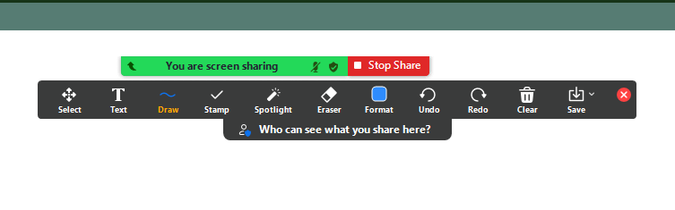
ZOOM
Use your Emojis!
Mute & Unmute Here
Use the Chat to send Messages!

Slide 5
Graphic Novel
Make sure to read before the first lesson!
The Junior Disease Detectives Operation: Outbreak Graphic Novel
Or Google ‘disease detectives operation outbreak CDC’

