Slide 1


Slide 2
How we influence people’s behaviors:
    motivate
    change attitudes
    educate
    enforce policy
    influence with peer pressure
    overcome barriers

Slide 3

Don’t touch your eyes, nose, mouth or face

Slide 4
YouTube Video
No touch video
https://www.youtube.com/watch?v=JwbwvppBGZU
Notes:
What do you want to do?
motivate
change attitudes
educate
enforce policy
influence with peer pressure
overcome barriers

Slide 5
Quarantine & Social Isolation

Slide 6
Face masks

Slide 7
Educational Video
How masks work video
https://www.youtube.com/watch?v=0Tp0zB904Mc&feature=share&fbclid=IwAR2-1XvAyh6SESNh3Nzaz4W2Xsfy8qJyVndjQ-Dn5xIT5k18-j1Sjf9vqR0
Show until 5:47
Notes:
What do you want to do?
motivate
change attitudes
educate
enforce policy
influence with peer pressure
overcome barriers

Slide 8
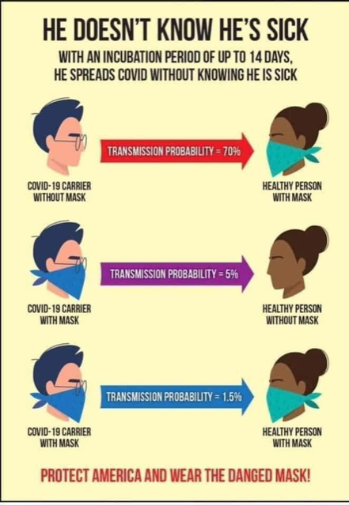
Social Media Post
Notes:
What do you want to do?
motivate
change attitudes
educate
enforce policy
influence with peer pressure
overcome barriers

Slide 9
Physical Distancing
Keep 6 feet apart

Slide 10
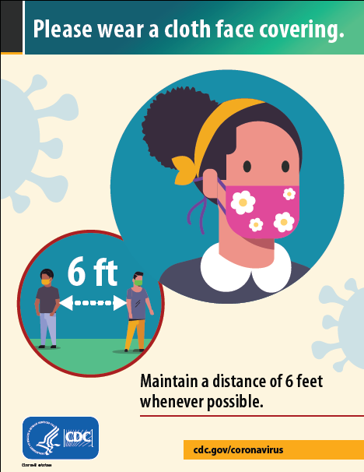
Poster
Notes:
What do you want to do?
motivate
change attitudes
educate
enforce policy
influence with peer pressure
overcome barriers

Slide 11
Song
Gimme 6 feet music video
https://www.youtube.com/watch?v=XjfCeY4D2QI
Play a portion
Notes:
What do you want to do?
motivate
change attitudes
educate
enforce policy
influence with peer pressure
overcome barriers

Slide 12
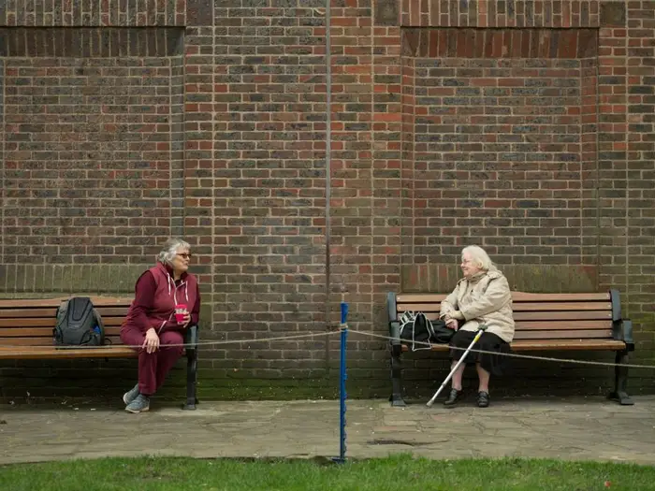
Subliminal Messaging
Notes:
What do you want to do?
motivate
change attitudes
educate
enforce policy
influence with peer pressure
overcome barriers

Slide 13
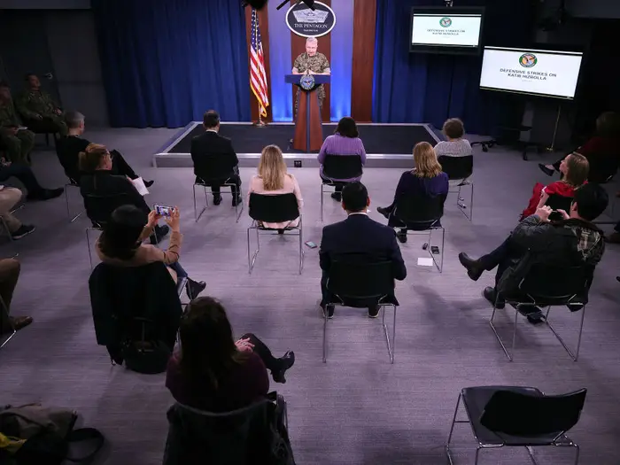
Polcies- Environment
Notes:
What do you want to do?
motivate
change attitudes
educate
enforce policy
influence with peer pressure
overcome barriers

Slide 14
Wash your hands

Slide 15
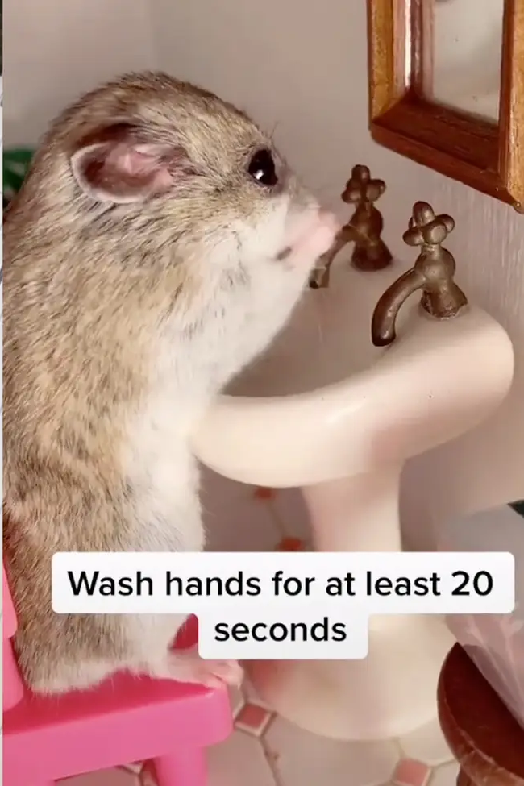
Meme
Notes:
What do you want to do?
motivate
change attitudes
educate
enforce policy
influence with peer pressure
overcome barriers

Slide 16
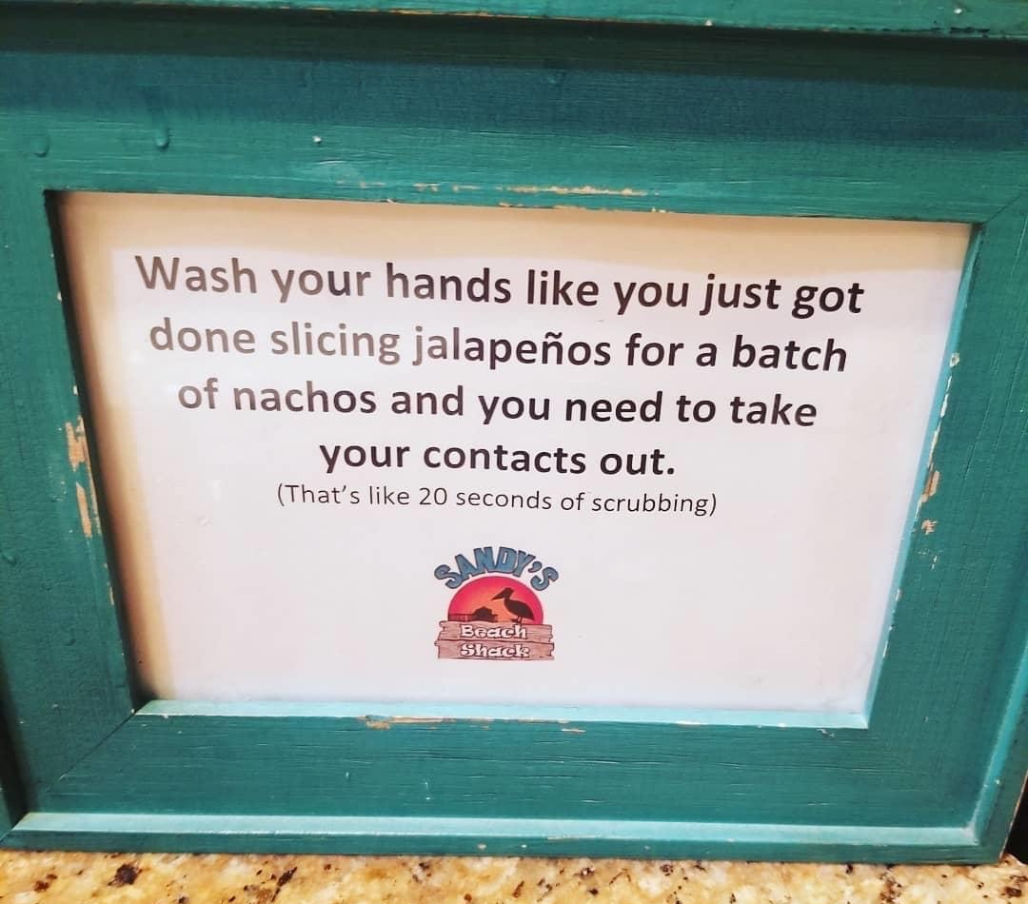
Sign
Notes:
What do you want to do?
motivate
change attitudes
educate
enforce policy
influence with peer pressure
overcome barriers

Slide 17
Educational Video
Hand sanitizer vs soap- Video
https://youtu.be/x7KKkElpyKQ
Play to 4:15
Notes:
What do you want to do?
motivate
change attitudes
educate
enforce policy
influence with peer pressure
overcome barriers

Slide 18
Clean & Disinfect

Slide 19
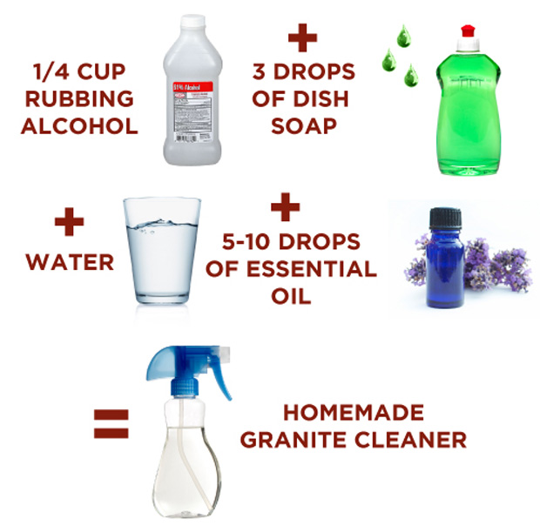
Instructions
Notes:
What do you want to do?
motivate
change attitudes
educate
enforce policy
influence with peer pressure
overcome barriers

Slide 20
Cover your cough and sneeze

Slide 21
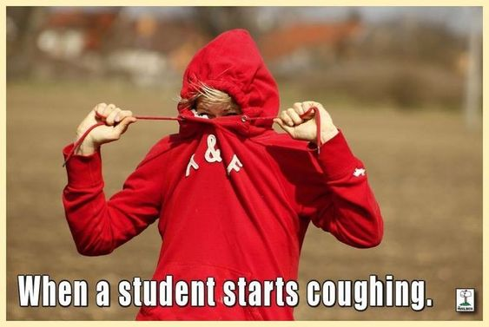
Meme
Notes:
What do you want to do?
motivate
change attitudes
educate
enforce policy
influence with peer pressure
overcome barriers

Slide 22
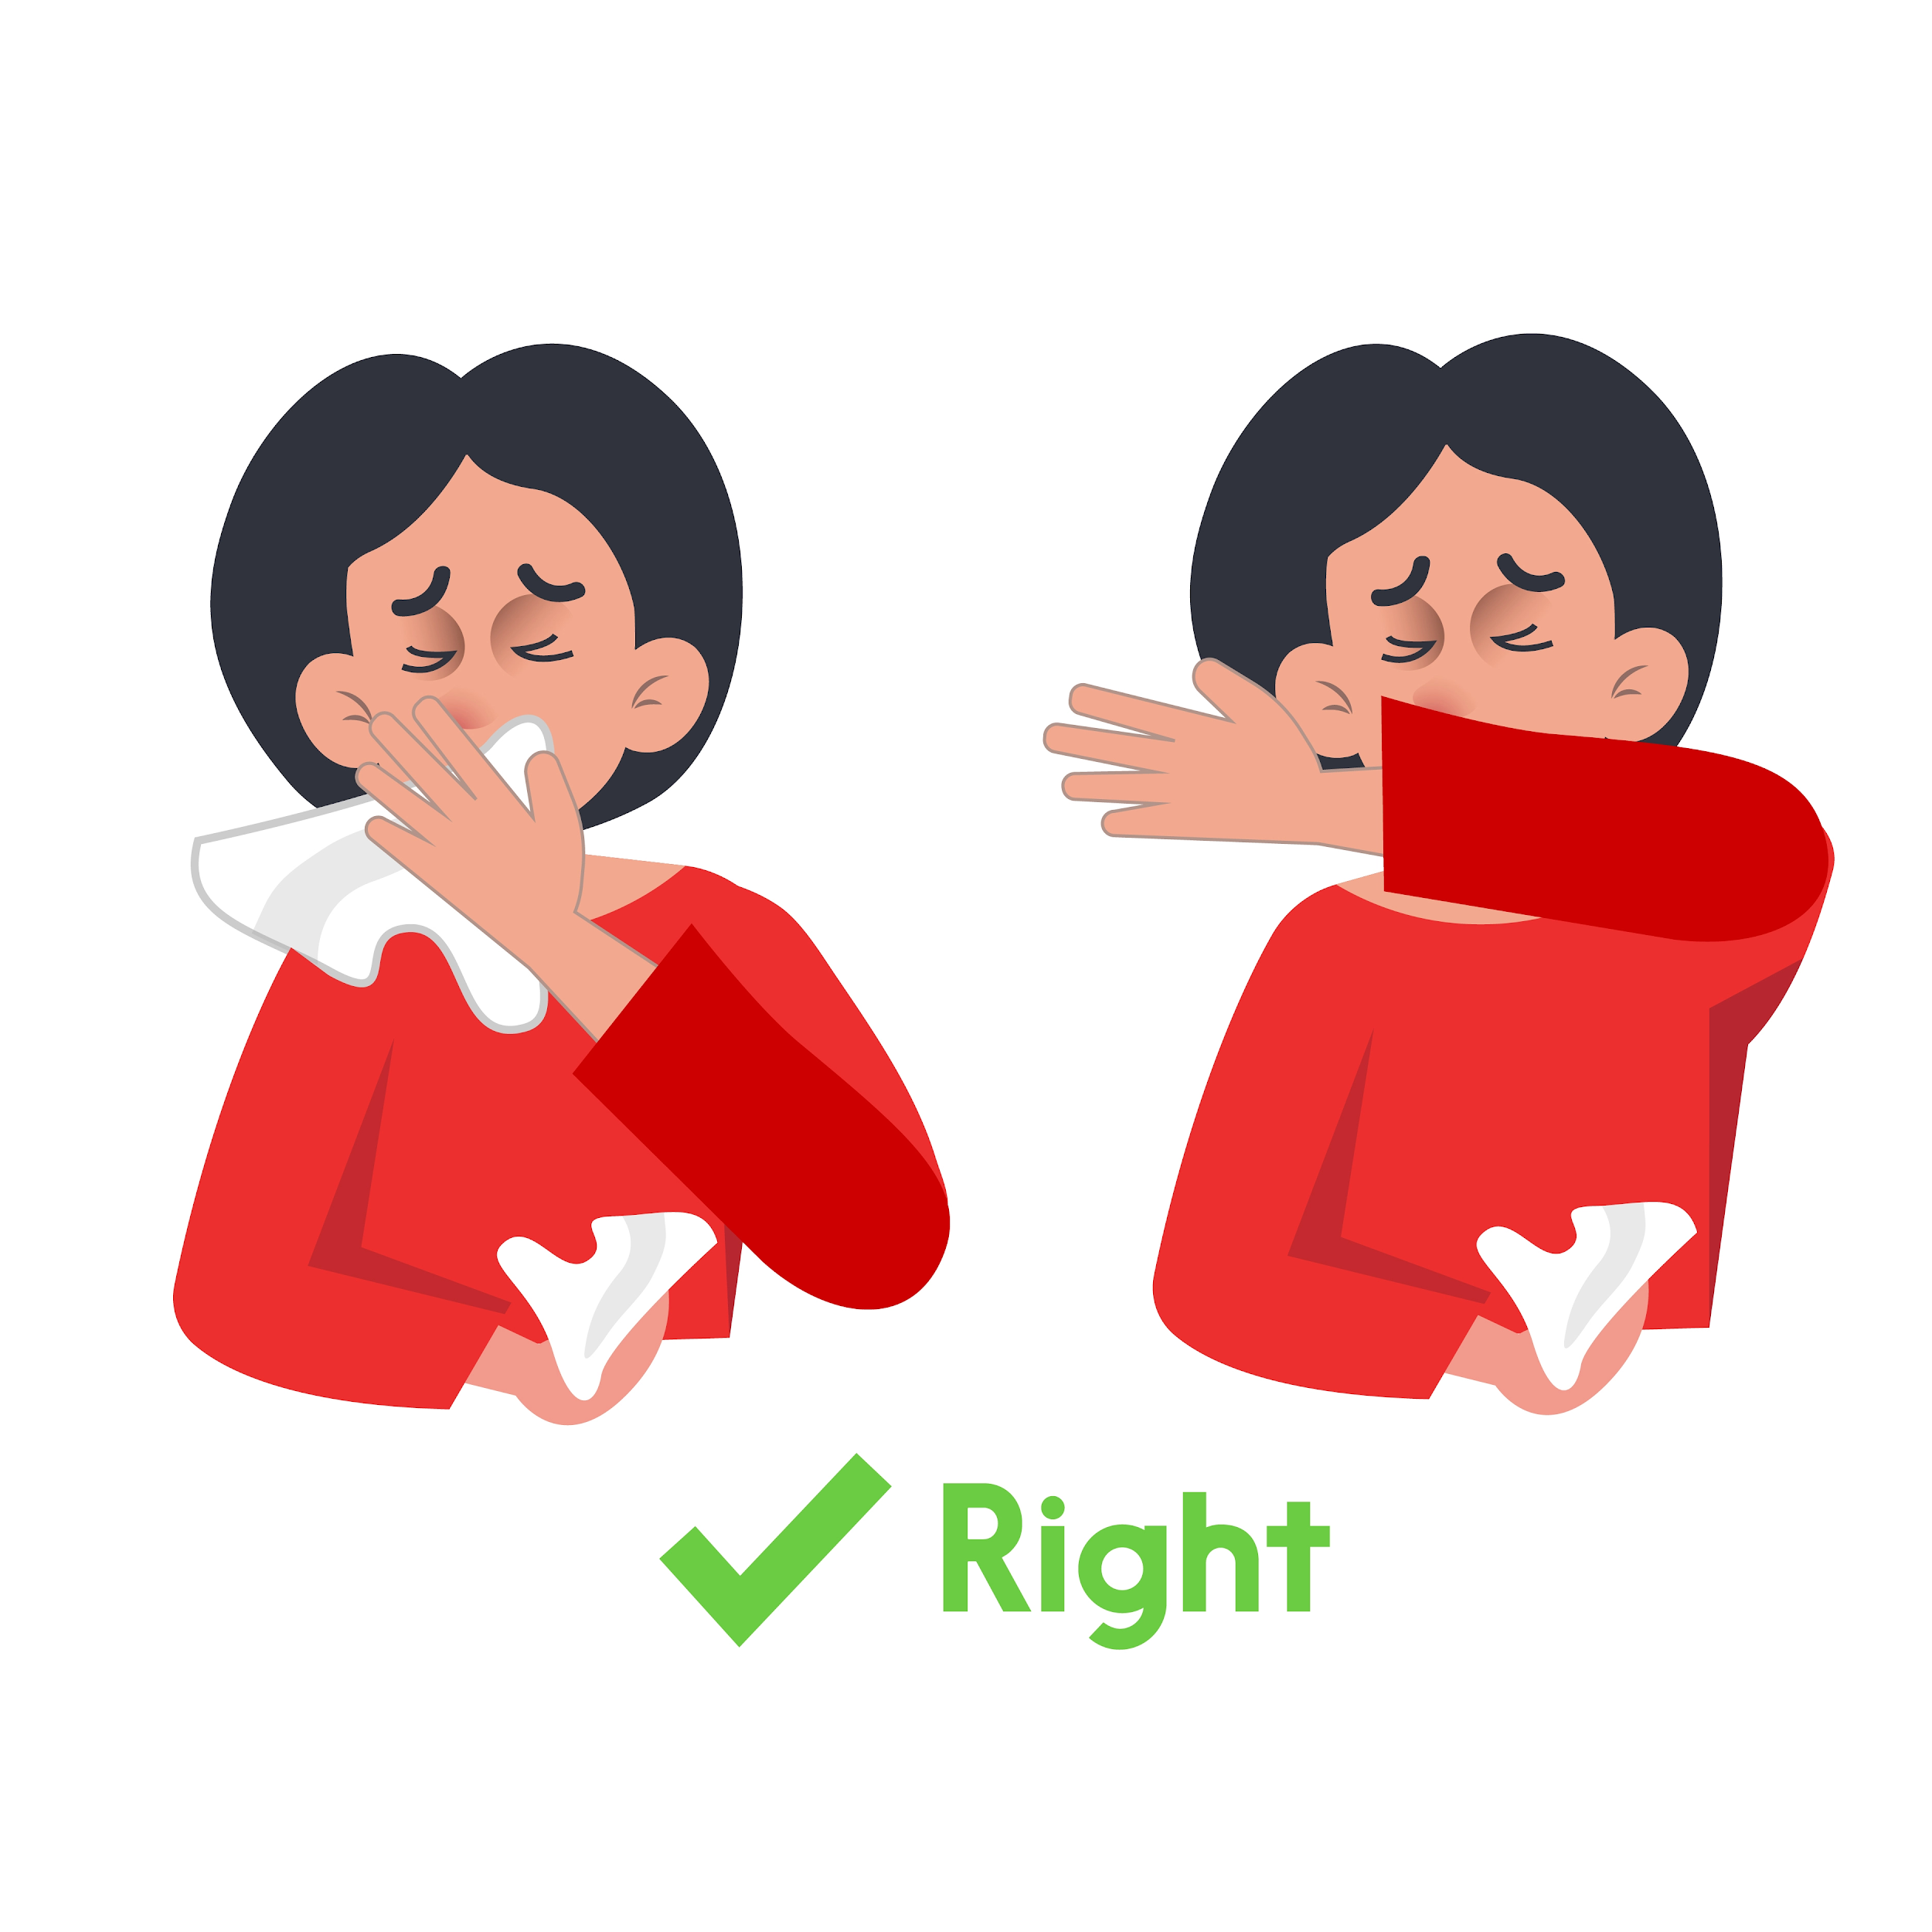
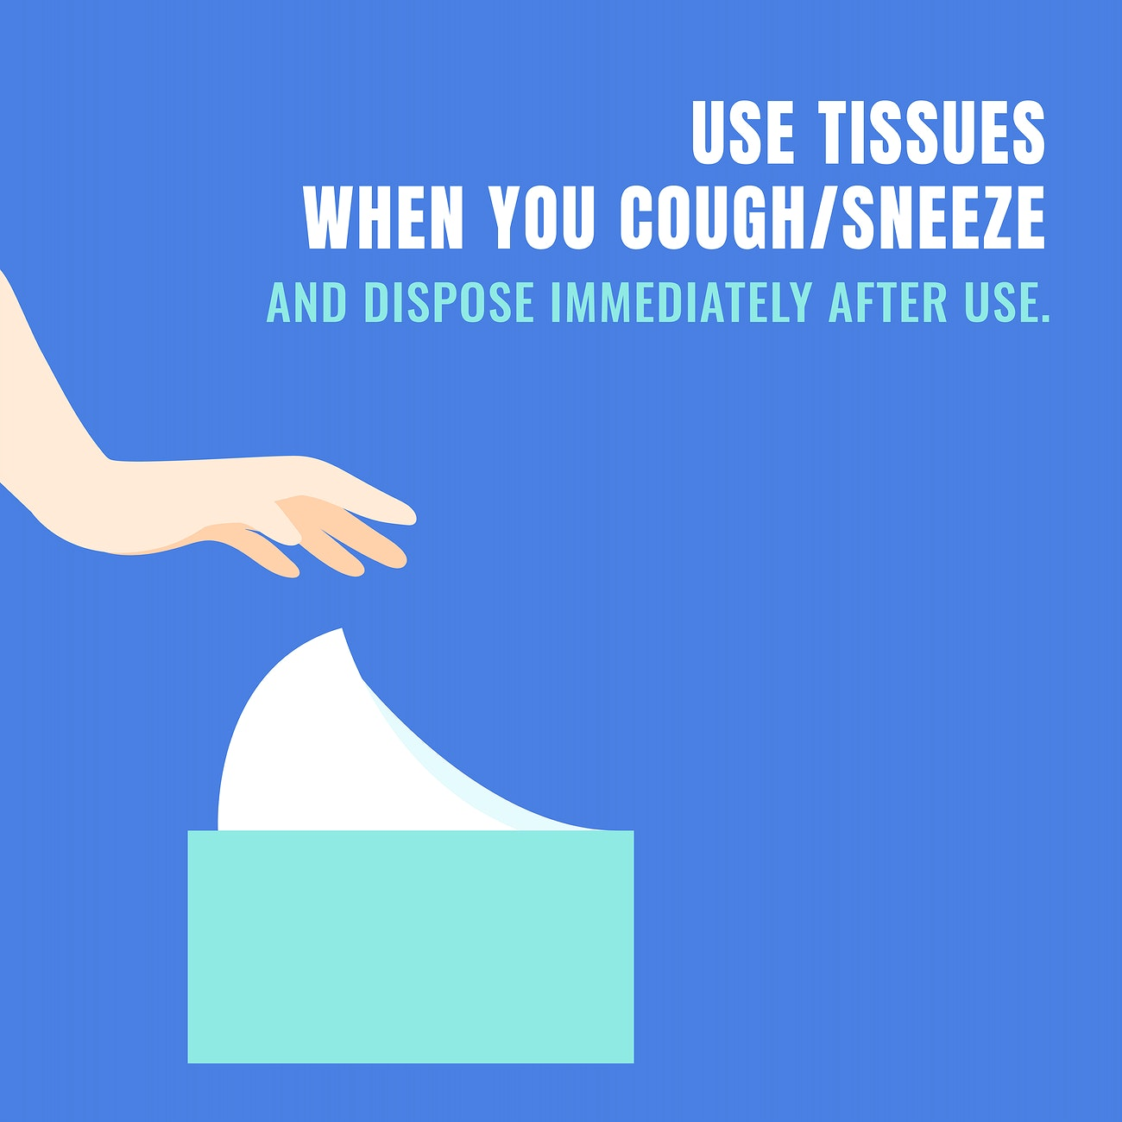
Point of use sign
Notes:
What do you want to do?
motivate
change attitudes
educate
enforce policy
influence with peer pressure
overcome barriers

Slide 23
Get fresh air, go outside
Fart mind experiment

Slide 24
Review

Slide 25
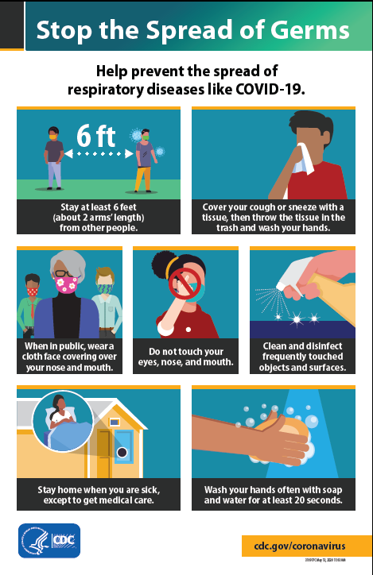
Poster
Notes:
What do you want to do?
motivate
change attitudes
educate
enforce policy
influence with peer pressure
overcome barriers

Slide 26
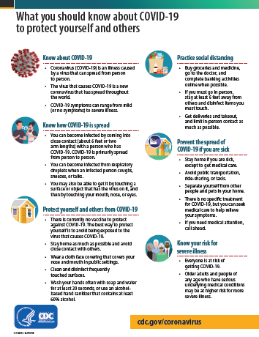
Handout
Notes:
What do you want to do?
motivate
change attitudes
educate
enforce policy
influence with peer pressure
overcome barriers

