Slide 1
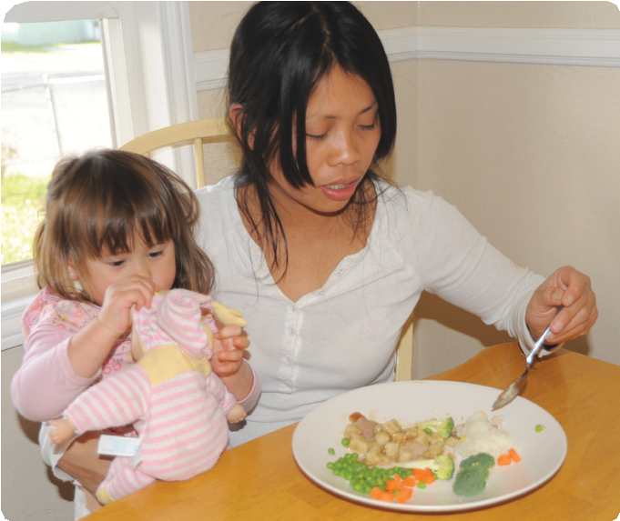
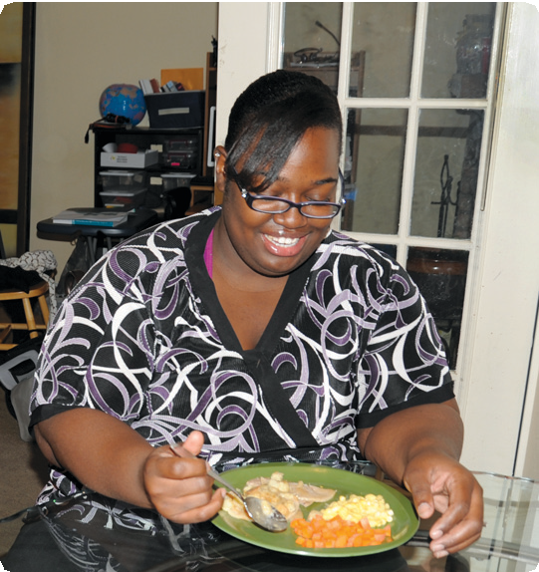
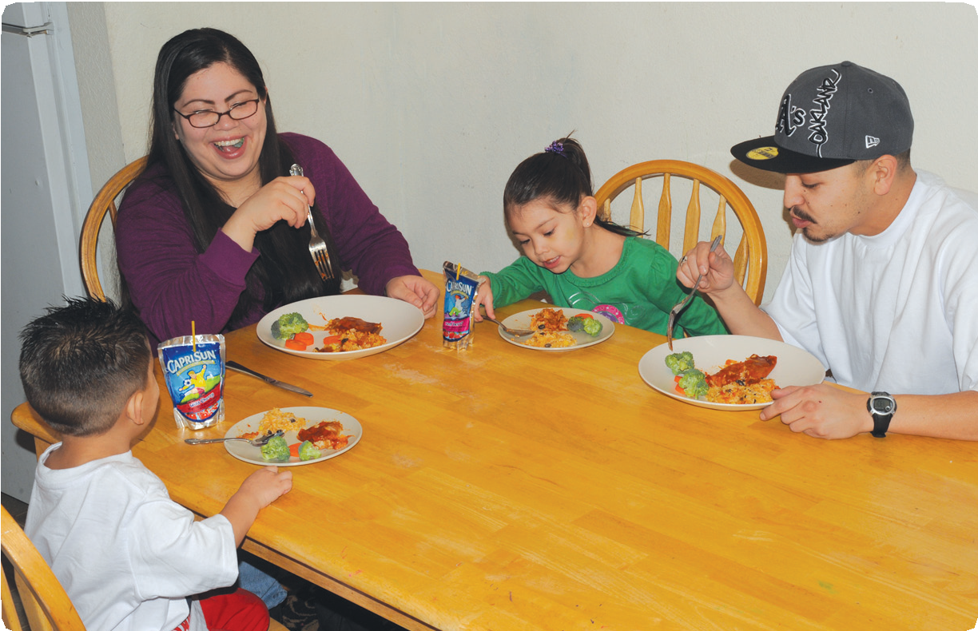
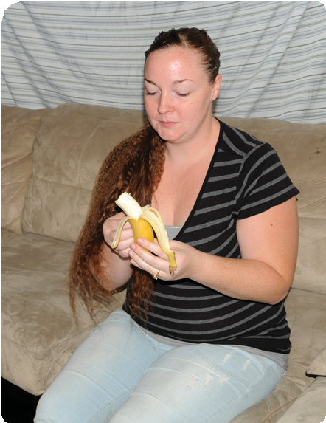
Food Tracker
What I ate yesterday
Save As Button
Name
Date
/ /
■
Lesson 1 or 2
Lesson 7 or 8
■
DO NOT COPY
EFNEP
Expanded Food and Nutrition Education Program
Copyright © The Regents of the University of California, 2014. All Rights Reserved.

Slide 2
Foods + Drinks
Meal or Snack
B = Breakfast L = Lunch
D = Dinner S = Snack
How much?
c = cup
lb = pound oz= ounce in = inch
T = Tbsp = tablespoon
Details
Store bought, restaurant or homemade? Brand?
How prepared: baked, boiled, broiled, pan fried, deep fried, sauteed, steamed, grilled, seared, roasted? With or without skin?
Did you add: gravy, butter, sugar/sweetener, salt, dressing, seasonings? How much of each? Dairy: nonfat, 1%, 2%, whole? Carton, canned, powdered?
₂B L S
t = tsp = teaspoon Drink type: 100% juice, juice blend, flavored drink, sports drink, milk, water?
1 3 4
Select meal
B L D S
Select meal
Select meal
B L S
Select meal
B L D S
Select meal
B L D S
Select meal
B L D S
Select meal
B L D S
Select meal
B L D S
DO NOT COPY
Copyright © The Regents of the University of California, 2014. All Rights Reserved.

Slide 3
1 23 4
Select meal
B L D S
Select meal
B L D S
Select meal
B L D S
Select meal
B L D S
Select meal
B L D S
Select meal
B L D S
Select meal
B L D S
Select meal
B L D S
5
Check
I reread my list of foods.
□
I included all meals and snacks.
□
DO NOT COPY
Copyright © The Regents of the University of California, 2014. All Rights Reserved.

Slide 4








Physical activity
Less than 30 min.
30–60 min.
More than 60 min.
Pregnant?
Nursing?
Y N
Y N
□
Monthly food costs $
Save As Button
FOR STAFF
Townsend MS, Ganthavorn C, Johns M, Schneider C, Neelon M, Donohue S. Food Tracker….What I Ate Yesterday, version 4 for FY 2014-15. [Group-adminis- tered 24-hour Dietary Recall 5-step multipass form. As one component of outcome evalu- ation, this 4-page booklet uses color to guide low-literate EFNEP participants through the 5-step process and is used in conjunction with the EFNEP Food Description MINI and EFNEP Portion Size charts.] University of California Cooperative Extension. © 2014, Regents of the University of California. All Rights Reserved. Graphic designer: M Reed.
The authors thank Estela Cabral De Lara, Jan Gillespie, Santos Lopez, Shirley Salado, Nelly Carrillo-Carlos, Vanessa Kenyon, Margarita Schwartz and Mary Maser for their valuable comments.
The University of California prohibits discrimination or harassment of any person in any of its programs or activities. (Complete nondiscrimination policy statement can be found at http://ucanr.org/sites/anrstaff/files/107734.doc) Inquiries regarding the University’s
equal employment opportunity policies may be directed to Linda Marie Manton, Affirmative Action Contact, University of California, Davis, Agriculture and Natural Resources, 2801 2nd Street, Davis, CA 95618, (530) 750-1318.
This work is/was supported by the U.S. Department of Agriculture (USDA), National Institute of Food and Agriculture, the Expanded Food and Nutrition Education Program. Any opinions, findings, conclusions or recommendations expressed in this publication are those of the author(s) and do not necessarily reflect the view of the USDA.
09/15/14 v.4
Educator
Data entry date
Participant ID
DO NOT COPY
University of Nevada Cooperative Extension
Cooperative Extension

