Slide 1
Online Record Book

Slide 2
Closed System
No outside access
Anyone registered in the 4hOnline system may have access
Club specific

Slide 3
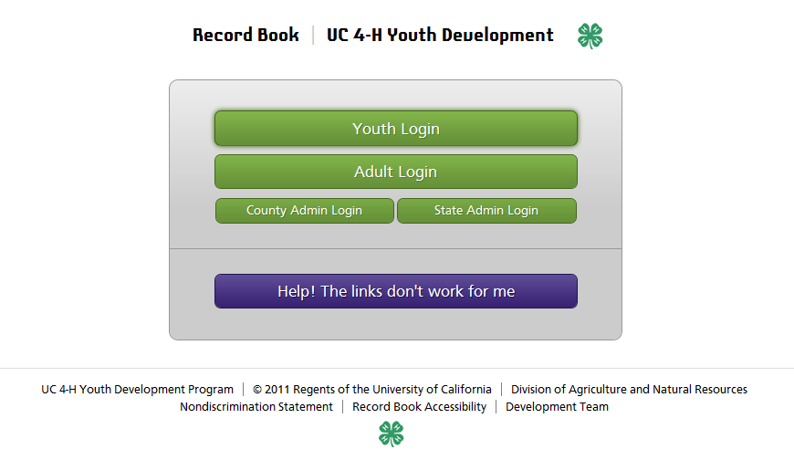

Slide 4
Mimics facebook interface
Familiar to general audience
Simple interface
Sparkle

Slide 5
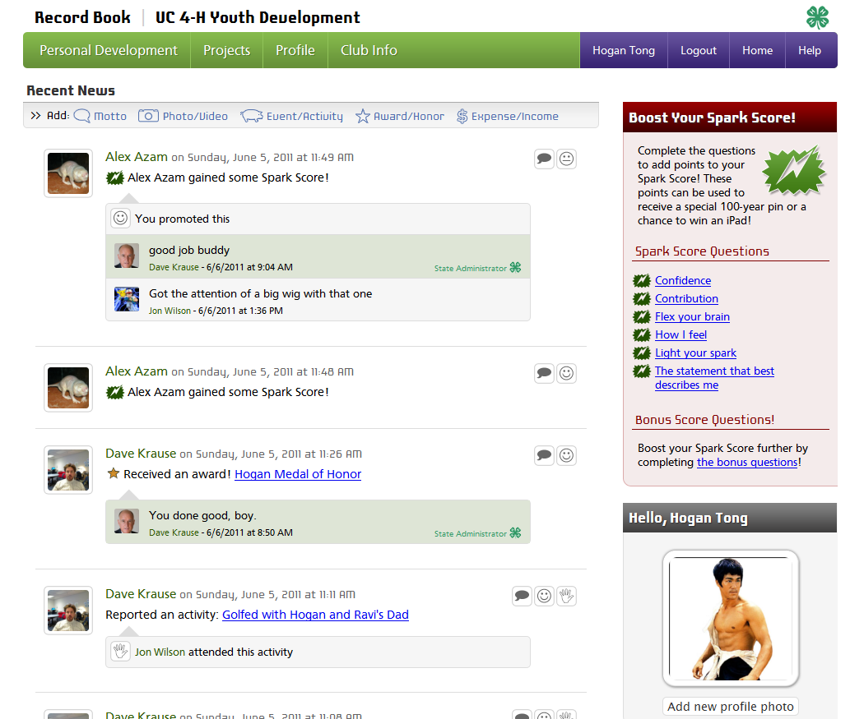

Slide 6
Tool Bar is the link to the 4-H Record Book
Follows users throughout sessions
Keeping it simple

Slide 7
More County Access to Clubs
Summary screens for members enrolled
Project meetings
Events
Awards

Slide 8
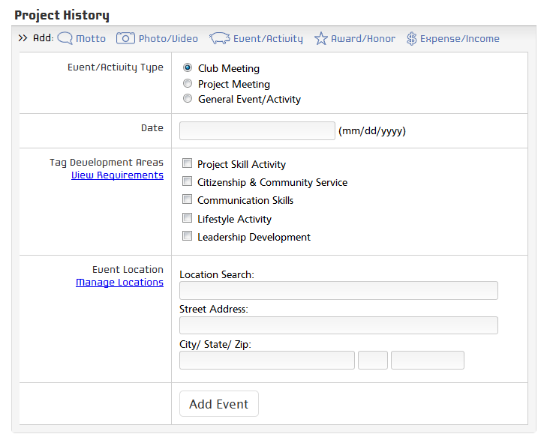
Forms will automatically populate

Slide 9
Timeline
June – July: programming completion of Basic system
July –September: System Testing
July – September: Develop Support Tools
July – September: Ensure paper forms and online forms correspond
September 1: Open to entire state
July – November: Correct basic issues found through use
July – December: I&R Committee develops State Judging guidelines

