Slide 1




Biomass Working Group
May 28, 2013
Forest Biomass and Energy in California
Stephen Kaffka, Doug Wickizer, and Nathan Parker
Department of Plant Sciences, UC Davis &
California Biomass Collaborative; Cal Fire, Institute for Transportation Studies, UC Davis

Slide 2
Forest Biomass and Energy
Overview
Biomass Management Zones
California Biorefinery Siting Model

Slide 3

California Biomass
Resources Are Diverse
Jenkins et al. (2006) A roadmap for the development of biomass in California
Notes:
From the CBC Roadmap. Total biomass vs potentially recoverable. Forest biomass is the largest pool of biomass resources in California, though only limited amounts are used for energy. Many of these values are re-assessed every year.

Slide 4
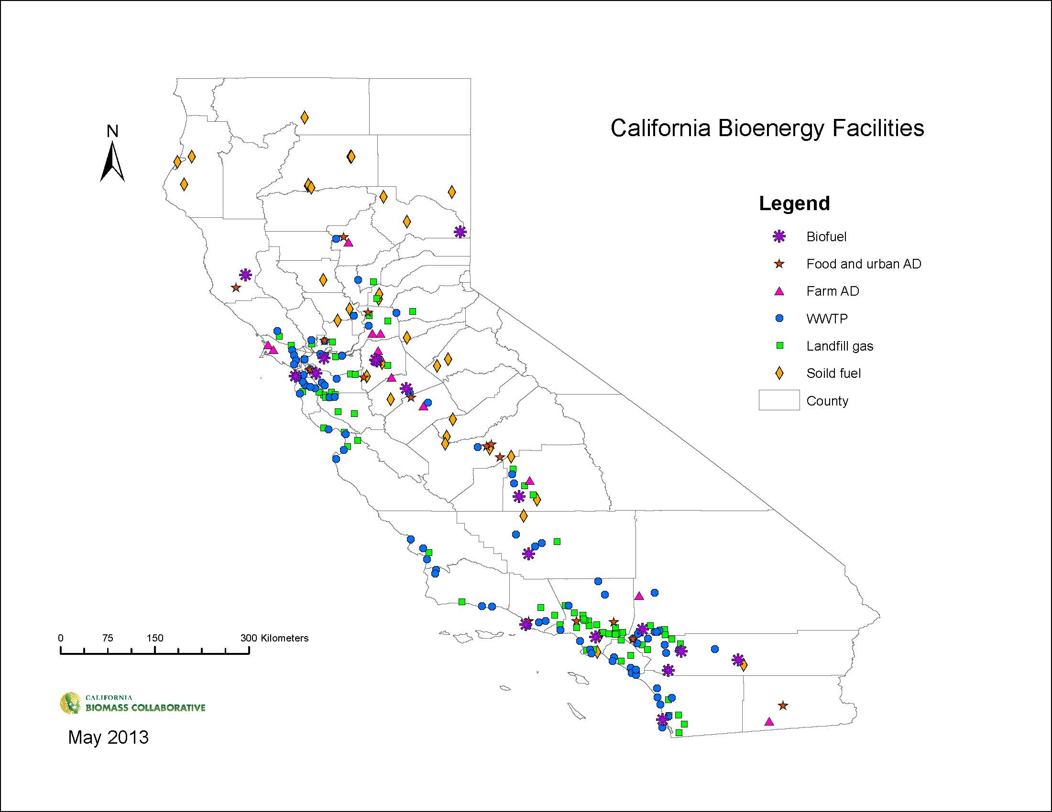
Notes:
California has a number of bioenergy facilities distributed throughout the state. Many solid fuel facilities are located in or near forest communities and use forest biomass to make power.

Slide 5
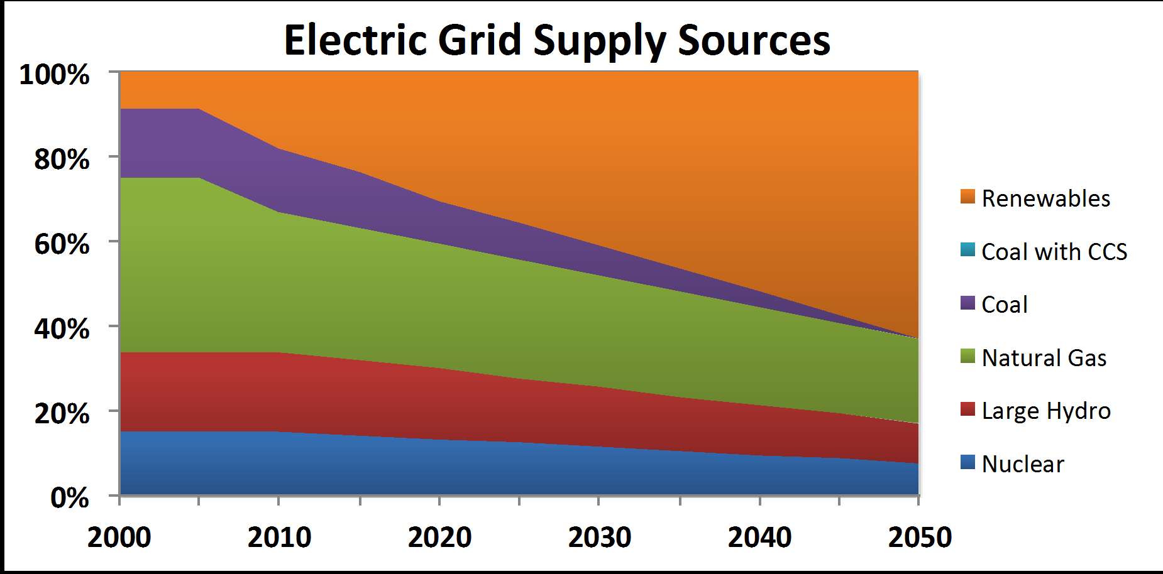
Possible Grid Power Sources in California to comply with AB 32 and LCFS Mandates
CARB projection
Notes:
Renewable energy sources are seen as central to the state’s attempt to reduce carbon emissions associated with energy use.

Slide 6
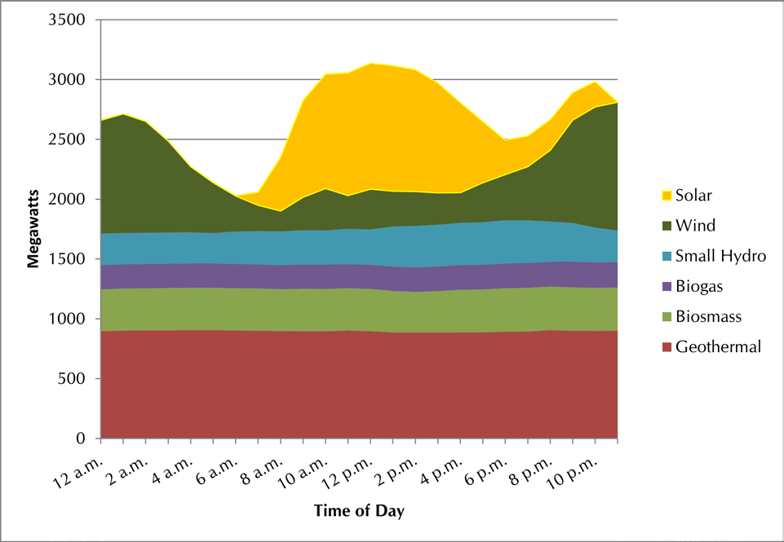
Hourly Breakdown of Renewable Resources for Operating Day September 13, 2012
Biomass is part of a larger renewable energy strategy
Source: California Independent System Operator. “Renewables Watch.” Website accessed September 13, 2012.
http://www.caiso.com/market/Pages/ReportsBulletins/DailyRenewablesWatch.aspx Little Hoover Commission, December 2012
Notes:
Example of role of biomass in supporting the use of intermittent renewable energy sources: wind and solar are intermittent sources. While valuable, to reach the state’s long-term goals, biomass power will continue to play a role in providing steady sources of power. Biomass is stored solar energy.

Slide 7
Current Biopower Capacity in California
5.8 TWh of in-state biopower production (17% of in-state renewable power and 2% of full California power mix)
Biopower Facilities
Facility Type | Net (MW) | Facilities
Solid Fuel (forest, urban & ag) | 574.6 | 27
LFG Projects (a) | 371.3 | 79
Waste Water Treatment Facilities (b) | 87.8 | 56
Farm AD (c) | 3.8 | 11
Food Process/Urban AD (c) | 0.7 | 3-5
Totals | 1038 | 175
Solid Fuel (MSW) (mass burn facilities / organic fraction only) | 63 | 3
* Includes: (a) LFG: 12 direct-use or CNG/LNG facilities; (b) WWTF: 8 heat or pipeline application; (c) AD: 12 Direct-use heat or fuel
Notes:
Forest biomass is mostly used for electricity production currently. Solid fuel facilities most commonly use residues from forest harvests, and lumber and mill residues for power. Most are older facilities built during the 1980s and burn biomass to make steam and electricity. Some capture heat to dry wood products. Commonly they are about 20% efficient.

Slide 8
Annual technically available forest biomass in CA*
Ownership | Slash & thinnings (BDT) | Mill Waste (BDT) | Shrub (BDT) | Total (BDT) | %
Private | 5,870,000 | 1,391,611 | 1,211,457 | 8,473,069 | 59.4
Federal | 2,385,689 | 1,907,786 | 1,296,354 | 5,589,892 | 39.2**
State | 101,777 | 29,771 | 71,905 | 203,453 | 1.4
Total | 8,357,466 | 3,329,168 | 2,579,716 | 14,266,351 | 100
% | 58.6 | 23.3 | 18.1% | 100
* CBC/CDFFP data and assumptions; **excluding federal reserves, wilderness areas, parks, etc.,
Notes:
The distribution of technically available forest biomass by type and ownership. Technically available biomass is not the same as actually used. Not all technically available biomass can or should be used for bioenergy.

Slide 9
CARB projections for the need for low carbon intensity biofuels under the Low Carbon Fuel Standard
Year | Displaced Petroleum (bgge) | Sources
2009 | 0.6 | Conventional biofuels (100%)
2020 | 3.0 | Conventional biofuels (20%) CNG, electricity, H2: (10%) Advanced biofuels: (70%)*
*MSW, Forestry Wastes, cellulosic biofuels, other ?
Notes:
If they could be converted to liquid fuels economically, forest biomass residuals could provide cellulosic biofuels, important for both the federal Renewable Fuel Standard and the LCFS.

Slide 10
The LCFS should stimulate he production of lower carbon fuels and supporting industries. With time, low carbon intensity biofuels should command a premium price. Most compliance scenarios include biofuels. But where will the fuels come from? Brazil? We should produce some of the fuel we consume in California in-state to create new wealth and jobs.
Notes:
Each year, a larger amount of low carbon intensity biofuel will be needed to meet the LCFS standard.

Slide 11
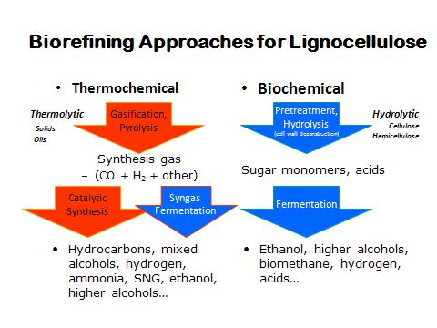
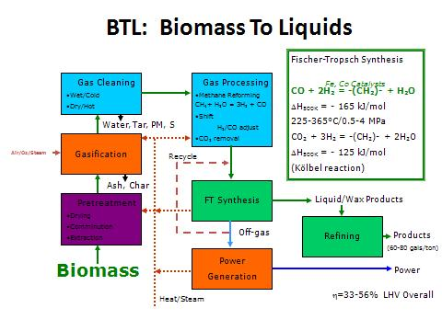
Some potential conversion pathways for lignocellulosic residues
Courtesy of B. Jenkins
Notes:
Biomass need not be burned for power. New conversion pathways offer promise for the use of woody biomass by creating valuable energy products.

Slide 12

Estimated Gross Ethanol Potential from Cellulosic Residues in California---Williams et al, (2007)-AB 118 Report
Biomass Source (residues) | Potential Feed stock (MBDT/yr) | Potential Ethanol (Mgal/yr) | Gasoline equivalent (Mgge/yr)
Field and seed crops | 2.3 | 160 | 105
Orchard/vine prunings | 1.8 | 125 | 83
Landfills: mixed paper | 4.0 | 320 | 213
Landfills: wood& green waste with ADC | 2.7 | 216 | 144
Forest biomass residues | 14.2 | 990 | 660
Total | 24.9 | 1,814 | 1,205*
*1.5 M acres of dedicated cellulosic energy crops could add 400 to 900 Mgge to potential.
These are not estimates of economically recoverable or sustainable biomass.
Notes:
This is the same number as the total in the previous table. Potential ethanol yield if forest biomass were converted to liquid biofuels instead of electricity. If converted to ethanol using biochemical means (pretreatment, fermentation by yeast), and an ethanol yield of 70 gal/ton DM. As noted, these are theoretical, not what might be economically possible.

Slide 13
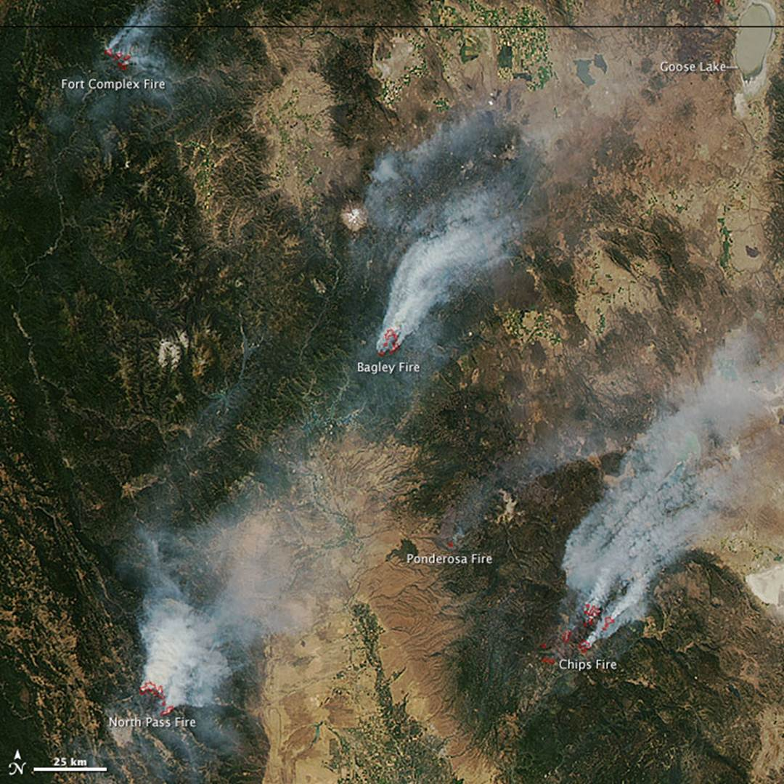
Chronic forest fires destroy large amounts of biomass annually in California, altering ecosystems, and causing public health problems. Reducing risk of fire through fuel load reduction is one way to link harvesting biomass for energy with other environmental and economic goods.

Slide 14

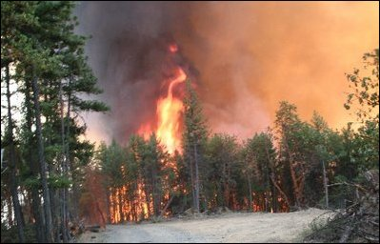

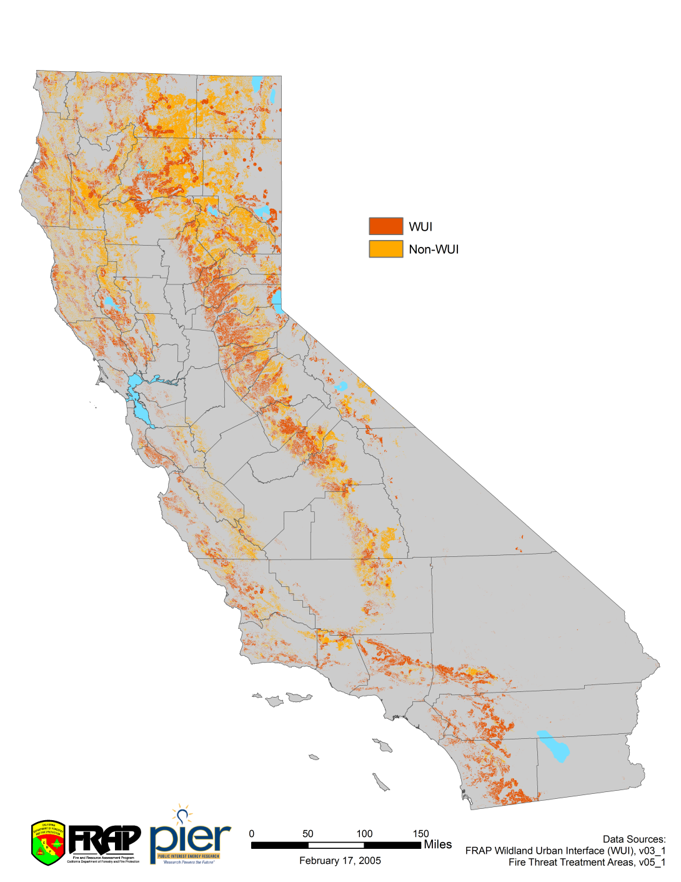
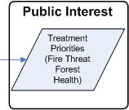
Treatment Priorities
Example treatment priorities map
Fire Threat Treatment Areas
Estimates for treatment priorities are reported within hauling distance
Potential Priority Areas
Fire Threat
Forest Health
Insect and Disease Risk
Notes:
Areas estimated by Cal Fire to be at high risk for wildfire occurrence, loss of property, and health impacts.

Slide 15
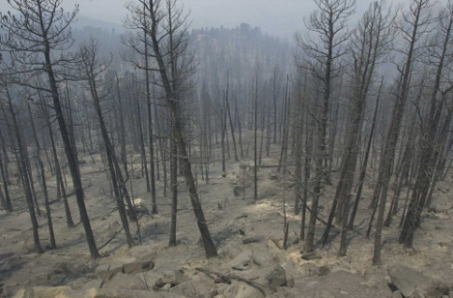

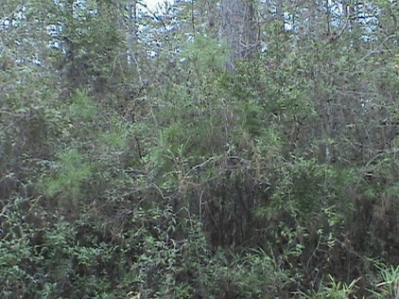
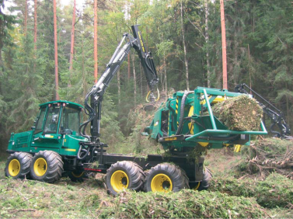
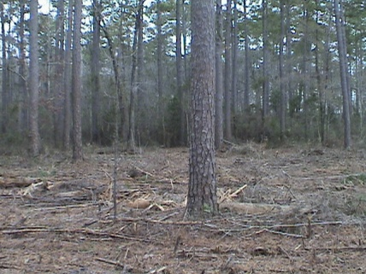
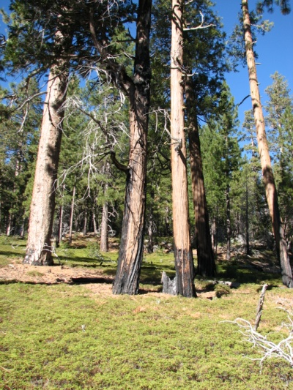
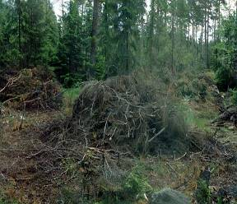
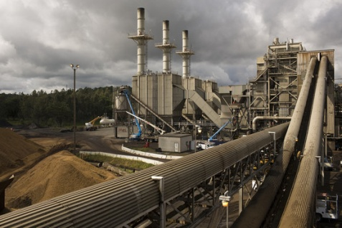
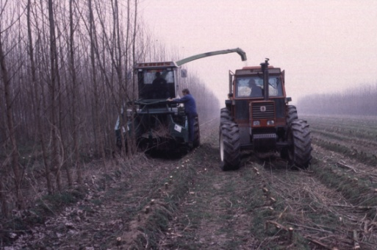
Biomass Management Zones
Biomass Management Zones (BMZ) have been defined as 'sustainably managed woodsheds and other biomass production regions' that will support the sustainable management of urban interface woodlands and forested lands to reduce fuel loading and the potential of uncontrolled wildfire, utilize biomass and residues from forest management/products to produce bio-energy and bio-products and to stimulate local economic activity and long-term stability.
Warming and Earlier Spring Increases Western U.S. Forest Wildfire Activity
A. L.Westerling,1,2* H. G. Hidalgo,1 D. R. Cayan, 1,3 T. W. Swetnam4 1Scripps Institution of Oceanography, La Jolla, CA 92093, USA. 2University of California, Merced, CA 95344, USA. 3US Geological Survey, La Jolla, CA 92093, USA. 4Laboratory of Tree-Ring Research, University of Arizona, Tucson, AZ 85721,USA. Science Express, July, 2006

Slide 16
Common elements and concerns in previous/current BMZ studies
There are several common elements in BMZ studies:
They involved the participation of multiple individuals, groups, non-governmental and governmental agencies. Most were originated within rural communities. Considerable care and attention was given to group process and documentation of activities, data review, and outcomes.
Creative interactions and group learning are essential to success and were emphasized. A rationally defined BMZ allows for groups and individuals to self-organize.
Most studies concluded that large amounts of diverse biomass were available, and that if accessible in sufficient quantities, economically viable systems for collection, transformation and use were possible.

Slide 17
Common elements and concerns in previous/current BMZ studies
All studies emphasize the vulnerability of large amounts of forest biomass to loss and the adverse ecological consequences of intense wildfire in the regions they study.
It is reasonable to assume that there is a widespread consensus among knowledgeable and affected communities about the need for intervention and management in many forested regions in California to prevent senseless losses and ecosystem degradation.
Additionally, all studies define and highlight employment gains in rural regions as an additional benefit of management

Slide 18
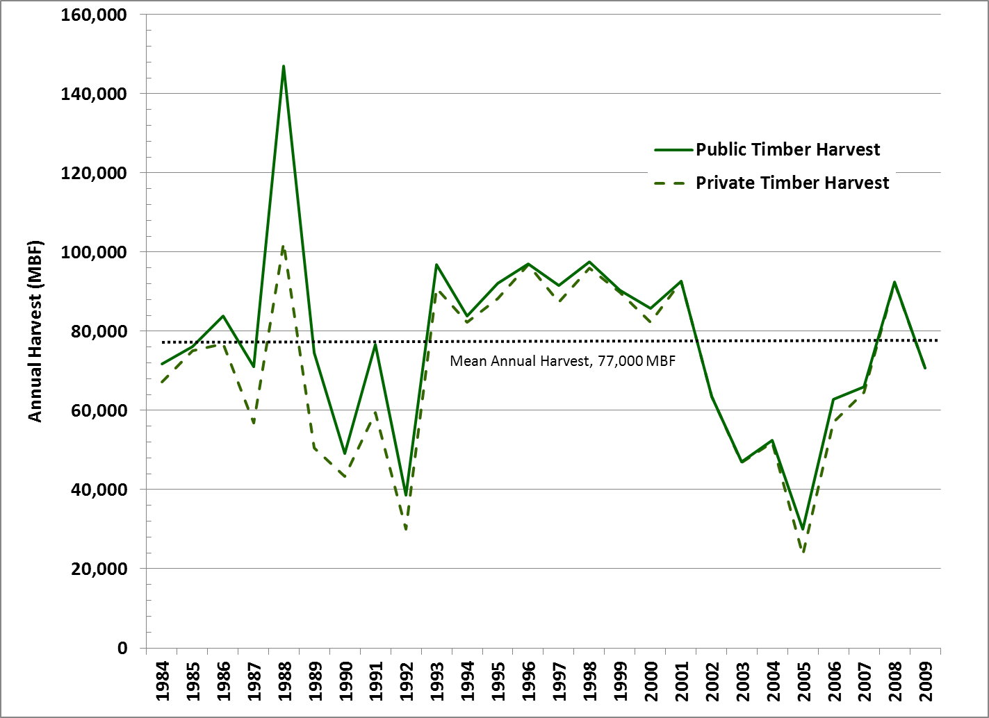
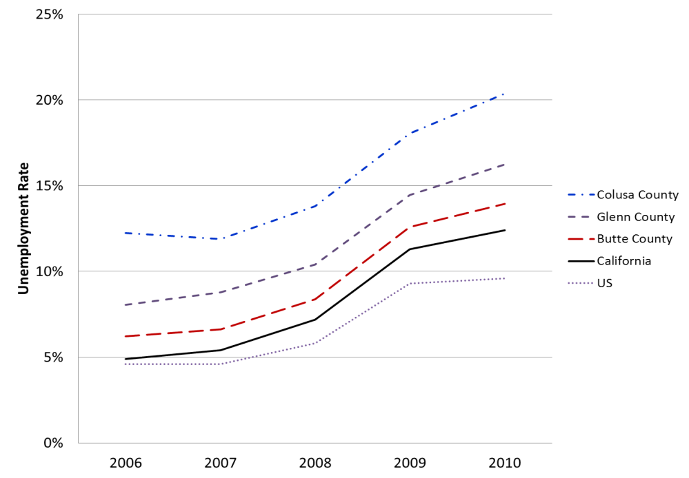
Timber harvest trends in the BMZ region
Growth in unemployment in BMZ region
Notes:
Recent timber harvest history in the Oroville BMZ region. Unemployment rends through 2010 in the Oroville BMZ. New bioenergy project could help provide employment.

Slide 19
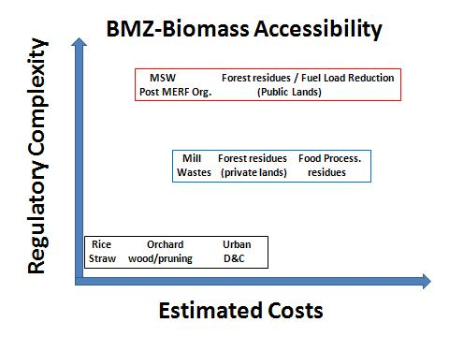
Notes:
Up to the present time, access to forest biomass from fuel load reduction treatments to help prevent catastrophic wildfires has been both expensive and inaccessible due to environmental regulations and political processes. At the same time, other forms of biomass are more readily available and/or costly to dispose. Combining different sources of low moisture (lignified ) biomass to a common facility would provide a pathway for forest biomass that would not depend entirely on changing levels of access to such materials.

Slide 20
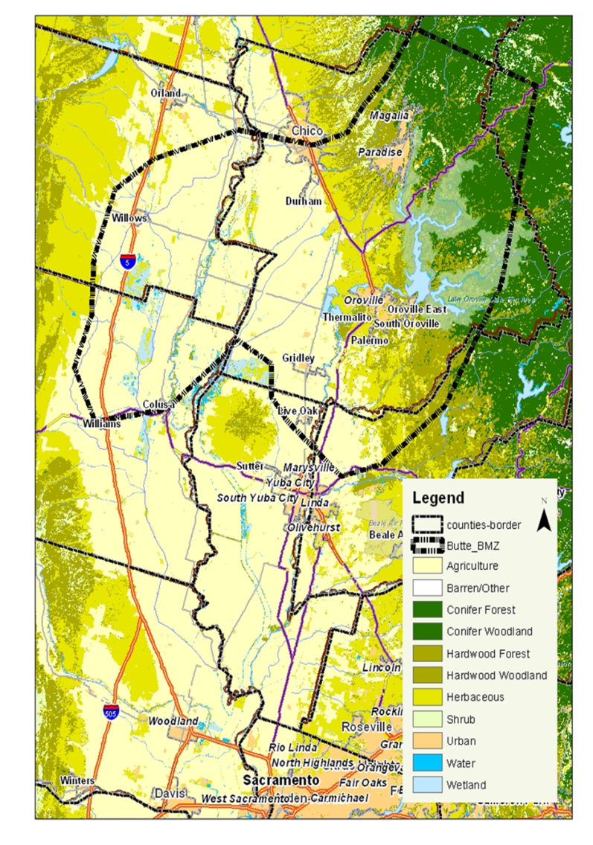
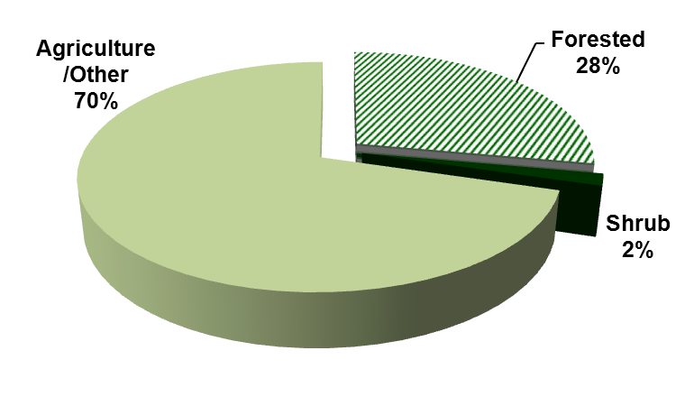
Chico-Oroville BMZ including diverse sources of biomass, all with different levels of cost and varying potential for acquisition. This region has had several severe wildfires in recent years.

Slide 21
Land composition in the Oroville BMZ
Notes:
Diverse land uses are combined in the BMZ.

Slide 22
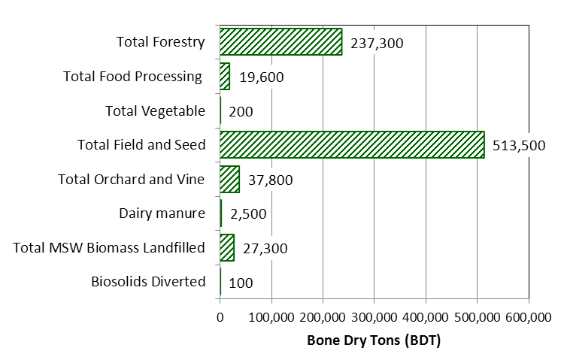
Summary of biomass resources in the Oroville BMZ
Notes:
Estimated total amounts of potentially available biomass in the BMZ. Agricultural sources dominate, but here is considerable technically available forest biomass as well. A conversion facility able to handle diverse sources of biomass would have a range of supplies.

Slide 23
Notes:
Estimates of economically available woody biomass in the BMZ. Data from several soruces.

Slide 24
Other potential biomass energy sources within the BMZ: Rice straw and food processing residues. Anaerobic digestion is modeled but lignified residues would be available to woody biomass facilities. More than one conversion system might be employed at a facility.

Slide 25
Additional agricultural sources within the BMZ

Slide 26







2012 Bioenergy Action Plan
Bioenergy Interagency Working Group Ann Chan, Chair, Bioenergy Interagency Working Group Deputy Secretary, California Natural Resources Agency
Cliff Rechtschaffen Senior Advisor to Governor Edmund G. Brown Karen Ross Secretary, Department of Food and Agriculture Matthew Rodriquez Secretary, California Environmental Protection Agency Mary Nichols Chair, California Air Resources Board Mark Ferron Commissioner, California Public Utilities Commission Carla Peterman Commissioner, California Energy Commission Ken Pimlott Director, Department of Forestry and Fire Protection Caroll Mortensen Director, Department of Resources Recycling and Recovery Pamela Creedon Executive Officer, Central Valley Regional Water Quality Control Board Stephen Kaffka Director, California Biomass Collaborative
It is state policy to promote the sustainable use of bioenergy

Slide 27
2012 Bioenergy Action Plan prepared by the Bioenergy Interagency Workgroup
The plan outlines state agency actions that:
stimulate cost-effective utilization of the state’s diverse biomass resources for conversion to “low-carbon” biofuels, biogas, and renewable electricity;
increase research, development and demonstration of bioenergy toward commercializing new technologies;
streamline the regulatory and permitting processes; and
quantify and monetize the benefits of bioenergy.

Slide 28
The importance of some of the key findings of the 2011 BAP are supported by this BMZ assessment:
• Biomass of diverse types is abundant;
• The use of biomass has diverse benefits, including many that have not been adequately quantified and incorporated into the price for bioenergy;
• Electric grid interconnection issues and the overall cost to collect and transport biomass feedstock remain economic barriers to the development of bioenergy projects in California;
• Regulatory uncertainty continues to reduce options to finance projects in the predevelopment stage, further inhibiting the development of bioenergy and other distributed energy projects; and
• Additional actions will be needed by the Bioenergy Interagency Working Group and the Legislature to streamline permitting for distributed energy projects. These are difficult challenges.

Slide 29
Nathan CA BSM slides here.

