Slide 1
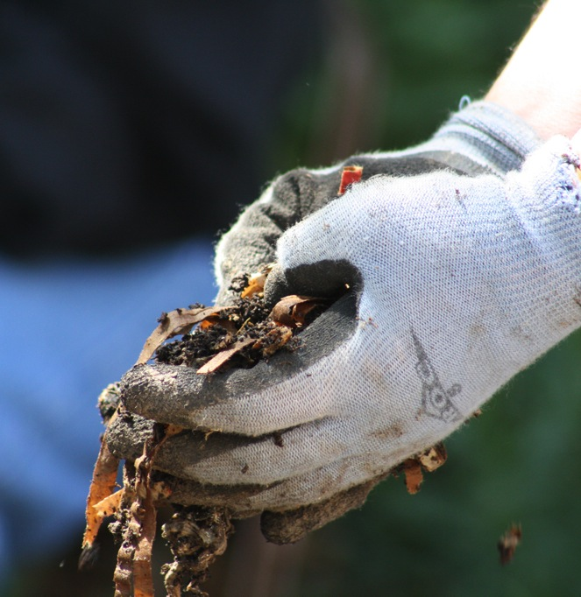
Make presentation notes brief.
Keep graphics
And text
To the point

Slide 2
Your headline here in Calibri.
Simple text is best.
Don’t read from your slides.

Slide 3
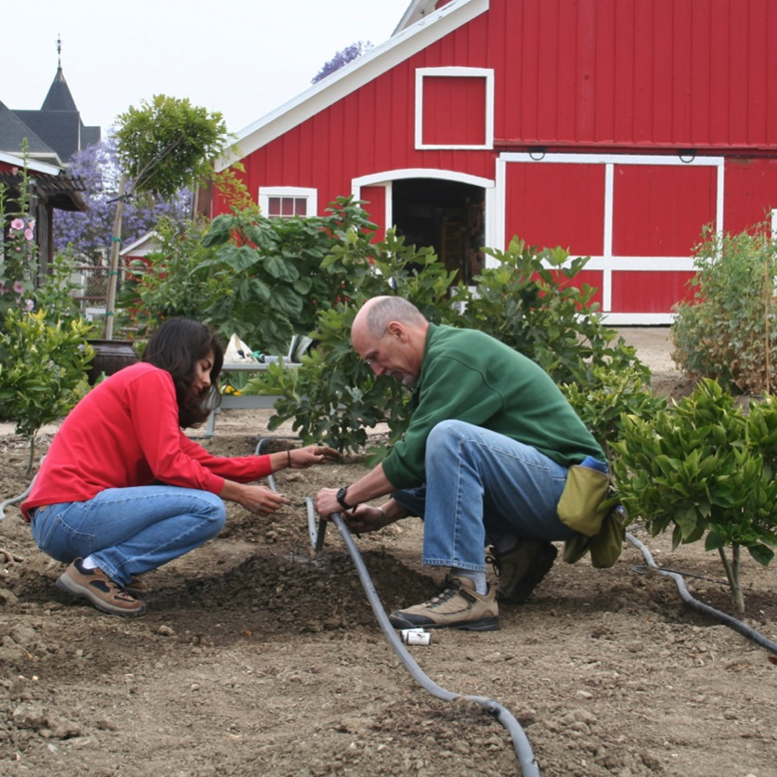
Title
Place photo on a slight angle and add a drop shadow for interest. Pay attention to cropping your photo so the subject stands out. For large photos, use the blank slide provided in this set. Not every slide needs to contain the ANR branding.
Caption text should be in Georgia Regular.

