Slide 1
Biochar
Greenhouse Gas Offset Protocol
Bruce Springsteen
Placer County Air Pollution Control District
Biomass Working Group
October 21, 2014

Slide 2
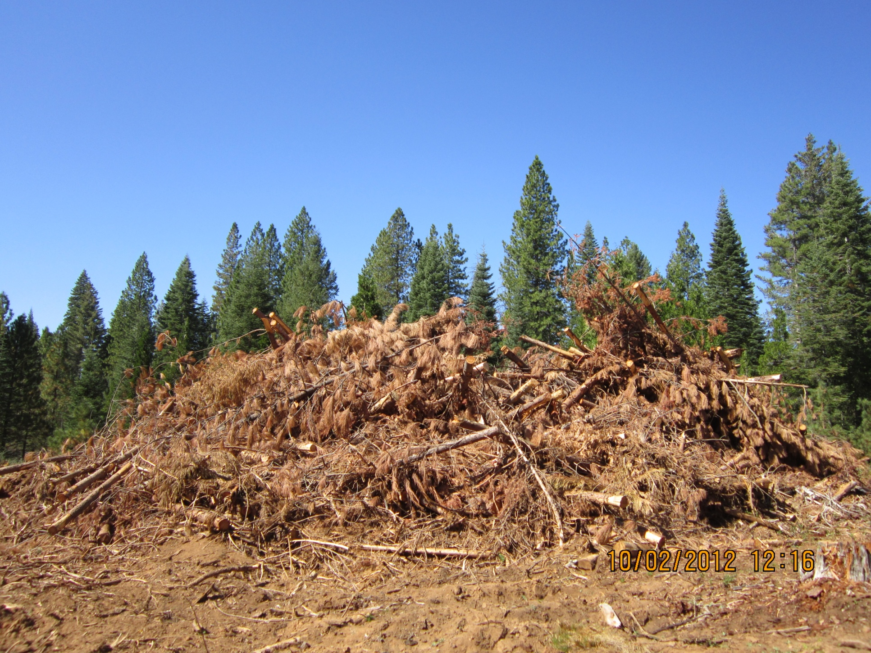
Forest Management
Greenhouse Gas Offset Protocols
  Biomass waste for energy
    -- Reduce methane from open pile burn or in-field decay/decomposition
    -- Avoided fossil fuel for equivalent electricity
  Biochar
    -- Sequester carbon in stable biochar
  Black carbon
    -- Reduce black carbon from open pile burn
  Forest hazardous fuel reduction thinning treatments
    -- Reduce wildfire severity and size
    -- Reduce tree mortality
    -- Stimulate forest growth
    -- Wood products, biomass energy

Slide 3
CAPCOA Greenhouse Gas Exchange
Launched in February 2014
Joint effort of Bay Area AQMD, Placer County APCD, Sacramento Metro AQMD, South Coast AQMD, San Joaquin Valley APCD, and Northern Sonoma APCD
Provide California-based Greenhouse Gas Credits
    Secure, transparent, and low-transaction cost exchange
    Local jobs, air pollution co-benefits
Responds to request from local governments and private industry for credits for compliance with CEQA, climate action plans, and other voluntary purposes
Protocols – biomass-for-energy, boiler efficiency, livestock manure, forest management, case-by-case

Slide 4
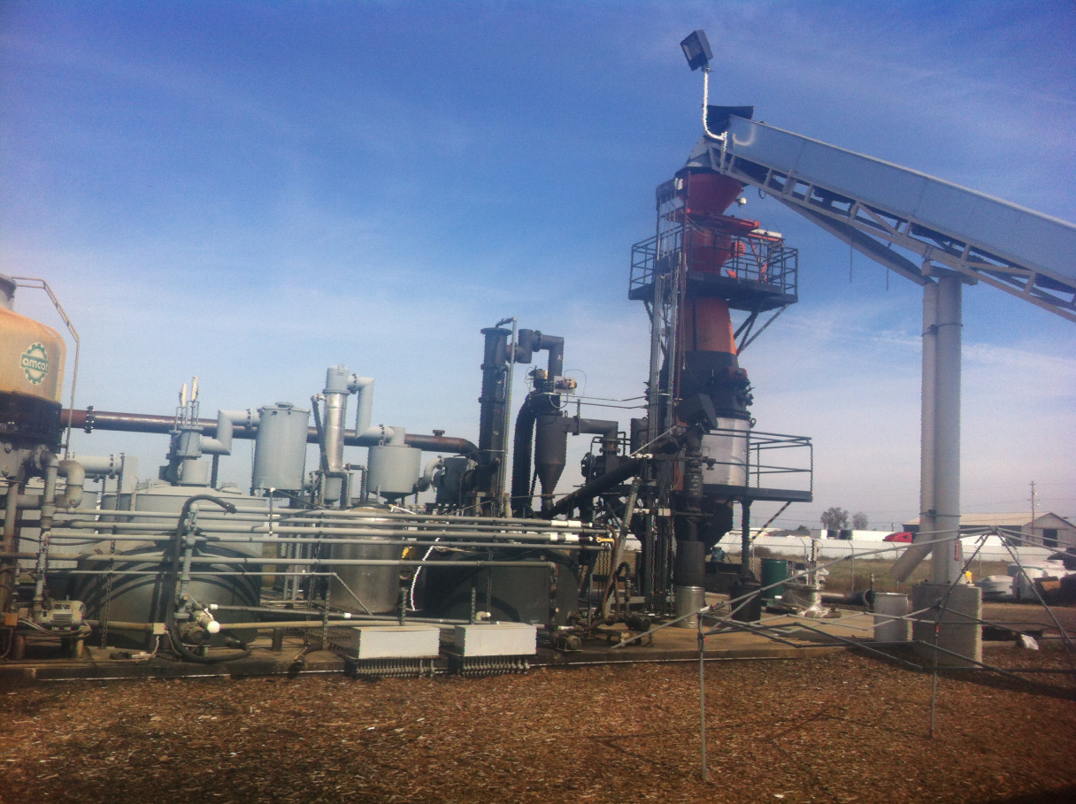
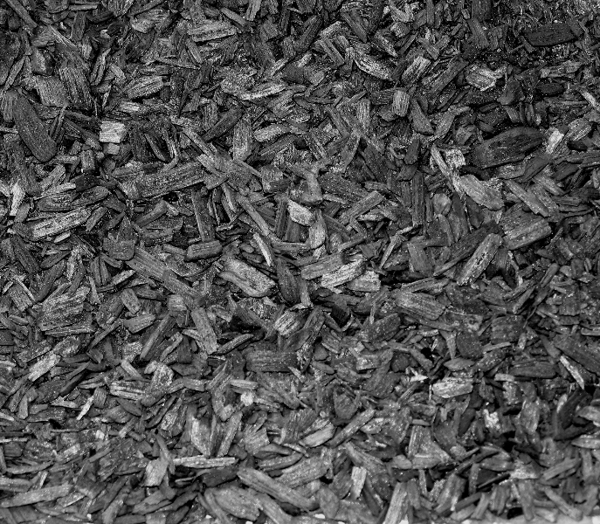
Biochar Protocol
Biochar -- porous, carbon-rich, charcoal -like solid
Formed from the thermal pyrolysis / gasification of biomass
Use as soil amendment:
  Sequesters carbon -- highly stable and resistant to decomposition
  Enhances soil fertility -- increases water and nutrient holding capacity
  Reduces soil emissions, enhances biomass growth
  Displaces fertilizer manufacturing
Also produces renewable energy

Slide 5
Biochar Protocol
Prasino Group,
The Climate Trust,
International Biochar Initiative
California forest and ag woody biomass that would have been open burned
All/any Biomass
American Carbon Registry
PCAPCD / CAPCOA GHG Exchange
2012 –
Nov 2014
Carbon sequestration GHG offset protocol
Dec 2014
Water retention
Fertilizer displacement
Plant growth
Agricultural Field Trials
Planning with Cal Dept. of Food & Ag

Slide 6
Biochar Protocol
Protocol review and approval process
  Draft completed -- September 2014
  Stakeholder webinar – September 9, 2014
  30 day public review close – October 9, 2014
  CAPCOA Engineering Protocol Review Committee -- November
  CAPCOA Board Approval -- December
http://www.placer.ca.gov/departments/air/apcdbiomass

Slide 7
Biochar Protocol
Location -- Biochar production project operations that are located within the state of California, including source of feedstock.
Feedstock
  Biomass waste byproduct.
  Production operations must protect or enhance long-term productivity of the site by maintaining or improving soil productivity, water quality, wildlife habitat, and biodiversity where the biomass originated.
  Harvesting of material must meet regulations from the National Environmental Policy Act (NEPA), California Environmental Quality Act (CEQA), California Forest Practices Rules and Regulations, and/or Timber Harvest Plans.
Baseline
  Open pile burned, decay in field, used for energy
  Economic test, regional common practice
Biochar
  IBI Standardized Product Definition and Product Testing Guidelines for Biochar that is used in soil.
  H/Corg < 0.7
  Land applied or mixed with soil, compost, or medium intended as a soil amendment.

Slide 8
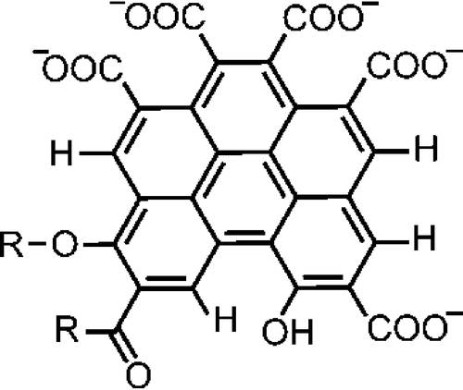
Biochar Stability
Fused aromatic carbon rings → material property most likely responsible for biochar

Slide 9
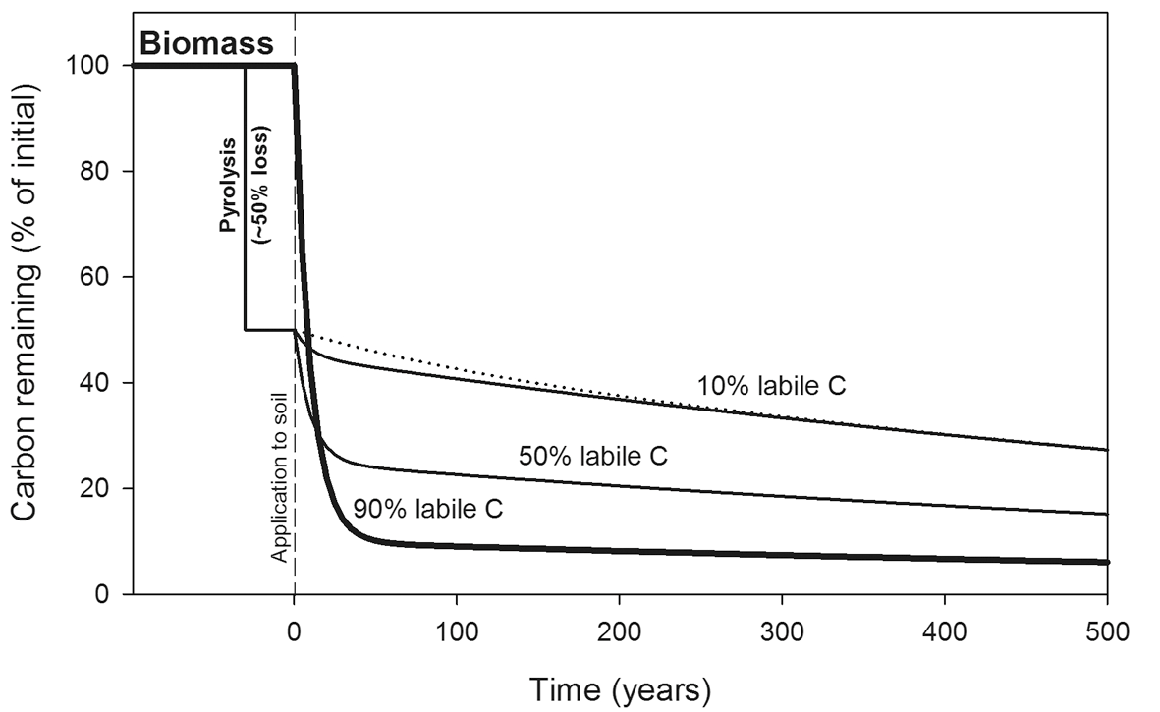
Biochar Stability

Slide 10
Biochar Stability
Hydrogen/Organic Carbon (H/C_{org})
At H/C_{org} <0.7 all biochars have MRT of >100 years
J. Lehmann, S. Abiven, M. Kleber, G. Pan, B.P. Singh, S. Sohi, A. Zimmerman. Persistence of biochar in soil. In: Biochar for Environmental Management - Science and Technology, 2nd edition. Johannes Lehmann and Stephen Joseph (eds.). Earthscan, and references therein

Slide 11
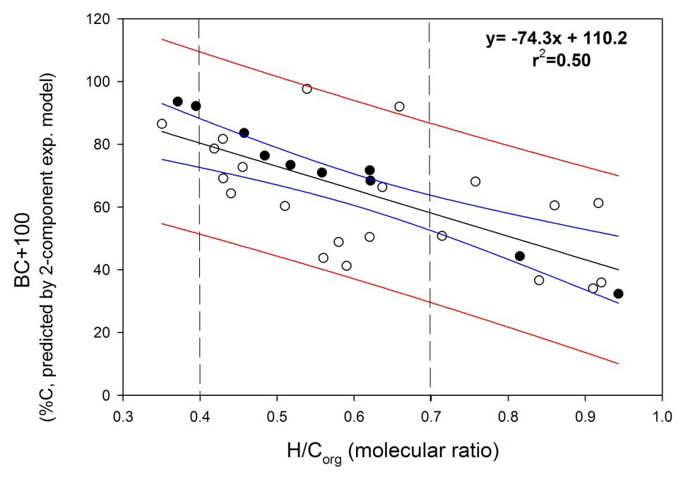
Biochar Stability
Amount (%) of C remaining in Biochar after 100 years

Slide 12
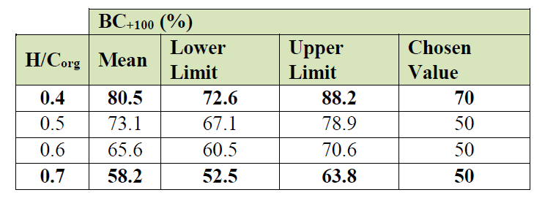
Biochar Stability
H/C_{org} and BC₊₁₀₀ equivalences at 95% confidence
Chosen values represent conservative estimates of biochar C expected to remain based on experimental data
Two levels identified:
  H/C_{org} < 0.4 → at least 70% biochar C expected to remain after 100 years
  H/C_{org} < 0.7 → at least 50% biochar C expected to remain after 100 years

Slide 13
Biochar Potential
Biochar production rate – 0.10 lb biochar/lb biomass
Carbon content of biochar – 0.75 lb C/lb biochar
CO₂ sequestered in biochar – 0.28 MT CO₂/BDT biomass

Slide 14
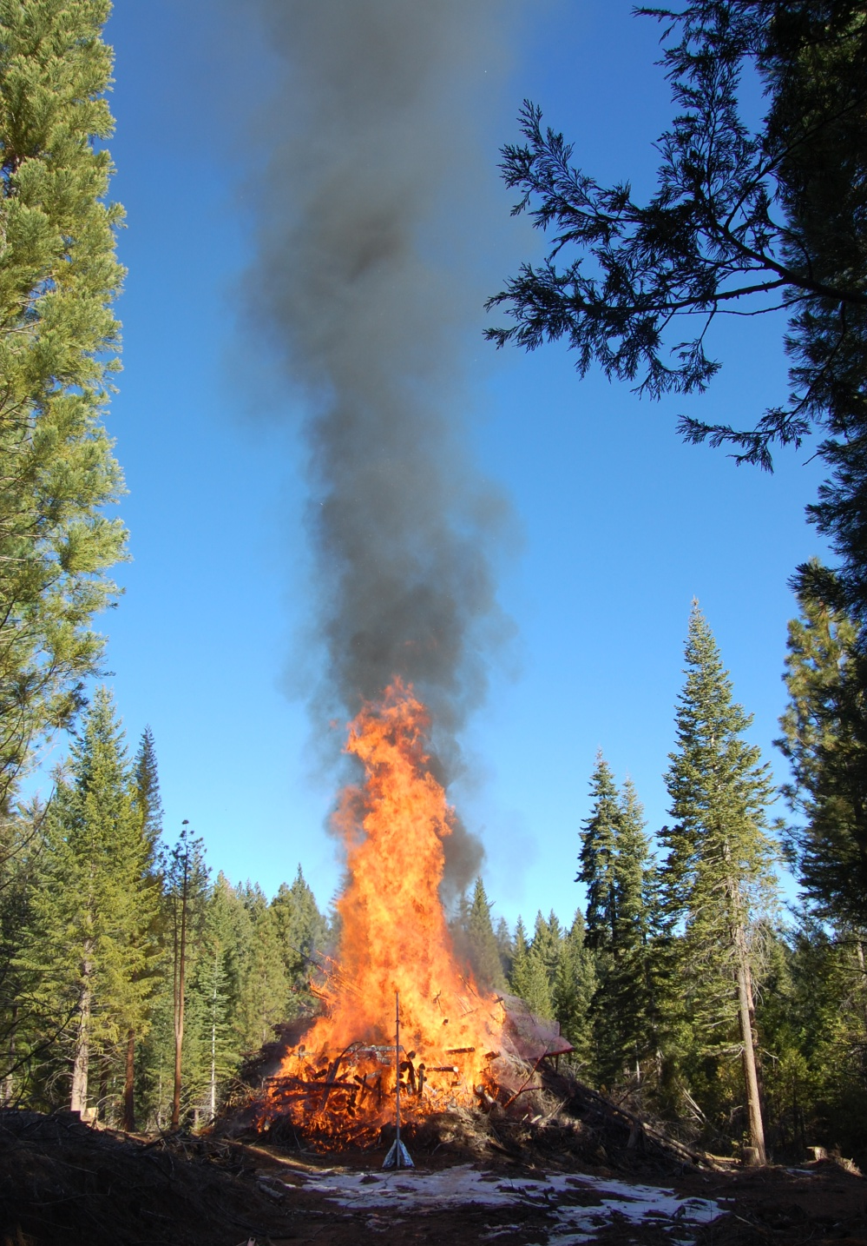
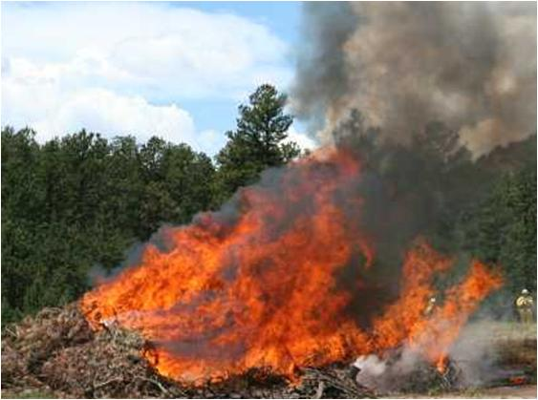
Black Carbon
Product of incomplete combustion
Soot
Small particles
Travel long distance through air
“Short-lived climate forcing”
900 times by weight more potent than CO₂

Slide 15
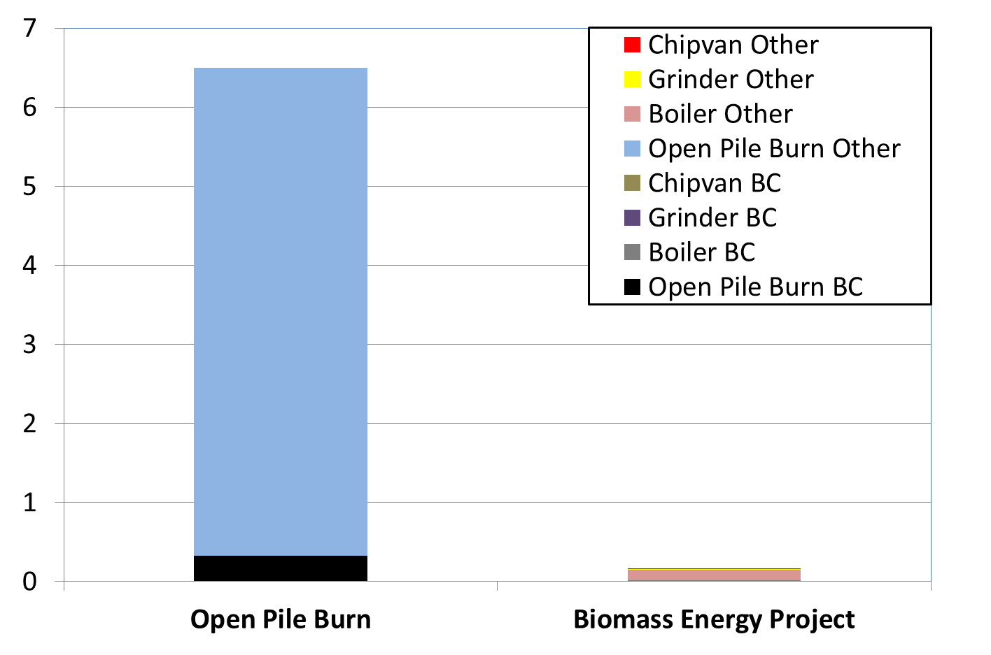
Black Carbon
Particulate (kg/ton dry biomass)
97% reduction in PM10

Slide 16
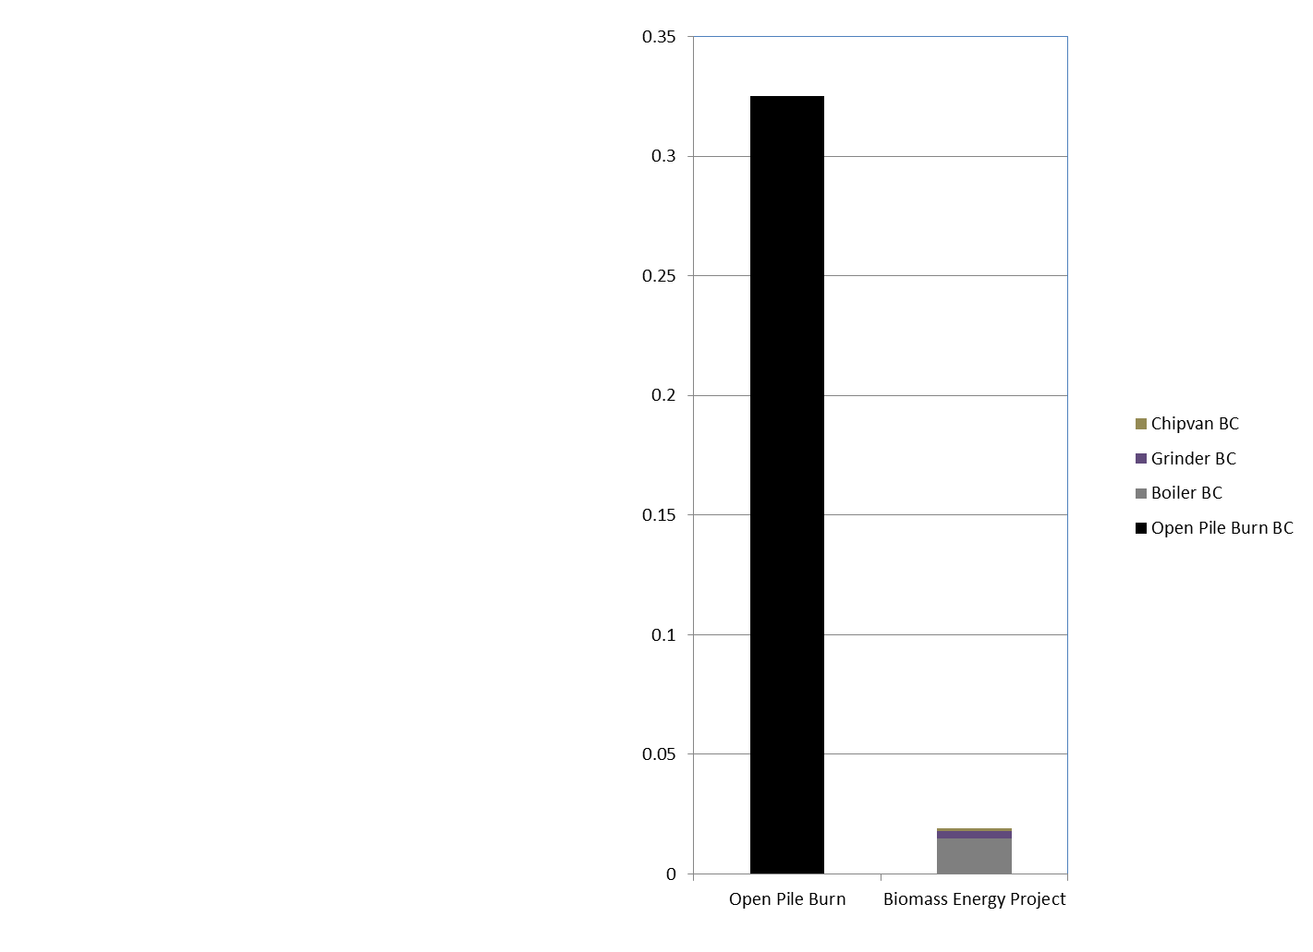
Black Carbon
94% reduction in Black Carbon
Particulate (kg/ton dry biomass)

Slide 17
Black Carbon
Working to develop a GHG offset protocol for black carbon reductions achieved through avoided open pile burning
  Forest slash
  Agricultural residues (orchard thinnings, removals, food processing wastes)
Forming a research team to characterize BC emissions from open pile burning
  Multi-agencies including UC, CAPCOA, CAL FIRE, USFS
Concurrent effort to evaluate black carbon reductions from wood stove upgrades and replacements

Slide 18
Forest Fuel Treatment Impact on Wildfires and Emissions
Working to continue research and development of GHG offset protocol for avoided wildfire from forest fuel treatment thinning projects
  Assembling multi-stakeholder research team – USFS, CAL FIRE, Spatial Informatics Group, UC Berkeley, CEC, California Forest Association, private forest land owners
  Securing funding
Case study demonstration
  Sierra Nevada forested land in watershed at risk for catastrophic wildfire, public and private ownership, on-the-ground inventory
  Fuel treatment prescription designs considering various management alternatives
  Evaluate wood products lifecycle specific to local mill and wood products displacement of alternative building materials (concrete, steel)
  Develop protocol that can be practically implemented but flexible to consider site specific considerations including fire return interval and wildfire emissions on a fire-shed basis

