Slide 1
Co-Operative Extension Offices
Landscape Plan
70 Cottonwood Avenue
Woodland, CA 95695

Slide 2
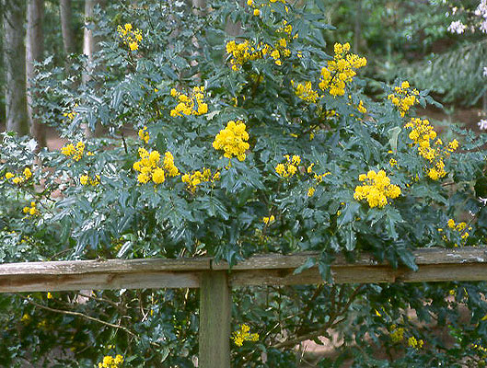
1. Mahonia aquifolium (Oregon grape)

Slide 3
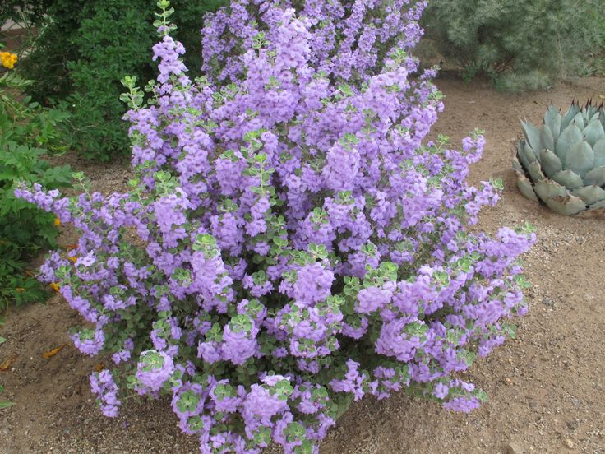
2. Leucophyllum langmaniae ‘Lynn’s Legacy’

Slide 4
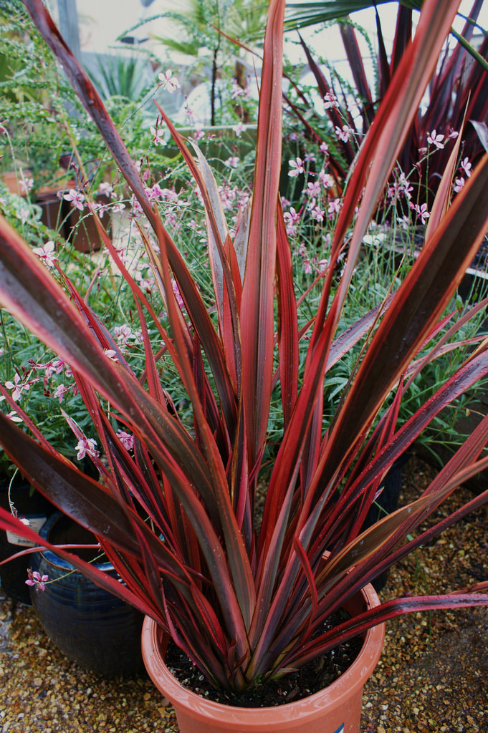
3. Phormium tenax 'Firebird'
New Zealand flax

Slide 5
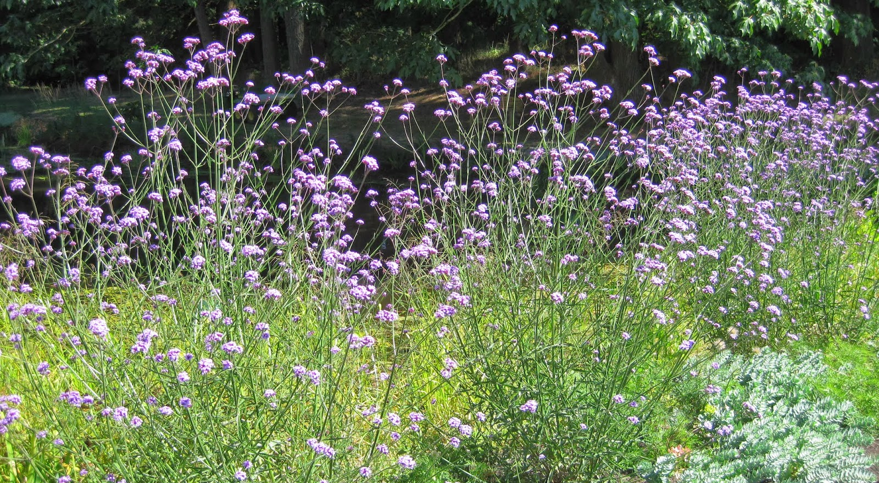
4. Verbena bonariensis
(purple top verbena)

Slide 6
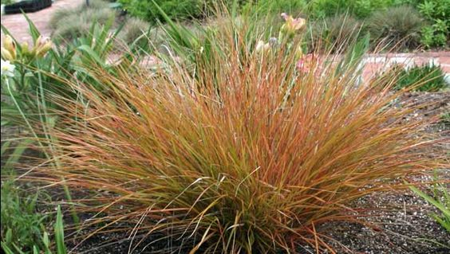
5. Stipa arundinacea
New Zealand wind grass

Slide 7
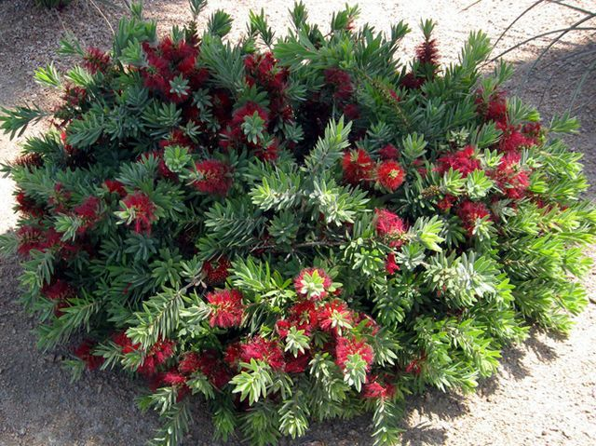
6. Callistemon ‘Little John’
(Little John bottlebrush)

Slide 8
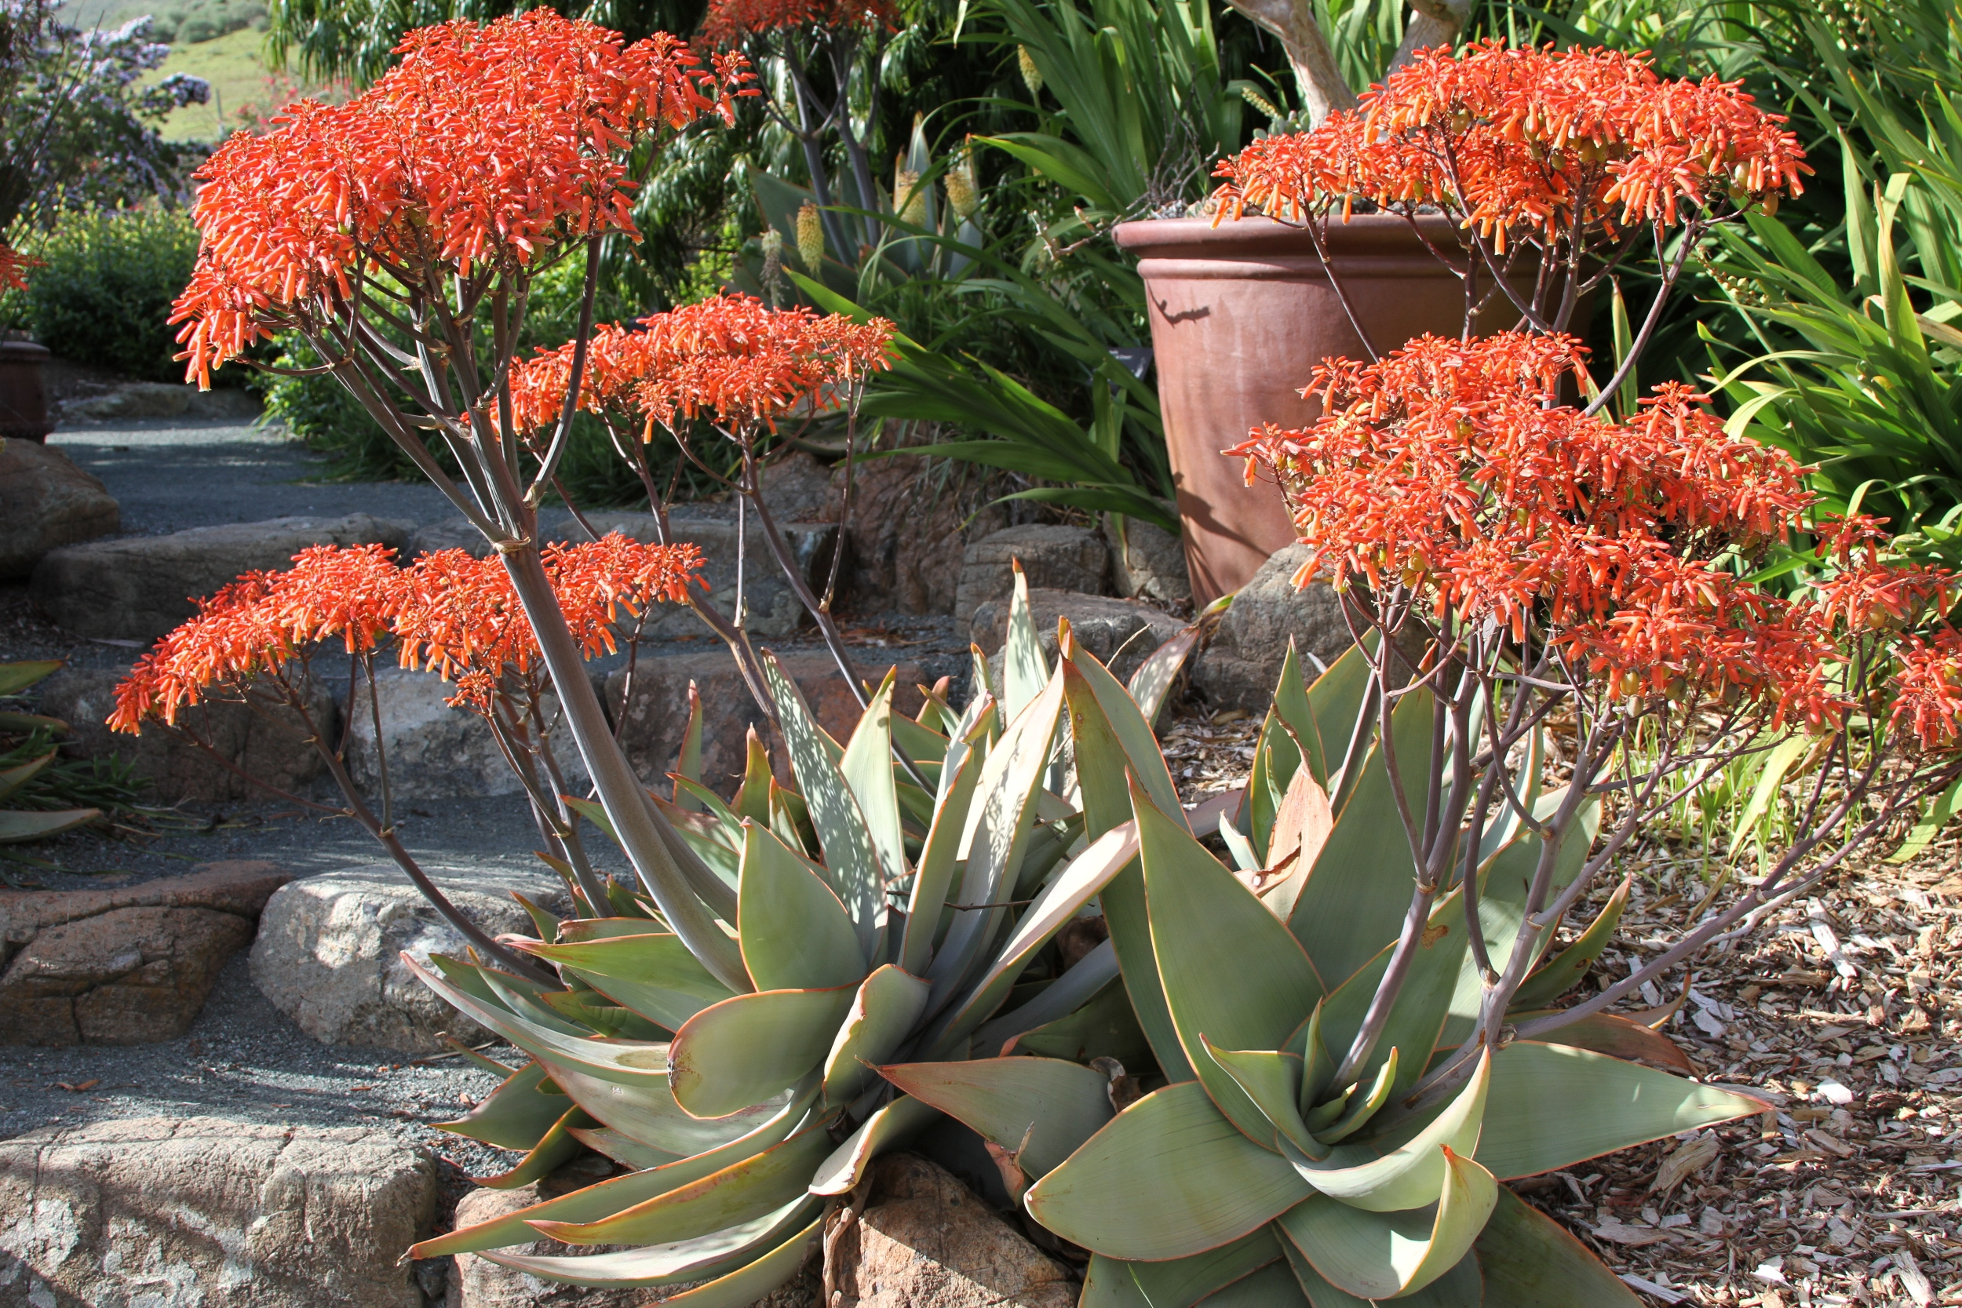
7. Aloe striata (coral aloe)

Slide 9
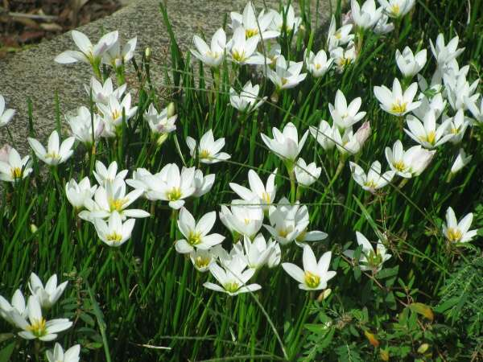
8. Zephranthes candida
(rain lily, fairy lily)

Slide 10
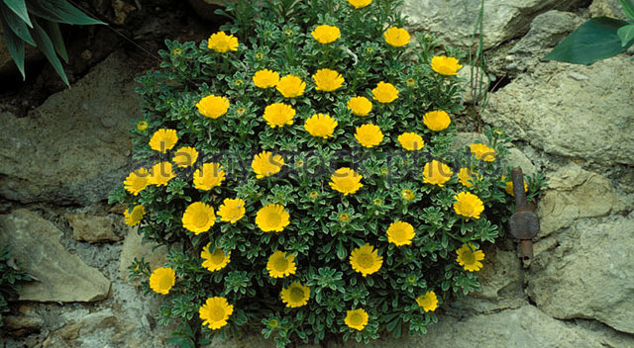
9. Astericus maritimus (gold coin)

Slide 11
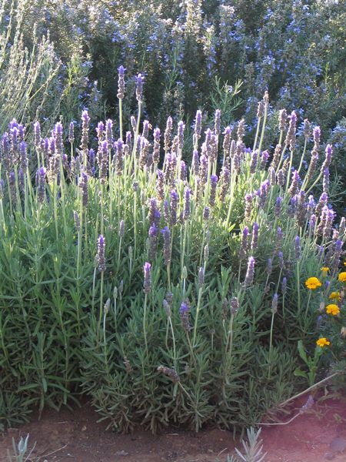
10. Lavandula dentata
(French lavender)

Slide 12
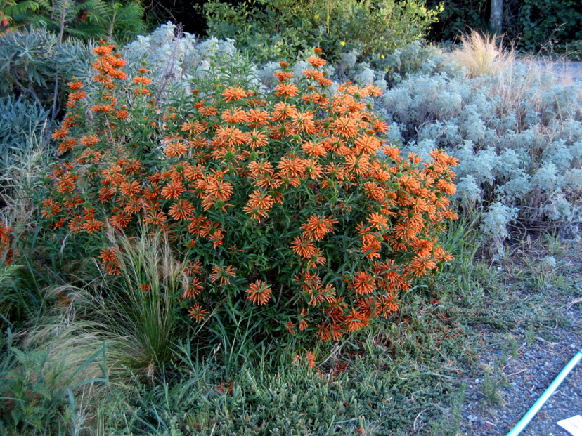
11. Leonotis leonurus (lion’s tail)

Slide 13
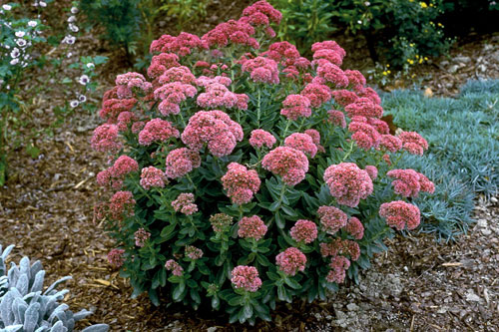
12. Sedum ‘Autumn Joy’
(Autumn Joy stonecrop)

Slide 14
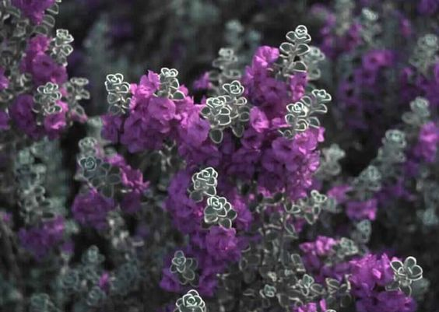
13. Leucophyllum zygophyllum 'Cimarron' (Cimarron Texas ranger)

Slide 15
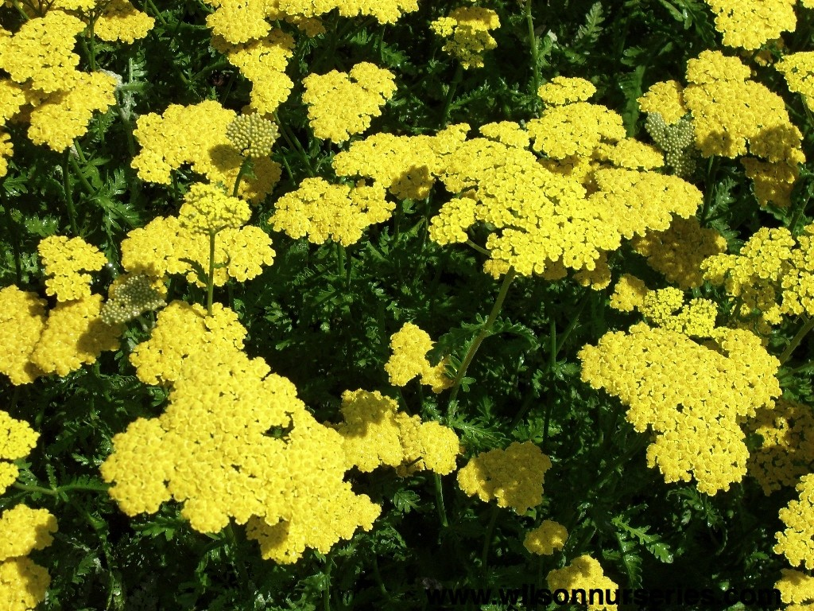
14. Achillea x Moonshine
(Moonshine yarrow)

Slide 16
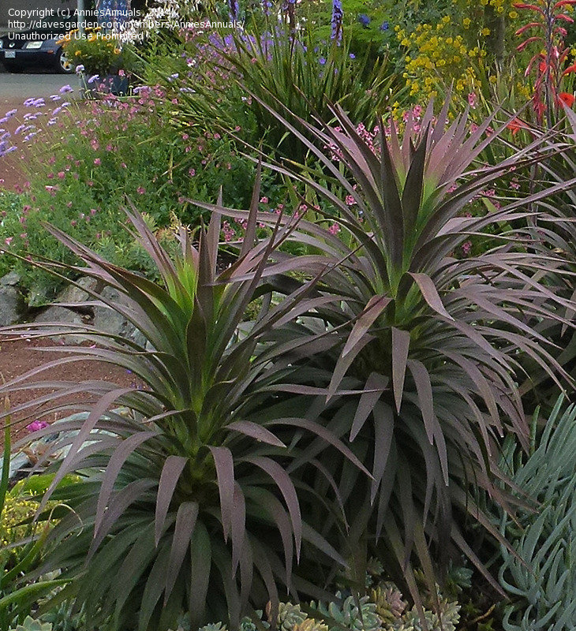
15. Yucca desmetiana 'Blue Boy'
(Blue Boy yucca)

Slide 17
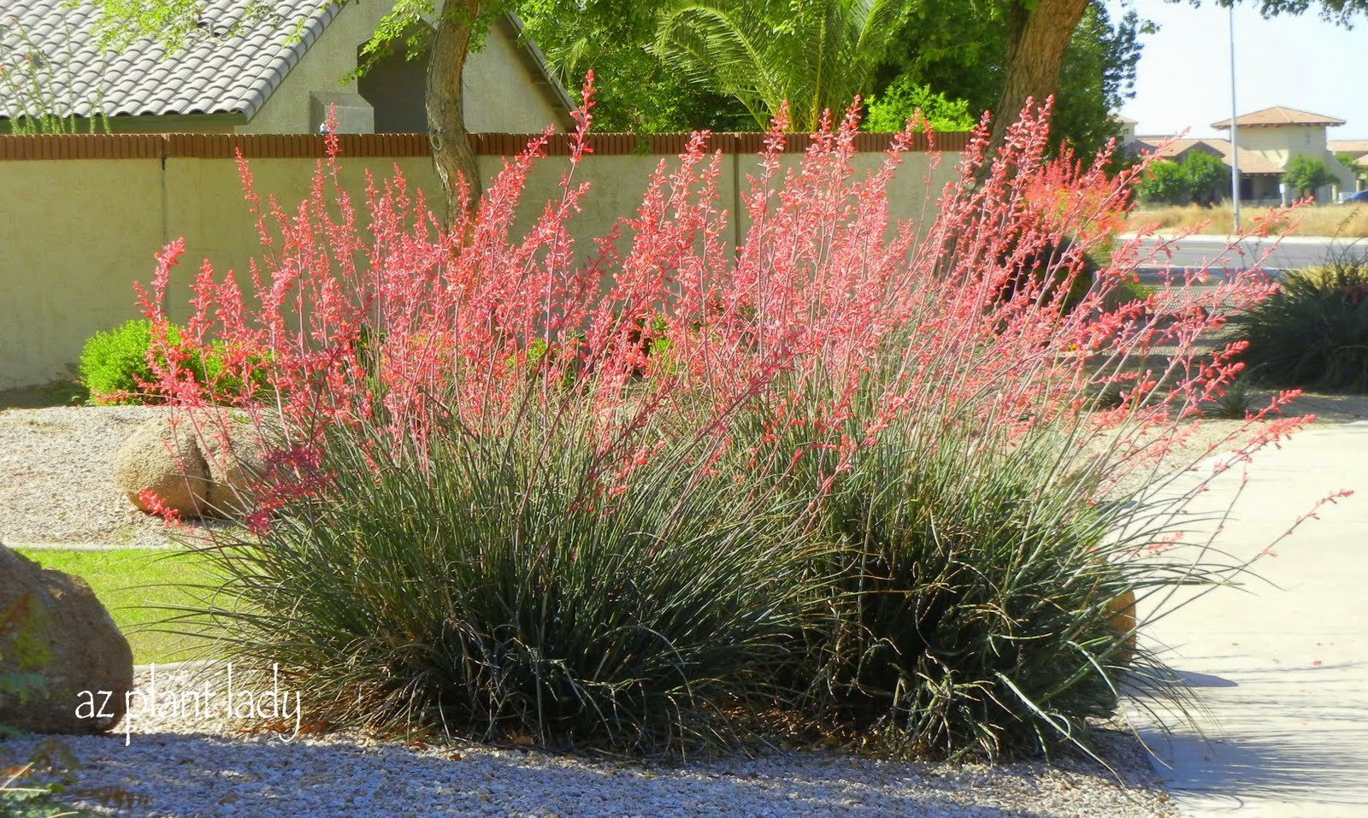
16. Hesperaloe parviflora (red yucca)

Slide 18
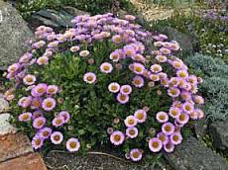
17. Erigeron glaucus ‘Wayne Roderick’
(seaside daisy)

Slide 19
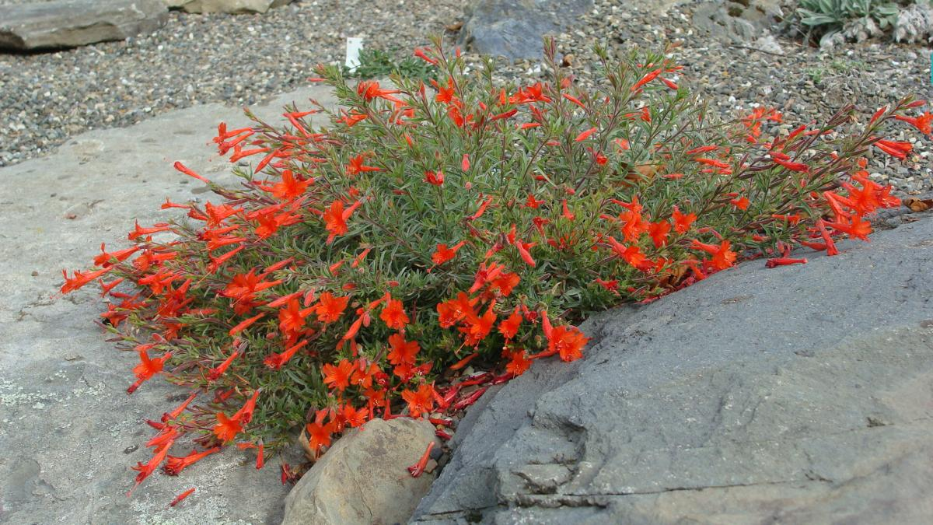
18. Zauchneria californica
(California fuchsia)

Slide 20
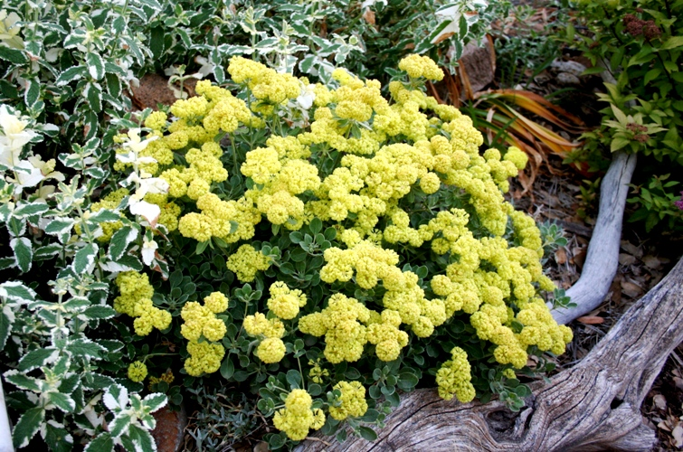
19. Eriogonum umbellatum 'Shasta Sulphur' (Shasta Sulphur buckwheat)

Slide 21
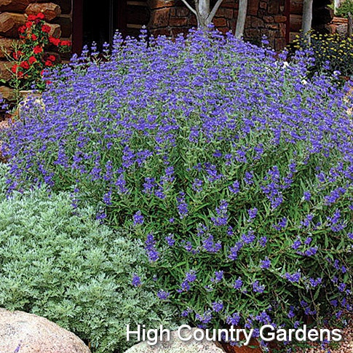
20. Caryopteris x clandonensis ‘Blue Mist’ (bluebeard)

Slide 22
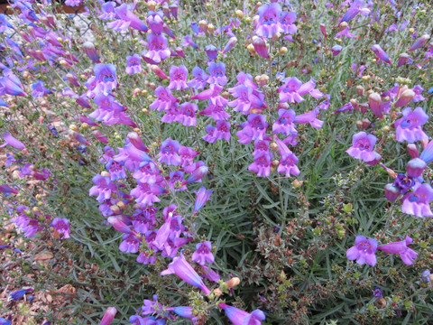
21. Penstemon heterophyllus
'Margareta BOP’ (foothill penstemon)

Slide 23
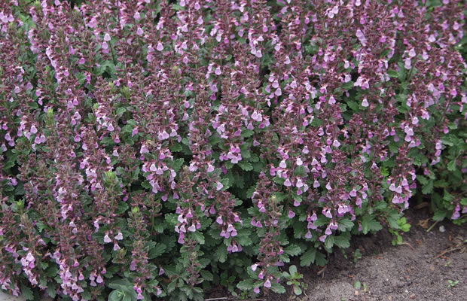
22. Teucrium x lucidrys (dwarf germander)

Slide 24
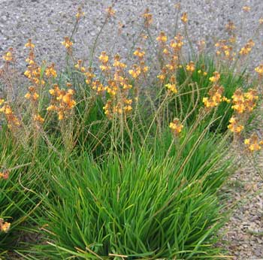
23. Bulbine frutescens
‘Hallmark’ (orange cape balsam)

Slide 25
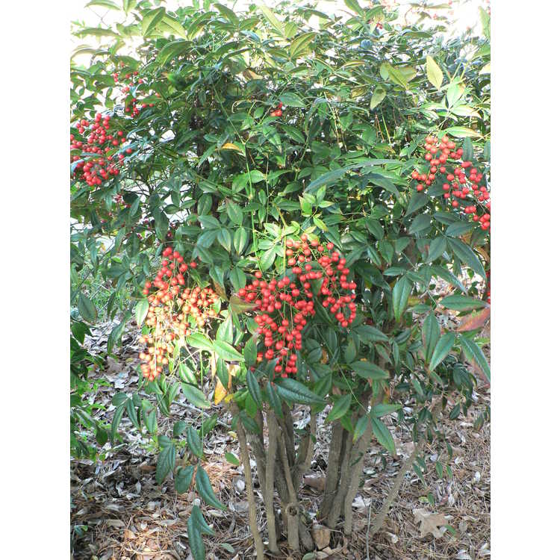
24. Nandina domestica
(heavenly bamboo)

