Slide 1
2018 U.S. Forest Service
Wood Innovations Program
Region 5 – California, Hawai’i,
& U.S. Affiliated Pacific Islands
Marcus Taylor
USFS Region 5
Larry Swan
USFS Region 5
Roger Swenson
Clean Development International

Slide 2
Outline
Resources
Category 1 - Wood Energy Markets & Products
Category 2 – Wood Products Market Expansion
Previous R5 Projects
Application Tips
Regional Application Priorities

Slide 3
Resources
WERC Website – http:///www.na.fs.fed.us/werc
Wood Innovations RFP
http://www.na.fs.fed.us/werc/wip/2018-rfp.shtm
UC Berkeley Website
http://ucanr.edu/sites/WoodyBiomass/
  Grants & Workshops links
Link to the National Webinar (Oct 30 16)
https://usfs.adobeconnect.com/pokyfg61g9tq/?launcher=false&fcsContent=true&pbMode=normal

Slide 4
Category 1: Expansion of Wood Energy Markets
Reduce high wildfire risk
Immediate and measureable on-the-ground results
Overcome market barriers and stimulate expansion of wood energy
Notes:
Category Purpose - Stimulate, expand and support wood energy markets that depend on forest residues or forest byproducts generated from all land types.
Preferences –
Projects that use wood generated from National Forest System and other forest lands with high wildfire risk.
Immediate and measurable on-the-ground results or substantially stimulate immediate adoption of wood energy.
Overcome market barriers and stimulate expansion of wood energy in the commercial sector.
Grant funding is not eligible for equipment, and should be used for costs such as engineering designs, cost analyses, and permitting, necessary in the later stages of wood energy project development to secure financing. Preference is given to proposals that bundle or address multiple wood energy projects and make use of wood generated from National Forest System and other forest lands with high wildfire risk. Projects in early scoping stages or early planning that need preliminary analyses, pre-feasibility assessments, or other assistance that is typical in the early phases of project development will not be competitive. Proposals incorporating technologies that are not commercially proven will not be competitive under this category.
Commercially Available or Proven Technologies (WERC Website FAQs)
A system that has a proven operating history specific to the proposed application. Such a system is based on established design, and installation procedures and practices. Professional service providers, trades, large construction equipment providers, and labor are familiar with installation procedures and practices. Proprietary and balance of system equipment and spare parts are readily available. Service is readily available to properly maintain and operate the system. An established warranty exists for parts, labor, and performance. (USDA – http://www.gpo.gov/fdsys/pkg/CFR-2011-title7-vol15/xml/CFR-2011-title7-vol15-sec4280-103.xml)

Slide 5
Examples of Potential Project Submissions in Category 1
Wood Energy Markets
Notes:
WOOD ENERGY MARKETS
Project Cluster - Develop cluster of projects in a specific geographic area or a specific subsector (e.g. schools, hospitals, conservation camps, conference centers).
Cooling Project - Develop cooling project in Central Valley.
Financing Opportunities - Develop financing and funding opportunities for small scale biomass power projects.
Overcoming Key Market Barriers - Define and demonstrate how to overcome key market barriers to stimulate expansion of wood energy in the commercial sector.
WOOD ENERGY PROJECTS
Late Stage Development - Engineering design, permitting, system impact study and other later stage activities to develop for biomass energy facility.
*No statewide wood energy team application will be accepted for USFS California Region.

Slide 6
Category 2: Expansion of Wood Products Markets
Establishment of new building codes
Showcase benefits of using wood as a building material in a commercial building
Develop manufacturing capacity and markets for wood products
Complete engineering designs, cost analyses, permitting, or other requirements for the final stages of commercial wood construction projects
Training or outreach about innovative wood construction
Strategize to stimulate market demand for wood technology in targeted sectors
Notes:
Category Purpose – Promote markets that create or expand demand for non-energy based wood products.
Preferences –
Projects that support commercial building markets and other markets that use innovative wood products.
Immediate and measurable on-the-ground results.
From Introduction:
Facilitate establishment of new building codes to support expanded use of wood materials.
Showcase the quantified environmental and economic benefits of using wood as a green building material in an actual commercial building and the projected benefits achieved if replicated across the United States based on commercial construction market trends.
Develop manufacturing capacity and markets for wood products that support forest ecosystem restoration.
Complete engineering designs, cost analyses, permitting, or other requirements for the final stages of commercial construction projects that use wood as a primary building material.
Develop training or perform outreach/communications about innovative wood construction (e.g., structural roundwood or cross-laminated timber).
Develop a regional or national strategy to stimulate market demand for wood technology in targeted sectors, especially commercial construction.
Establish statewide wood utilization teams that focus on using wood in support of Forest Service Regional/Area priorities and State Forest Action Plans. Proposals to establish a Statewide Wood Utilization Team in the following States will not be considered because a team is already in place: MI, MN, MT, OR, SC, and WI.
*Demonstration projects and applied research may be considered, but need to consult with Larry.

Slide 7
Examples of Potential Project Submissions in Category 2
Wood Products Market Expansion
Notes:
IDEAS TO CONSDER (not exhaustive)
Training/Outreach - Training or outreach about innovative wood construction materials or building designs that incorporate wood into commercial construction (e.g. structural roundwood or CLT).
Strategies - Regional or national strategy to stimulate market demand for use of wood in targeted sectors, especially commercial construction.
Statewide Wood Utilization Team - Establish statewide wood action teams that focus on using wood in support of USFS Regional and State Forest Action Plan priorities.
Building Codes - Facilitate establishing new building codes to support expanded use of wood.
Expanding on Underserved Markets – e.g. mulch and soil amendment usage, whole log shavings, post and pole
Quantifying Wood Benefits in Actual Commercial Building - Showcase and quantify environmental and economic benefits of using wood as a green building material in an actual commercial building and project benefits if adapted to larger market (e.g. U.S.) based on commercial market trends.
Carbon Markets - Develop carbon trading market protocol for wood building materials that account for fossil carbon offset.
Manufacturing Capacity - Develop manufacturing capacity and markets for wood products that support forest ecosystem restoration.
Final State Commercial Construction Projects - Complete engineering designs, cost analyses, permitting or other requirements for final stages of commercial construction projects that use wood as the primary building material.

Slide 8
2016 Projects in Region 5
Project Title | Organization | State
Northeastern California Community Biomass Energy Cluster | Fall River Resource Conservation District | CA
Mariposa Biomass Project | Mariposa County Resource Conservation District | CA
Bioenergy/Biomass Financing Technical Assistance Initiative | Northern California Community Loan Fund | CA
Business Innovation: Biomass Combined Heat and Power Implementation | Sierra Institute for Community and Environment | CA
Soper-Wheeler Bulk Mulch Market Development | Soper-Wheeler Co. LLC | CA
Adding Value to Forest Biomass with Innovative Niche Mulch Market | Viramontes Express, Inc. | CA

Slide 9
2017 Projects in Region 5
Project Title | Organization | State
Wood-based Biochar as an Adsorption Media in Wastewater Treatment | California Association of Sanitation Agencies | CA
Camptonville Forest Biomass Business Center Bioenergy Facility | Camptonville Community Partnership | CA
Rebuilding Biomass Energy Feedstock Trucking Capacity in Northeastern California | Honey Lake Power Co. | CA
Hazardous Fuels and Tree Mortality Removals | J.W. Bamford Inc. | CA
Building Momentum for Biomass: Designing Quincy High School’s Biomass Heating System | Plumas Unified School District | CA
Mammoth Lakes Integrated Biomass Waste Processing Center | Town of Mammoth Lakes | CA

Slide 10
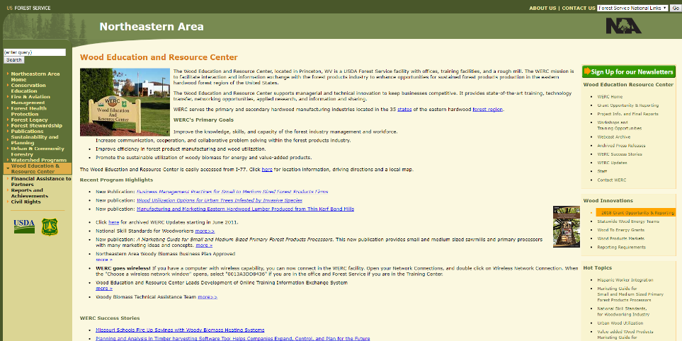
Previous Wood Innovations Grants
SEARCH PREVIOUS GRANTS

Slide 11
Other Application Requirements or Considerations
Match Documentation
Partners & Management Team
DUNS Number
SAM Registration
Tips for Application
Contact Regional Coordinators
Project Abstract
Page Lengths
Letters of Support
Notes:
Match Documentation- Letters of support are required to document individual match commitments (have to add up to total).
Partners and Management Team – Appropriate partners and qualified management teams, with clear description of relevant qualifications and roles.
DUNS Number and Contractor Registration – Data Universal Number System, identifier for businesses and is used to establish a business credit file. Recommend obtaining DUNS number and registering at www.sam.gov (procrastination will delay if not cancel award).
SAM System Award Management (formerly Central Contracting Registration) – sam.gov
Abstract should include specifics on what material is being used, where it comes from, what impacts it will have relative to the purpose of the program, and a basic timeline of how these things will be accomplished. Concise explanation of the project that will have details explained in the rest of the document.
Page Lengths listed in the Application are suggestions for each individual section but mandatory for overall length (9 pages).
Letters of Support, especially from public entities and documenting match funds, should be obtained early. These are critical to the success of the project and with holidays close to the end of the application period it is better to obtain them (or at least have dates when they will be received) early.

Slide 12
Application Sections
Part 1: Cooperator Contact Information, Narrative and Program of Work, and any appendices;
Part 2: Required Financial Forms
Notes:
Organization of Application
Part 1, Project Summary Page – Contact information and short description (1 p)
Each submittal must consist of two separate searchable PDF (or Word) files, as follows:
Part 1: Cooperator Contact Information, Narrative and Program of Work, and any appendices;
Part 2: Required Financial Forms
A maximum of 9 pages per proposal for Part 1 of the Application, not including the Cooperator Contact Information page or appendices:
Basic Project Information
Project Goals and Objectives
Program of Work & Technical Approach
Project Impact
Qualifications of Team and Partners
Annual Progress Reports and Final Reports
Budget Summary and Justification in Support of SF–424A
Appendices could be:
Feasibility Assessments.
Woody Biomass Resource Supply Assessment.
If appropriate, quotes for professional engineering services and rationale for selection of contractor, if already selected.
Letters of support from partners, individuals, or organizations, especially those playing a key role or providing matching funds. Letters of support should display the degree of collaboration occurring between the different entities engaged in the project.
Miscellaneous items, such as schematics, engineering designs, or executive summaries of reports.
List of all other Federal funds received for this project within the last 3 years (include agency, program name, and dollar amount).
Letters of Support
Part 2, Required Forms and Assurances
*Very important to obtain Letter of Support if using USFS raw material.
*Letters much include match commitments and they all need to add up.

Slide 13
Application Review Process
Regional Level Review
National Level Review
Washington Office & USDA Review
Notes:
Regional Level Review – USFS Region screens proposals for administrative requirements and evaluates how pertinent they are to Regional needs.
National Review – Qualified projects are forwarded to Wood Education and Resource Center (WERC, Princeton, VA) where they are distributed and reviewed and ranked.
WO and USDA Review – Ranked projects are provided to the Chief of the USFS for consideration of rankings and Regional priorities, and forwarded to USDA Office of the Secretary.
Projected Dates for Notification and Award – The ranked project list will be forwarded to the Chief of the USFS by about 3/30/2017. The Secretary of Agriculture will then make the award announcement, which will likely happen by 6/1/2017. The USFS has no control over the date of the announcement. Grants should be finalized within about 6 weeks or sooner of the announcement by the Secretary of Agriculture, depending upon how many corrections are needed, and if the DUNS and SAM registration are properly completed. Applicants can request in writing permission for pre-award authorization to expend funds that they want reimbursed and are part of the grant. If authorized, this permission begins on the date the USFS signs the letter authorizing it.

Slide 14
USFS California, Hawai’i, & U.S. Affiliated Pacific Islands –
Region 5 Wood & Biomass Utilization Mission
Retain a competitive and resilient wood products industry infrastructure to help accomplish ecosystem restoration objectives, create and retain jobs, and partially defray management cost through innovation and market diversification.
Notes:
USFS RO5 Wood & Biomass Utilization Mission
Retain a competitive and resilient wood products industry infrastructure to help accomplish ecosystem restoration objectives, create and retain jobs, and partially defray management cost.

Slide 15
Priority Emphasis Areas for USFS R5
Infrastructure retention
Market diversification
Utilize large volumes of woody biomass by the end of the grant
NFF/USFS Statewide Wood Business Opportunity Follow-Up
Governor’s Tree Mortality Emergency Proclamation (California)
Projects that advance priorities within State Forest Action Plan
Notes:
2017 USFS Priority Emphasis Areas
Infrastructure retention
Market diversification for woody biomass
Projects that will utilize large volumes of wood by the end of the grant cycle:
Maintaining and expanding existing wood processing infrastructure (energy and products)
Existing sawmills, veneer plants, particle board plant, and other major wood processing facilities (e.g. greater than 10,000 green tons log or biomass consumption/yr)
National Forest Foundation/USFS Statewide Wood Opportunity Assessment Follow-Up (https://www.nationalforests.org/who-we-are/regional-offices/california-program/california-assessment-of-wood-business)
Governor’s Tree Mortality Emergency Proclamation

Slide 16
Contact Information
Larry Swan
lswan01@fs.fed.us
707.562.8917
Marcus Taylor
marcustaylor@fs.fed.us
707.562.9122
Wood & Biomass Utilization Specialists
USDA Forest Service

