Slide 1
Burn Unit Preparation and Firing Techniques

Slide 2
Objectives
Review actions needed for burn unit preparation.
Review the basic elements of a firing operation.
Review the six primary firing techniques.

Slide 3
Burn Unit Preparation
Assessment of Conditions
Permits in order?
Notifications made?
Recon Burn Unit
  Fuels, weather, topography
  Test fire location
  Access to the unit
  Assess for firing operations
Notes:
When to shut the it down. Endpoint of firing operations
Type of fire spread and mitigation techniques
Techniques and Patterns
In prescription?
Weather The state of the atmosphere with respect to wind, temperature, cloudiness, moisture, pressure, etc. Weather refers to these conditions at a given point in time (e.g., today's high temperature), whereas Climate refers to the "average" weather conditions for an area over a long period of time (e.g., the average high temperature for today's date).

Slide 4
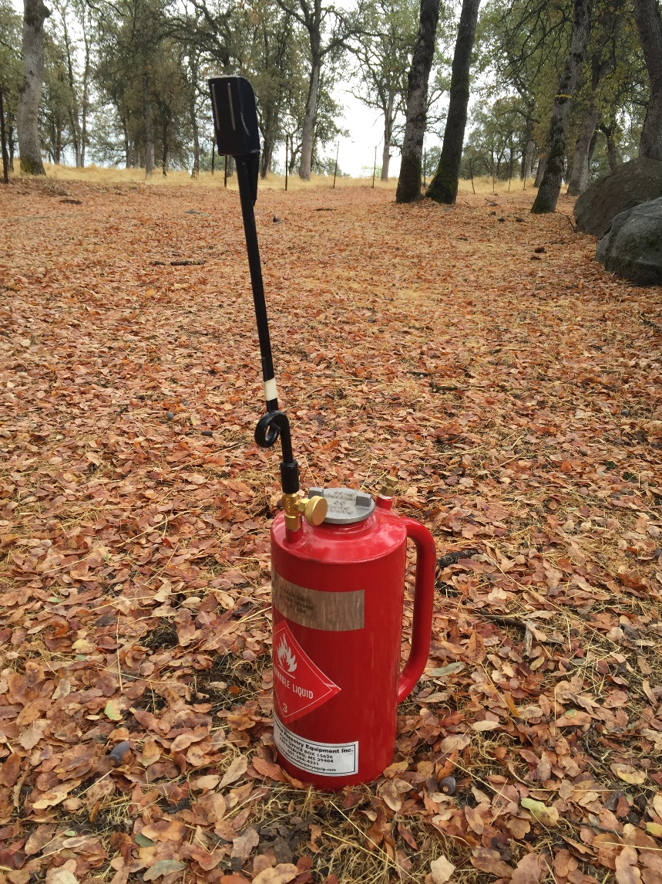
Burn Unit Preparation
Type of/Time needed for prep
  Who will be completing the prep?
  Any hazard mitigations?
  Line is complete, need to be cleaned?
  Exclude areas within the burn units?
Resources available?
Equipment
  In working order and available for use
  In place prior to ignitions
Notes:
When to shut the it down.
In prescription?
Portable pumps, drip torches, fuel for firing ops

Slide 5
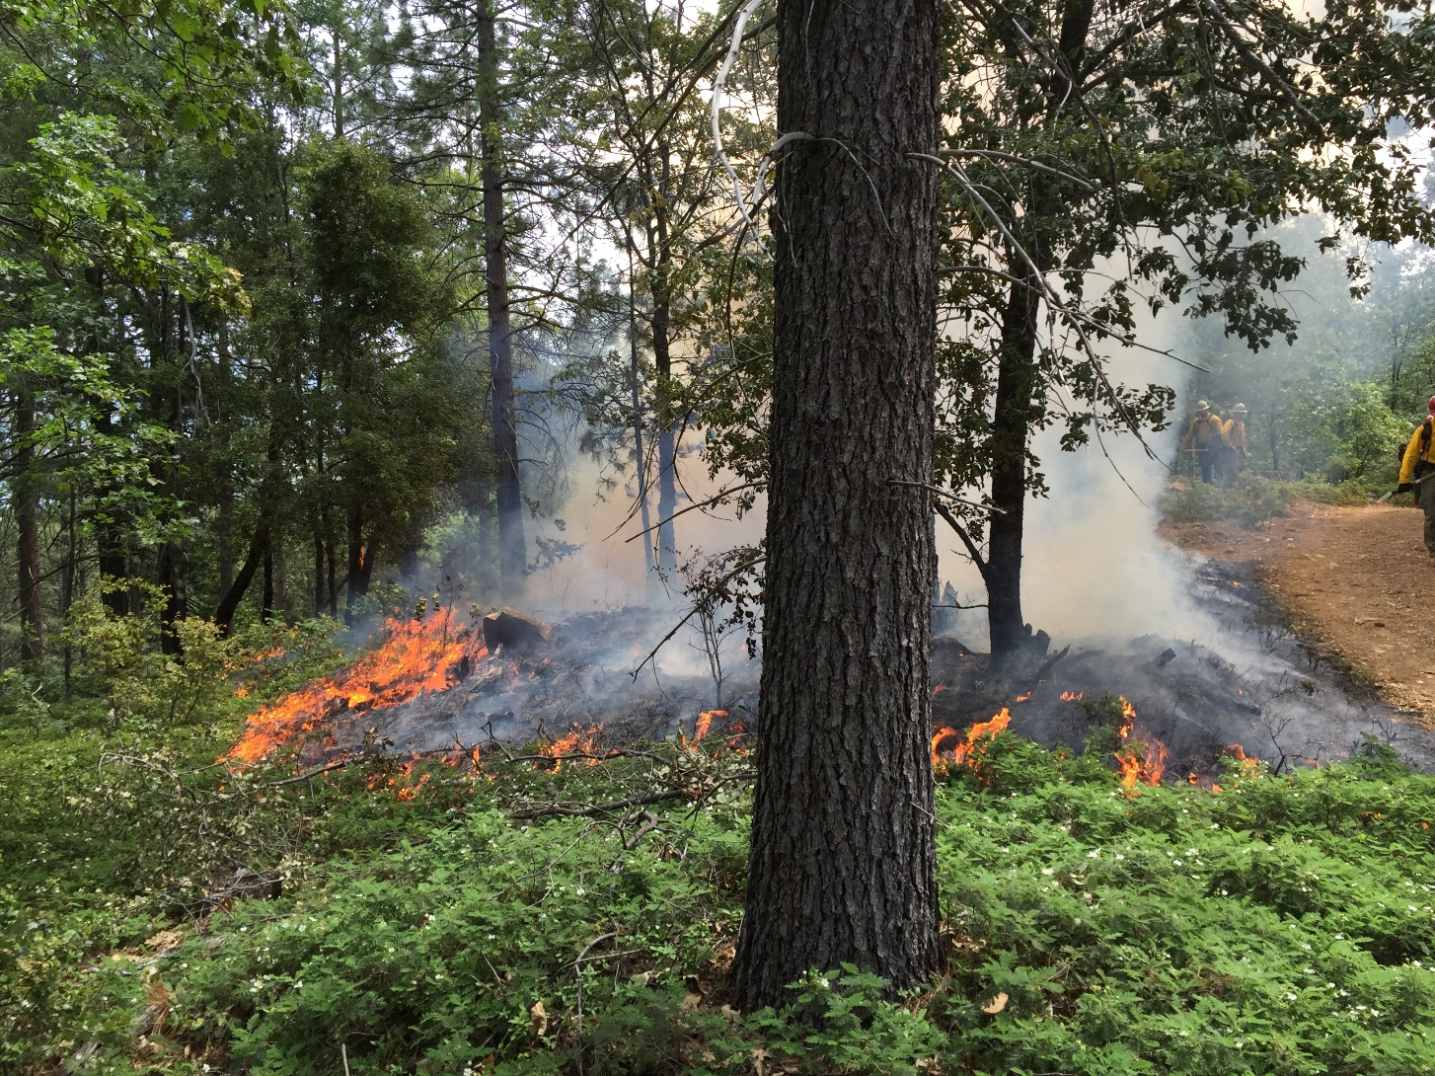
Basic Elements of a Firing Operation
Test Fire Location
Methods
  Hand, ground, aerial
Devices
  Equipment to be used
Firing Techniques
  Six primary types
Firing Patterns
  Staggering, sequencing
  and spacing
Notes:
Equipment depends on fuel type, size of project, terrain, objectives,

Slide 6
Common Firing Devices
Drip Torches Fusees
Notes:
What technique is best for your operation? To achieve objectives?
Fire intensity, lifting and dispersing of smoke

Slide 7
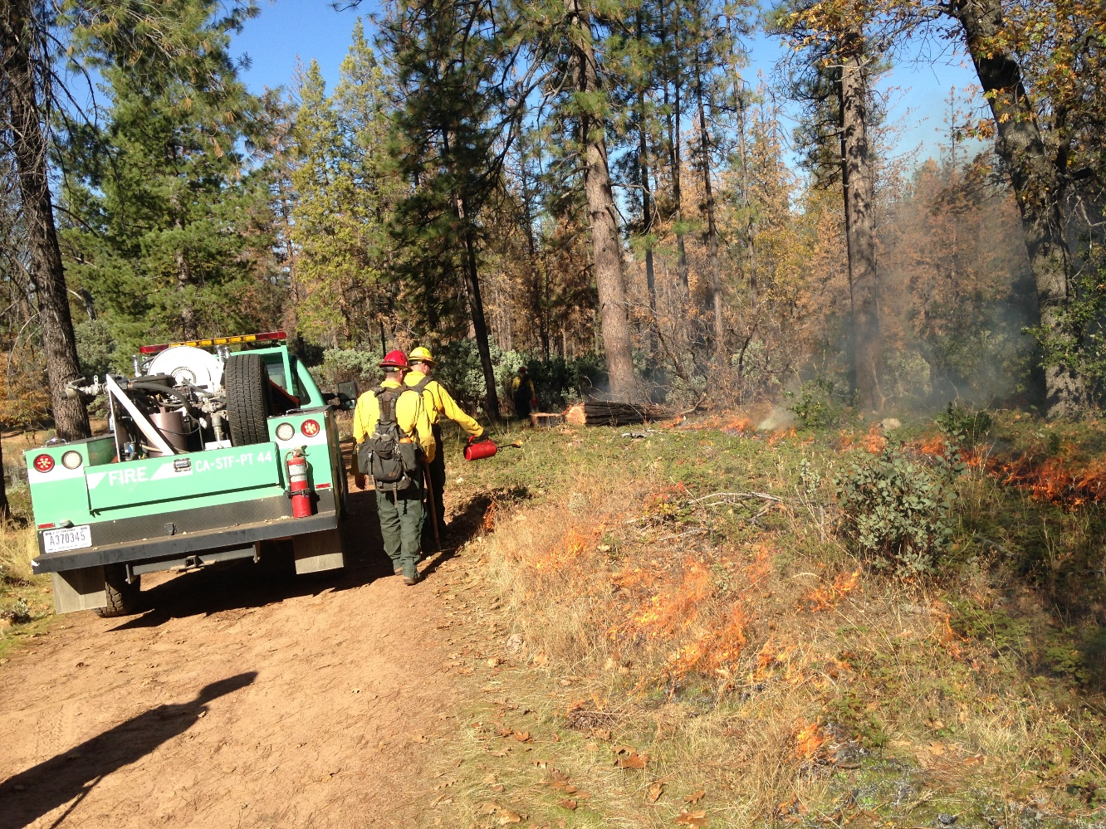
Firing Techniques
Techniques
  Strip
  Dot
  Flanking
  Ring
  Chevron
  Concentric
Notes:
What technique is best for your operation? To achieve objectives?
Fire intensity, lifting and dispersing of smoke

Slide 8
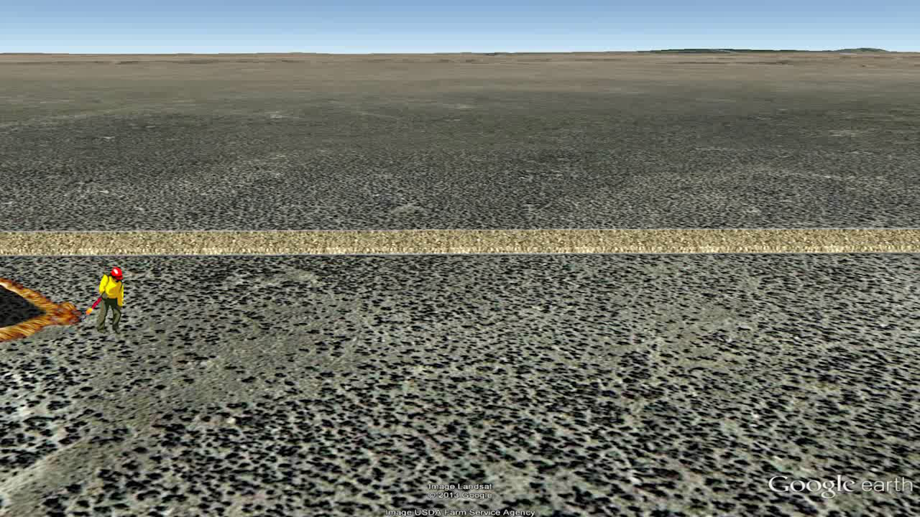
Strip Firing

Slide 9
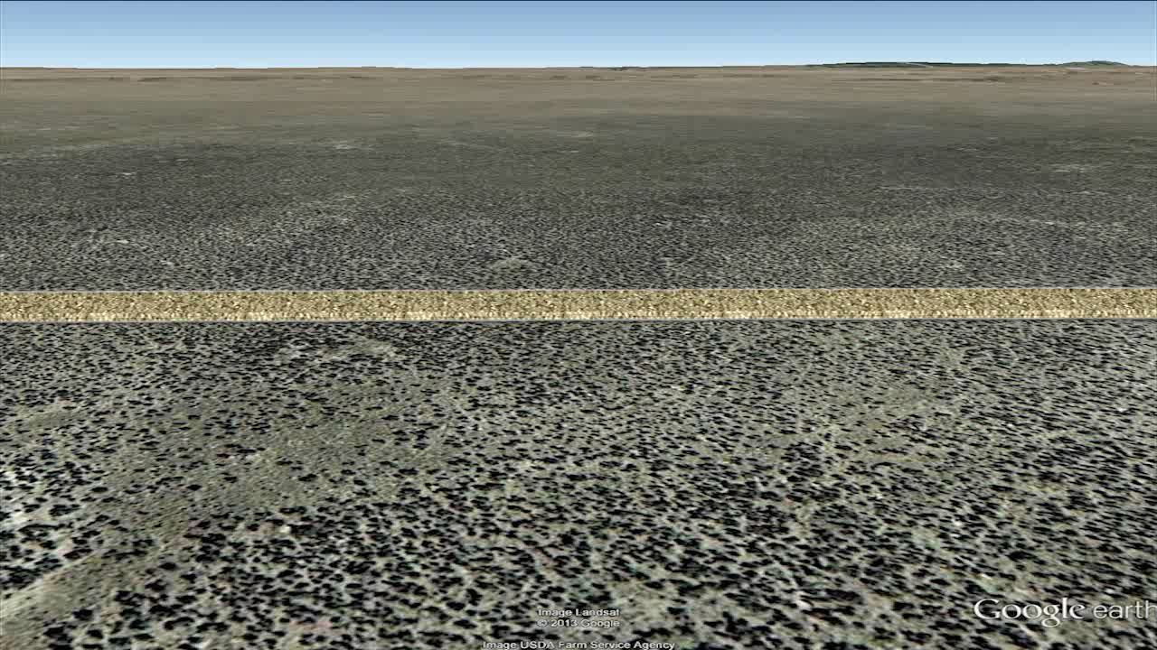
Dot Firing

Slide 10
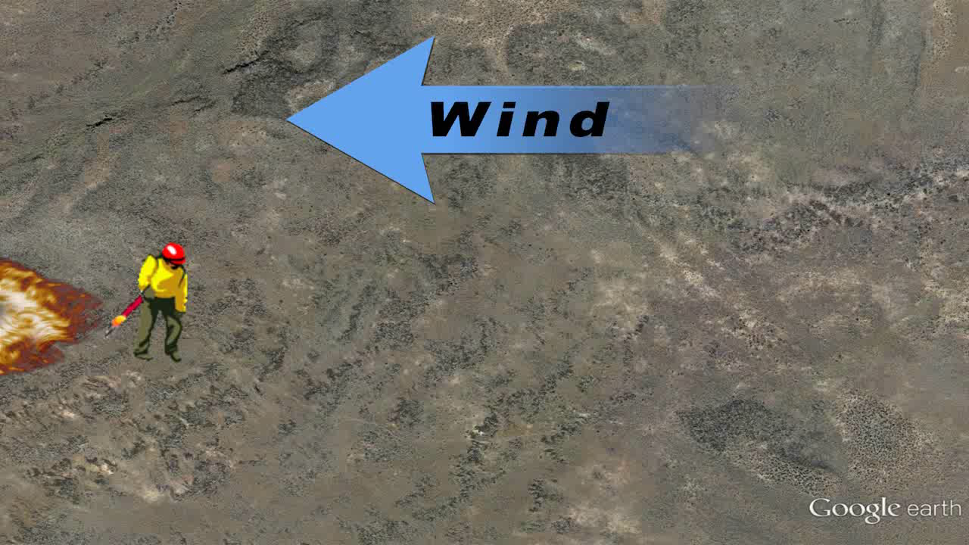
Flanking Fire

Slide 11
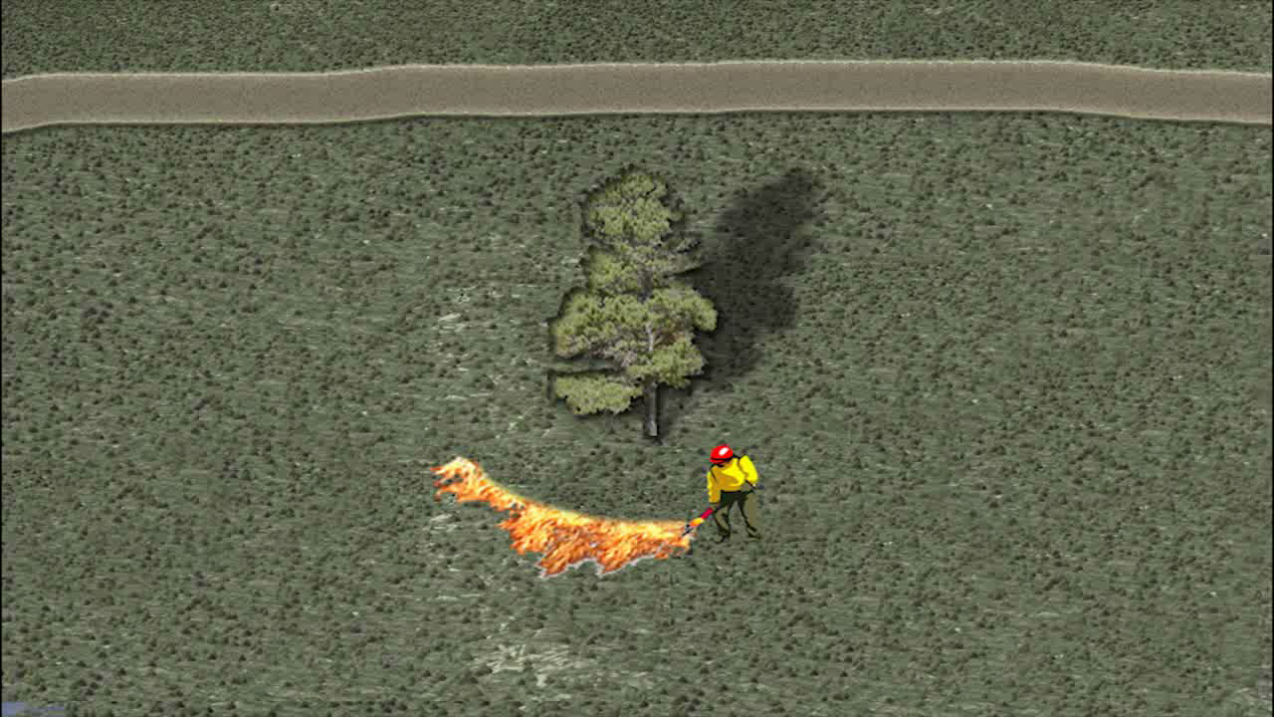
Ring Firing

Slide 12
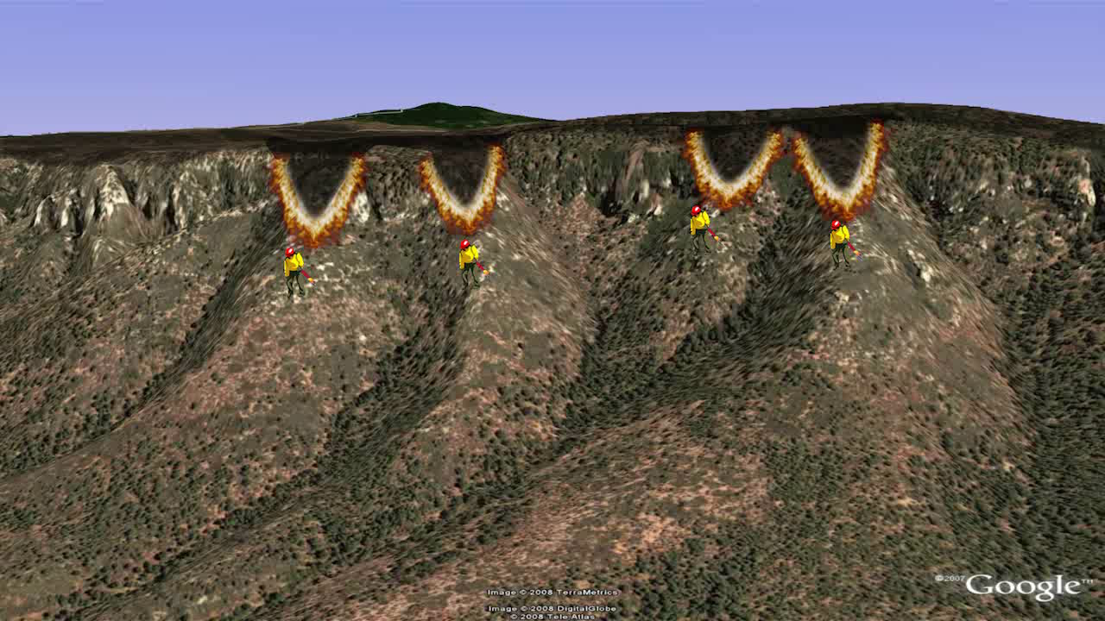
Chevron Firing

Slide 13
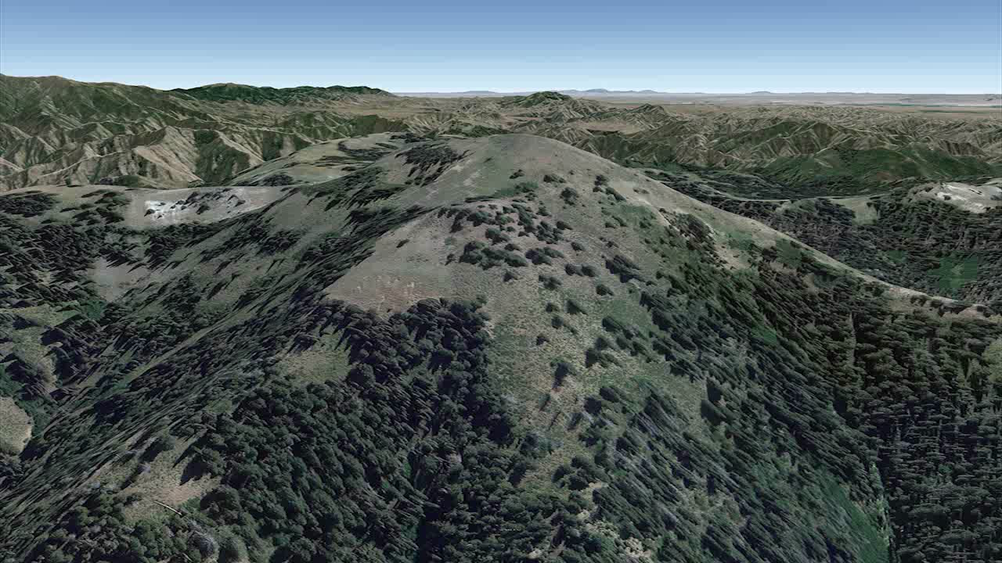
Concentric Firing

Slide 14
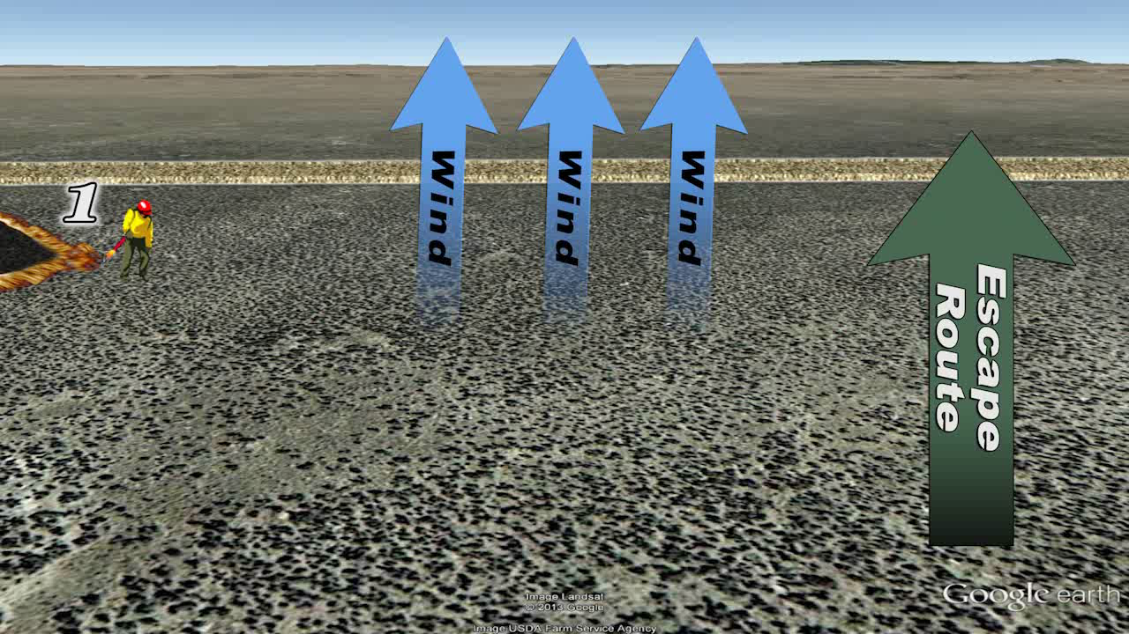
Staggered Firing Pattern

Slide 15
Objectives
Review actions needed for burn unit preparation.
Review the basic elements of a firing operation.
Review the six primary firing techniques.

Slide 16
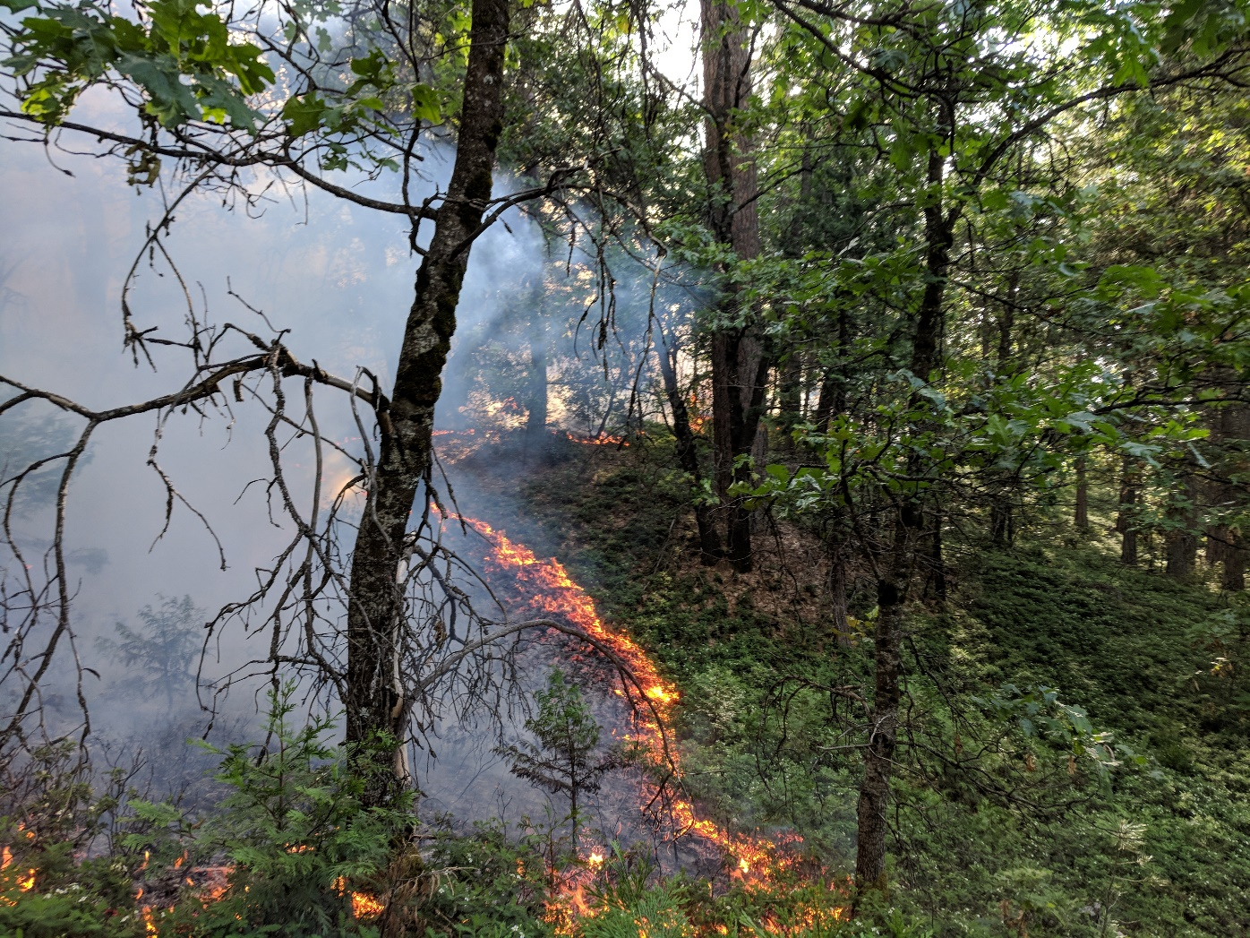
Questions?

