Slide 1
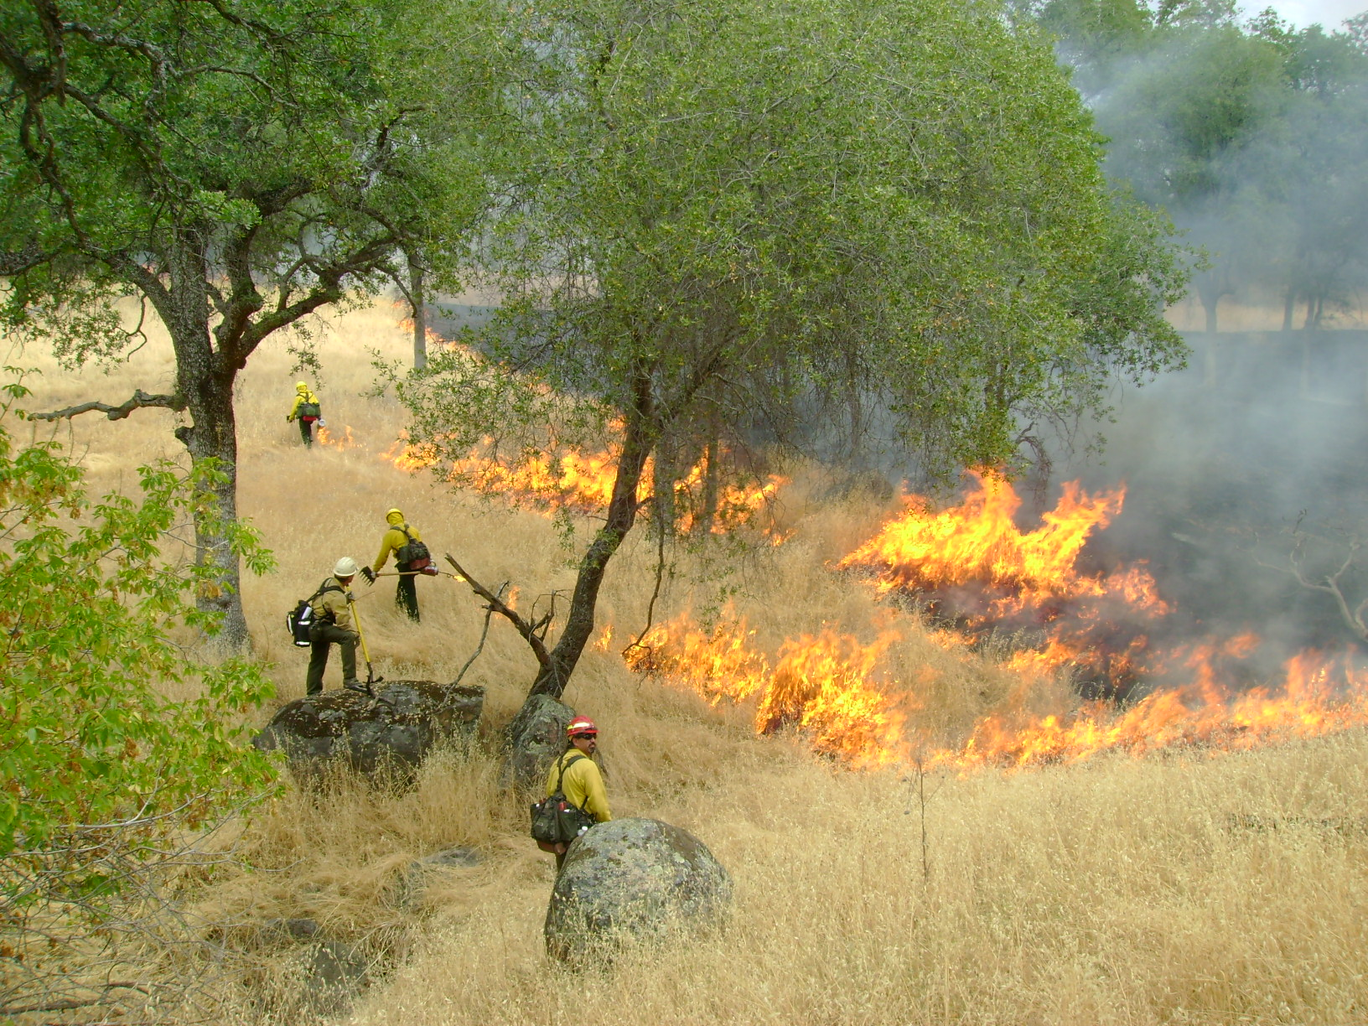
BURN PLANNING
UCCE Rx Workshop
October 4, 2018
Arnold, CA
Ben Jacobs, Calaveras Big Trees State Park

Slide 2
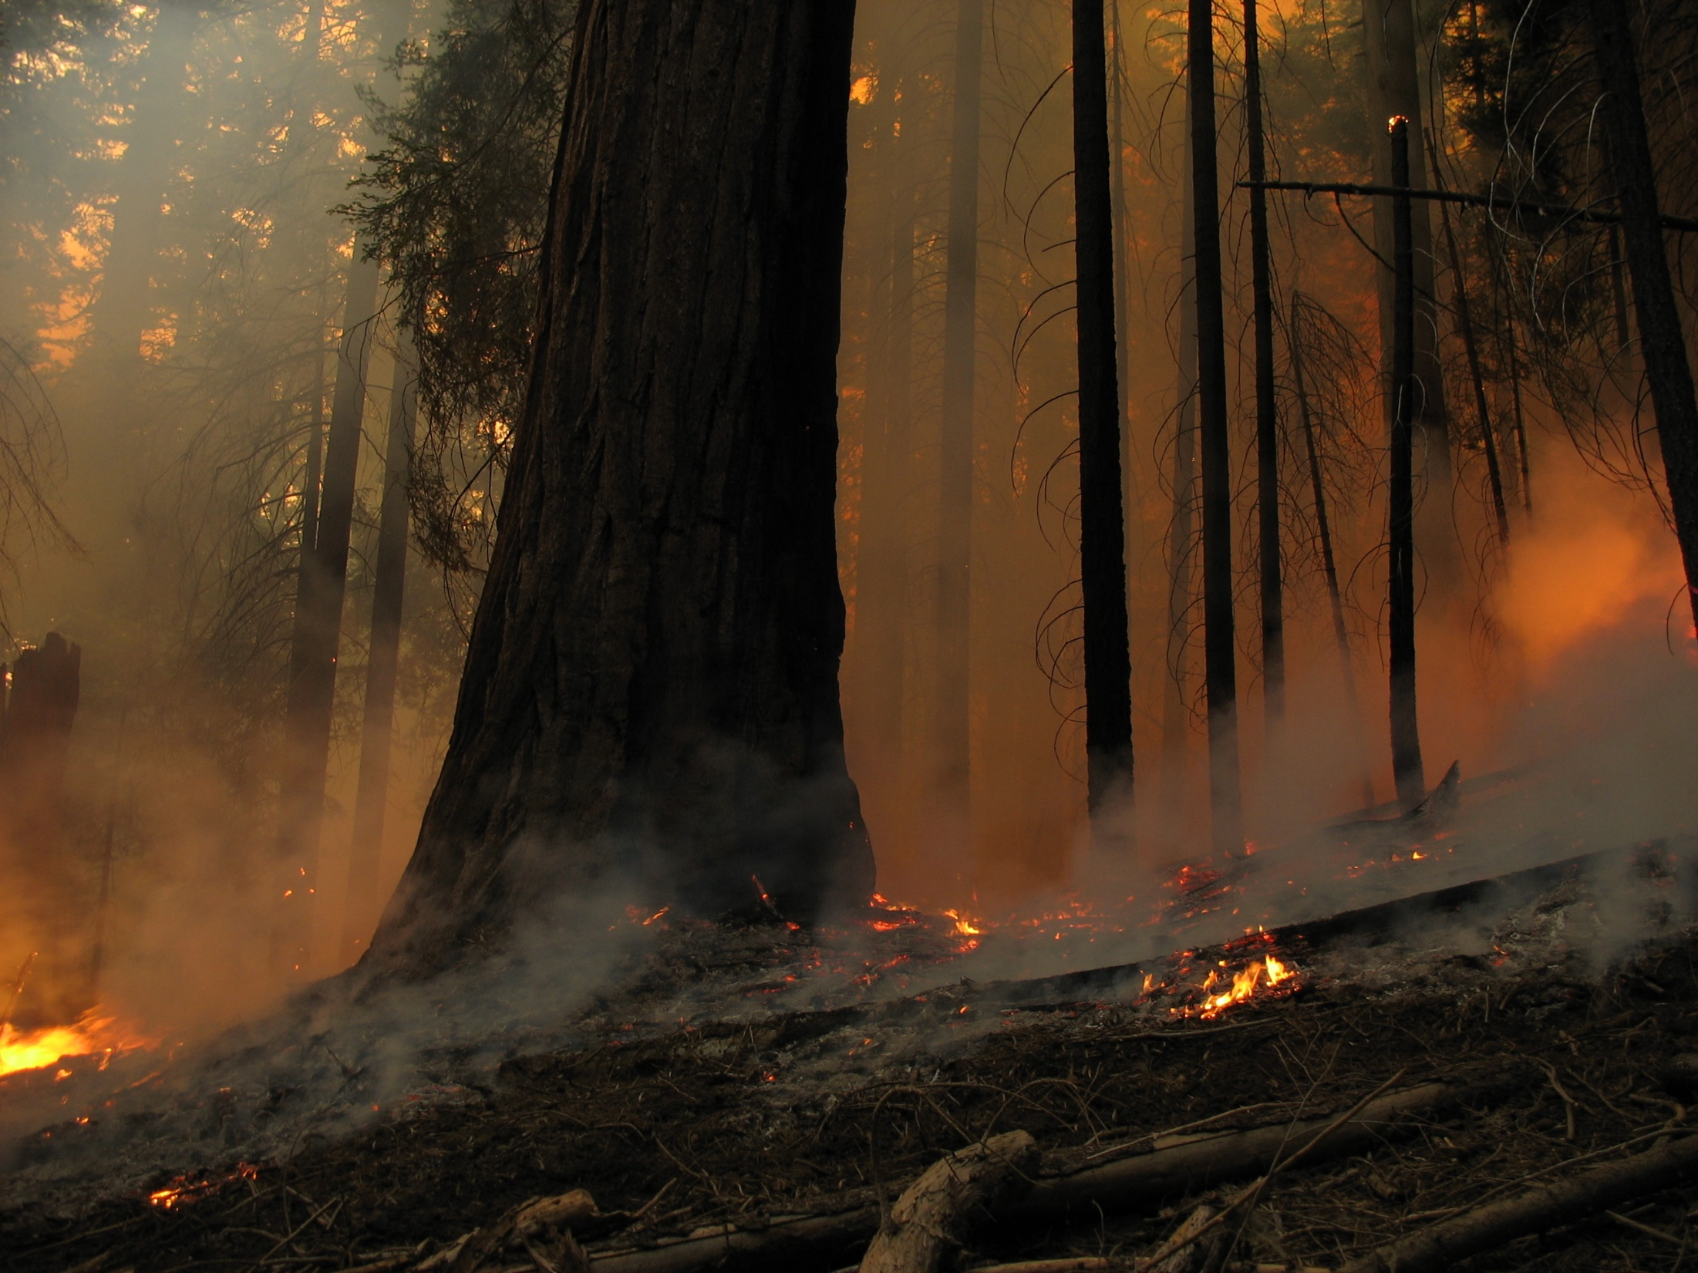
PRESCRIBED BURNING IS CRITICALLY IMPORTANT, BUT VERY SERIOUS BUSINESS!

Slide 3
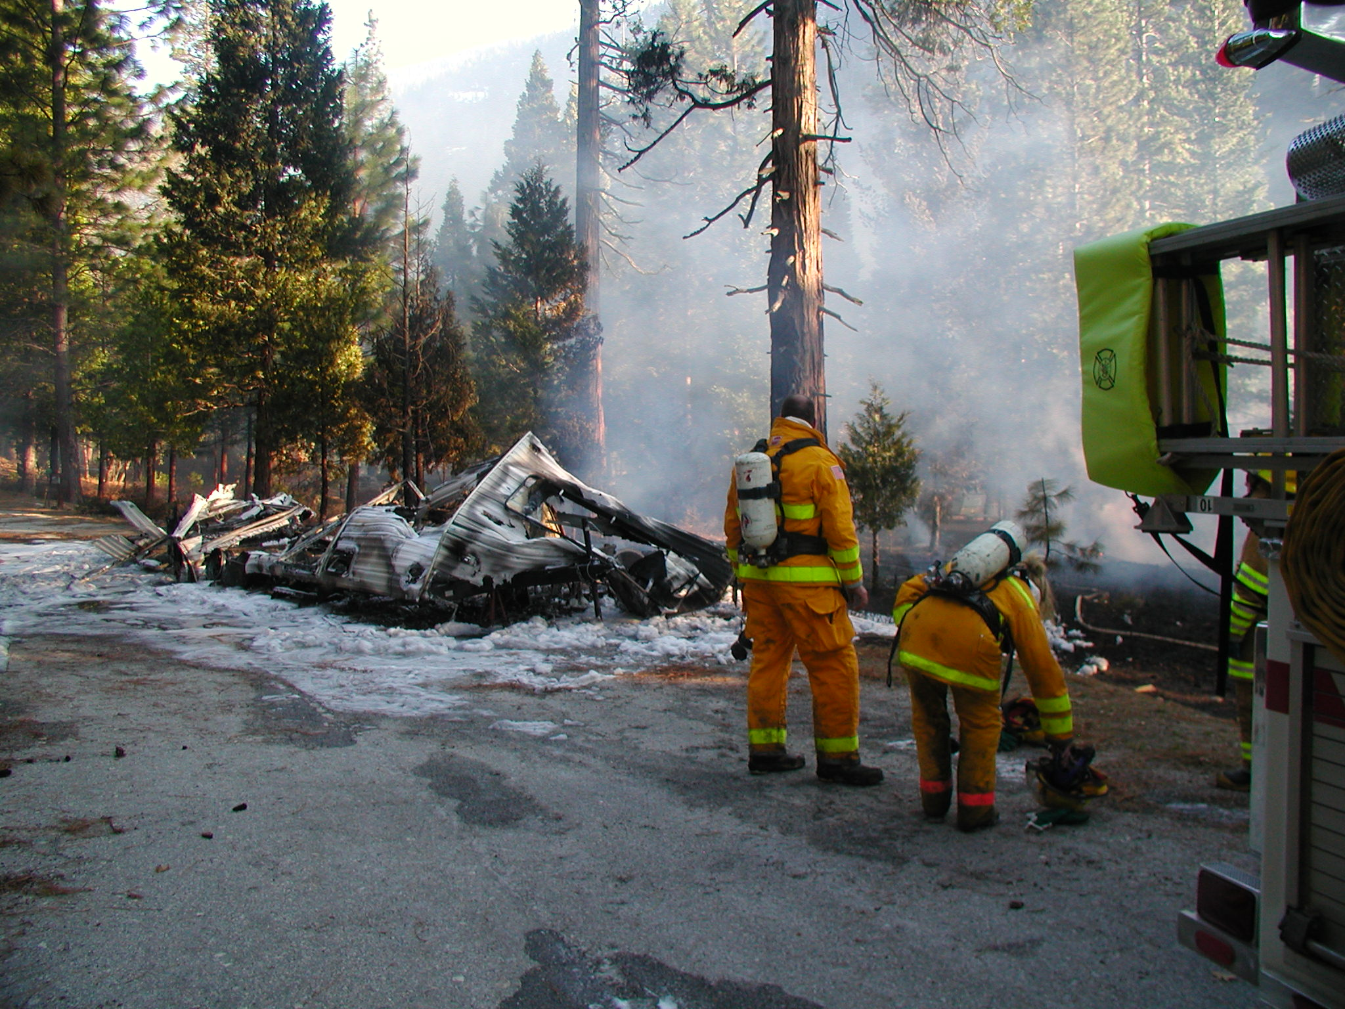
BECAUSE THINGS CAN GO WRONG!

Slide 4

REALLY WRONG!

Slide 5
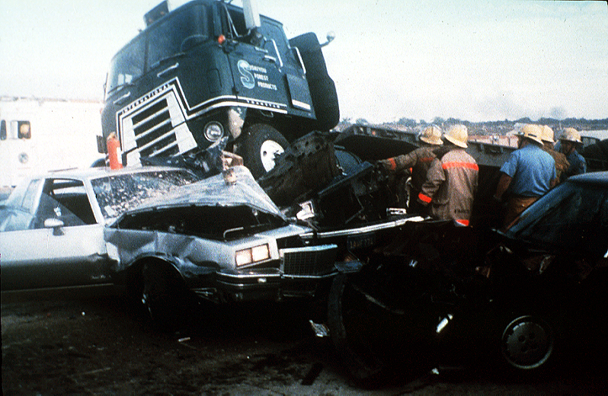
AND GUESS WHO WILL BE LIABLE?
AS THE LANDOWNER, THAT WOULD BE YOU!

Slide 6
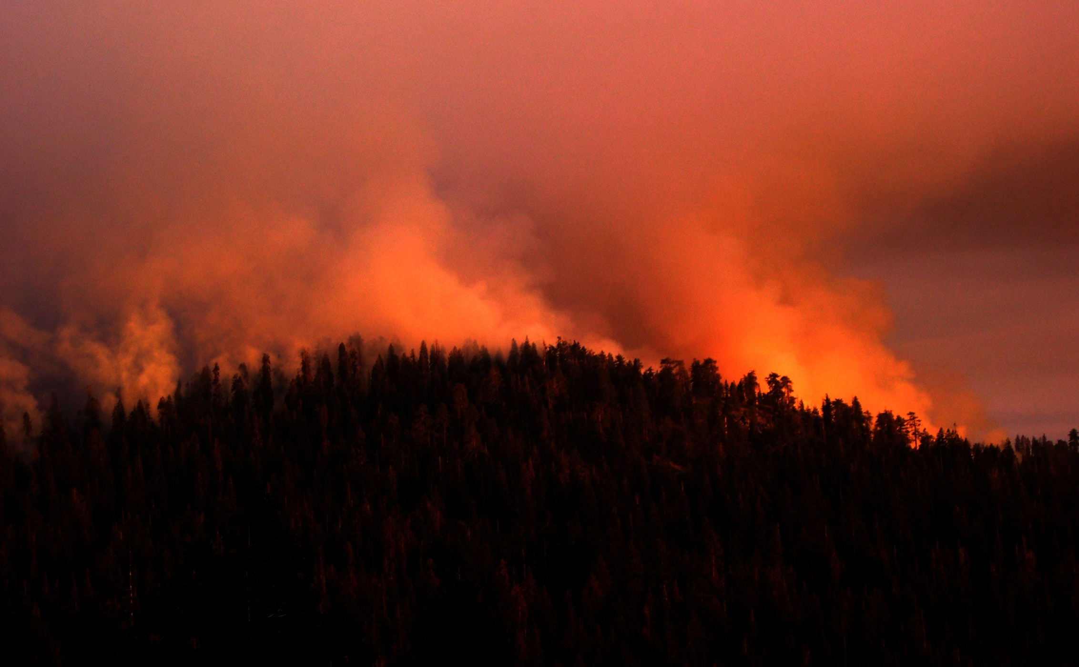
WHAT DOES THE TERM ‘BURN PLANNING’ MEAN TO YOU?
WHY IS BURN PLANNING IMPORTANT?

Slide 7
PRESCRIBED FIRE PLAN
ADMINISTRATIVE UNIT NAME(S): Calaveras Big Trees State Park
PRESCRIBED FIRE NAME:
Prescribed Fire Unit (Ignition Unit): Big Tree Creek Rx Burn
PREPARED BY:
Name (print): Qualification/Currency:
Signature: Date:
REVIEWED BY:
Name (print):
Signature: Date:
Senior Environmental Scientist – Supervisory
TECHNICAL REVIEW BY:
Name (print): Qualification/Currency:
Signature: Date:
COMPLEXITY RATING:
MINIMUM BURN BOSS QUALIFICATION:
APPROVED BY:
Name – Agency Administrator (print):
Signature – Agency Administrator: Date:
HOW MANY OF YOU ARE FAMILIAR WITH A BURN PLAN?
HOW MANY HAVE WRITTEN A BURN PLAN?
WHAT KIND OF PLAN DID YOU WRITE?

Slide 8
A BURN PLAN IS NOT THE SAME THING AS AN INCIDENT ACTION PLAN (IAP)
IAPs ARE IMPORTANT AND ARE REQUIRED BY CALFIRE AND MOST FEDERAL AGENCIES ON RX BURNS

Slide 9
IAPs CONTAIN CRITICAL INFORMATION FOR THE ACTUAL TACTICAL OPERATION SUCH AS:
OBJECTIVES
RESOURCE ASSIGNMENTS
COMMUNICATION PLAN
SAFETY MESSAGE
MEDICAL PLAN
FIRE BEHAVIOR AND WEATHER FORECASTS

Slide 10
BURN PLANS ARE A MORE DETAILED DOCUMENT CONTAINING MUCH MORE INFORMATION ABOUT PLANNING ALL PHASES OF THE BURN
AN IAP IMPLEMENTS THE BURN PLAN THE ACTUAL DAY OF IGNITION
PRESCRIBED FIRE PLAN
ADMINISTRATIVE UNIT NAME(S): Calaveras Big Trees State Park
PRESCRIBED FIRE NAME:
Prescribed Fire Unit (Ignition Unit): Big Tree Creek Rx Burn
PREPARED BY:
Name (print): Qualification/Currency:
Signature: Date:
REVIEWED BY:
Name (print):
Signature: Date:
Senior Environmental Scientist – Supervisory
TECHNICAL REVIEW BY:
Name (print): Qualification/Currency:
Signature: Date:
COMPLEXITY RATING:
MINIMUM BURN BOSS QUALIFICATION:
APPROVED BY:
Name – Agency Administrator (print):
Signature – Agency Administrator: Date:

Slide 11
HOW MANY OF YOU ARE FAMILIAR WITH NWCG AND THE NWCG BURN PLAN TEMPLATE?

Slide 12
NWCG Burn Plan Elements
Signature Page
2a Agency Administrator Ignition Authorization
2b Prescribed Fire Go/No Go Checklist
Complexity Analysis Summary and Final Complexity
Description of the Prescribed Fire Area
Objectives
Funding
Prescription
Scheduling
Pre-burn Considerations and Weather
Briefing
Organization and Equipment
Communication
Public and Personnel Safety, Medical
Test Fire
Ignition Plan
Holding Plan
Contingency Plan
Wildfire Declaration
Smoke Management and Air Quality
Monitoring
Post-burn Activities
Appendix A Maps
Appendix B Technical Review Checklist
Appendix C Complexity Analysis
Appendix D Job Hazard Analysis
Appendix E Fire Behavior Modeling Documentation or Empirical Documentation
Appendix F Smoke Management Plan and Smoke Modeling Documentation (optional)
WHICH ELEMENTS ARE IMPORTANT TO YOU?

Slide 13
NWCG Burn Plan ElementS
Signature Page
2a Agency Administrator Ignition Authorization
2b Prescribed Fire Go/No Go Checklist
Complexity Analysis Summary and Final Complexity
Description of the Prescribed Fire Area
Objectives
Funding
Prescription
Scheduling
Pre-burn Considerations and Weather
Briefing
Organization and Equipment
Communication
Public and Personnel Safety, Medical
Test Fire
Ignition Plan
Holding Plan
Contingency Plan
Wildfire Declaration
Smoke Management and Air Quality
Monitoring
Post-burn Activities
Appendix A Maps
Appendix B Technical Review Checklist
Appendix C Complexity Analysis
Appendix D Job Hazard Analysis
Appendix E Fire Behavior Modeling Documentation or Empirical Documentation
Appendix F Smoke Management Plan and Smoke Modeling Documentation (optional)
THESE ARE WHAT STAND OUT TO ME AS A LONG TIME BURN BOSS

Slide 14
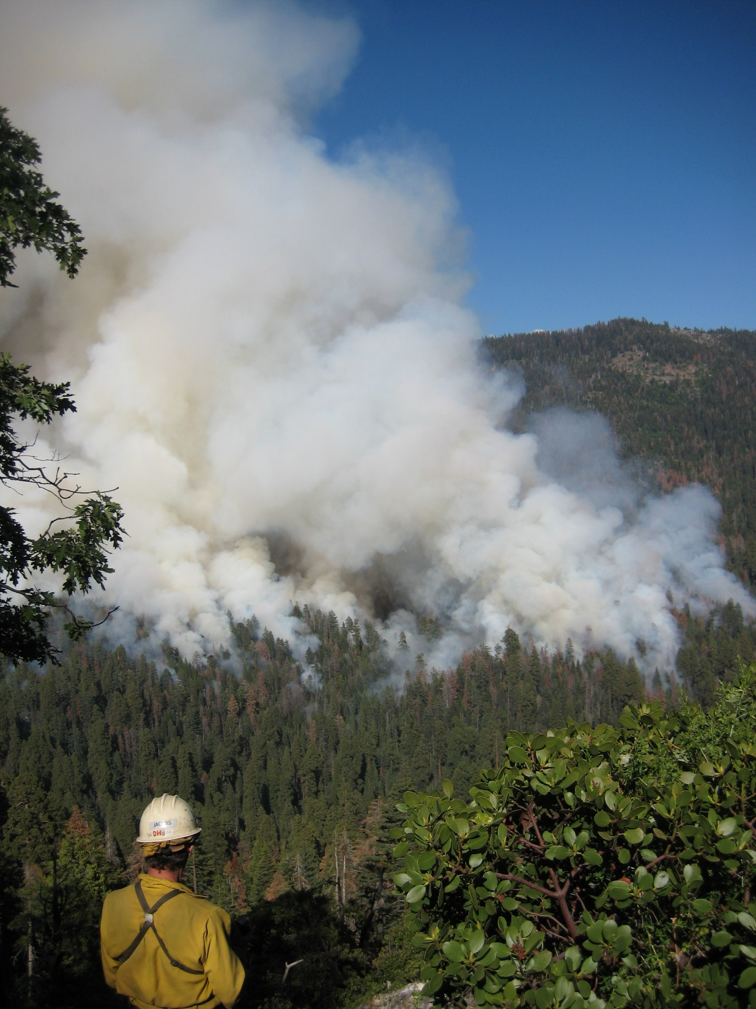
WHAT’S YOUR PRESCRIPTION?
HOW ARE YOU MEASURING IT?
WHAT WILL YOU DO IF YOU GO OUT OF PRESCRIPTION?

Slide 15
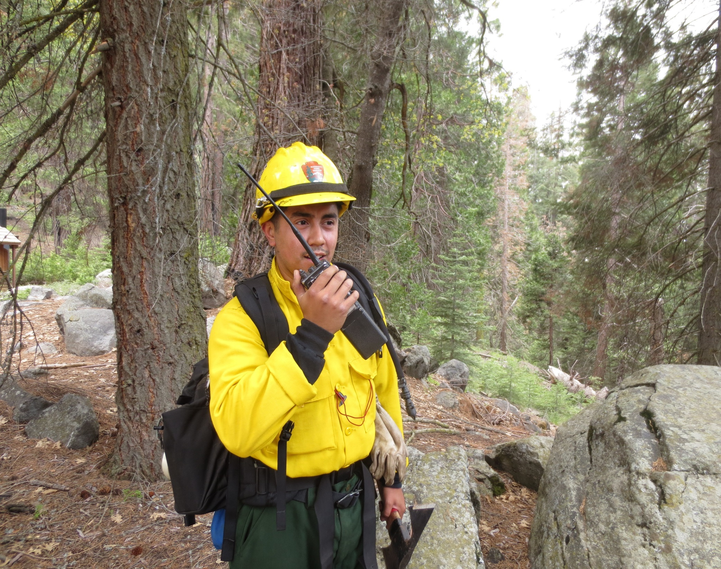
WHAT’S YOUR COMMUNICATION PLAN?
IN OTHER WORDS, HOW ARE WE GOING TO TALK TO EACH OTHER?
DO YOU HAVE ACCESS TO A RADIO CACHE?
DO YOU HAVE A FREQUENCY SO DIFFERENT AGENCIES CAN TALK TO EACH OTHER?
ARE THERE ENOUGH RADIOS?

Slide 16
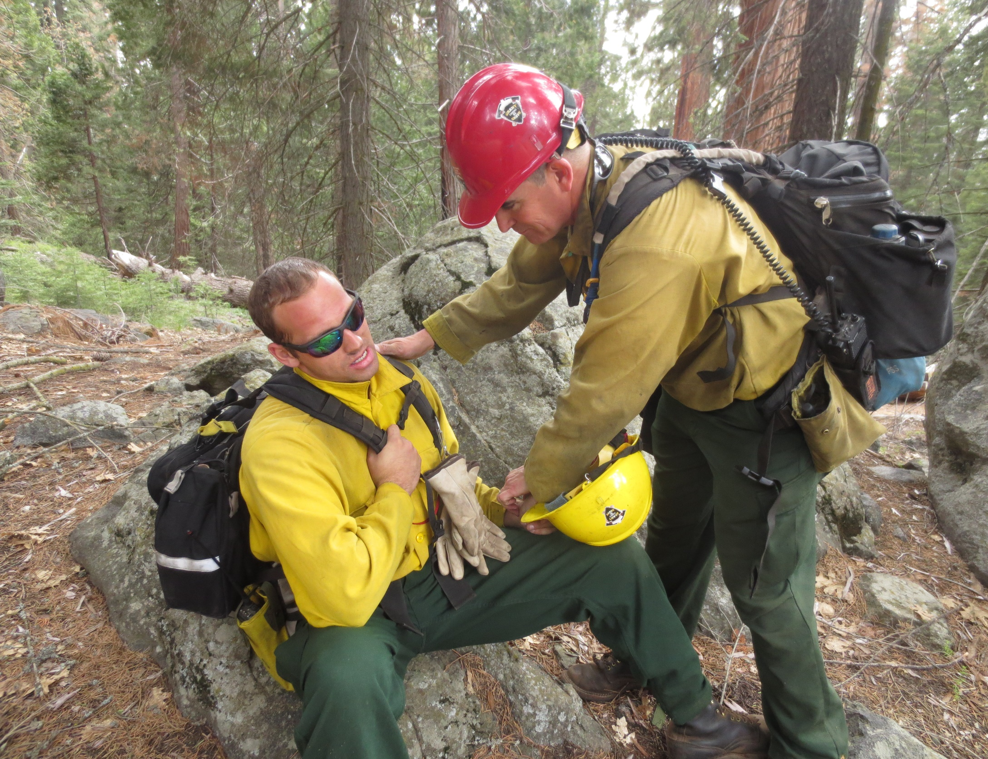
WHAT ARE YOU GOING TO DO IF SOMEONE GETS HURT?
HOW ARE YOU GOING TO GET THEM OUT OF THERE?
HOW LONG WILL IT TAKE?

Slide 17
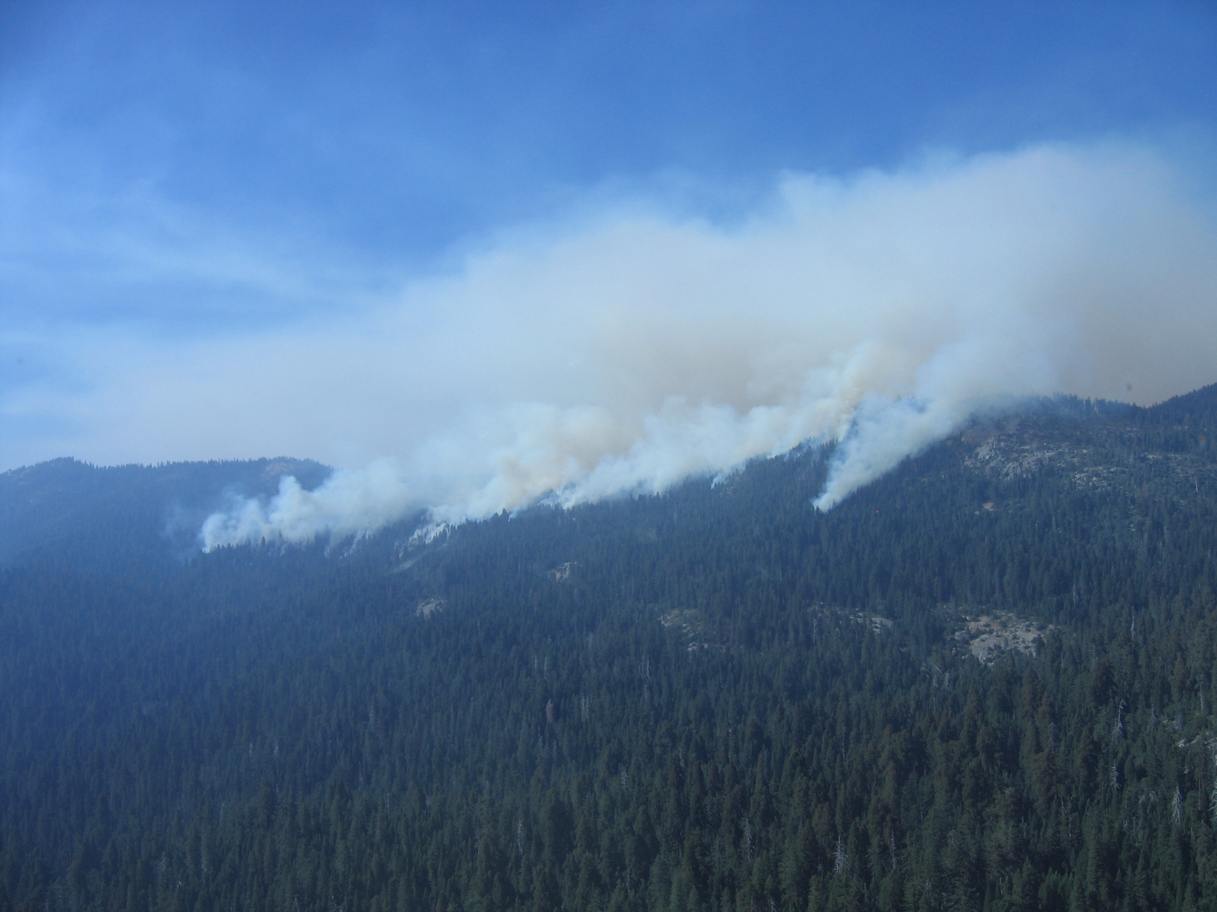
WHAT’S YOUR CONTINGENCY PLAN IF SMOKE BECOMES A PROBLEM?

Slide 18
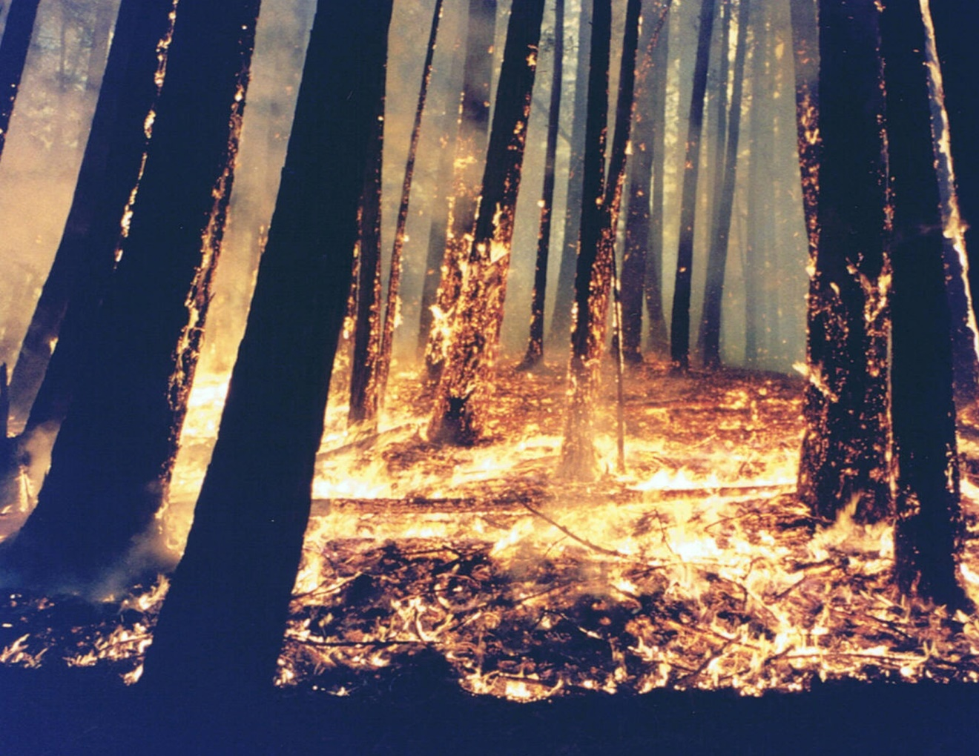
OR IF FIRE BEHAVIOR BECOMES TOO HOT AND YOU START HAVING CONTROL PROBLEMS?

Slide 19
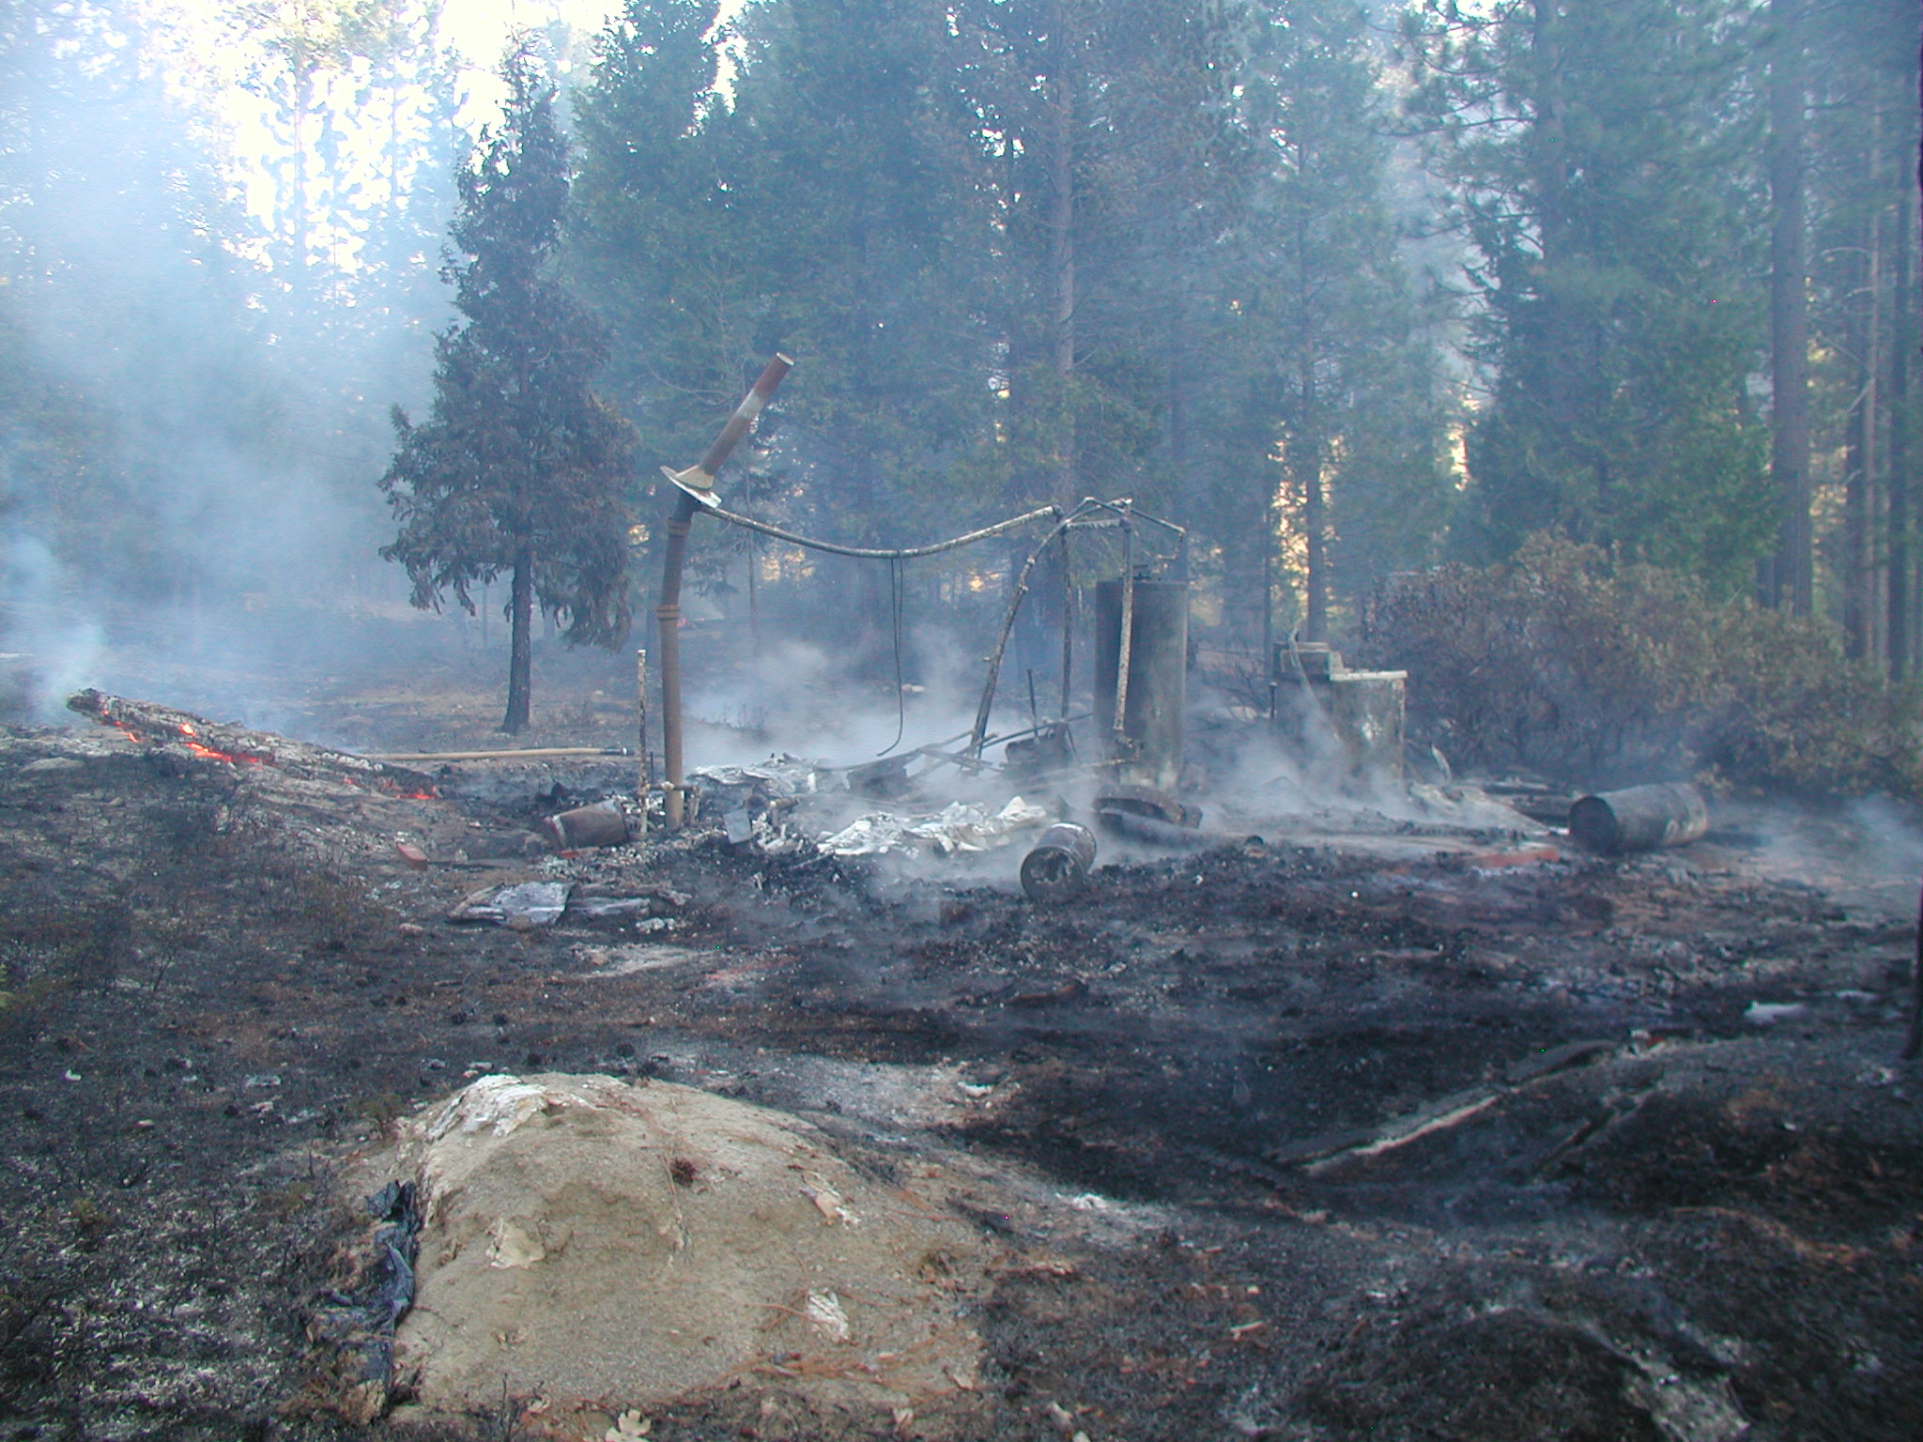
OR IF FIRE LEAVES THE UNIT AND DAMAGES SOME PROPERTY?

Slide 20
PRESCRIBED FIRE PLAN
ADMINISTRATIVE UNIT NAME(S): Calaveras Big Trees State Park
PRESCRIBED FIRE NAME:
Prescribed Fire Unit (Ignition Unit): Big Tree Creek Rx Burn
PREPARED BY:
Name (print): Qualification/Currency:
Signature: Date:
REVIEWED BY:
Name (print):
Signature: Date:
Senior Environmental Scientist – Supervisory
TECHNICAL REVIEW BY:
Name (print): Qualification/Currency:
Signature: Date:
COMPLEXITY RATING:
MINIMUM BURN BOSS QUALIFICATION:
APPROVED BY:
Name – Agency Administrator (print):
Signature – Agency Administrator: Date:
A GOOD SOLID PLANNING DOCUMENT, SUCH AS A BURN PLAN, IS ESSENTIAL SO YOU’RE PREPARED FOR THE UNEXPECTED

Slide 21
PRESCRIBED FIRE PLAN
ADMINISTRATIVE UNIT NAME(S): Calaveras Big Trees State Park
PRESCRIBED FIRE NAME:
Prescribed Fire Unit (Ignition Unit): Big Tree Creek Rx Burn
PREPARED BY:
Name (print): Qualification/Currency:
Signature: Date:
REVIEWED BY:
Name (print):
Signature: Date:
Senior Environmental Scientist – Supervisory
TECHNICAL REVIEW BY:
Name (print): Qualification/Currency:
Signature: Date:
COMPLEXITY RATING:
MINIMUM BURN BOSS QUALIFICATION:
APPROVED BY:
Name – Agency Administrator (print):
Signature – Agency Administrator: Date:
BURN PLANS SHOULD BE PREPARED BY AN EXPERIENCED QUALFIED BURN BOSS OR STATE EQUIVALENT

Slide 22
BURN PLANS ARE LEGAL DOCUMENTS AND SHOULD BE DEFENSIBLE IN THE EVENT OF A BAD OUTCOME, BECAUSE…
…BAD OUTCOMES USUALLY TRIGGER SOME SORT OF INVESTIGATION AND/OR LAW SUIT
PRESCRIBED FIRE PLAN
ADMINISTRATIVE UNIT NAME(S): Calaveras Big Trees State Park
PRESCRIBED FIRE NAME:
Prescribed Fire Unit (Ignition Unit): Big Tree Creek Rx Burn
PREPARED BY:
Name (print): Qualification/Currency:
Signature: Date:
REVIEWED BY:
Name (print):
Signature: Date:
Senior Environmental Scientist – Supervisory
TECHNICAL REVIEW BY:
Name (print): Qualification/Currency:
Signature: Date:
COMPLEXITY RATING:
MINIMUM BURN BOSS QUALIFICATION:
APPROVED BY:
Name – Agency Administrator (print):
Signature – Agency Administrator: Date:

Slide 23
PRESCRIBED FIRE PLAN
ADMINISTRATIVE UNIT NAME(S): Calaveras Big Trees State Park
PRESCRIBED FIRE NAME:
Prescribed Fire Unit (Ignition Unit): Big Tree Creek Rx Burn
PREPARED BY:
Name (print): Qualification/Currency:
Signature: Date:
REVIEWED BY:
Name (print):
Signature: Date:
Senior Environmental Scientist – Supervisory
TECHNICAL REVIEW BY:
Name (print): Qualification/Currency:
Signature: Date:
COMPLEXITY RATING:
MINIMUM BURN BOSS QUALIFICATION:
APPROVED BY:
Name – Agency Administrator (print):
Signature – Agency Administrator: Date:
ONE OF THE FIRST THINGS LOOKED AT IN AN INVESTIGATION IS:
DID YOU HAVE A GOOD BURN PLAN THAT MET SOME SORT OF POLICY?
DID YOU FOLLOW THAT PLAN?

Slide 24
I’D HIGHLY RECOMMEND USING THE NWCG BURN PLAN TEMPLATE AND FOLLOWING NWCG POLICY OR THE STATE EQUIVALENT AS YOUR PLANNING DOCUMENT AND GUIDANCE

Slide 25
THIS IS A GREAT DOCUMENT WHICH CAN HELP YOU THROUGH THE PLANNING PROCESS
https://www.nwcg.gov/sites/default/files/publications/pms484.pdf

Slide 26
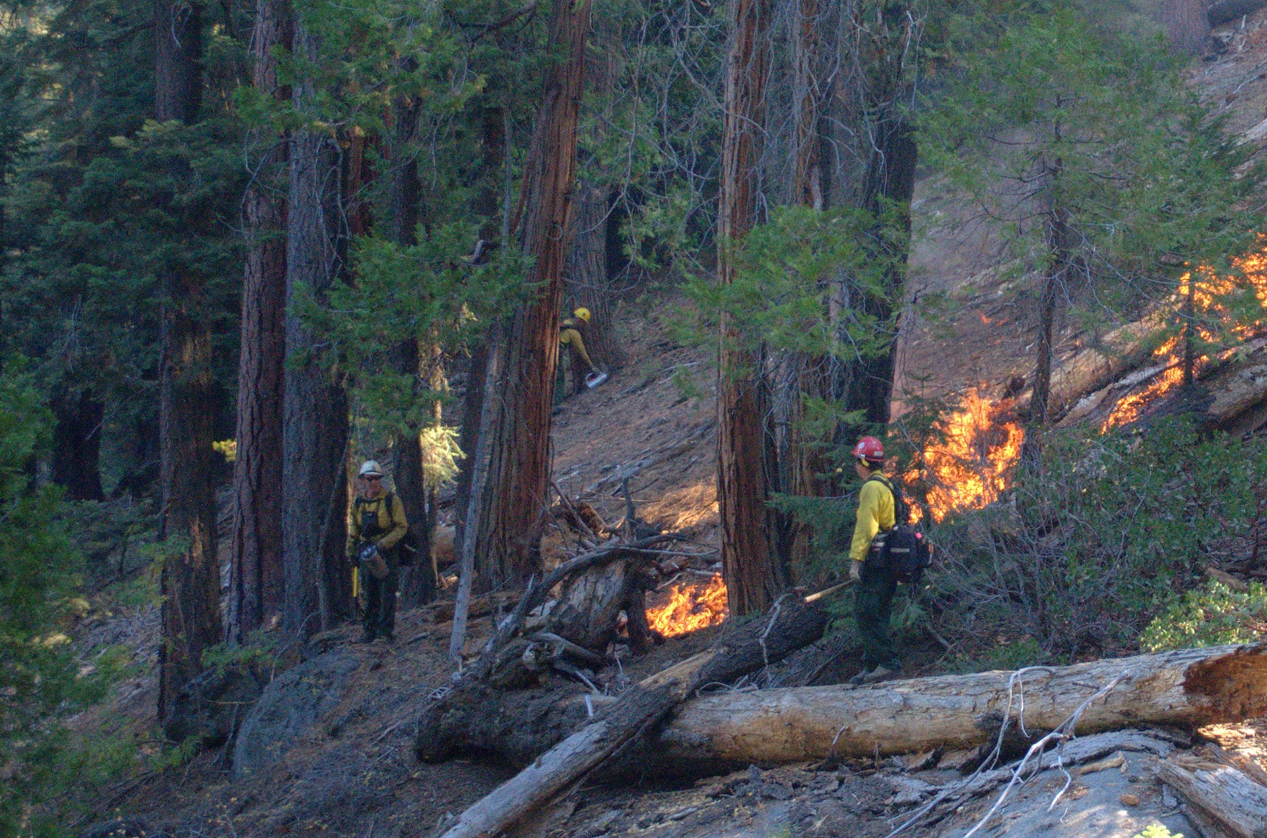
PRESCRIBED BURNING IS AN ESSENTIAL TOOL TO RESTORE OUR LANDS AND ECOLOGICAL PROCESSES

Slide 27



HOWEVER, ONE BAD OUTCOME MAY SHUT THE WHOLD PROGRAM DOWN

Slide 28
PRESCRIBED FIRE PLAN
ADMINISTRATIVE UNIT NAME(S): Calaveras Big Trees State Park
PRESCRIBED FIRE NAME:
Prescribed Fire Unit (Ignition Unit): Big Tree Creek Rx Burn
PREPARED BY:
Name (print): Qualification/Currency:
Signature: Date:
REVIEWED BY:
Name (print):
Signature: Date:
Senior Environmental Scientist – Supervisory
TECHNICAL REVIEW BY:
Name (print): Qualification/Currency:
Signature: Date:
COMPLEXITY RATING:
MINIMUM BURN BOSS QUALIFICATION:
APPROVED BY:
Name – Agency Administrator (print):
Signature – Agency Administrator: Date:
FOR THE SAKE OF ALL OF US IN THIS ROOM, BE PREPARED BY DOING DILIGENT BURN PLANNING AND HAVING (AND FOLLOWING) A TOP NOTCH BURN PLAN!

Slide 29
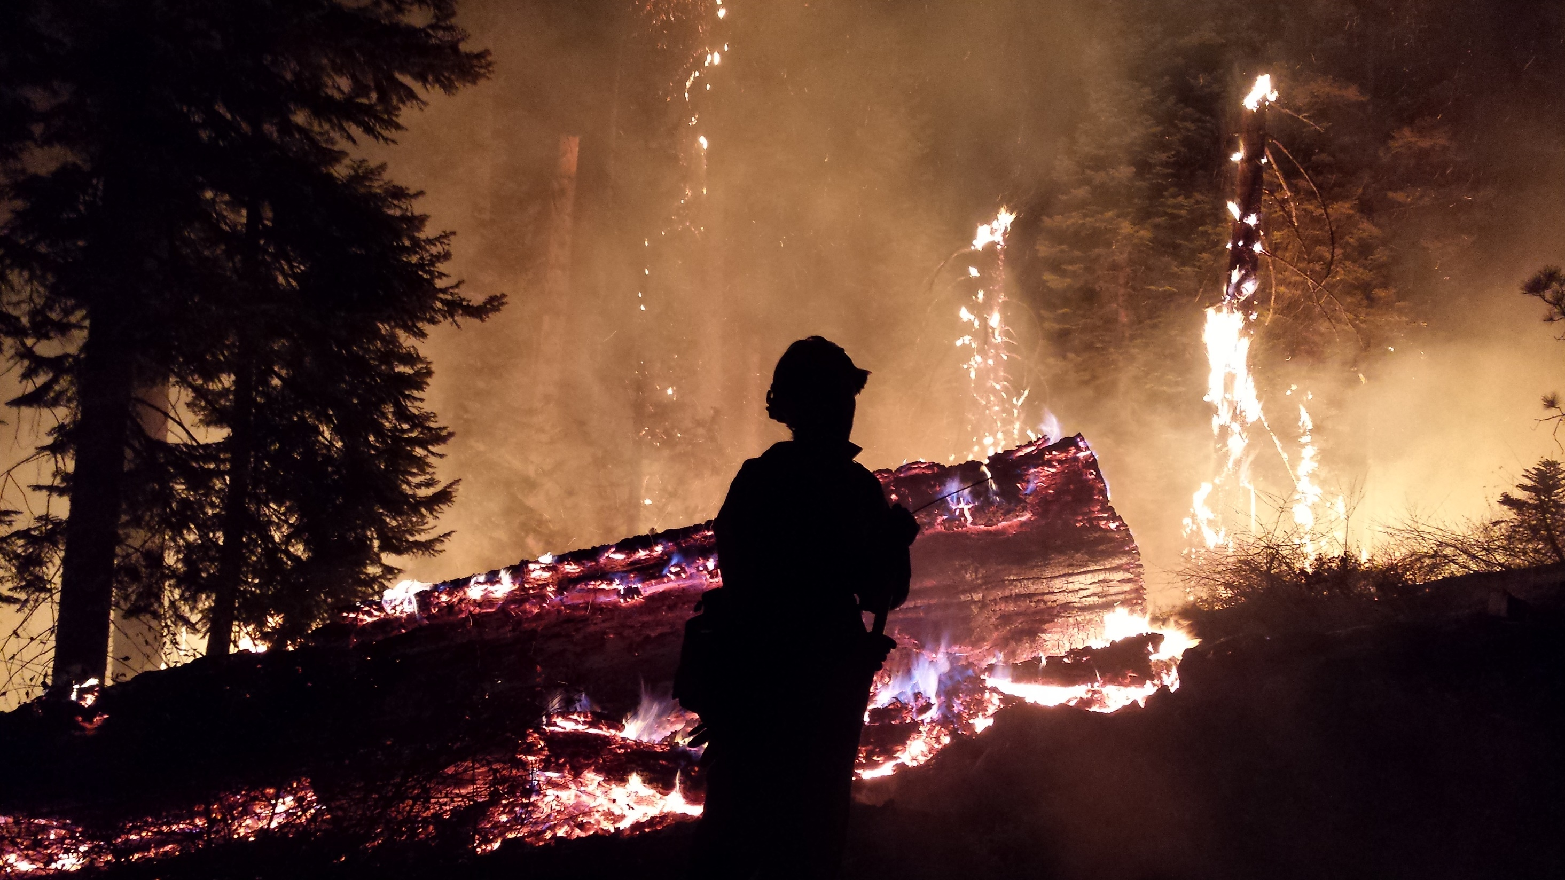
QUESTIONS?
COMMENTS?
Ben Jacobs
bjacobs111111@gmail.com
559-679-0047

