Slide 1
Staff Assembly Council
FY23 Year End Report
Presented June 1, 2023

Slide 2
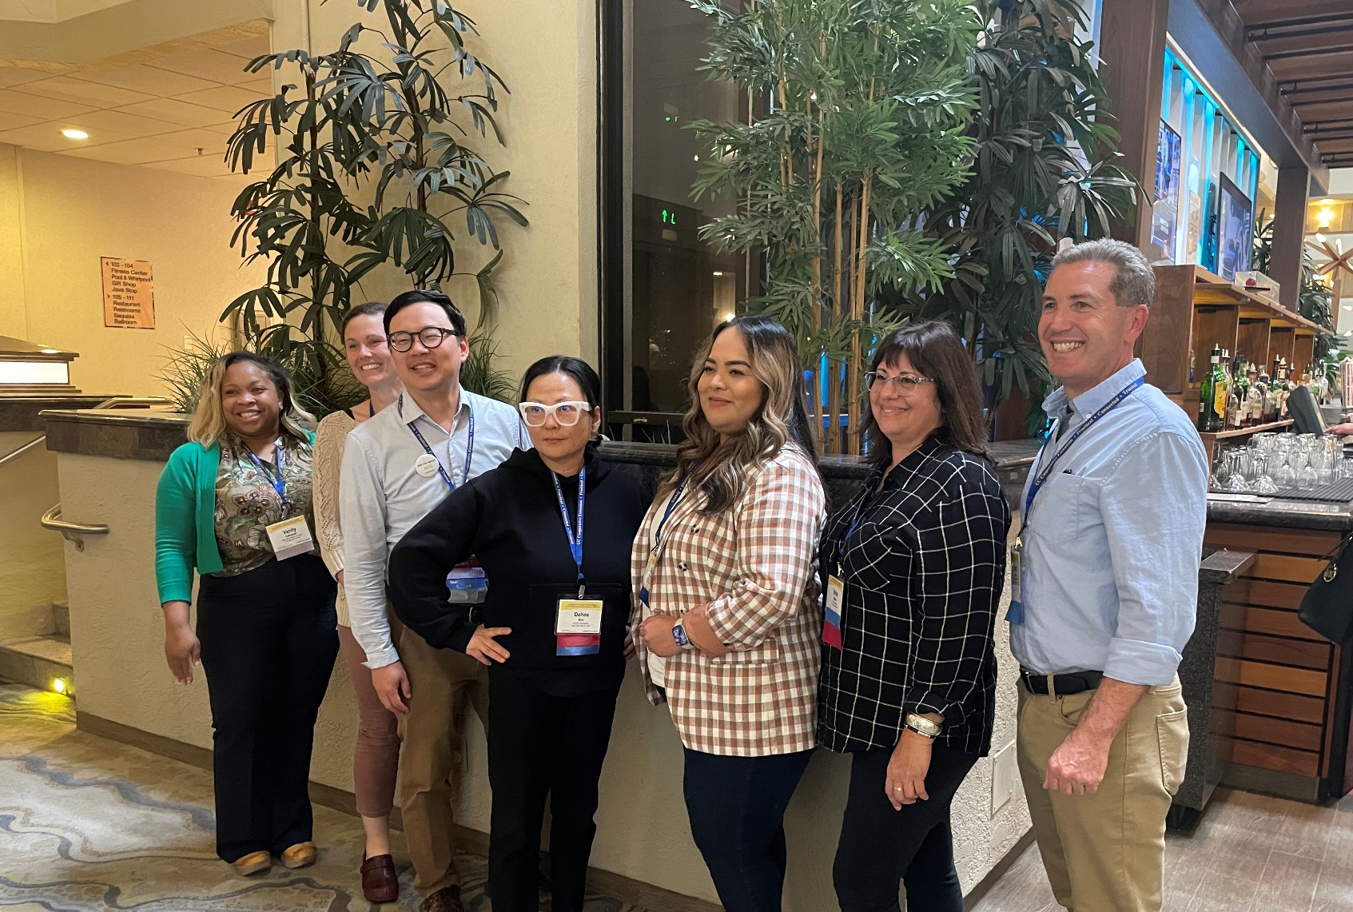
Leadership
Staff Assembly Council (SAC) met monthly discussing ways to cultivate a satisfied, dedicated and professional staff
Ambassadors met monthly to relay information on issues of concern to leadership
Staff Assembly Council met monthly with UC ANR leadership on ways to promote interests and welfare for all staff

Slide 3
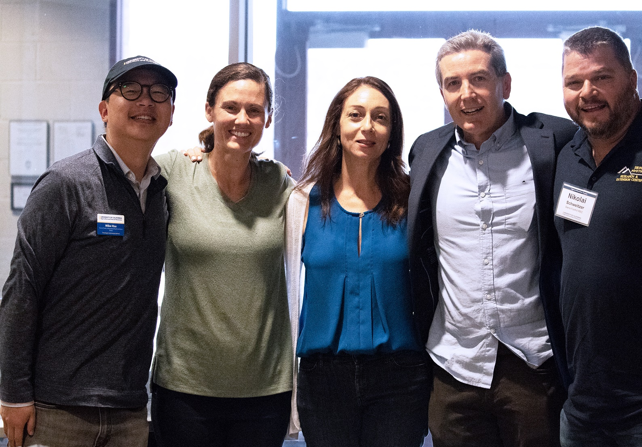
Communications
Created The Current, a Staff Assembly e-newsletter which reaches over 2,000 subscribers monthly with updated information
Hosted Staff Assembly Council meet and greet at the ANR Second Street building
Hosted Interim Executive Director of Human Resources Bethanie Brown for discussion about the Market Equity Adjustment program

Slide 4
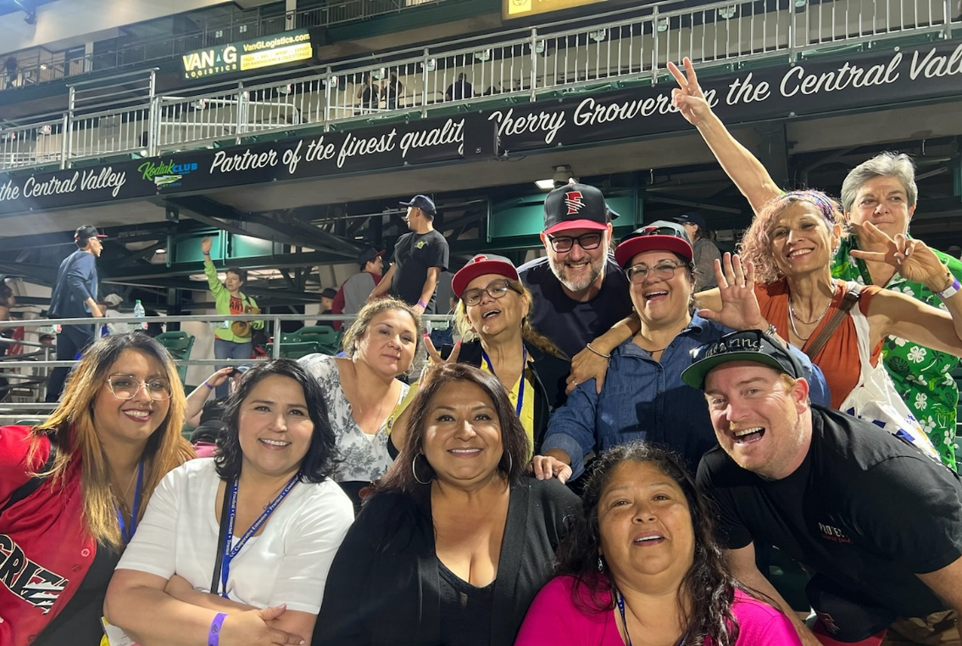
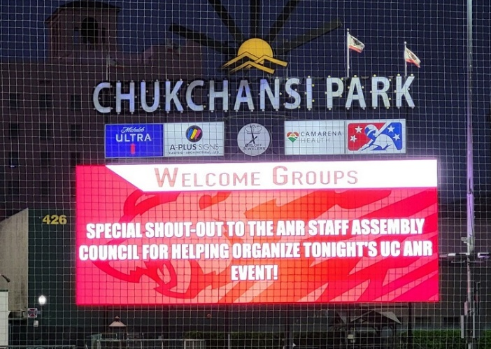
Statewide Conference
Coordinated a fun engagement event at the Fresno Grizzlies baseball game
Over 430 UC ANR employees RSVP’d for the game
More than 330 participated in the UC ANR Moves walk to the stadium

Slide 5
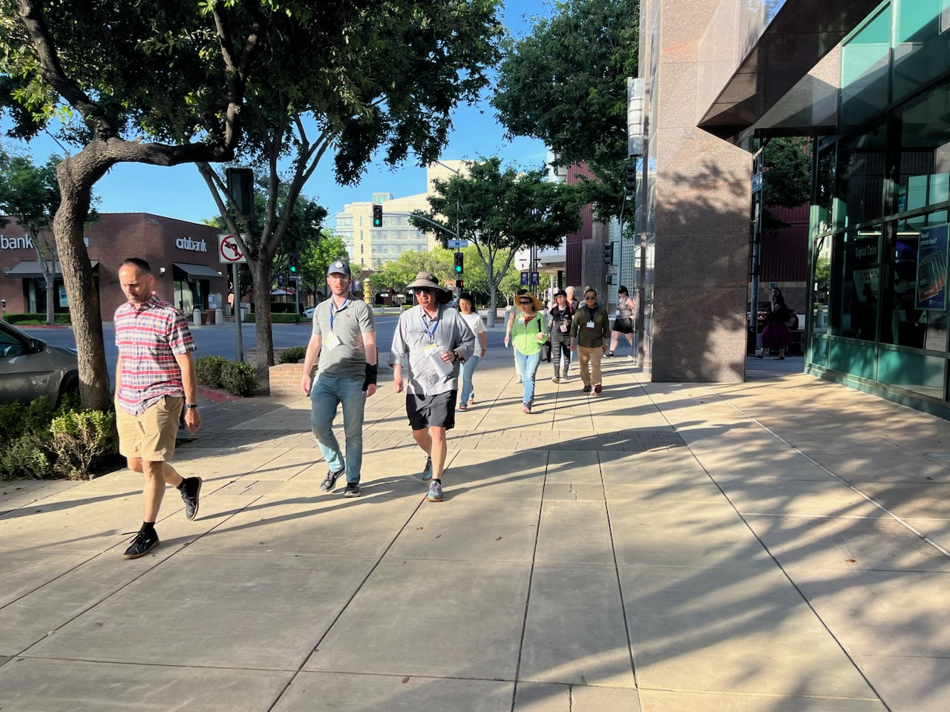
Education and Wellness Opportunities
Delivered over $8,600 in education reimbursements
Delivered almost $7,000 in wellness reimbursements
Over 100 staff participated in and benefited from these programs

Slide 6
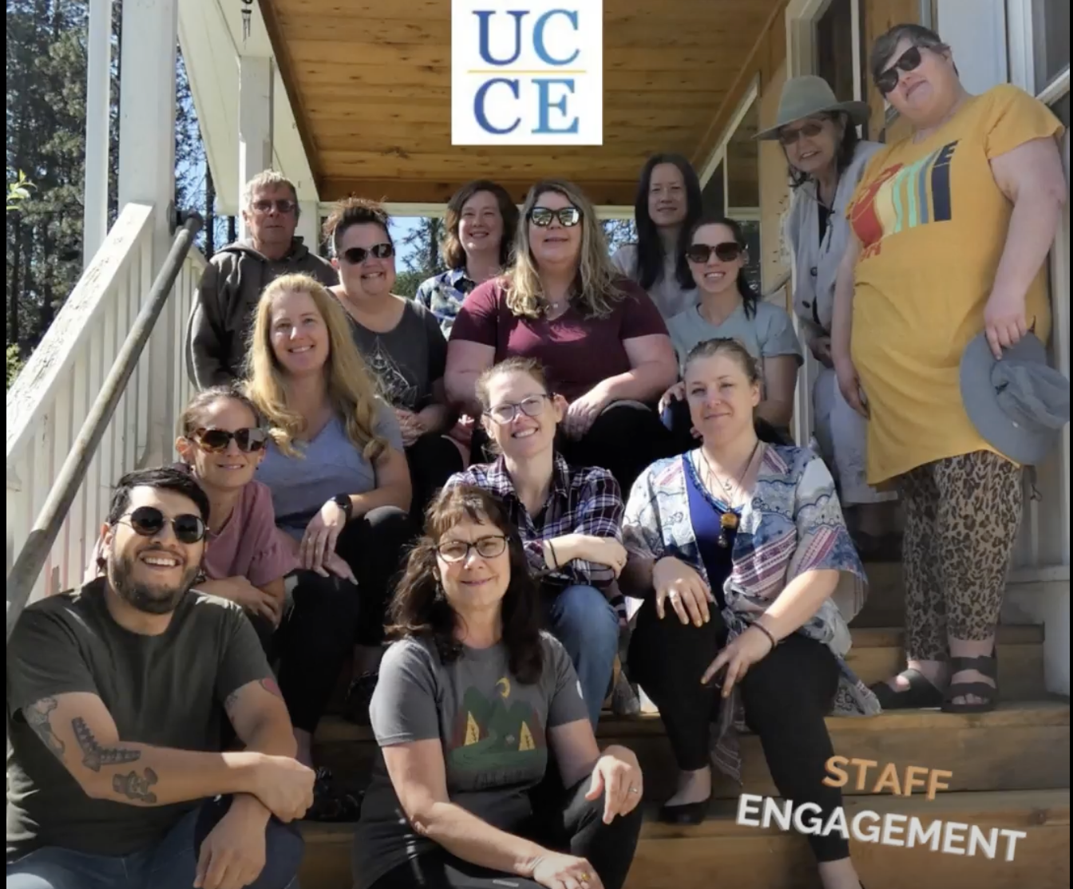
Ambassadors
Delivered over $4,000 in employee experiences through new Employee Experience and Engagement Challenge (E3-C)
The E3-C program is a results-oriented program designed to promote teamwork and build community

Slide 7
Vision for next year
FY24 SAC Positions | Delegate
Chair | Scott Brayton
Vice Chair | Dohee Kim
Sr. CUCSA delegate | Shirley Salado
Jr. CUCSA delegate | Monica Drazba
Treasurer | Sue Lake
Scribe | Christine Davidson
Communications Chair | Mike Hsu
Program Co-Chairs | Rosalinda Ruiz, Andrea Warner
Program Co-Vice Chairs | Kathryn Stein, Brooke Haley-Herevia
Wellness Chair | Jodi Azulai
Education Reimbursement Chair | Rosa Vargas
Ambassador Chair | Saoimanu Sope
Recruited 14 members to participate in the Staff Assembly Council for FY24
This is a believed to be the largest SAC in UC ANR history

Slide 8

Thank you!

