Slide 1
Infographic Customization Training
August 19, 2025
Hosted by Amanda Linares

Slide 2


Access the recording & slides
Find the webinar recording and this slide deck on the IOE and Adult DE Eval websites

Slide 3

Training Objectives
Become familiar with the new process for IOE data dissemination
  EATS interactive dataset (Excel)
  Infographic template (Canva)
Understand how to generate results at the desired level in the interactive dataset template
Know how to populate these results in the infographic template

Slide 4
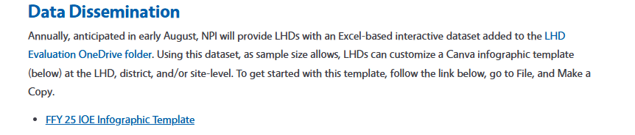

Where to Get Supplies
Canva infographic templates are on the websites
  IOE: EATS > Data Dissemination
  Adult: Survey & Evaluation Resources > Data Dissemination
Interactive datasets are in your LHD Evaluation OneDrive folder, but only IOE datasets for now

Slide 5
Why change the process?
Site-level infographics were not the ideal data product for all.
Small schools, rural schools, and afterschool sites could not always attain 30 matched pairs at the school-level.
Some LHDs requested analyzed data for other purposes, e.g., LHD year-end reporting, but NPI does not have the capacity to do custom LHD-by-LHD data analysis.
ADA best practices in Canva are time-consuming on a large scale, which delays getting you your data products.
As we sunset CFHL, the interactive datasets may act as data entry templates of old. If you plan to continue to utilize EATS in some capacity, interactive datasets can do a basic analysis of your data. If interested, reach out!

Slide 6
New Data Dissemination Process
Two Components
An IOE Infographic Template that each LHD can customize to create a visually appealing infographic that can be printed or shared digitally (Canva)
An Interactive* Dataset that analyzes and summarizing your LHD’s pre/post findings (Excel)
*Interactive indicates results can be filtered at multiple levels including school, district, LHD, and curricula.

Slide 7
Canva: Account Types
Like the Data Storytelling Toolkit, the template was created in Canva, using features available to free Canva accounts.
With a free Canva account, you can update text, change graphic colors, swap out graphics, rearrange text and graphics, and add or delete content.
If you have a paid Canva Pro account, you can access premium graphics and additional collaboration features.
All graphics in the IOE Infographic Template are free and it is already branded according to CFHL branding guide.

Slide 8
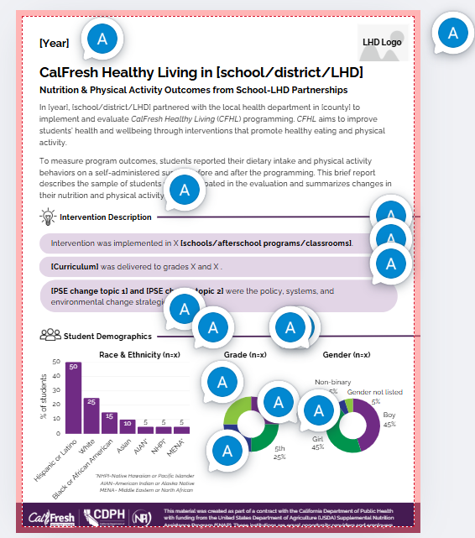
Canva: Instructions
The template contains instructions throughout in the form of comments which will alert you to the necessary customizations.
Please do not alter comments in the parent template nor add new comments.

Slide 9
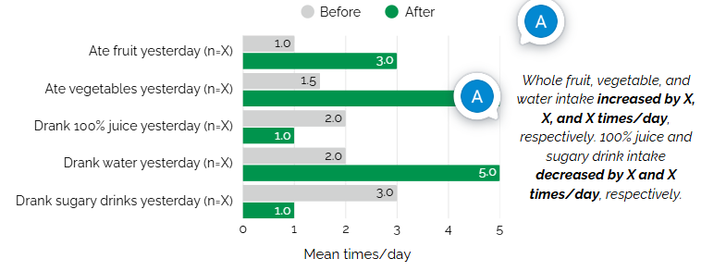
Canva: Updating Data
To serve as a visual, there is example data in the template’s graphs that you will need to update with your own data.
Sample sizes and pre/post finding statements are represented by an “X” in the template. You will replace the “X” with your data.

Slide 10
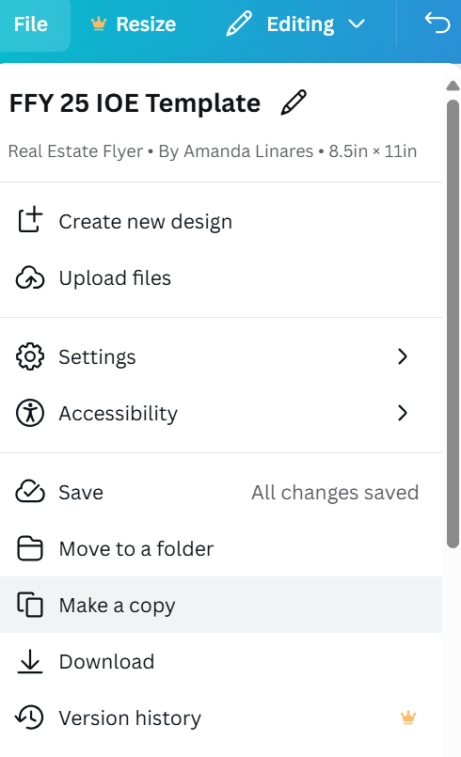
Canva: Get Started
To get started, after you’ve created a Canva account, follow the link to the parent template, go to File, and Make a Copy.
The copy will appear in a new window and will not have my comments/instructions, so refer to the parent version when customizing.

Slide 11

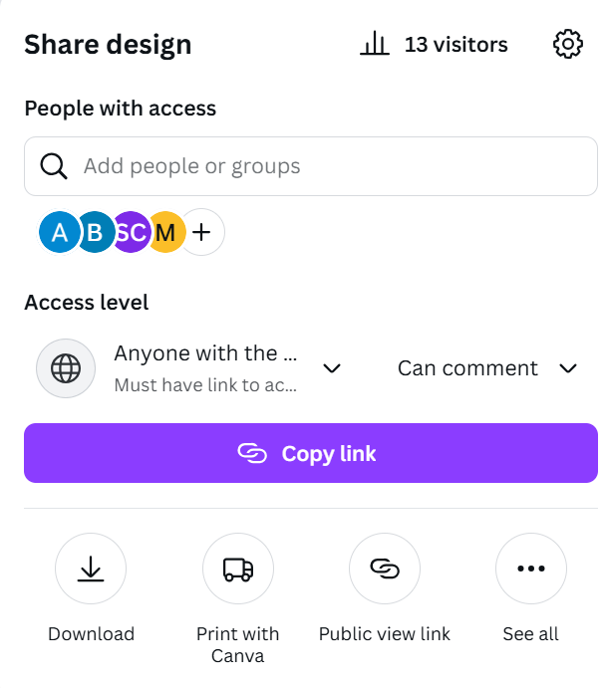
Canva: Collaborate
Your copy is only visible to you. To collaborate with your team, go to the Share button in the top right corner of your screen. From here, you have two options:
Manually enter your team members’ emails in the People with access bar.
Change the setting under Access level from ‘only you can access’ to ‘anyone with the link can…[edit/view/comment].’ You can then copy the link to share with team members.
Note: collaborators will need to log in or sign up for Canva to edit or make comments.

Slide 12
Canva: Navigating Core Features
Free versus premium elements: when adding new graphics/images, look for the crown icon; this denotes premium elements that you will be required to pay for when you download your document.
Edit text: double-click where you’d like to begin editing to update text, similar to how you would in a Word document.
Add text: to create a new text box, select text in your left navigation panel and click on add a text box. Settings for that text box will appear on the top panel.
Changing icons and graphics: to delete existing graphics, click on the element and delete or backspace. To replace a graphic, navigate to elements in your left panel and search for what you want. You can also upload your own images using uploads in the left panel.
Adjust the size/spacing of an element: text boxes and graphics can be moved and resized by selecting the outline, similar to how you would in PowerPoint.

Slide 13

Canva: Navigate Core Features
Adjust gauges to reflect your data: click on a gauge. You will notice a menu appear in the left panel of your screen. Percentage reflects your data. Change the number here and the gauge will adjust automatically. Line weight refers to the thickness of the gauge itself; you can keep the default setting or adjust based on your taste.
Change a group of elements at once: You can move, delete, or resize multiple elements at once by clicking and dragging your mouse to highlight multiple elements. Selected items will have a purple outline. Drag them or move them with your arrow keys.
Duplicating, deleting, and adding pages: above each page you will see the menu pictured below. The double-page icon with the plus sign will duplicate that page. The trash icon will delete that page. The right-most plus icon will add a blank page.

Slide 14
Canva: Share a Finished Product
Review your file’s name. To export click the Share button in the top right corner of your screen. Select Download. From the dropdown, choose a file type for your download.
If you included premium elements in your design, you will be prompted to upgrade your account to ‘Canva Pro,’ purchase a license for those elements, or proceed to download with those elements watermarked.

Slide 15
Don’t Forget! Accessibility and 508 Compliance
Complex documents like this contain elements that may not be auto-tagged accurately for assistive technology. To ensure full accessibility, please review and adjust your document in Adobe or equivalent software before sharing digitally. To learn more about accessible PDFs, check out this YouTube video [7:49].

Slide 16
Canva Help
Refer to page 5 and 6 on the Data Storytelling Toolkit Instruction Guide for detailed information about Canva’s core features!

Slide 17
Interactive Dataset
“Interactive” because the user can filter data to calculate change (but not p-values).
There are 8 components, i.e., tabs, to the dataset, but the user will only see 6.
Analysis dataset and pivot tables contain calculations that, if accidently modified, could affect the analysis. They are hidden and protected with a password.

Slide 18
Interactive Dataset: Components
Notes: Explains the purpose of each section of the workbook, how to use the filters, and provides a matched sample size for each site.
Codebook: Provides the typical components of a codebook- variable name, type, value, and label for each variable in the dataset.
Datasheet = dataset
Filters: Allow you to look at data by LHD, site, district, unique groups of sites, or curriculum.
Pre-Post tables: Display N’s and demographic % and the pre/post mean and % change for student nutrition and physical activity outcomes.
p-values*: Provides the p-value (significance) for each outcome for the LHD and each site with ≥ 30 matches.
*Calculated outside the template and added by hand

Slide 19
Let’s take a look at the templates together…

Slide 20
Additional Info
P-values are only available at the LHD and school level if sample size allows (≥ 30 matched pairs).
We advise not completing an infographic or disseminating in other ways results for samples < 30.
Depending on your familiarity with Canva, we expect each infographic to take ~20-45 min to complete.
We expect CFHL adult datasets to be ready by end of September.
If you need any assistance, reach out for help: amlinares@ucanr.edu

Slide 21

Questions

Slide 22

Thank you

