Slide 1
Introduction to Freeze Drying
Presented by: Eileen Hidahl
Title: Master Food Preserver
Date 08/16/2025

Slide 2
Freeze Drying
(Sublimation/Lyophilization/Cryodesiccation)
UNITS
*Home
*Pharmaceutical
*Industrial
Commercial HR 100
2025 Brands:
Harvest Right, Cuddon, Fisher Scientific, Wave, Cube,
4Patriots, Blue Alpine. Stay Fresh

Slide 3
History
* Early—13th Century Incas in Andes Machu Picchu (low atmospheric pressure, extreme cold)
* Ist patent--1934
* WW II—developed to transport blood products and antibiotics to wounded
* NASA—refined technology for lightweight, nutritious meals for astronauts
Ice Cream story
*1950, 1960--Pharma
*Harvest Right—2018 for home preservation (Salt Lake City, Utah)
*Prep4life, THE CUBE (Utah)—early 2023

Slide 4
Dehydrating vs Freeze Drying
Dehydrating Freeze Drying
Heat/Fan Sublimation ice->vapor) freeze & heat
Wicks Moisture 60-70% 99% moisture sublimation (vapor)
*Desiccant (silica packet) *Oxygen Absorber (Iron oxide)
mineral: silicon + O2 Iron + O2
absorbs moisture absorbs O2 (300cc)
Pre freeze: 24-48 hrs
Temp 105 F-165 F Temp -40 F + Heat (95-145)
Timer 0-26 hours Time 24-36 hrs
Shelf Life: 1 year Shelf Life: 25 years
Storage
eliminate O2, light, moisture

Slide 5
Harvest Right App
* Settings
* Register
* Setup (Wifi, Bluetooth)
* Machine communicates cycle
* About Freeze Drying
Maintenance, Manuals, Packaging, Rehydration
* Drying tips (guidelines for all products)
* Instant Support--AI
* Helpdesk (tickets/support)
* Store (Sales, Download Guide, Accessories

Slide 6
Maintenance Tips
* Defrost and Drain after each cycle
* Wash drum & freeze dryer trays with soap and water after ever batch (no harsh chemicals)
* Remove front gasket--washing with soap and water
* Complete removal of interior trays
* Never submerge trays as they have sensors
* Minimal air flow/ mold
* Can turn on heater for 20 min with door cracked (Leaf logo/Functional test)
* Periodically check seal contact to door (adjustments)
* Wash interior walls with soap and water or bleach (remove inner tray unit)
* Empty bucket each cycle (prevent water from being pulled back and ruining product)
* Check oil level before each cycle use (gauge between high/low)
* 25 cycles usually before oil filtering/change
* As alike a computer complete shut down is good

Slide 7
Maintenance of Pump
* 25 cycles before oil change-machine generally tells you
* Change if yellow, cloudy, particles appear
* Easiest to change after a cycle as oil is warm
* Shift pump to edge, place canister under valve, open drain & filter
* To refill unscrew Demister and fill with new oil to half way mark
* Make sure gasket is on correctly

Slide 8
Harvest Right Dongle
GAME CHANGER
* USB port
* Wifi Upgrade Kit (alike a router or modem, QR code scan ability)
(5.4v 5.5v)
* $70
* Updated to 6.0
* Remote control from smartphone
* Monitor process and get notifications
Batches finished
Extend drying time
New patented Candy Mode
Save your own settings, recipes
Tips provided

Slide 9
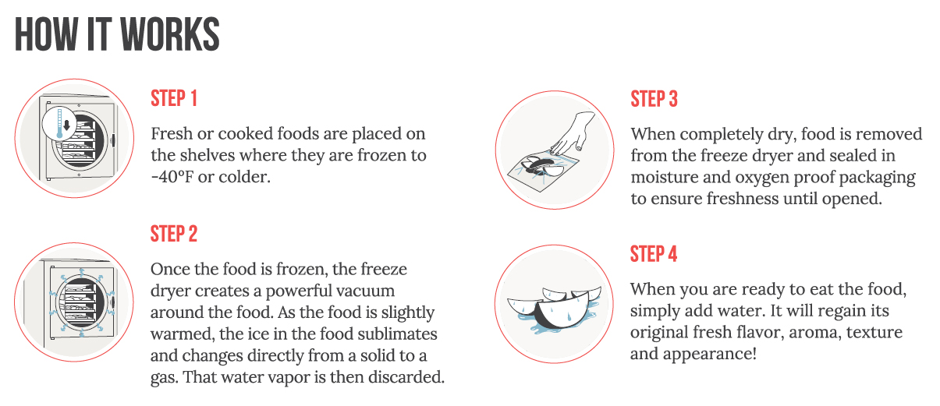
Brief Overview of Process

Slide 10
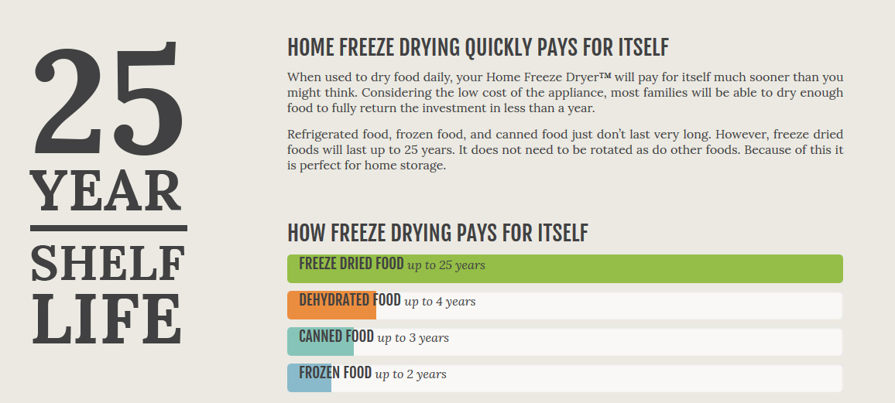
Information from Harvest Right Re: Shelf Life

Slide 11
Benefits
*Emergency Prep: Emergency Supply/Lightweight/Survival/Backpackers
*Garden/Orchard: Nutritional value/nutrients/vitamins/minerals
*Camping/Hunting: Lightweight/easy to rehydrate (mylar bags)
*Food Storage: No refrigeration/Easy to prepare
*Healthy Living: No preservatives, emulsifiers, additives
*Pet Food
*Taste: Appearance/Color/Texture/Aroma/Flavor/Nutrition
*Shelf Life: 25 years
*Versatility: Fruits/Vegetables/Meats/Fish/Eggs/Dairy
Cheese/Snacks/Meals/Casseroles/Soups/Gravy/Sauces/Stock/
Desserts/Ice Cream/Candy, Flowers
*Waste Not/Want Not: leftovers, excess foods, canned goods expiring, clear freezer

Slide 12
Freeze Drying
Preserve food for up to 25 years with 95% its flavor, color, nutrition, vitamins, natural enzymes
polyphenols, anthocyanins, protein, amino acids.
Process results in high quality food preservation/Superior method of preserving
University Research—little thus far (quality, longevity, bacterial studies) Utah State Extension
Process minimizes oxidation, but you can blanch or pretreat with ascorbic acid
Doesn’t do well…Honey, peanut butter, chocolate, high sugar items, baked goods, oils and fats/rancid
Does not destroy bacteria/microorganisms…dormant (listeria, e coli, salmonella, others)
Rehydration 1:1 ratio—spritz (Milk 1/3 c:1 c water)
Easy-to-use – just press start & the freeze dryer will beep when finished allowing you to walk away and come back to it later
Upgrade--Dongle
Smart technology calculates the necessary dry time & automatically monitors the freeze dry process to completion (~20-40 hrs)
Freeze dry up to 3,000 lbs. fresh food per year* (*This would require a person to use the freeze dryer 4 times a week for 50 weeks a year)
~ cost-$1.25-2.80 per day
Foraging, Cannabis, Taxidermy, Nutraceuticals (ferments), Seaweed, Placentas

Slide 13
Smart Technology
Easy to operate-pre programmed
USB/upgradable software (Dongle)
Prefreeze food 24/48 hours/-40degees/heat/extra dry cycle
mTorr: pressure variance d/t elevation (vacuum pressure)
calculates extra dry time

Slide 14
Harvest Right Units
*Small: 4 trays/434 sq. inches (110 volt/15 amp)
6-10 lbs per batch ~$ 2,295
*Medium: 5 trays/675 sq. inches (110 volt/15 amp)
10-15 lbs per batch ~ $ 2,895
*Large: 6 trays/1107 sq. inches (110 volt/15 amp)
18-27 lbs per batch ~ $ 3,600
*X Large: 7 trays/ 2251sq. inches (110 volt/15 amp)
40-50 lbs per batch ~ $5,000
*Commercial- HRC100:9 trays/ 2925 sq. in (220 volt/30 amp)
90 lbs per batch ~ $10,000 (EDC Food Bank)

Slide 15
Energy Usage
AC: 110 volts x 10 amps = watts
* 20-40 hours run time
Saving tips:
Pre freeze foods 24-48 hours
Process full loads
Once stored there is no other costs
Freeze Dryers have largest energy use of all processes
Easily stored, portability, Light weight, flavor, nutrient value
* You can use generators and off grid systems-back up batteries

Slide 16
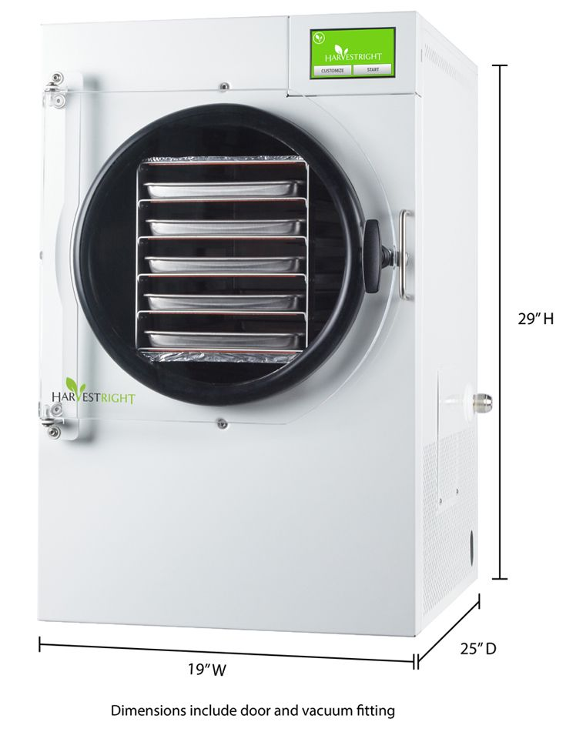
Harvest Right Pro-Freeze Dryer Specifications
Dimensions
Weight and warranty
Fully Automated
Software upgradable/USB (Dongle)
Weight of freezer dryer 119 lbs
Three year limited warranty
Sizes: Small, Medium, Large, X-Large
Commercial
Medium Size-5 trays
Dimensions (19” W x 29” Ht x 25” D)
Commercial Grade-Stainless Steel (+$200)

Slide 17
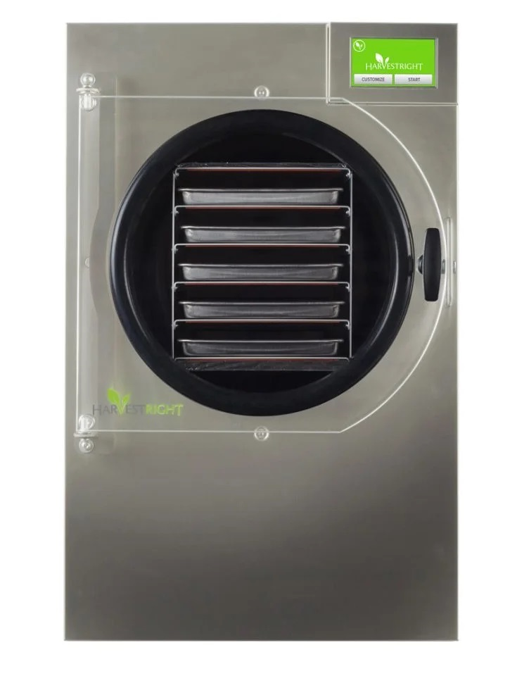
Harvest Right Pro Freeze Dryer Components
Appearance
Parts (stainless steel for commercial use)
Freeze dryer Commercial grade vacuum pump (18” X 9” X 14”)
Five stainless steel trays (7.5”X18”X.75”)
Silicone liners/Parchment
Mylar starter kit of 50 mylar bags, a mylar bag sealer and 50 oxygen absorbers
Oil filter/Oil
Insulator door pad/Gasket + (Backer Rod)
Power cord (100V)
Owner’s manual
Guide to Freeze Drying

Slide 18
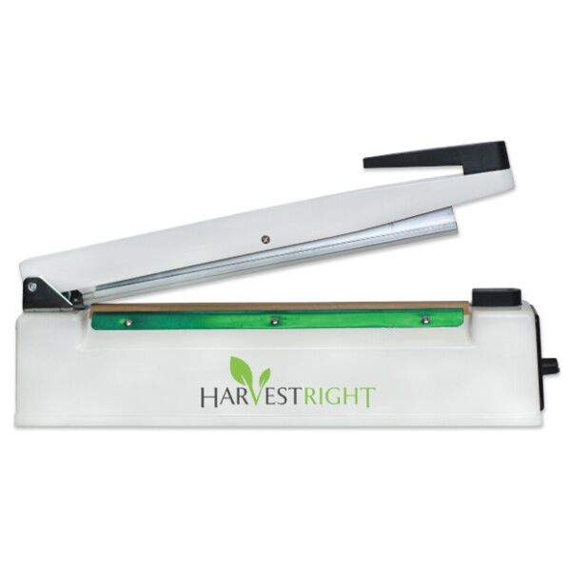
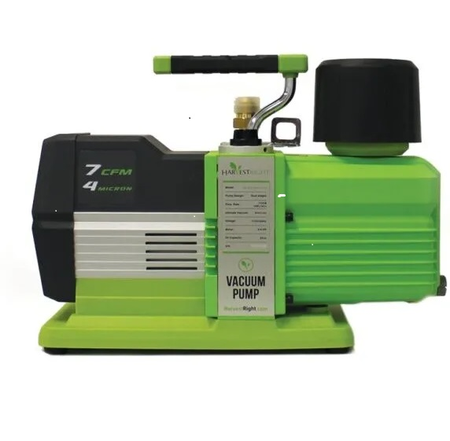
Items included with purchase (cont’d)
Harvest Right 12” Impulse Sealer
Harvest Right Freeze Dryer Vacuum Premium Pump Oil/Oiless

Slide 19
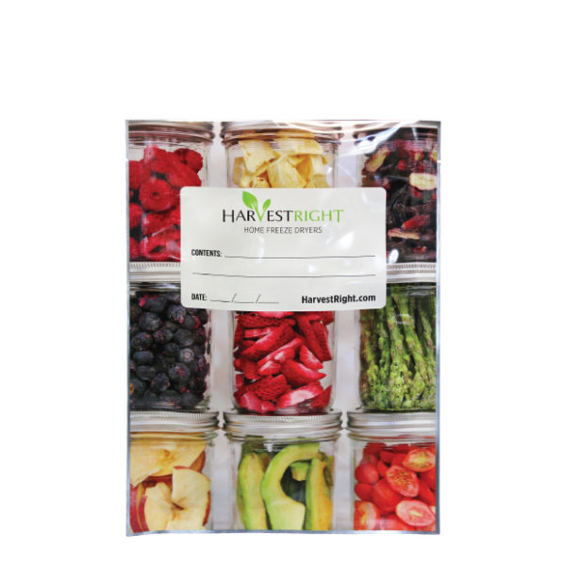
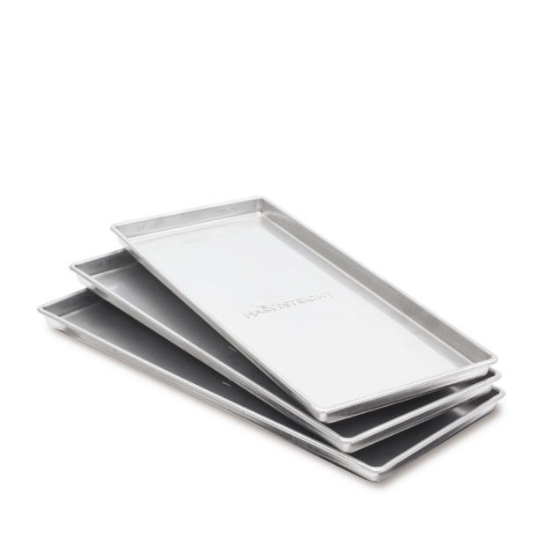
Items included with purchase (cont’d)
Mylar bags starter kit – 50 bags
7 MIL Thickness
Harvest Right Home Freeze Dryer Trays

Slide 20
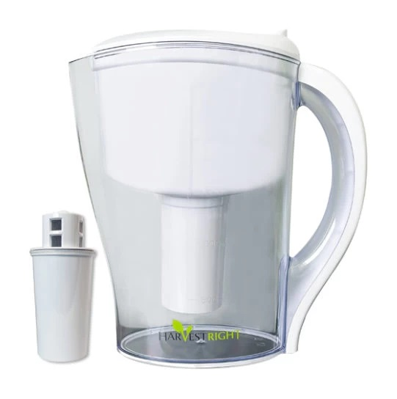
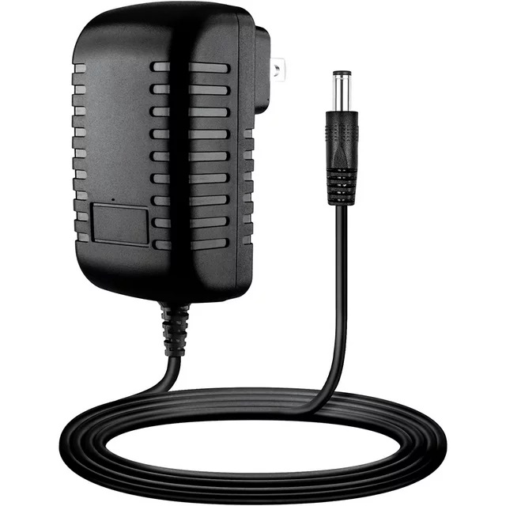
Items included with purchase (cont’d)
Freeze Dryer Oil Filter
100V Power Cord

Slide 21
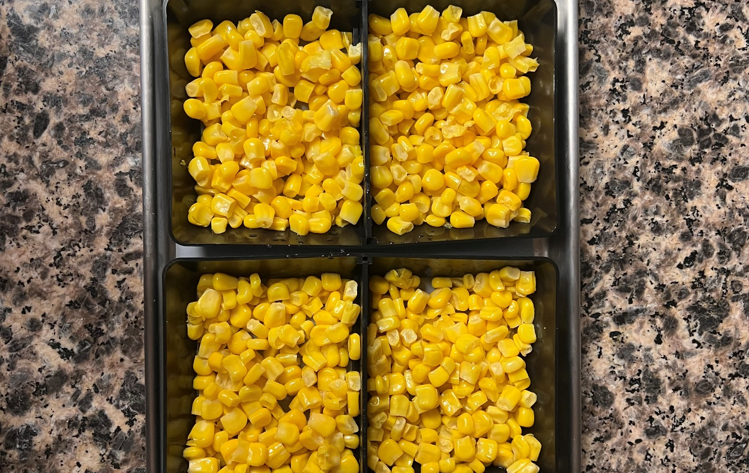
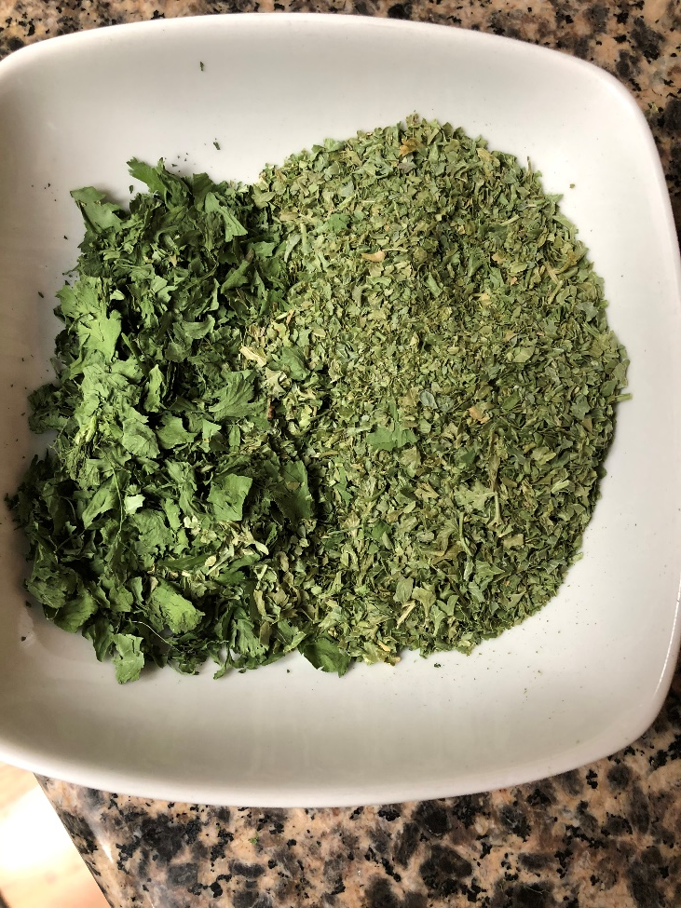
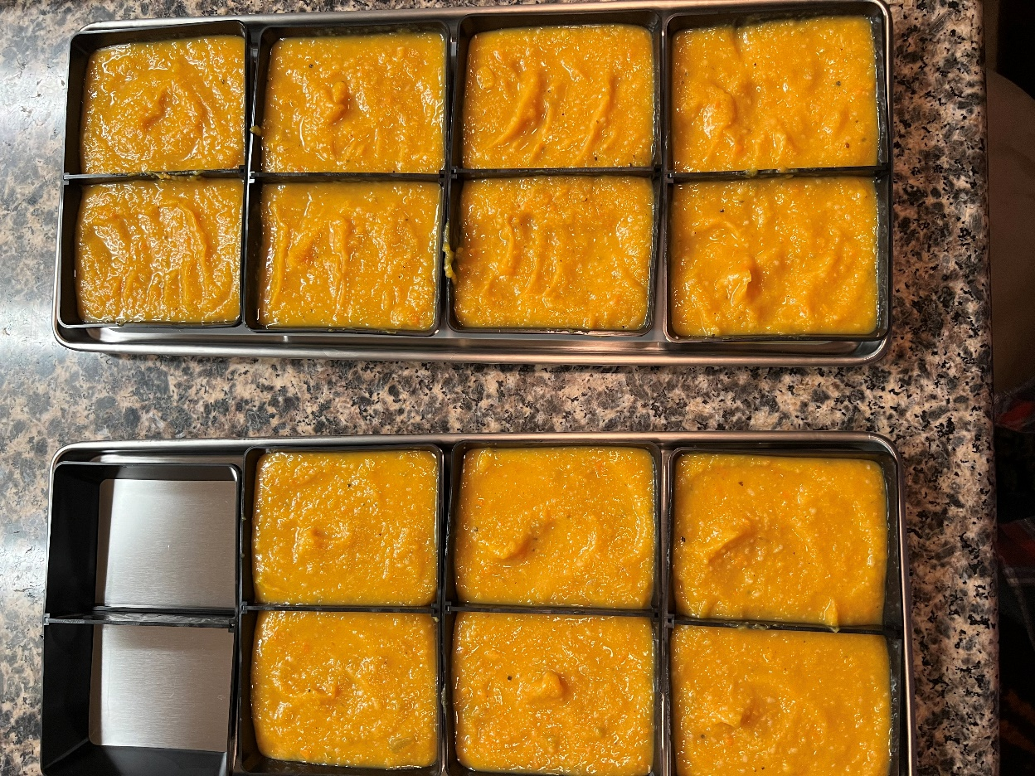
Options: Full Tray
Divide Portions: silicone, molds,
Powder form

Slide 22
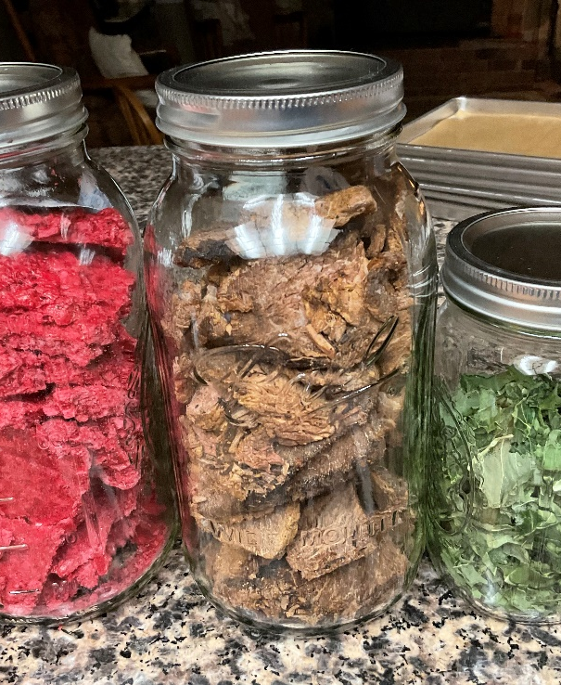
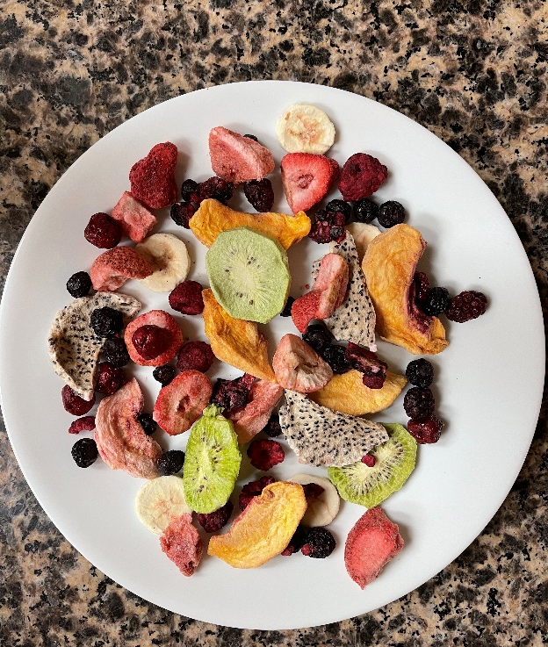
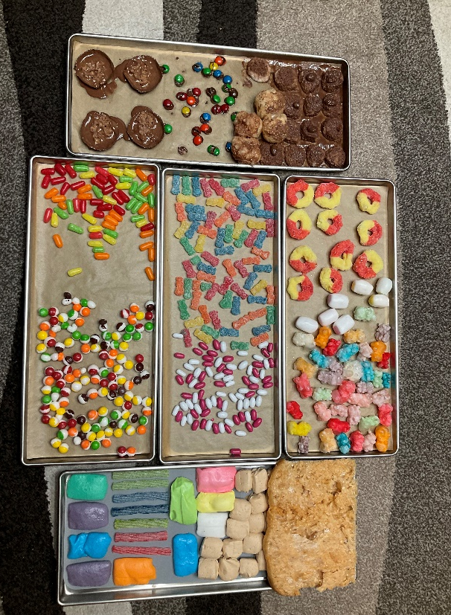
Fruit Meat Soups Candy
Pre freeze products 24-48 hours
Reduces explosive events
Adjust temperature:
Customize as needed:
Yogurt-95-110 degrees F
Candy-more heat
Herbs-less heat

Slide 23
For more layout choices view options when inserting a new slide

Slide 24
For more layout choices view options when inserting a new slide

