Slide 1
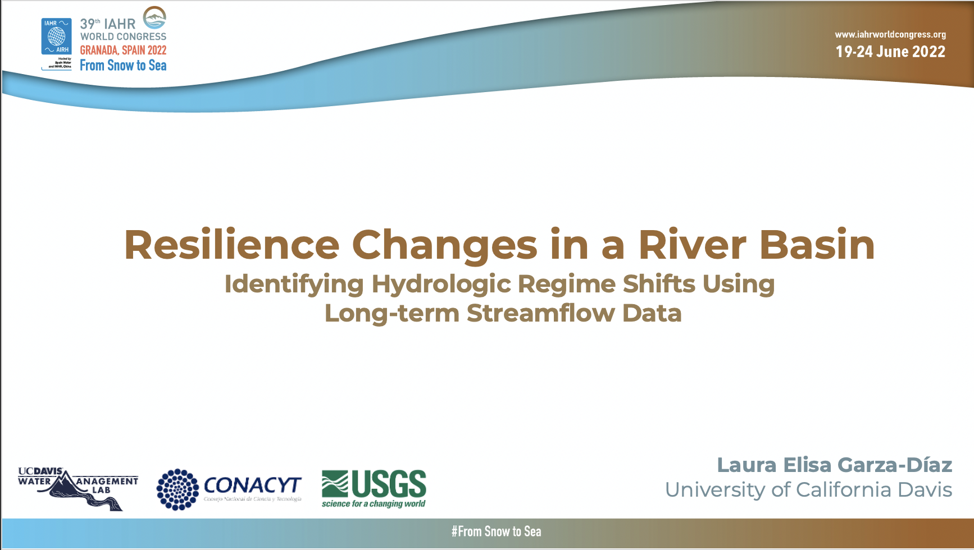
Resilience Changes in a River Basin using long-term streamflow data
legarza@ucdavis.edu

Slide 2

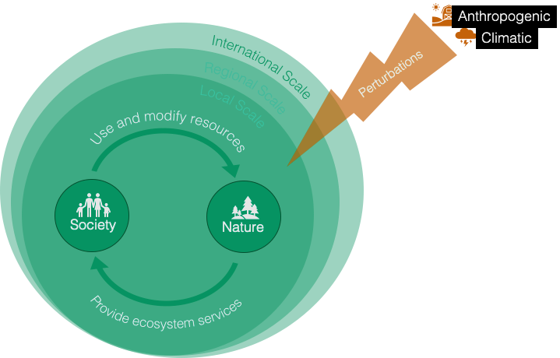

River Basins
As resilient social-ecological systems
Anthropogenic
Climatic
Regional Scale
Introduction
Notes:
River basins are unique resilient SES which are the pillar of human development and environment interaction across scales
However, widespread anthropogenic development and climatic forcing have resulted in highly stressed systems

Slide 3
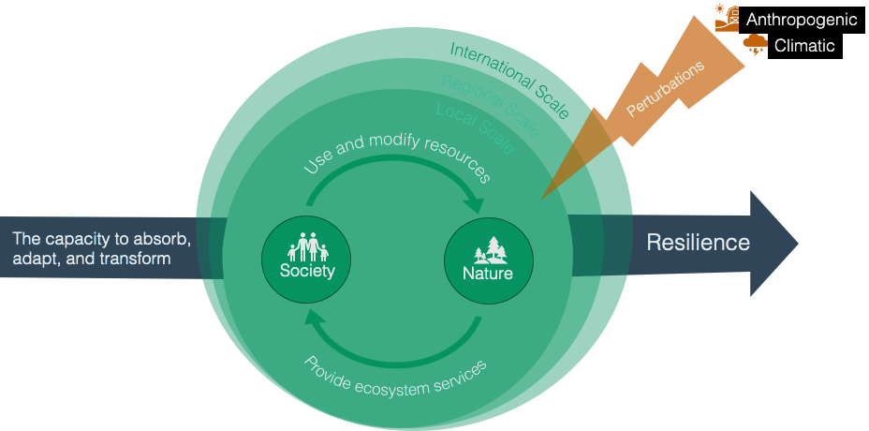
River Basins
As resilient social-ecological systems
Anthropogenic
Climatic
Regional Scale
“Ecological Resilience is the magnitude of disturbance a system can tolerate before it changes into an alternative regime”
(Holling, 1974)
Introduction
Notes:
According to resilience theory, river basins have the property of ecological resilience the capacity to absorb, adapt and transform to perturbations

Slide 4
River Basins
As resilient social-ecological systems
Anthropogenic
Climatic
Regional Scale
“Ecological Resilience is the magnitude of disturbance a system can tolerate before it changes into an alternative regime”
(Holling, 1974)
Introduction
Notes:
Persistent forcing, can bring the system to a critical threshold or limit, reaching a tipping point and causing undesirable regime shifts
the question is?

Slide 5
River Basins
As resilient social-ecological systems
Anthropogenic
RESEARCH QUESTIONS
How much perturbation a river basin can absorb before it experiences a regime shift?
Climatic
Regional Scale
Introduction
Notes:
the question is?

Slide 6
River Basins
As resilient social-ecological systems
Anthropogenic
RESEARCH QUESTIONS
How much perturbation a river basin can absorb before it experiences a regime shift?
Climatic
Regional Scale
If it does,
Can we identify when it happened?
Introduction

Slide 7
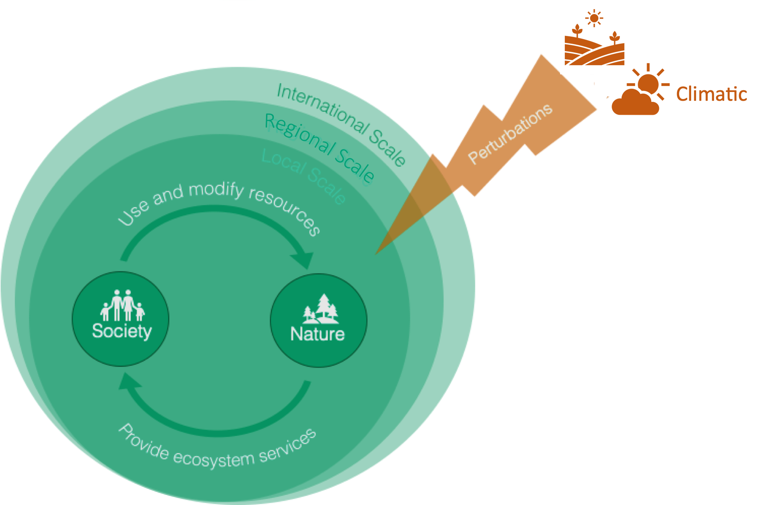
OBJECTIVE
Identify regime shifts,
and changes in the stability landscape of a river basin using long-term streamflow data through an ecological resilience assessment
Research Question and Objective

Slide 8
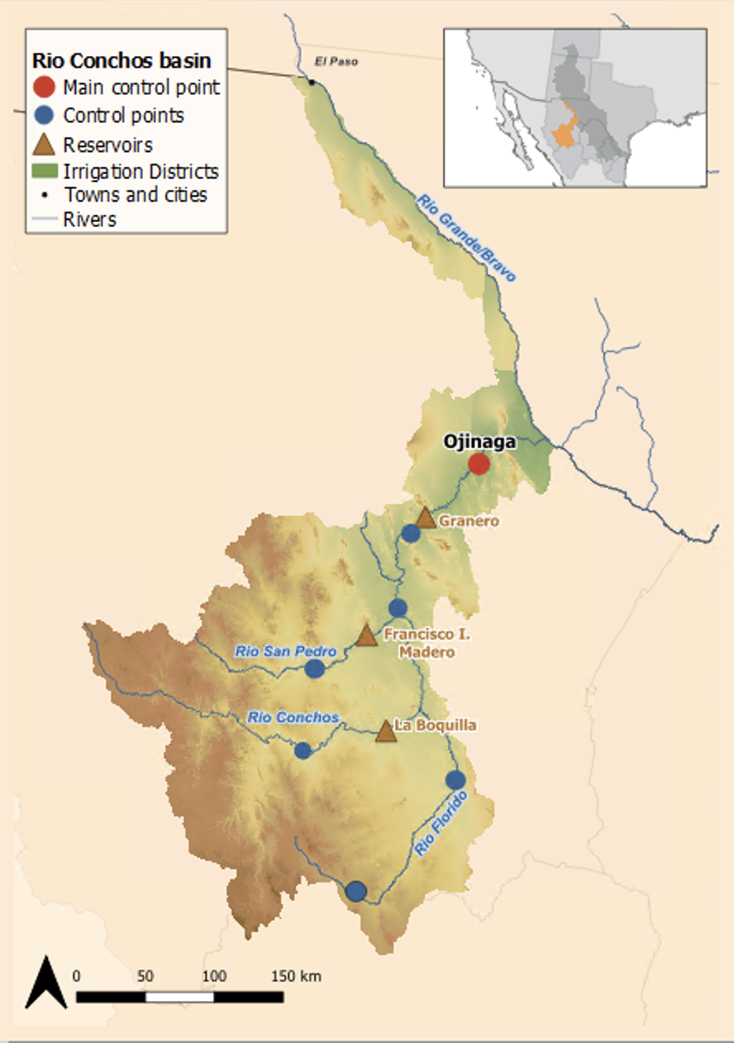
Case Study
The Rio Conchos
The Rio Conchos Basin is one of the most important areas of northern Mexico and it is a vital tributary of the transboundary Rio Grande-Bravo basin shared between the U.S. and Mexico
Data: 7 Control Points
Period of 110 years (1900-2010)
Timestep: Monthly
Results: at Ojinaga control point
Case Study
Notes:
Results will be shown downstream of the basin at Ojinaga station

Slide 9
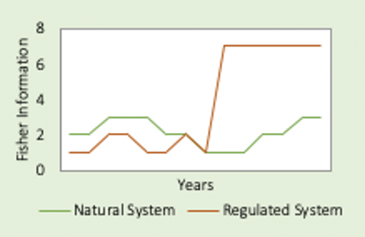
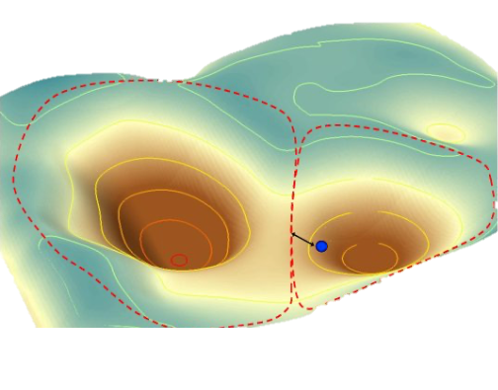

Ecological Resilience Assessment
Output
Output
Input Data: Regulated streamflow time series from 1900-2010
Water Balance
Regime Shifts
1. Streamflow Naturalization
$$Q_{t}^{nat}=O_{t}−I_{t}+ ∆S_{t}$$
Naturalized Streamflow timeseries
Streamflow Drought Index (SDI)
Time-window: 120 months
2. Hydrologic Assessment
Stability Landscapes
Naturalized and Regulated SDI values
Fisher Information (FI) (Ahmad et al., 2016)
Regime Shift Analysis
  Sustainable Regime Hypothesis
  Mann-Kendall non-parametric test (CI 95%)
  Probability Density Functions
3. Regime Shift Assessment
Methodology
Notes:
The ecological resilience assessment consist of 3 main steps,
Streamflow naturalizations using gauged streamflow timeseries: to convert gaged flows to natural flows that would have occurred in the absence of anthropogenic impacts such as reservoir development, water supply diversions, return flows, stream losses, and other factors (Wurbs and Asce, 2006).
Hydrologic Assessment: the SDI is used to normalize streamflow allowing an adequate comparison of the naturalized and regulated hydrologic conditions of a single control point.
3. Regime shift Assessment: is performed using quantitative indicator Fisher information (FI) captures the detection of regime shifts
The outputs of the ecological resilient assessment will be
Fisher Index: offers a means of measuring the amount of information about an unknown parameter based on current observations (Ahmad, Derrible, and Cabezas, 2017). This approach collapse the behavior of one or multiple variables of a complex system into an index, showing the overall system dynamics, regimes, and regime shifts (Fath, Cabezas, and Pawlowski, 2003; Karunanithi et al., 2008). FI has been used in ecosystem regime shift analysis including shallow lakes (Karunanithi et al., 2008), marine ecosystems (Mantua, 2004) , predator-prey dynamics (Mayer, 2005 ) and social-ecological systems including analysis of regime shifts in the sustainability of a regional system (Eason and Cabezas, 2012), in water supply systems (Skarbek, M. 2019 ),

Slide 10
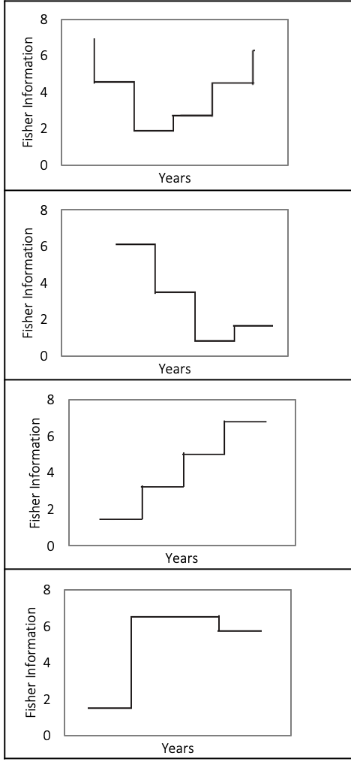
How do we determine regime shifts?
Sustainable Regime Hypothesis (Cabezas and Fath, 2002)
(1) A system is dynamic when a non zero Fisher Index (FI) is constant
(2) A steady decrease in FI indicates warning of regime shift
(3) A steady increase in FI indicates the system is becoming organized and stable
(4) A sharp change in FI denotes a regime shift*
*FI values are greater than +-2 SDV from the mean of FI (Gonzalez-Mejía et al., 2012).
Methodology
Notes:
The SRH is a frameqoekr developed to determine if a regime shift occurred using FI patterns.
For example:
Give the examples of the 2SDV

Slide 11
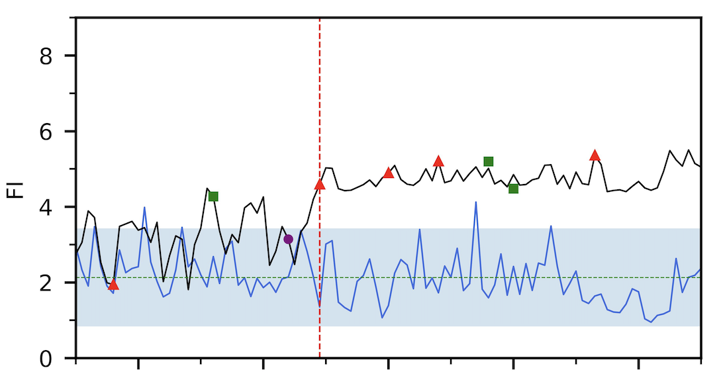
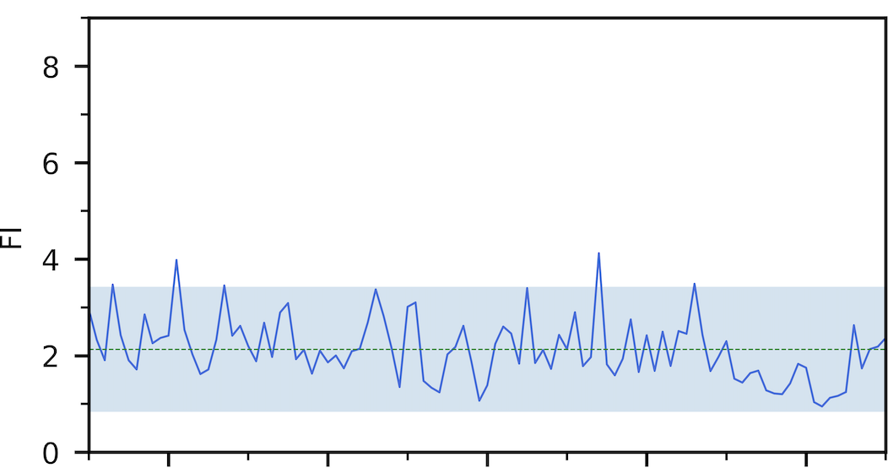

Regime Shift Analysis
Results
Notes:
Regime shift analysis is performed throught Fisher information results. In this graph we compare Fisher Information values of the natural and the regulated states of the system.

Slide 12
Regime Shift Analysis
Sustainable Regime Hypothesis
(2) A steady decrease in FI indicates warning of regime shift
Natural System remains within the +-2SDV range
Mann-Kendall showed a decreasing trend indicates
warning of regime shift. (2)
Results
Notes:
Regime shift analysis is performed throught Fisher information results. In this graph we compare Fisher Information values of the natural and the regulated states of the system.

Slide 13
Regime Shift Analysis
Results
Notes:
Regime shift analysis is performed throught Fisher information results. In this graph we compare Fisher Information values of the natural and the regulated states of the system.

Slide 14
Regime Shift Analysis
Sharp increase in 1948,.
FI values move outside of the +-2SDV
indicative of a regime shift (4)
The system remains in a new regime
Results
Notes:
Natural System remains within the +-2SDV range : meaning the system stays at an orderly dynamic state
Mann-Kendall showed a decreasing trend: (3) indicates warning of regime shift.
The system is perturbed with climatic forces but still persists in time.
In the regulated system I was expecting a regime shift but tdidn't know when,
this is a larger system that has been
The regulated system shows a sharp increase in FI outside of +-2SDV range in 1948 that kept the system outside of the 2sdv range
An increase in the system is related to dynamic order. However, it is not an indication that the system is moving toward a more humanly preferable state

Slide 15
Regime Shift Analysis
Sustainable Regime Hypothesis
Sharp increase in 1948, FI values remain outside of the +-2SDV
indicative of a regime shift (4)
The system remains in a new regime
(4) A sharp change in FI denotes a regime shift*
*FI values are greater than +-2 SDV from the mean of FI (Gonzalez-Mejía et al., 2012).
Results
Notes:
Natural System remains within the +-2SDV range : meaning the system stays at an orderly dynamic state
Mann-Kendall showed a decreasing trend: (3) indicates warning of regime shift.
The system is perturbed with climatic forces but still persists in time.
In the regulated system I was expecting a regime shift but tdidn't know when,
this is a larger system that has been
The regulated system shows a sharp increase in FI outside of +-2SDV range in 1948 that kept the system outside of the 2sdv range
An increase in the system is related to dynamic order. However, it is not an indication that the system is moving toward a more humanly preferable state

Slide 16
Changes in Stability Landscape
Basins of attraction
Naturalized System
Regulated System
Results
Notes:
Moving into a graphical resilience representation are the stability landscapes of a system.
Stability landscapes represents the resilience attributes of the system (Walker, 2004), wide basins mean a greater number of system states can be experienced without crossing a threshold, while deep basins indicate greater perturbations are required to change the current state of the system away from the attractor (Walker et al., 2002).
These figures depict the conditional probability of a given SDI value (SDI_{t}) given a previous SDI value (SDI_{t-1}).
For clarity, the shadow in the quadrant plate reflects the probability density function of the basins of attractions. Stable states in the stability landscape are shown as the several occurring valleys and the hilltops mark the boundaries between basins of attraction and represent the states where the system exists for a period of time.

Slide 17
Conclusion
A resilient river basin system can cope with shocks and perturbations until its sustainable carrying capacity allows it.
      A regime shift occurred in the Rio Conchos Basin by 1948.
      Four perturbations are identified as the causes of a regime shift:
      Changes in resilience and are visible using stability landscapes
Closing knowledge gaps
Ecological resilience assessments have long remained mostly conceptual in hydrology; thus, there is a need to use quantitative methods for estimating resilience and understand the effects of rapid global change river basins
Conclusion
13/15
Notes:
provide insights into new opportunities for ecosystem improvement and management strategies..

Slide 18
Resilience Changes in a River Basin using long-term streamflow data
legarza@ucdavis.edu

Slide 19
How do we determine a regime shifts?
Sustainable Regime Hypothesis (Cabezas and Fath, 2002)
(1) A system is dynamic when a non zero Fisher Index (FI) is constant
(2) A steady decrease in FI indicates warning of regime shift
(3) A steady increase in FI indicates the system is becoming organized and stable
(4) A sharp change in FI denotes a regime shift*
*FI values are greater than +-2 SDV from the mean of FI (Gonzalez-Mejía et al., 2012).
Methodology
10/15
Notes:
The SRH is a frameqoekr developed to determine if a regime shift occurred using FI patterns.
For example:
Give the examples of the 2SDV

