Slide 1


UC Master Gardener Program Brand Refresh
Launching October 13, 2025

Slide 2

Evolution Through the Years

Slide 3

Brand visual alignment project
Why?
  Visual alignment and modernization of our sub-brand logos will help grow awareness of the total impact and value of UC ANR
  Sub-brand visual alignment can help existing clientele connect with other ANR programs that might benefit them

Slide 4
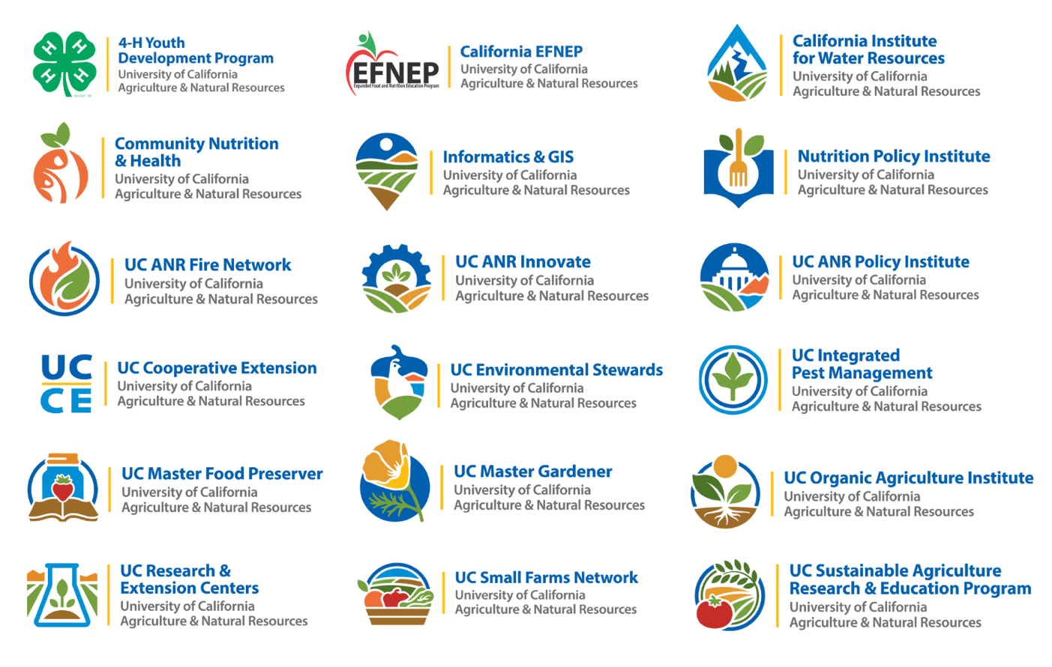

The New UC ANR Look

Slide 5



The California poppy remains at the heart of who we are—honoring our history while welcoming the next chapter of our story ...

Slide 6
What’s New
  UC Master Gardener name appears first for stronger visibility
  Updated fonts and colors for accessibility
  Simplified design that works across digital and print
  Modern yet timeless, connects our legacy and future

Slide 7


Three Line Lock-up
Brand Symbol
Brand Wordmark
Gold Divider
Please allow a safe area of white space around all four sides of the logo equal to the height of the bottom three lines of text in the Brand Wordmark, as demonstrated by X.
This ensures that the brand stands on its own.

Slide 8
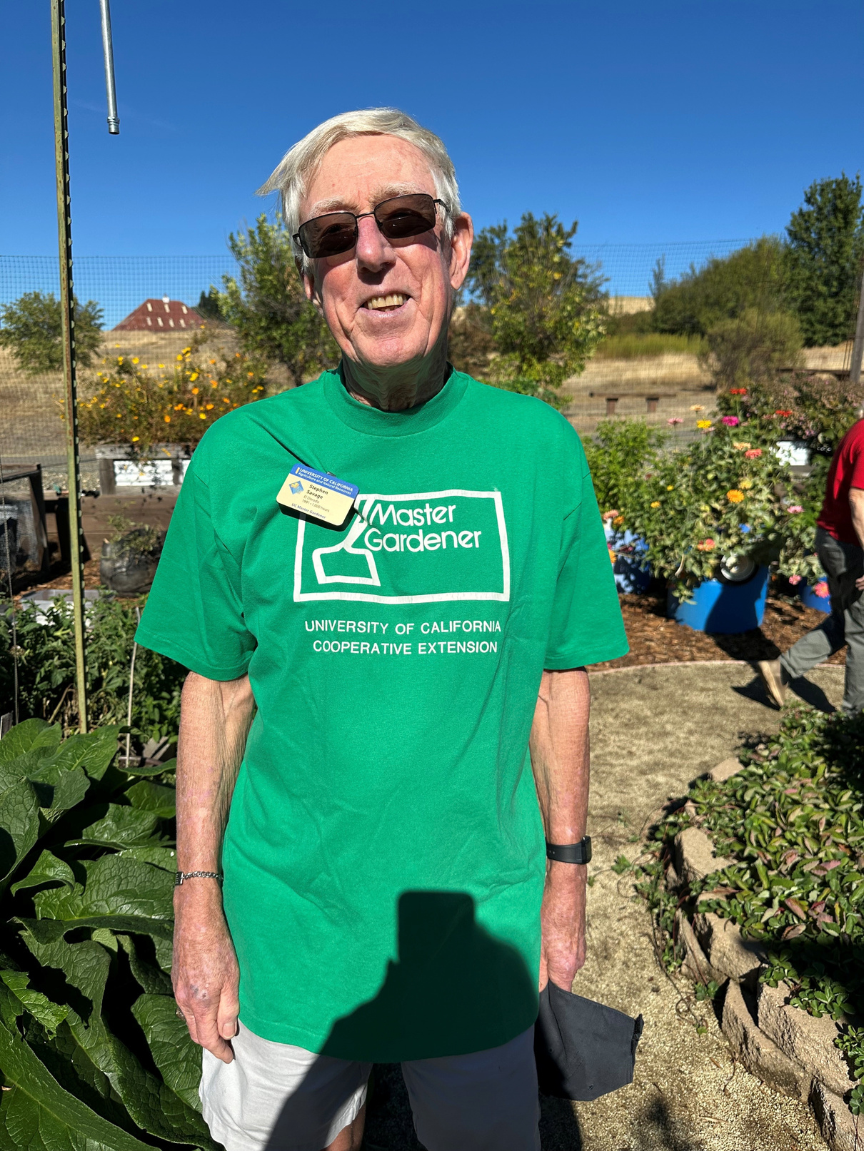
Strengthening
Our Impact
  Our refreshed logo aligns with UC ANR, strengthening recognition and trust in our program
  The updated design reflects how our program has grown, polished, forward-thinking and rooted in science
  A unified and consistent look helps the public see how our program connects with the broader network of UC ANR resources and expertise
Stephen Savage at the Sherwood Demo Garden has been a UC Master Gardener in El Dorado County since 1991. Photo credit | Missy Gable

Slide 9
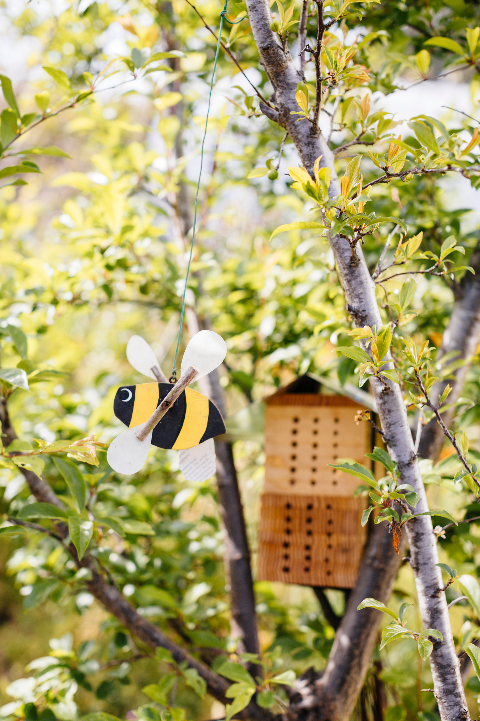
Support During
the Change
  We understand this logo is part of your identity
  Change can feel bittersweet — and that’s totally okay
  We’re honoring past logos and celebrating this next chapter together
  Support includes communications plan, FAQs, office hours, updated materials

Slide 10

Timeline at a Glance
Oct. 2025
Year 1
Year 2
Year 3
Year 5
  Press release, social media, website updates, and volunteer communications shared statewide.
  Coordinators and volunteers gain access to toolkits, FAQs, and Canva templates.
  High-use materials (PowerPoint templates, flyers, certificates, digital assets) updated and distributed.
  Coordinators and volunteers begin using new templates in internal and external communications.
  Fully transitioned to the new logo in daily communications.
  Secondary branded items redesigned and available for ordering and replacement of materials that are old or no longer functioning (banners, table runners, patches, folders, notecards).
  Continued phasing out of older physical materials (pop-up banners, tablecloths, signage, etc.) as counties re-order and replace stock.
  Expansion of branded assets and collateral to meet program needs.
  Legacy logos and outdated materials fully retired.
  Rebrand celebrated as fully embedded in program identity, celebration at program’s 50th anniversary.

Slide 11
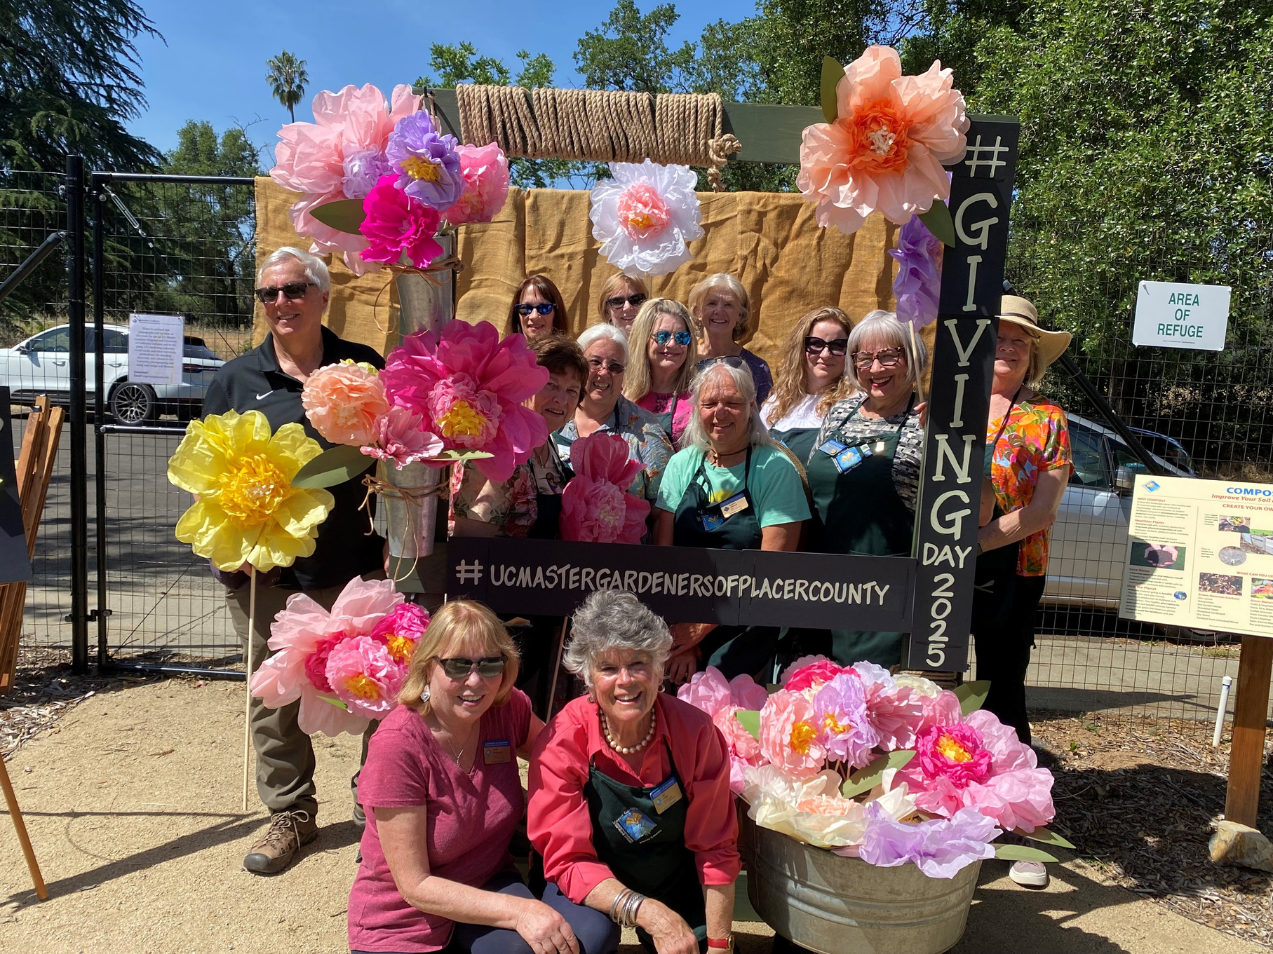
How you can help!
  Start using new templates and logos for digital materials
  Update email signatures
  Share the story with volunteers and community partners
  Retire older materials as they phase out
Photo credit | UC Master Gardeners of Placer County

Slide 12
Where to Find Resources
  Rebrand webpage & communications toolkit
  Canva templates
  Office hours & brand trainings
  FAQs
ucanr.edu/site/uc-master-gardener-coordinators/branding

Slide 13
Thank you!

