Slide 1
UC ANR
Chart of Accounts Review
FY 25-26
Presented by BOC and SWPR
August 28th, 2025

Slide 2

Agenda
Chart of Accounts Segments
General Ledgers CoAs
  Change - ASCR for FY 25-26
PPM CoAs
Segmentor and Finjector
Resources

Slide 3
Chart of Accounts (CCOA) Segments
Chart strings are long combinations of accounting information that are used to track expenses and revenue for each campus.
Each segment contains a value that relates to a specific element of the Chart of Accounts such as Fund or Financial Department
UCANR Entity (3310)-Fund-Financial Department-Natural Account-Purpose-Program-Project-Activity
Notes:
Chart of Accounts Segments
Each chart string may include the following components:
Segment
Description
Entity
Always 3310 for UC ANR
Fund
Identifies the source of funding
Financial Dept
Code for your county/department
Natural Account
Specifies what is being purchased or reimbursed
Purpose
Used for financial statement classification
Program
Indicates academic/location activity (e.g., PPS, UT)
Project
Tracks financials for a specific body of work
Activity
Optional; used for recurring or time-specific transactions
📝 Not all chart strings include every segment, but most will use several of them.

Slide 4
General Ledger (GL)
Types of funds managed in the GL – Central Funds
  Advisor Support
  Additional Advisor Support
  New Advisor Startup
  CE Specialist Program Support
  New CE Specialist Startup
  Community Educator Support
  UCCE unit and Director General Support
  Academic Salary Cost Recovery FY 25-26
Notes:
Chart of Accounts Segments
Each chart string may include the following components:
Segment
Description
Entity
Always 3310 for UC ANR
Fund
Identifies the source of funding
Financial Dept
Code for your county/department
Natural Account
Specifies what is being purchased or reimbursed
Purpose
Used for financial statement classification
Program
Indicates academic/location activity (e.g., PPS, UT)
Project
Tracks financials for a specific body of work
Activity
Optional; used for recurring or time-specific transactions
📝 Not all chart strings include every segment, but most will use several of them.

Slide 5
Correct CoA
Using the correct CoA—with its assigned segments
  ensures our ledgers are accurate,
  makes it easier to track expenses and balances,
  supports better decision-making throughout the year
Notes:
Chart of Accounts Segments
Each chart string may include the following components:
Segment
Description
Entity
Always 3310 for UC ANR
Fund
Identifies the source of funding
Financial Dept
Code for your county/department
Natural Account
Specifies what is being purchased or reimbursed
Purpose
Used for financial statement classification
Program
Indicates academic/location activity (e.g., PPS, UT)
Project
Tracks financials for a specific body of work
Activity
Optional; used for recurring or time-specific transactions
📝 Not all chart strings include every segment, but most will use several of them.

Slide 6
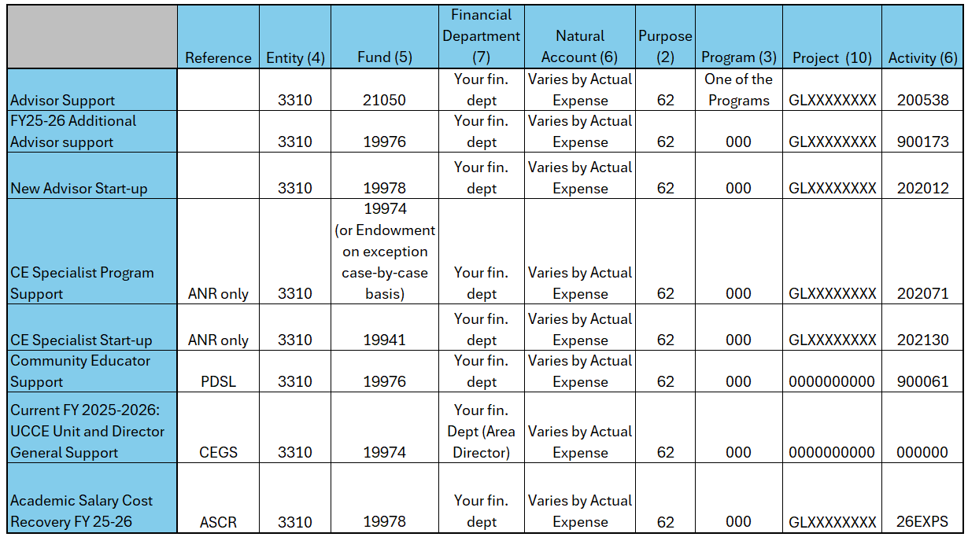
GL Chartstring for Central Funds – At a Glance

Slide 7
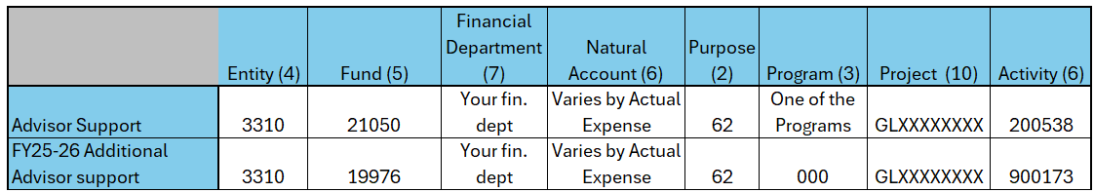
Advisor Support
Advisor Support – $2,000 per fiscal year – expires June 30th
  fund 21050 (Federal Funds)
  always use a Program (WTR, IPM, APS, PPS, FAF, WLS, NUT, YCD)
  GL Project of Advisor – GL + ORG/UNIT + 4 digits (i.e. GLALAM0520)
  Activity – 200538 (Faculty Support)
FY 25-26 Additional Advisor Support – $2,000 per fiscal year – expires June 30th
  fund 19976 (State Funds)
  GL Project of Advisor – GL + ORG/UNIT + 4 digits (i.e. GLALAM0520)
  Activity – 900173
Notes:
WTR Water Resources
IPM Endemic and Invasive Pest Management
APS Animal Production Systems
PPS Plant Production Systems
FAF Forestry and Fire
WLS Working Landscapes
NUT Nutrition
YCD Youth and Community Development
https://ucanr.edu/site/uc-anr-business-operations-center/ucce-funding-allocations#AdvisorSupport
Uses and allowable expenses

Slide 8
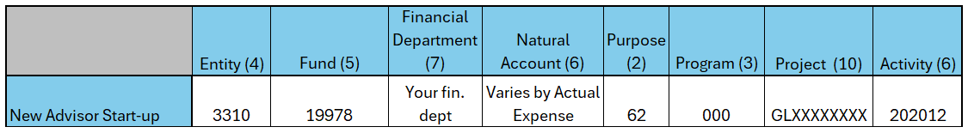
Advisor Startup
New Advisor Start-up
  fund 19978 (State Funds)
  GL Project of Advisor – GL + ORG/UNIT + 4 digits (i.e. GLALAM0520)
  Activity – 202012 (Faculty Start-up)
  Expires in 3 years (June 30th of that 3rd year)
Notes:
https://ucanr.edu/site/uc-anr-business-operations-center/ucce-funding-allocations#AdvisorStartup
Uses

Slide 9
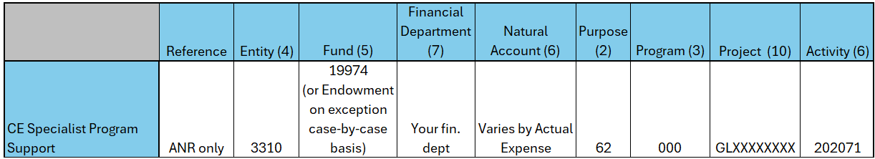
CE Specialist Program Support
CE Specialist Program Support – expires June 30th
  fund 19974 (State Funds)
  GL Project of Academic – GL + ORG/UNIT + 4 digits (i.e. GLUCSC6150)
  Activity – 202071 (Specialist Support)

Slide 10
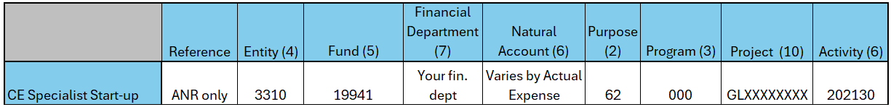
CE Specialist Start-Up
CE Specialist Start-up
  fund 19941 (Unrestricted Funds)
  GL Project of Academic – GL + ORG/UNIT + 4 digits (i.e. GLUCSC6150)
  Activity – 202130 (CE Specialist Start-up)
Notes:
Reference Entity Fund Financial Department Natural Account Purpose Program Project ID Activity

Slide 11
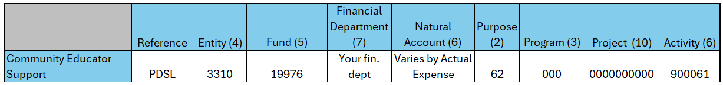
Community Educator Support
Community Educator Support
  fund 19976 (State Funds)
  Program and Project – Default (always enter all the zeros 3 and 10, respectively)
  Activity – 900061
  $1,000 per CES
  Expires June 30th
Notes:
https://ucanr.edu/site/uc-anr-business-operations-center/ucce-funding-allocations#CES

Slide 12
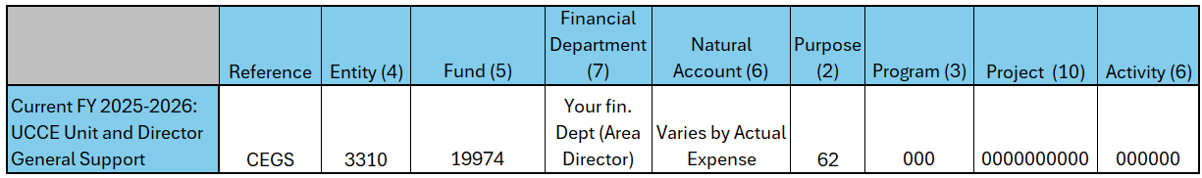
UCCE Unit and Director General Support
UCCE Unit and Director General Support
  fund 19974 (State Funds)
  Program, Project and Activity – Default (always enter all the zeros 3,10 and 6 respectively)
  Each County has a permanent set amount
  Area Directors – allocation is done to home financial department of the Area Director.
    All counties under that Area Director need to use that specific financial department, not their own.
  Expires June 30th
Notes:
https://ucanr.edu/site/uc-anr-business-operations-center/ucce-funding-allocations#Director%20Support

Slide 13
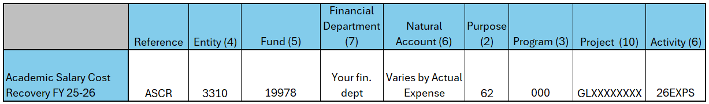
Academic Salary Cost Recovery FY 25-26
Academic Salary Cost Recovery for FY 25-26 – will be managed in the GL
  fund 19978 (State Funds)
  GL Project of Academic – GL + ORG/UNIT + 4 digits (i.e. GLALAM0520)
  Activity – 26EXPS
  Expires in 2 years (June 30th of that 2nd year)
ASCR for FY 23-24 and FY 24-25 will stay in the PPM as before
PPM Project – FP + ORG + 4 digits
TASK – ACR024 or ACR025
Notes:
https://ucanr.edu/site/uc-anr-business-operations-center/ucce-funding-allocations#AdvisorStartup
Uses

Slide 14
Project Portfolio Management (PPM)
Types of funds managed in the PPM – various
  Academic Salary Cost Recovery FY 23-24 (ACR024) and FY 24-25 (ACR025)
  Conference Funds – CNF001
  Income Funds – INC001
  Gift Funds – GFT001
  Endowment Funds – END001
  Internal Awards – IAW001
  Research and Education Funds – RED001
Notes:
Chart of Accounts Segments
Each chart string may include the following components:
Segment
Description
Entity
Always 3310 for UC ANR
Fund
Identifies the source of funding
Financial Dept
Code for your county/department
Natural Account
Specifies what is being purchased or reimbursed
Purpose
Used for financial statement classification
Program
Indicates academic/location activity (e.g., PPS, UT)
Project
Tracks financials for a specific body of work
Activity
Optional; used for recurring or time-specific transactions
📝 Not all chart strings include every segment, but most will use several of them.

Slide 15
Faculty Project and Department Projects in PPM
All ANR Advisors and CE Specialists have a Faculty Project
  Naming structure of Faculty Projects
  FP+ORG+4 DIGIT HIRE DATE (MMDD)
    • Example: FPALAM1001 John Smith UCCE Alameda County (for new UCCE advisor for Alameda County with hire date of 10/01)
Counties and Statewide Programs and Institutes have a Department Project
  Naming structure of Department Projects
  DEP+ORG+001
    Example: DEPHUMB001, DEPIPMP001, DEPIGIS001
Notes:
Chart of Accounts Segments
Each chart string may include the following components:
Segment
Description
Entity
Always 3310 for UC ANR
Fund
Identifies the source of funding
Financial Dept
Code for your county/department
Natural Account
Specifies what is being purchased or reimbursed
Purpose
Used for financial statement classification
Program
Indicates academic/location activity (e.g., PPS, UT)
Project
Tracks financials for a specific body of work
Activity
Optional; used for recurring or time-specific transactions
📝 Not all chart strings include every segment, but most will use several of them.

Slide 16
PPM Faculty Project Task Structure Example
Task | Task Number
Sarah Light UCCE SUTTERYUBA COUNTIES PPM ONLY | FPSUTY6114
CLOSED ACADEMIC COST RECOVERY FY1920 | ACR020
CLOSED 151SRSL ACADEMIC COST RECOVERY FY2021 | ACR021
CLOSED 151SRSL ACADEMIC COST RECOVERY FY2122 | ACR022
CLOSEDv151SRSL ACADEMIC COST RECOVERY FY2223 | ACR023
ACADEMIC COST RECOVERY FY2324 | ACR024
ACADEMIC COST RECOVERY FY2425 | ACR025
GIFT COVER CROPS 46092 | GFT001
151CSF1 2325 CLIMATE SMART FARMING SAREP | IAW001
151SLIG RESEARCH AND EDUCATION | RED001
  Project – FPSUTY6114
  Expenditure Org –9923258 (UCCE Sutter Yuba)
  Expense Type – Varies
  Task – ACR024
Notes:
Chart of Accounts Segments
Each chart string may include the following components:
Segment
Description
Entity
Always 3310 for UC ANR
Fund
Identifies the source of funding
Financial Dept
Code for your county/department
Natural Account
Specifies what is being purchased or reimbursed
Purpose
Used for financial statement classification
Program
Indicates academic/location activity (e.g., PPS, UT)
Project
Tracks financials for a specific body of work
Activity
Optional; used for recurring or time-specific transactions
📝 Not all chart strings include every segment, but most will use several of them.

Slide 17
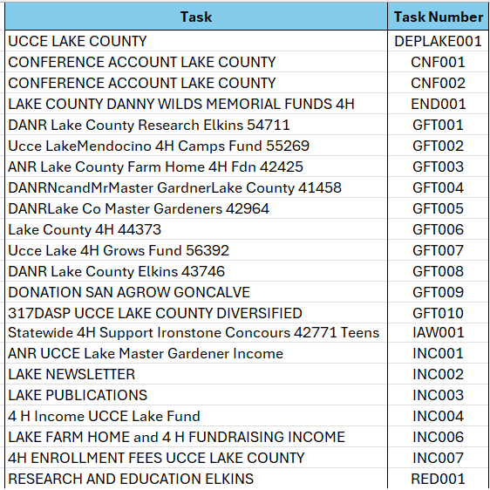
PPM Department Project Task Structure Example
  Project – DEPLAKE001
  Expenditure Org –9923225 (UCCE Lake County)
  Expense Type – Varies
  Task – GFT005
Notes:
Chart of Accounts Segments
Each chart string may include the following components:
Segment
Description
Entity
Always 3310 for UC ANR
Fund
Identifies the source of funding
Financial Dept
Code for your county/department
Natural Account
Specifies what is being purchased or reimbursed
Purpose
Used for financial statement classification
Program
Indicates academic/location activity (e.g., PPS, UT)
Project
Tracks financials for a specific body of work
Activity
Optional; used for recurring or time-specific transactions
📝 Not all chart strings include every segment, but most will use several of them.

Slide 18
Resources
UC ANR Aggie Enterprise Portal:
  GL Chart string is always represented in the following format:
  Entity - Fund – Financial Department – Natural Account (NA) – Purpose – Program – Project – Activity
  PPM Chart string is always represented in the following format (POET abbreviation of PPM Chart string):
  Project – Expenditure Org – Expense Type – Task
  Note:
  Entity is constant value “3310”
  Expenditure Org. is the financial department where project expenses are expensed
  Expense Type – Is the Natural Account

Slide 19
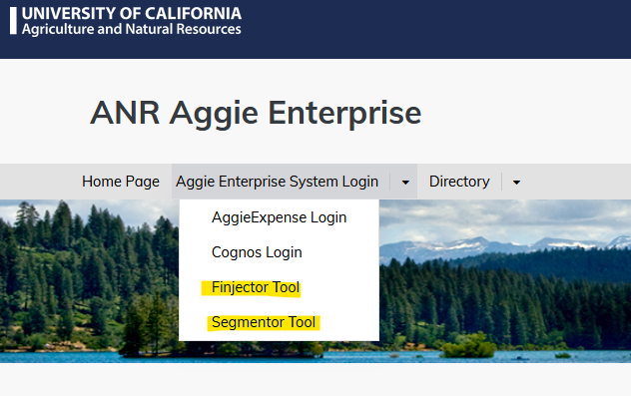
Segementor & Finjector – New Tools
Segmentor & Finjector
Links for both can found on the UC ANR Aggie Enterprise web page
Notes:
Encourage bookmarking pages
https://ucanr.edu/site/anr-aggie-enterprise

Slide 20
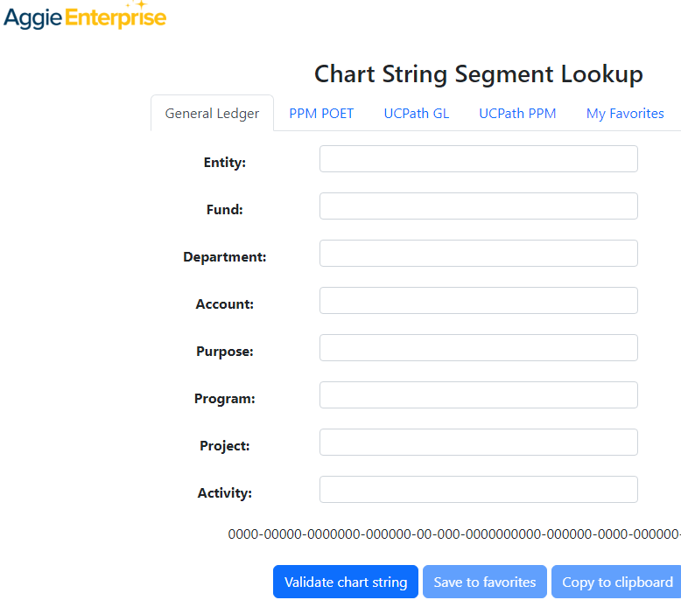
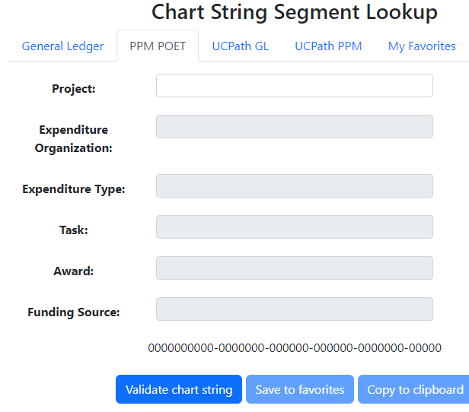
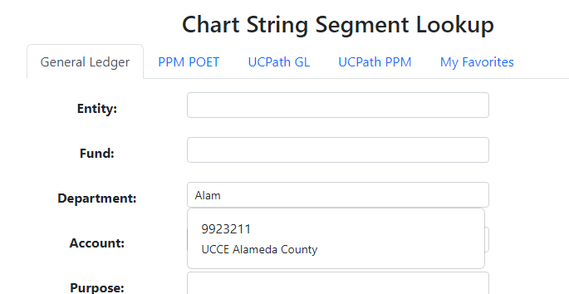
Segmentor
The Segmentor tool was developed to facilitate the creation and validation of CCOA chart strings, which can then be entered into Aggie Enterprise and related boundary applications. While this tool operates independently from the Aggie Enterprise system, the values and validation rules used by Segmentor are the same as those in Aggie Enterprise.
G
                Search by Description:
Notes:
Show real time looking up financial department, Activity, Project in UCPath PPM
https://segmentor.ucdavis.edu/

Slide 21
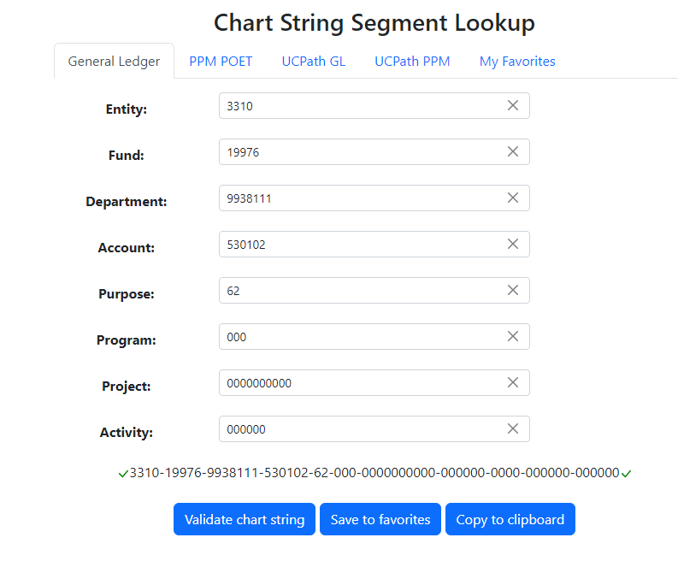
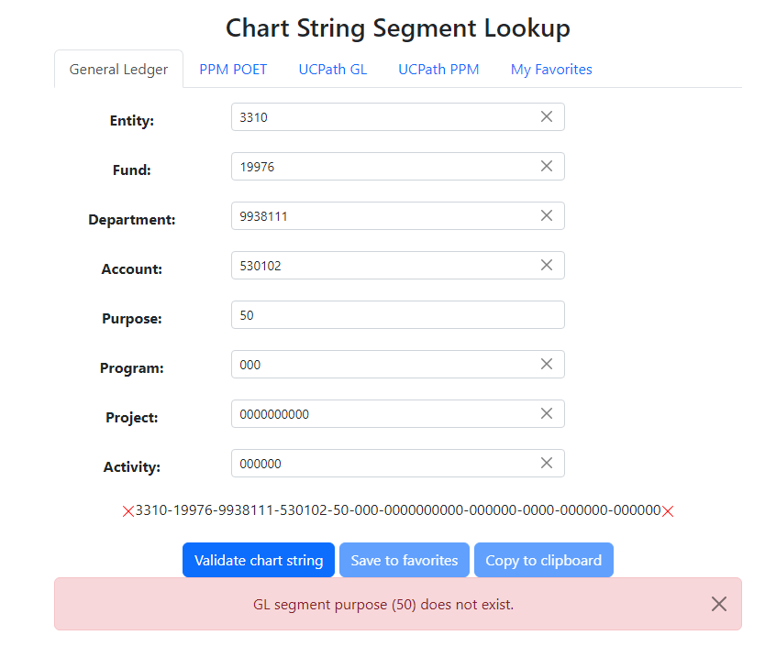
Segmentor GL Examples
Valid: Invalid:
Notes:
Show real time looking up financial department, Activity, Project in UCPath PPM

Slide 22
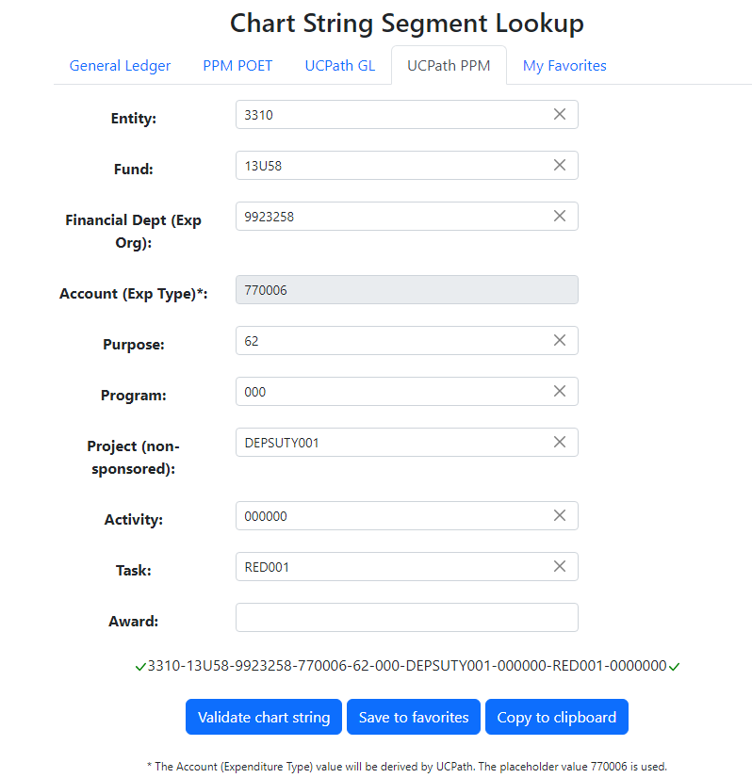
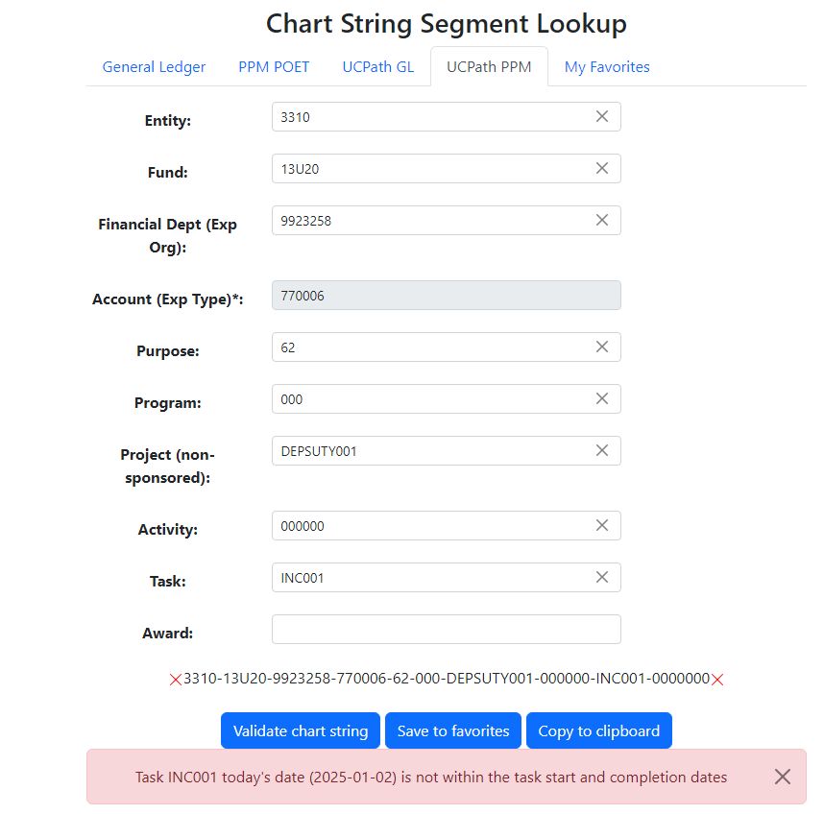
Segmentor PPM Examples
Valid:
Invalid:
Notes:
Show real time looking up financial department, Activity, Project in UCPath PPM

Slide 23
Finjector
A tool to help you organize your department’s Aggie Enterprise Chart strings.
Chart strings are placed within a folder by the Fiscal Officer labeled either GL (General Ledger) or PPM (Project Portfolio Manager).
Folders are grouped by “Teams”, each with a list of users and permissions.
  If you need access or can’t find an account you need, please reach out to your BOC Team
UCCE Counties:
- 1 Folder Per County
Advisors:
- 1 Folder Per Advisor
CE Specialists:
- 1 Folder Per Specialist
Statewide Programs and Institutes:
1 Folder Per Program or Institute
Admin Units:
- 1 Folder Per Department
Notes:
https://finjector.ucdavis.edu/teams

Slide 24
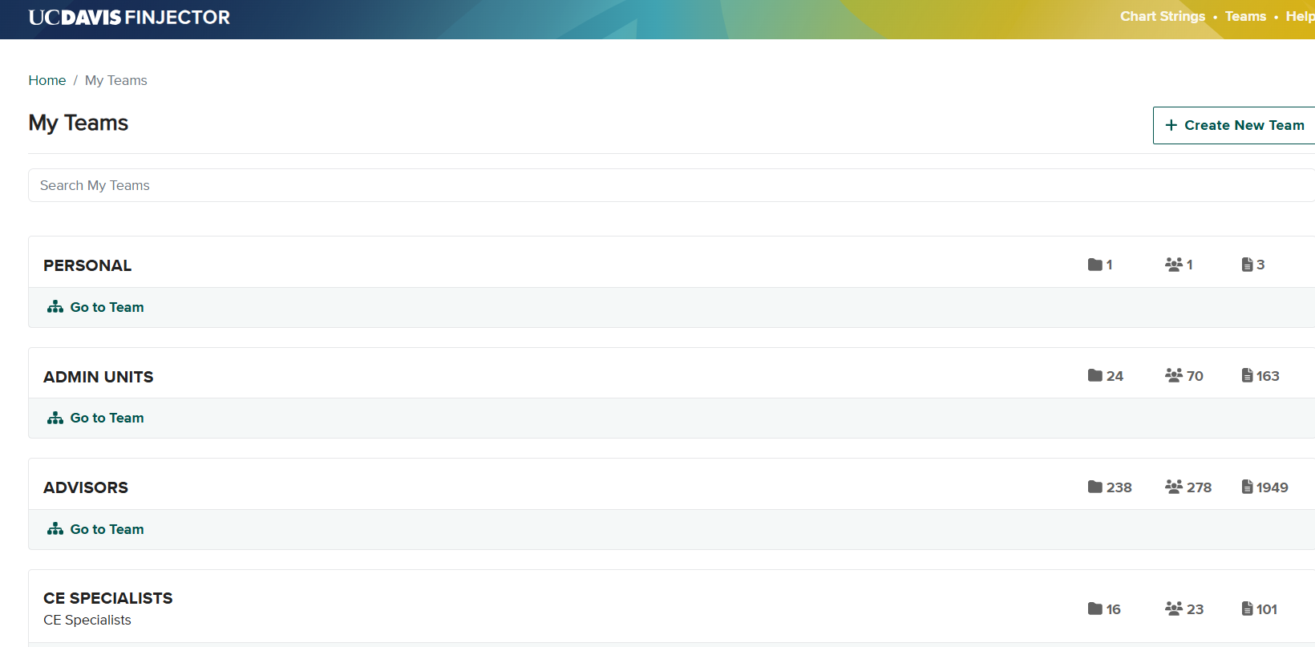
Finjector
Notes:
https://finjector.ucdavis.edu/teams

Slide 25
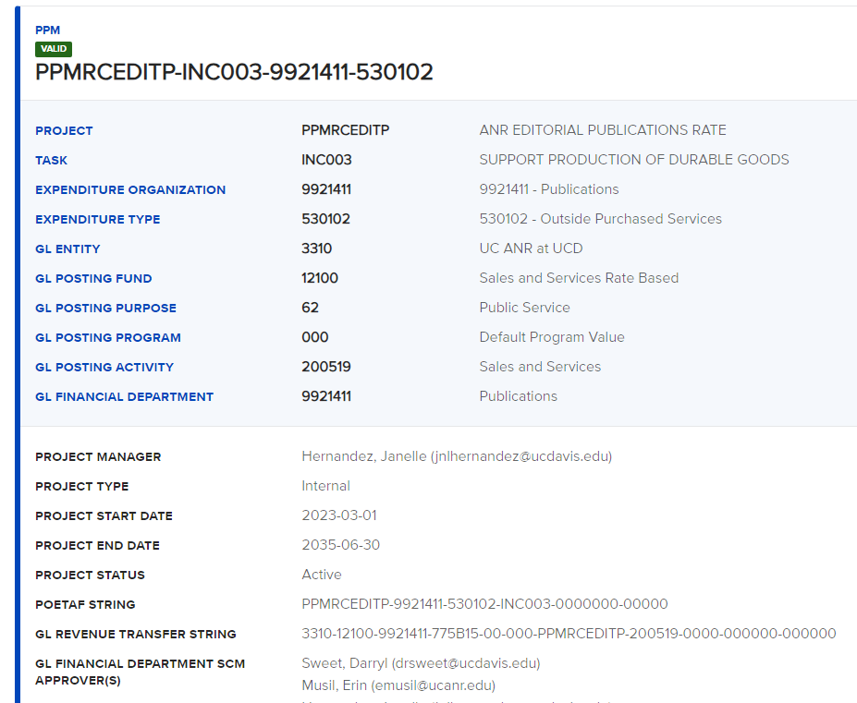
Finjector example

Slide 26
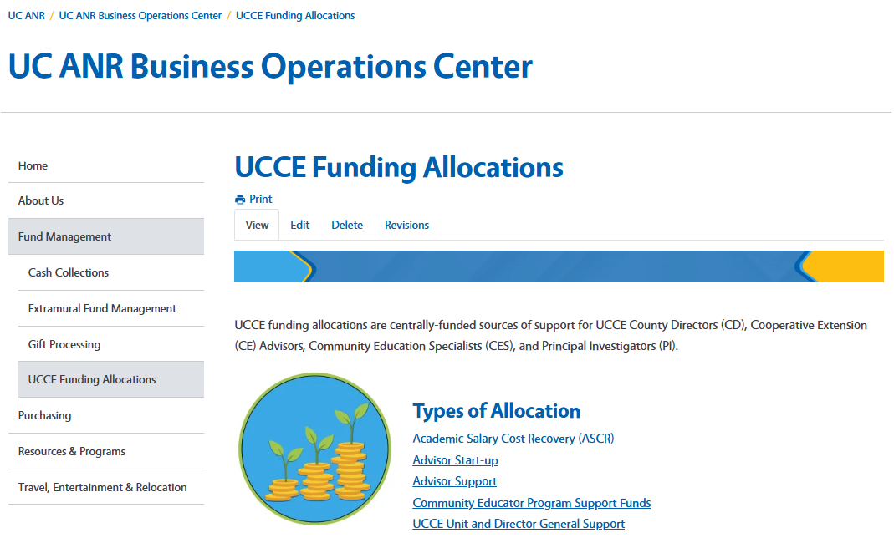
UCCE Funding Allocations
https://ucanr.edu/site/uc-anr-business-operations-center/ucce-funding-allocations
Notes:
Share screen and walk through webpage with more information on this: https://ucanr.edu/site/uc-anr-business-operations-center/ucce-funding-allocations
Fund Management -> UCCE Funding Allocations
https://ucanr.edu/site/uc-anr-business-operations-center/fund-management

Slide 27
Resource Links
UC ANR AggieEnterprise IWP Website ANR Aggie Enterprise
Report Feedback Tool Distribution Report Feedback
COA (Enterprise Structure) EnterpriseStructureReport Document.xlsx
Aggie Enterprise Sign-in AE Sign-in
Resource Home page on Website Resources
Guidelines for CoA Segment Naming Convention Naming Convention Guidelines
Support/Helpdesk Email helpdesk

Slide 28
    Thank you!
Notes:
Formal decision process | Powered by Box

Slide 29
    Additional Resources
Notes:
Formal decision process | Powered by Box

Slide 30
Glossary………………………………………………..…1 of 2
Term/Abbreviation | Definition
GL | General Ledger
PPM | Project and Portfolio Management
Sponsored Project | Any Project that begin with a prefix KL or SP
Non-sponsored Project | Any Project that begin with a prefix other than KL or SP
Net Position | Represents accumulated resources in a Fund, department, Project, Activity or combination of those chart fields. It is a carried forward balance from previous fiscal year.
Changes in Net Position | Any increase or decrease to Net Position is calculated as: Net Position carry forward balance + Revenues Less Expenses Plus Other changes.

Slide 31
Glossary………………………………………………….2 of 2
Term/Abbreviation | Definition
SCM | Supply Chain Management
PO | Purchase Order
Encumbrance | Funds reserved for a future expense
Commitment | The automated process of setting funds aside for the Charge Account string when a requisition is fully approved. The commitment is automatically released when the associated Purchase Order is created. If a fully-approved Requisition is canceled before a Purchase Order is created, the commitment is automatically released at that time.
Obligation | Process of setting funds aside to pay for the purchase. When a Purchase Order is created in Aggie Enterprise, an obligation is automatically created and the commitment previously created is released. When the Purchase Order is fully invoiced and/or otherwise closed, all remaining obligations are automatically removed.

Slide 32
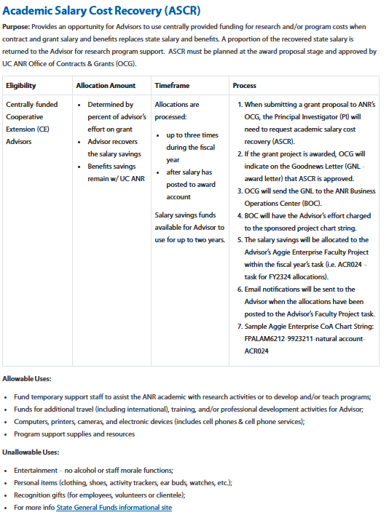
UCCE Funding Allocations: ASCR
Notes:
Share screen and walk through webpage with more information on this: https://ucanr.edu/site/uc-anr-business-operations-center/ucce-funding-allocations
Fund Management -> UCCE Funding Allocations
https://ucanr.edu/site/uc-anr-business-operations-center/fund-management

Slide 33
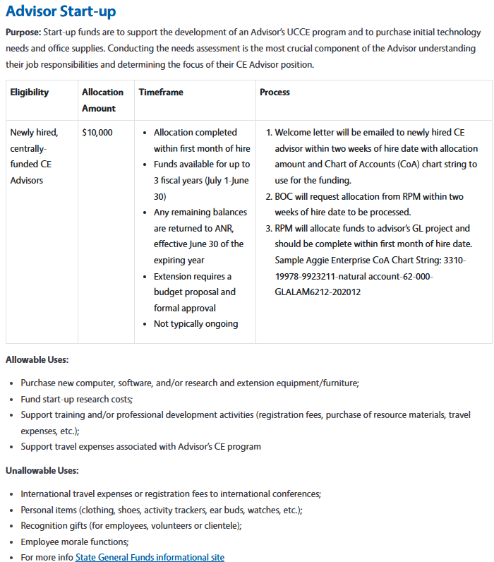
UCCE Funding Allocations: Advisor Start-Up
Notes:
Share screen and walk through webpage with more information on this: https://ucanr.edu/site/uc-anr-business-operations-center/ucce-funding-allocations
Fund Management -> UCCE Funding Allocations
https://ucanr.edu/site/uc-anr-business-operations-center/fund-management

Slide 34
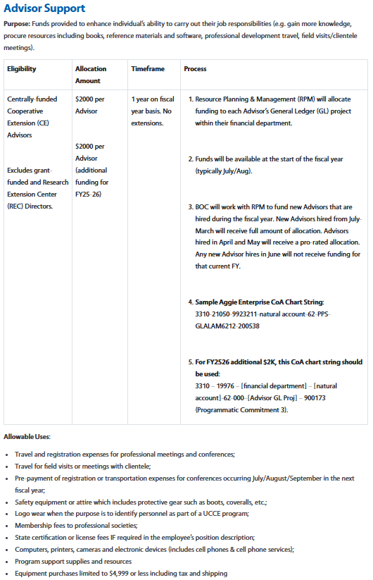
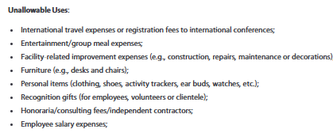
UCCE Funding Allocations:
Advisor Support
Notes:
Share screen and walk through webpage with more information on this: https://ucanr.edu/site/uc-anr-business-operations-center/ucce-funding-allocations
Fund Management -> UCCE Funding Allocations
https://ucanr.edu/site/uc-anr-business-operations-center/fund-management

Slide 35
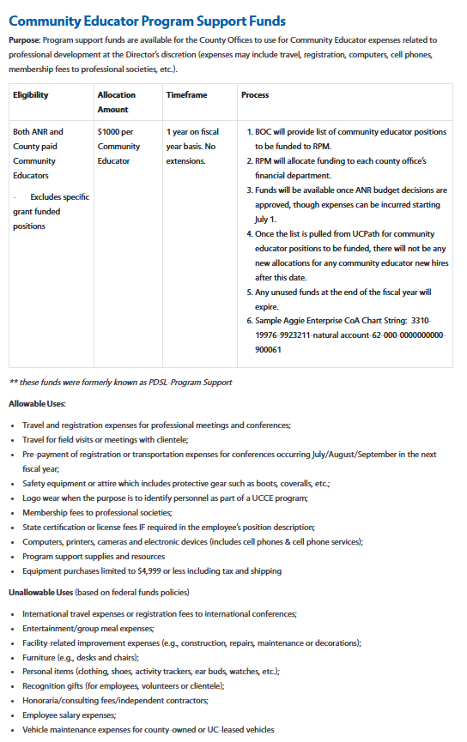
UCCE Funding Allocations:
Community Educator Support Funds
Notes:
Share screen and walk through webpage with more information on this: https://ucanr.edu/site/uc-anr-business-operations-center/ucce-funding-allocations
Fund Management -> UCCE Funding Allocations
https://ucanr.edu/site/uc-anr-business-operations-center/fund-management

Slide 36
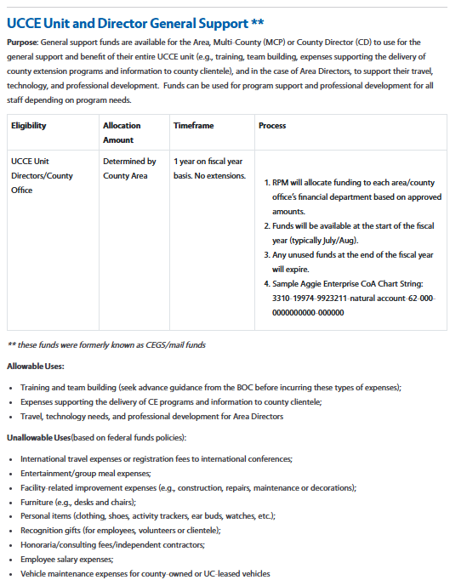
UCCE Funding Allocations:
UCCE Unit Director General Support
Notes:
Share screen and walk through webpage with more information on this: https://ucanr.edu/site/uc-anr-business-operations-center/ucce-funding-allocations
Fund Management -> UCCE Funding Allocations
https://ucanr.edu/site/uc-anr-business-operations-center/fund-management

