Slide 1
Understanding Cold Conditioning in Strawberry
2023-2025
Mark Bolda, UC Cooperative Extension
CBC
Naturipe - UC
Blazer-Wilkinson
Lassen Canyon Nursery
Crown Nursery
February 10, 2026

Slide 2
Introduction
Dormancy and cold conditioning of plants
The two parts of cold conditioning in California strawberry
Explanation of what we will be looking at together
2023-2024 CBC trial
2024-2025 Naturipe Trial
Summary and concluding thoughts

Slide 3
What happens to the plant in dormancy and afterwards:
Toward the end of the growing season, as temperatures drop and light decreases, the plant slows down and moves sugars into reserves as starch.
Given that the plant once taken out of storage has no leaves, the plant must draw on its stored reserves to grow new leaves and recommence producing its own sugars through photosynthesis.

Slide 4
Definition of chill in strawberry
In-ground, field chill: Temperatures between 33 and 45 degrees.
Supplemental chill: Post harvest, boxed plants. Temperatures held at steady (or close to it) 34 degrees.

Slide 5
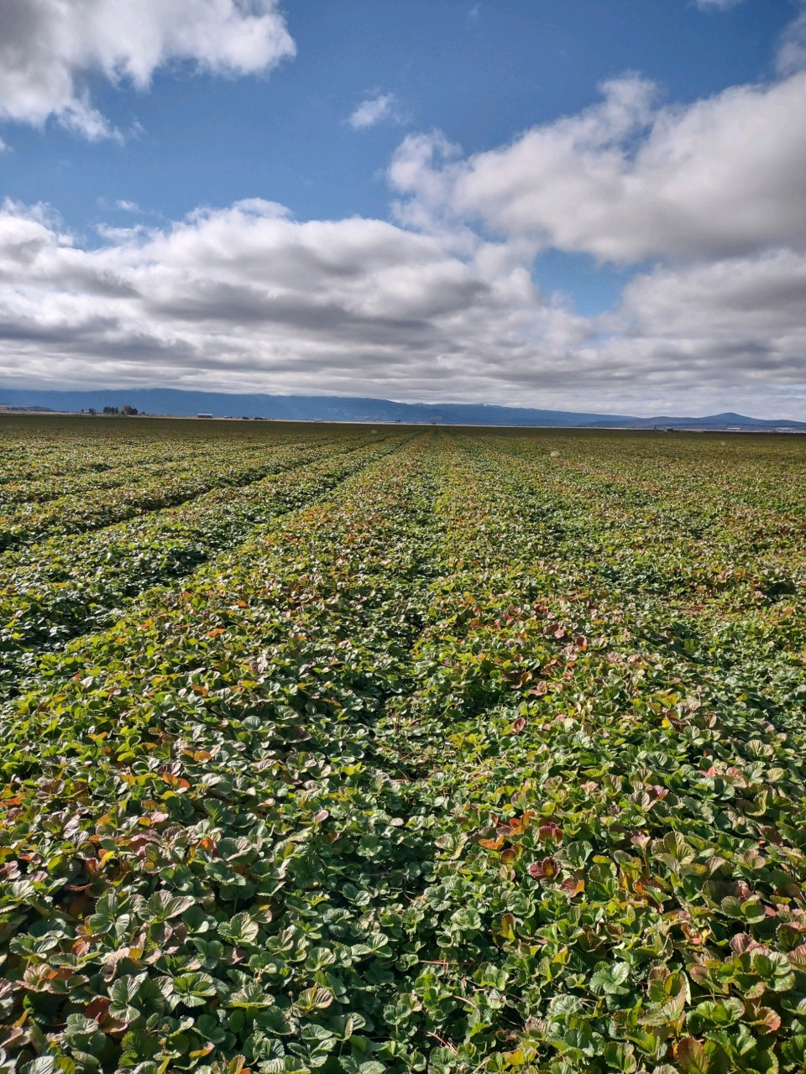
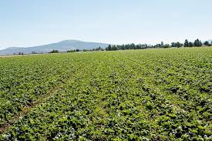
High elevation, MacDoel
October 7, 2021 245 hours of chill
Photo courtesy Doug Thomas, Crown Nursery
October 17, 2021, 305 hours of chill
Photo courtesy Doug Thomas, Crown Nursery

Slide 6
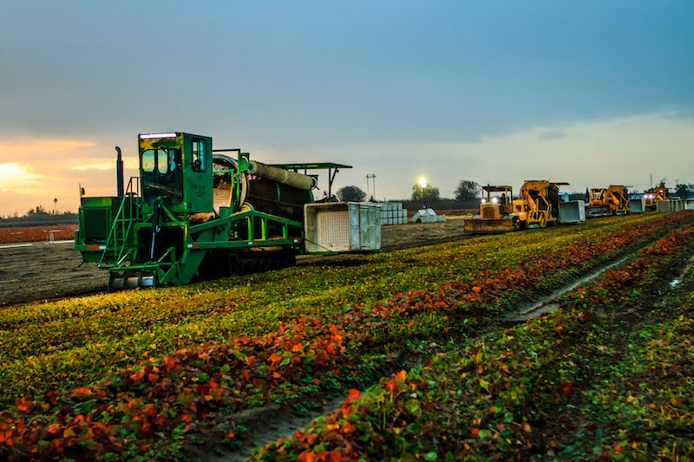
Harvest of strawberry transplants

Slide 7
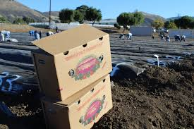
Strawberry transplants shipped in boxes

Slide 8
Why is this important?
What is the right amount of in-field chill?
What is the right amount of supplemental chill?
What are the mechanics of dormancy and dormancy breaking in strawberry?

Slide 9
2023-2024 CBC trial
Varieties Monterey and Alturas
Plants harvested 10/17/2023 (308 units chill)
Final dig date on November 2 (449 units of chill) had Monterey taken.

Slide 10
Carbohydrate and Sugar Dynamics – Monterey
2023
Monterey | Glucose % | Fructose % |  | Starch %
17-Oct | 3.7 | 2.4 |  | 15.9
1 wk hold | 5.86* | 4.1* |  | 11.5
2 wk hold | 5.28* | 3.8* |  | 8.8*
3 wk hold | 4.3 | 3.9* |  | 7.9*
* Significantly different from Oct 17 (receipt) sample at 95% confidence level.
Monterey | Glucose % | Fructose % |  | Starch %
Nov 9 – no supplemental | 4.0 | 3.5 |  | 15.8

Slide 11
Carbohydrate and Sugar Dynamics – Alturas
2023
Alturas | Glucose % | Fructose % |  | Starch %
17-Oct | 4.7 | 2.6 |  | 13.7
1 wk hold | 6.3* | 3.5* |  | 8.3*
2 wk hold | 5.8 | 4.3* |  | 8.2*
3 wk hold | 4.9 | 4.2* |  | 7.5*
* Significantly different from Oct 17 (receipt) sample at 95% confidence level.

Slide 12
Harvest, first week, first month, first half and totals
 | First Harvest | April total | First half thru June | Total yield
Monterey, 1 week sup | 32 | 261 | 4108 | 9221
Monterey, 2 week sup | 20 | 264 | 4897 | 9748
Monterey, 3 week sup | 35.2 | 251 | 4211 | 8539
 | First Harvest | April total | First half thru June | Total yield
Alturas, 1 week sup | 61.2 a | 534.5 | 5276.5 b | 13433.3 b
Alturas, 2 week sup | 94.2 a | 683.5 | 6310.8 a | 15512.5 a
Alturas, 3 week sup | 31.8 b | 480.0 | 6062.8 a | 14775.8 ab

Slide 13
2024-2025 Naturipe Study

Slide 14
Introduction
Evaluate the physiological changes the strawberry varieties Monterey, Eclipse, Golden Gate, Monarch and Keystone undergo during field and supplemental chill.
2024-2025: Evaluate the field performance of these varieties exposed to three variations of supplemental chill; 0 weeks chill (Nov 1,2024), 1 week of chill (Nov 7, 2024) and 2 weeks of chill (Nov 14, 2024). Chill accumulation at harvest (Oct 30)= 411 hours.

Slide 15
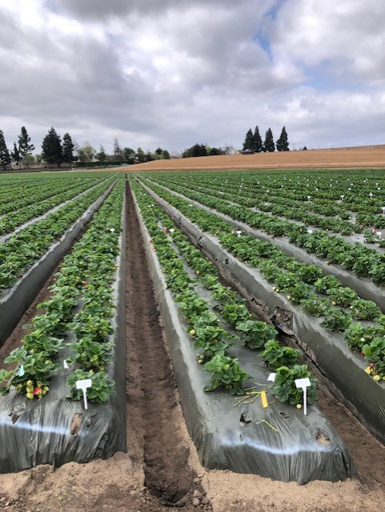
Test Plot: Naturipe Research Farm, Salinas

Slide 16
Variety 2024- 2025 | Weeks cold storage | Glucose (%) | Fructose (%) | Starch (%)
Golden Gate | 0 | 3.0 | 3.0 | 10.9
Golden Gate | 1 | 2.9 | 2.5 | 12.1
Golden Gate | 2 | 3.5 | 3.3 | 6.4*
Eclipse | 0 | 3.4 | 3.7 | 9.0
Eclipse | 1 | 4.1* | 3.8 | 5.2*
Eclipse | 2 | 5.0* | 5.1 | 5.5
Keystone | 0 | 4.8 | 4.2 | 10.0
Keystone | 1 | 3.7 | 3.3 | 10.8
Keystone | 2 | 4.0 | 3.7 | 8.4
Monarch | 0 | 4.3 | 3.9 | 15.6
Monarch | 1 | 5.2* | 4.6* | 13.7
Monarch | 2 | 4.4 | 3.3 | 11.1
Monterey | 0 | 3.8 | 3.8 | 12.3
Monterey | 1 | 3.1 | 4.0* | 14.3
Monterey | 2 | 4.8 | 4.4 | 11.5

Slide 17
Runner Production – Golden Gate & Eclipse
Variety | Weeks cold storage | 4/16/2025 | 5/14/2025 | 6/11/2025 | 7/9/2025 | 8/15/2025
Golden Gate | 0 | 0.0 | 34.7 | 71.3 | 53.7 | 14.3
Golden Gate | 1 | 0.7 | 71.7 | 109.0 | 62.3 | 19.0
Golden Gate | 2 | 2.3 | 81.3 | 110.7 | 49.0 | 38.3
Eclipse | 0 | 14.3 | 76.7 | 70.3 | 36.3 | 17.3
Eclipse | 1 | 19.0 | 113.3 | 87.3 | 35.3 | 19.0
Eclipse | 2 | 38.3* | 108.7 | 73.7 | 28.0 | 10.7

Slide 18
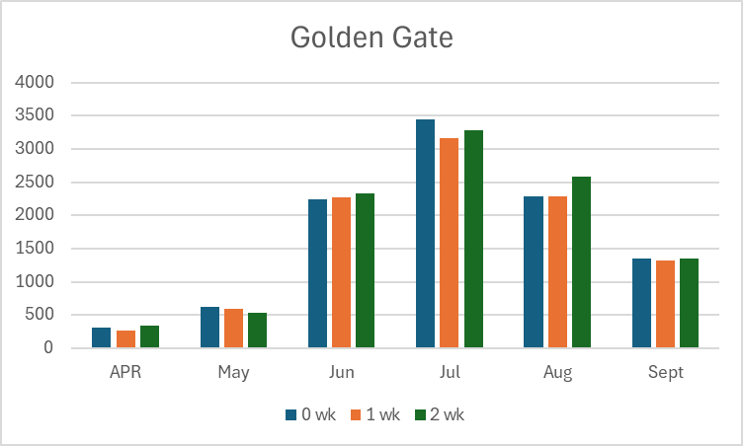
Yields by Month
Total season yields – Golden Gate
Supplemental Chill | Yield in 10# crate / acre
0 weeks | 10262
1 week | 9889
2 weeks | 10428

Slide 19
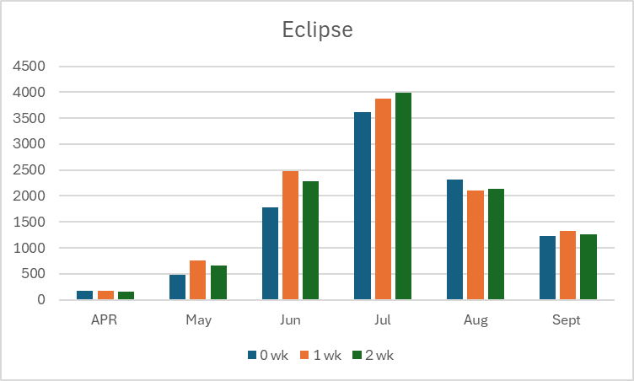
Yields by month
Supplemental Chill | Yield in 10# crate / acre
0 weeks | 9601 b
1 week | 10687 a
2 weeks | 10473 a

Slide 20
Concluding Slide
The effects on the strawberry plant of field chill and supplemental chill are qualitatively different.
The effects of chill on subsequent plant performance in the production field can affect certain varieties, others not so much.
It would be interesting to do this work on short day varieties.
Thank you to the many people involved in this work!

