Slide 1
Workshop: Cottage Food Production for Small Farms
UCCE Capitol Corridor Food Systems Program
Olivia Henry
UCCE Regional Food Systems Area Advisor
Dec. 11, 2025

Slide 2
Agenda
Part 1: Establishing and operating a cottage food business
9:45 – 10:15 Sac County EMD on CFO licenses (30 min)
10:15 – 10:30 Panel response (15 minutes)
10:30 – 10:40 UCCE presentation on other licenses (10 min)
10:40 – 10:55 Panel response (15 min)
10:55 – 11:00 Break (5 min)
11:00 – 11:40 Marketing panel (40 min)
11:40 – 12:10 Announcements and lunch (20)

Slide 3
Agenda
Part 2: Master Food Preserver techniques
12:10 – 12:15 Orientation and getting into groups
12:15 – 12:45 Rotation 1
12:45 – 1:15 Rotation 2
1:15 – 1:45 Rotation 3
1:45 – 2:00 Evaluations and give-away

Slide 4
Evaluating a value-added enterprise
Marketing
Market windows
Farm brand
Regulations
Food safety
Sales outlets
Resources
Business support programs
Profit analysis
Direct, indirect costs
Profit margin
Farm mission
Notes:
.

Slide 5
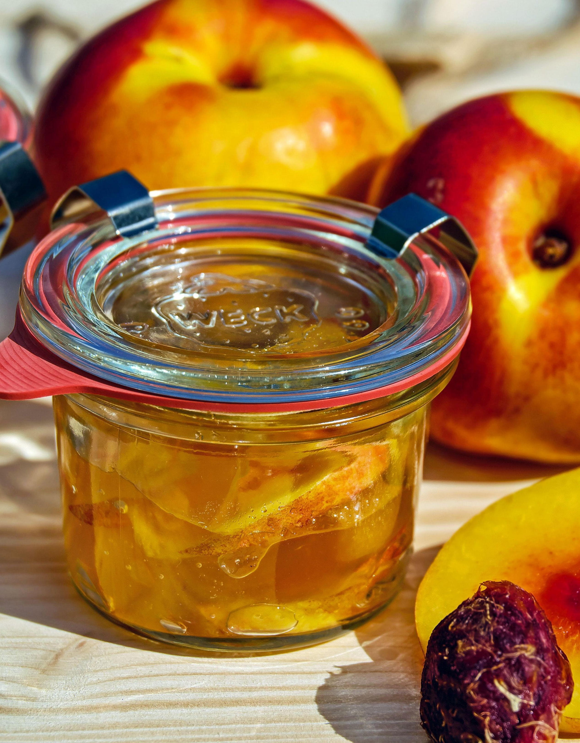
How many cottage food producers are there?
Sacramento County (March 2025)
  Class A: 300
  Class B: 168
  Source: Public records request
Yolo County (Sept. 2025)
  Class A: 45
  Class B: 10
  Source: Public records request
Solano County (2019)
  Class A: 62
  Class B: 11
  Source: Kiesel, 2019

Slide 6

2016 survey of U.S. cottage food producers
(McDonald, 2019)
Demographics: 83% female, 50% live in rural area
Livelihood: 42% use CFO as supplemental income, 35% as hobby
Products: 69% produce baked goods. Dry goods, preserves and snacks all produced by less than 5% of sample
Photo: Peter Griffin, CC0 Public Domain.

Slide 7
2016 survey of U.S. cottage food producers
(McDonald, 2019)
Sales outlet: Largely sold at farmers’ markets and from home
Time commitment: Average of 15 hours/week spent on the business
Capital: Average start-up capital of $500
Income: Producers earned $2,000 in median annual sales and $500 in median annual profits in 2016
Photo: Peter Griffin, CC0 Public Domain.

Slide 8
Evaluating a value-added enterprise
Marketing
Market windows
Farm brand
Regulations
Food safety
Sales outlets
Resources
Business support programs
Profit analysis
Direct, indirect costs
Profit margin
Farm mission

Slide 9
Panel response

Slide 10

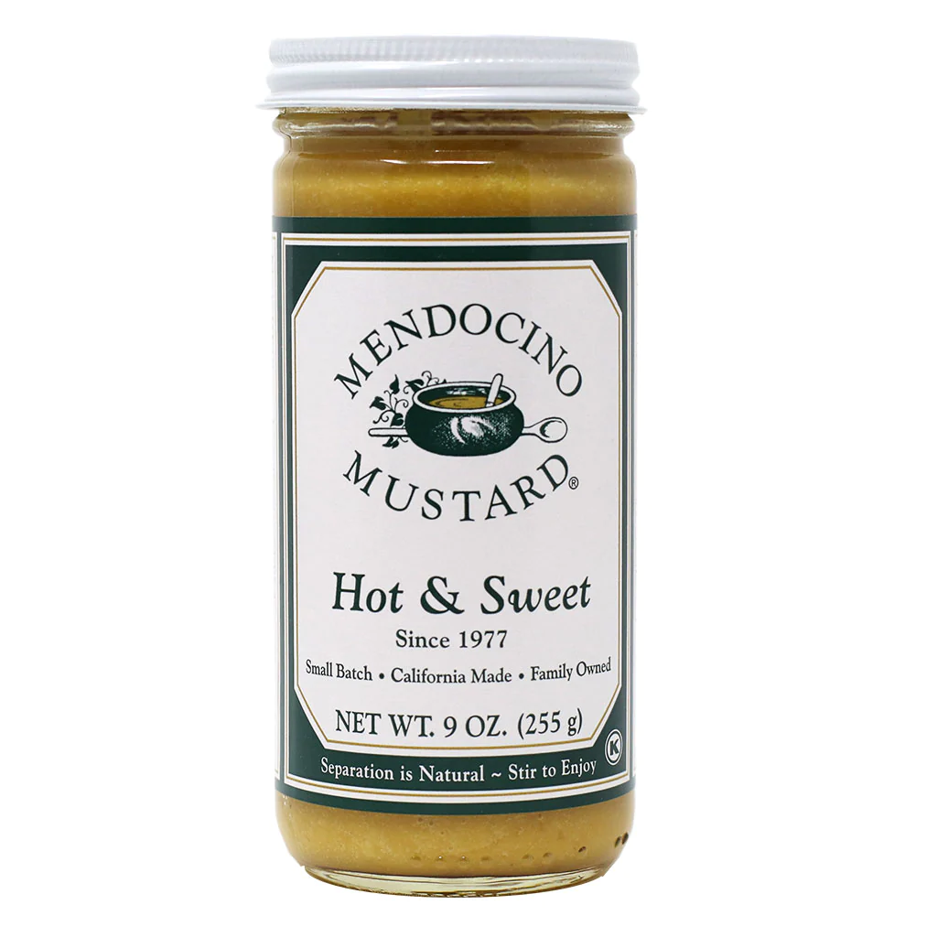
Quiz! Which of these products is an allowable CFO product?
*No eggs

Slide 11
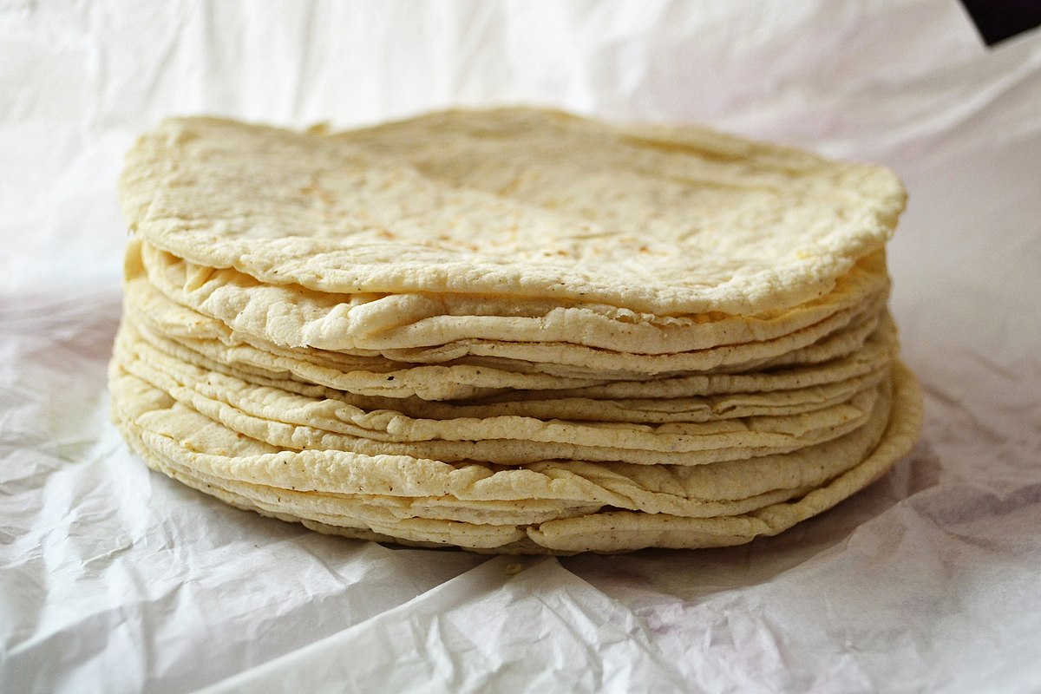
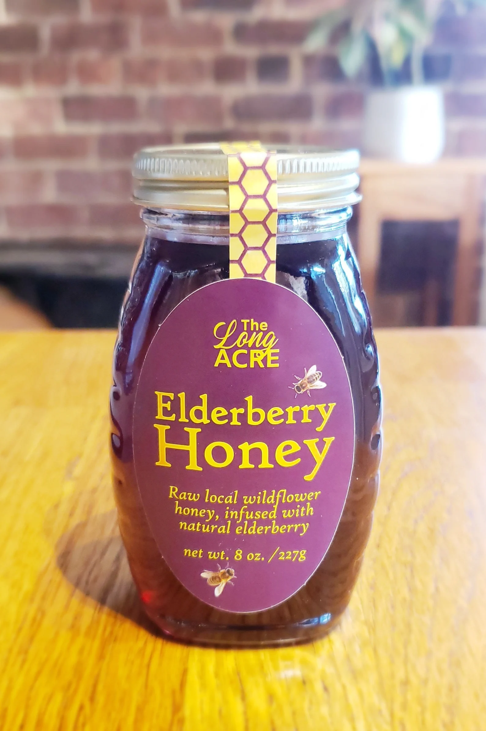
Quiz! Which of these products is an allowable CFO product?

Slide 12
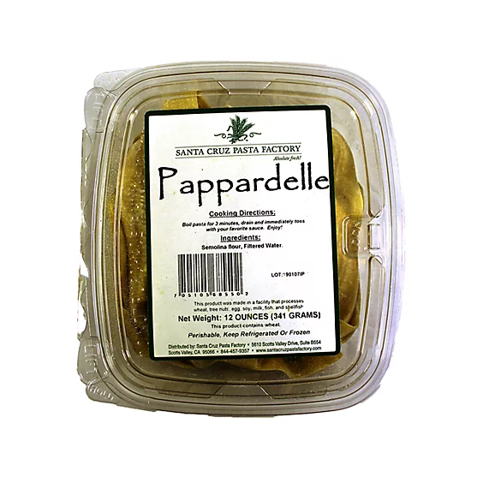
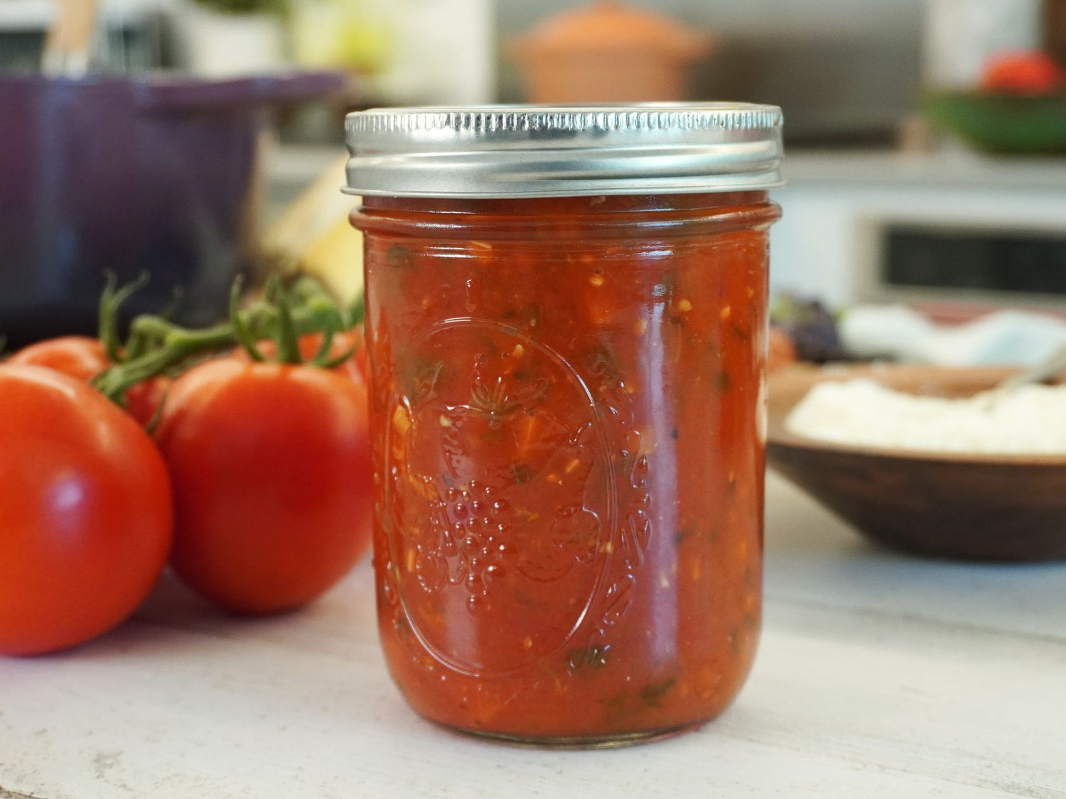
Quiz! Which of these products is an allowable CFO product?

Slide 13

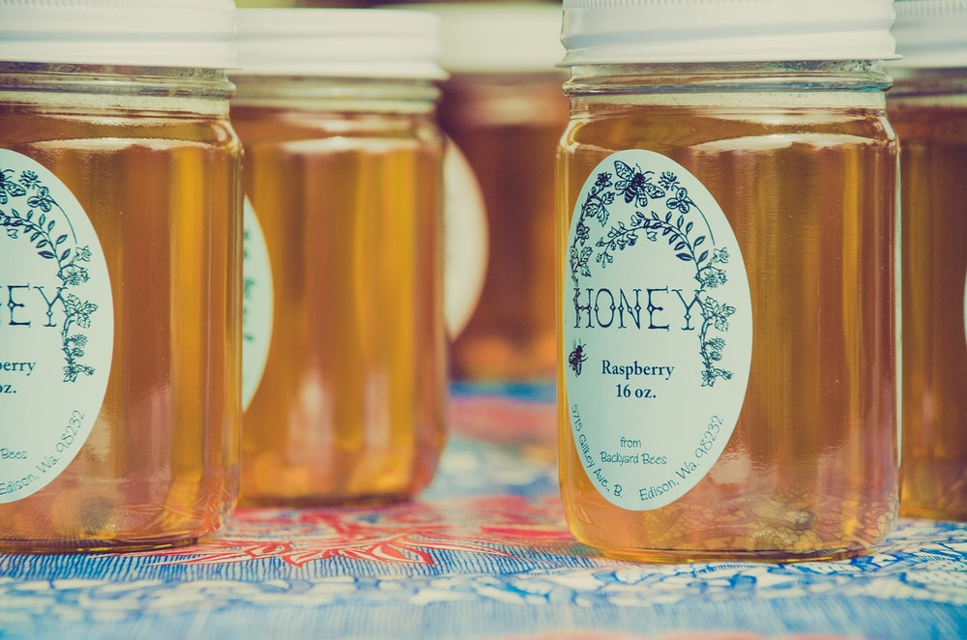
Permit fees by county
Sacramento County Fees FY 25-26
Class A CFO: $297
Class B CFO: $513
Yolo County Fees FY 24-25:
Class A CFO: $409
Class B CFO: $730
Solano County Fees FY 25-26:
Class A CFO: $119
Class B CFO: $408

Slide 14
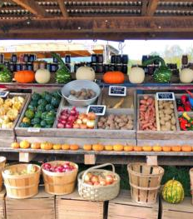
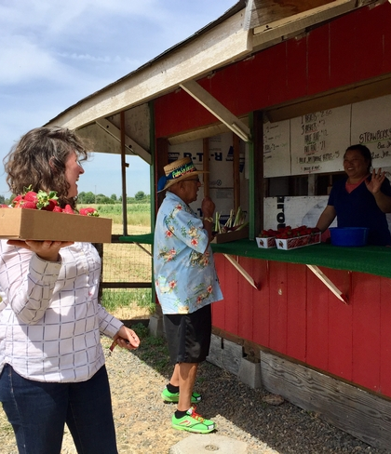
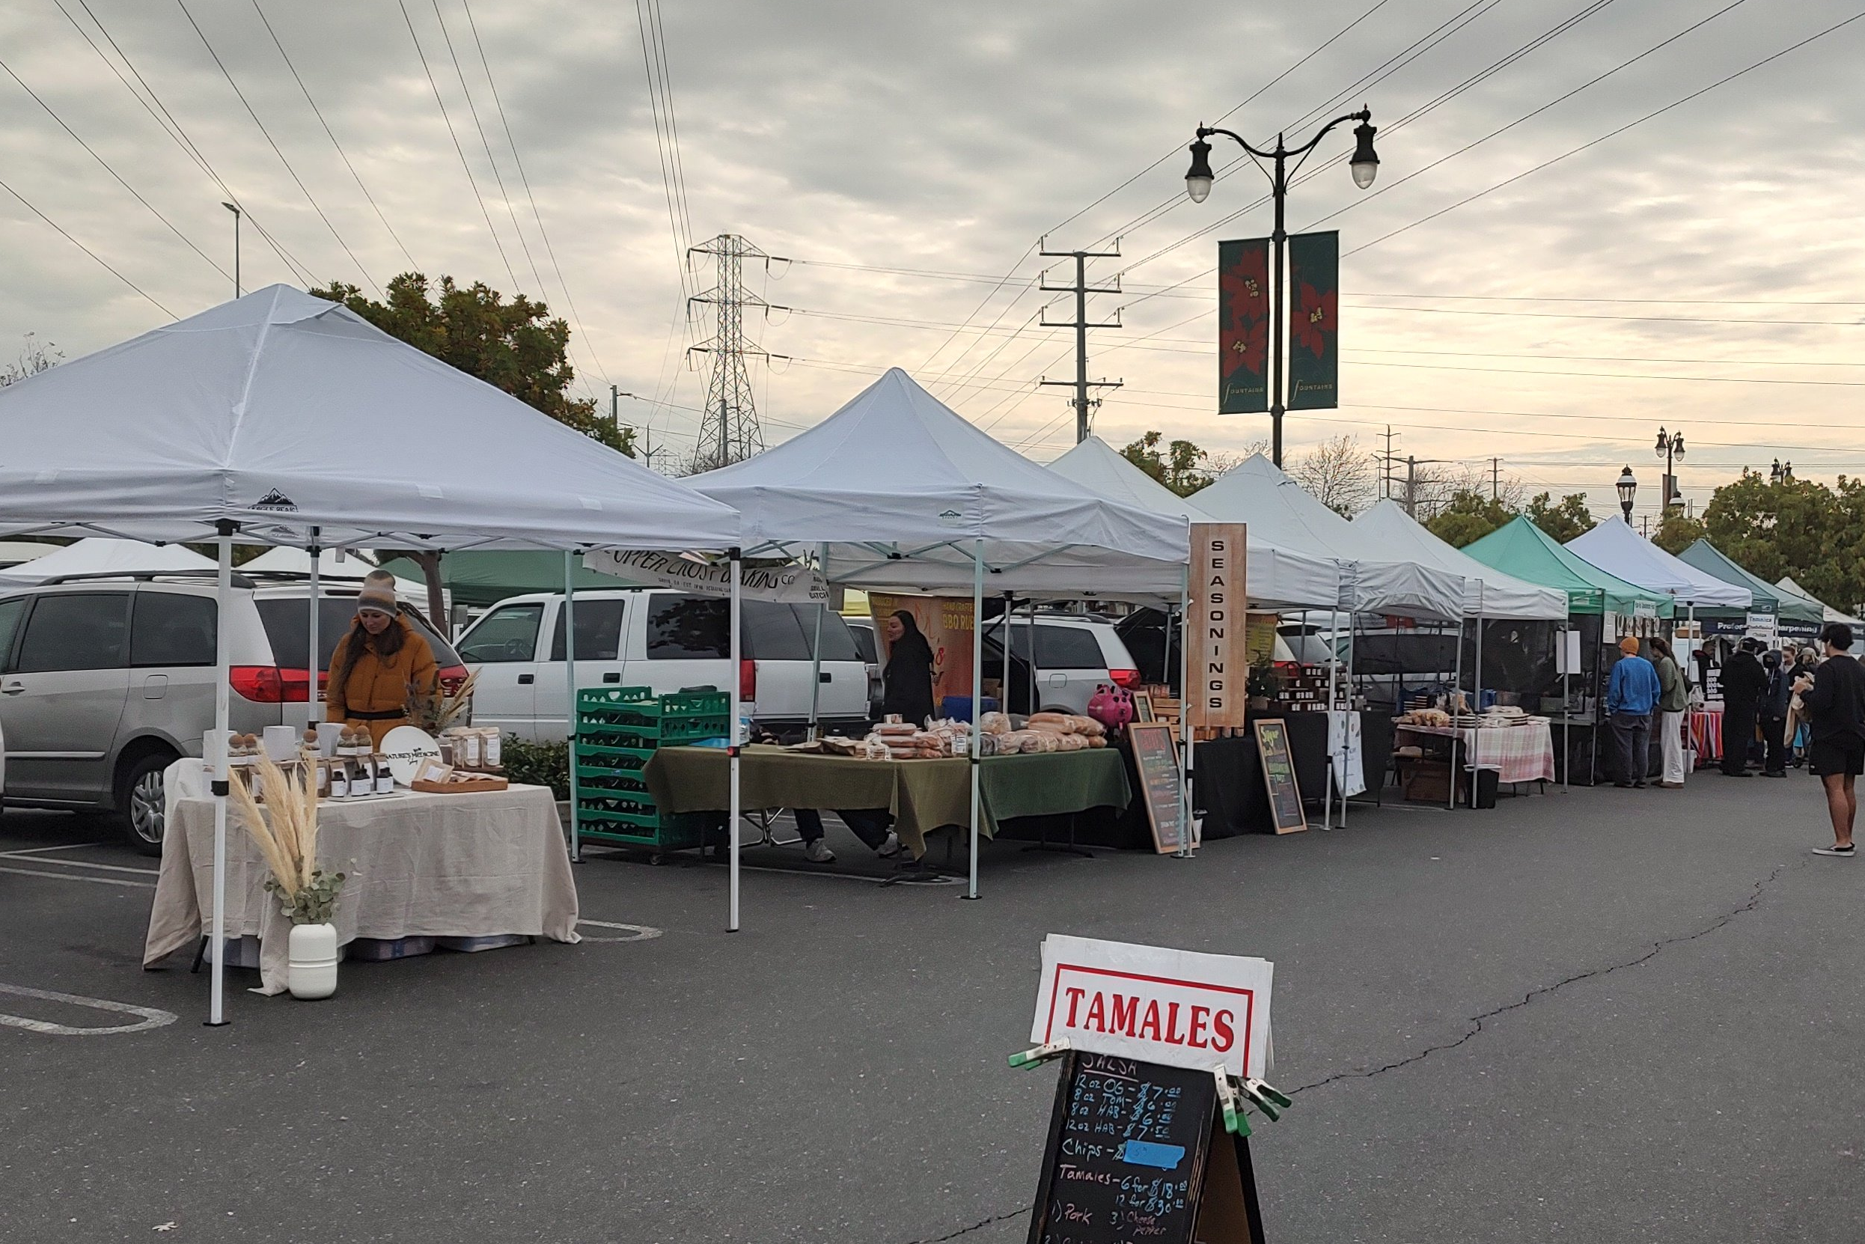
Regulatory considerations around sales outlets
Farm stands
  Sacramento County ordinance:
    Field retail: Raw produce only
    Farm stand: “Food preparation” items limited to 25% of sales and storage area
      Requires environmental health permit
      FY 25-26: $402
Farmers’ markets
  Demonstrate permits to market manager
  If operating with a CPC, check that products are certifiable
  Temporary food facility permit
    FY 25-26: $113

Slide 15

Example of business and regulatory costs
For a City of Sacramento-based CFO business in 2023
Business Operations Tax: $30
Home Occupation Permit Fee: $156
California Seller’s Permit: $0
Fictitious Business Name: $49
DBA Publication: $150
Cottage Food Registration – A: $274
Food Handler’s Card: $15
Food product liability insurance: $25/month
Business Bank Account: $8/month
Total: $707

Slide 16
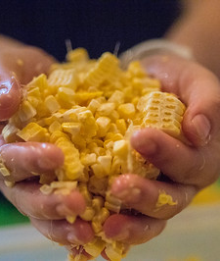
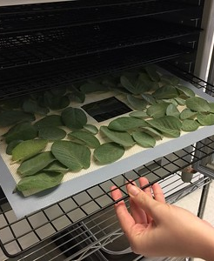
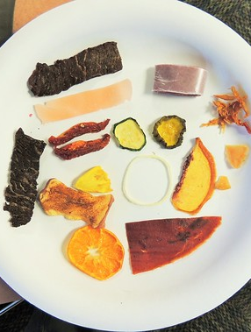

What really adds value?
“Value-added products must ADD value (not just convert product to another form).”
(Dan Macon, UCCE Livestock & Natural Resources Advisor, Economic Principles for Small-Scale Farmers)

Slide 17

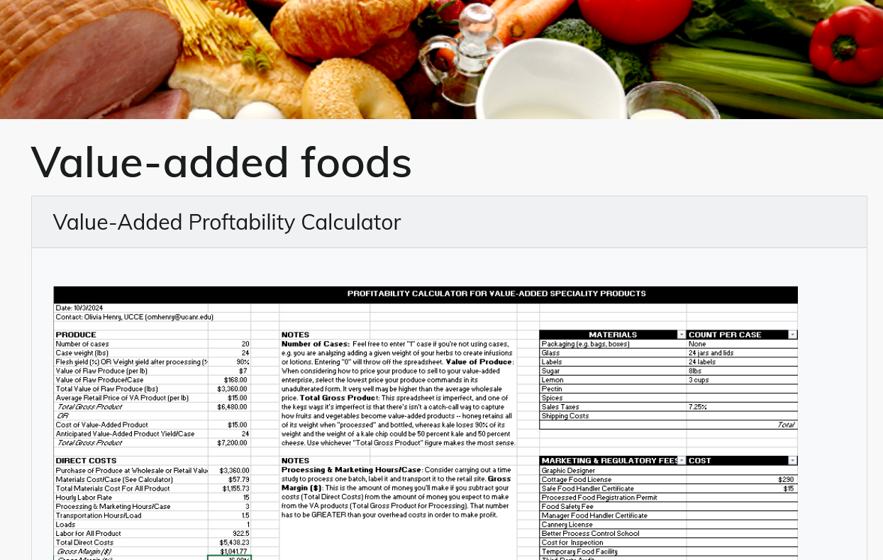
Two profitability/break-even tools
University of Missouri Extension:
Break-even Analysis Tool
UC Cooperative Extension:
Value-Added Profitability Calculator

Slide 18
Example: Profitability of peach jam (480 jars)
BUYING PEACHES FROM YOURSELF
20 cases at 24 lbs each $3,360
DIRECT COSTS
Jam ingredients and glass $1,155.73
Labor, processing and driving $922.50
INDIRECT COSTS
Mileage $20.40
Storage $100
Product Liability Insurance $300
Regulatory Fees $305
NET PROFIT/LOSS
Total Net Profit $336.77
Net Profit Margin 5%

Slide 19
Example: Profitability of peach jam (480 jars)
BUYING PEACHES FROM YOURSELF
20 cases at 24 lbs each $3,360
DIRECT COSTS
Jam ingredients and glass $1,155.73
Labor, processing and driving $922.50
INDIRECT COSTS
Mileage $20.40
Storage $100
Product Liability Insurance $300
Regulatory Fees $707
NET PROFIT/LOSS
Total Net Loss 65.23
Net Profit Margin 1%
Ex: Farm stand permit, $402

Slide 20
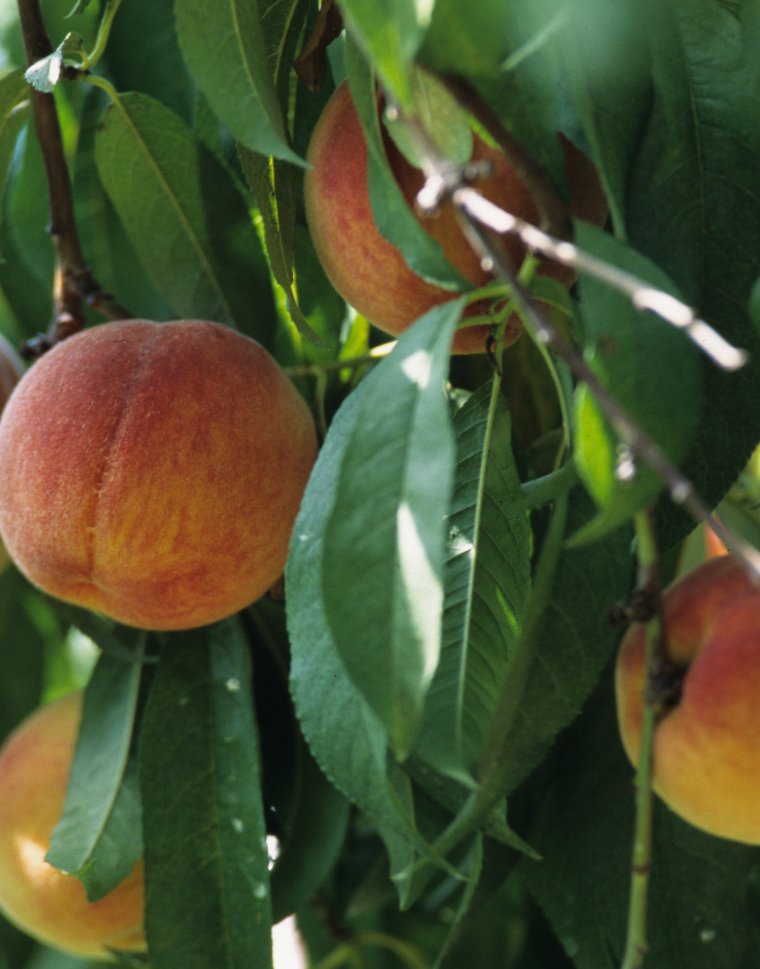
Profitability analysis: Decision points
What if I’m not making a profit?
Bring costs down
Increase prices or volume
Choose to sell raw produce

Slide 21

Economic Principles for Small-Scale Farmers
KNOW YOUR NUMBERS – you can then analyze new opportunities quickly. We have a responsibility to know our numbers so that we’re not undercutting other farmers.
If an enterprise is losing money or only generating a small gross margin, fix it or drop it. Don’t let it distract you from your core enterprise.

Slide 22
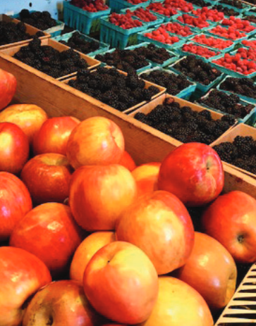
Final questions
What crops could be a good fit?
  Signature crops for your farm
  Abundance
  Waste, seconds
Do I have the time do this well?
Do I enjoy the work of drying, dehydrating, packaging, etc.?
What is my tolerance for navigating regulations?

Slide 23
Processed Food Registration

Slide 24
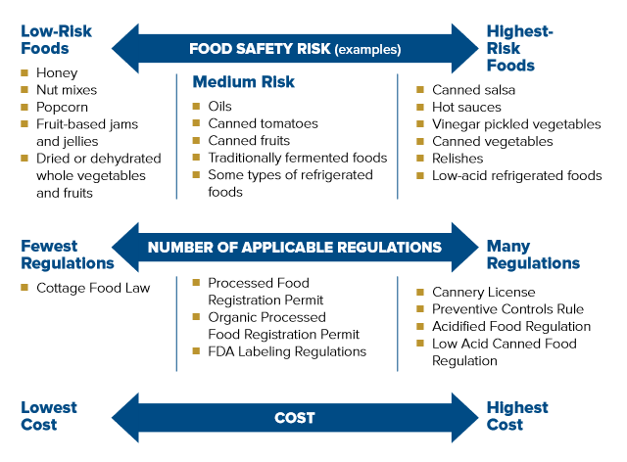
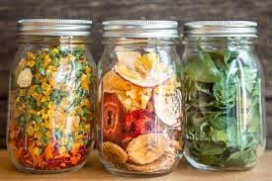
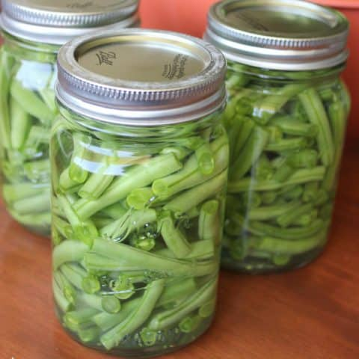
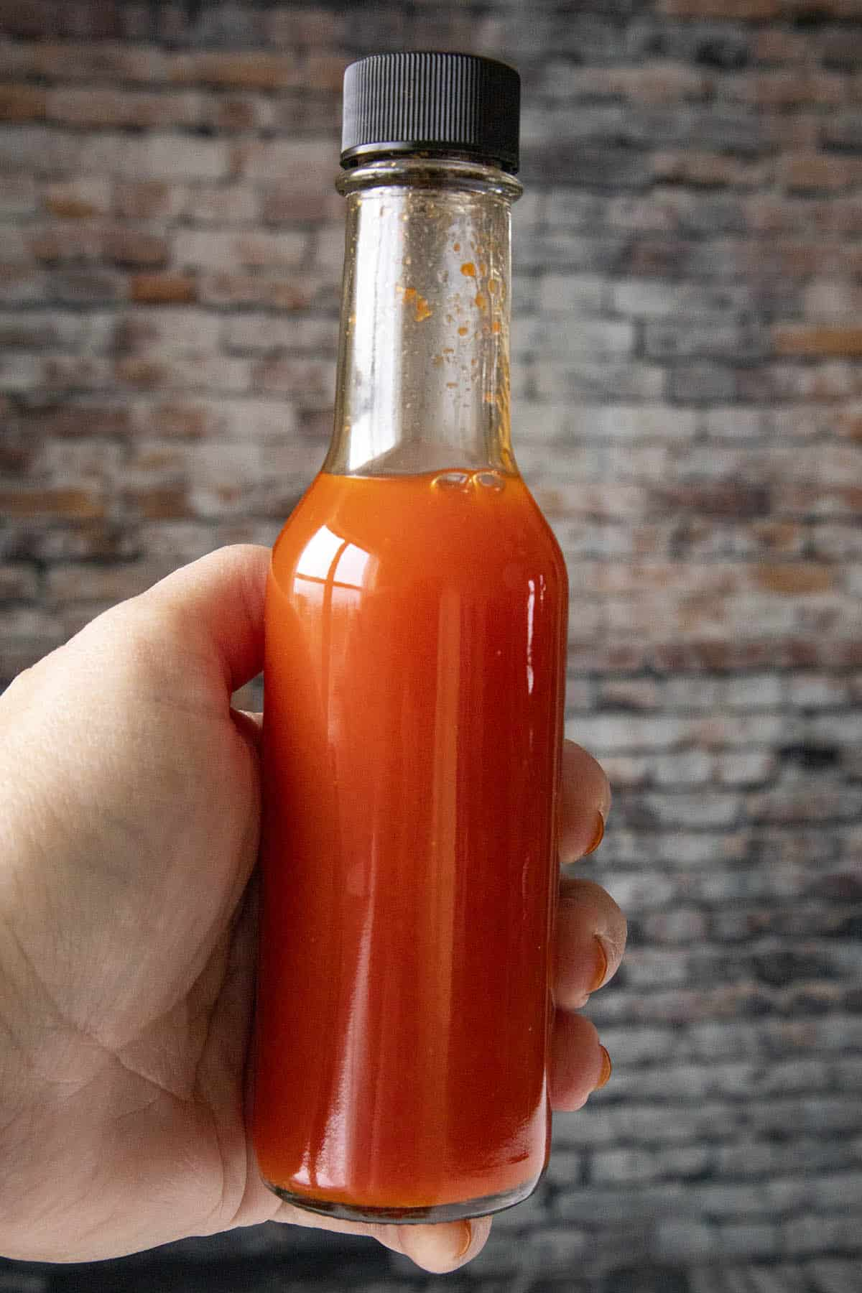
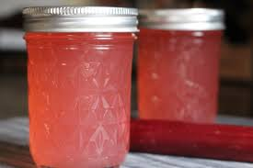
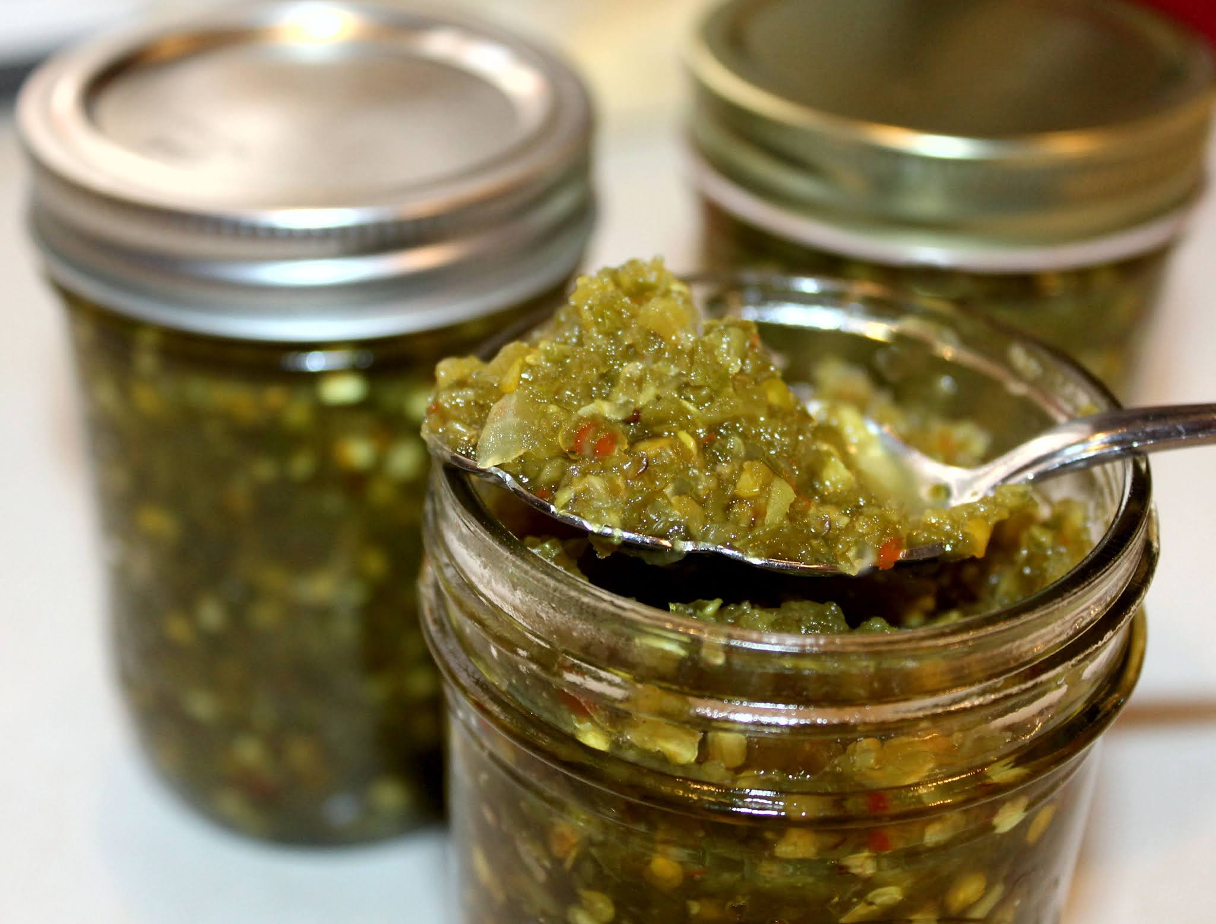
Food safety risk, regulations and cost

Slide 25
UC Food Safety: Products that likely require a PFR
These are presented as examples and exemptions exist depending on product formulation:
Some baked Goods
Noodles
Oils (safflower, olive, sunflower)
Canned fruits
Canned tomatoes
Refrigerated foods
Some jams/jellies
  Fruit based
  Non-traditional bases if water activity below 0.85
Traditionally fermented foods
  Kimchi
  Sauerkraut
  Fermented pickle

Slide 26
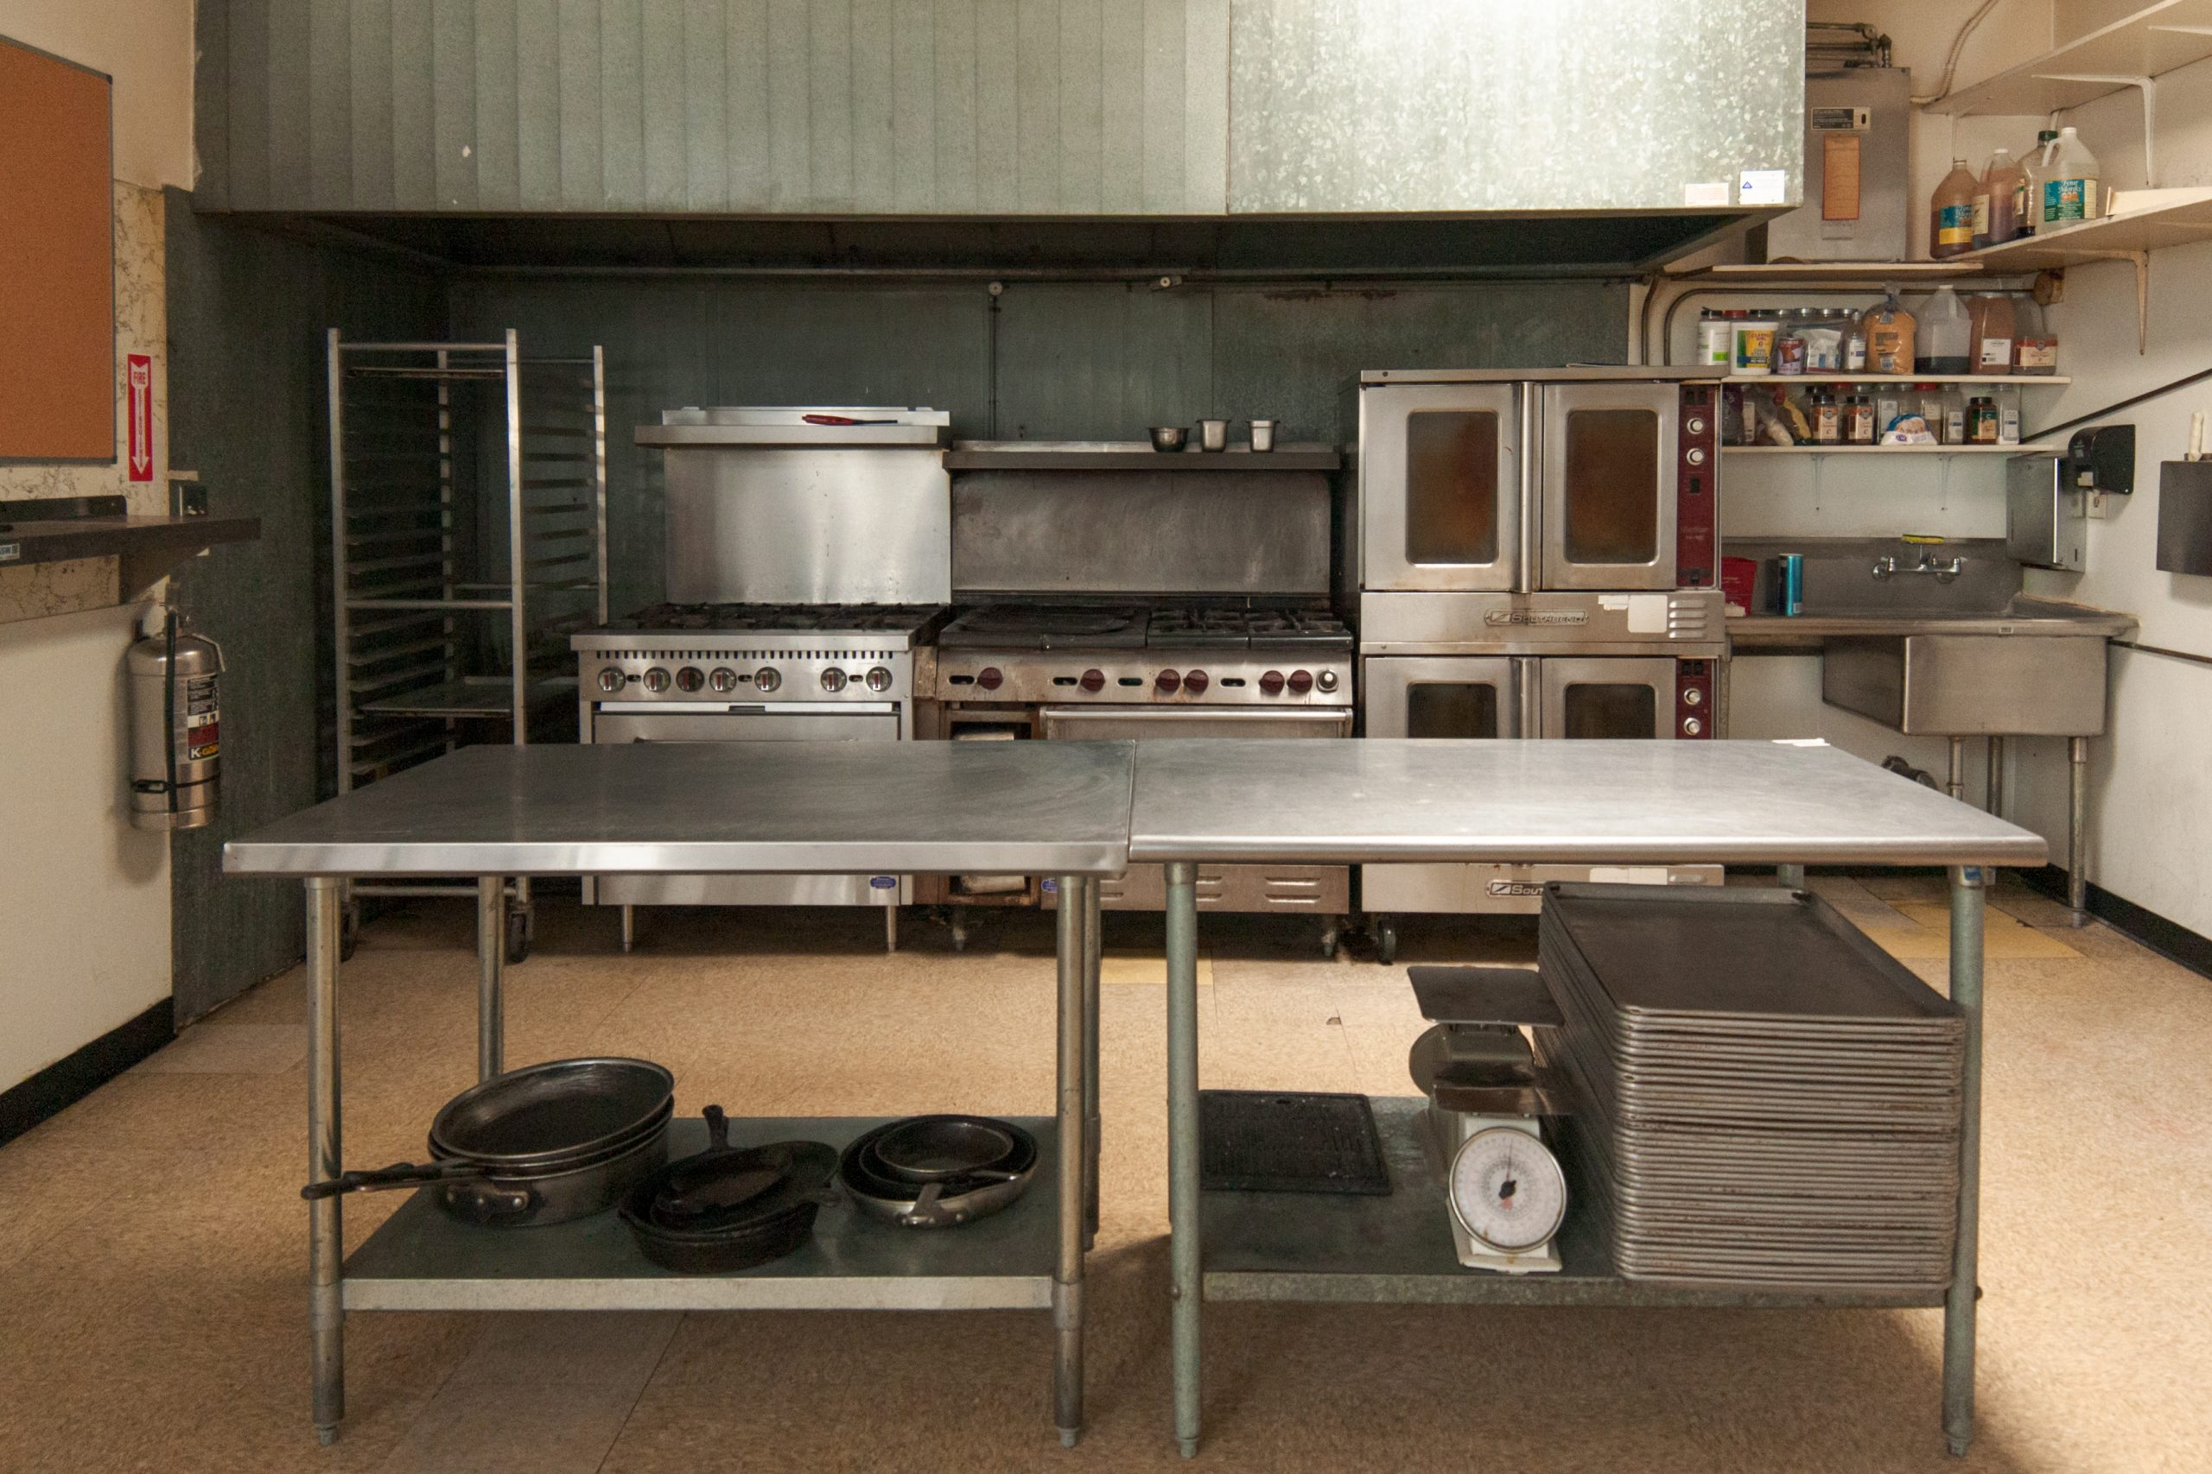
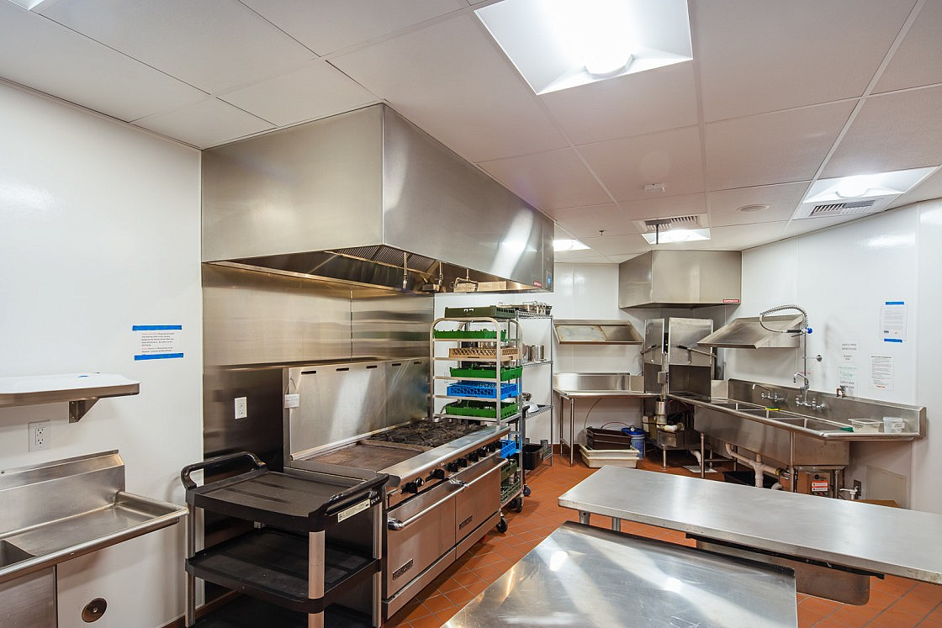
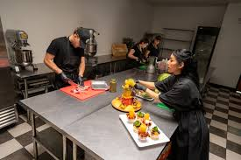
Examples of commercial kitchens
The Raleys Food Lab @ AgStart
Unitarian Universalist Society of Sacramento
Lulu’s Kitchen
Minimum monthly membership is $125
$35 hour per station, 2-hr min.
Storage is an extra fee
$750 deposit
$25 per hour
Storage available

Slide 27
Cannery License

Slide 28
UC Food Safety: Products likely to require a Cannery License in California
This is not an exhaustive list and products may fall under different categories depending on the product formulation. The products listed here are given as general examples. All products need to be evaluated on a case-by-case basis by the CA Process authority.
Acidified canned foods
Canned tomato sauces with added vegetables
Canned salsa
Vinegar vegetable pickles (not fermented*)
Hot sauces (not fermented*)
Pickled eggs
Relishes
Low-acid canned foods
Canned vegetables
Canned soups
Canned stocks
*Only items that are traditional fermented products to which no acid (vinegar, lemon juice, etc.) is added in the recipe are exempt from the CA pH Control Program

Slide 29



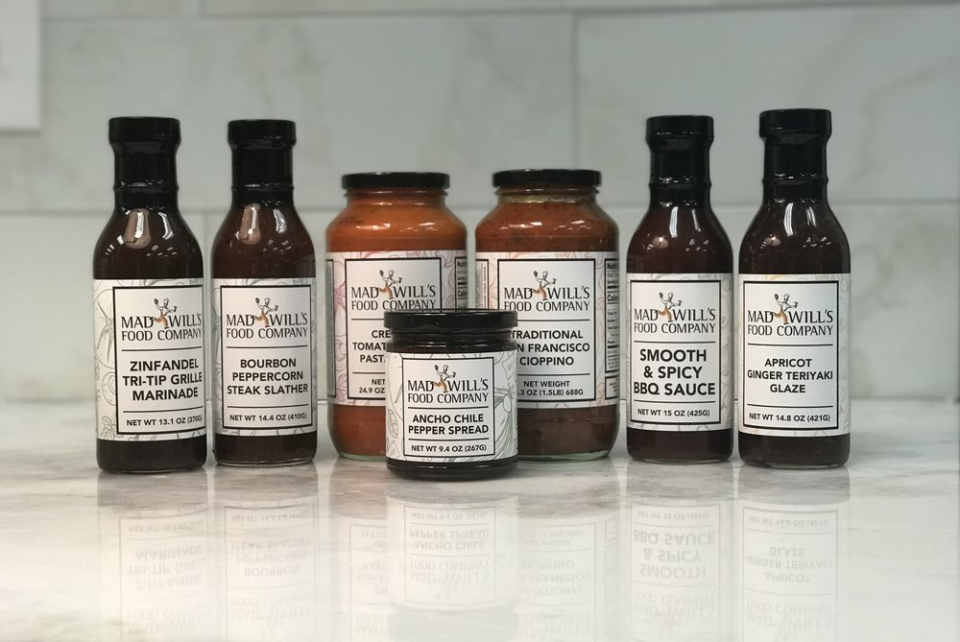
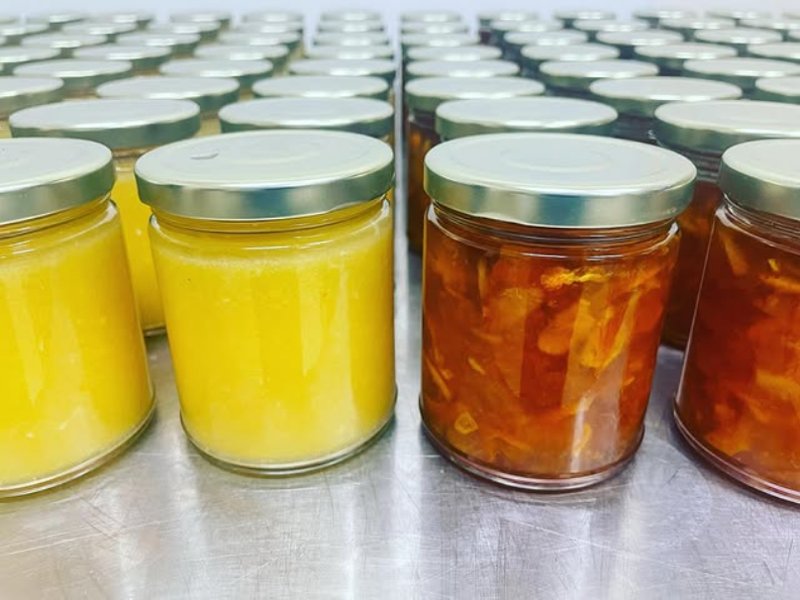
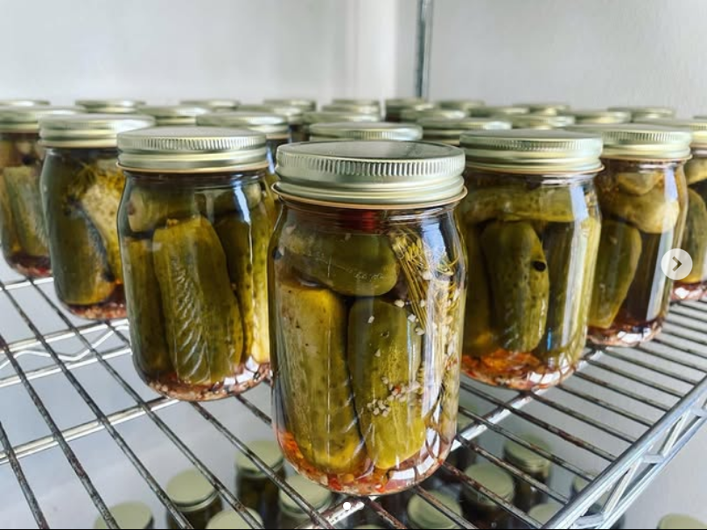
Examples of canneries that co-pack with small farms

Slide 30
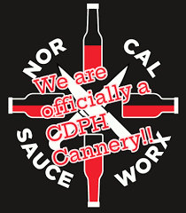

Examples of canneries that co-pack with small farms

Slide 31
Panel response

Slide 32
Evaluating a value-added enterprise
Marketing
Market windows
Farm brand
Regulations
Food safety
Sales outlets
Resources
Business support programs
Profit analysis
Direct, indirect costs
Profit margin
Farm mission

Slide 33
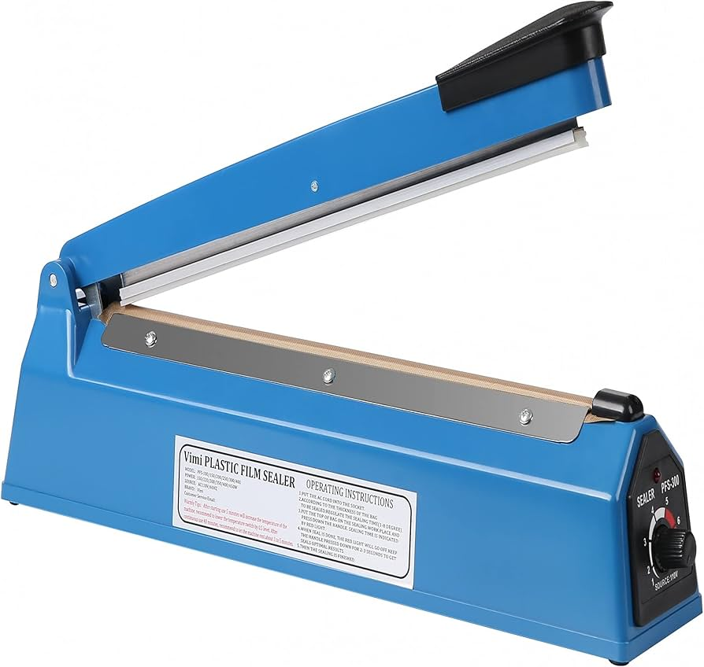

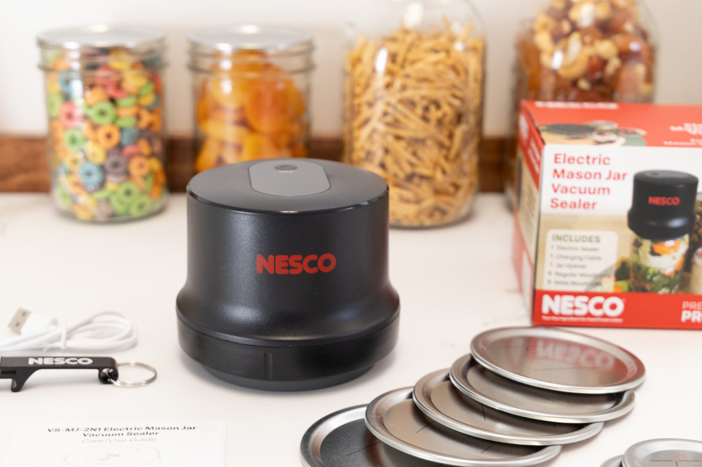
Packaging for food safety and shelf life
Dried foods are susceptible to insect contamination and moisture reabsorption
Packaging techniques:
  Vacuum sealing
  Adding oxygen absorbers
  Opaque packaging, e.g. mylar

Slide 34
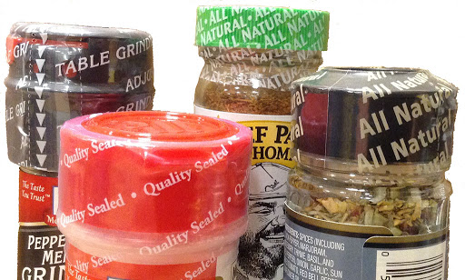


Packaging for food safety and shelf life
Presentation techniques may increase consumer confidence in your product
  Shrink bands applied with heat gun
  Tamper proof stickers

Slide 35
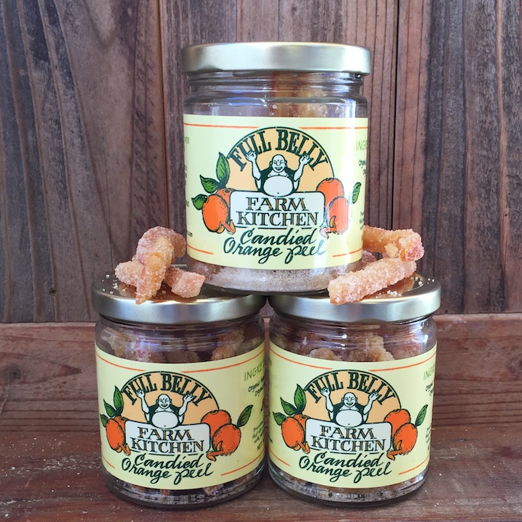
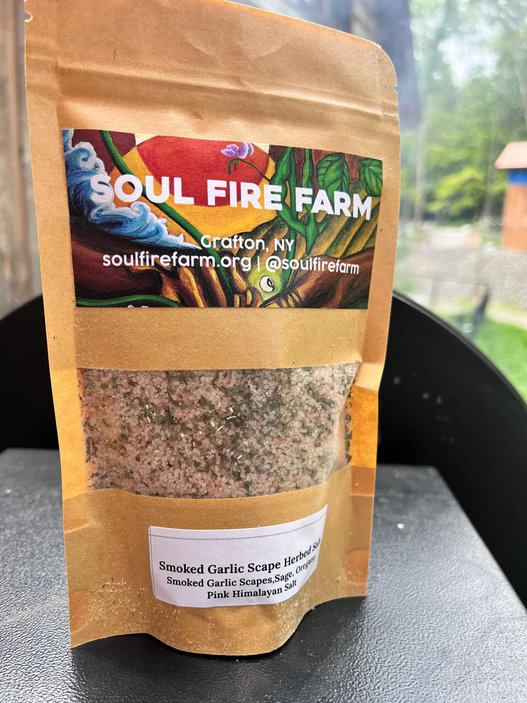
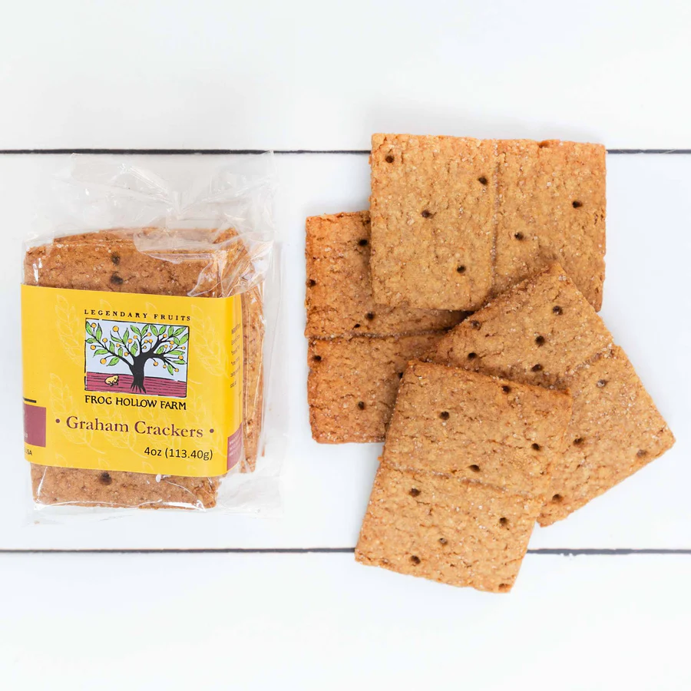
What can you do that no one else can do?

Slide 36
Evaluating a value-added enterprise
Regulations
Food safety
Sales outlets
Market Research
Market windows
Farm brand
Resources
Business support programs
Profit analysis
Direct, indirect costs
Profit margin
Farm mission

Slide 37

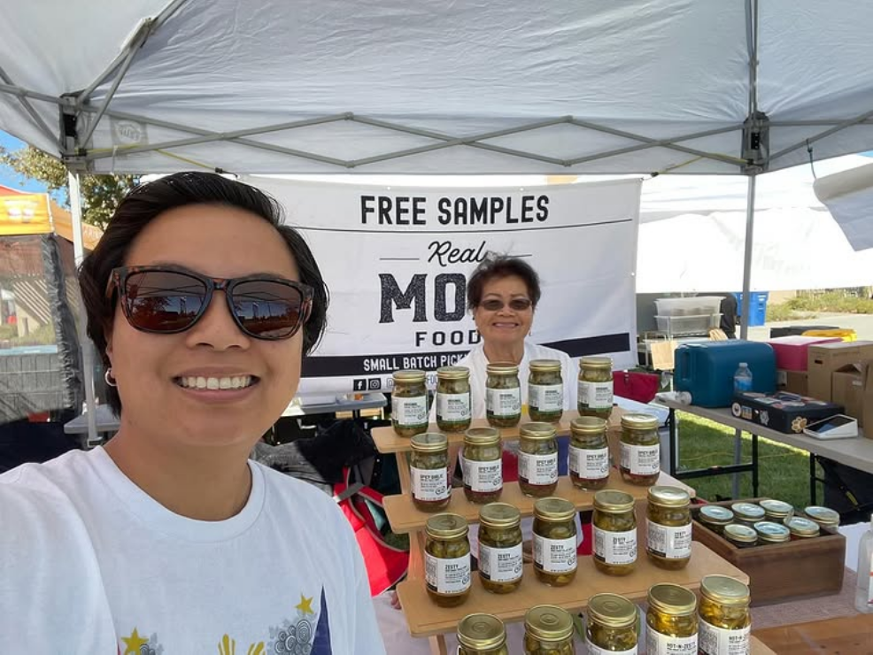
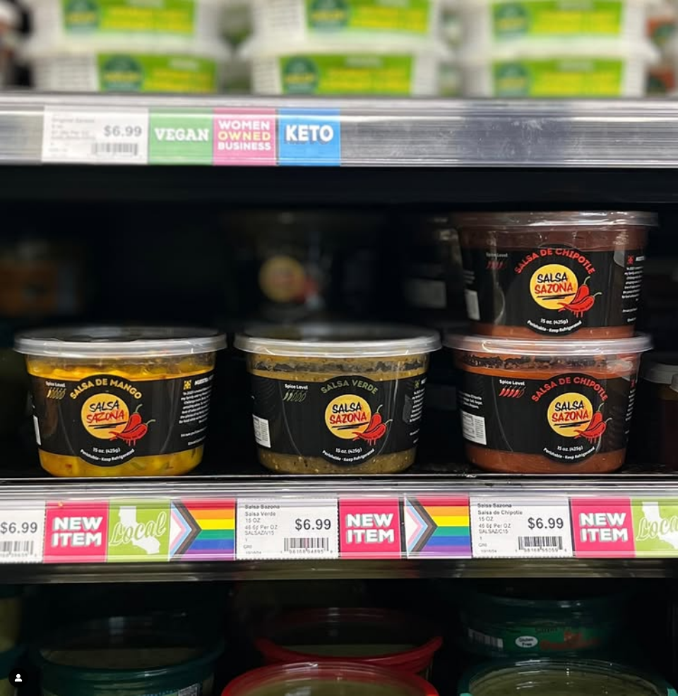

Value-added food business support

Slide 38
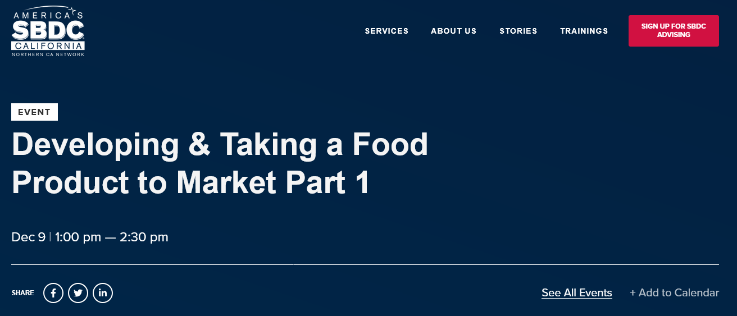

Value-added food business support

Slide 39
Panel:
Marketing cottage food products

Slide 40


Slide 41
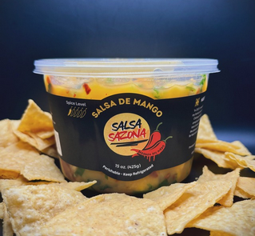

Slide 42
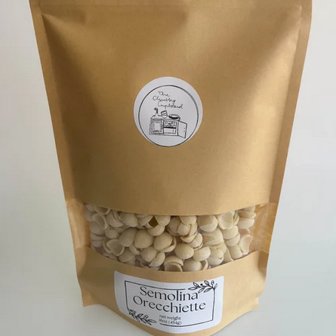

Slide 43
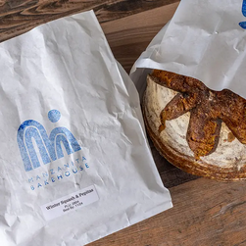

Slide 44
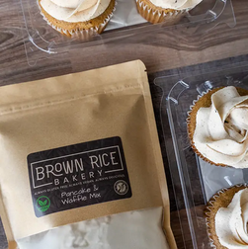

Slide 45
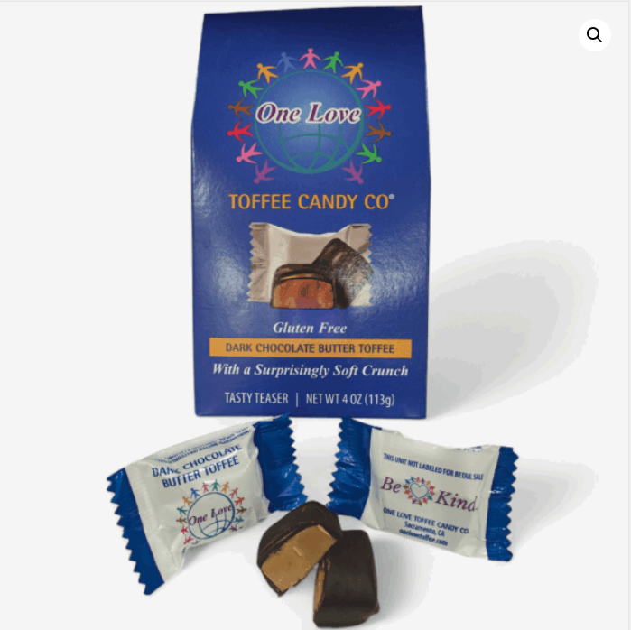

Slide 46
Workshop: Cottage Food Production for Small Farms
UCCE Capitol Corridor Food Systems Program
Olivia Henry
UCCE Regional Food Systems Area Advisor
Dec. 11, 2025

