Slide 1
The Sensory Effects of Carbonic Maceration
Linda F. Bisson
Red Wine Production Strategies
June 6, 2014

Slide 2
Carbonic Maceration
Whole clusters placed in a sealed container
Berries asphyxiate following oxygen consumption by microbial and berry activity
Berry enzymatic activity continues until inhibited by ethanol and CO₂: berries “rot from inside”
Ethanol is produced by berry fermentation of glucose
Temperature of holding varies (25-35°C/75-95°F)
Time of holding varies (one to two weeks)
Tank oxygen can be flushed by carbon dioxide to limit microbial activity
Clusters are crushed, must pressed and microbial fermentation initiated

Slide 3
Carbonic Maceration
CO₂ Atmosphere
Fermenting must

Slide 4
Sensory Characteristics of Carbonic Maceration
Juice is light in color due to loss of anthocyanin
Fruit, particularly strawberry, is more intense but less complex
Varietal characters are lost
A characteristic damp hay or silage character develops
Tannins are softened by the maceration process
Wines can be consumed young
Wines do not age well

Slide 5
Whole Cluster Fermentation
The presence of whole clusters in juice or must during primary fermentation
Fermentation occurs in two stages: pre and post crushing/pressing of the whole clusters
Time on whole cluster pre crushing/pressing varies

Slide 6
Whole Cluster Fermentation
Must/juice

Slide 7
Whole Berry Fermentation vs. Carbonic Maceration
In whole berry fermentation the ethanol produced by yeast penetrates berry inhibiting “decay” reactions seen with carbonic maceration
Presence of whole berries during most active phase of fermentation traps volatile aroma characters and prevents loss due to CO₂ entrainment, increasing the varietal character of the finished wine

Slide 8
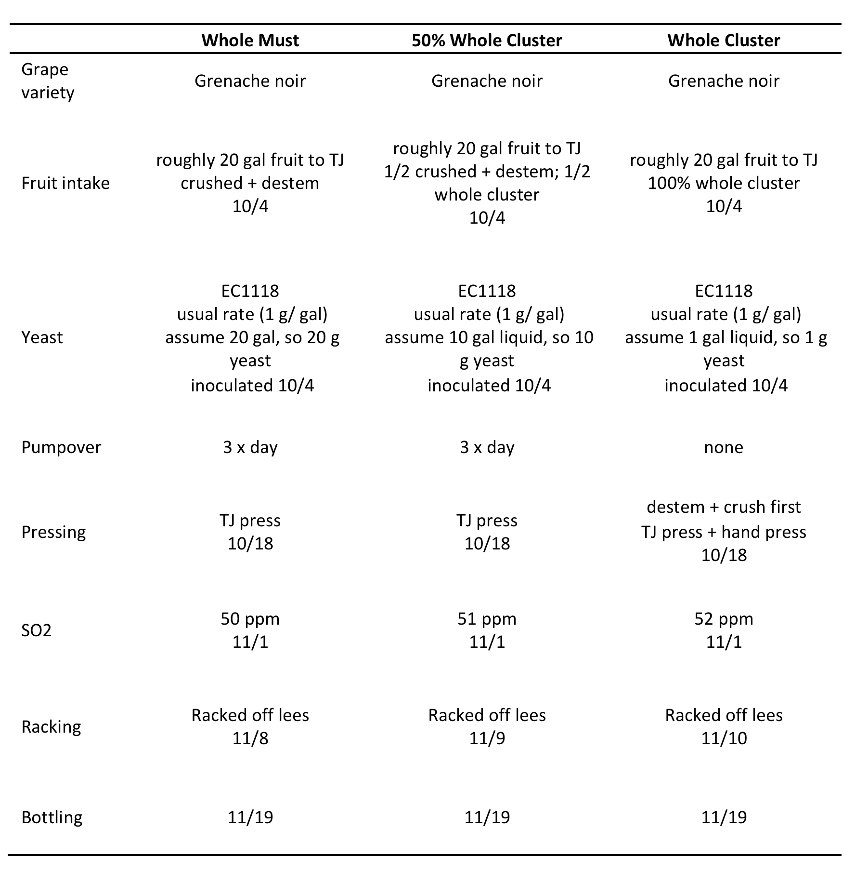
Steps in Winemaking Process

Slide 9
Fermentation curves

Slide 10
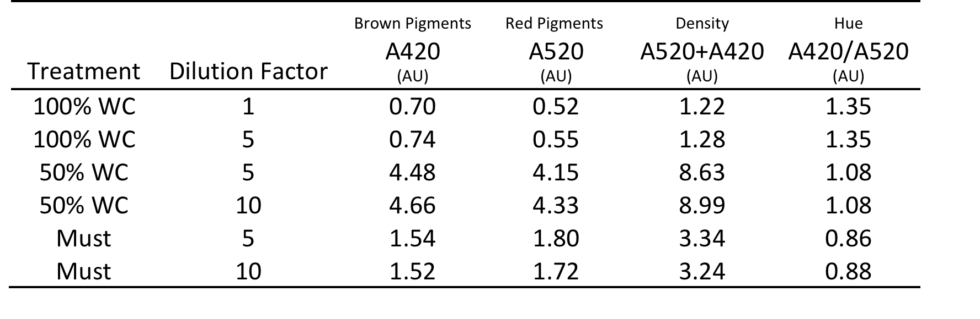
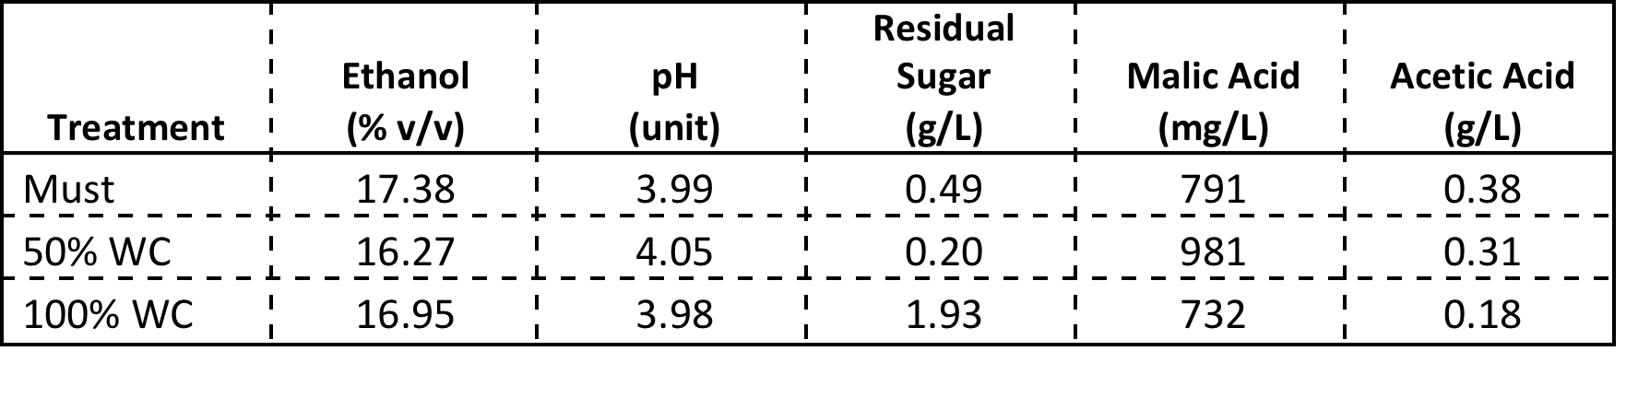
Chemical Analyses

Slide 11
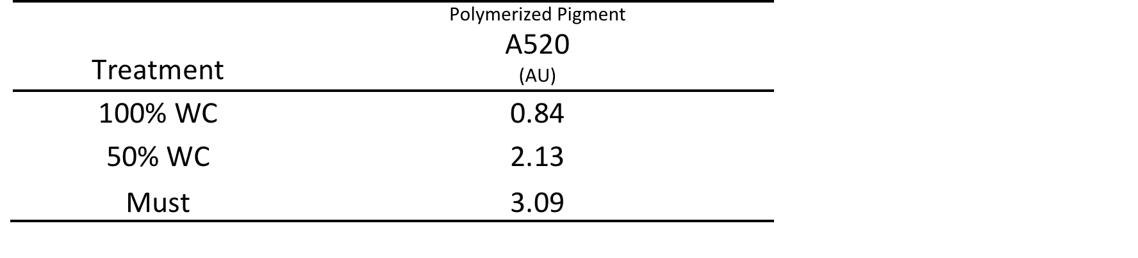
Pigment Analysis

Slide 12
Sensory Analysis: Opaque glasses
50% whole cluster was most fruity and most preferred
Carbonic maceration was most intense and least preferred
50% whole cluster versus blend of ½ Must and ½ carbonic maceration are aromatically different at the 99% confidence level

Slide 13
Sensory Analysis: Transparent Glasses
Wines were clearly distinguishable by color and results were as expected with must perceived as most intensely colored
Must ranked highest in fruitiness, intensity, and preference in transparent glasses than in black glasses implying a bias based on wine color

Slide 14
Acknowledgments
Thanks to the students who did the work:
  Jennifer Angelosante
  Mike Garrison
  Yan Luo

