Slide 1
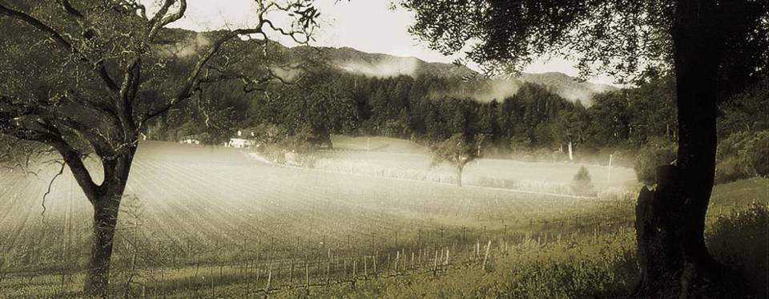
Red Wine Strategies
(Phenolics Focus)
Corey Beck
Director of Winemaking
Francis Coppola Winery
June 6th 2014

Slide 2
Phenolic Profile Assay in Winemaking
Adopted Harbertson-Adams Assay in 2003:
  Anthocyanin: “color” measured by spec at 520 nm
  Tannin: measured by protein precipitation
  Total Phenols: Iron reactive
Real-time ‘in-house’ wet chemistry analysis for measuring color, tannin, total phenols and polymeric pigments. Very useful tool, especially during harvest and macerations.
The assay quantifies phenolic compounds in wine by measuring and analyzing the chemical properties of those compounds. It separates chemicals into functionally-defined categories.
2.5-3 Hour Run Time

Slide 3
How Can Assay Help With Winemaking Decisions?
Use Phenolic Assay to provide grower feedback
  Adjustments in the vineyard to reach quality goals
  Grower becomes part of ‘goal oriented winemaking’
Quantify Theories
  Measure amount of tannin/anthocyanin lost using fining agents
Assist in defining wine ‘Style’
  Vintage quality

Slide 4
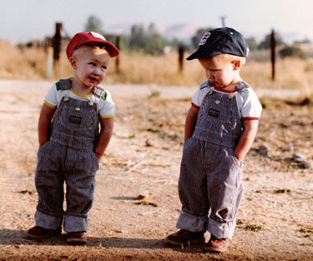
How is Phenolic Data Useful to Growers?
Helps grower understand wine style so adjustments can be made in vineyard
Creates Third Party if there’s a difference in opinion over wine quality
Helps define quality and closes the loop between grower and consumer
Gives grower more data to market their fruit

Slide 5
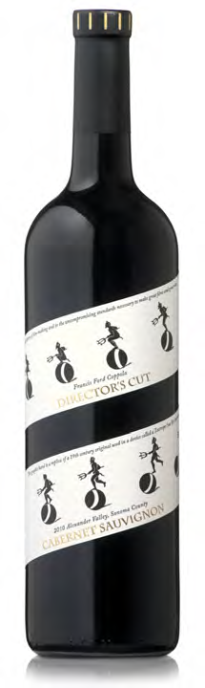
2012 Director’s Cut Cabernet Sauvignon- Alexander Valley
Target a given wine style within the confines of each vintage
Grower has greater sense of ownership to the wine and vintage
Notes:
Each vintage is different and gives us different levels of phenolics
Grower is involved in achieving this style
Grower has greater sense of ownership to the wine and each vintage

Slide 6
Typical Graph Presented to Grower
Phenolic Data- 2012 Cabernet Sauvignon- Alexander Valley
Notes:
Many growers were intimidated by wine tasting and too winemaker’s opinion of wine quality for granted
Phenolics give growers greater authority and understanding of wines
Growers are concerned with antho and tann # rather than brix and pH

Slide 7
2012 Grower Feedback Cabernet Sauvignon
Vineyard- Critical to Balance Vigor and Crop Load
  2 clusters per shoot
  Crop adjustment at onset of veraison
  Lateral removal
  Leaf removal to add light into canopy
Cabernet Sauvignon Profile in Winery at Harvest
  Dark brick red to deeply colored berries
  Black cherry flavor profile
  Anthocyanin typically on of the highest out of Bordeaux varietals
  Monitor tannins in fermentor
  Recycle skins

Slide 8
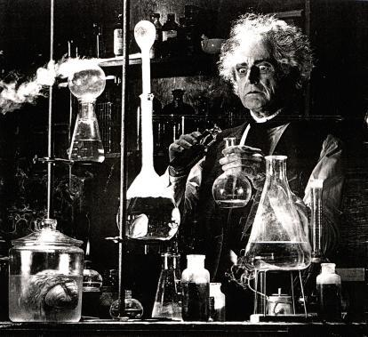
Phenolic Assay Can Help Quantify Beliefs
Blending
  Allows for earlier blending of similar lots based on the combination of sensory, chemistry and phenolics
Fining
  See which agents affect tannin fining without significant color loss
Drain & Press
  Make ‘real time’ decisions with stylistic considerations
  Measuring daily phenolics to help with pressing/pump-over decisions

Slide 9
Measuring Anthocyanin
Blending Zinfandel and Petite Sirah during fermentation
PPM
34% Higher Color
DAYS IN FERMENTOR

Slide 10
Measuring Tannin
Blending Zinfandel and Petite Sirah during fermentation
PPM
DAYS IN FERMENTOR

Slide 11
Fining Agent (Gelsol) and it’s Effect on Tannin
2009 Dry Creek Zinfandel
12%
PPM
Rates of Gelsol

Slide 12
Fining Agent (Gelsol) and it’s Effect on Anthocyanin
2009 Dry Creek Zinfandel
PPM
Rates of Gelsol

Slide 13
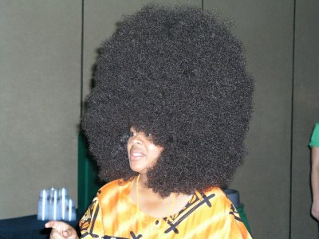
Phenolic Assay Assists in Defining Style
Use of Phenolic Assay to Plot Anthocyanin and Tannin
Helps with vineyard and varietal selection
Use Phenolic Assay as a tool to help define program and asses quality
Keeps vintages consistent
Creates history of vineyards/growers for winemaking team and owners

Slide 14
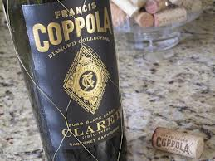
Identifying Wine Style- Claret

Slide 15
2009 Anthocyanin -Claret Components

Slide 16
2009 Tannin- Claret Components

Slide 17
2009 Claret Elevation
Addition of (CF, PV & MB) adds more Color and Tannin

Slide 18
Average Color/Tannin for Sonoma County Cabernet
(2009-2013)

Slide 19
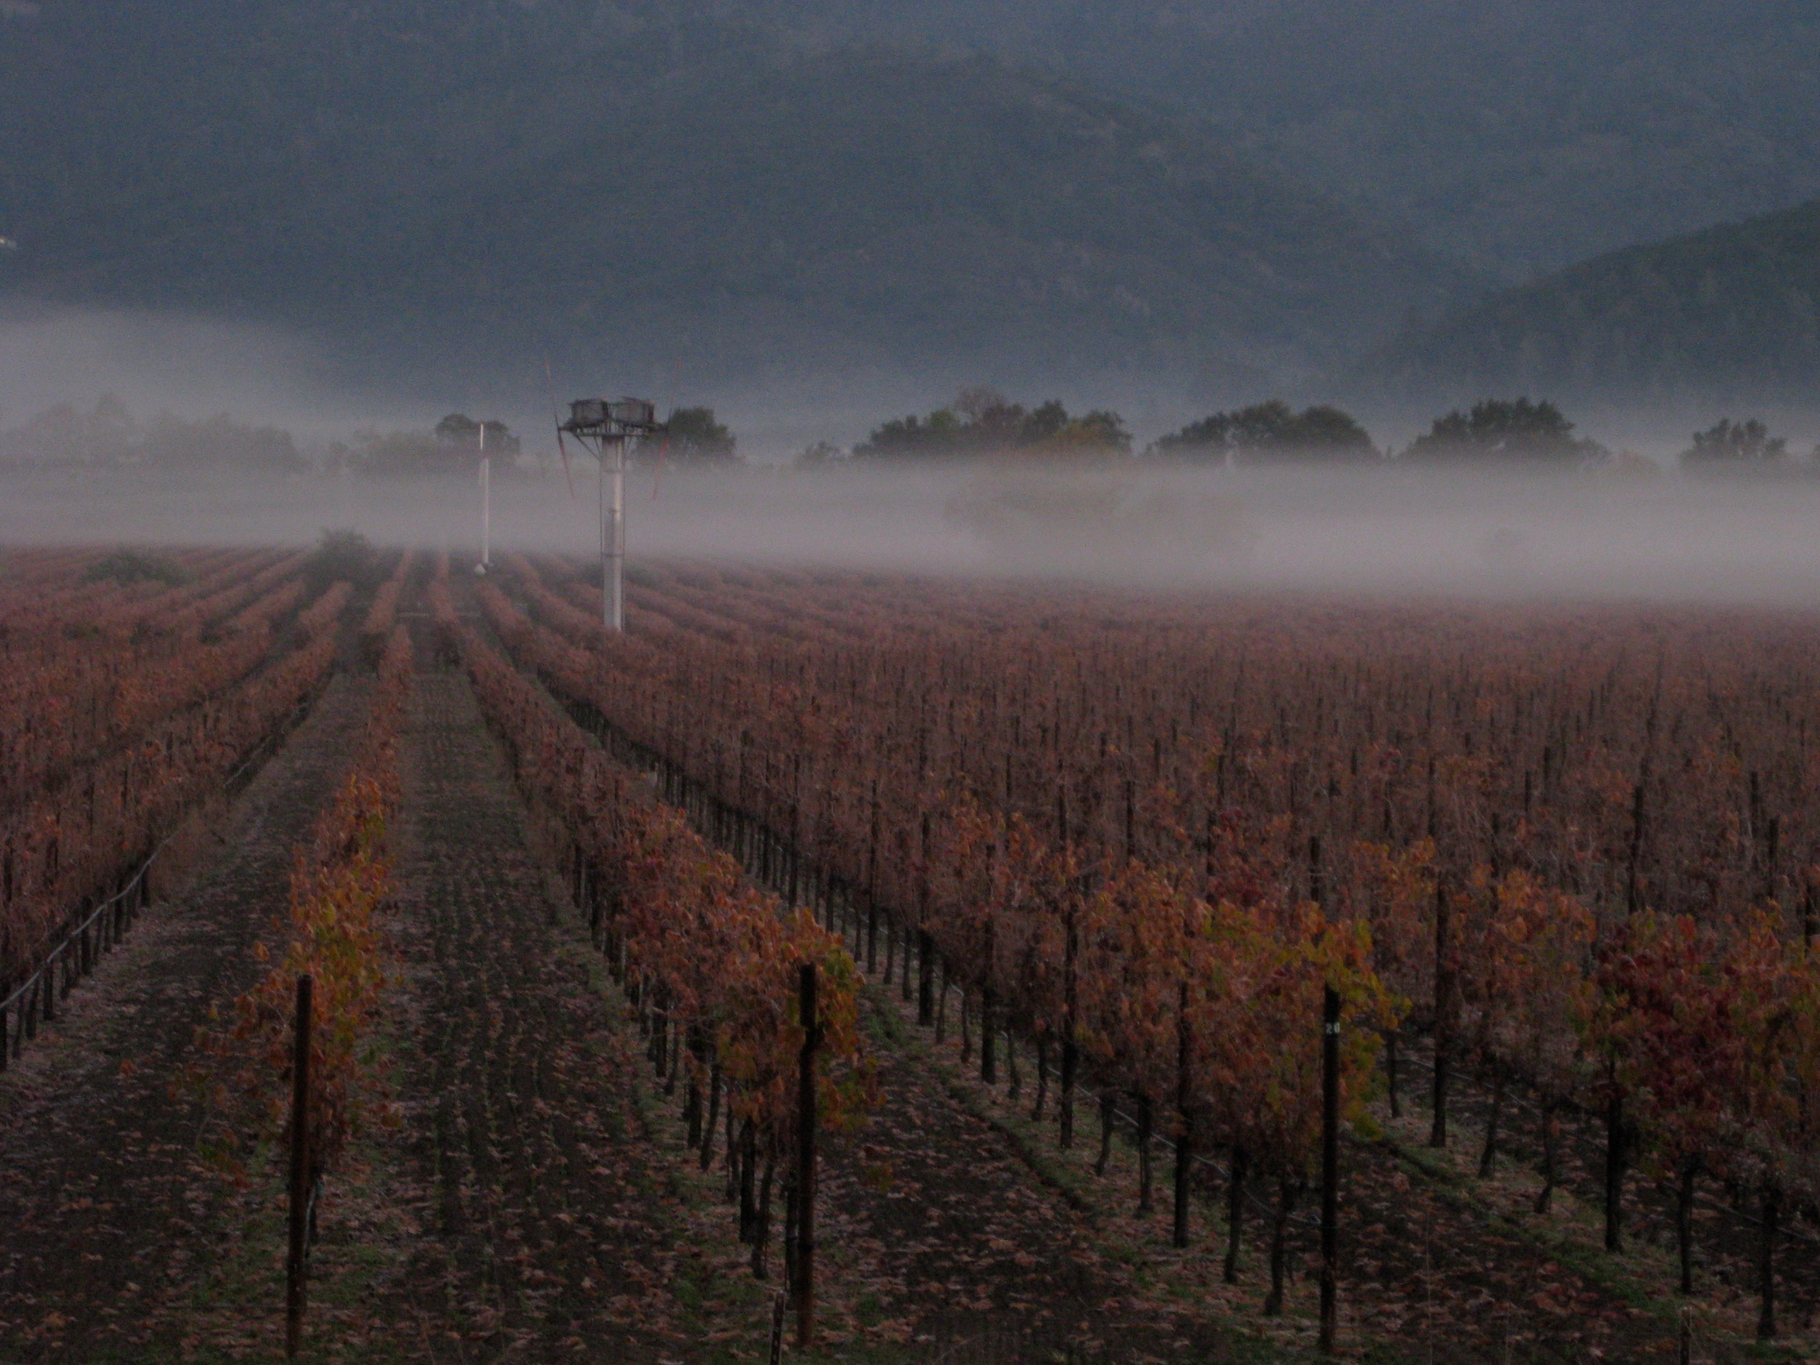
Summary
Help improve winemaking decisions
  Blending
  Fining
  Pressing
Improve Grower Relationships
Help Identify Wine Style
Gauge Vintage during harvest

Slide 20
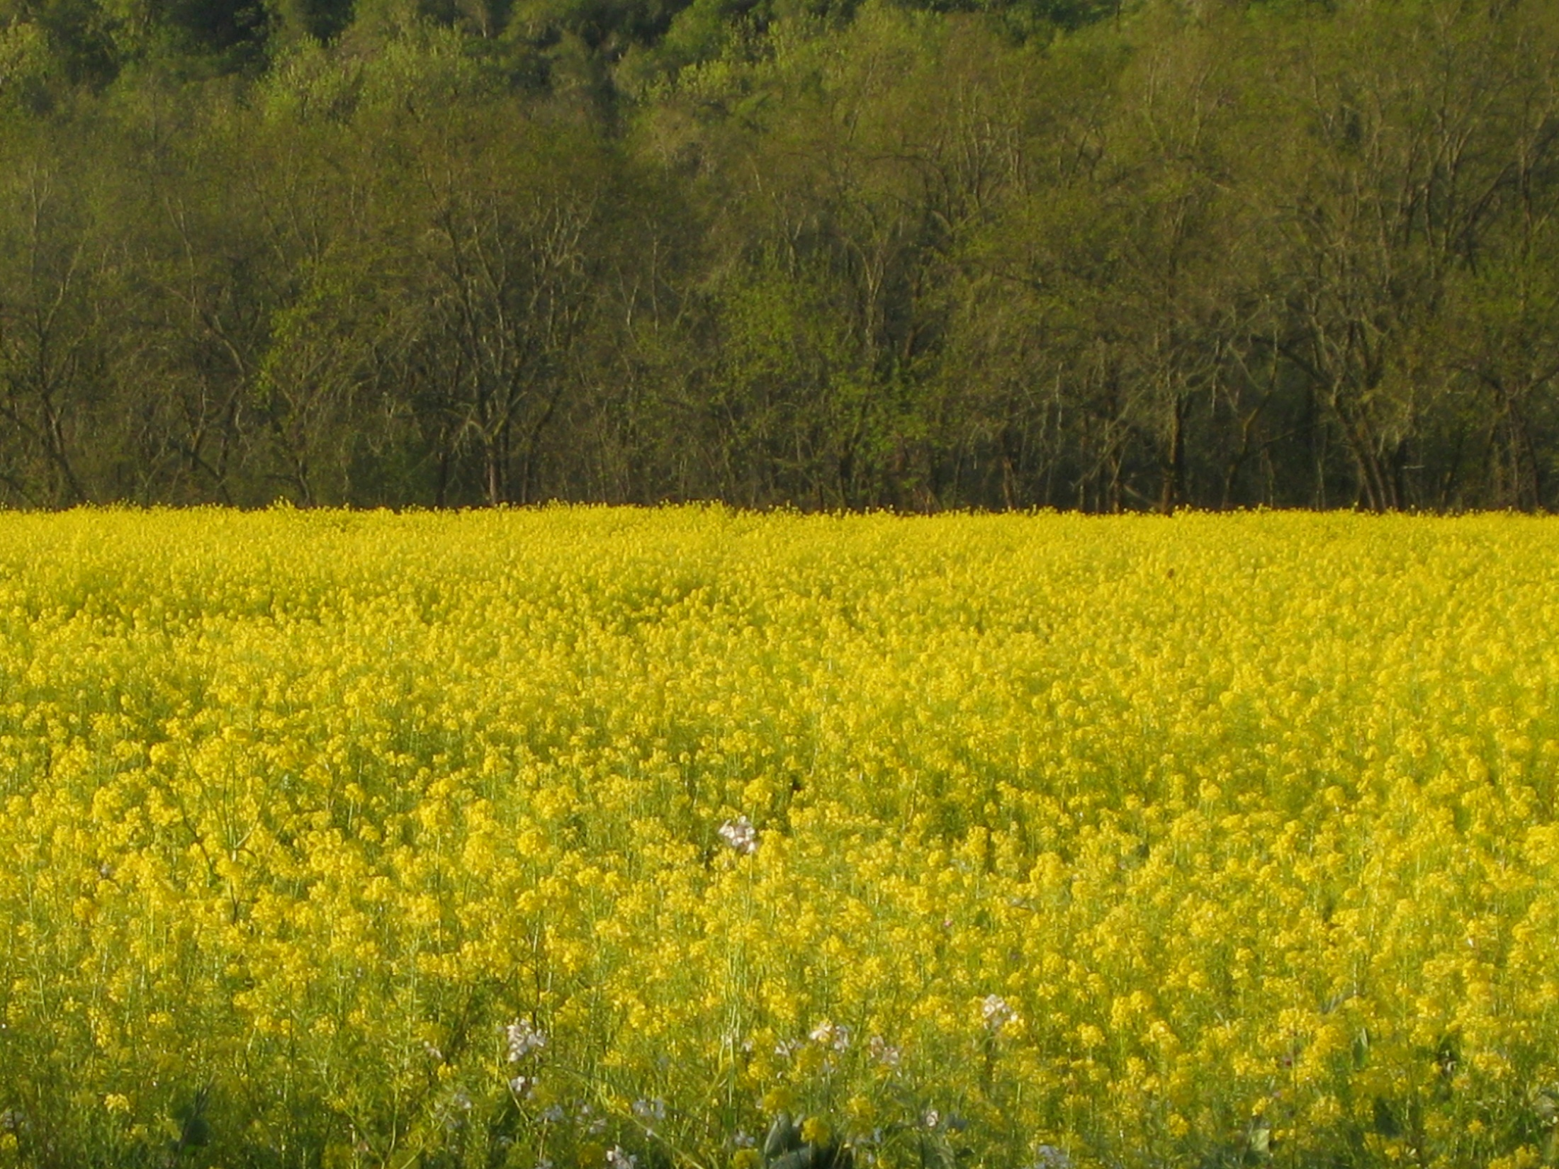
Many thanks to:
Evan Schiff and Tondi Bolkan-Use of Harbertson-Adam Assay in production world
Drs. Jim Harbertson & Doug Adams
Lise Asimont-Director of Grower Relations, Francis Ford Coppola Winery
The Growers of the Francis Ford Coppola Winery

