Slide 1

Impact of mechanical harvesting and optical berry sorting on wine composition
Anita Oberholster
Wine Flavor 101D: Techniques to Tailor Wine Composition
June 5th, 2015

Slide 2
Introduction
Background
Experimental design
Chemical data
  Grapes
  Wines
    0 and 3 months
Descriptive sensory analysis
Conclusions
Future work
Acknowledgements

Slide 3
Background
Mechanical harvesters
  Concerns:
    Damage to berries
    Inclusion of more MOG
    ↑microbial + enzymatic activity between picking and processing
    Loss of juice
Hypothesis
  New age mechanical harvesters with optical berry sorting = hand picking

Slide 4
Background
Advantage of machine harvesting and sorting
  Much faster (40 tons per day)
  Fewer field and winery workers needed
  ± $300/ton machine harvest and optical sorting
Disadvantage
  Expensive equipment
  Loss in yield?

Slide 5
Am. J. Enol. Vitic 1990 vol. 41 no. 2 176-181
Background: previous studies
Machine harvested vs hand picked Chardonnay
  Machine harvested
    ↑ yield, but more juice loss
    More second crop
    Similar chemical profiles
  Wines:
    Duo trio test: not differentiable
    Preference test: no statistical preference
Clary et al. 1990. Am. J. Vitic. Enol. 4:176-181.

Slide 6
Background – previous studies
Machine harvested vs hand picked
  Traditional bow rod mechanical harvester
    Hand-picked vs machine harvested
    Must: pH 3.11 vs 3.3
    Must: Tot Phenols ↑9% with machine harvest
    Wine: pH difference persist (3.08 vs 3.24)
    Wine: Tot Phenols ↓9% in machine harvest
      Oxidation?
    Sensory differences not remarkable
      Most noticeable acidity
Arfelli et al. (2010) J. Int. Sci. Vigne Vin 44: 101-115.

Slide 7
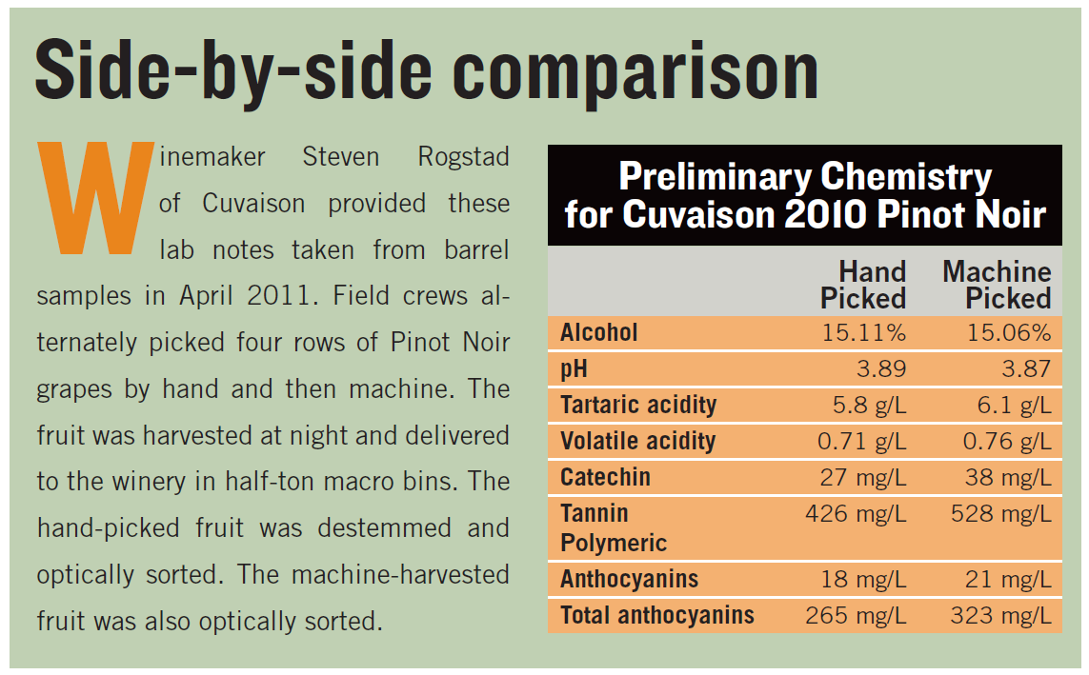
Background – Informal studies
Excerpt from Ulrich (2012) Wines & Vines pp: 86-90.

Slide 8
Background: Chardonnay Sorted vs Unsorted
Wines | Sorted | Unsorted
pH | 3.60 | 3.47
280 nm | 5.8 | 4.8
Gluc, fruc (g/L) | 0.8 | 0.4
Descriptive analysis
  Sorted wines
    ↑ tropical fruit aromas
    ↑ sweetness
Falconer et al. 2006. Am. J. Vitic. Enol. 57 (4): 491-496

Slide 9
So far…….
Studies found some impact due to harvest method - but not enough for quality impact
One study looking at optical sorting of Chardonnay – no major impact
Impact of new harvesters?
Optical sorting on red grapes?
Synergistic effects?

Slide 10
Our study - Objectives
Compare machine harvested fruit with hand-picked fruit with and without optical berry sorting
Determine individual and synergistic influence of machine harvest and optical berry sorting on grape and wine composition
Investigate potential differences in wine styles

Slide 11
Introduction
Background
Experimental design
Chemical data
  Grapes
  Wines
    0 and 3 months
Descriptive sensory analysis
Conclusions
Future work
Acknowledgements

Slide 12
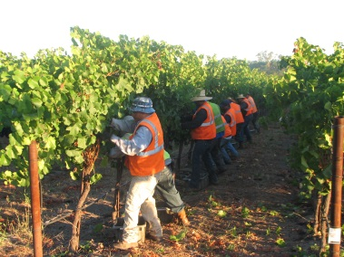
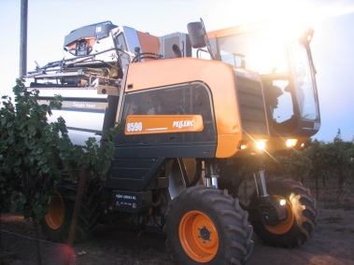
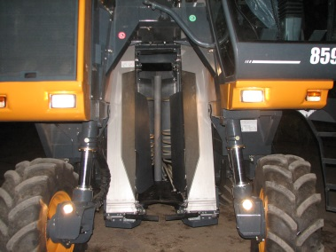
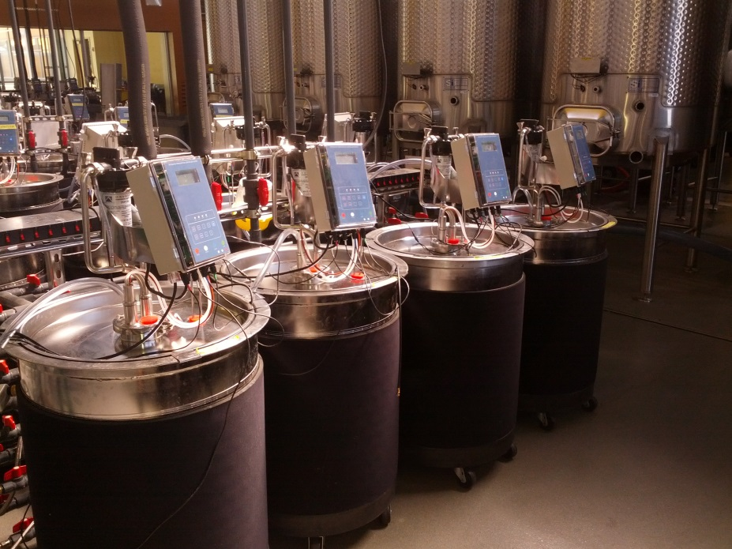
Hand picked
Pellenc Selectiv’ harvester
Bow rod machine harvester
No sorting
Optical sorting
No sorting
Optical sorting
No sorting
Optical sorting
Analysis
Adams-Harbertson assay, UV-Vis
HPLC
GCMS
Descriptive sensory analysis

Slide 13
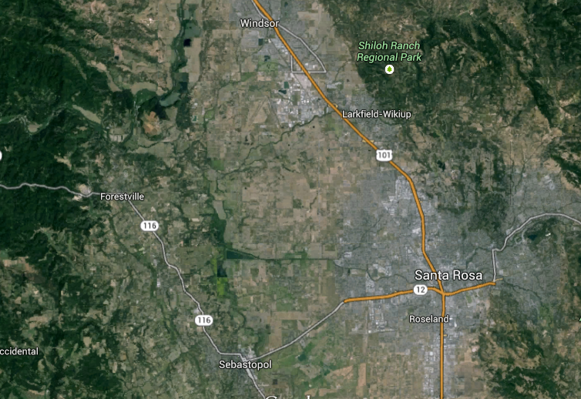
Pinot noir clone 667, 1103 Paulsen rootstock
Russian River Valley AVA
Harvested at night on September 17, 2013
Harvest method alternated to minimize row to row variation

Slide 14
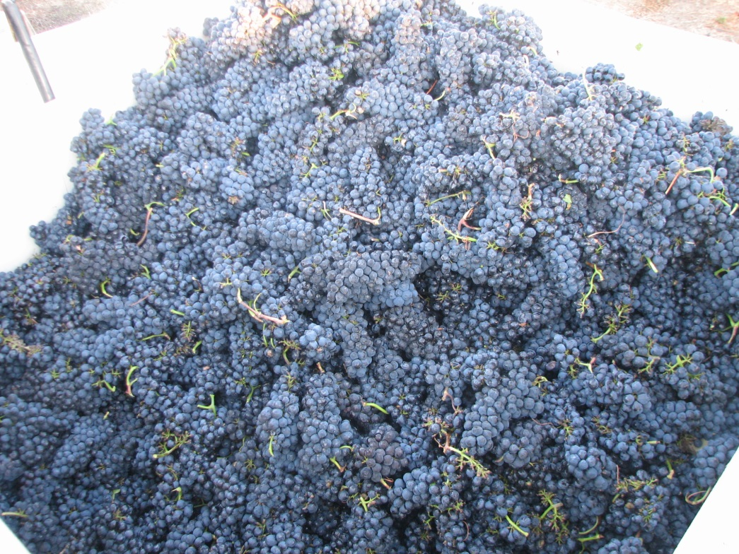
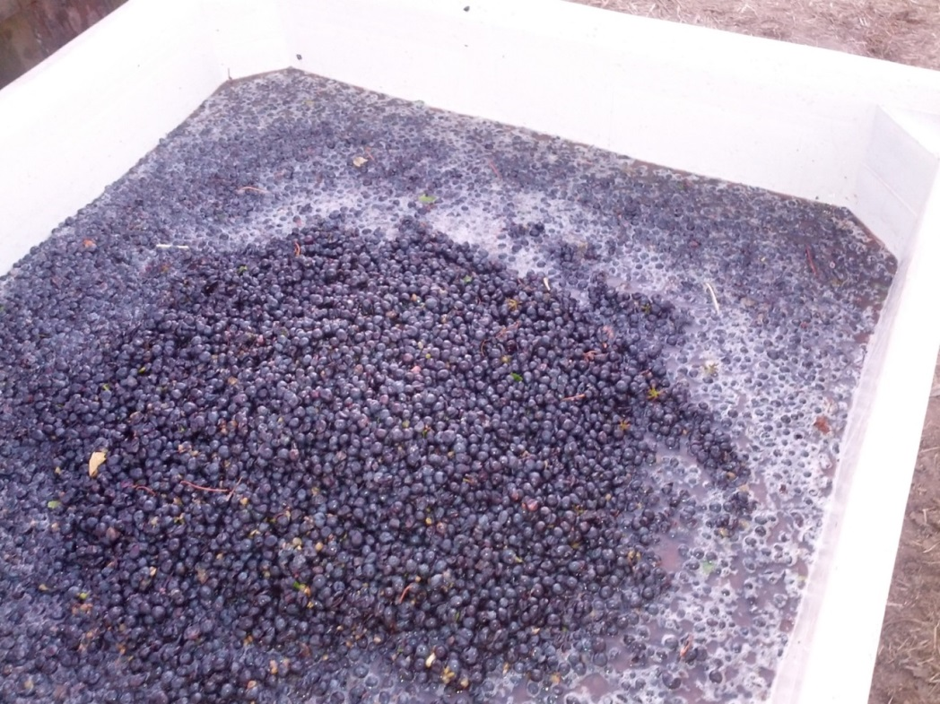
Hand Harvested
Machine Harvested

Slide 15
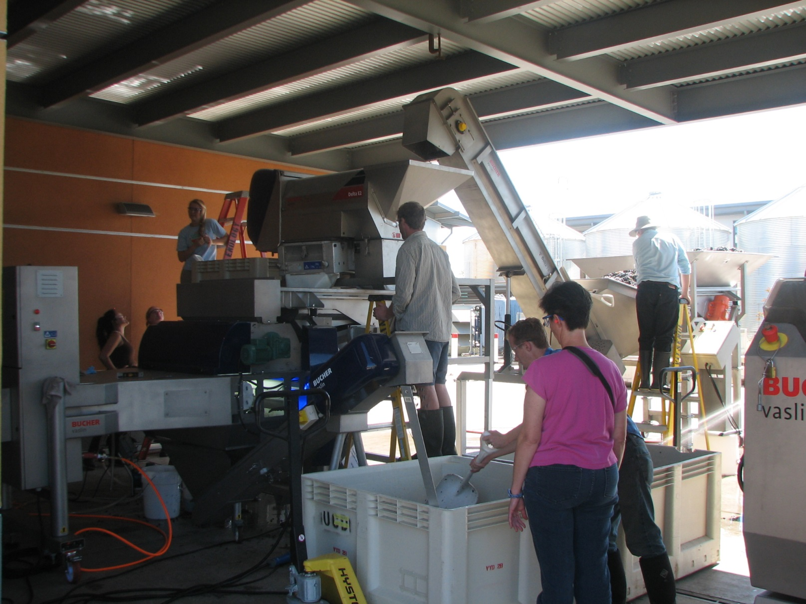
Bucher Vaslin Vistalys R1 Optical Sorter

Slide 16
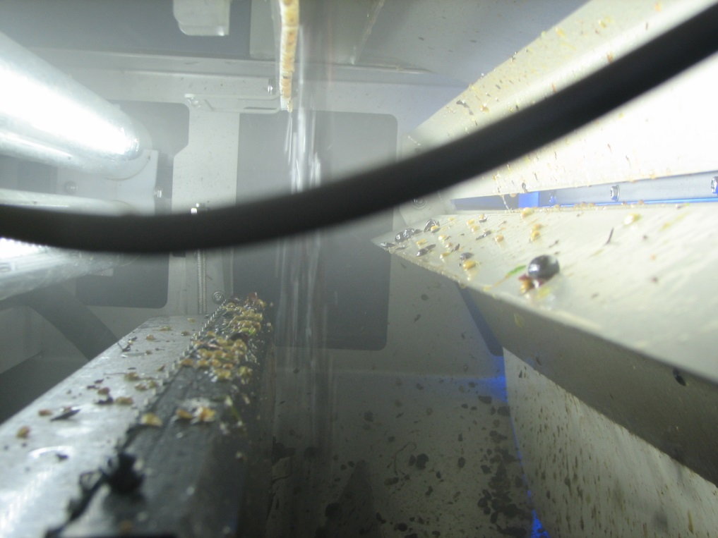
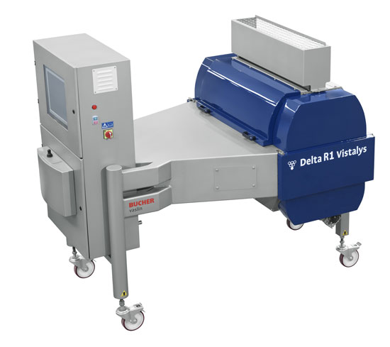
Bucher Vaslin Vistalys R1 Optical Sorter
Uses 100 ejection nozzles, 6 bar air blasts
1,000 FPS, 10 billions pixels
1-5 tons/hour
Training process

Slide 17
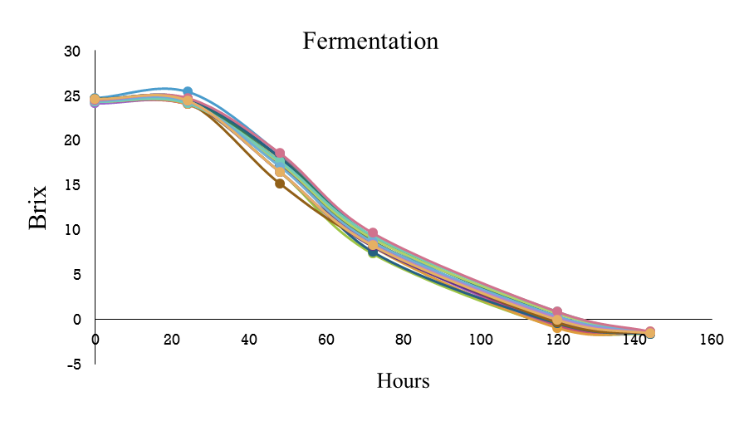
Winemaking
  Triplicate 30 gal ferments
  Whole berry
  300 ppm YAN
  50 ppm SO₂
  Inoculated for primary and secondary fermentation
  3 pump-overs/day, one aerative

Slide 18
Introduction
Background
Experimental design
Chemical data
  Grapes
  Wines
    0 and 3 months
  Descriptive sensory analysis
Conclusions
Future work
Acknowledgements

Slide 19
Chemical analyses of grape musts
Treatments | Brix | pH | TA (g/L)
Hand, no sort | 24.6 | 3.7 | 5.3
Hand, optical | 24.3 * | 3.7 | 5.3
Selectiv’, no sort | 24.5 | 3.8 | 5.1
Selectiv’, optical | 24.6 | 3.8 | 5.1
Machine, no sort | 24.5 | 3.8 | 5.2
Machine, optical | 24.3 * | 3.7 | 5.2
* Significantly lower (p<0.05)
Hendrickson et al., Am. J. Vitic. Enol. (In review)

Slide 20
Introduction
Background
Experimental design
Chemical data
  Grapes
  Wines
    0 and 3 months
Descriptive sensory analysis
Conclusions
Future work
Acknowledgements

Slide 21
Chemical analyses of wines at bottling
Treatments | % v/v ETOH | pH | TA (g/L) | RS (g/L) | Malic acid (g/L) | AA (g/L)
HHNS | 13.9 | 3.74 | 4.86 | 0.44 | 17.00 | 0.39
HHVS | 13.2 | 3.71 | 5.03 | 0.28 | 19.00 | 0.43
PSNS | 14.4 | 3.76 | 4.64 | 0.46 | 19.67 | 0.34
PSVS | 14.0 | 3.76 | 4.82 | 0.38 | 22.67 | 0.41
MHNS | 14.4 | 3.81 | 4.54 | 0.50 | 21.33 | 0.34
MHVS | 14.4 | 3.71 | 4.65 | 0.50 | 21.00 | 0.31
HHNS – Hand-picked not sorted
HHVS – Hand-picked vistalys sorted
PSNS – Pellenc Selectiv’ not sorted
PSVS - Pellenc Selectiv’ vistalys sorted
MHNS - Mechanical harvest not sorted
MHVS - Mechanical harvest vistalys sorted
Hendrickson et al., Am. J. Vitic. Enol. (In review)

Slide 22
Wine Data: UV-VIS
No differences in color density (A₄₂₀ + A₅₂₀ + A₆₂₀) by 3 months (not shown)
Sorting eliminates hue differences

Slide 23
Total phenols in final wines
Total phenolic concentration in wines after 3 months of aging as determined by the Adams-Harbertson assay. Treatments sharing common letters do not differ significantly at p<0.05 (n=9).
Sorting decreased phenol levels
  This pattern confirmed by HPLC (catechin, epicatechin, and tannin)
  Whole-berry fermentations

Slide 24
Total anthocyanins in final wines
Total anthocyanin concentration in wines after 3 months of aging as determined by the Adams-Harbertson assay. Treatments sharing common letters do not differ significantly at p<0.05 (n=9).
Anthocyanins decrease with aging with simultaneous increase in pol. pigments
  Confirmed with RP-HPLC
  Whole-berry fermentations

Slide 25
PCA of GC-MS results: wines
6
1.0
farnesol
nerolidol
Hand pick, no sort
sesquiterpene.II
ethyl.acetate
ethyl.3.methylbutyrate
4
sesquiterpene.I
X2.octanol
benzaldehyde
Hand pick, optical
ethyl.butanoate
hexanoic.acid
linalool
ethyl.dihydocinnamate
X2.hexen.1.ol
benzyl.alcohol
isoamyl.acetate
0.5
X1.octen.3.ol
X..terpinene
2
ethyl.decanoate
ethyl.cinnamate
geraniol
ethyl.2.methylbutyrate
ethyl.hexanoate
nerol
X..damascenone
X..nonalactone
acetoin
X2.ethylphenol
cyclocitral
ethyl.lactate
isoamyl.alcohol
Dim.2
0
Machine, optical
Dim.2
octanoic.acid
isobutanol
0.0
ethyl.octanoate
ethyl.isobutyrate
trans.3.hexenol
phenethyl.acetate
cis.3.hexanol
Selectiv’, no sort
nerol.oxide
p.cymene
-2
hexyl.acetate
isobutyric.acid
Machine, no sort
diacetyl
-0.5
citronellol
-4
X..myrcene
X..ionone
Selectiv’, optical
X2.phenethyl.alcohol
-6
-1.0
hexanol
limonene
-6
-4
-2
0
2
4
6
-1.0
-0.5
0.0
0.5
1.0
No specific compound drove differences among treatments
Dim.1
Dim.1
Score (A) and loadings (B) plots of a principle component analysis (PCA) of scaled data of the significant (p<0.05) volatile compounds analyzed by GCMS in wines after 3 months in bottle (n=9).
Hendrickson et al., Am. J. Vitic. Enol. (In review)

Slide 26
Introduction
Background
Experimental design
Chemical data
  Grapes
  Wines
    0 and 3 months
Descriptive sensory analysis
Conclusions
Future work
Acknowledgements

Slide 27
Spider plot of descriptive analysis results
*
*

Slide 28
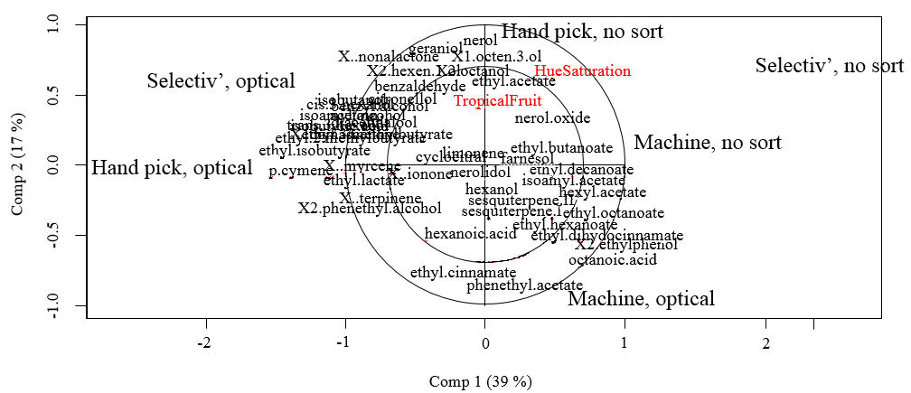
Overlaid score and correlations plot
Overlaid score and correlations plot of partial least squares regression (PLSR) analysis between significant (p<0.05) volatile compounds in wines analyzed by GCMS after 3 months in bottle and significant attributes from the corresponding descriptive sensory analysis.
Hendrickson et al., Am. J. Vitic. Enol. (In review)

Slide 29
In Summary
Optical sorting decreased/removed compositional differences among harvest treatments
Some chemical differences persisted in final wines due to whole berry fermentation
  Crushing would decrease these differences
Only two sensory attributes signf diffr
  Hue saturation
  Small tropical fruit (<2.5 our of 10)

Slide 30
To conclude.....
Impact of mechanical harvesting on wine quality – inconsequential
Optical sorting rather replacement of hand sorting
  Faster, more efficient in removing MOG, raisoned berries etc.
  Not essential with mechanical harvesting
Findings should be confirmed with different variety

Slide 31
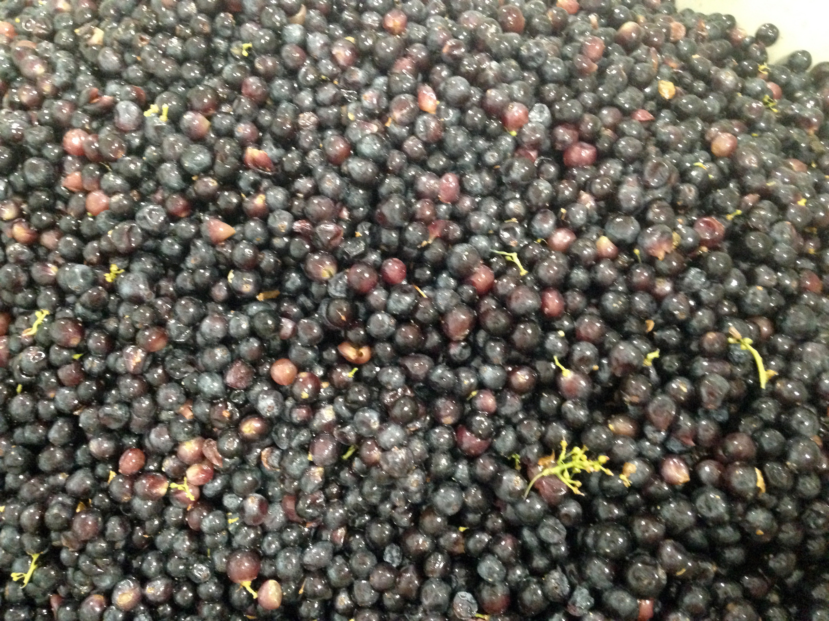
Other optical berry sorting applications?
  Optical berry sorting
    Sorting according to ripeness??
    Differences in wine style using different optical sorting parameters?

Slide 32
Color sorting
  Crush pad test
    Field blend (50% Zinfandel, 30% Mourvédre, 10% Petit Syrah, 5% Carignan, 5% Alicante Bouche)
    Varied ripeness
    Tested sorting according to different color parameters
    Fermented
      Sorted fruit (rejected 30-50%)
      Unsorted + rejected fruit (25%)

Slide 33
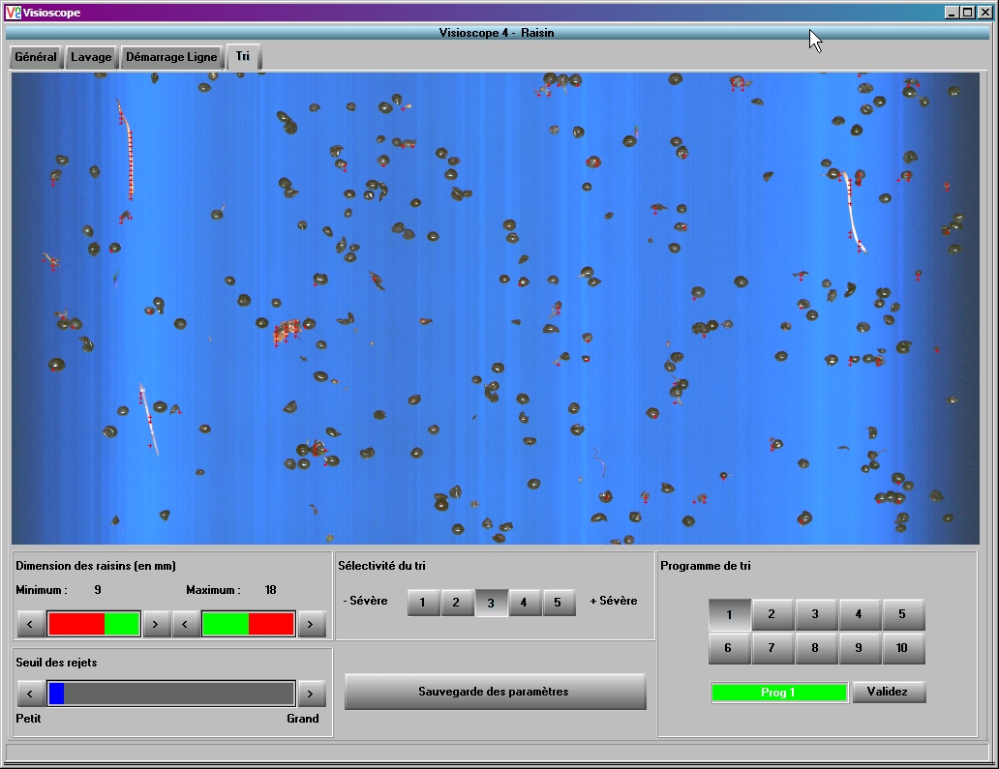
Sorting Page : Mode 3 - 4 - 5
New Cursor

Slide 34
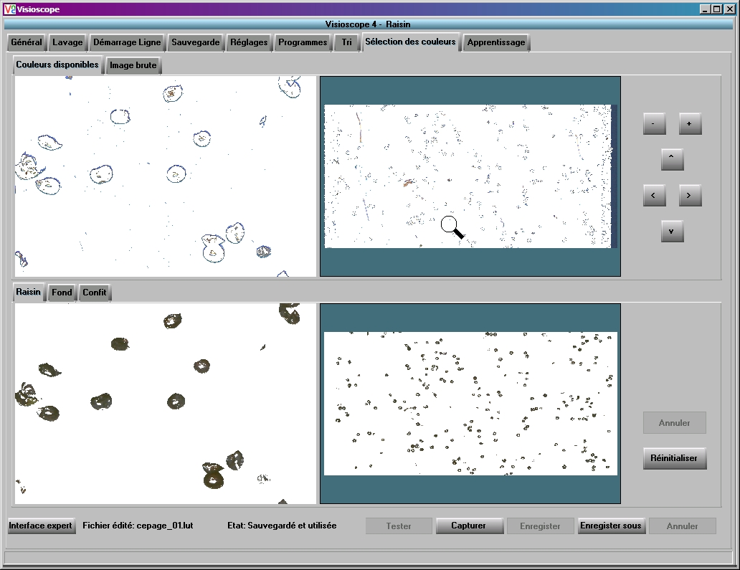
Basic User Interface
Color Selection Tab
Captured Image
Zoom Zone
Window for pixel
selection

Slide 35
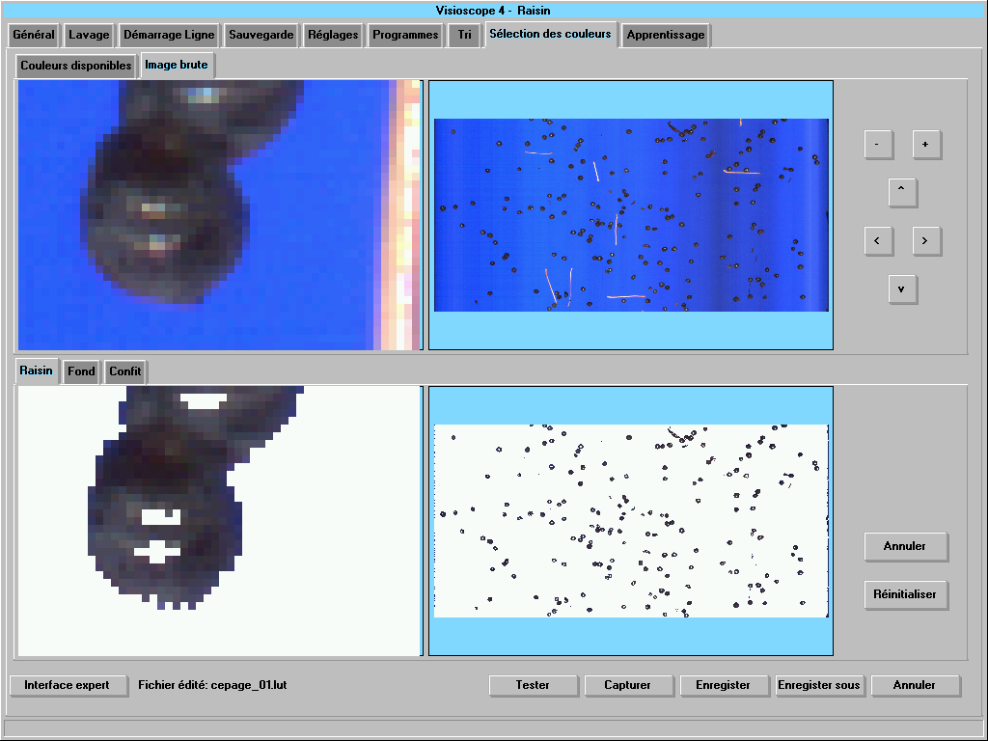
Basic User Interface
Selection color tab
Filmed image
Area to Zoom
Windows of pixels
selection

Slide 36
Color sorting
  Crush pad test
    Field blend (50% Zinfandel, 30% Mourvédre, 10% Petit Syrah, 5% Carignan, 5% Alicante Bouche)
    Varied ripeness
    Tested sorting according to different color parameters
    Fermented
      Sorted fruit (rejected 30-50%)
      Unsorted + rejected fruit (25%)

Slide 37
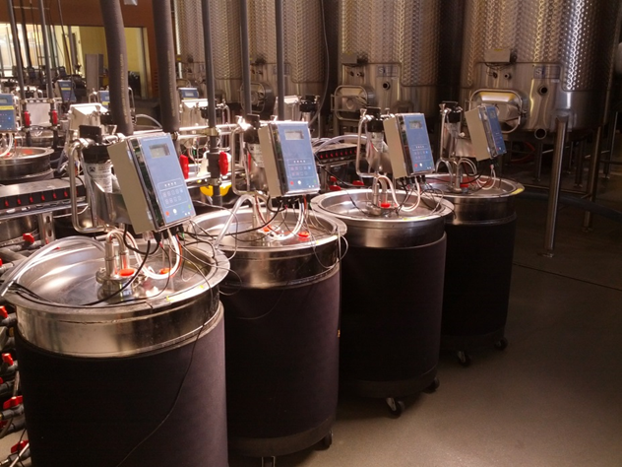
Winemaking conditions
  SO₂ 50 mg/L after crushing
  Yeast EC1118, 25゜C fermentation temp
  Pump-overs 3 x day for 1 tank vol
  Pressed after 5 days
  Fermented until dry (RS < 1 g/L)
  Inoculated for MLF (Viniflora oenos)
  MLF completed in 2 wks
    Racked, 50 mg/L SO₂ added

Slide 38
Wine chemical data
Wine | Alc % (v/v) | pH | TA (g/L) | RS (g/L) | Malic acid (mg/L) | AA (g/L)
Sorted | 13.46 | 3.49 | 6.53 | 0.29 | 0.00 | 0.00
Unsorted + reject | 12.89 | 3.54 | 6.64 | 0.22 | 13.00 | 0.05
Wine | Tot Phen (mg/L CE) | Anth (mg/L M3G) | SPP+LPP (AU) | Tannin (mg/L CE)
Sorted | 1380.7 ± 2.2 | 149.3 ± 6.0 | 1.2 ± 0.2 | 585.2 ± 11.5
Unsorted+ Reject | 1247.4 ± 168.7 | 102.0 ± 1.8 | 1.4 ± 0.1 | 548.2 ± 33.8

Slide 39
Tasting
Glass 1: Red wine blend – sorted fruit
Glass 2: Red wine blend – 75% unsorted + 25% rejected fruit

Slide 40
Acknowledgements
Industry support
  Napa Valley Vintners
  Silverado Premium Properties
  Pellenc America Inc.
  Bucher Vaslin
  Wine Spectator Scholarship
  Walsh Vineyards Management, Inc.
People
  Dave Hendrickson
  Karen Block
  Michelle Novi
  Alison Crowe
  Mea Leeman
  Chik Brenneman
  Jesse Plautz
  Dave Block
  Paul Green
  Winery students

Slide 41
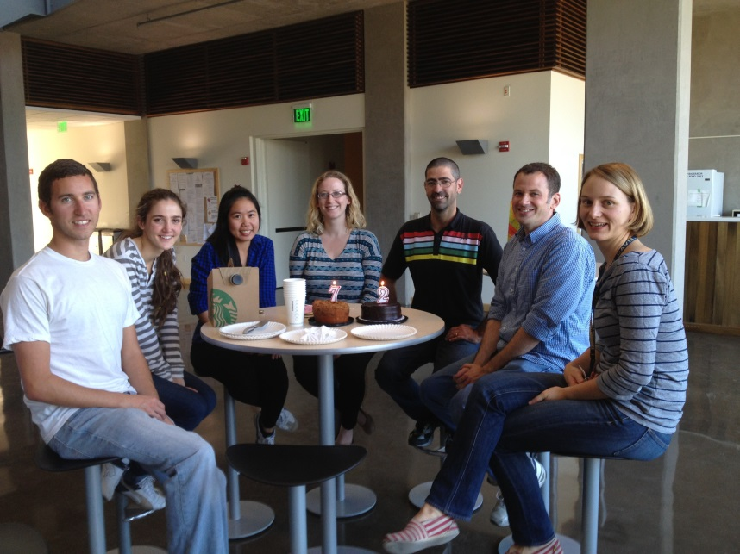
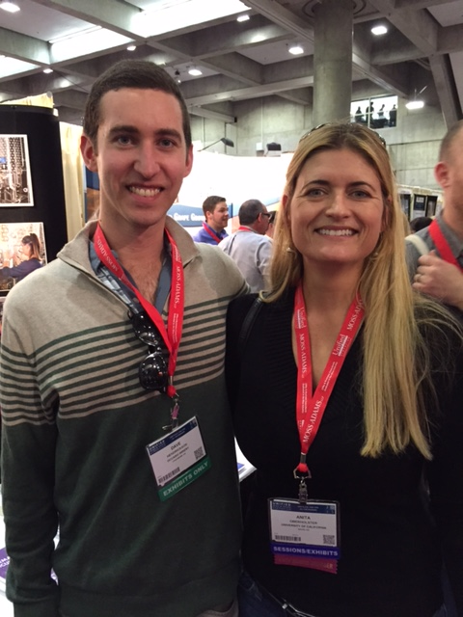
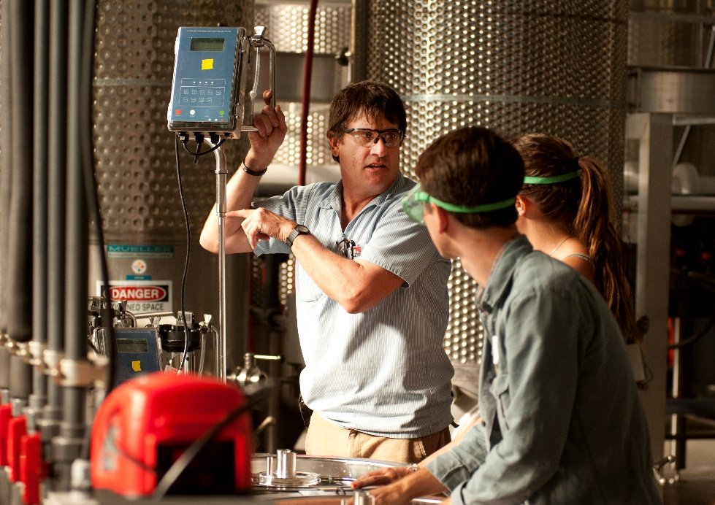
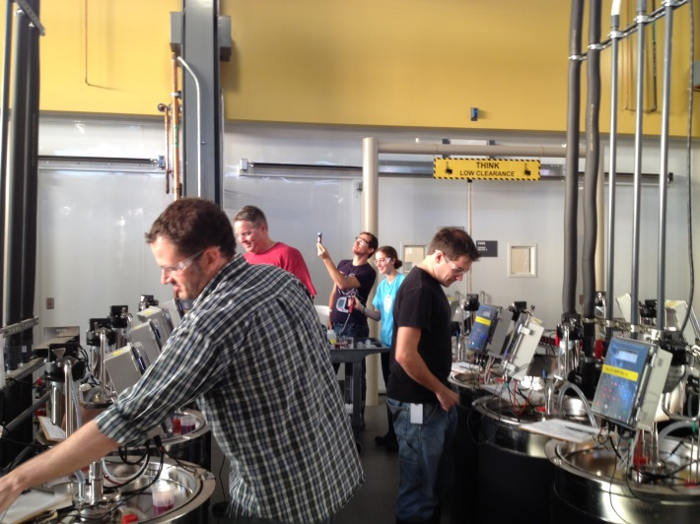
THE LAB and associates

