Slide 1
Overview of fermentation factors that impact wine composition
Anita Oberholster
June 5, 2015
Wine Flavor 101D: Techniques to Tailor Wine Composition

Slide 2
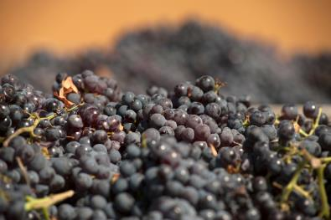
Content: Fermentation Factors
Berry conditioning
  Sorting*
  Crushing or not*
  Saignee
Heat treatment
  Flash détente
  Thermovinification
Cold soak
Yeast
SO₂
Glutathione*

Slide 3
Content: Fermentation Factors
Macerating Enzymes
Tannin
Oak contact*
O₂*
Fermentation temp
Cap Management
Extended maceration

Slide 4
Grape phenolics
Anthocyanins (520 nm)
Color in red wine
Copigmentation
Polymeric pigments (510-580 nm)
Hydroxycinnamic acids (300-330 nm)
cofactor
White wine color
Polymerization reactions
Flavan-3-ols (280 nm)
Bitterness, astringency
Tannin sub-units
Flavonols (340-370 nm)
Cofactor

Slide 5
Tannin
Proanthocyanidins/
tannin (280 nm)
Astringency, bitterness, mouthfeel
Polymerization reactions
Stabilizing color
Wine aging

Slide 6
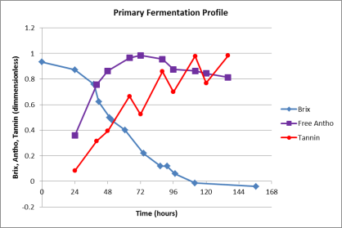
Extraction during fermentation
Anthocyanins from skins
  Early during fermentation (3-5 days)
Seed and skin tannin/proanthocyanidins (PA)
  Increase extraction with temp, % EtOH
  Polymerization reactions
  between anth and PA or
  between PA and PA

Slide 7
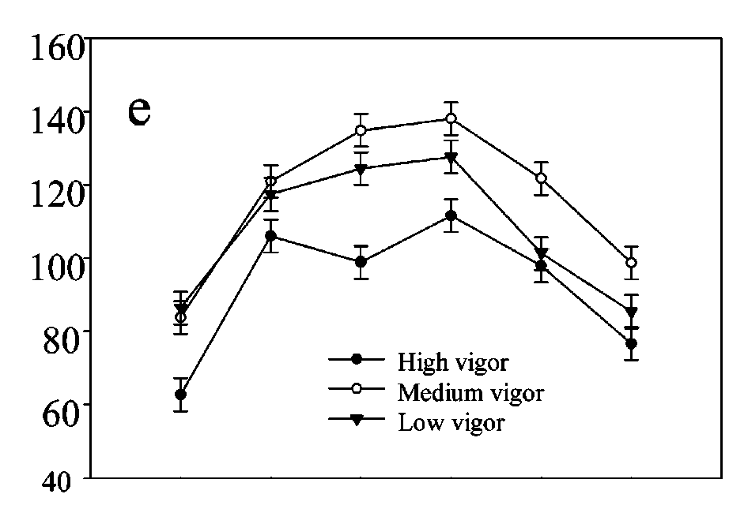

Phenol Extraction
Extraction of malv-3-gluc during fermentation (Pinot noir)

Slide 8
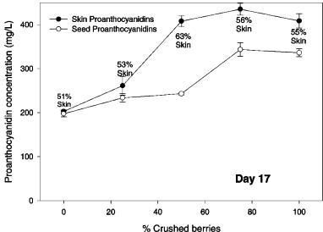
Sorting and maceration
Very little scientific data on sorting
  Discussed later today (A. Oberholster)
Crushing
  Study with Merlot, 0 – 100 % crushed fruit, 25% increments (Cerpa-Calderon et al., 2008)
    75% fruit ↑ skin and seed PA (79%)

Slide 9
Cold soak/maceration
Must at 10 – 15°C for several days before fermentation
  Results are varies in and between varieties
    Color ↑↔↓
      Pinot noir show mostly no or neg effect
    ↑ Seed tannin (Busse-Valverde et al., 2010, Moreno et al., 2013)
    Potential factors: berry ripeness and starting grape composition

Slide 10
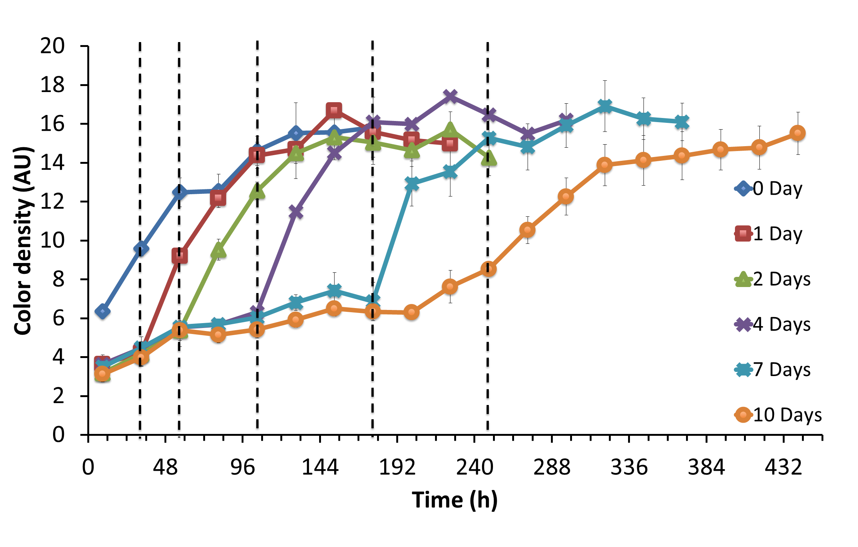
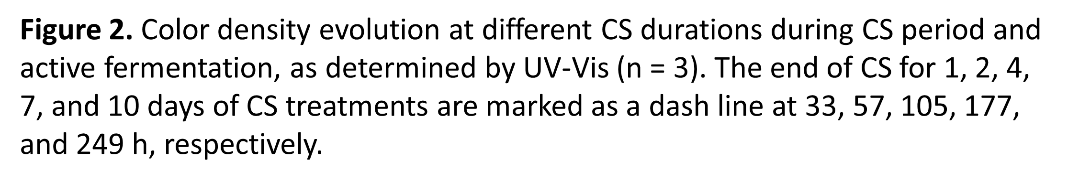
Cold Soak: Cab Sauv
Panprivech et. al., (2015) Molecules 20:7974-7989.

Slide 11
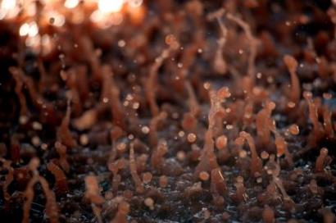
Cold soak – other factors
  Reynolds et al. 2001 ↑ anth with low ferm temp (15, 20°C) not 30°C
  CS no sensory impact on Cab Sauv, Barbera, Syrah, Malbec, Merlot and Pinot noir (Casassa 2015)
  No signf diffr between control and cold soak aroma via sensory eval although chem diffr in Cab Sauv (Gardner et al., 2011)

Slide 12
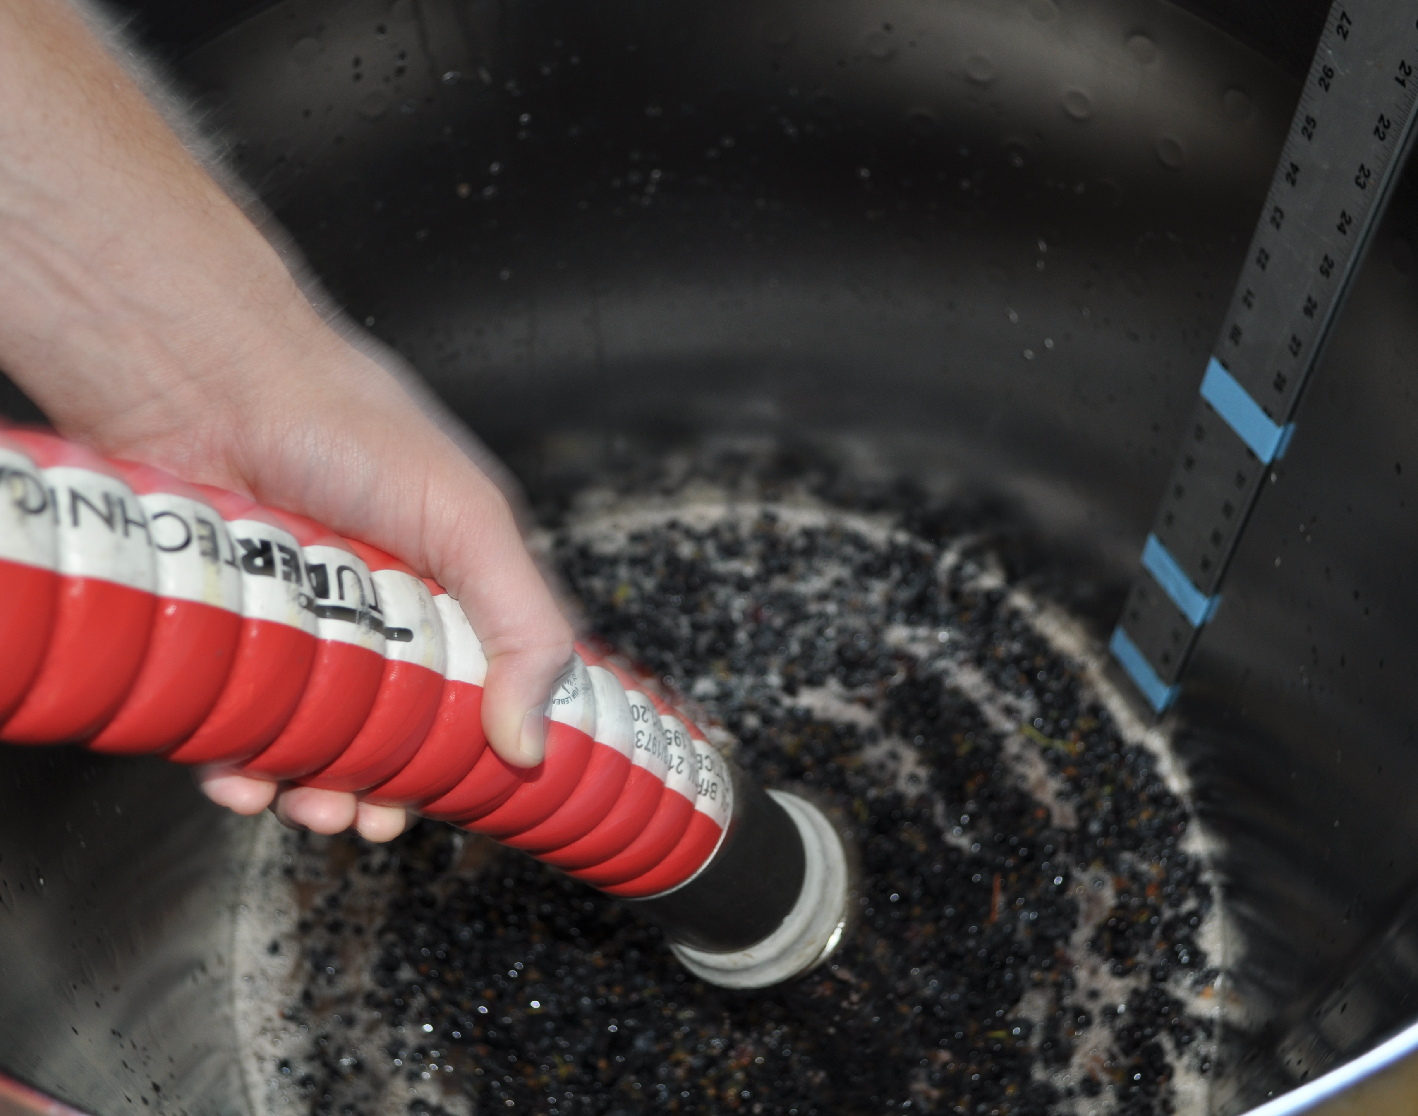
Saignée (prefermentation juice runoff)
  After 4 months - Anth ↑ Flavonoid ↑, 9 varieties - 10% runoff (Zamora, 1994)
  After 6 months no diffr in Syrah with 10 and 20% run-off (Gawel et al., 2001)
  ↑ Anth ↑tannin with ∼ 16% runoff in Merlot
  (Harbertson et al., 2009)

Slide 13
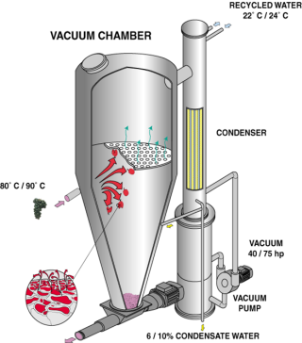
Heat treatment
Thermovinification (best effect Pinot noir)
  Increase anth and skin tannin extraction
    Need skins in contact with juice
  Loss of varietal character
New Technology: Flash-Détente
(Flash Release)
  Increase extraction of phenols
  up to 50% if ferment with skins
  Tested with Grenache, Mourvedre
  Carignan

Slide 14

Fermentation additions
Different levels of SO₂ additions
  Can be a difference in color and anth extraction early on
  After 6 months no significant effect
Glutathione (A. Heelan)
O₂ (L. Bisson)

Slide 15
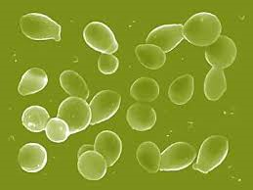
Fermentation additions
Yeast
  Previously found no great impact on non-volatile composition (Sacchi, 2005)
  Differences between strains/species
    Hayasaka (2007) found ↓anth, ↑pol pigm Sacch cerevisiae compared to Sacch bayanus
    Sacch Bayanus ↑ color
  Aroma profiles are influence by both grape composiotion, fermentation conditions and yeast (Styger, 2011)

Slide 16
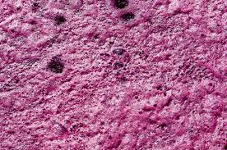
Macerating Enzymes
Breaks down skin cell walls
Increase juice yield (skin:juice ratio)
  Enzymatic activities
    Pectolytic – polygalacturonase, pectin methyl esterase, or pectin lyase
    Cellulase – thought to release tannin
    Hemicellulase – thought to release tannin
    Acid protease

Slide 17
Macerating Enzymes
Breaks down skin cell walls
Varied effect depending on enzyme used
  Due to enzyme activity or grape composition?
In general
  ↑ Colour intensity or no effect
  ↑ or no effect on tannin conc
  ↑ Extraction rate

Slide 18
Use of Exogenous/Commercial Tannin
Tannin addition for following purposes or problem correction:
  Contribute to mouthfeel/taste
  Protect against oxidation enzymes,
  Assist to precipitate proteins,
  Modify aromas including vegetative aromas
  Increase aging potential
  Stabilize wine color
Few scientific publications about effect of commercial tannin addition

Slide 19
Tannin addition
Treatment and source | Type of tannin according to the supplier | Dosage (mg/L)
Tanenol Rouge (TR) | Condensed & hydrolysable | 100 | 300
Oenotan (Oeno) | Hydrolysable | 100 | 300
QCTN | Hydrolysable | 100 | 300
Tanin VR Supra (VR S) | Condensed & hydrolysable | 300 | 500 | 1000
Tanin VR Supra NF (VR NF) | hydrolysable | 300 | 500 | 1000
Control (Cntrl)
Addition of different commercial tannins to wine (Merlot, Cabernet Sauvignon, Syrah) before fermentation (2004-5)
Small diffr in phenol comp end of fermentation, diminished over time
Parker et al, 2007 Shiraz – similar results

Slide 20
Condensed tannin addition
Some found↑ tot phenol ~ color intensity (Sims and Morris, 1986; Baurtista-Ortin, 2005)
  Impact decrease over time
Addition of grape seeds ↑ tot phenols, ↑ color intensity at 60g seeds/kg grapes (Kovac et al., 1992, 1995)
No, normal and 2x the amount of seeds (Pinotage and Cab. Sauv.) (Geldenhuys et al. 2009)
  Increase in total phenols and color
  Saturation with 2x seeds, little difference between 1x and 2x seeds

Slide 21
Condensed tannin addition
Some found↑ tot phenol ~ color intensity (Sims and Morris, 1986; Baurtista-Ortin, 2005)
  Impact decrease over time
Addition of grape seeds ↑ tot phenols, ↑ color intensity at 60g seeds/kg grapes (Kovac et al., 1992, 1995)
No, normal and 2x the amount of seeds (Pinotage and Cab. Sauv.) (Geldenhuys et al. 2009)
  Increase in total phenols and color
  Saturation with 2x seeds, little difference between 1x and 2x seeds

Slide 22
Fermentation with oak
Oak chips (4 or 8 g/L) or Am or French barrel during fermentation
  Analysis by descriptive analysis
    Am oak chips ↑coconut, vanilla, bitterness, astringency compared to barrels
    Oak origin more visible in chips compared to barrels
    Quantity of chips used greater impact then oak source
    All oak treatments vegetative aroma ↓
Chik will discuss barrel vs SS ferment
O₂ during fermentation (L. Bisson)

Slide 23
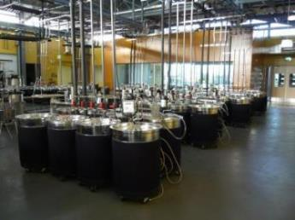
Fermentation Temperature
↑ Temp, ↑ color + phenol extraction + pol pigments
Lower temp preserve more fruit character
Opt temp ±30°C (86F) (Pinot noir, Pinotage)
Other studies looked at lesser known varietals
  Ex. Vranac (opt temp
  24-27 °C)
Marais, et al. (2003)S. Afr. J. Enol. Vitc. 24:70-75; Pajovic et al., Acta Agric. Serb.(2011)16 (32): 145-154; Sacchi, et al., (2005) Am. J. Enol. Vitic. 56 (3): 197-206.

Slide 24
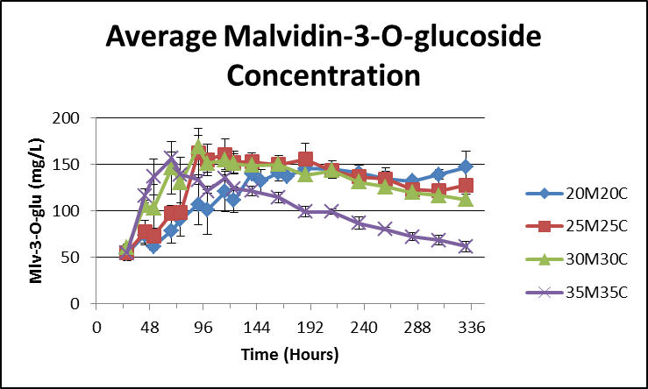
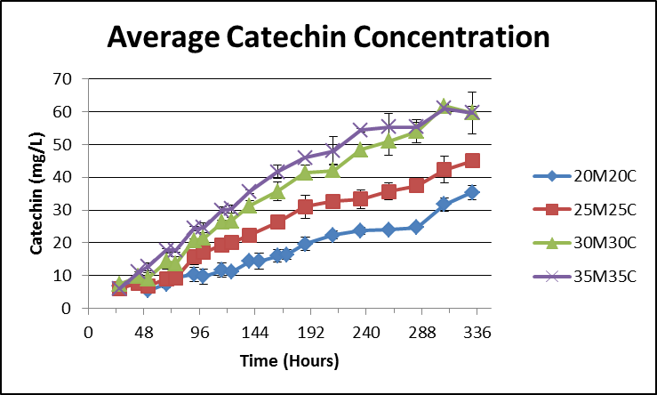
Influence of temp on extraction
Cabernet Sauvingnon
↑Temp:
  Increase flavanol extraction + rate
  Increase malv-3-gluc extraction rate

Slide 25
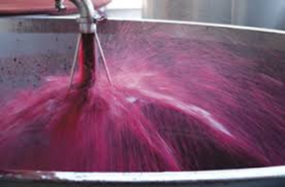
Cap Management
Why?
  Keep cap moist for yeast activity
  Reduce temp gradient between cap and liquid for yeast activity
  Increase skin contact for phenol extraction etc.

Slide 26
Influences on extraction: Cap Management
Cap management techniques
  Punch-down, pump-over (various irrigators), rotor, delestage, submerged cap, timed gas-pressure release (Ganimede), pneumatage
  Studies compared punch-down, pump-over, rotor and delestage
    Variable effect with cultivar
    Rotor > mechanical punch down >pump over > manual punch down > delestage > Ganimede (order of phenol extraction)

Slide 27
Pump-over frequency/volume
1, 2, 4, 8 PO, tot 4 vol
  Similar extraction rates
PO 0.5V, 1V, 2V 2x per day
  Similar extraction

Slide 28
Extended maceration
Extended maceration time
  Increase in tannin, not anthocyanins
  Total phenols increase up to 36 days
  Anthocyanins reach maximum within 3 – 5 days, although some studies have increases up to 10 days
  Pomace contact of 4 – 16 days were preferred by judges (this test was done on Merlot)

Slide 29
Extended maceration
Comparing Merlot and Cab Sauv wines 10 vs 30 days skin contact
  Both M and CS ↑ in PA, bitterness and astringency
  Mainly ↑ in seed PA from ∼ 55% to 75%
  ↓Anth, ↑ Pol Pigment
  In Cab Sauv EM neg impact on unripe fruit (20.3°Brix)

Slide 30
Concluding remarks
Fermentation factors that potentially have the largest impact
  Heat treatment
  Saignée
  Yeast
  Maceration Enzymes
  Fermentation temp
  Extended maceration

