Slide 1
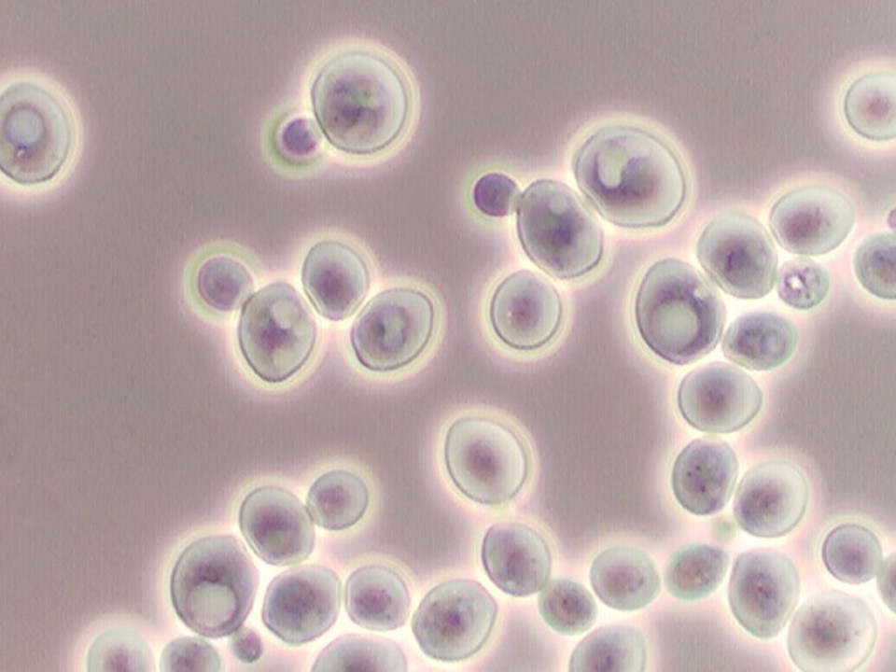
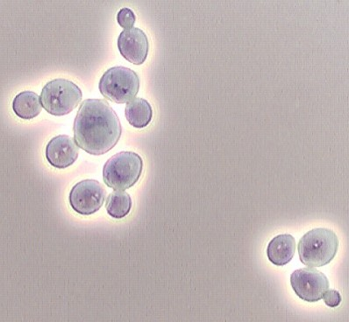
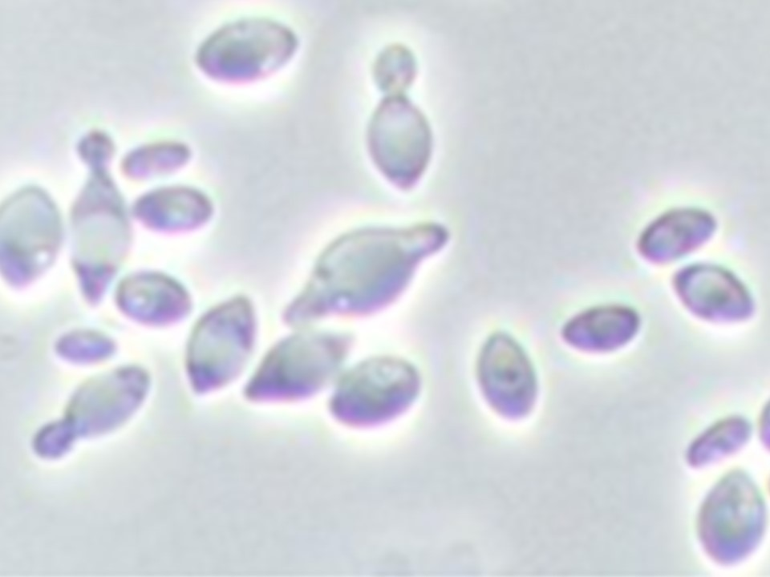
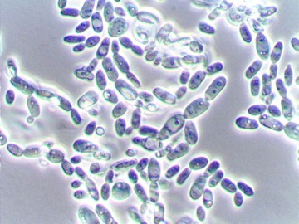
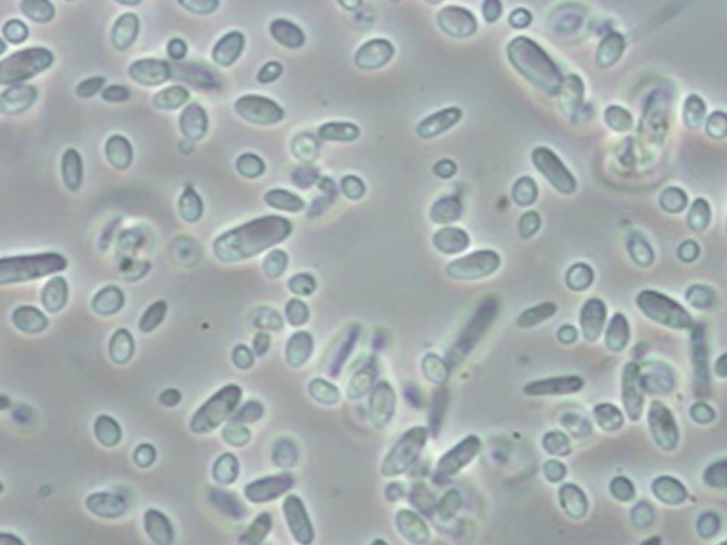
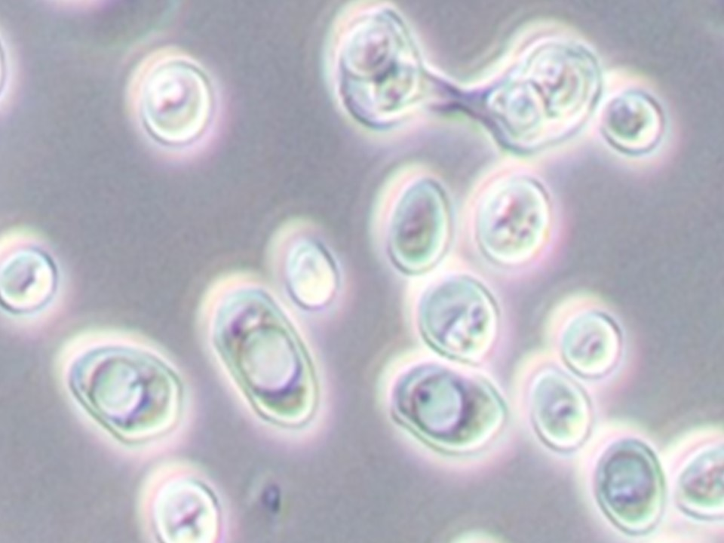
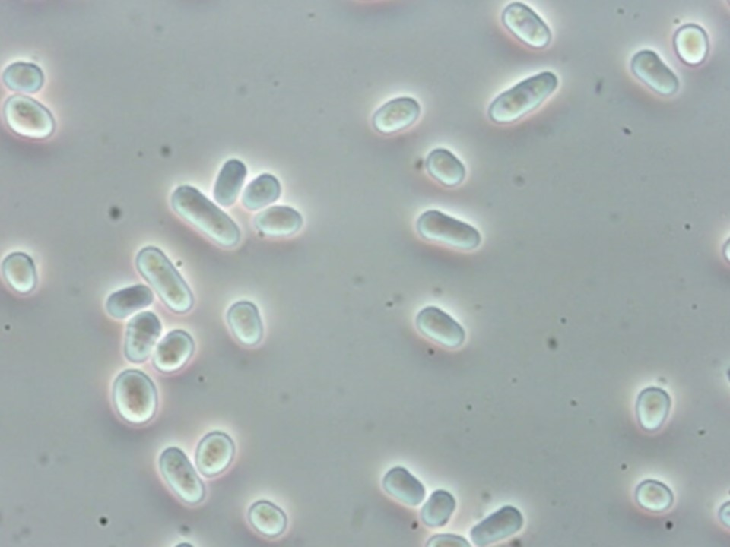
Commercial
Non-Saccharomyces Options
Saccharomyces
Torulaspora
Metschnikowia
Hanseniaspora
Candida
Pichia
Zygosaccharomyces
Schizosaccharomyces
Lucy Joseph
Department of Viticulture and Enology
UC Davis

Slide 2
Native Fermentations
Identified more than 20 genera
More than 700 species involved

Slide 3
Spoilage?
Do these non-Saccharomyces yeast cause spoilage?
Can they be controlled?
Why inoculate with non-Saccharomyces?

Slide 4
Problems with Non-Saccharomyces
Low fermentation rate
Low SO₂ resistance
Low ethanol tolerance
Spoilage metabolite production
Off-flavor production

Slide 5
Advantages of Non-Saccharomyces
Production of hydrolitic enzymes (β-glucosidase, esterase, protease)
Production of glycerol, volatile compounds, mannoproteins,....

Slide 6
Native Fermentations
Improved peculiarities such as complexity, mouth-feel (texture)
Uncontrolled process with no constant or negative results
By delaying the inoculum of S. cerevisiae it is possible to promote the initial activity of autochthonous non-Saccharomyces yeasts in winemaking
Still uncontrolled process
Possible stuck fermentation

Slide 7
Mixed Fermentations
A valid alternative to improve the aroma complexity and to enhance a particular characteristic of a wine
Co-culture with Saccharomyces
Intra-species variability of the non-Saccharomyces yeast

Slide 8
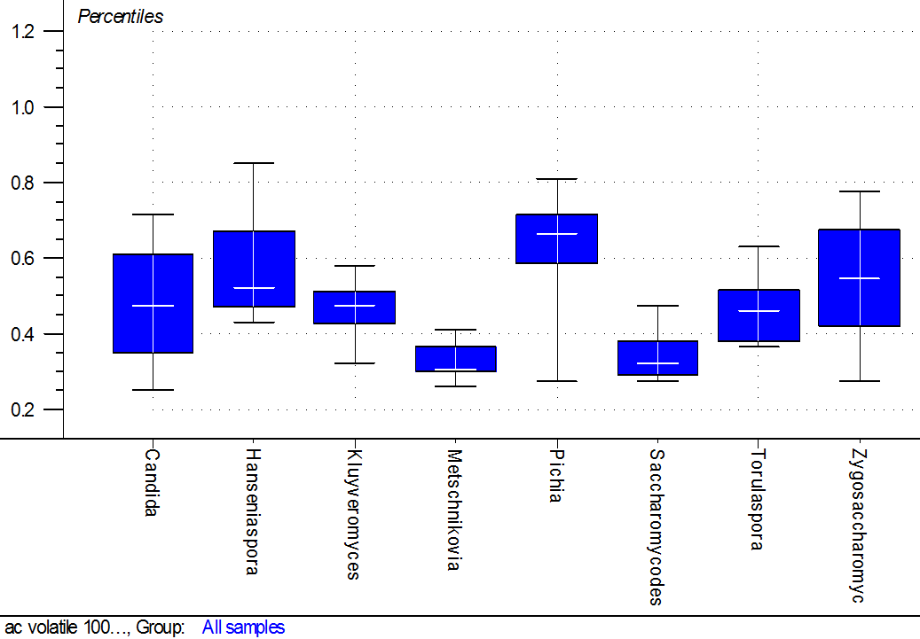
Intra-species Variability
Volatile
Acidity

Slide 9
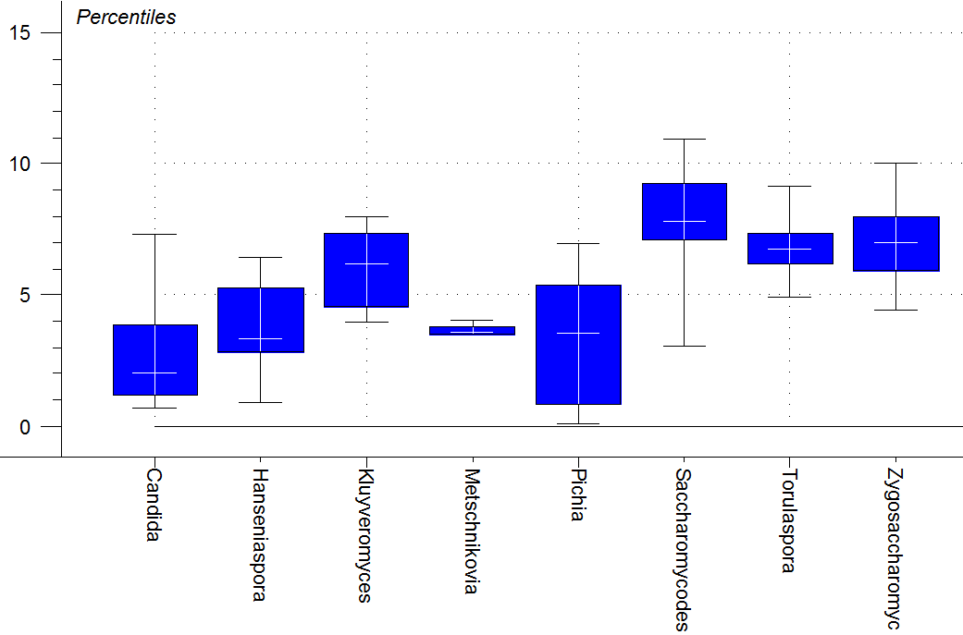
Non-Saccharomyces Variability
% Ethanol

Slide 10
Mixed Culture with Saccharomyces
Negative characteristic of non-Saccharomyces yeasts may not be expressed or may be modified
Could improve aromatic profile of wines through metabolic interaction between yeast species

Slide 11
Which non-Saccharomyces Yeast Have Been Tested?
S. cerevisiae + Candida stellata
S. cerevisiae + Torulaspora delbruecki
S. cerevisiae + Metschnikowia pulcherrima
S. cerevisiae + Lachancea thermotolerans
S. cerevisiae + Zygosaccharomyces florentina
S. cerevisiae + Saccharomycodes ludwigii
S. cerevisaie + Issatchenkia orientalis
S. cerevisiae + Hanseniaspora uvarum
S. cerevisiae + Hansenula anomala
S. cerevisiae + Pichia fermentans
S. cerevisiae + Pichia kluyveri
S. cerevisiae + Schizosaccharomyces pombe
S. cerevisiae + Kazachstania gamospora
S. cerevisiae + Zygosaccharomyces kombuchaensis

Slide 12
Characteristics Changed
Aroma:
  esters
  terpenols
  higher alcohols
  volatile thiols
Structure:
  glycerol
  mannoproteins
Acidity
Alcohol content

Slide 13
AROMAS

Slide 14
Esters
Increase
  S. cerevisiae + Lachancea thermotolerans
  S. cerevisiae + Candida zemplinina (+ ethyl esters)
Decrease
  S. cerevisiae + Candida zemplinina (acetate esters)

Slide 15
Terpenols
Increase
S. cerevisiae + Torulaspora delbrueckii
S. cerevisiae + Candida zemplinina
S. cerevisiae + Debaryomyces vanriji
S. cerevisiae + Debaryomyces pseudopolymorphus

Slide 16
Volatile Thiols
Increase
  S. cerevisiae + Pichia kluyveri
Decrease
  S. cerevisiae + Candida zemplinina
  S. cerevisiae + Torulaspora delbrueckii
  S. cerevisiae + Metschnikowia pulcherrima

Slide 17
Increase Alcohol Production
S. cerevisiae + Torulaspora delbrueckii
S. cerevisiae + Metschnikowia pulcherrima (+ higher alcohol)
S. cerevisiae+ Candida zemplinina (+ higher alcohol)
S. cerevisiae+ Hanseniaspora uvarum (+ higher alcohols)
S. cerevisiae+ Saccharomycodes ludwigii (+ higher alcohols)
S. cerevisiae+ Issachentia orientalis (- higher alcohols)

Slide 18
Increase 2-phenyl ethanol, phenylethyl acetate
S. cerevisiae + Torulaspora delbrueckii
S. cerevisiae + Candida zemplinina
S. cerevisiae + Hanseniaspora vinae
S. cerevisaie + Hanseniaspora guillermondi
S. cerevisiae + Lachancea thermotolerans
S. cerevisiae + Metschnikowia pulcherrima

Slide 19
Increase Isoamyl acetate
S. cerevisiae + Pichia anomala
S. cerevisiae + Metschnikowia pulcherrima
S. cerevisiae + Hanseniaspora uvarum
S. cerevisiae + Williopsis saturnus
S. cerevisiae + Hanseniaspora guillarmondi

Slide 20
Decrease Acetaldehyde
S. cerevisiae + Torulaspora delbrueckii
S. cerevisiae + Metschnikowia pulcherrima
S. cerevisiae + Issatchenkia orientalis

Slide 21
Decrease Ethyl Acetate
S. cerevisiae + Hanseniaspora uvarum
S. cerevisiae + Hanseniaspora guilliermondii

Slide 22
Structure

Slide 23
Increase Glycerol
S. cerevisiae + Candida stellata*
        (*Candida zemplinina)
S. cerevisiae + Candida cantarellii
S. cerevisiae + Lachancea thermotolerans
S. cerevisiae + Metschnikowia pulcherrima
S. cerevisiae + Zygosaccharomyces florentinus
S. cerevisiae + Schizosaccharomyces pombe

Slide 24
Increase Mannoproteins
S. cerevisiae + Candida zemplinina
S. cerevisiae + Lachancea thermotolerans
S. cerevisiae + Hanseniaspora uvarum
S. cerevisiae + Saccharomycodes ludwigii
S. cerevisiae + Zygosaccharomyces florentina
S. cerevisiae + Pichia fermentans
S. cerevisiae + Schizosaccharomyces pombe
S. cerevisiae + Metschnikowia pulcherrima
S. cerevisiae + Torulaspora delbrueckii
S. cerevisiae + Schizosaccharomyces pombe

Slide 25
Mannoprotein Affects
Improvement of mouth-feel
Increasing sweetness and roundness
Decreases in astringency
Reduction in protein and tartrate instability
Prevention of tannin aggregation and precipitation
Addition of complexity and aromatic persistence
Stabilization of the color of red wines
Stability of the foam of sparkling wines

Slide 26
Mannoproteins
mg/L
Pichia
Candida
Lachancea
Torulaspora
Hanseniaspora
Metchnikowia
Saccharomyces
Saccharomycodes
Zygossaccharomyces

Slide 27
Acidity
Increase Total
  S. cerevisiae + Lachancea thermotolerans
  S. cerevisiae + Candida stellata
Decrease Volatile
  S. cerevisiae + Torulasopora delbrueckii
  S. cerevisiae + Lachancea thermotolerans
  S. cerevisiae + Metschnikowia pulcherrima
  S. cerevisiae + Starmerella bacillaris

Slide 28
Malic Acid Conversion
S. cerevisiae + Schizosaccharomyces pombe
S. cerevisiae + Issatchenkia orientalis

Slide 29
Ethanol Reduction
S. cerevisiae + Metschnikowia pulcherrima
S. cerevisiae + Candida stellata
S. cerevisiae + Hanseniaspora uvarum
S. cerevisiae + Zygosaccharomyces spp

Slide 30
Commercialization
Select the specific pair
  S. cerevisiae/non-Saccharomyces
Inoculation
  Co-inoculation or sequential inoculation; ratio
Fermentation
  Temperature, oxygen, nutrient conditions…

Slide 31
Commercially Available
Pichia kluyveri
  Increase volatile thiols
Lachancea (Kluyveromyces) thermotolerans
  Increase esters
  Increase 2-phenyl ethanol, phenylethyl acetate
  Increase glycerol
  Increase mannoproteins
  Increase TA; decrease VA
Torulaspora delbrueckii
  Increase terpenols
  Increase 2-phenyl ethanol, phenylethyl acetate
  Increase mannoproteins
  Decrease volatile thiols
  Decrease acetaldehyde
  Decrease VA

