Slide 1
Crush Strategies to Maximize Quality
Eucalyptus Smoke Taint
2013 Pinot Noir

Slide 2
Eucalyptus Smoke Taint
  Eucalyptus/grass fire
  Flash fermented on skins
  9 months post fermentation
 | Guaiacol ppb | 4-methylguaiacol
Standard Ferment | 14.9 | 2.5
Flash | 5.3 | <1.0

Slide 3
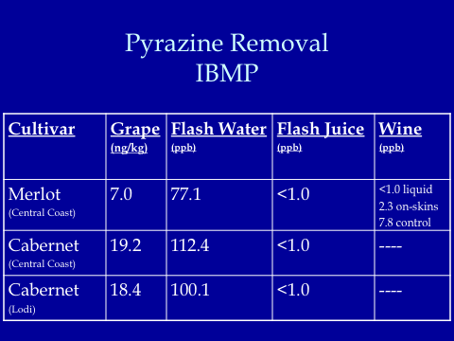
Game Changer: Flash Detente

