Slide 1
Brettanomyces Aroma and Flavor Effects
Lucy Joseph
Department of Viticulture and Enology
U.C. Davis

Slide 2



Brettanomyces Aromas in Wine
Horse sweat - Leather
Earthy
Medicinal
Band Aid
Smoky
Tobacco
Barnyard
Putrid
Lilac

Slide 3
Brett Effect in Wine
Loss of ‘fruit’, ‘floral’ & ‘honey’ aromas
Increase in overall complexity
Acetic acid, vinegar aroma
Spice and smoke aroma
Chemical, Plastic, BandAid aroma
Metallic bitter taste
Mousiness

Slide 4
Chemicals Produced
Chemical Type | Odor Impact | Detection Threshold
Ethyl Phenol | Chemical, Band Aid, smoke, burnt, medicinal, spicy | 0.14 to 0.62 ppm
Vinyl Phenol | Leather, burnt, metallic, woody | 0.1 to 15 ppm
Fatty Acid | Barnyard, sweat, rancid, solvent, sewage | 5 ppm
Pyridine | Mousy, rancid tortilla chips, crackers | 2 to 18 ppb
Aldehyde | Solvent, burnt rubber, air freshener | 1 to 100 ppm
Long Chain Alcohol | Floral, fruit, chemical, furniture polish | 0.1 to 50 ppm
Ester | Fruit, floral | 0.1 to 100 ppm
Terpene | Spicy, floral, resin | 0.1 to 0.5 ppm

Slide 5
Where Do These Chemicals Come From?

Slide 6
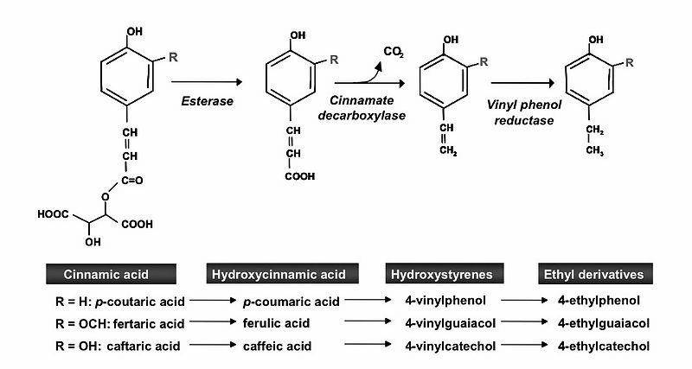
Vinyl and Ethyl Phenols from Cinnamic Acids

Slide 7
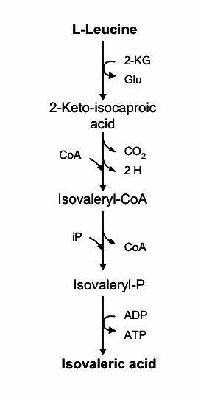
Fatty Acids From Amino Acids and Sugars

Slide 8
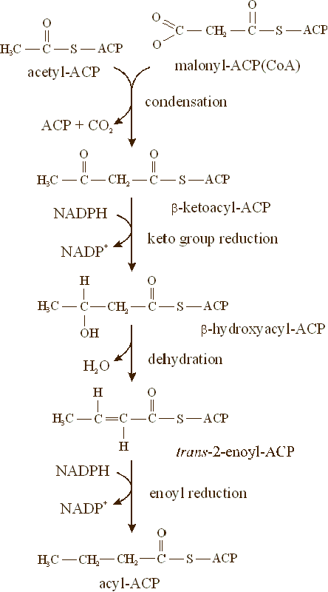
Fatty Acid Synthesis

Slide 9
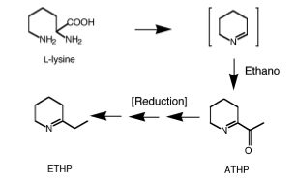
Mousiness from Lysine
ETHP = 2-ethyltetrahydropyridine
ATHP = 2-acetyltetrahydropyridine
E.M. SNOWDON, M.C. BOWYER, P.R. GRBIN, P.K. BOWYER
J. Agric. Food Chem. 2006, 54, 6465−6474

Slide 10
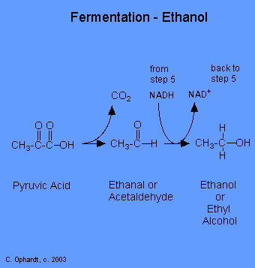
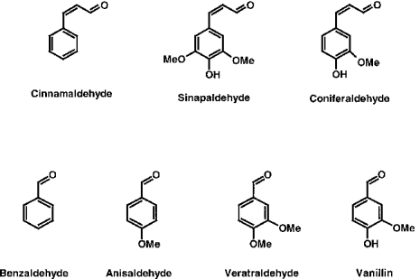
Aldehyde Synthesis From Organic
Acids

Slide 11
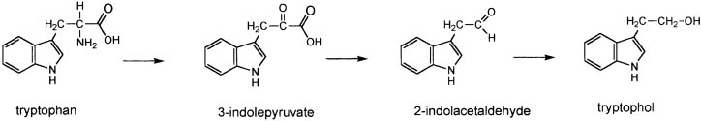
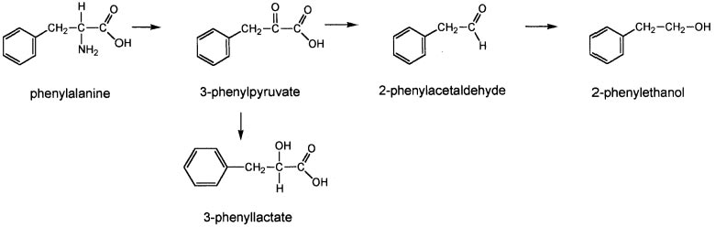
Alcohols From Amino Acid

Slide 12
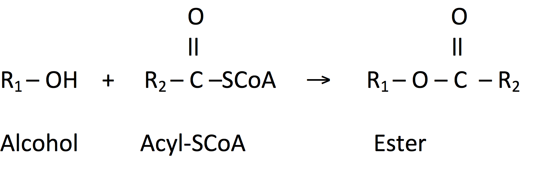
Ester Synthesis From Alcohols

Slide 13
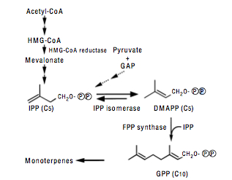
Terpene Biosynthesis From Sugars
IPP = isopentenyl diphosphate
acetyl-CoA = acetyl coenzyme A
HMG-CoA = 3-hydroxy-3-methylglutaryl coenzyme A
DMAPP = dimethylallyl diphosphate
FPP = farnesyl diphosphate
GPP = geranyl diphosphate

Slide 14
Recent Genome Sequence Analysis
Linda Hellborg and Jure Piškur, Department of Cell and Organism
Biology, Lund University, Sweden
Brettanomyces bruxellensis is either a result of a hybridization event where two similar genomes fused together. Or the common progenitor of the modern isolates lost its sexual cycle and the initially diploid genome now accumulates mutants.
The existence of two “independent” genome copies, as well as additional duplications, presents the basis for a tremendous variation in the number and sizes of chromosomes.
Such a degree of variation has never been observed before within isolates belonging to the same species.

Slide 15
Lactic Acid Bacteria Found in Wine
Lactobacillus – Lb. brevis, Lb. casei, Lb. hilgardii, Lb. plantarum, Lb. lindneri, Lb. kunkeei
Pediococcus – Pd. damnosus, Pd. parvulus, Pd. ethanolidurans
Oenococcus – O. oeni

Slide 16
Spoilage Compounds Produced by Lactics
Bacteria | Compound | Sensory Effect | Threshold
LAB | Acetic Acid | Vinegar, pungent, sour | 0.2 ppt
LAB | Ethyl acetate | Nail polish remover | 7.5 ppm
Lb., Oeno. | Diacetyl | Butter, nutty, caramel | 0.1 to 2 ppm
Lb., Pd. | 2-Ethoxy-3,5-hexadiene | Geranium leaves | 0.1 ppb
Lb., Oeno. | 2-Acetyl-tetrahydropyridine | Mousy | 4 to 5 ppb
Lb., Oeno. | 2-Ethyltetrahydropyridine | Mousy | 2 to 18 ppb
Lb., Oeno. | 2-Acetyl-1-pyrroline | Mousy | 7 to 8 ppb
Lb., Pd. | Acrolein (+anthocyanin) | Bitter
Pd. | b-D-Glucan | Ropy, viscous, oily
Oeno. | Mannitol | Viscous, sweet
LAB | Skatole (indole) | Fecal | 1.7 ppm (1.8)
LAB | Biogenic Amines | None (headache)
Letters in Applied Microbiology 48 (2009) 149–156 ; E.J. Bartowsky

Slide 17
Where Do These Chemicals Come From?

Slide 18
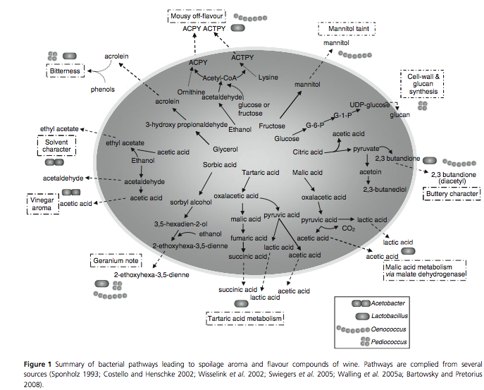
Metabolic Pathways

Slide 19
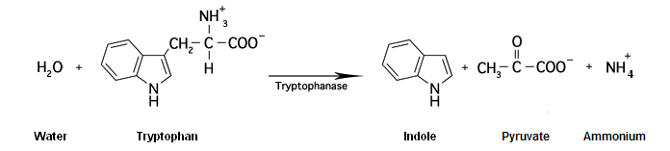
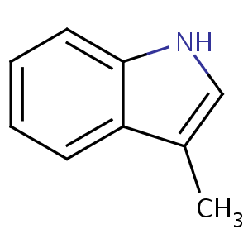
Metabolic Pathways
(Indole and Skatole)
Skatole

Slide 20
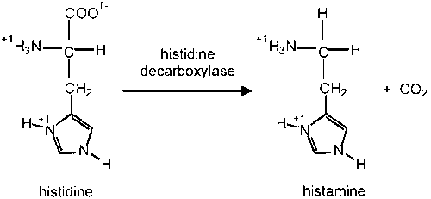
Metabolic Pathways
(Biogenic Amines)

Slide 21
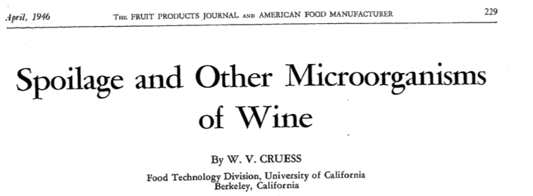

Writing about spoiled wines by lactic acid bacteria:

Slide 22
Monitoring Lactic Acid Bacteria
Microscopic examination
Plating
Q-PCR

Slide 23
Monitoring for Brettanomyces Contamination
Microscope
Plating
Q-PCR
ELISA Assay
Ethyl phenol production

Slide 24
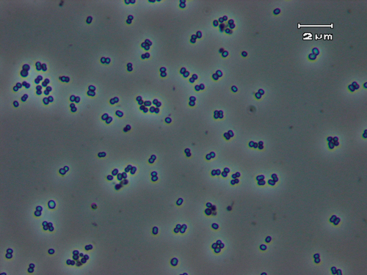
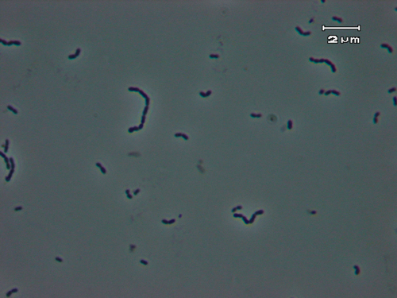
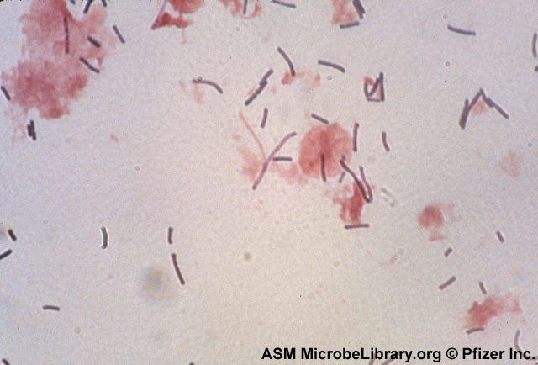
Images of Lactic Acid Bacteria
Pediococcus ⬆
Oenococcus ⬆
⬅Lactobacillus

Slide 25
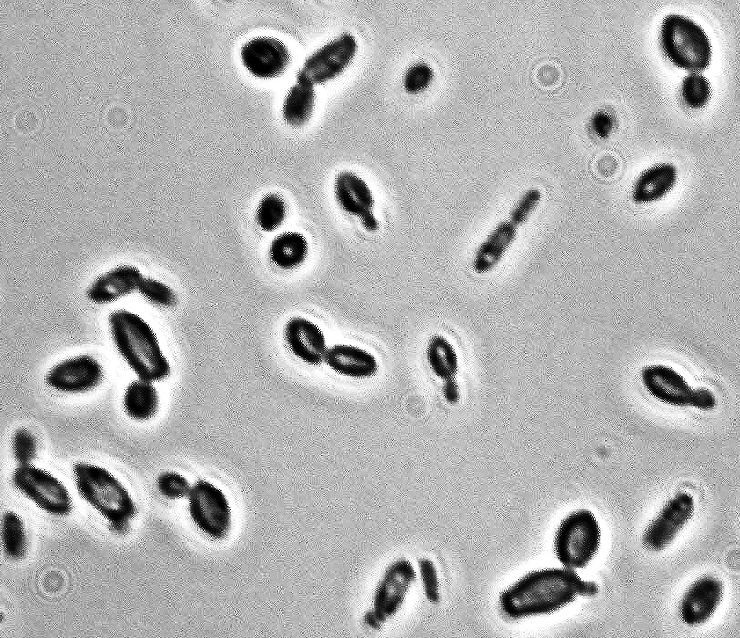
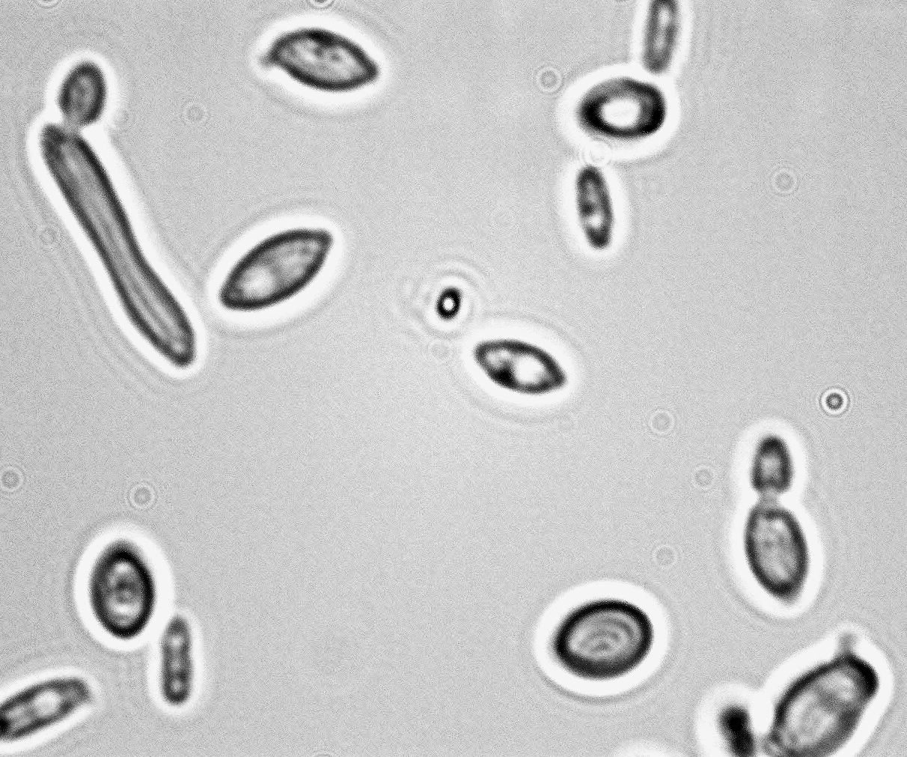
Microscopic observation

Slide 26
Plating on Selective Media
We use MLAB (0.5x MRS with 100 ml/liter of V8 juice) for lactic acid bacteria
We use Wallerstein nutrient agar with cycloheximide (WLD) for Brettanomyces bruxellensis
Bacteria are very dark green, small colonies on WLD
Brett grows very slowly, if at all, on MLAB

Slide 27
Colony Morphology

Slide 28
Q-PCR
SYBR Green PCR Chemistry
1. Target Gene
2. PCR
3. SYBR Green binds

Slide 29
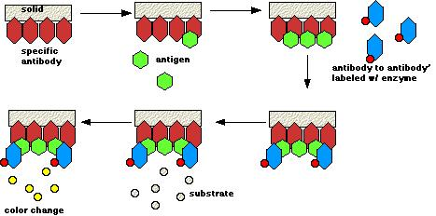
ELISA Assay
Antibody assay

Slide 30
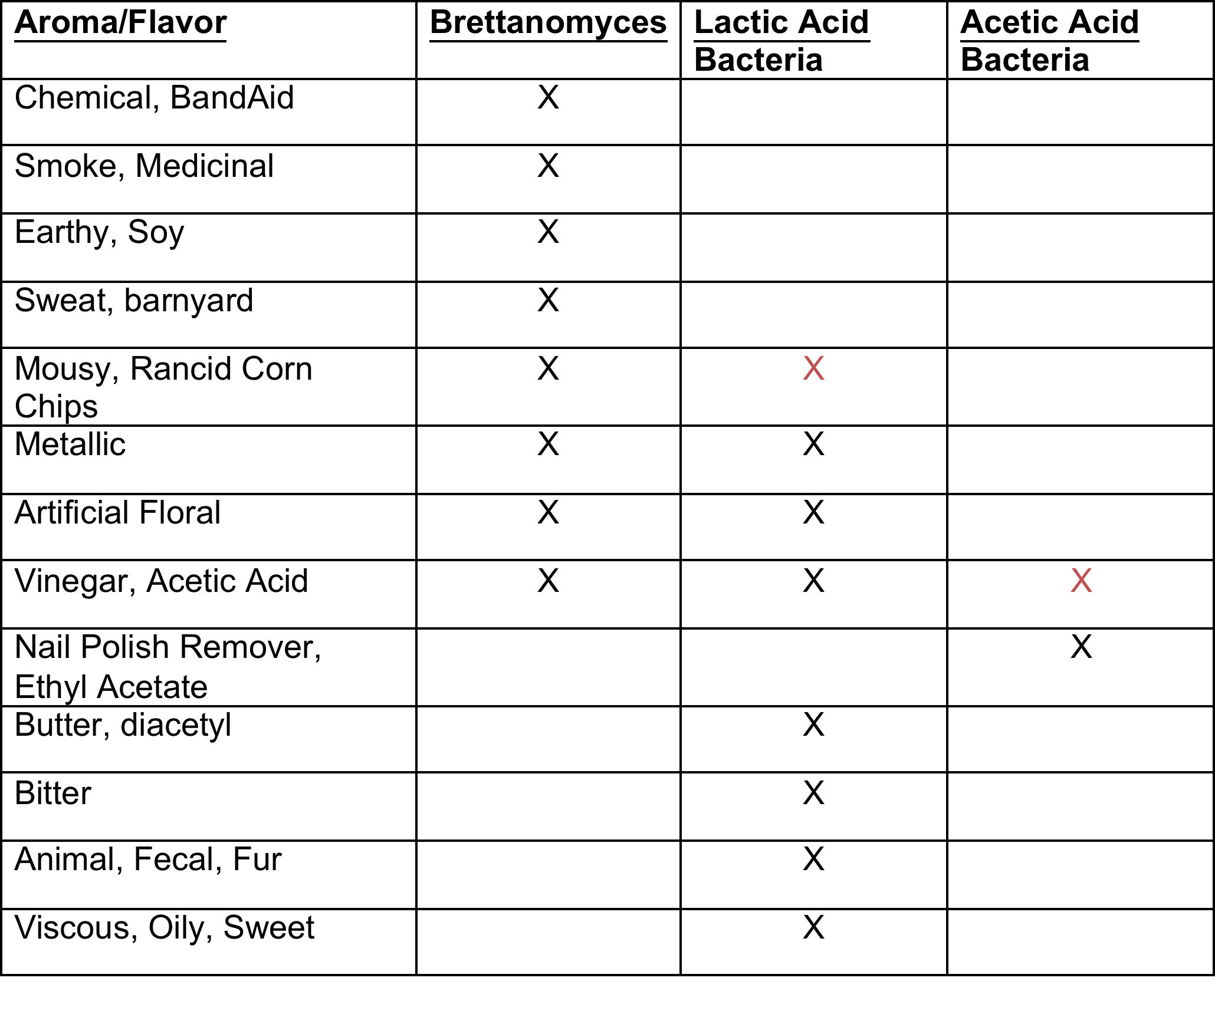
Summary

Slide 31
Acknowledgments
Linda Bisson
Bisson Lab
American Vineyard Foundation
California Competitive Grants
Volunteers

