Slide 1
Alternative Oaks
European Oak Options

Slide 2
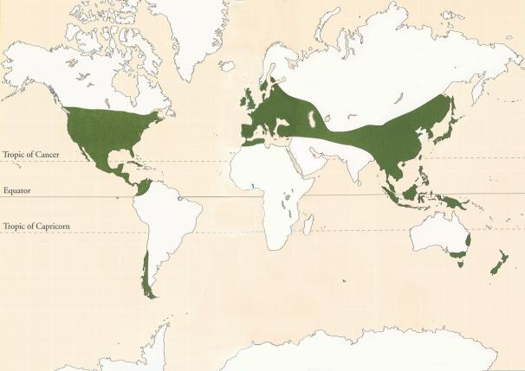
World wide Distribution

Slide 3
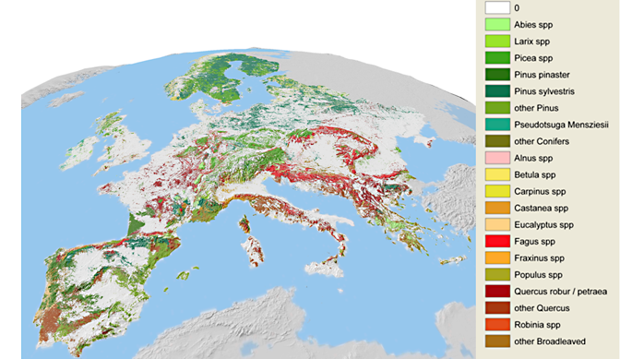
European Distribution

Slide 4
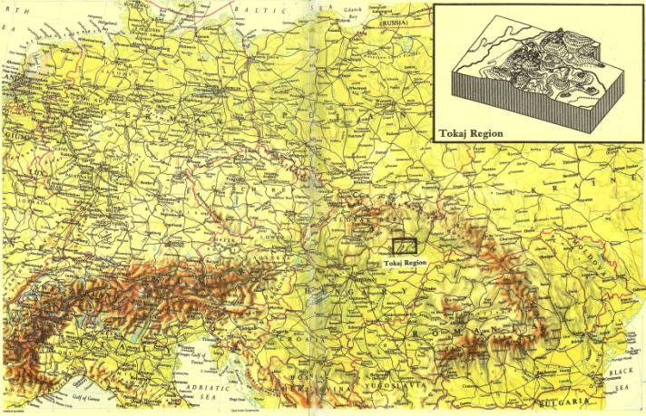
Hungarian Distribution

Slide 5
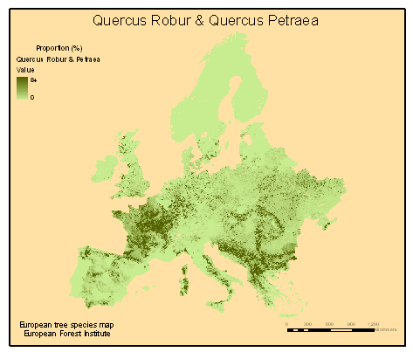
European Tree Species

Slide 6
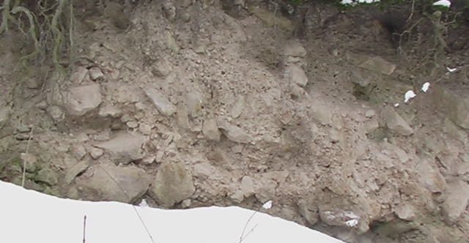
Zemplen Soil Profile

Slide 7
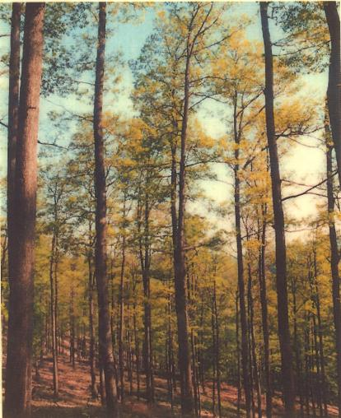
European Hardwood Forest

